Slide 1







What Physics did we hope to get from single bunch FACET II first run?
Chan Joshi
University of California Los Angeles
C Joshi, E Adli, W An, CE Clayton, S Corde, S Gessner, MJ Hogan, et al., Plasma wakefield acceleration experiments at FACET II
Plasma Physics and Controlled Fusion 60 (3), 034001
Work supported by DOE-HEP

Slide 2
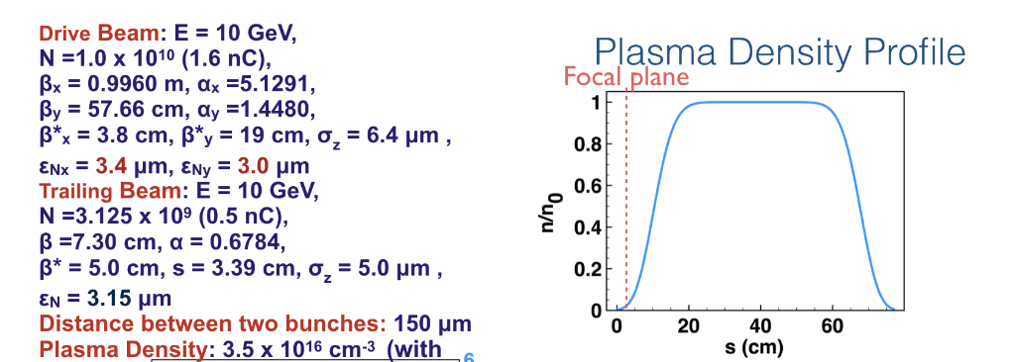
Ideal Beam Parameters Used in our PPCF paper
Energy Doubling (10-20+ GeV) with <1% Energy Spread
,Pump Depletion and > 40% Pump to trailing bunch energy transfer efficiency

Slide 3
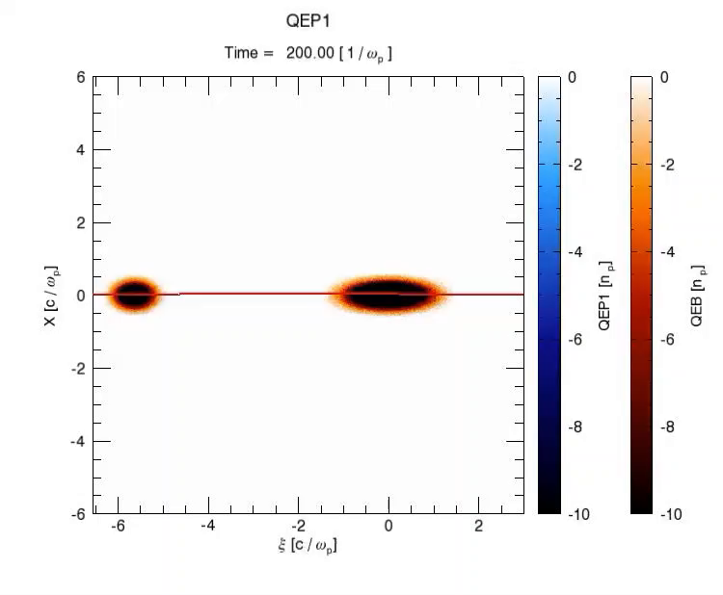
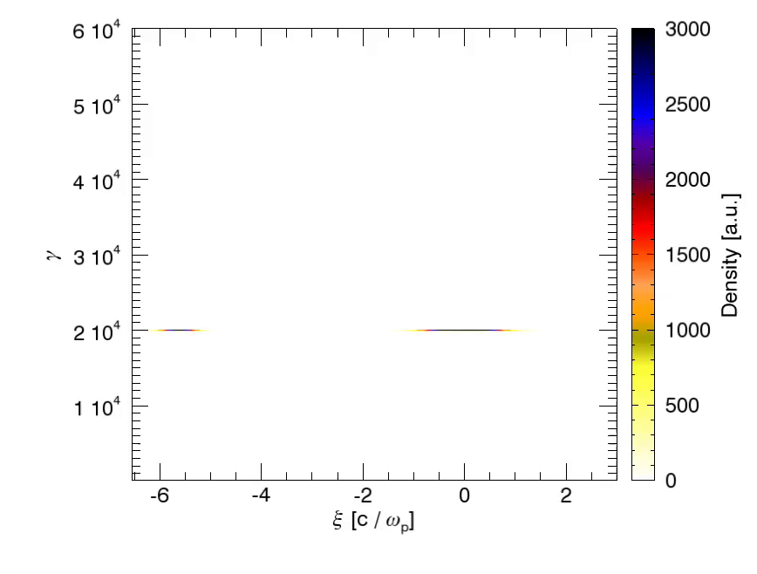
Two-bunch PWFA
Energy Doubling (10-20+ GeV) with <1% Energy Spread
,Pump Depletion and > 40% energy transfer efficiency
Plasma and beam density
with on-axis Ez line out
Beam Energy
Energy Doubling
Drive Bunch
Drive
Bunch
Trailing Bunch
Trailing
Bunch
Simulations by W. An UCLA, .Joshi et al. PPCF 2018

Slide 4
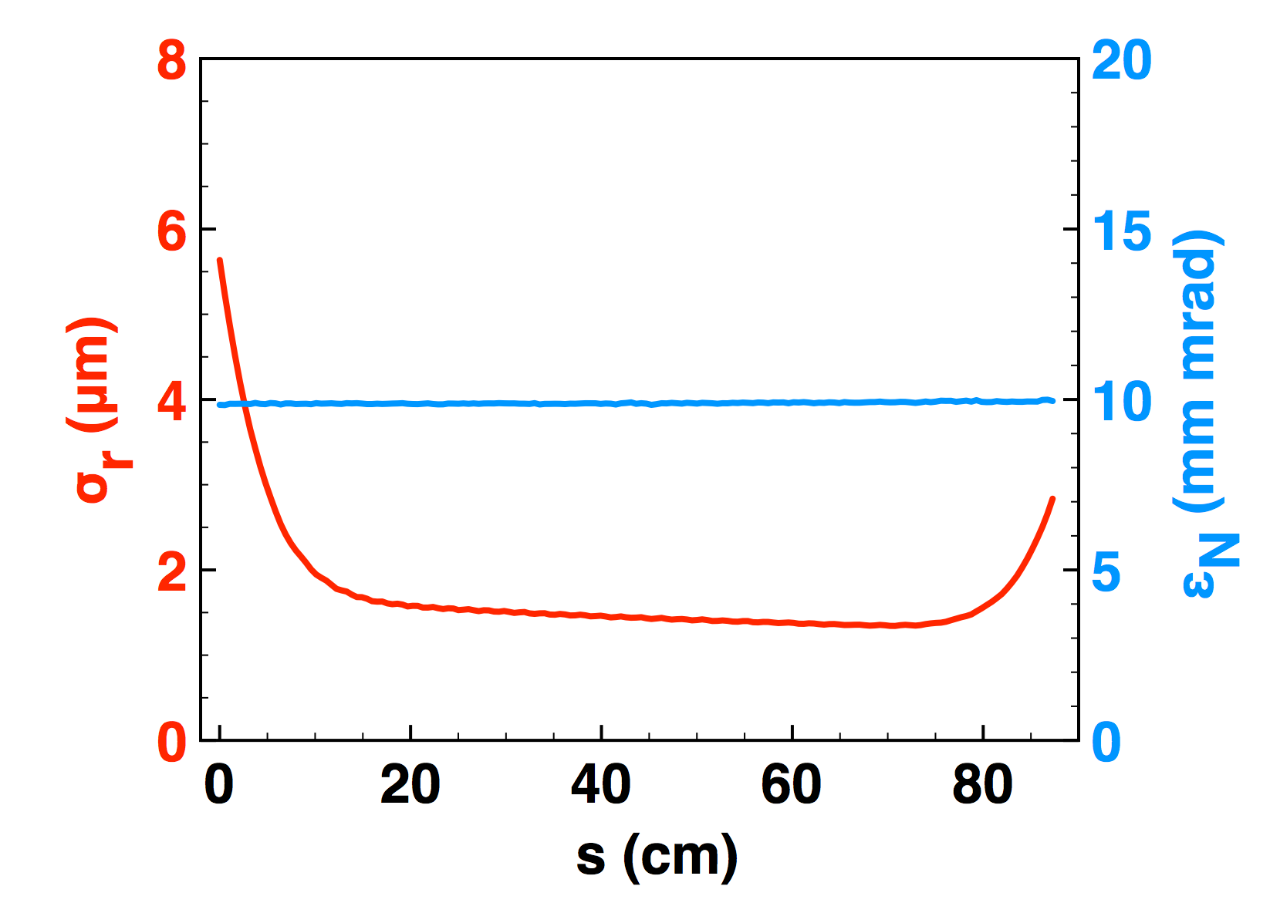
Two-bunch PWFA
Beam Matching in and out of plasma accelerator
And emittance preservation
Plasma
Ramp
Matched Beam in Plasma
Simulation Results: Weiming An

Slide 5
What are the science goals: definition of success and target time for each goal (from last ZOOM E300 meeting)
The Grand Science Goal is to reach the beam parameters needed of a single stage
of a future linear collider as far as FACET II infrastructure will allow.
1 Significant energy depletion of the drive bunch
with bulk of the particles fully energy depleted Year 1
2 Efficient (>30%)energy extraction from the wake by
the trailing bunch while close to doubling it’s energy Year 1 and 2
3Understand the conditions for optimum beam loading
to minimize the energy spread Year 2
4 Understand and optimize the beam matching for
emittance preservation at 10 micron or less level Year 2 and 3
5 Quantify the extent of transverse BBU or hosing instability Year 3
6 Perform preliminary experiments for next set of pressing issues Year 3

Slide 6
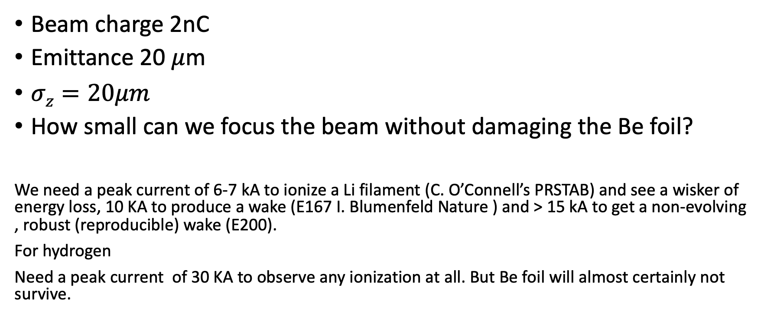
Beam Parameters for Single Bunch Experiment
Beam charge 2nC
Emittance 20 $μ$m
$σz=20μm$
How small can we focus the beam without damaging the Be foil?
We need a peak current of 6-7 kA to ionize a Li filament (C. O’Connell’s PRSTAB) and see a wisker of energy loss, 10 KA to produce a wake (E167 I. Blumenfeld Nature ) and > 15 kA to get a non-evolving , robust (reproducible) wake (E200).
For hydrogen
Need a peak current of 30 KA to observe any ionization at all. But Be foil will almost certainly not survive.

Slide 8
If the Be foil does not survive the tightly focused beam
Then we have to seriously think about try out beam ionization of H₂
The wake may very well be in a partially ionized non uniform but much longer plasma.
Characterized by low energy loss and small to no energy gain. Relatively poor overall energy transfer efficiency to the wake.
Laser pre-ionization of Hydrogen is possible in the future.
Will we face strong hosing of the beam due to longitudinal bunching of the beam and transverse displacements of portions of this beam?
Finally, according to Glen, the drive and the trailing bunches have a 2um misalignment in the x direction and the drive beam has a long low charge tail that connects the drive beam to the trailing beam. Is this still the case?

