Slide 1
Simulation of the multi-view imaging system with differentiable ray tracing
August 2022

Slide 2
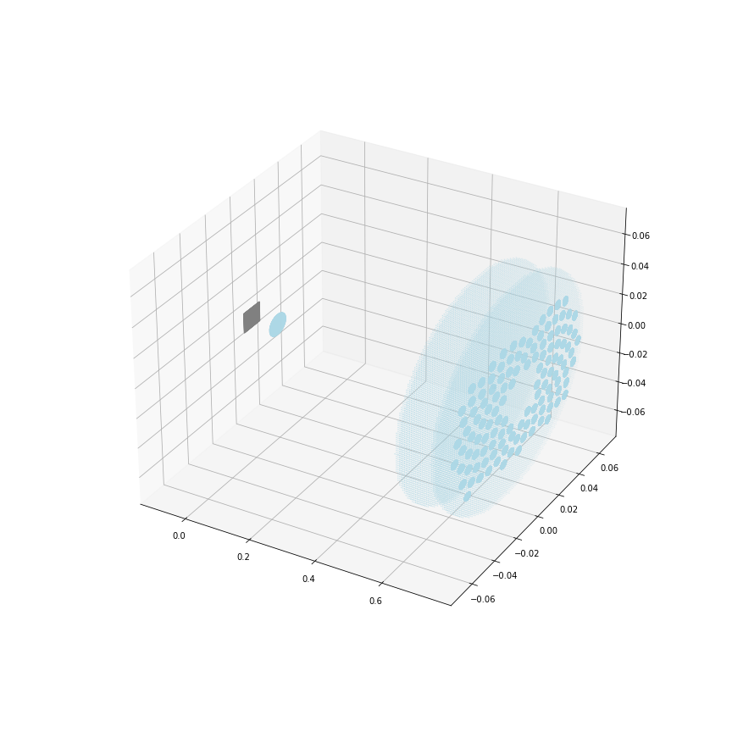
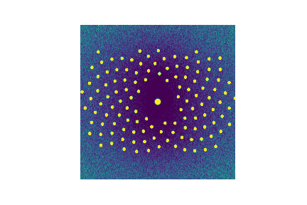
New dome
100 x 100px
f74p726mm_m0p1_N4p67, 10us imaging time, 76% QE, no readout noise, 2${mm}^{3}$ cloud

Slide 3
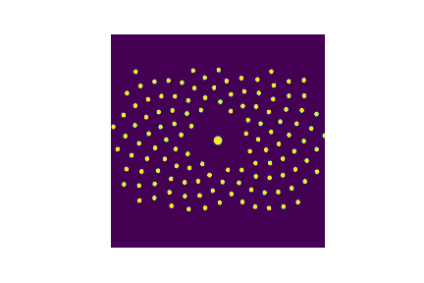
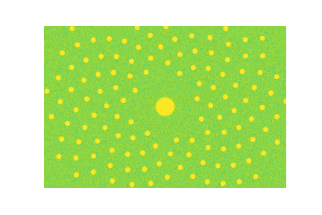
gradoptics.Camera

Slide 4
New dome
F2
F4.67
100 x 100px
F5.5
f74p726mm_m0p1_N4p67, 10us imaging time, 76% QE, 3.3 readout noise, 2${mm}^{3}$ cloud

