Slide 1

Diagnostic Imaging System for MAGIS-100
Simulation of Mounting Tolerance & Performance
Sanha Cheong, Murtaza Safdari
SLAC MAGIS Group Meeting June 6th, 2022

Slide 2
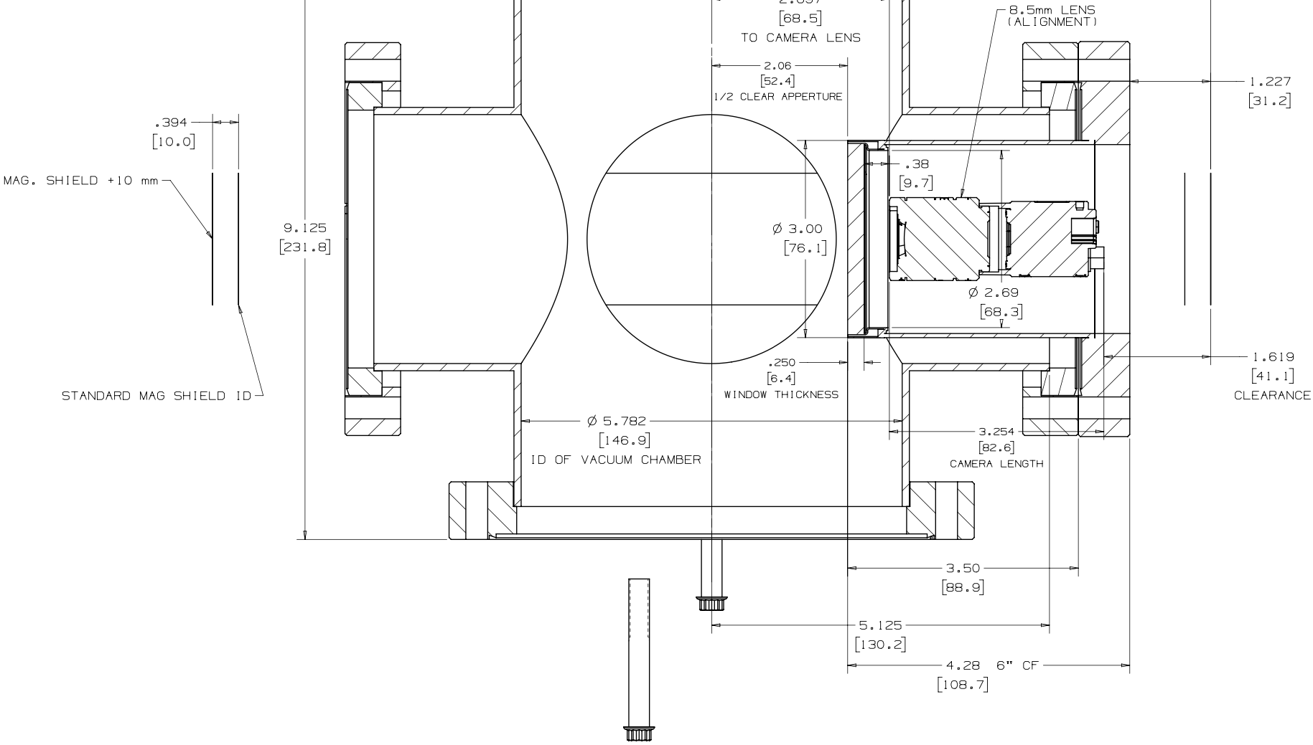
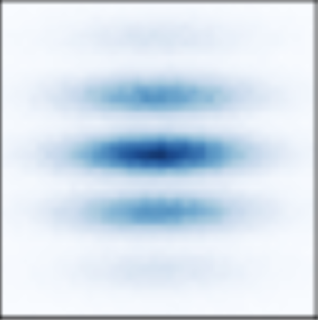
Diagnostic Imaging System: Overview
Triple Camera Node Configuration
Camera and Lens choice for the alignment cameras is close to final
Final dimensional checks need to be made
Camera and Lens choice for the physics camera is also close to final
Decision on lens size / camera tradeoff needs to be made
Final dimensional checks needs to be made
Physics Lens
tuned for higher magnifications
m = 0.6
Alignment Lens
tuned for large field of view
m = 0.1
w/ Remotely adjustable base for focus
w/ Fixed mount
11 mm
10 cm
2 mm
3 mm
Alignment Lens
tuned for large field of view
m = 0.1
FoV: 7.4 cm
FoV: 12.5 mm
‹#› / MAGIS-100 DIS Studies

Slide 3
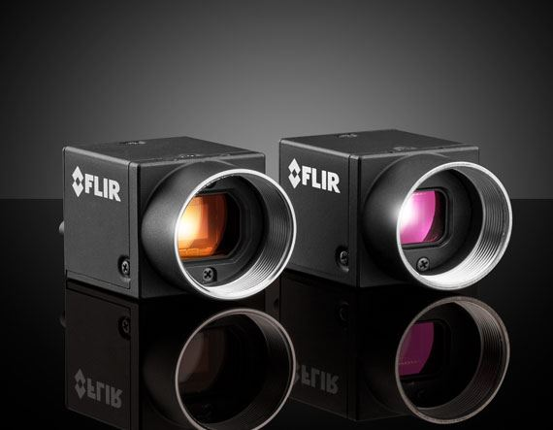
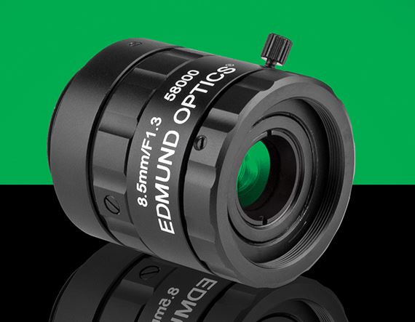
DIS: Alignment Camera Summary
Specs relevant for today’s studies
Two alignment cameras / node
8.5mm lens
Nominal mag. = 0.1
Working distance = 93.5mm
Field of view: 49.8mm ⨉ 74mm
Depth of field: 10mm for 5lpmm, 40mm for 1lpmm
Other details:
2.4µm pixel size
3072 ⨉ 2048 pixels
Exposure time: 25µs - 30s
‹#› / MAGIS-100 DIS Studies

Slide 4
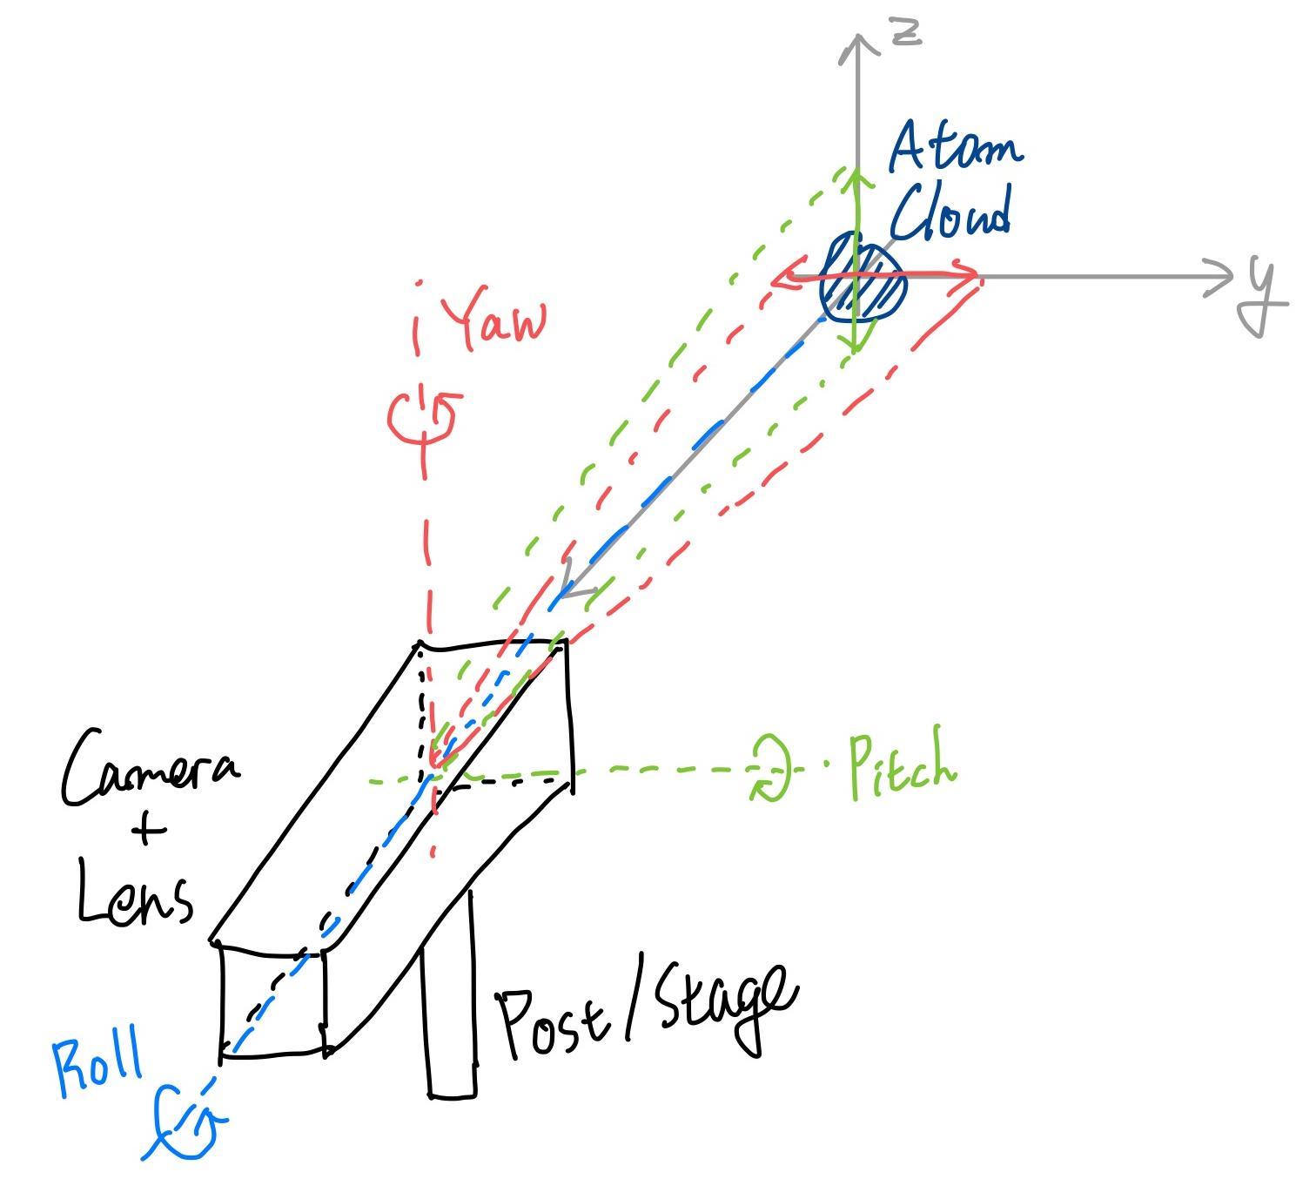
Camera Mounting Tolerance
From discussions with Fermilab engineers (Dirk Hurd, Noah Curfman)
“What kind of mounting mechanism/precision do you need for DIS?”
This study:
“Assuming some reasonable tolerance T, what kind of location precision can we get from DIS?”
Assumed mounting tolerances:
±1mm uniform error in x, y, z positions
±0.5° uniform error in pitch & yaw angles
At 93.5mm, this causes ±0.8mm effect
Small roll doesn’t affect our measurement
‹#› / MAGIS-100 DIS Studies

Slide 5
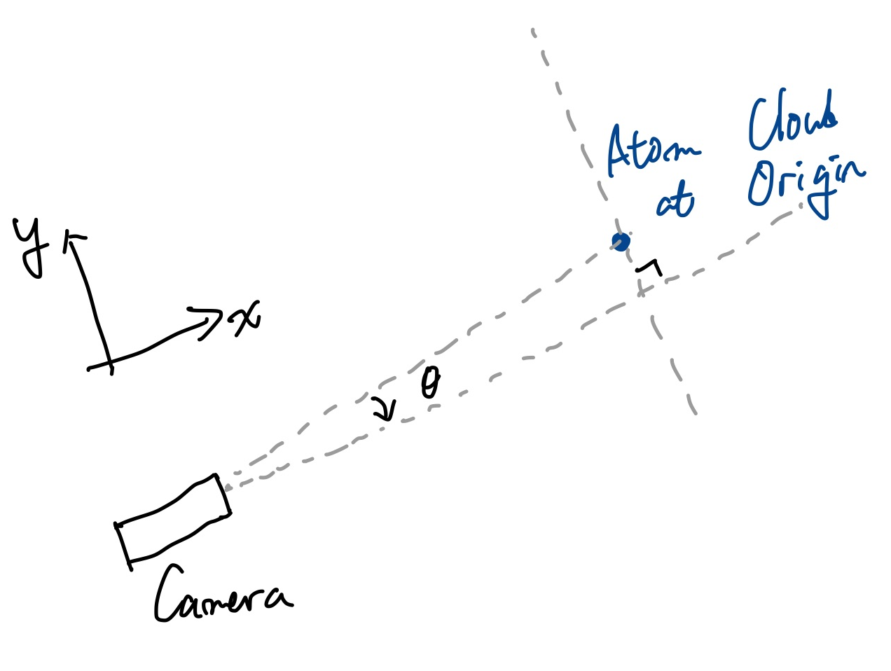
Simulation Set-up
Simplifying assumptions
Everything is in focus; no de-focusing information
No other ray-tracing things
`DIS` class has following variables:
Focal length
Working distance (internal)
Nominal position and some offset
Nominal orientation and some offset
and following functions:
View image from object
Relative object coordinate ⨉ real magnification
Infer object position from image
Transverse: image coordinates / internal mag.
Axial: internal working distance
Everything is implemented differentiably, in PyTorch
With small off-set angle 𝜃, the camera “sees” (WD cos(𝜃), WD sin(𝜃)) instead of (WD, 0)
‹#› / MAGIS-100 DIS Studies

Slide 6
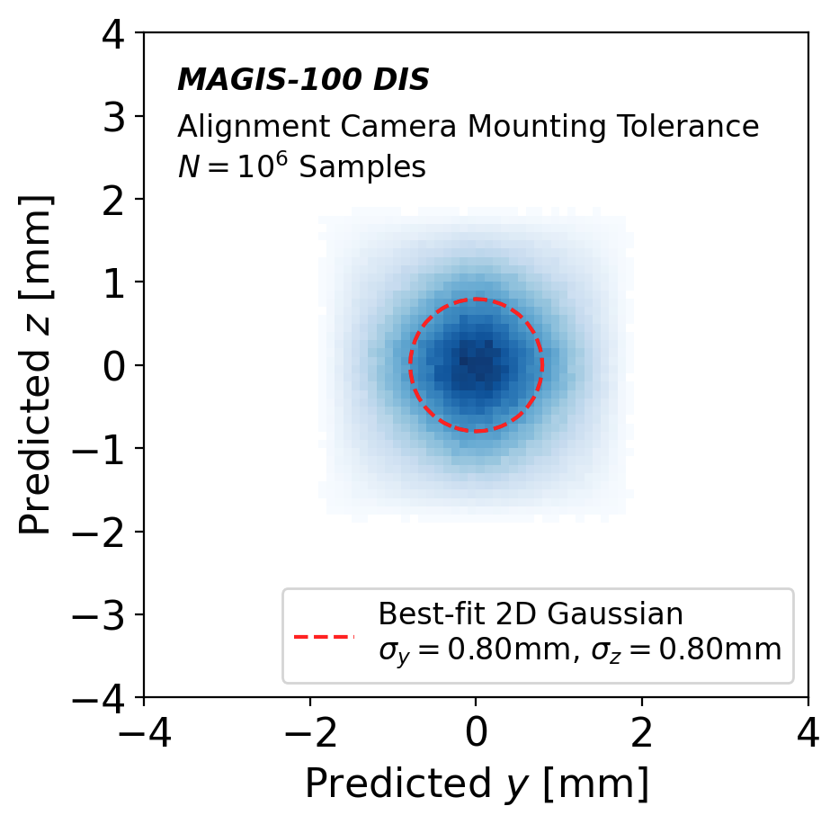
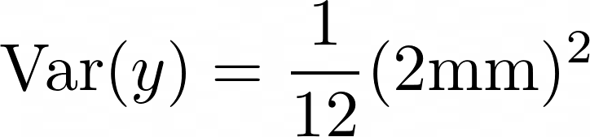
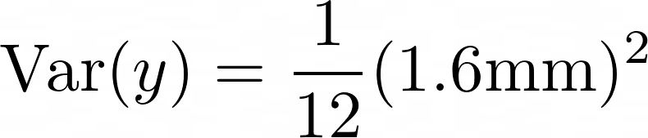
Verifying Simulation & Basic Tolerance Check
Atom cloud fixed at origin
One alignment camera at (-93.5mm, 0, 0) with some tolerance
±1mm uniform error in x, y, z positions
±0.5° uniform error in pitch & yaw angles
At 93.5mm, this causes ±0.8mm effect
This camera can predict transverse position with ±2mm range, ±0.80mm Gaussian resolution
Rough sanity check:
±1mm uniform error in y, z positions ⇒
±0.5° uniform error in pitch & yaw angles ⇒
These add up to ±0.75mm stdev.
‹#› / MAGIS-100 DIS Studies

Slide 7
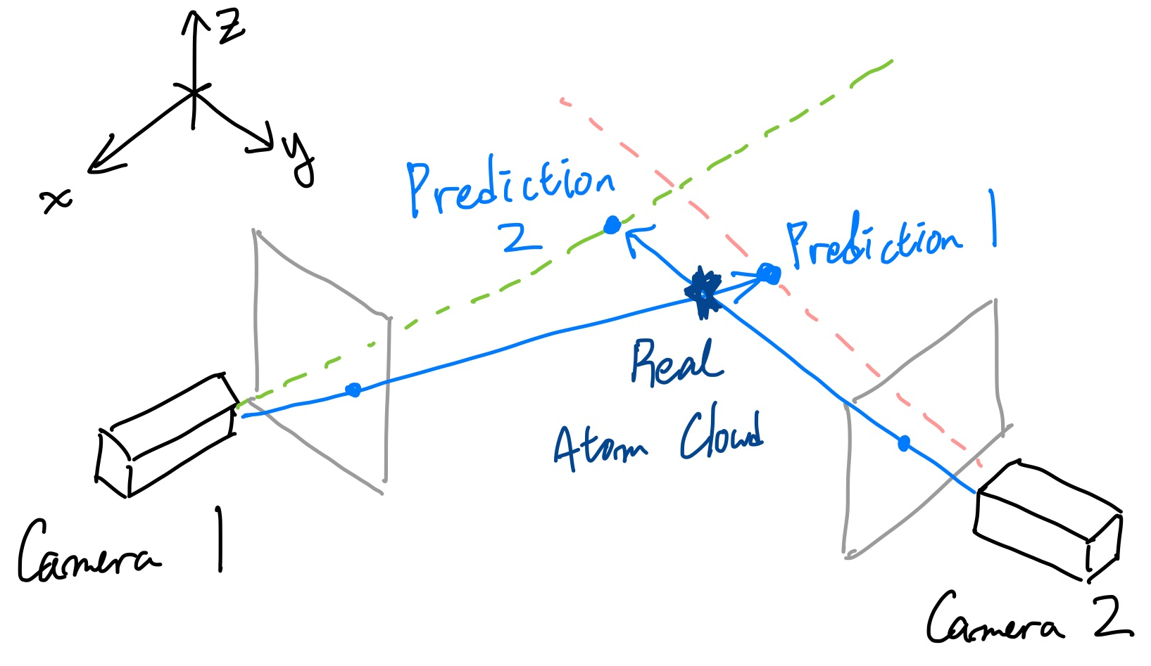
Combining Two Alignment Cameras
One alignment camera cannot predict depth / axial distance
De-focus is small (high DOF)
Depth is hard to predict from a simple image
We have two cameras mounted perpendicularly along x and y axes
How to combine information from two cameras?
Each camera predict 3D coordinate
Transverse based on image
Depth just as its “internal WD”
Minimize the difference between two predictions only by tuning working distance
‹#› / MAGIS-100 DIS Studies

Slide 8
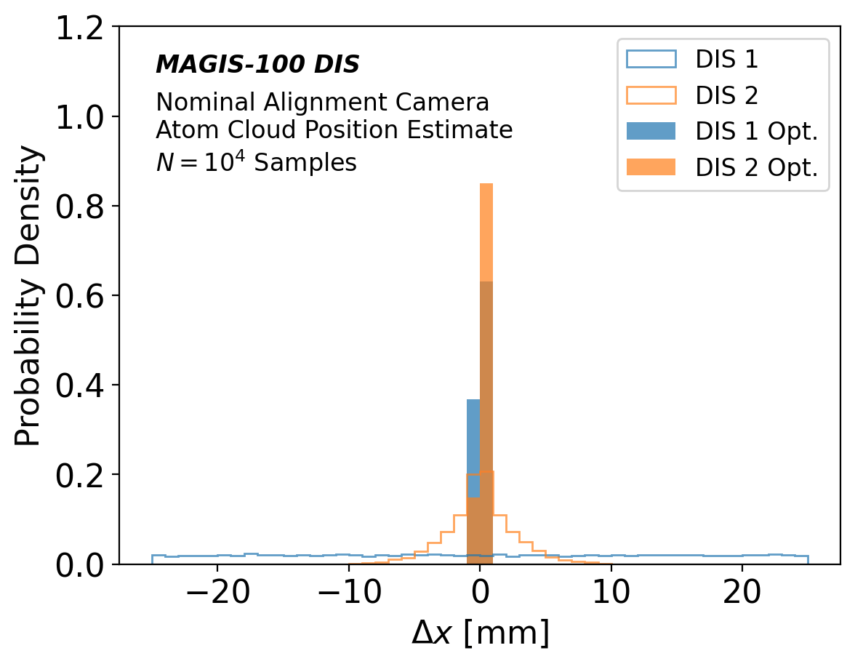
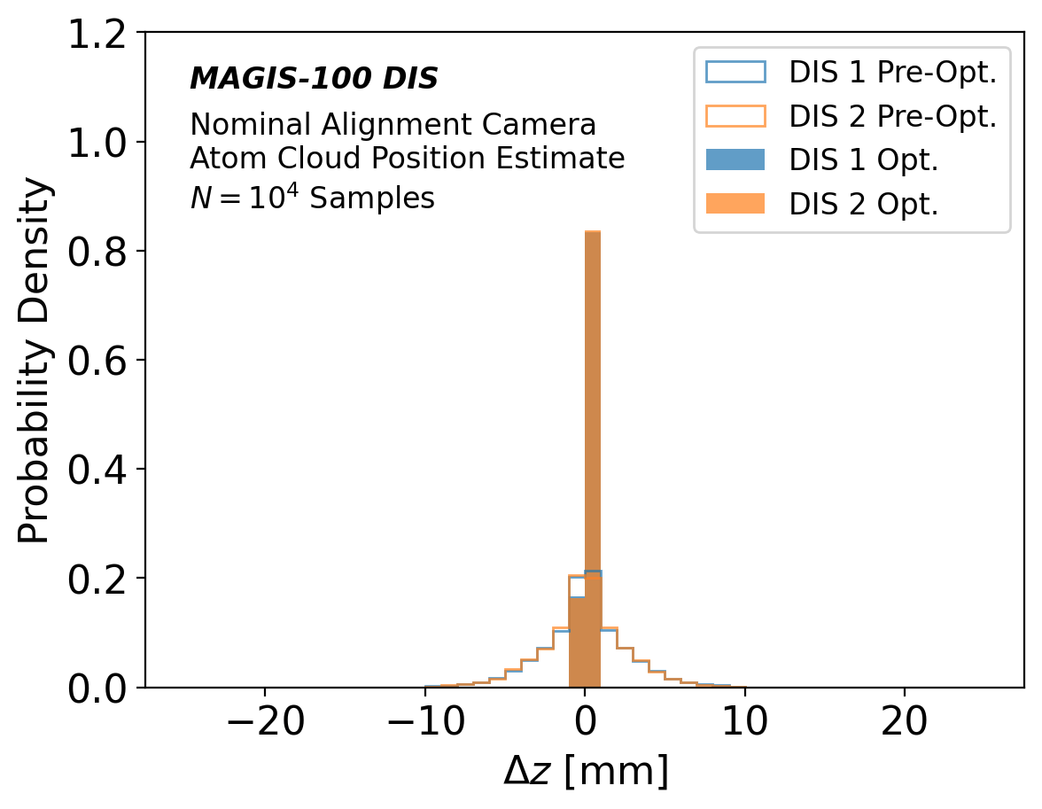
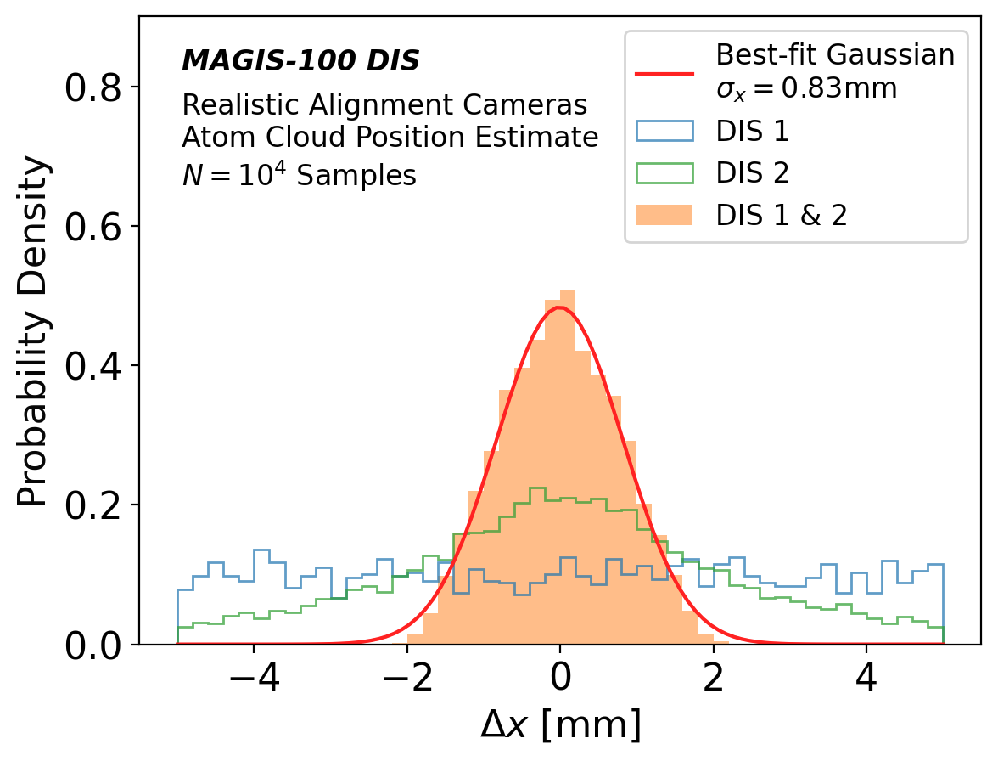
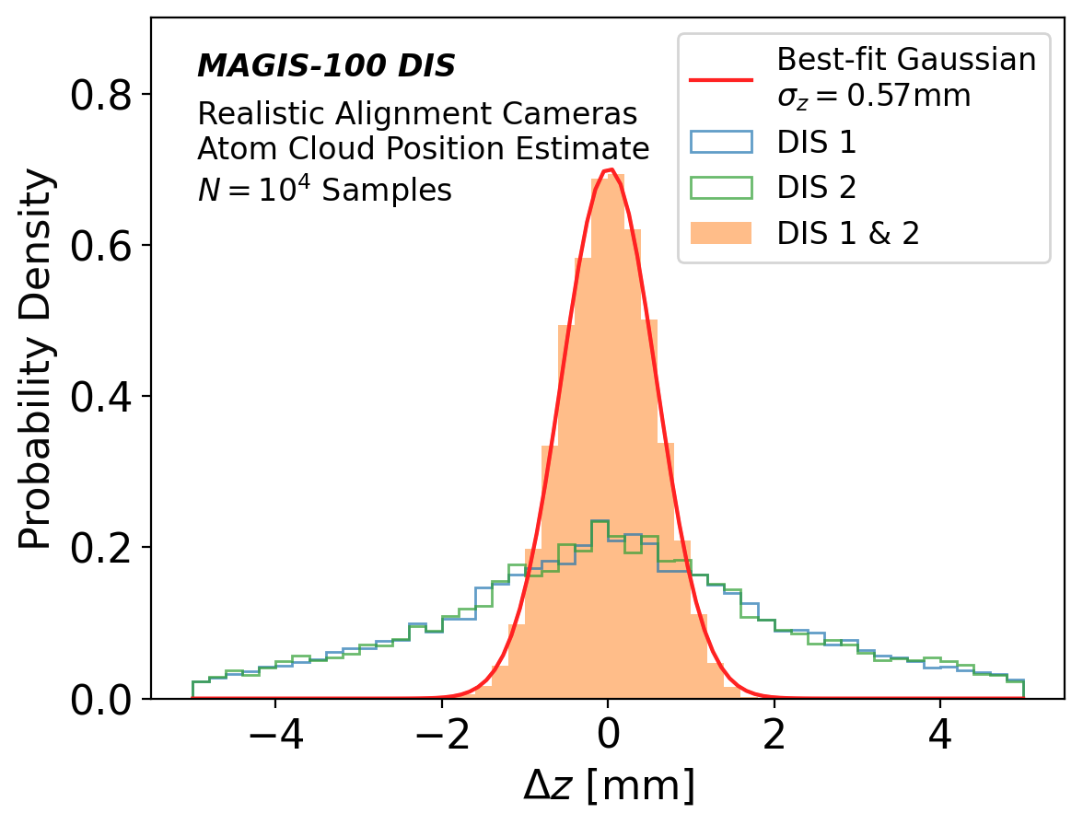
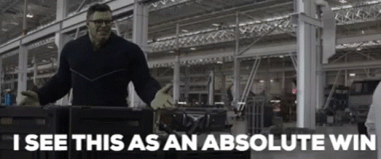
Two-Camera Performance Results
Atom cloud displaced uniformly over (5cm)³ volume
Two cameras mounted perfectly: ⇒ this method finds the atom cloud perfectly in 3D
With realistic mounting tolerances: ⇒ (±2mm)³ volume range or ±0.83mm (x and y) and ±0.57mm (z) Gaussian resolution
Performance seems good!
‹#› / MAGIS-100 DIS Studies

Slide 9
Summary
Differentiable, geometric simulation for DIS alignment algorithm
Performance seems good with ±1mm & ±0.5° tolerances
Effects not considered:
Finite pixel size at the sensor
2.4µm pixel corresponds to 24µm at nominal WD
Atom cloud is not a point; we need image → centroid finding
This is probably easy (unless there is noisy, bright bkg.)
Both these effects can be added to the current set-up and studied, but probably won’t change the conclusion
Plots sent to Jason (DOE Review for MAGIS this week)
Next steps
Repeat studies with a few other tolerance levels
Respond to Fermilab engineers with tolerance numbers
Add missing effects mentioned above
‹#› / MAGIS-100 DIS Studies

