Slide 1
Ray-tracing simulation ideas for RICH detector design/optimization
Ariel Schwartzman
19-May-2022

Slide 2
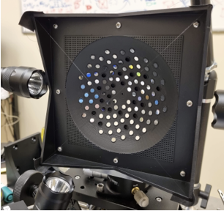
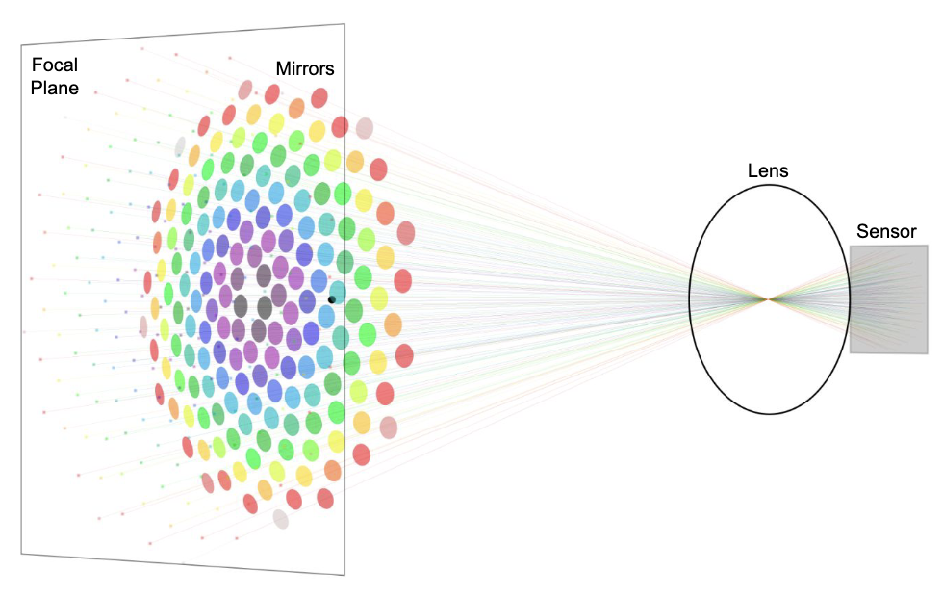
Context: Light Field imaging device for the MAGIS-100 Experiment designed at SLAC

Slide 3
Differentiable-Optics Simulator
Leveraging our group’s machine learning expertise, we developed a ray tracing simulator for system simulation, image formation, and reconstruction
  Fully differentiable, allowing Machine Learning design optimization
  Written in PyTorch (Python) and optimized for GPUs: vectorized and parallelized

Slide 4
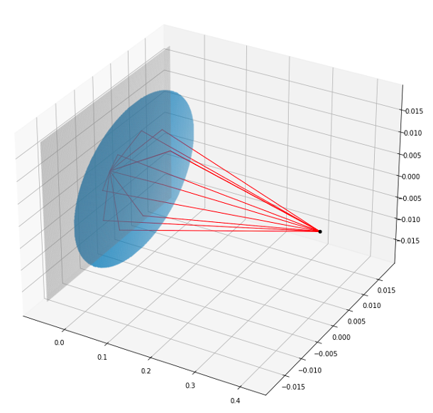
Differentiable-Optics (diffoptics)
diffoptics: Simulator of optical system and image generation
  Geometric Optics Approach: Ray tracing
  Building blocks: Optical Elements
    Thin & thick lenses, sensors, viewing windows, mirrors, etc.
  Photon shot noise included
  PSF implemented with convolutions
Python: written within PyTorch framework
  C++ and CUDA backend
  Vectorized, compile-able, and GPU compatible
End-to-end differentiable (discussed in later slide)

Slide 5

Simulation

Slide 6
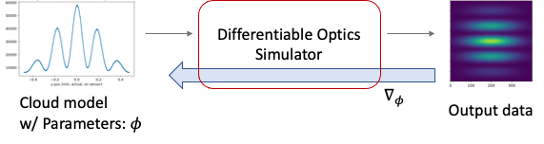
Differentiable framework
Optics simulator is differentiable:
  Write function: f(x) {…}; ⇒ Get derivative function automatically: df(x) {…};
Derivatives give access to sensitivities of reconstructed imaged data (rings) w.r.t. detector parameters (mirror locations, angles, sizes, refraction index, SiPMs parameters, …)
  Enables gradient-based optimization approaches to calibration, detector optimization, reconstruction, etc.

Slide 7
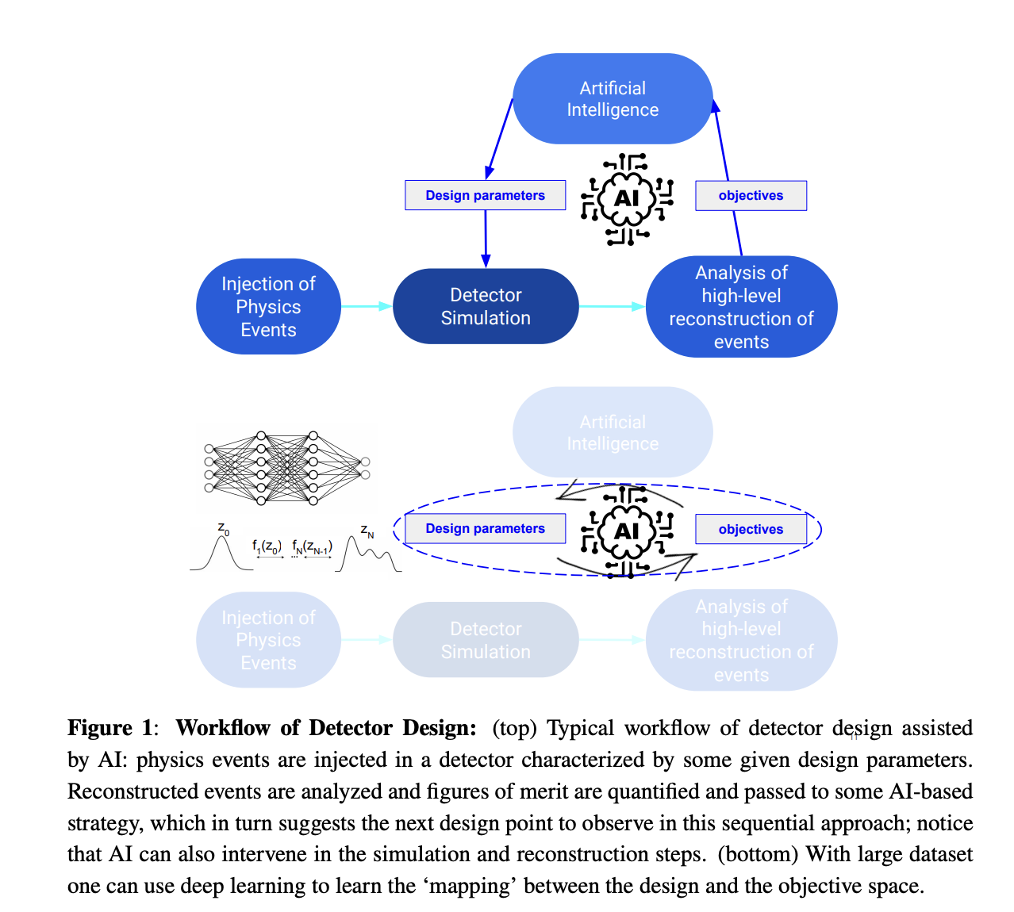
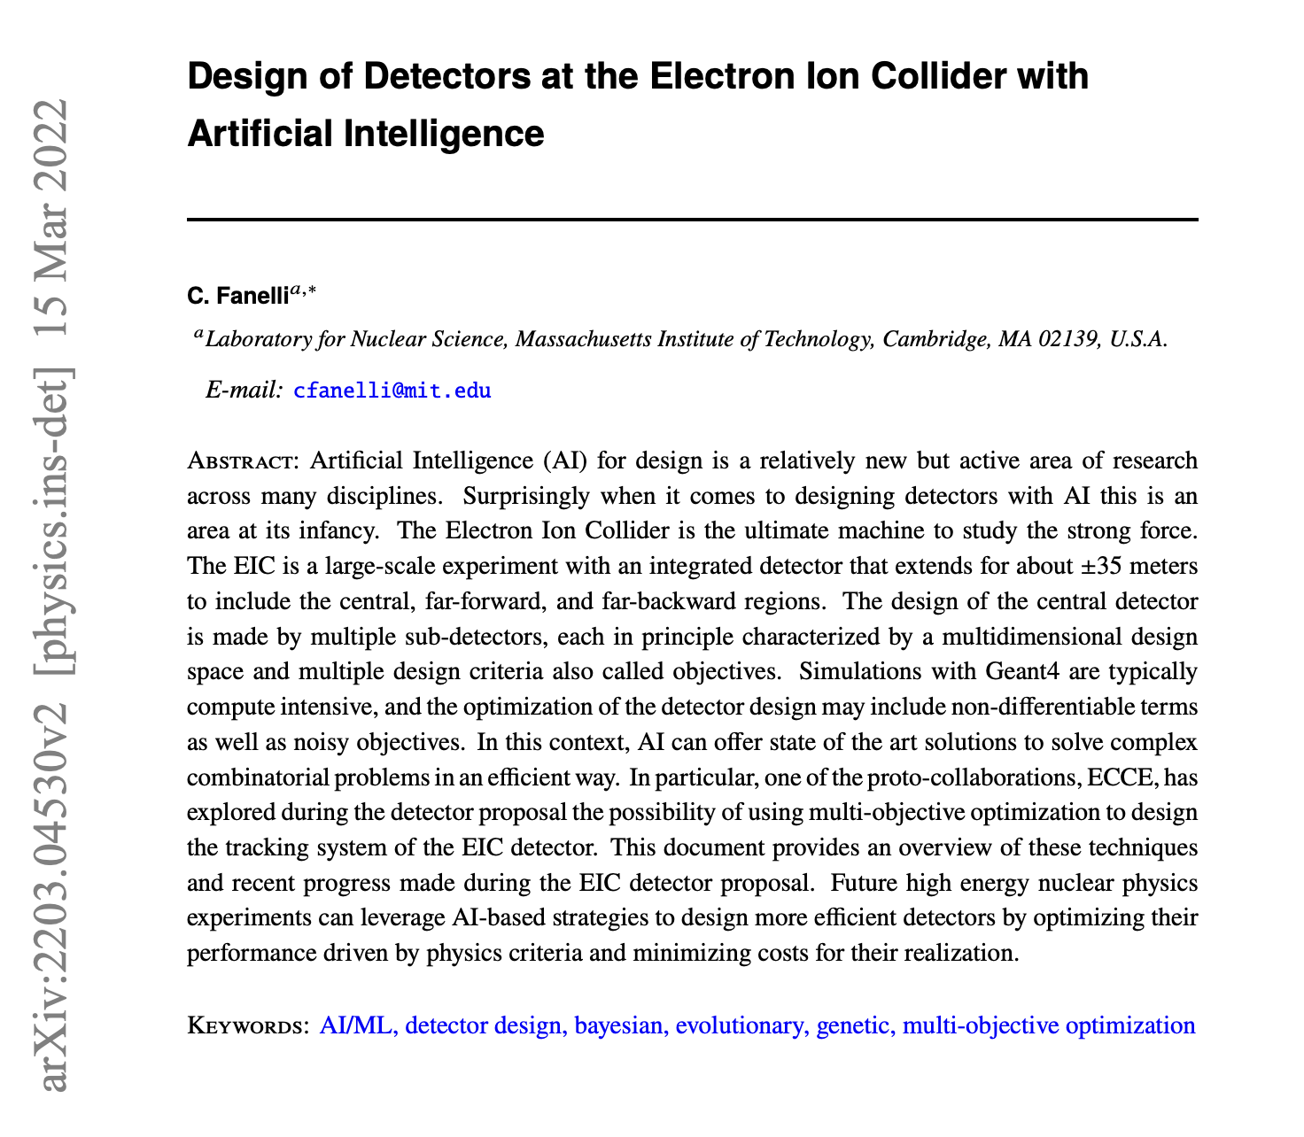
https://arxiv.org/abs/2203.04530

Slide 8
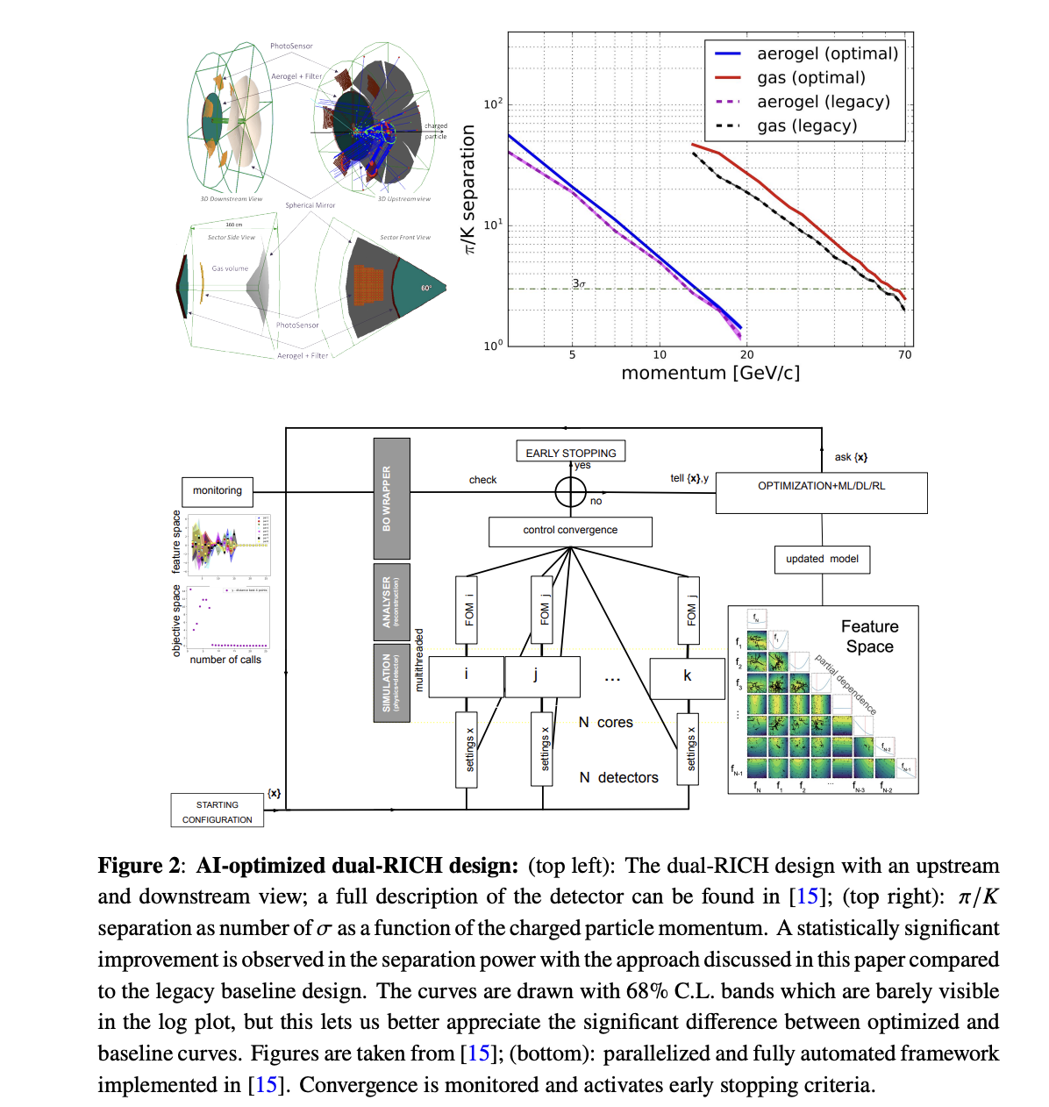

Slide 9
Discussion
Diffoptics offers key advantages over traditional ray tracing software
  Fully differentiable → Machine Learning Detector Optimization
    Can put us at the forefront of ML-based detector design (EIC RICH using Bayesian Optimization and starting to explore differential programming)
  Flexible, easy to use, and local expertise – Synergies with MAGIS-100 group
    Invaluable software to design our imaging system!
  If there is interest in moving forward, the next step is to implement Cherenkov light propagation in the simulator
  Geant 4 integration?
  Alternatives? DD4hep

