Slide 1
FACET-II Simulations using 6D phase space of incident beam (Ref. Glen 2020)the robust acceleration of trailing beam without
beam break-up (BBU)
^ D phase simulations using QuickPIC
Hiroki Fujii, L. Hildebrand, K. A. Marsh, W. Mori and Chan Joshi
ECE Department, UCLA

Slide 2
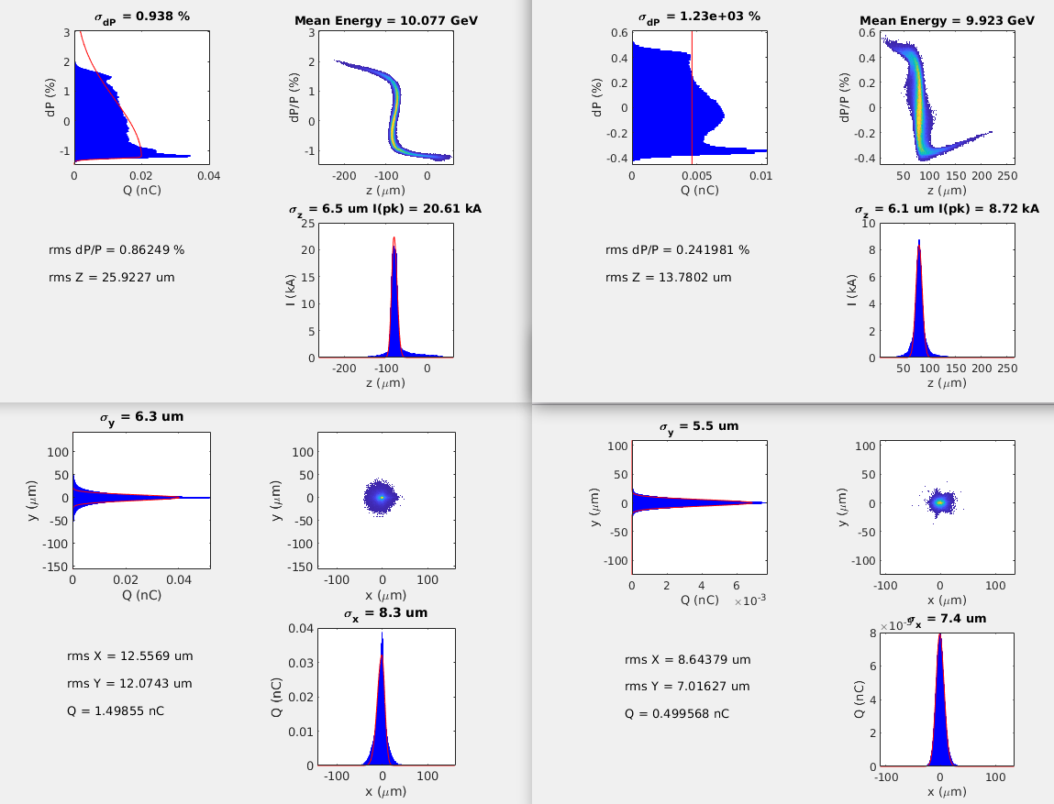
Drive and Trailing bunch Information from Glen

Slide 3
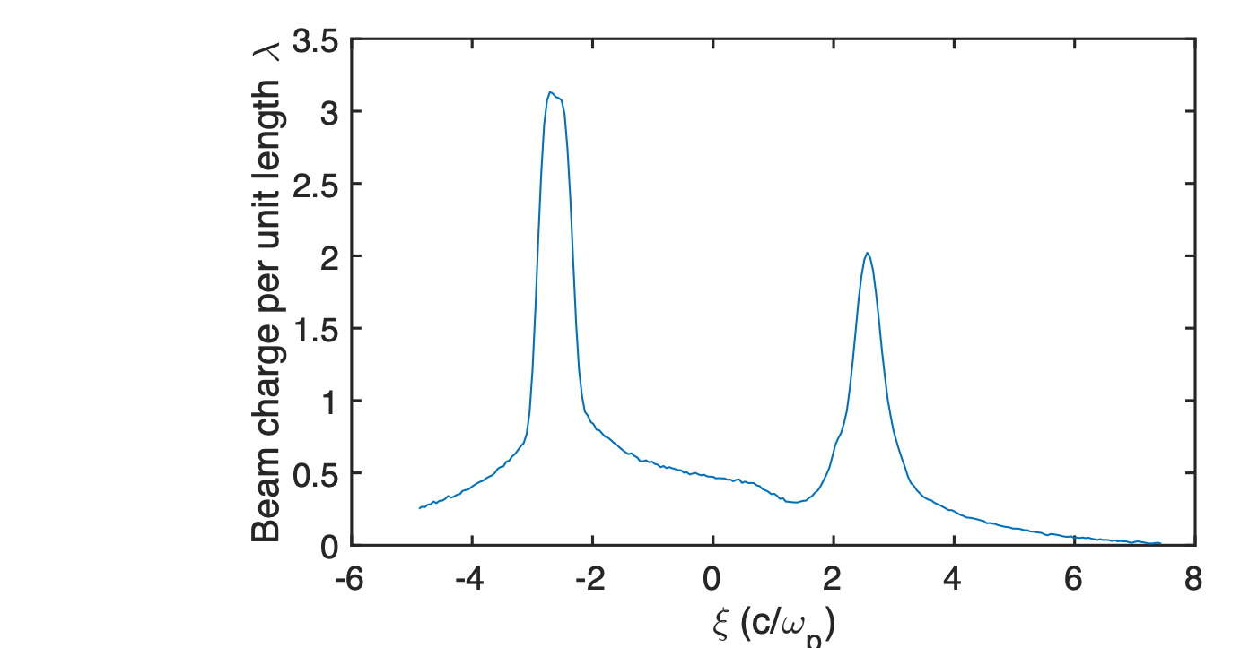
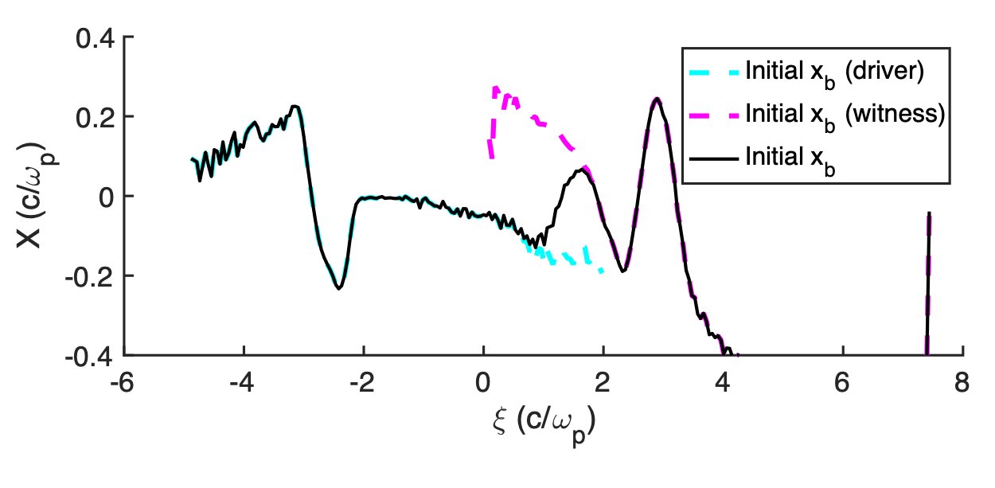
On Axis Charge distribution and Centroid offset of the longitudinal slices
Charge per unit length λ(ξ)
Maximum offset is around 0.2 c/ωp and embedded in the driver bunch
Embedded spectrum in centroid offset is unprecedented in hosing study,
i.e., ξ dependent rather than linear tilt
Glen claims this is due to the chromaticity of the IP 20 focusing, and some contribution from Coherent Synchrotron Radiation (CSR) effect.
Driver
Trailer
Initial centroid
Other parameters :
Drive charge : 1.5 nC
Trail charge : 0.5 nC
Beam radius : σr ~0.3 c/ωp

Slide 4
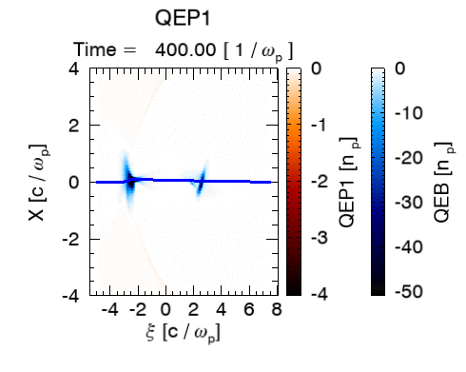
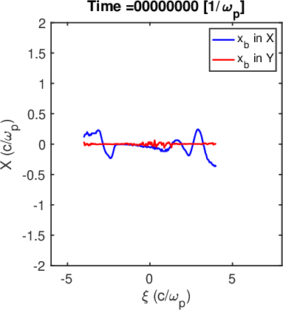
Background
Initial centroid offset provided by the beam designer is than studied in the past
Charge per unit length λ(ξ)
Driver
Trailer
Initial centroid
Beam centroid motion
The simulation performed for the following parameters
# of macro-particles : 1 million each
Plasma density : 3.0x10¹⁶ cm⁻³
Skin depth : 30.7 um
Drive charge : 1.5 nC
Trail charge : 0.5 nC
Beam radius : σr ~0.3 c/ωp

Slide 5
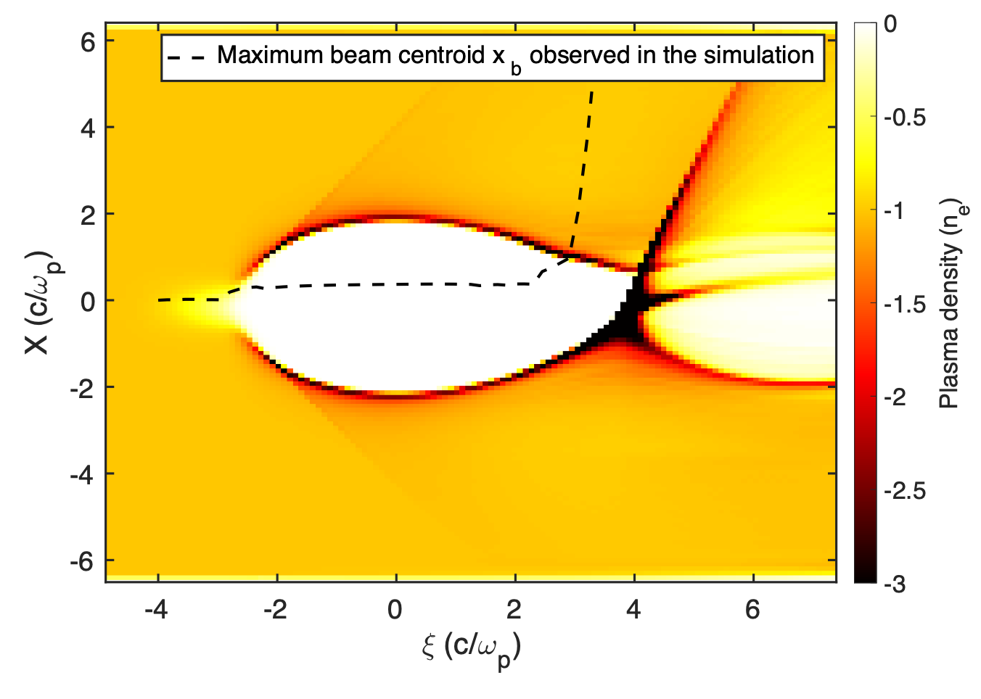
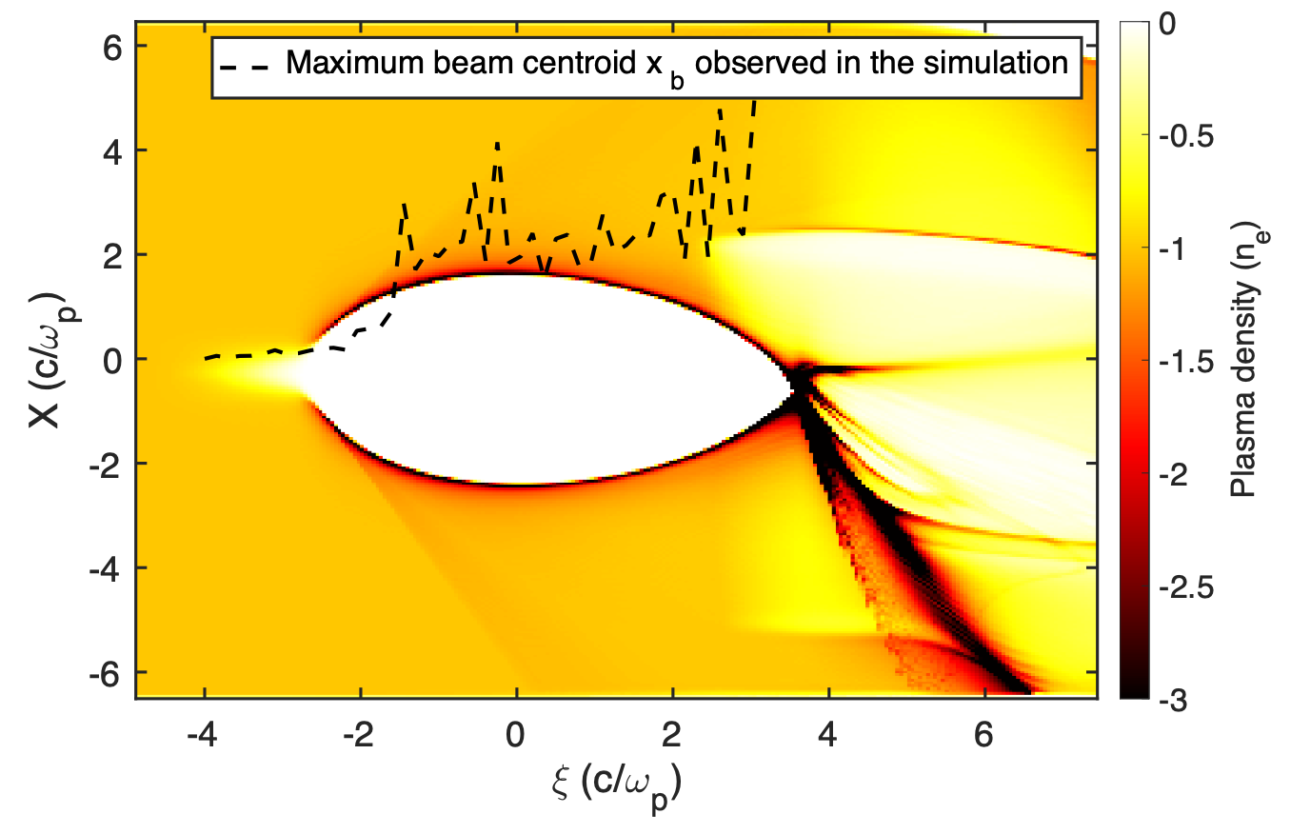
Background
Initial centroid offset provided by the beam designer is than studied in the past
Charge per unit length λ(ξ)
Coarse grid resolution ~ 0.1 c/ωp
Driver
Trailer
Initial centroid
too coarse for describing the physics
Finer grid resolution ~ 0.05 c/ωp
The simulation performed for the following parameters
# of macro-particles : 1 million each
Plasma density : 3.0x10¹⁶ cm⁻³
Skin depth : 30.7 um
Drive charge : 1.5 nC
Trail charge : 0.5 nC
Beam radius : σr ~0.3 c/ωp
Jaggy maximum envelope because sampling frequency is low (every 1 cm)

Slide 6
1)As far as I understand it it is highly unlikely to know
for certain what the 6d phase space of the beam looks like
2) OUR BEST BET IS TO MEASURE THE ENERGY LOSS AND
TRANSVERSE DEFLECTIONS OF THE DRIVE BEAM AND FIT
COMPARE THE RESULT WITH SIMULATIONS WITH AND
WITHOUT LASER HEATING OF THE BEAM/ BEAMS
3) We may need to chop off the long tail of the drive bunch
To get another experimental point. Can we do it.
4) Good news is that LCLS has a similar problem and they are
using the laser heater to damp the CSR instability.

