Slide 1
Status of the laser probelines
E300 Collaboration meeting
Henrik Ekerfelt

Slide 2
Outline
Current setup
Future upgrades and changes

Slide 3
Probelines
E324: Lithium oven probe
EOS BPM: Laser and e-beam timing and e-beam positioning
Shadowgraphy: Gas-jet shadowgraphy probe
Ionizer: Transverse laser beam ionizing the gas jet

Slide 4
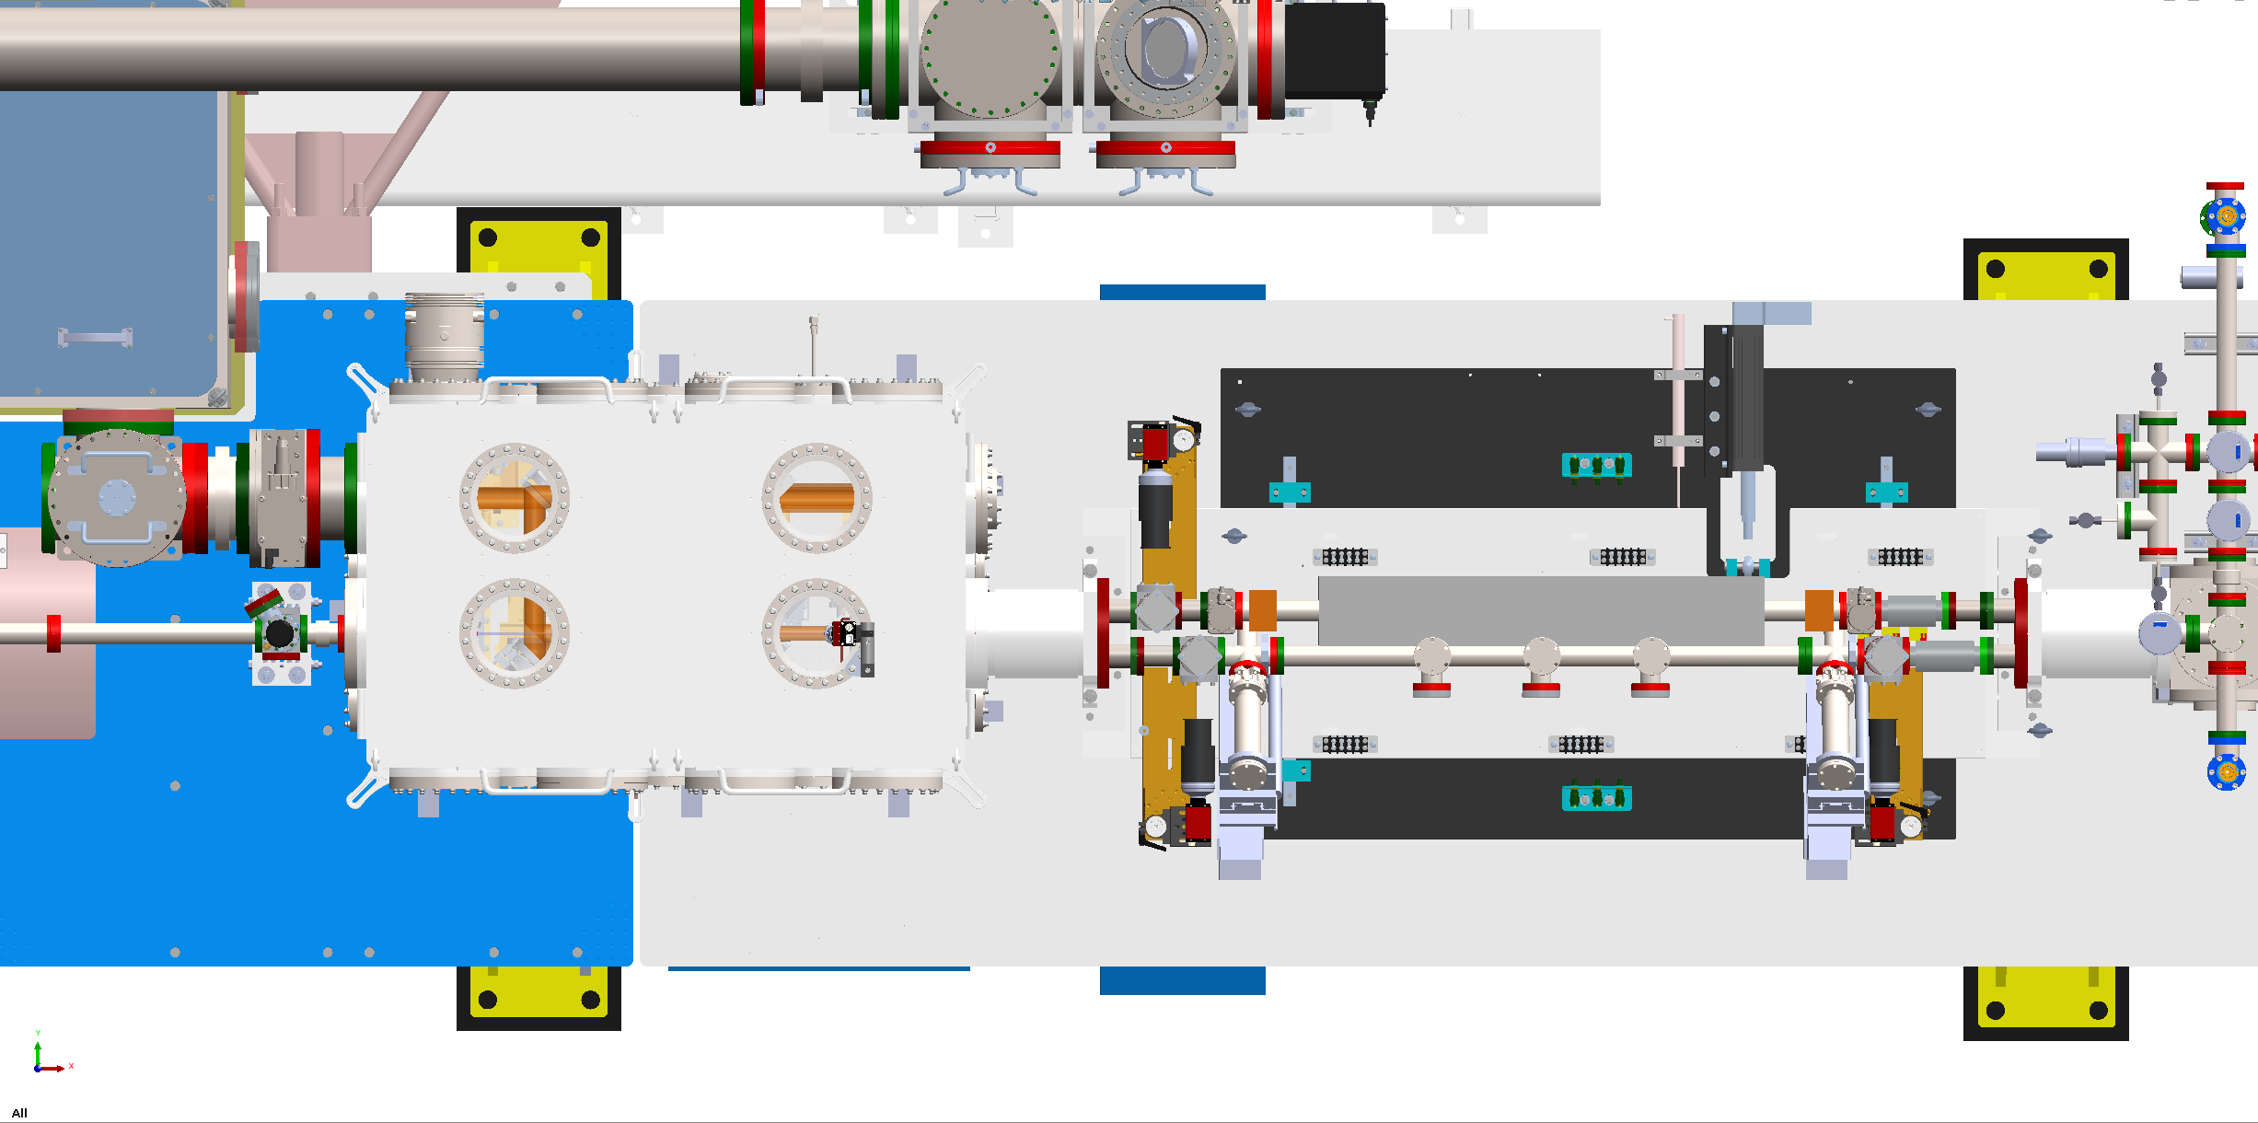
IP area

Slide 5
IP area
Laser transport
Laser compressor
Picnic Basket
Lithium oven

Slide 6
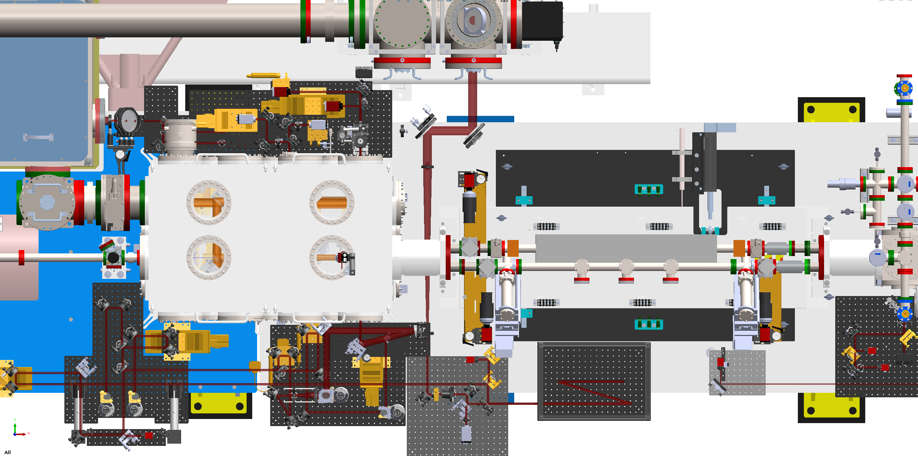
IP area
Laser transport
Laser compressor
Picnic Basket
Lithium oven
Probe compressor

Slide 7
IP area
Laser transport
Laser compressor
Picnic Basket
Lithium oven
Probe compressor

Slide 8
IP area
Beamsplitter
Ionizer/shadowgraphy
Beamsplitter
EOS/E324
Beamsplitter 1

Slide 9
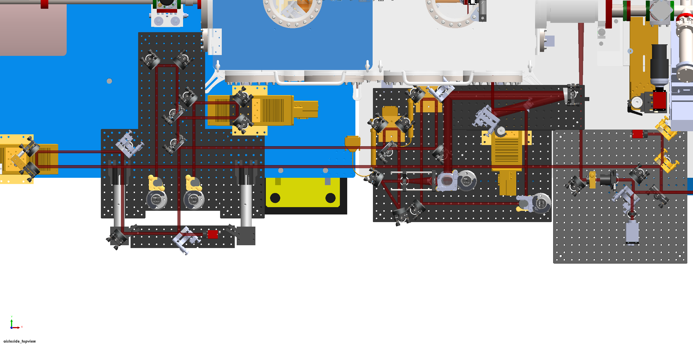
IP area
Beamsplitter
EOS/E324
Beamsplitter
Ionizer/shadowgraphy
Beamsplitter 1

Slide 10
Delay lines
E324
Shadowgraphy
Ionizer
EOS/Master

Slide 11
IP area
Ionizer periscope
E324 Periscope
EOS Periscope
Shadowgraphy periscope

Slide 12
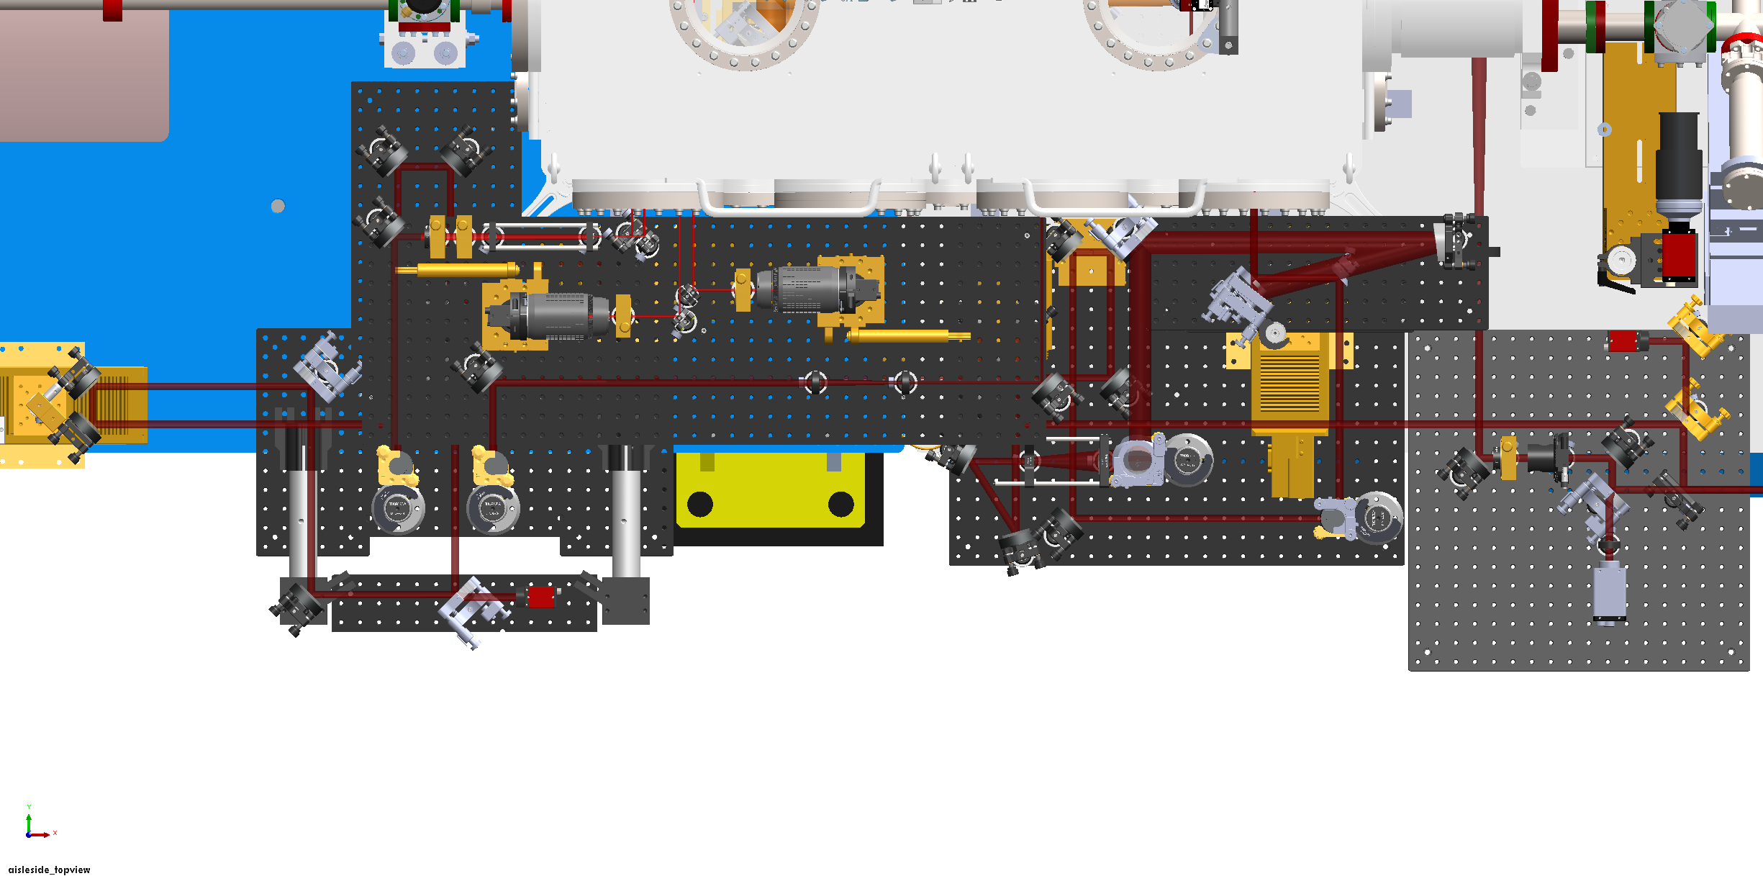
IP area
Ionizer periscope
E324 Periscope
EOS Periscope
Shadowgraphy periscope

Slide 13
IP area
EOS
Ionizer
E324
Shadowgraphy

Slide 14
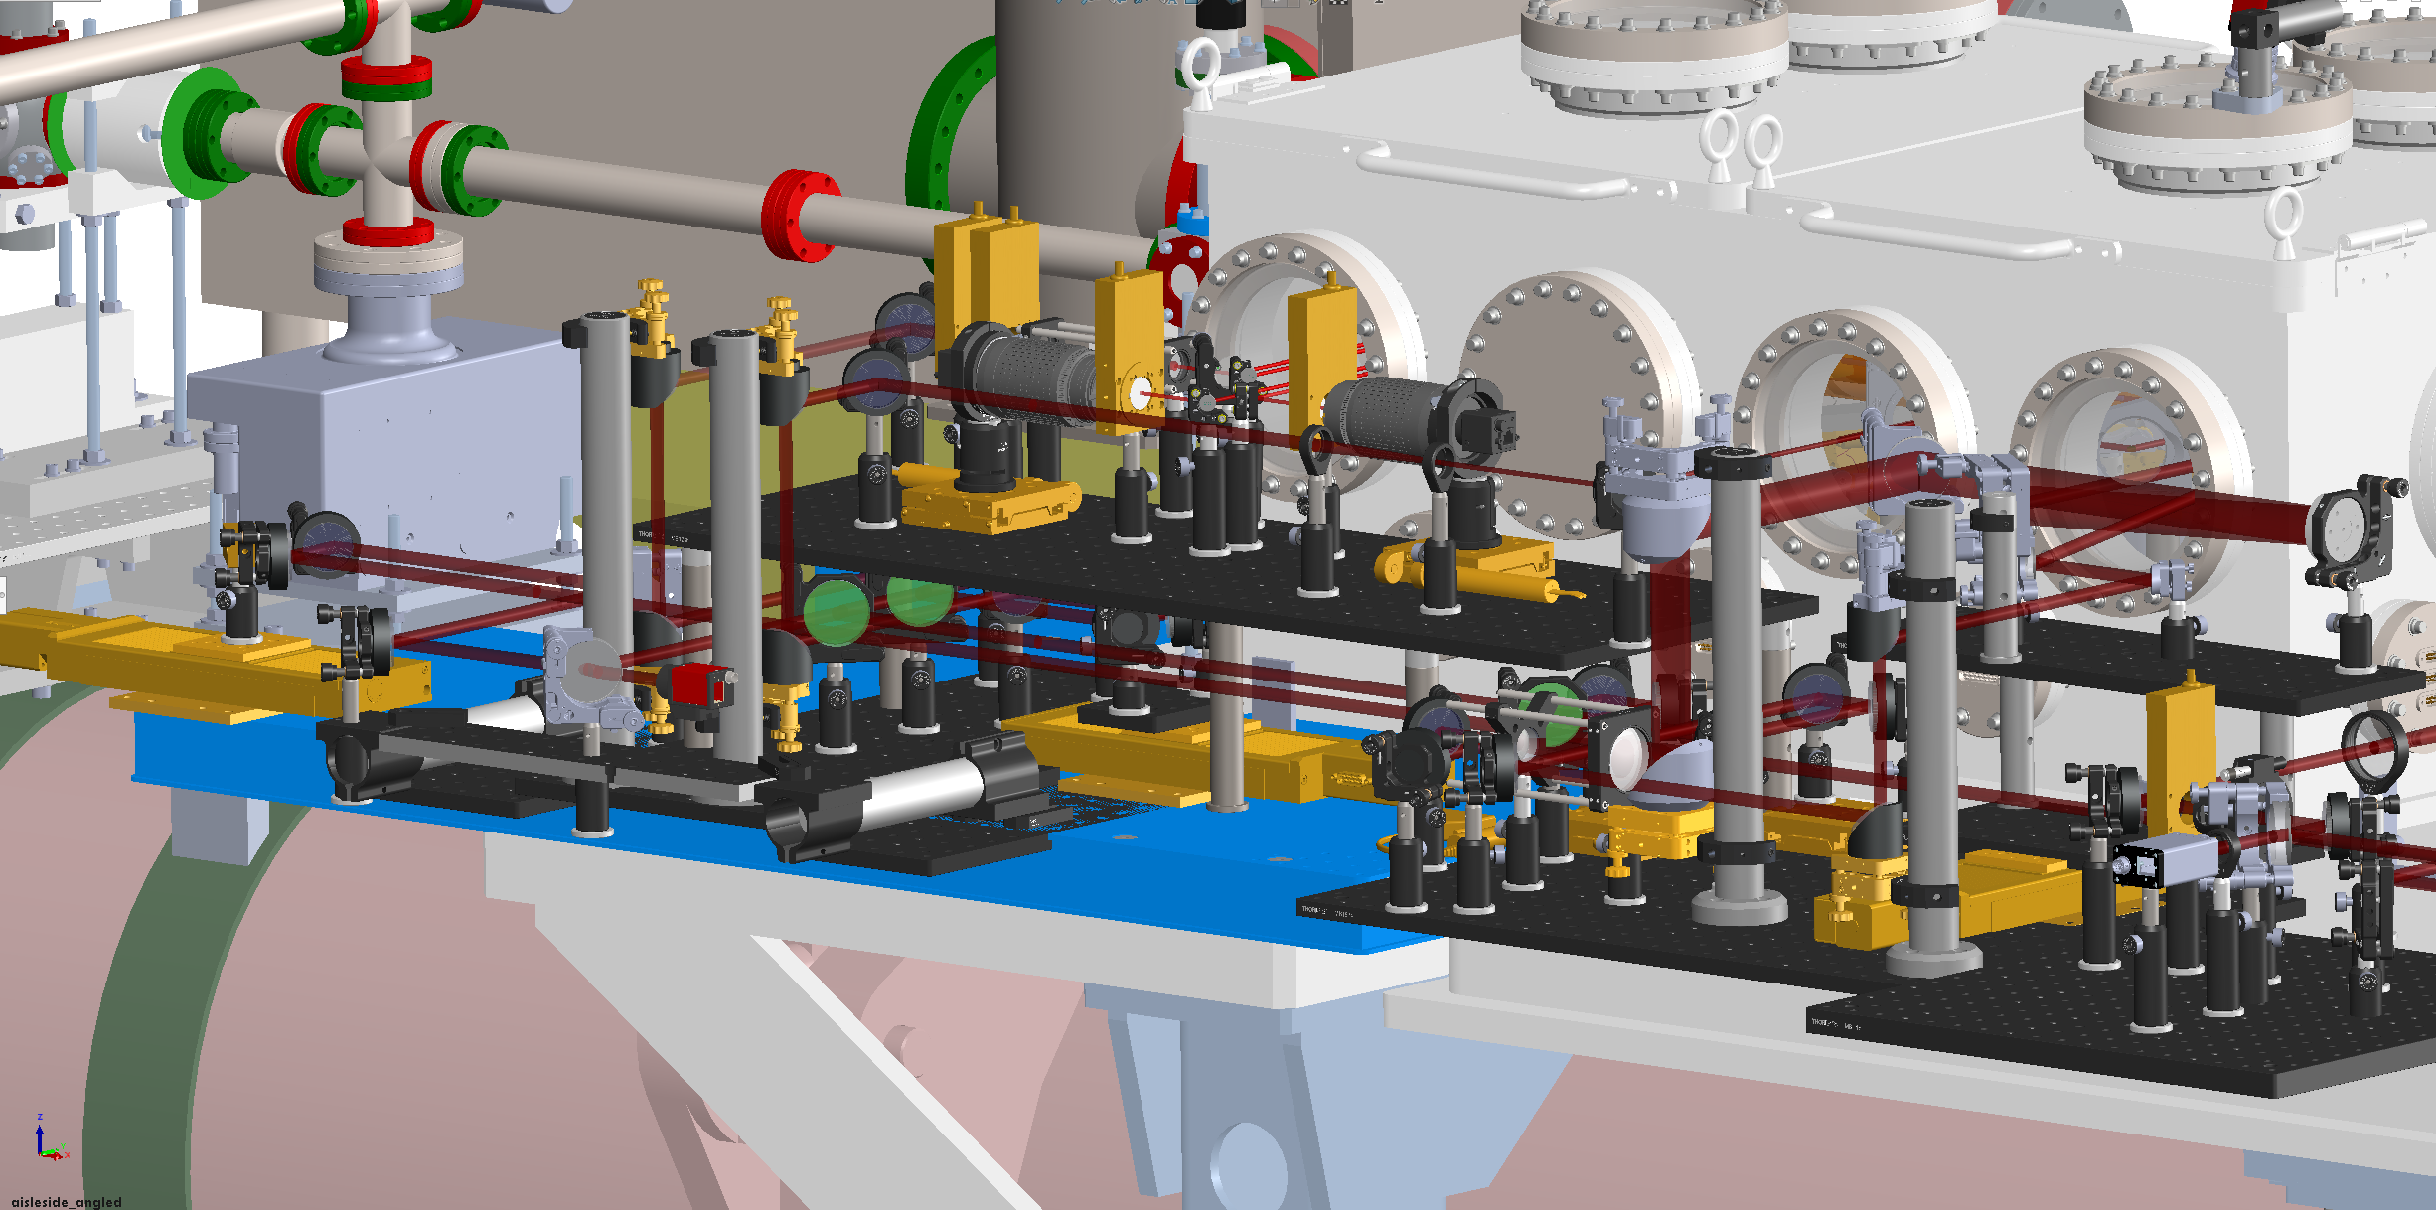
IP area
Ionizer
EOS
E324
Shadowgraphy

Slide 15
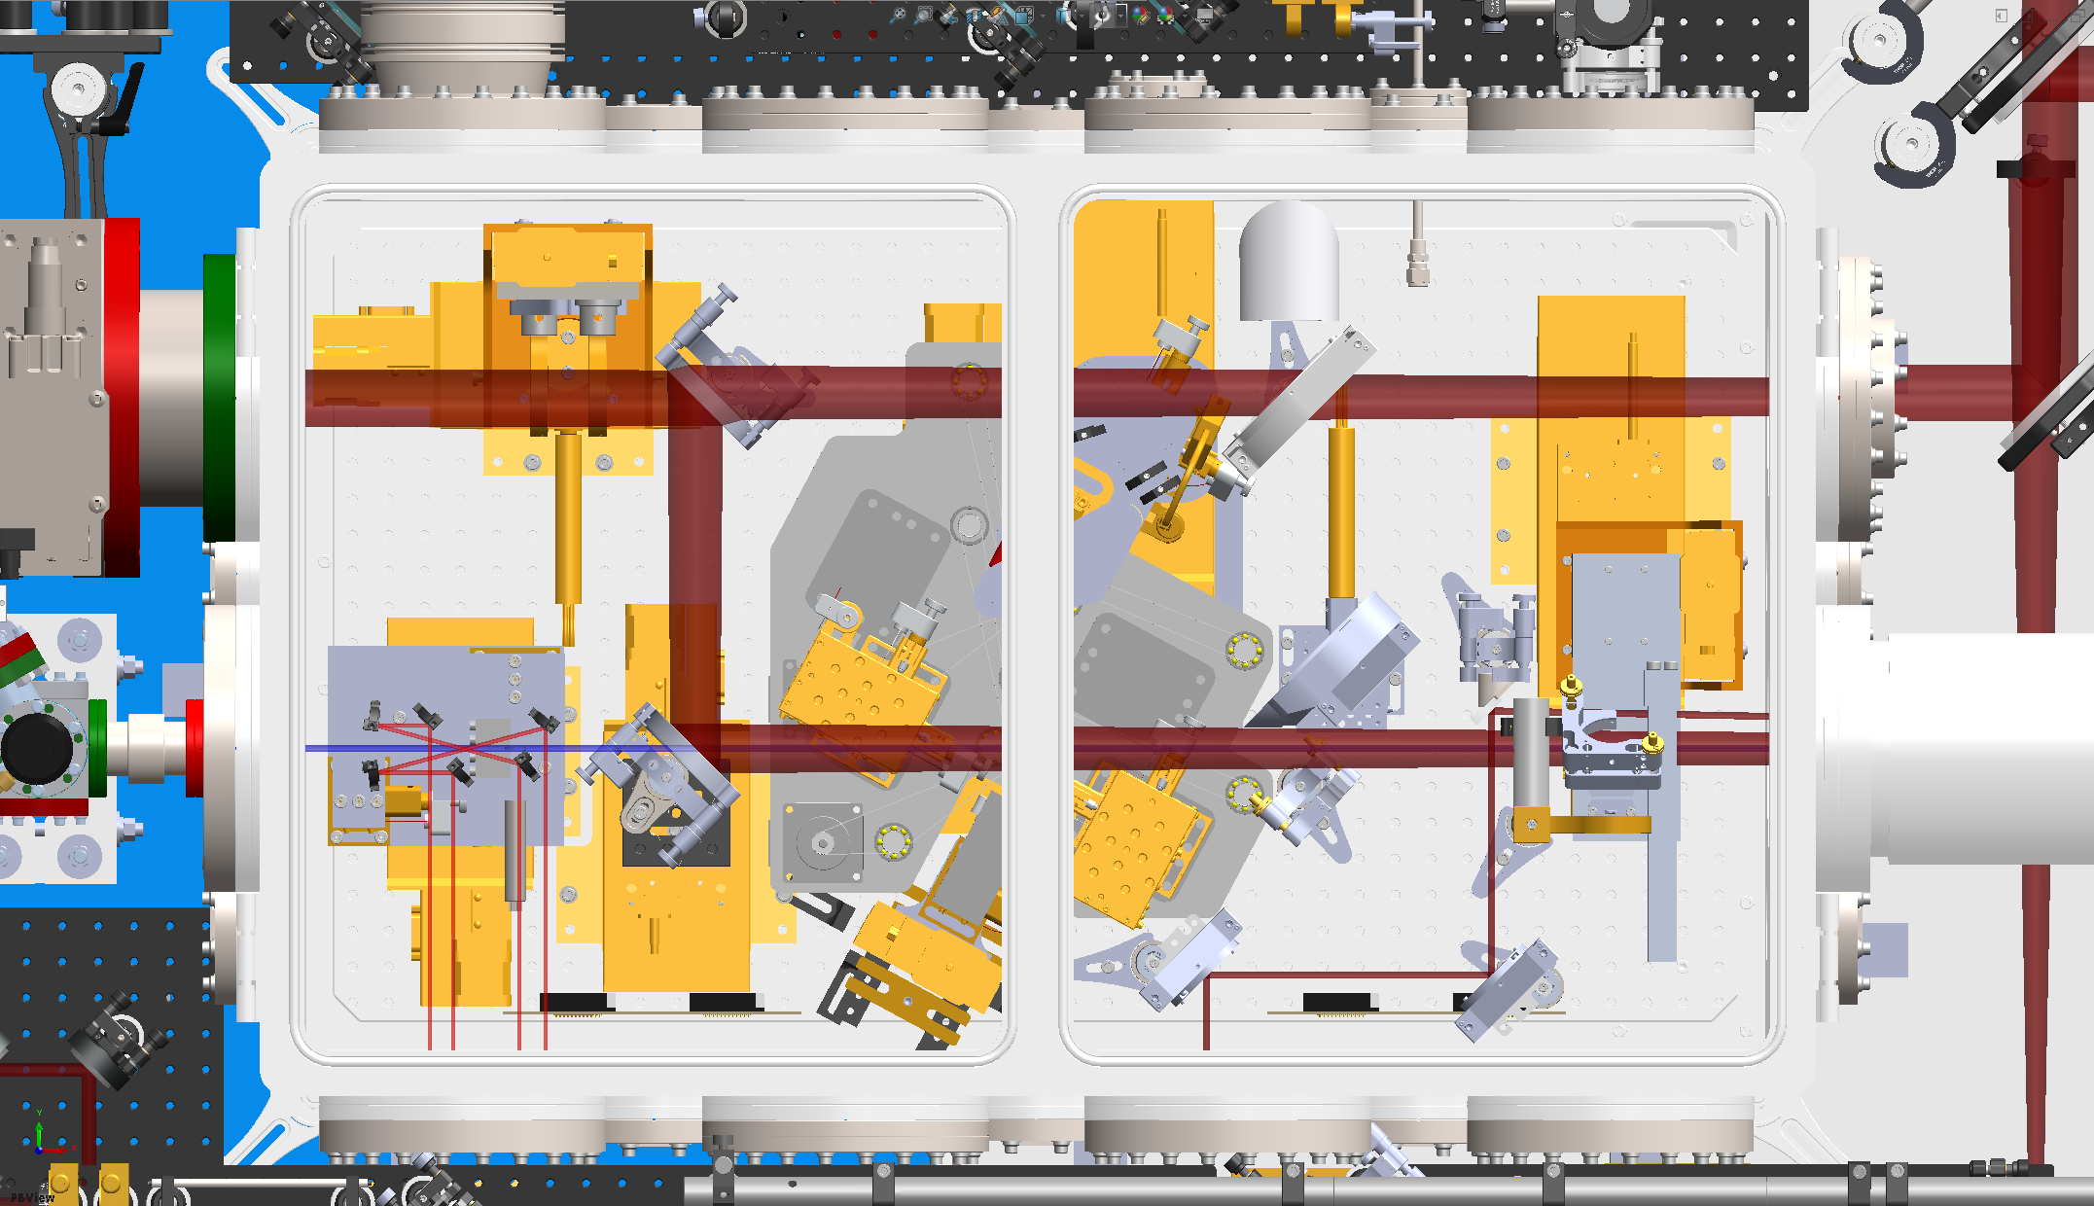
IP area
Axicon beam
E324
EOS

Slide 16
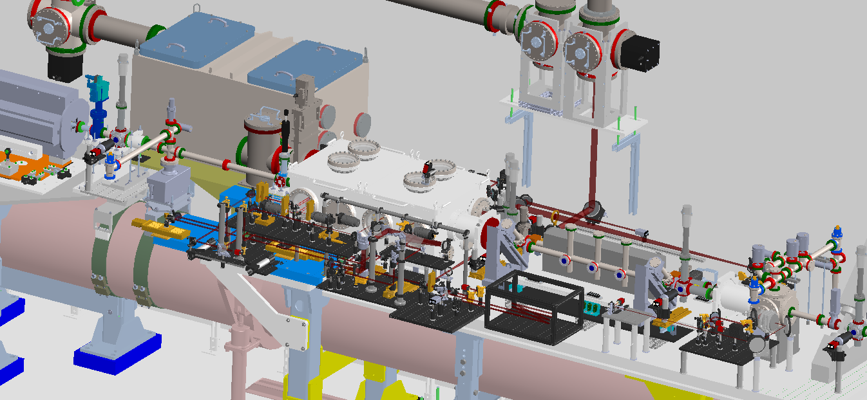
IP area

Slide 17
Probelines
E324: Imaging tested, now misaligned
EOS BPM: 1 ZnTe crystal aligned to find t0
Shadowgraphy: Aligned with microscope objective installed
Transverse ionizer: Aligned with focus imaging installed
All probelines tested, 3 out of 4 currently aligned

Slide 18
Future plans
Verify probe pulse length
E324 and Shadowgraphy will be converted to 400 nm
Simultaneous timing for all probelines need to be verified
Trojan horse probeline

Slide 19
Summary
Original plan is finally implemented
Need some experience operating in different configurations
Looking at future capabilities

Slide 20
Thank you!
henrik.ekerfelt@slac.stanford.edu

