Slide 1

Spectrometer electron diagnostics and expected performance
Doug Storey
May 3, 2022

Slide 2
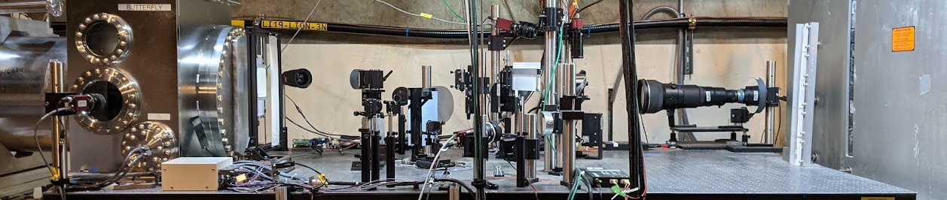
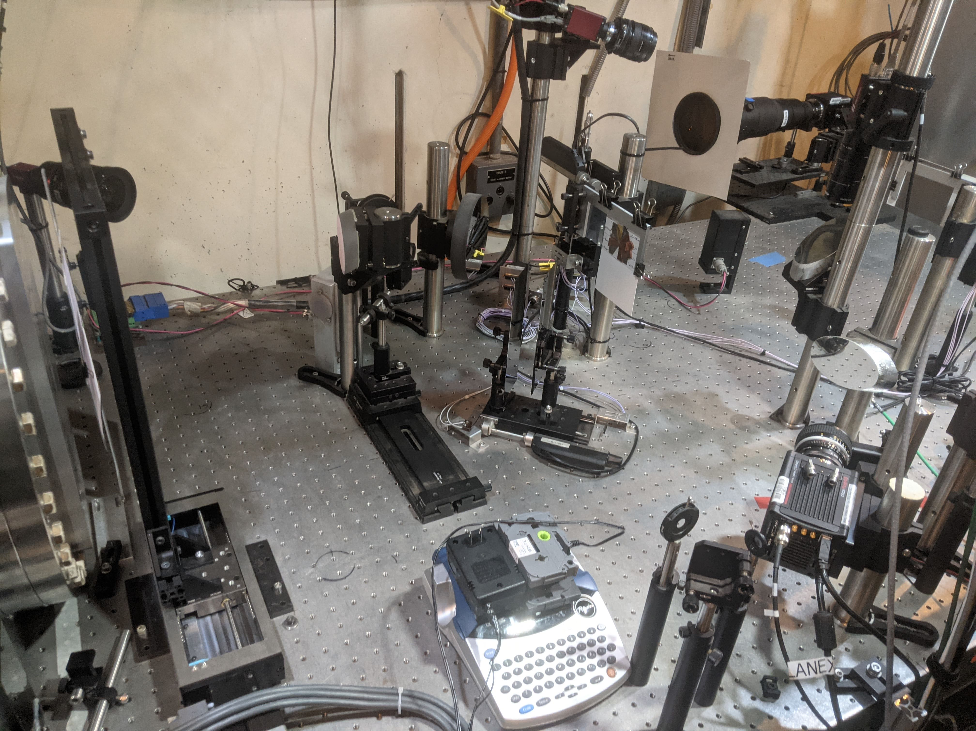
Current state of the Dump Table
GAMMA1
GAMMA2/3
PRDMP
DTOTR1/2
CHER
LFOV
Gammas
Electrons
CHER
Electron devices (covered in this talk):
DTOTR1 and DTOTR2 – YAG and OTR
LFOV – DRZ-FINE + Phosphor
CHER spectrometer
PRDMP – mainly used by ops
Gamma screens (covered by Pablo in next talk):
GAMMA1 – DRZ + CsI array
GAMMA2/3 – with camembert filter + DRZ fine

Slide 3
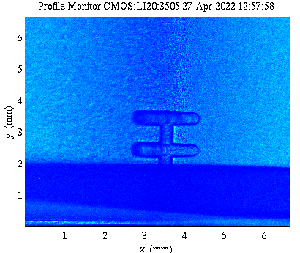
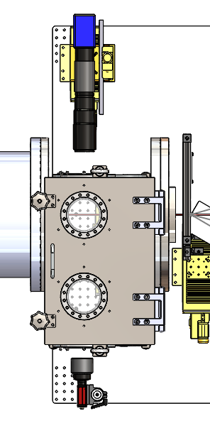
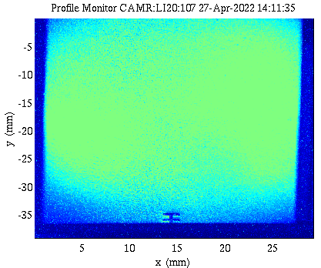
DTOTR
DTOTR1
High resolution in-vacuum profile monitor
Used for TCAV measurements, butterfly emittance, etc
FOV = 7x7 mm
Resolution 4.5 µm → 0.01% energy resolution
DTOTR2
Larger field of view option as DTOTR1 (for alignment, etc)
40mm Ø YAG disk, 30 µm pixel size
FOV = 40x25 mm
Can view YAG simultaneously with DTOTR1
DTOTR1
DTOTR1
Beam Direction
DTOTR2
DTOTR2

Slide 4



DTOTR Expected Performance
DTOTR1: $ε_{N}=3$µm, $β_{0}=5$cm
Single shot emittance measurement
Expected Resolution: <5% emittance resolution for measuring matched beams at plasma exit
Limitations: Phase mismatch and existing correlations
Dispersive quad scan emittance measurement
Provides energy dependency of emittance and measurement of low energy spread beams
Limitations: requires multi-shot stability
2-D longitudinal phase space
Will be used with M.L. techniques to train a virtual diagnostic to provide a non-invasive estimate of the LPS for every shot (C. Emma)
Input: $ε_{n}=19.4$µm $β=19$cm
Fit: $ε_{n}=21.2$µm $β=17$cm
$I_{meas}$ = 26 kA, $I_{pk, Drive}$ = 65 kA
$I_{meas}$ = 17 kA, $I_{pk, Wit.}$ = 31 kA
DTOTR1 – 2 Bunch w. XTCAV
Notes:
Butterfly emittance analysis performed on images generated by PIC simulations:
Gaussian input beams
10 GeV to 18 GeV PWFA acceleration
Energy spread of 0.25% at input → 2% at output
PIC simulations performed by Hiroki Fujii (formerly UCLA)

Slide 5
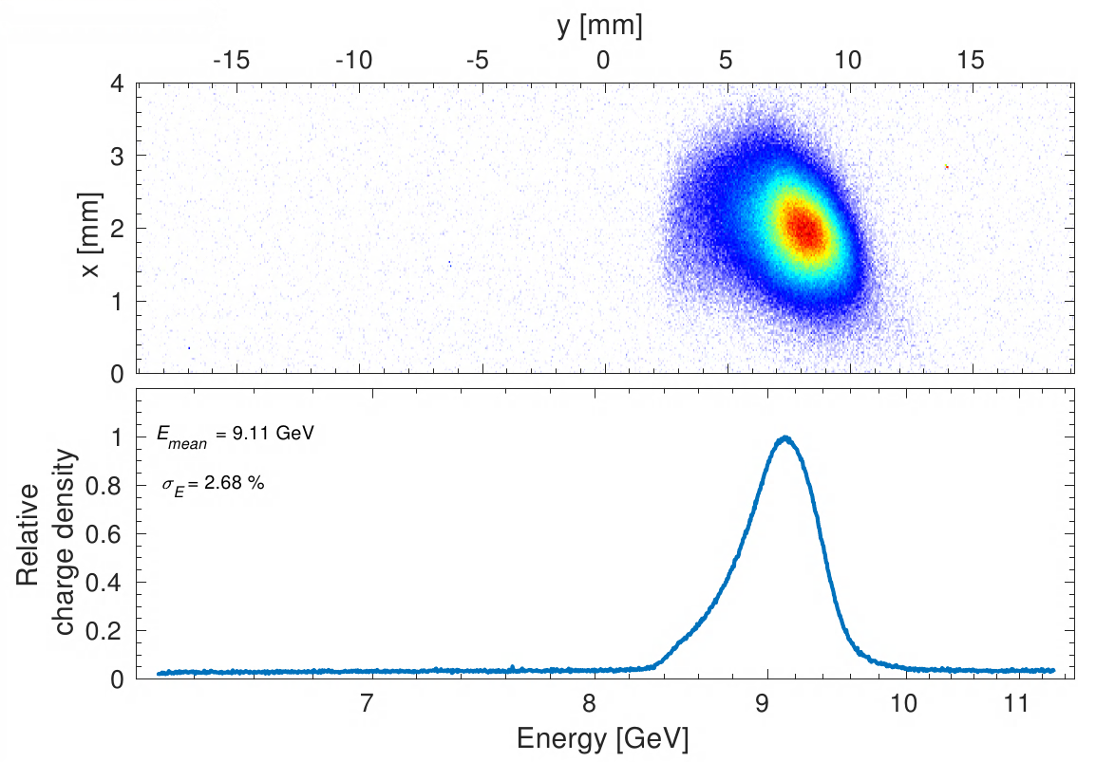
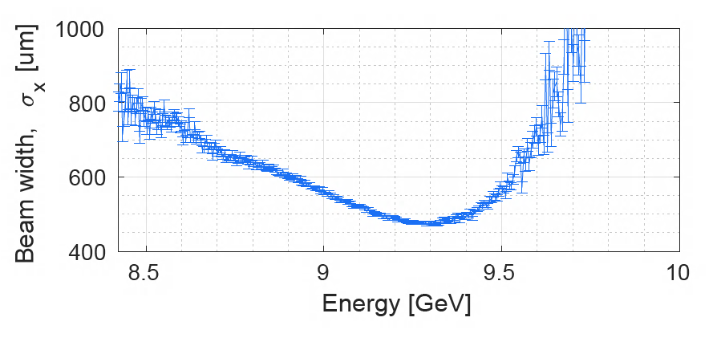
DTOTR Initial Performance
Energy Spectrum Measurement
Dump table beam diagnostics beam commissioning shifts in August, December 2021
Plots show analysis from data collected on DTOTR2 in Aug 2021 run
Calibration of energy axis on dump diagnostics
Measurement of energy spectrum
Butterfly image captured, however in non-ideal beam and optics configuration
Shift plans written up to redo these and other
measurements within next 2 weeks
Butterfly Pre-processing

Slide 6
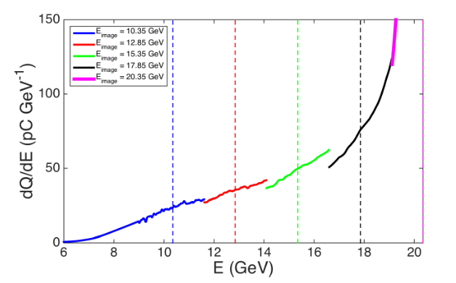
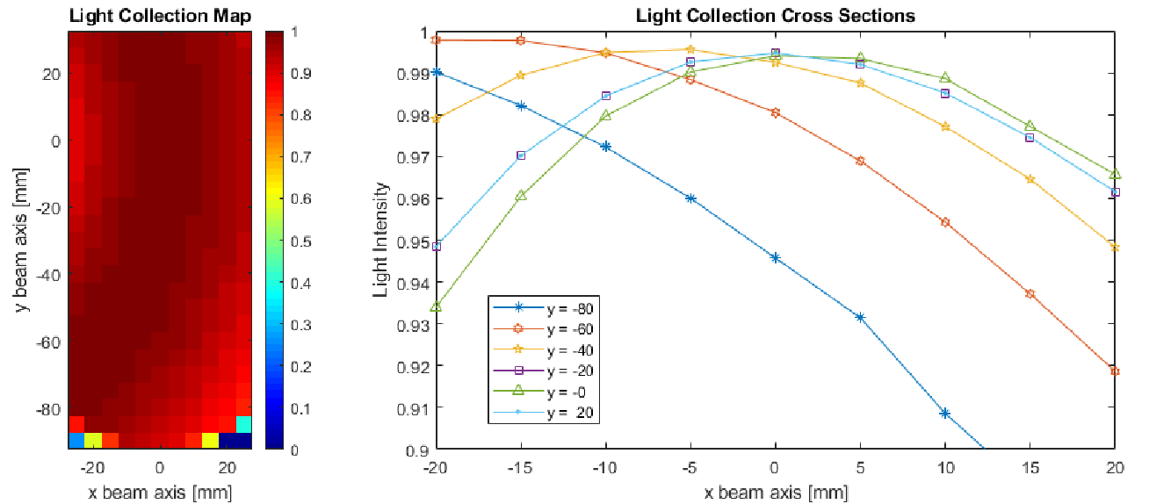
CHER Spectrometer
E200 Piecewise spectral measurement
Specifications:
Images the cherenkov radiation emitted within a gap between 2 silicon wafers
FOV = 4.5 x 12cm
Imaging resolution = ~230 µm → 0.4% energy res.
The large FOV makes CHER the main electron energy spectrometer
This will be key to showing Chan’s first goal of energy depletion of the drive bunch.
Online, but requires calibration, and characterization of the light collection efficiency across the field of view
CHER Optical Charachterization

Slide 7
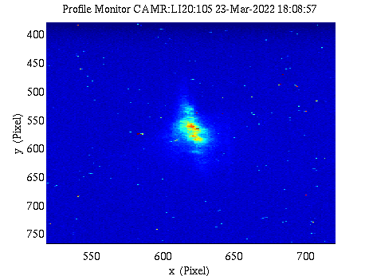
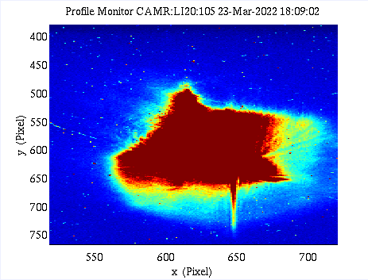
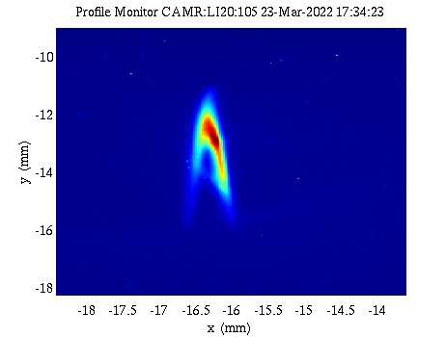
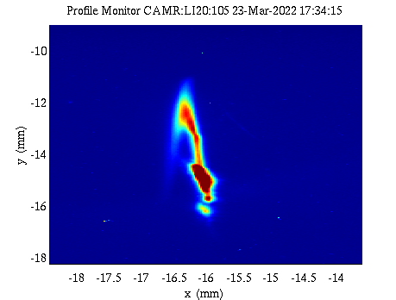
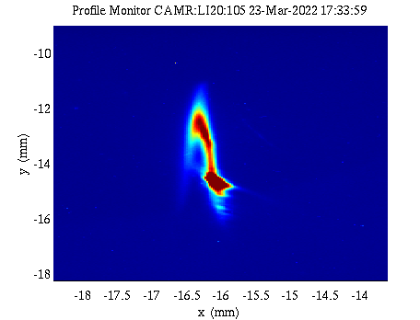
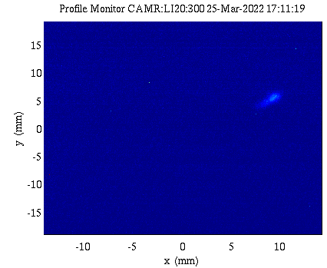
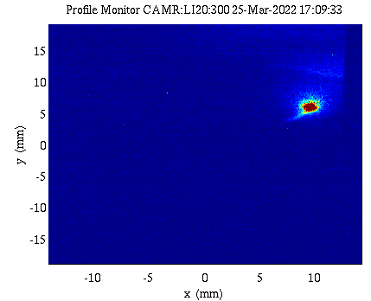
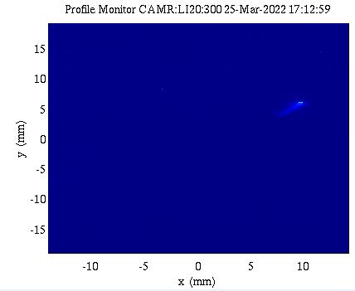
COTR observations on the dump and IP cameras
Intermittent flashes of OTR light seen on various S20 screens
Not correlated with charge measurements
Flashes can be suppressed by inserting an earlier screen
IPOTR2 and DTOTR2 shown here, but seen on almost all IP and dump OTR cameras
From scaling studies below – COTR can emit orders of magnitude more light than incoherent OTR, so even a small charge spike can overwhelm the normal OTR signal
IPOTR2
No other screens in
S10 screen in
IPOTR2
S10 screen in
DTOTR2
IPOTR2 screen in

Slide 8
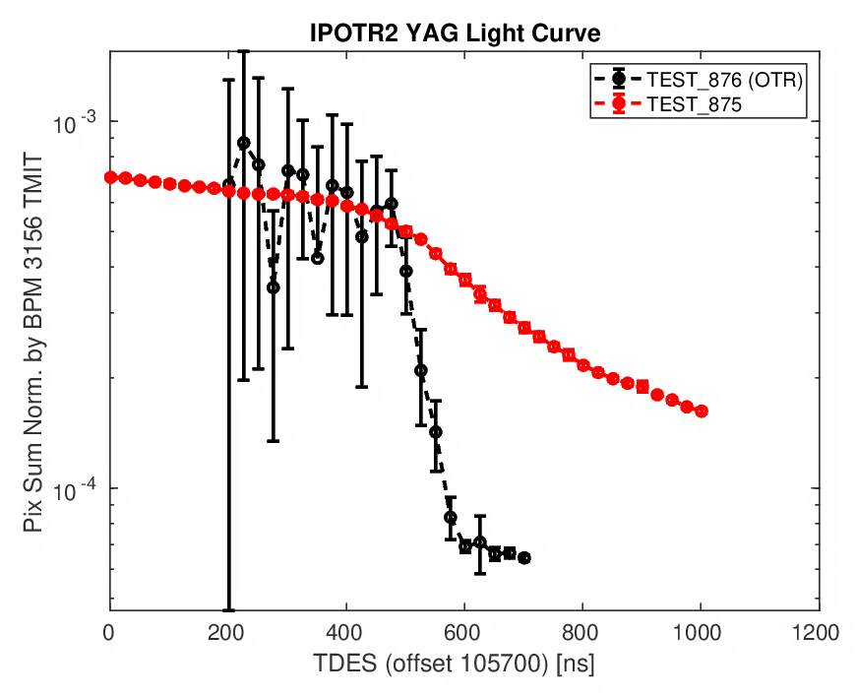
COTR mitigation
Current YAG screen setup:
Viewing at off angle:
Laser heater – as Claudio covered
Will inhibit COTR from microbunching altogether
Using blue pass filters on cameras
Will block longer wavelengths of light that start emitting coherently first
Filters installed on IPOTR2 camera to test at next opportunity
Color camera
Can get cool color images so we can see the color content of COTR
Have the camera, but requires some additional hardware. Will replace USOTR with color camera
OTR rejection techniques:
Reject all OTR light and image only scintillator light
Off axis scintillator imaging
Time delayed scintillator imaging
a)
Beam
YAG
lens
camera
COTR light
YAG
lens
Beam
COTR light
camera
reflection axis
b)
Acquire image after “prompt” OTR light

Slide 9
Summary and next steps
Summary
Dump table now fully outfitted with first iteration of diagnostics
Experience has been gained over a few shifts, but more dedicated beam commissioning required to test out emittance and LPS measurements
COTR starting to appear → more sophisticated suppressions required
Commissioning procedures prepared for upcoming beam commissioning shifts:
Dump table e- diagnostics:
https://docs.google.com/document/d/1A3RfoVOopjoxTbNDSk-5PemZUkAwEaoEGOnekJzoszs/edit?usp=sharing
Gamma diagnostics: Pablo is currently preparing
XTCAV 2D LPS:
https://docs.google.com/document/d/1jKNhruicX-gDcYPo8y_O7JgQAJ5cplsF7GNMh3K3Jt0/edit?usp=sharing

