Slide 1
Alternatives to the Lithium Oven
E300 Collaboration meeting
May 3, 2022
Robert Ariniello
Notes:
Done

Slide 2
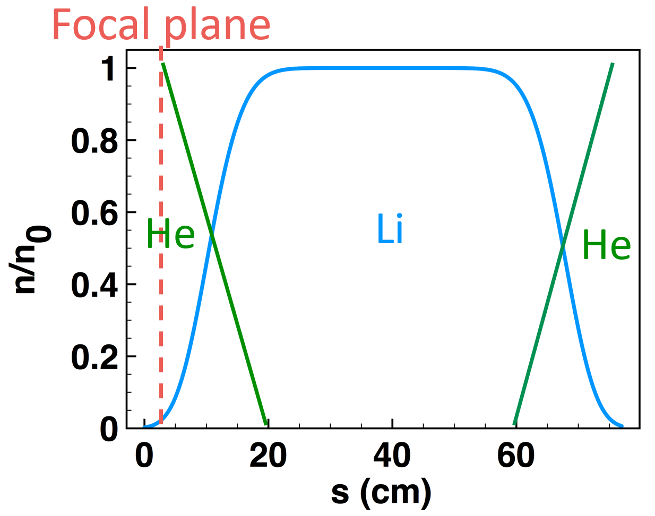
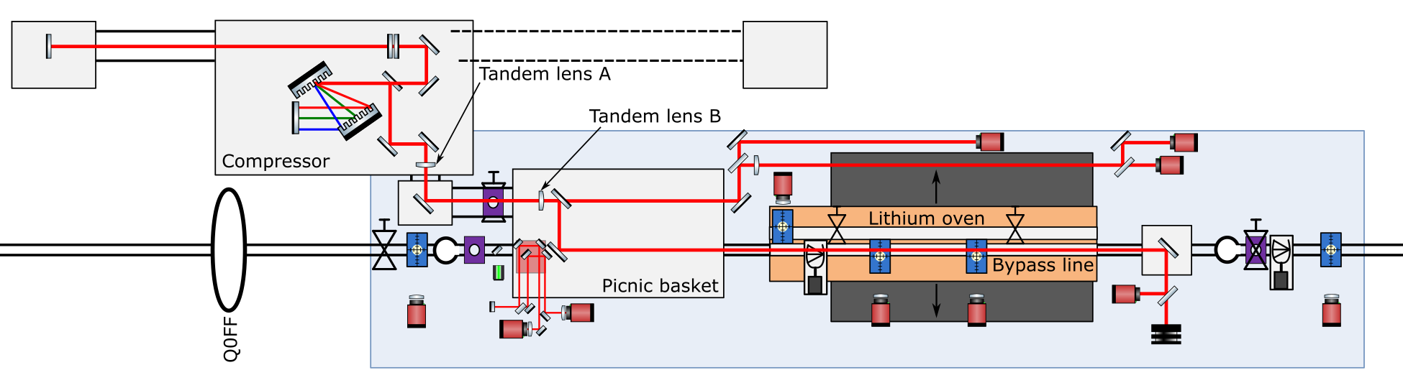
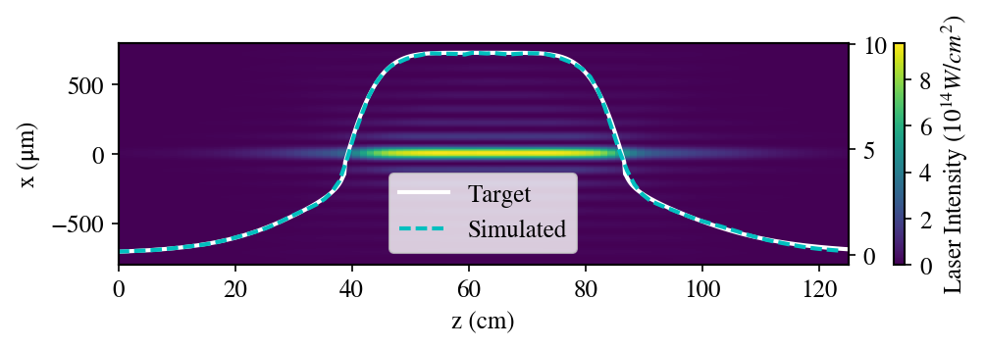
E301 as an alternative to the lithium oven
E301 shapes the density ramps via partial ionization of a uniform gas.

Slide 3
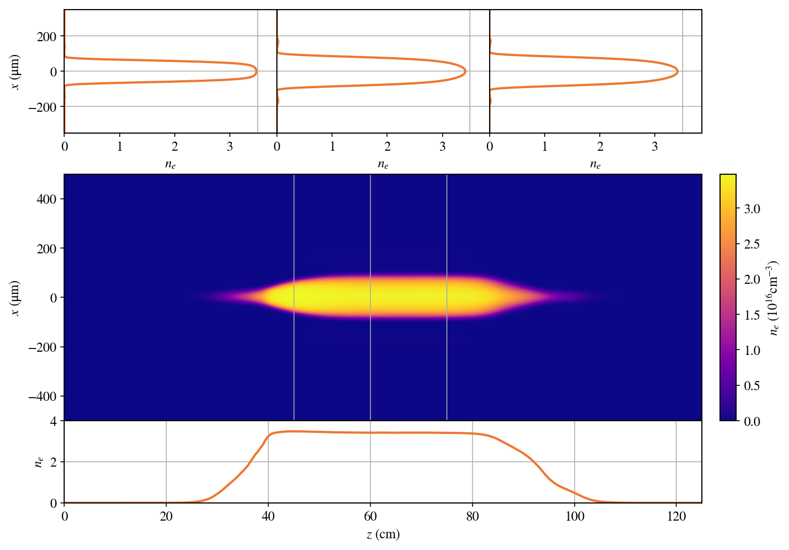
Expected plasma density in helium
Laser Parameters
Laser energy: 500mJ
Pulse duration: 70fs
Wavelength: 796nm
Beam width: 40mm FWHM
Beam profile: Super Gaussian
Beam Energy
Energy to ionize: 1.05mJ
Plasma heating energy: ~1mJ
Energy after optics: 222mJ
Optics efficiency: 80%
Energy before optics: 278mJ
Lost to aberrations: 50mJ
Lost to aperture: 150mJ
Required energy: 478mJ
Laser refraction simulation
Split step Fourier based code.
Energy loss due to ionization.
No dispersion, no self-focusing.

Slide 4

Expected plasma density in hydrogen
Laser Parameters
Laser energy: 100mJ
Pulse duration: 70fs
Wavelength: 796nm
Beam width: 40mm FWHM
Beam profile: Super Gaussian
Beam Energy
Energy to ionize: 0.62mJ
Plasma heating energy: ~1mJ
Energy after optics: 45.4mJ
Optics efficiency: 80%
Energy before optics: 56.8mJ
Lost to aberrations: 10mJ
Lost to aperture: 30mJ
Required energy: 97mJ
Laser refraction simulation
Split step Fourier based code.
Energy loss due to ionization.
No dispersion, no self-focusing.

Slide 5
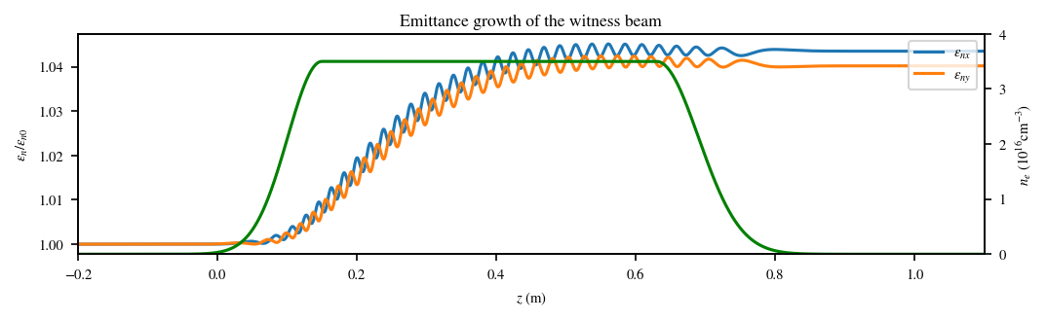
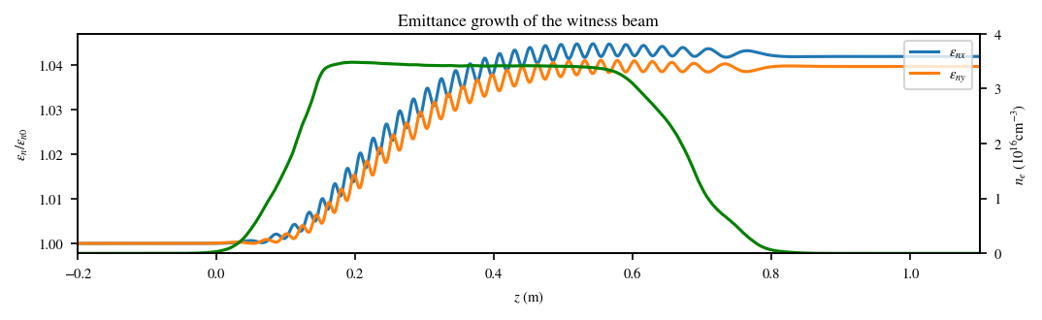
Ramps from simulation preserve emittance
Emittance growth in the target ramp shape.
Plasma profile distortion due to refraction has minimal impact on emittance growth.
Emittance growth in the simulated ramp shape.
Better control over the plasma shape than the lithium oven.

Slide 6
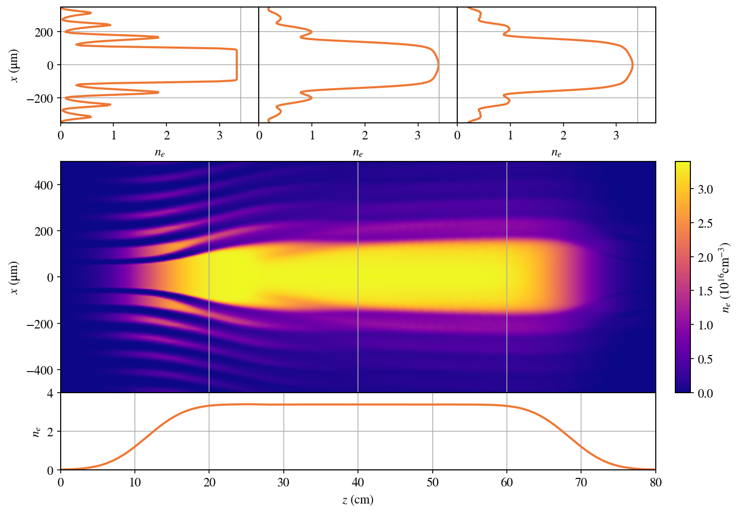
Tests of tandem optics for the lithium oven
Laser Parameters
Laser energy: 15mJ
Pulse duration: 70fs
Wavelength: 796nm
Beam width: 40mm FWHM
Beam profile: Super Gaussian
Beam Energy
Energy to ionize: 2.86mJ
Plasma heating energy: ~2mJ
Energy after optics: 7.32mJ
Optics efficiency: 80%
Energy before optics: 9.15mJ
Lost to aberrations: 2.5mJ
Lost to aperture: 1.1mJ
Required energy: 12.8mJ
Laser refraction simulation
Split step Fourier based code.
Energy loss due to ionization.
No dispersion, no self-focusing.

Slide 7
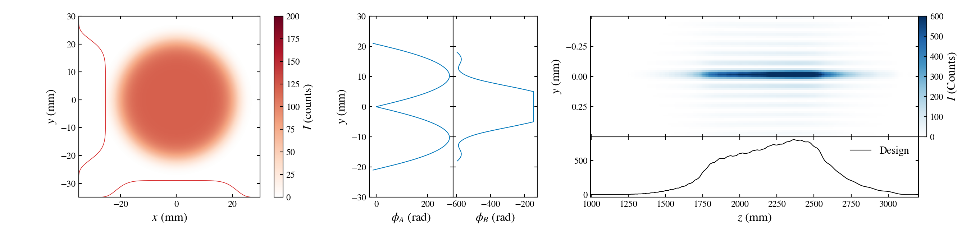
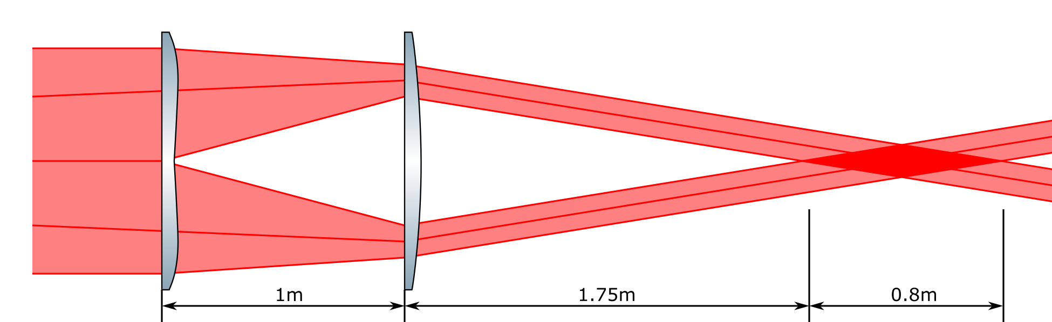
Designed for the FACET laser
Lens A shapes intensity
Lens B shapes phase

Slide 8
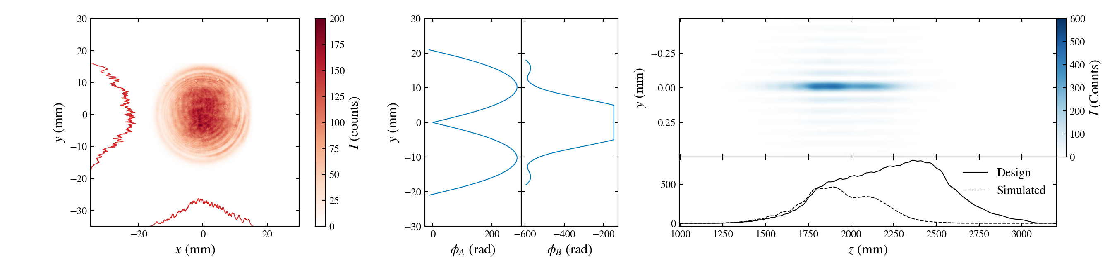
Tested with the CU laser
Laser used for tests produces a much shorter focus. Data compared against simulation of test laser.
Lens A shapes intensity
Lens B shapes phase

Slide 9
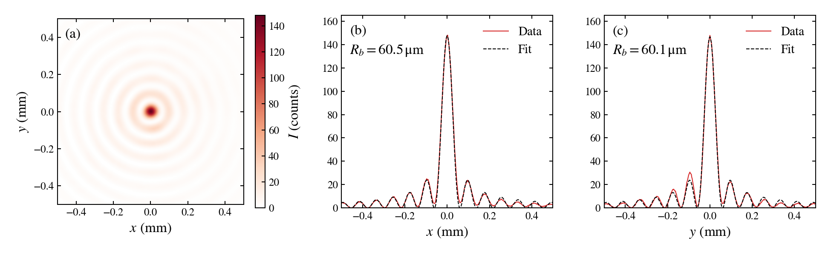
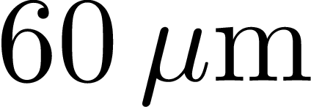
Bessel focus measured 1.5m after lens B.
The measured Bessel width matches the design, , within 1%.

Slide 10
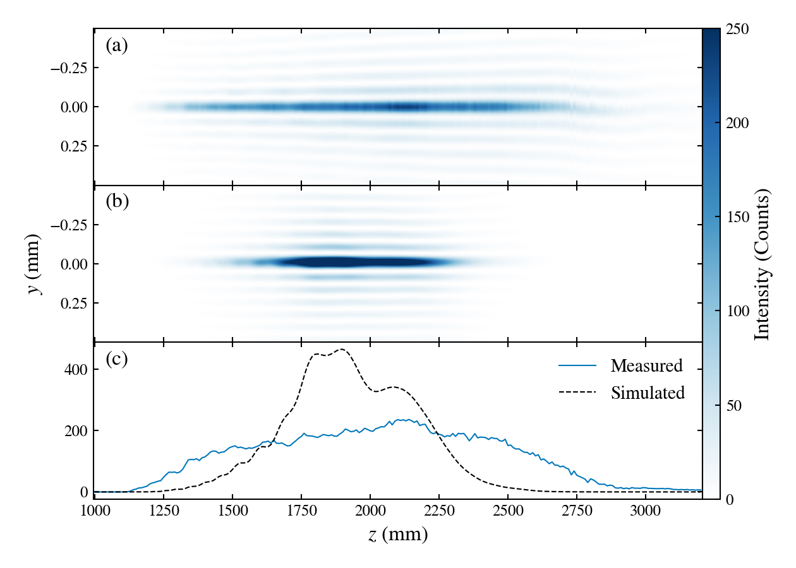
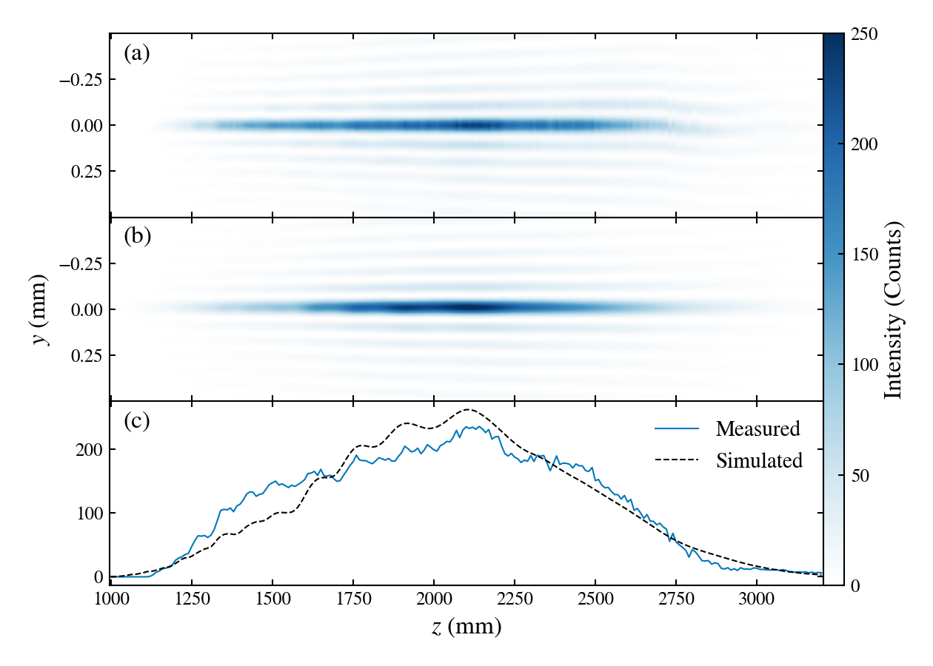
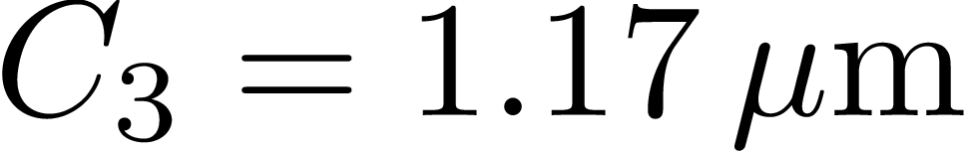
Deviations between the test and the design
Measured intensity vs. design
Measured intensity vs. simulated with divergence
Measured
Measured
Simulated
Simulated
Accounting for collimation, the tandem lens appear to be working as designed.

Slide 11
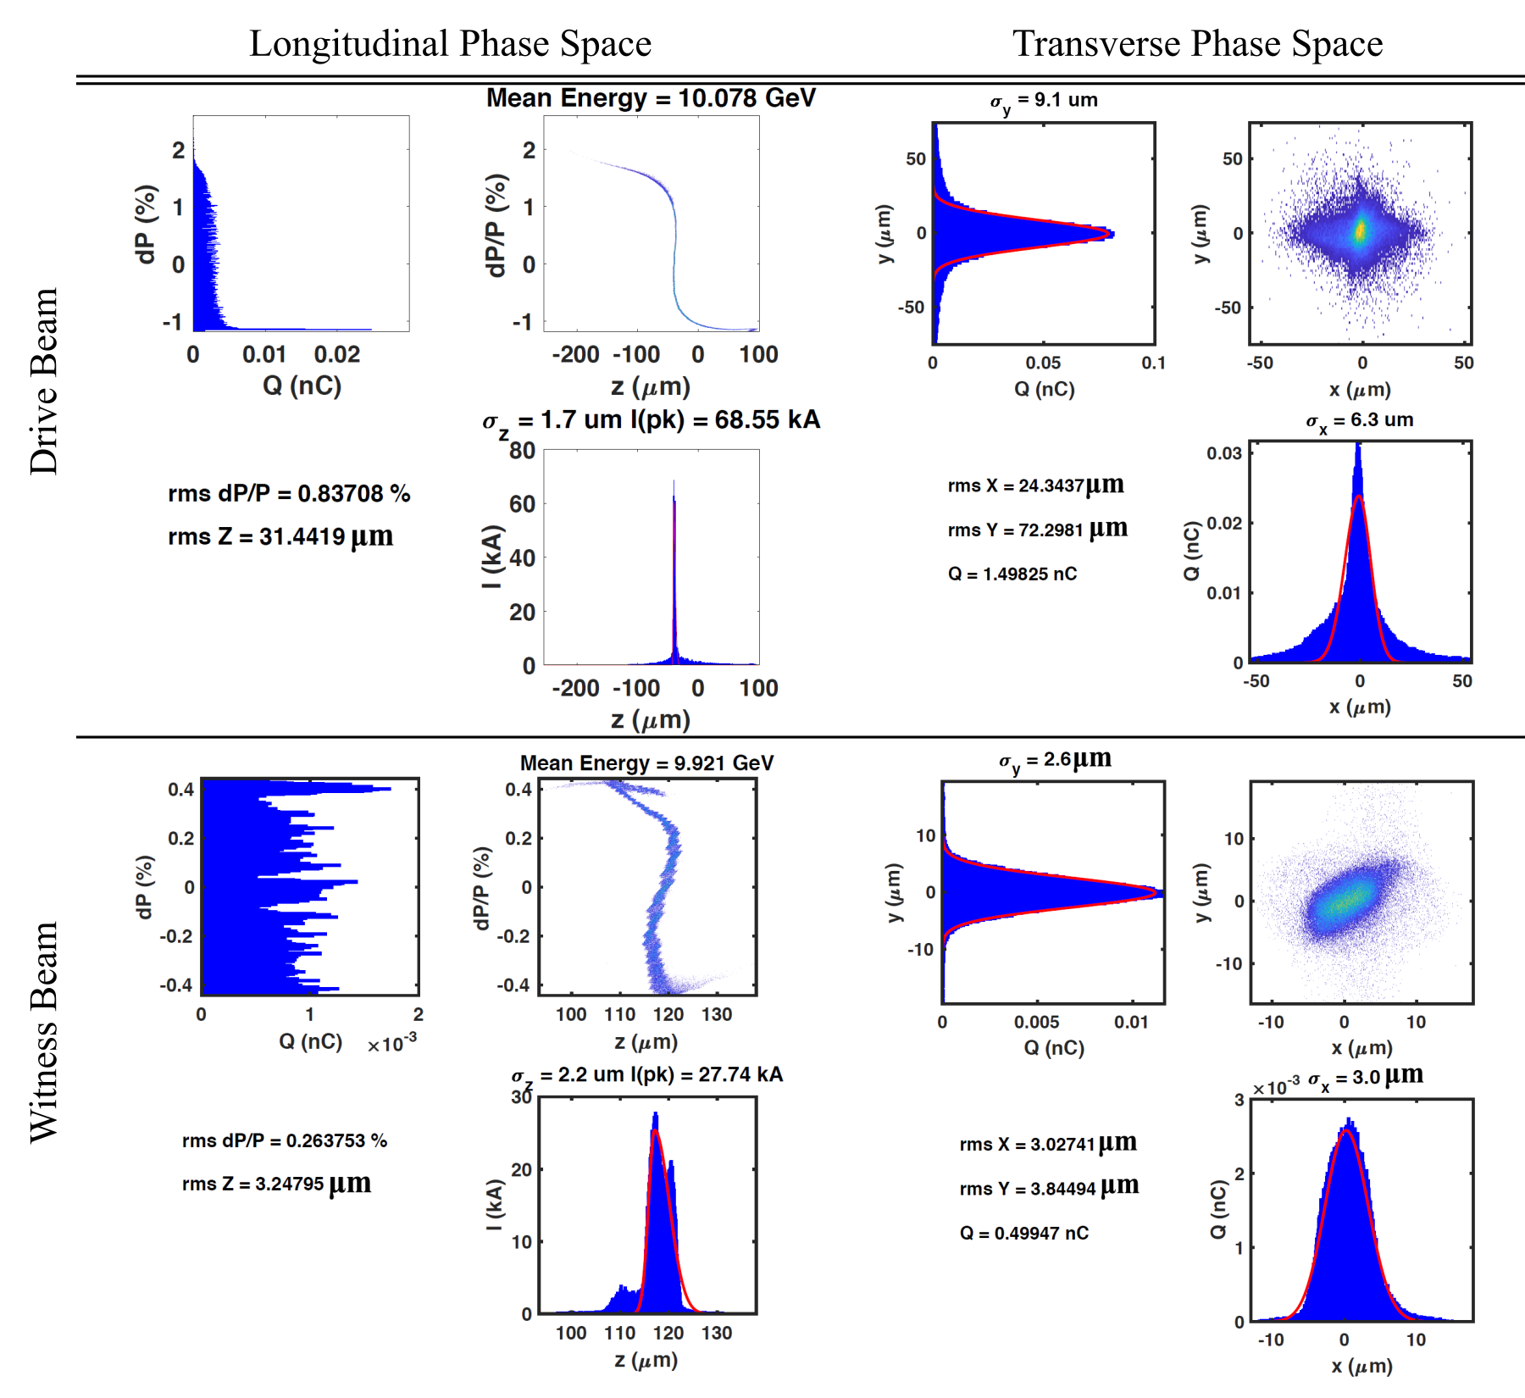
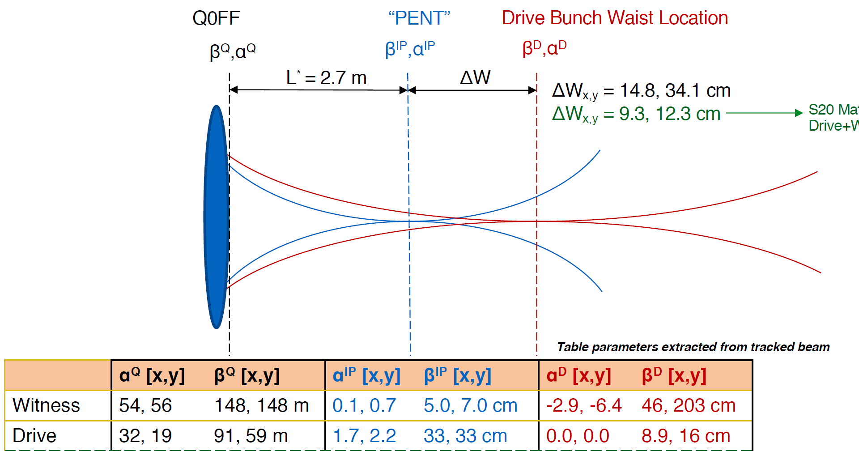
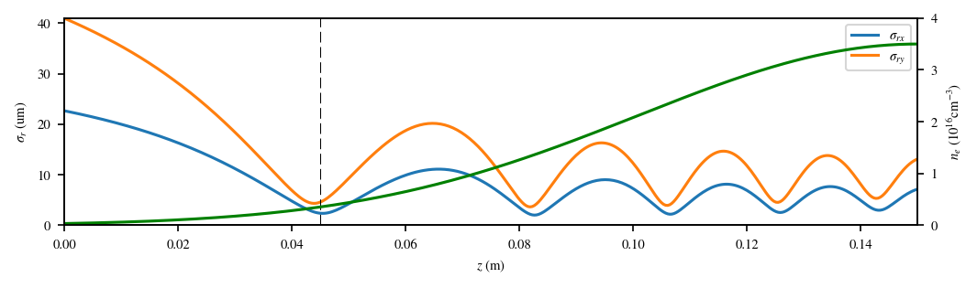
FACET-II beam parameters can ionize He
Drive beam and witness beam focus are at different locations
Drive beam will pinch down in the ramp
Beam ionization of He will occur with low emittance beams.
The emittance will grow as a result.
Glen White, FACET-II Science Workshop, 2019

Slide 12
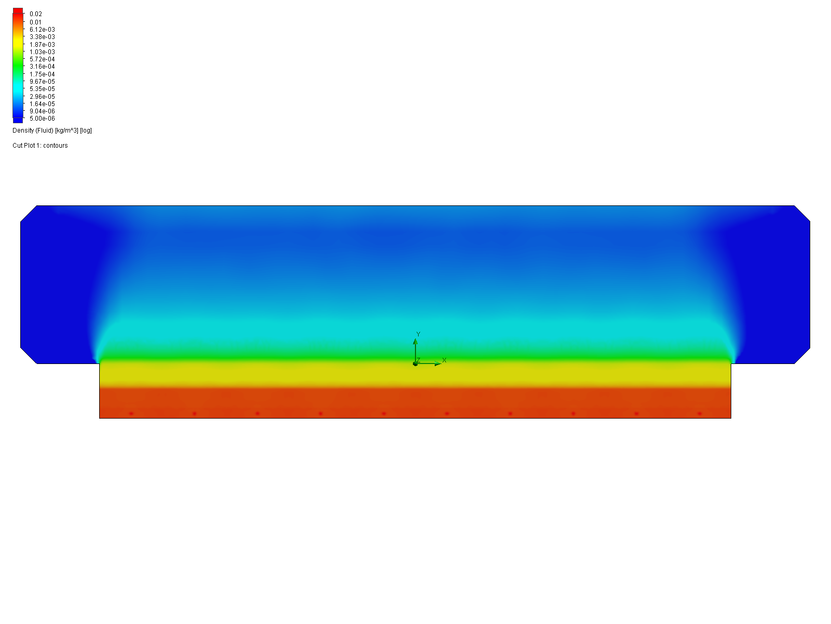
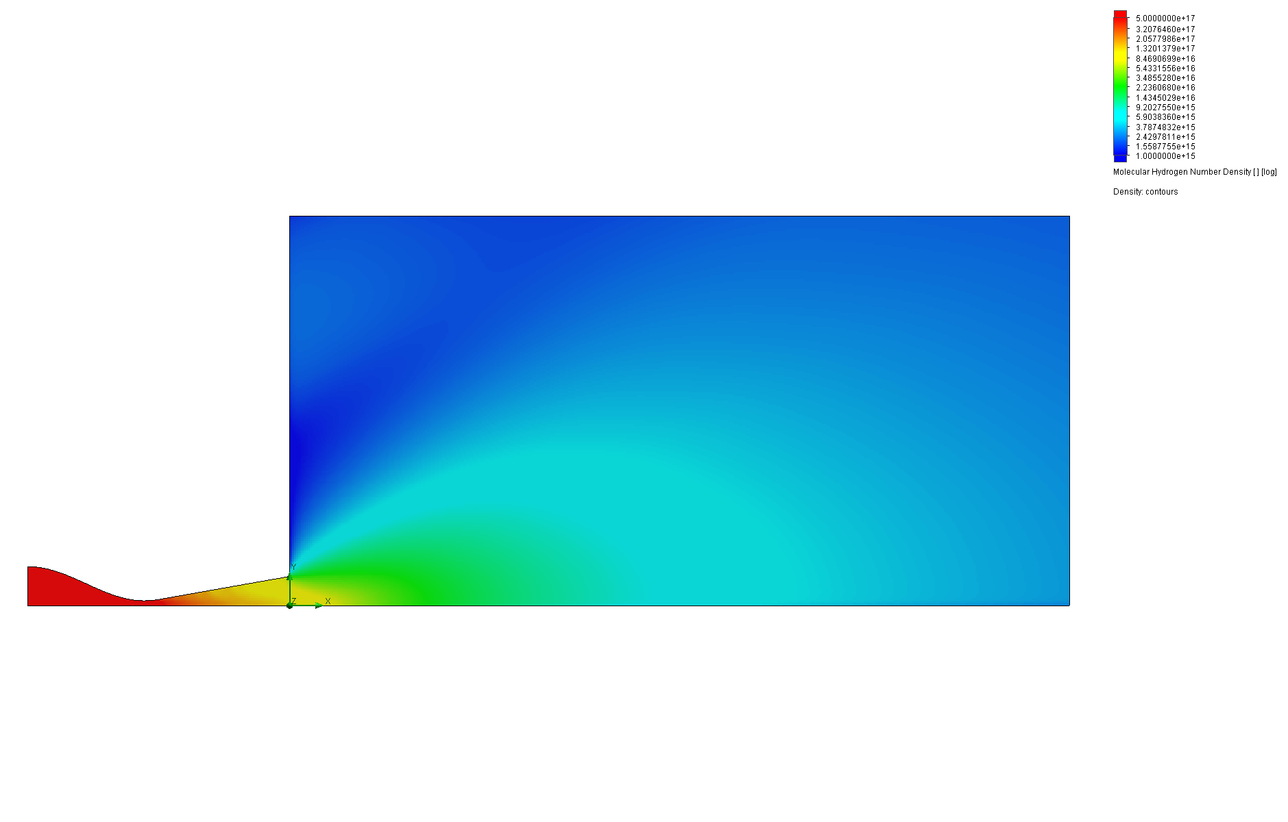
Solution – shape the ramps from the gas density
We simulated various geometries of >40cm long gas jets.
Beam Direction
Three main ways to shape density:
Gas cell
  Small apertures make laser ionization difficult.
Gas jet
  Easy laser access.
  Lots of gas flow into the chamber.
  Gas feed system is not trivial.
Gas capillary
  Requires laser guiding to optically ionize.
  Otherwise, discharge ionization.
  Questions about gas uniformity in the capillary.

Slide 13
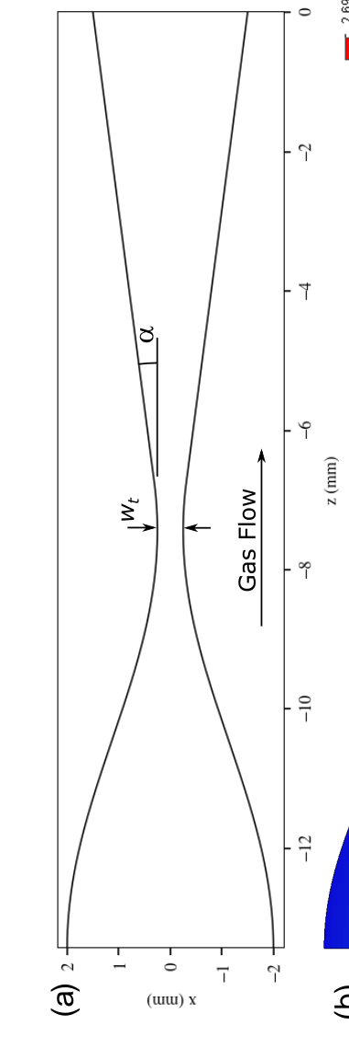
Simulations of the elongated gas jet - transverse
Area ratio
Diverging angle
Throat width

Slide 14
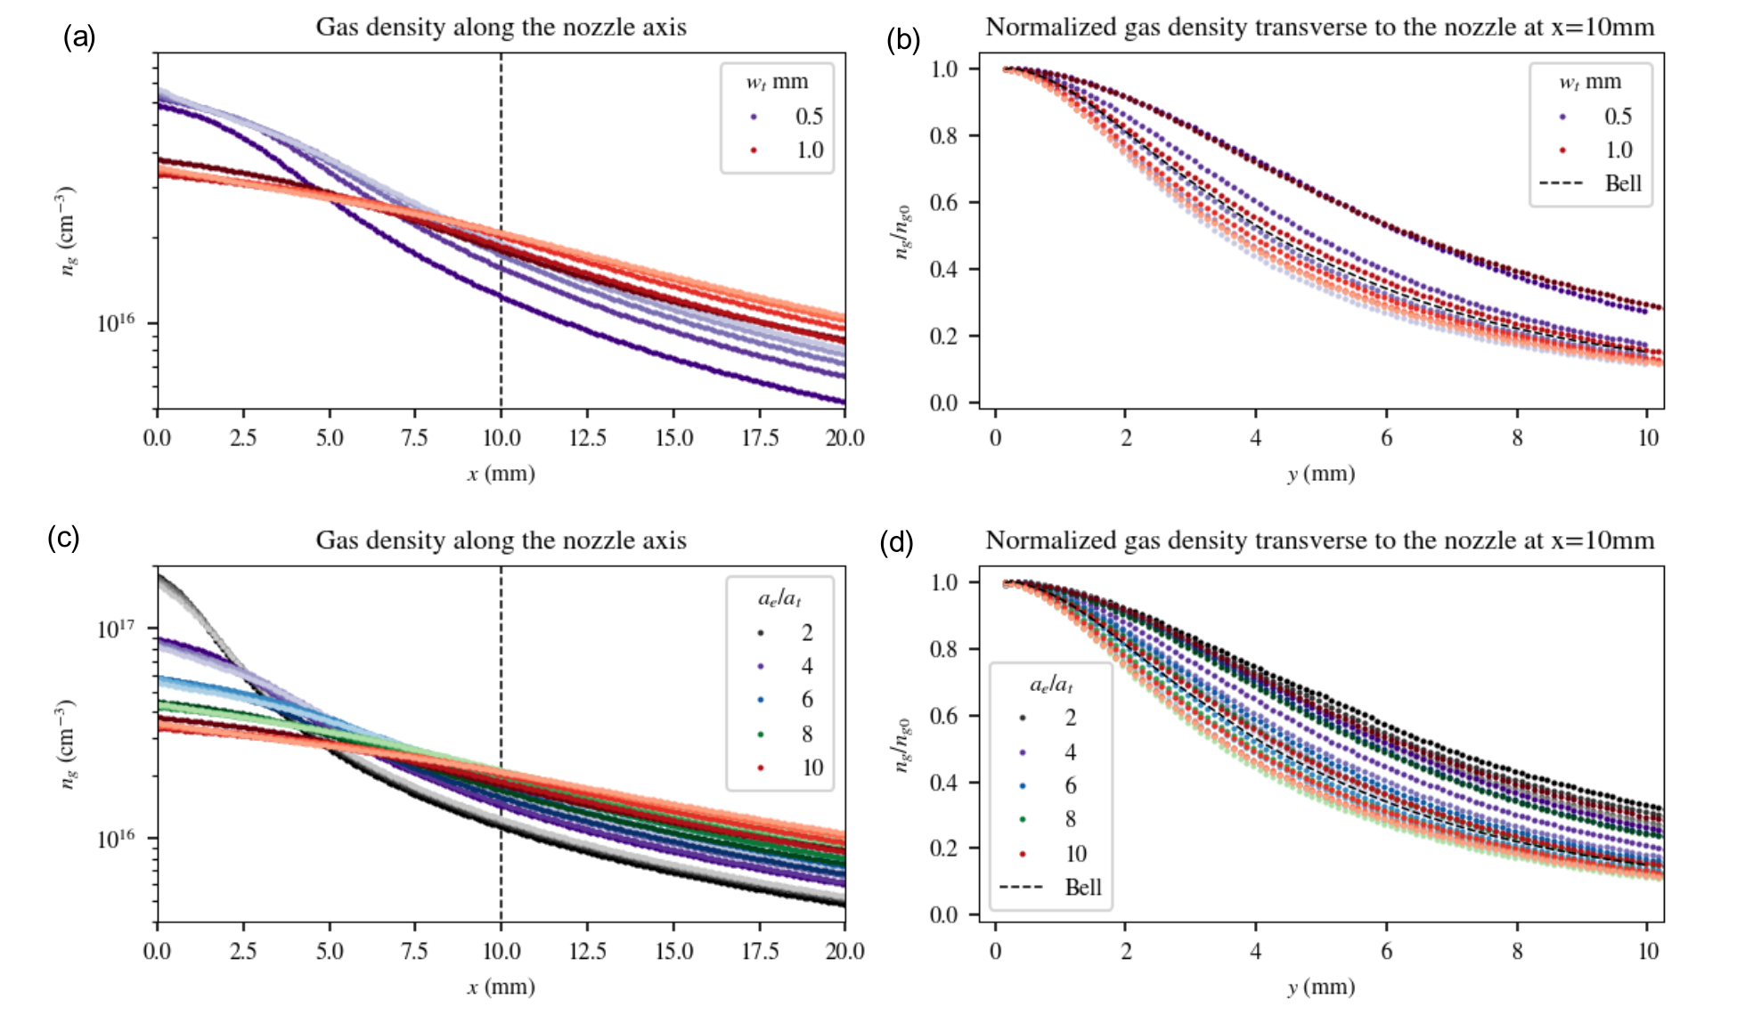
Simulations of the elongated gas jet - transverse
Area ratio
Diverging angle
Throat width
Parameter | Increasing results in …
Area Ratio | Lower density at nozzle exit, slower axial drop-off in density
Throat Width | Lower density at nozzle exit, slower axial drop-off in density
Divergence Angle | Slower axial drop-off in density, narrower plume
We have a good idea of how all three parameters impact the transverse density of the plume.

Slide 15
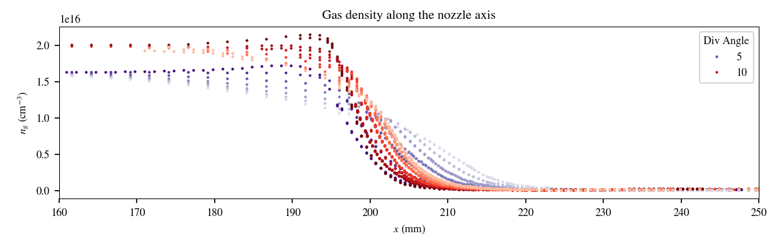
Simulations of the elongated gas jet - ramps
Min: 8cm
Max: 36cm
Can produce ramps in the length regime needed for matching (10-20cm).

Slide 16
Summary
E301 partially laser ionized plasma source
Better control over the plasma profile than the lithium oven.
Sufficient plasma width is an issue.
Distortion of the plasma profile due to refraction is not a showstopper.
Low emittance beams will ionize the plasma in the ramp, changing its shape – similar to lithium oven.
Elongated gas jet
Avoid beam ionization by fully ionizing the gas in the ramps.
Plasma density profile comes from the jet’s gas density profile.
Ramp shapes/lengths seem to be the correct length scale.

Slide 17
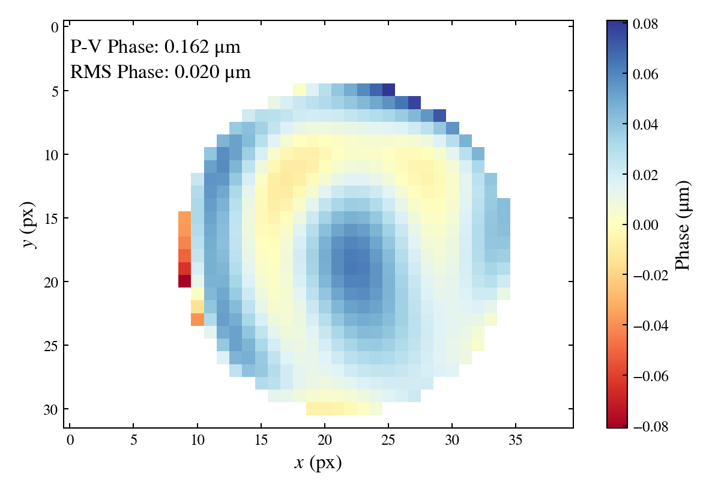
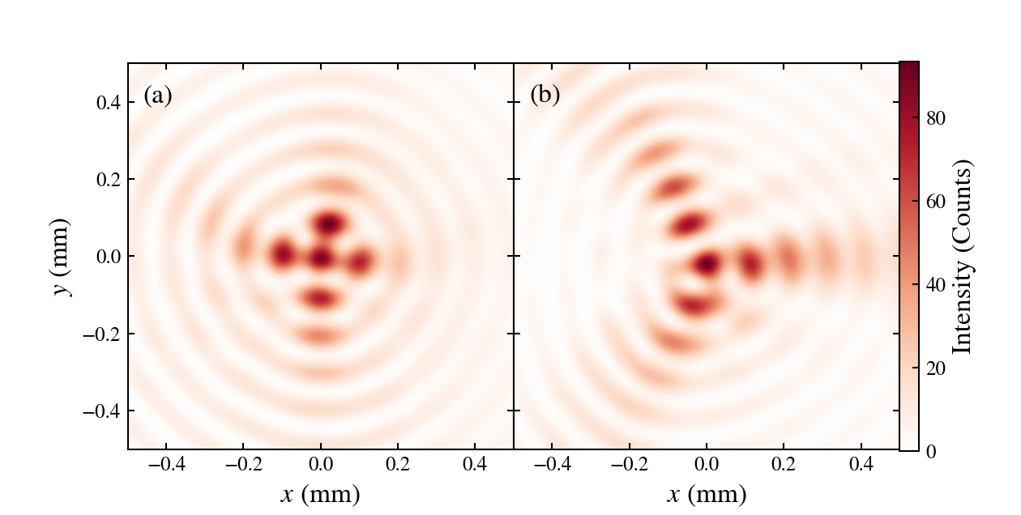
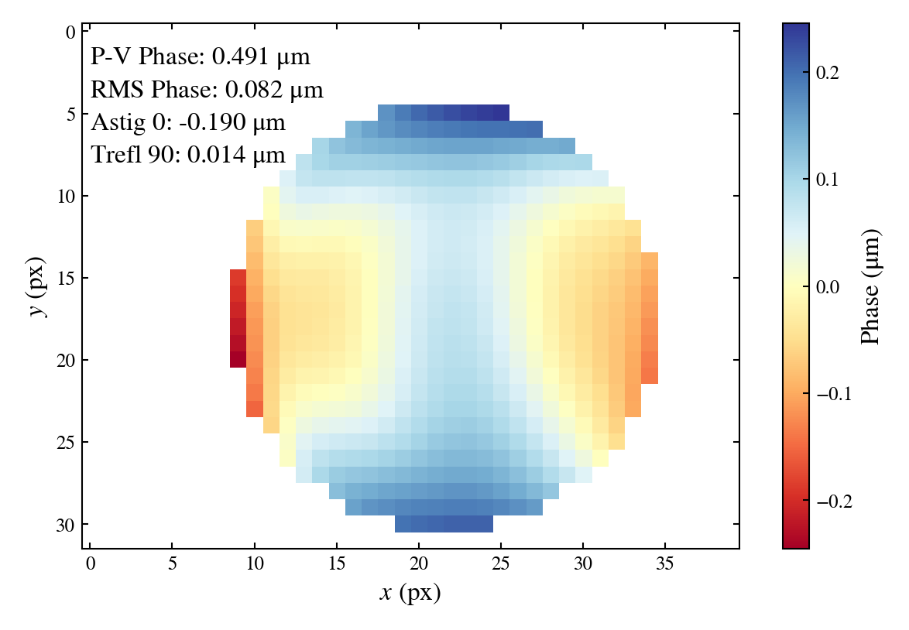
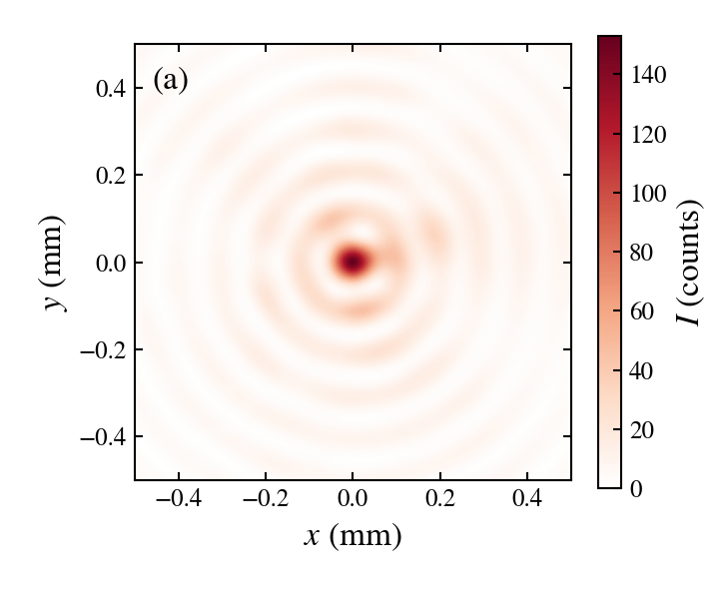
Phase correction to improve the Bessel focus
Wavefront sensor says the incoming phase is flat.
Look at the end of the Bessel focus for aberrations.
Astigmatism
Trefoil
Bessel profile at the end of the focus can be used to dial in phase correction.
Add wavefront to correct Bessel

Slide 18
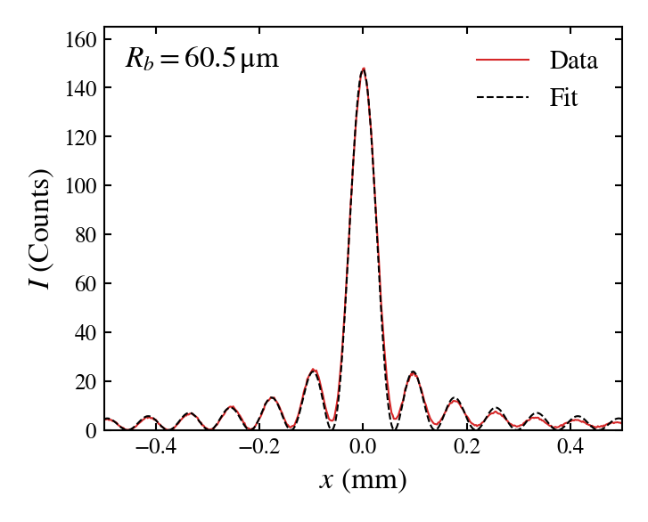
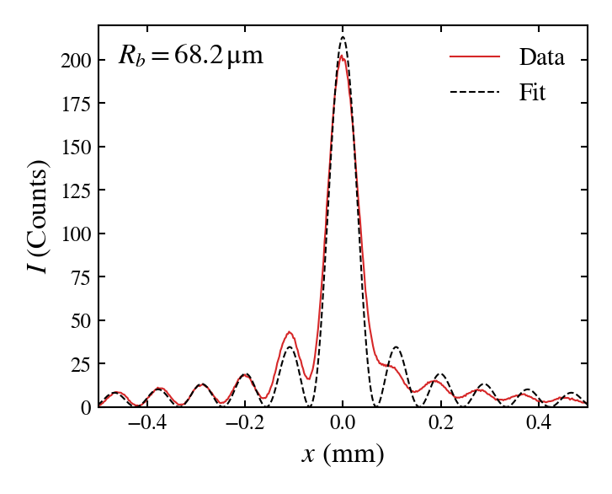
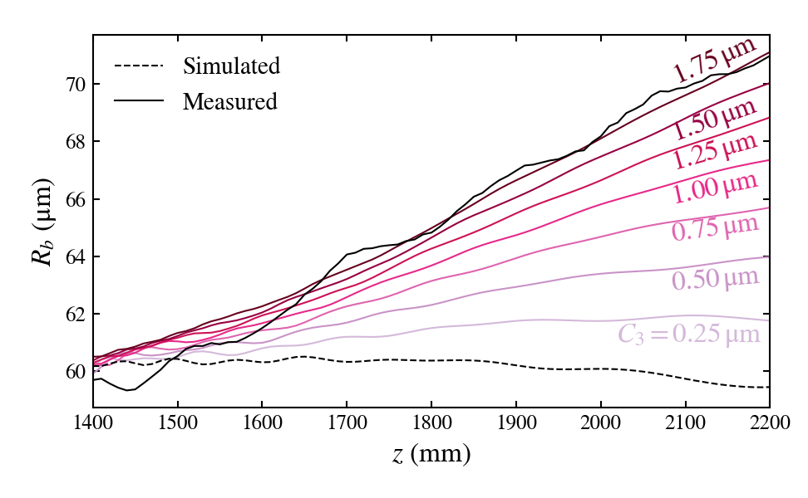
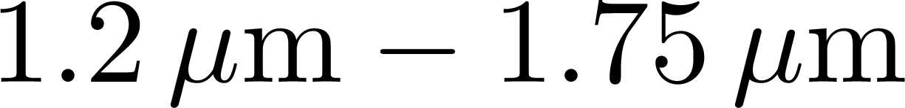
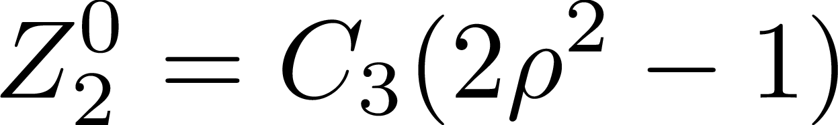
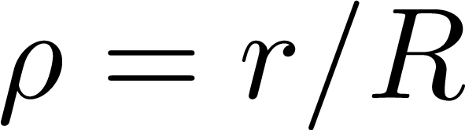

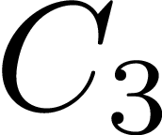
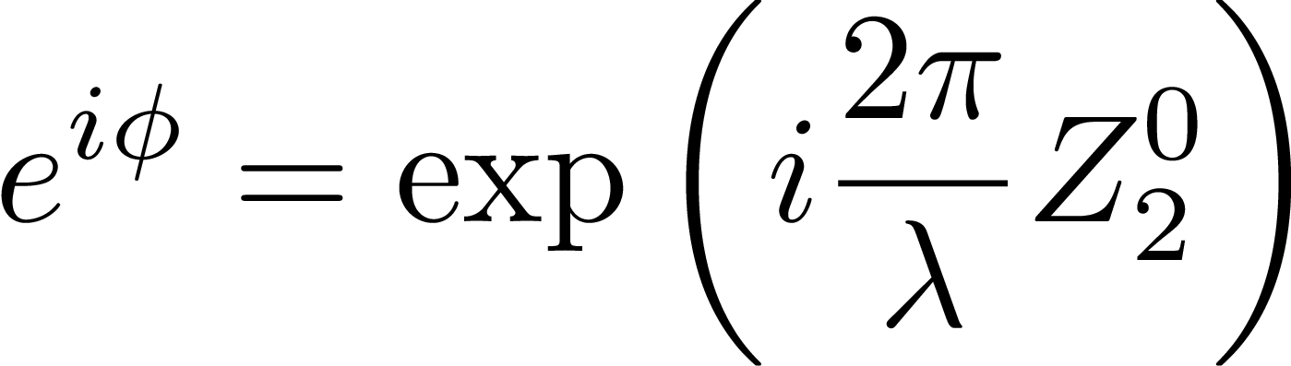
Variation in the Bessel width along the focus
Measured 1.5m after lens B.
Measured 2.0m after lens B.
Width of the Bessel increases along the focus.
Simulated the beam propagation with different amounts of defocus and compared to the measured Bessel width.
Defocus defined as
with
Magnitude is value of . Phase is
Bessel width and profile are consistent with the laser having a defocus of .

Slide 19
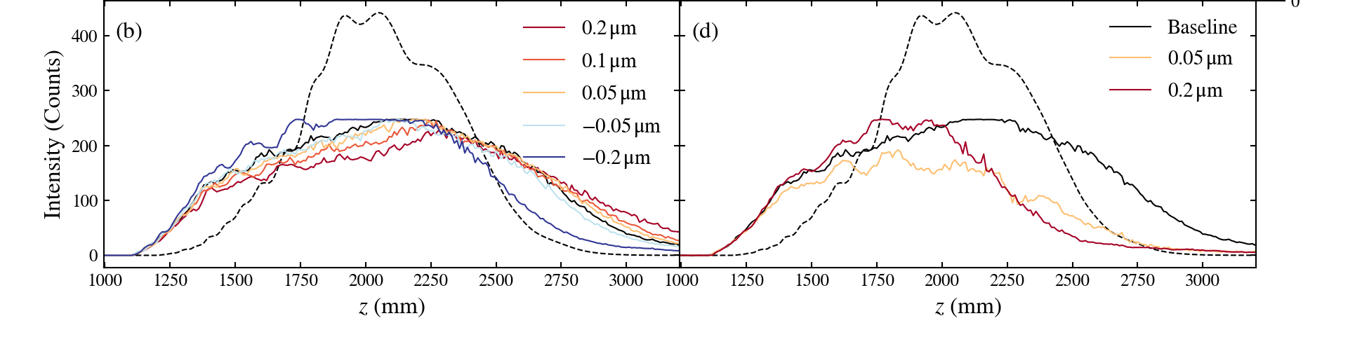
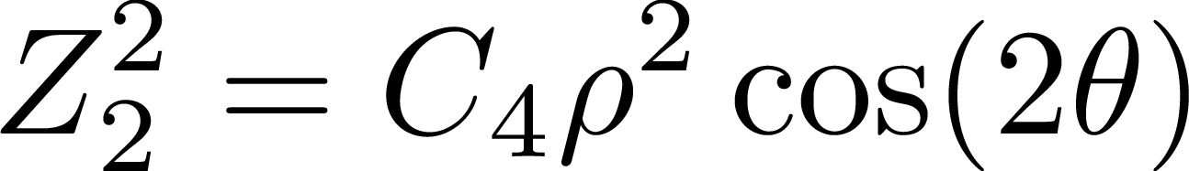
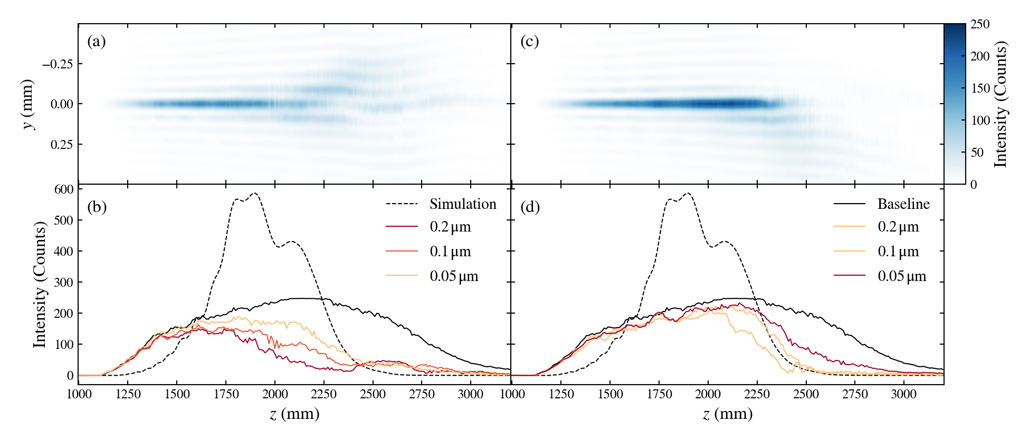
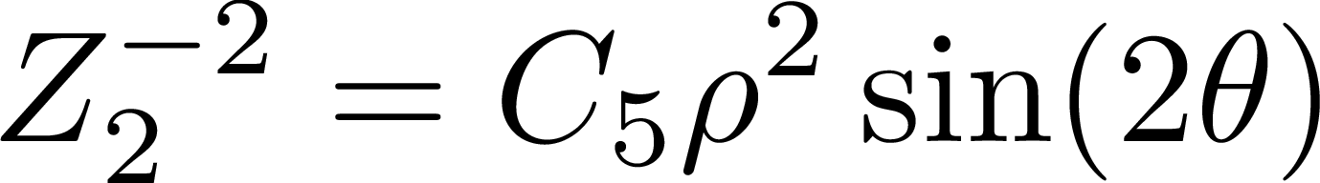
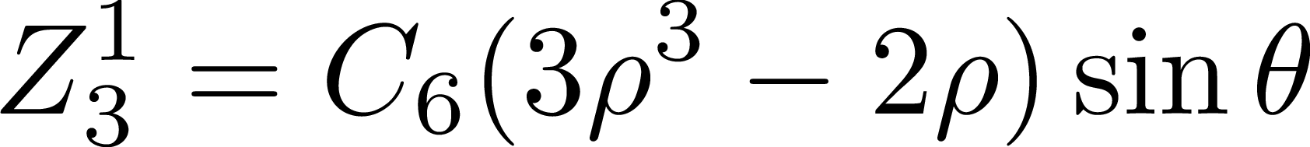
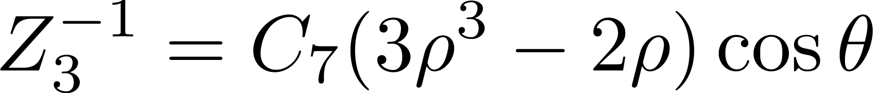
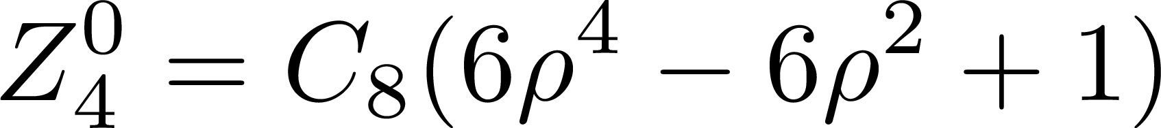
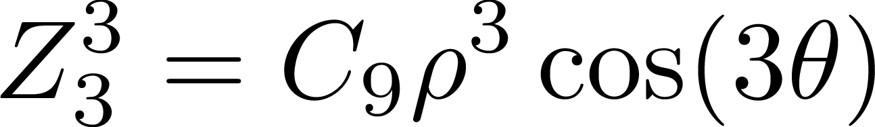
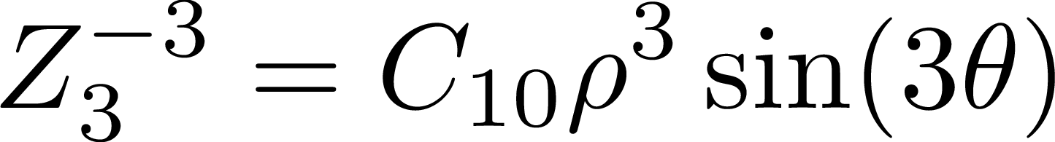
Wavefront aberrations
Focus
Coma
Phase error definition:
Coefficient on Zernike polynomial
Polynomials are not normalized
Radius normalized to
Lowest order polynomials ( ):
Defocus:
Astigmatism 0:
Astigmatism 45:
Coma 0:
Coma 90:
3rd spherical:
Trefoil 0:
Trefoil 90:
Quadrupole focus
Bottom triple focus
Astigmatism
Trefoil

Slide 20
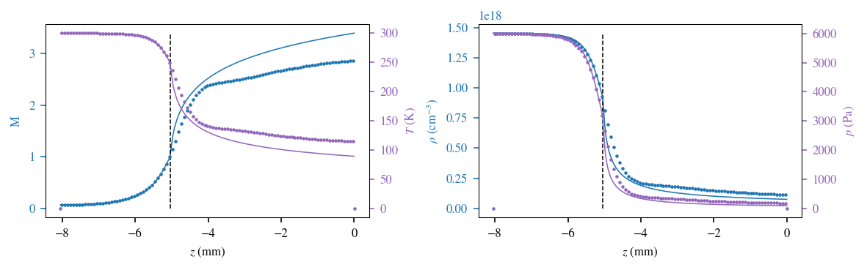
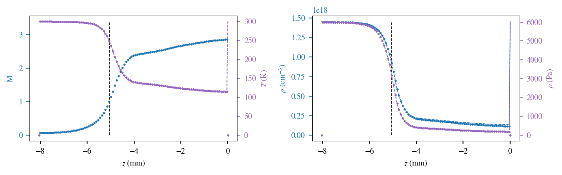
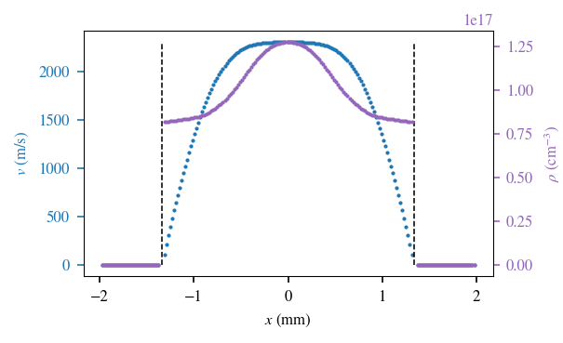
1D isentropic theory compared to simulation
Top plots show a comparison between 1D isentropic theory (solid line) and CFD simulation (dots).
Bottom plot shows the predictions of isentropic theory using the simulated Mach number as input.
Deviation from isentropic behavior is due to irreversible processes in the fluid, i.e. friction. In this case it is the boundary layers.

