Slide 1

Results of the diﬀerential pumping system test in experimental area
Doug Storey
May 3, 2022

Slide 2
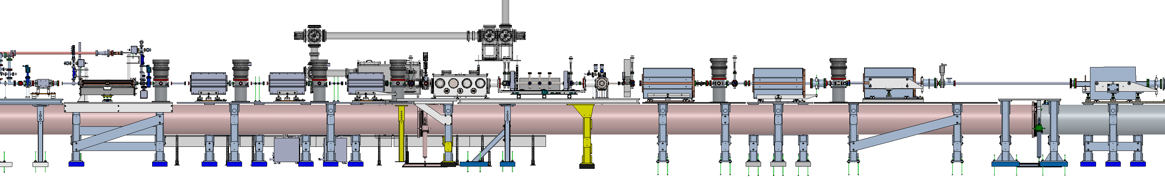
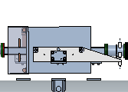
Experimental Area Differential Pumping System
Upstream DPS and final focus quads
Li Oven
Downstream DPS and reimaging quads
Spectrometer Bend
-10m
-5m
0
5m
10m
Requirements for E300 (from FACET-II Differential Pumping System ESD)
Gas Load: Up to 5 Torr He gas at IP, steady state
Upstream pressure: P~1e-9 Torr at location of the XTCAV
Upstream apertures: Adhere to nominal beam stay clear requirements. Upstream apertures must be located upstream on the holed mirror in the picnic basket
Downstream pressure: P<1e-1 Torr with 2 meters of the exit of the plasma oven
Downstream Apertures: Adhere to nominal beam stay clear requirements. Downstream apertures must be located downstream of the holed mirror in the 8” cube. Apertures should not reduce the acceptance angle of the diagnostics beyond that defined by the spectrometer magnets.

Slide 3
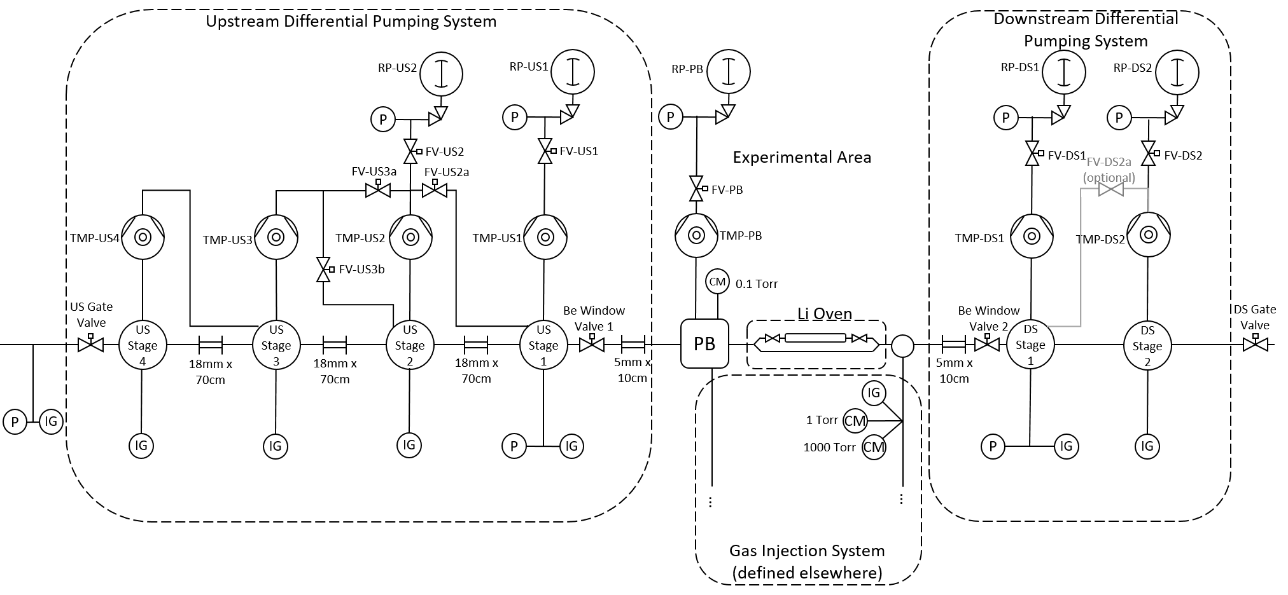
DPS Vacuum Schematic
4x 160 l/s roughing pumps
4x 2000 l/s TMP
Be windows on removable valves
2x 2000 l/s TMP
18mm Ø by 70cm long inserts inside the FF quads
No further restrictions in spectrometer
5mm Ø by 10cm long straw on either side of IP

Slide 4
DPS Vacuum Schematic – State 1: Li Oven
Upstream Differential Pumping System
Downstream Differential Pumping System
RP-US2
RP-US1
RP-PB
RP-DS1
RP-DS2
2e-1 Torr
P
P
P
P
P
FV-US2
FV-US1
Experimental Area
FV-DS1
FV-DS2a
(optional)
FV-DS2
3e-8 Torr
2e-5 Torr
FV-US3a
FV-US2a
2e-1 Torr
FV-PB
2e-1 Torr
2e-1 Torr
TMP-US4
TMP-US3
TMP-US2
TMP-US1
TMP-PB
TMP-DS1
TMP-DS2
FV-US3b
CM
0.1 Torr
US Gate Valve
Be Window Valve 1
Li Oven
Be Window Valve 2
DS Gate Valve
US
Stage 4
US
Stage 3
US
Stage 2
US
Stage 1
PB
DS
Stage 1
DS
Stage 2
18mm x 70cm
18mm x 70cm
18mm x 70cm
5mm x 10cm
5mm x 10cm
IG
10 Torr-l/s
1 Torr
10 Torr-l/s
P
IG
CM
IG
IG
IG
P
IG
1000 Torr
CM
P
IG
IG
1e-9 Torr
3e-8 Torr
2e-5 Torr
1e-2 Torr
5 Torr
1e-2 Torr
1e-4 Torr
…
…
Gas Injection System
(defined elsewhere)

Slide 5
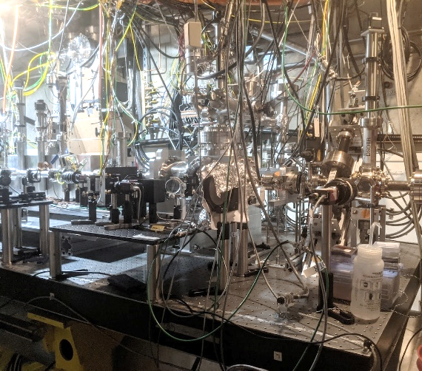
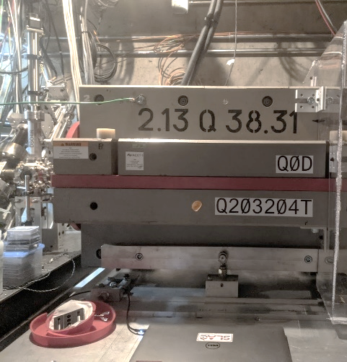
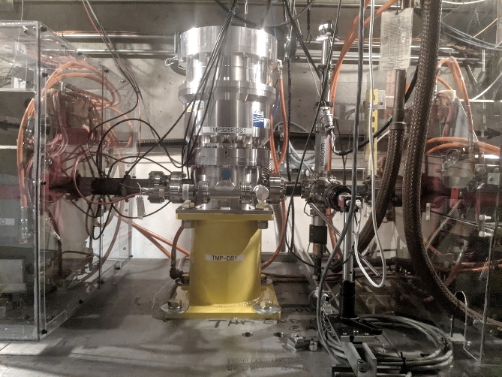
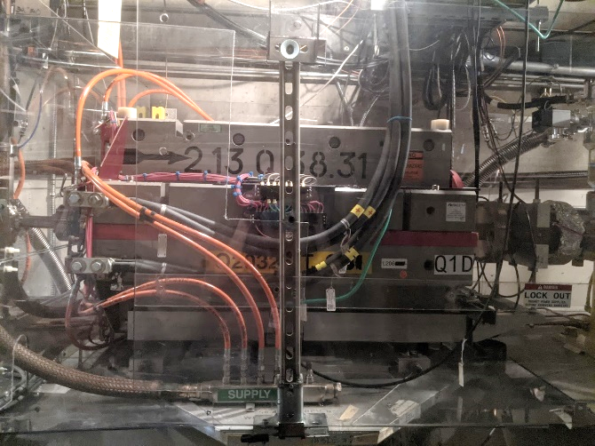
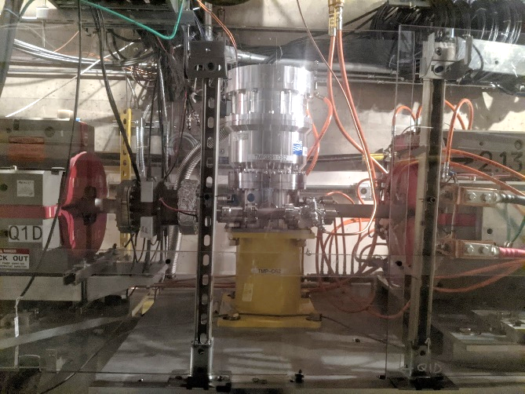
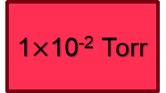
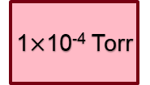
Overview of the downstream DPS installation
Beamline installation:
Installation of downstream DPS system in Jan 2022
First test with “straw aperture” on 4/7/2022
Upstream-DPS ready to install
Simplified sketch:
Plasma Oven
He input
Q0D quad
Stage 1 Turbopump
Q1D quad
Stage 2 Turbopump
Q2D
Vacuum schematic:
Straw
aperture
1$×$10⁻² Torr
1$×$10⁻⁴ Torr
5 Torr He
steady state

Slide 6
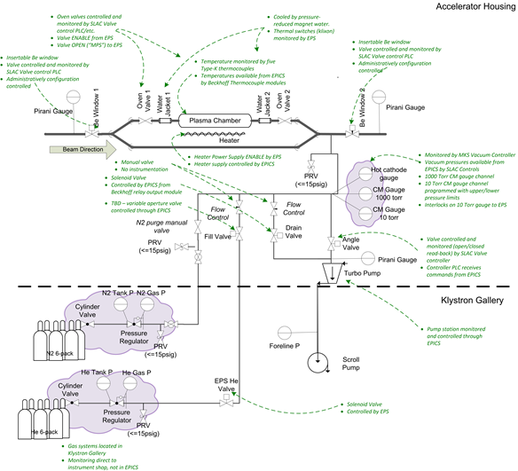
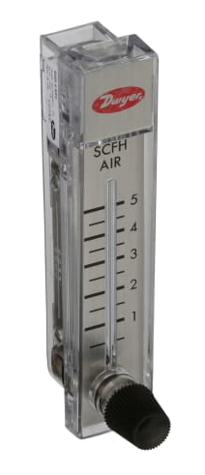
Changes to gas delivery system
Manual flow valve added to helium gas fill line
No further changes made to gas delivery at this time
Changes are compatible with Li oven operation with static fill
US-DPS
DS-DPS

Slide 7
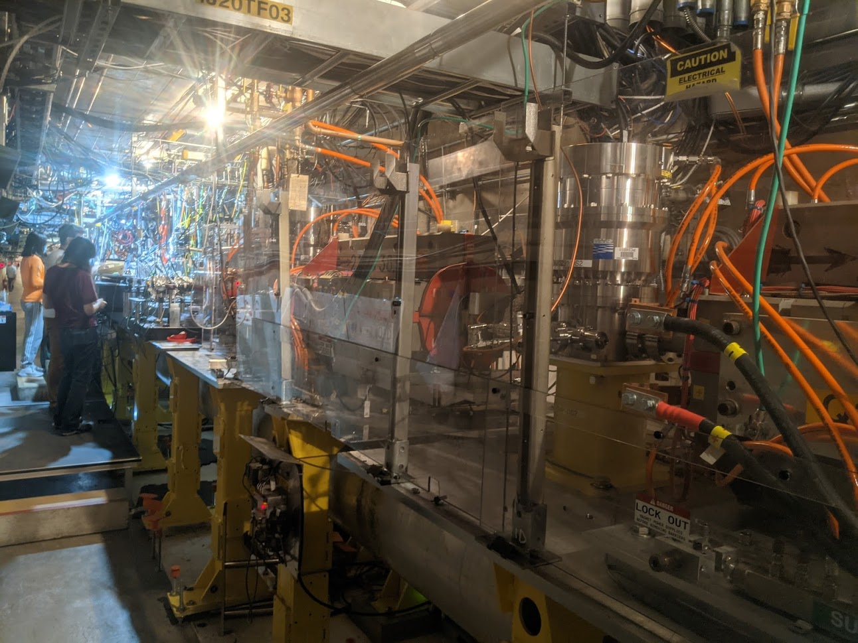
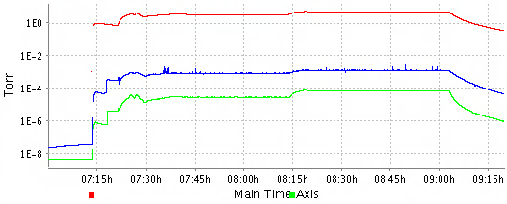




Initial test results from the downstream DPS
Beamline apertures installed:
5mm Ø x 10 cm straw before Q0D (removed after test)
no additional aperture required on stage 2
Pressure drop along the beamline meets requirement.
Experimental area pressure stable to <0.5% over duration of test.
Pump temperatures remain well within operating limits.
DS-DPS test with 5mm Ø x 10cm long straw
Exp Pressure
3.32 Torr
4.99 Torr
1.4$×$10⁻³ Torr
5.3$×$10⁻³ Torr
DS1 Pressure
2.7$×$10⁻⁵ Torr
7.0$×$10⁻⁵ Torr
DS2 Pressure
04/07/2022

Slide 8
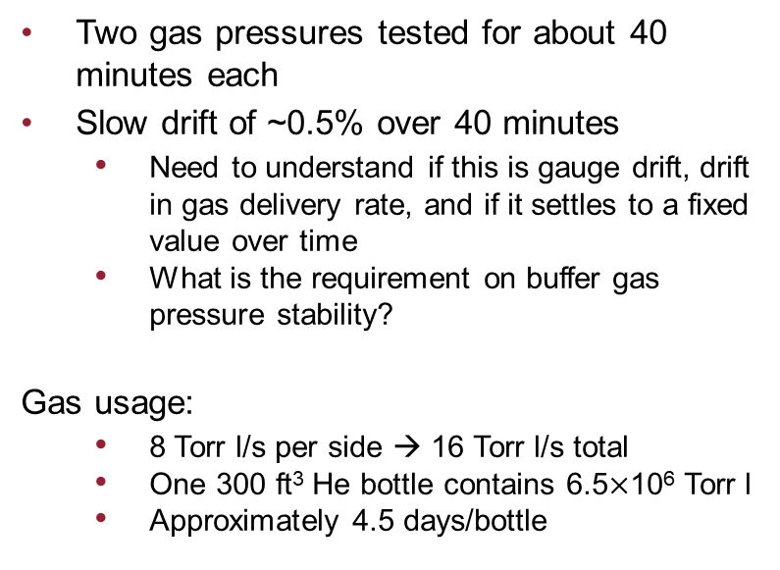
Pressure stability and gas usage
Two gas pressures tested for about 40 minutes each
Slow drift of ~0.5% over 40 minutes
Need to understand if this is gauge drift, drift in gas delivery rate, and if it settles to a fixed value over time
What is the requirement on buffer gas pressure stability?
Gas usage:
8 Torr l/s per side → 16 Torr l/s total
One 300 ft³ He bottle contains 6.5$×$10⁶ Torr l
Approximately 4.5 days/bottle

Slide 9
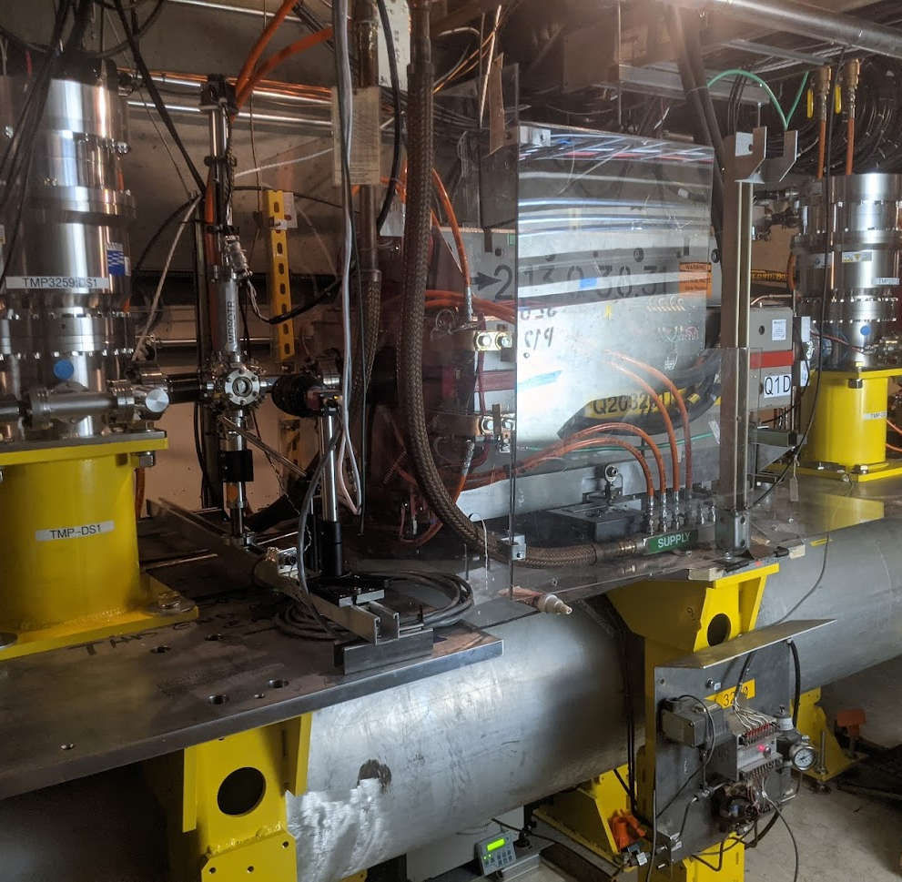
Radiation related issues
Turbopumps have been operating in the tunnel without issue for ~3 months
Turbo controllers are located in gallery
Roughing pumps have been tripping off ~1/week
Trips are highly correlated with high radiation measured by experimental area radiation monitors
Controllers are on the pumps, pumps located below the beamline
Studying mitigation options:
Move the roughing pumps out of the tunnel
Testing conductance limitations for a ~40ft foreline
Move the pumps upstream of the IP
Once nominal radiation levels are more controlled this could be an option
Add local shielding to pumps

Slide 10
Next steps + Discussion
Sort out roughing pump operational issues
Installation of the US-DPS pumps and guages
Installation of aperture restrictions inside the final focus quads
Design and installation of 5mm x 10cm straws and upstream Be window
Test of the full system with the XTCAV
Discussion questions:
What are the requirements for pressure stability for Li oven operation?
How will the oven behave in the various failure modes, i.e. sudden loss of a pumping stage
What other requirements exist for first test with oven
What will it take to convince ourselves that we are ready for a test of the full system with the Li oven?

Slide 11
Extra slides

Slide 12
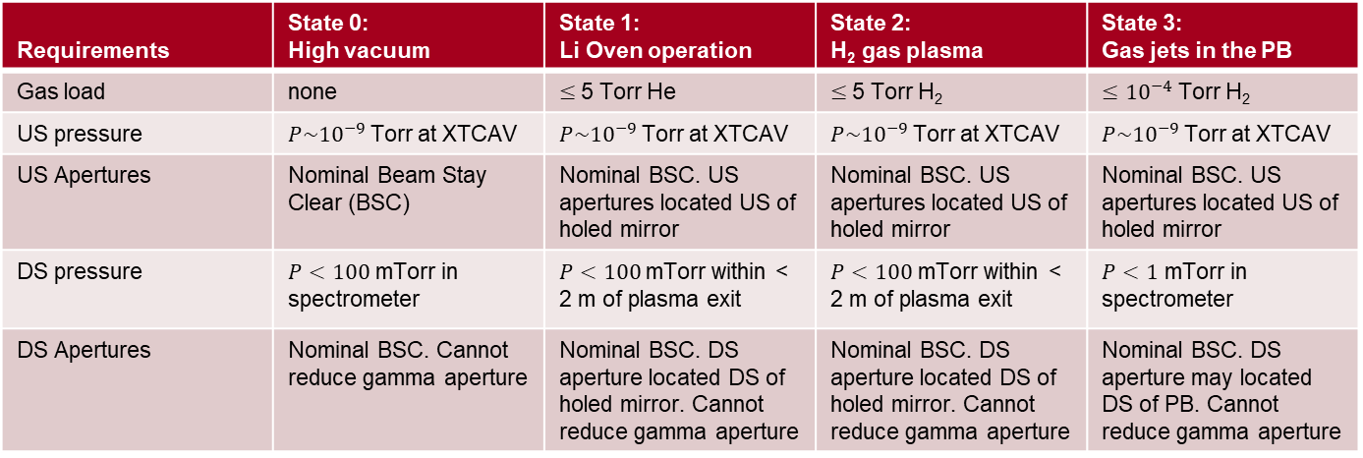
Differential Pumping Requirements
Differential Pumping System (DPS) will:
Isolate the IP experimental area beamline from the upstream UHV conditions for the TCAV and linac
Limit emittance growth from beam-gas scattering
Maintain beam stay clear requirements whenever possible
Must fit into the available space between quadrupoles
Four modes of operation will serve most of the experimental programs:
Requirements | State 0: High vacuum | State 1: Li Oven operation | State 2: H₂ gas plasma | State 3: Gas jets in the PB
Gas load | none | $≤$5 Torr He | $≤$5 Torr H₂ | $≤{10}^{−4}$ Torr H₂
US pressure | $P\sim {10}^{−9}$Torr at XTCAV | $P\sim {10}^{−9}$Torr at XTCAV | $P\sim {10}^{−9}$Torr at XTCAV | $P\sim {10}^{−9}$Torr at XTCAV
US Apertures | Nominal Beam Stay Clear (BSC) | Nominal BSC. US apertures located US of holed mirror | Nominal BSC. US apertures located US of holed mirror | Nominal BSC. US apertures located US of holed mirror
DS pressure | $P<100$ mTorr in spectrometer | $P<100$mTorr within < 2 m of plasma exit | $P<100$ mTorr within < 2 m of plasma exit | $P<1$ mTorr in spectrometer
DS Apertures | Nominal BSC. Cannot reduce gamma aperture | Nominal BSC. DS aperture located DS of holed mirror. Cannot reduce gamma aperture | Nominal BSC. DS aperture located DS of holed mirror. Cannot reduce gamma aperture | Nominal BSC. DS aperture may located DS of PB. Cannot reduce gamma aperture

Slide 13
Differential Pumping Performance – Upstream DPS
State | Exp. Condition | Stage 1: Eff. TMP speed / Pressure | Stage 2: Eff. TMP speed / Pressure | Stage 3: Eff. TMP speed / Pressure | Stage 4: Eff. TMP speed / Pressure | Stage 1 flow rate
0 | ~1e-9 Torr | ~1800l/s 1e-9 Torr | n/a | n/a | n/a | minimal
1 | 5 Torr He | ~780 1e-2 Torr | ~1800 l/s 2e-5 Torr | ~1800 l/s 3e-8 Torr | ~1800 l/s ~1e-9 Torr | 10 Torr l/s
2 | 5 Torr H₂ | ~300 7e-2 Torr | ~1800 l/s 2e-4 Torr | ~1800 l/s 3e-7 Torr | ~1800 l/s ~1e-9 Torr | 23 Torr l/s
3 | 1e-4 Torr H₂ | ~1100 5e-8 Torr | ~1800 l/s ~1e-9 Torr | n/a | n/a | minimal
Performance estimated by matching the rate of flow though tubes to TMP pumping speed
Assumed 2000 l/s TMP pumping speed curve
Pressure at final stage expected to be limited by outgassing rate
Performance of State 1 first stage confirmed by bench tests
State 1 - US Differential Pumping Calculated Performance
Stage 1
Stage 2
Stage 3
Stage 4

Slide 14
Differential Pumping Performance – Downstream DPS
State | Exp. Condition | Stage 1: Eff. TMP speed / Pressure | Stage 2: Eff. TMP speed / Pressure | Stage 1 flow rate
0 | ~1e-9 Torr | ~2000l/s 1e-2 Torr | n/a | minimal
1 | 5 Torr He | ~780 1e-2 Torr | ~2000 l/s 1e-4 Torr | 10 Torr l/s
2 | 5 Torr H₂ | ~300 7e-2 Torr | ~1800 l/s 1e-3 Torr | 23 Torr l/s
3 | 1e-4 Torr H₂ | Aperture removed ~1100 1e-6 Torr | n/a | minimal
Downstream DPS easily meets requirements in 2 stages
The downstream aperture may be removed completely in State 3 to increase the gamma and electron angular acceptance
Flowrate through stage 1 on both sides defines the gas consumption of the system:
20 Torr-l/s He = ~ 4 days use
46 Torr-l/s H₂ = ~ 4 hours use

Slide 15
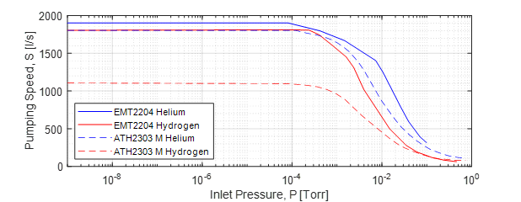
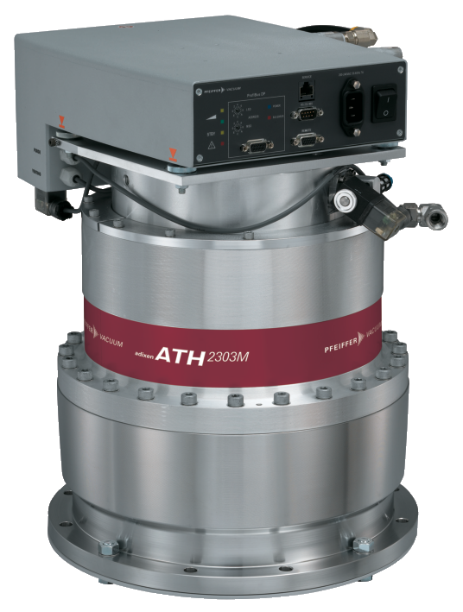

Choice of pumps
Turbopumps:
2000 l/s class TMP that can withstand ~krad radiation dose/week
Remote controller unit and >20m cable
Low vibration → magnetic levitation bearing
Low maintenance
Choices:
Ebara EMT 2204
Pfeiffer ATH 2303M
H2 pump speed is low
Backing pumps:
Large flow rate required
Dry, low maintenance
N2 purge gas to increase light gas pumping speed
Choices:
Ebara EV-S100P
Pfeiffer ACP40
Leybold Ecodry 65 Plus
TMP Pumping Speeds
Ebara
EMT 2204:
Pfeiffer ATH 2303M:

Slide 16
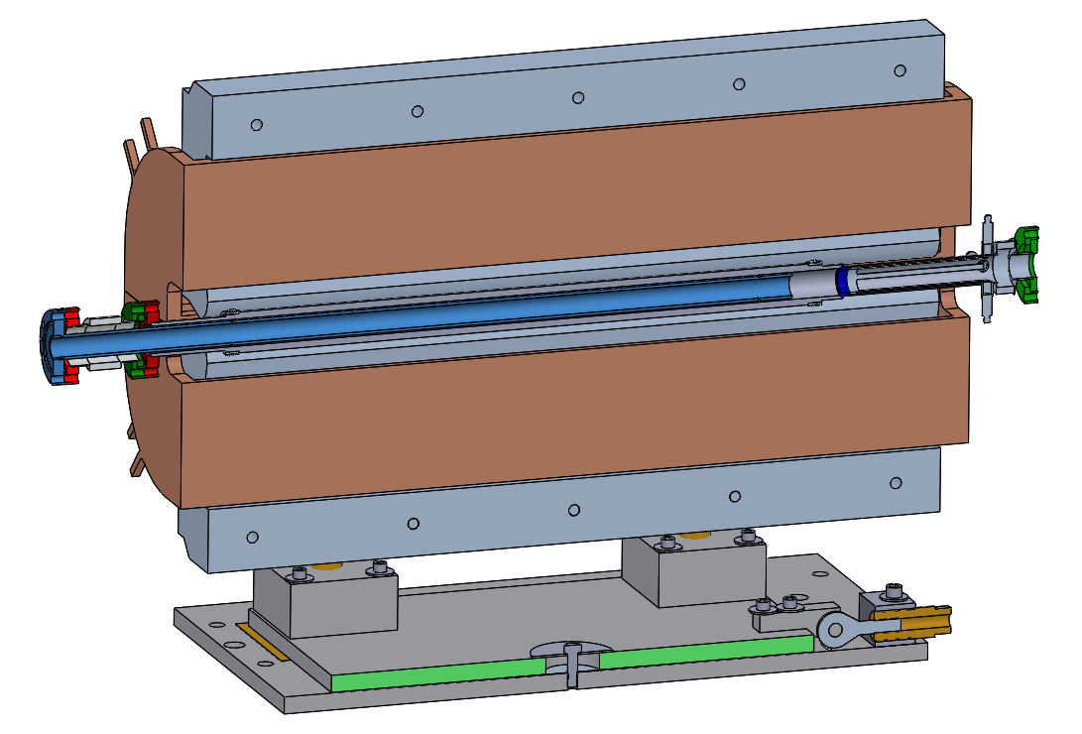
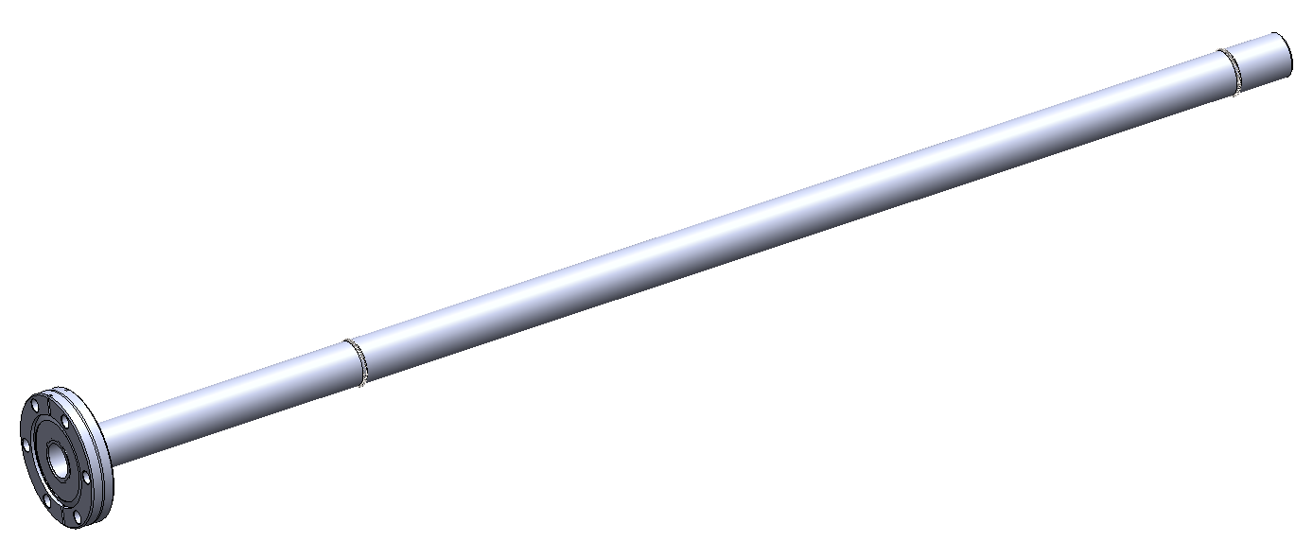
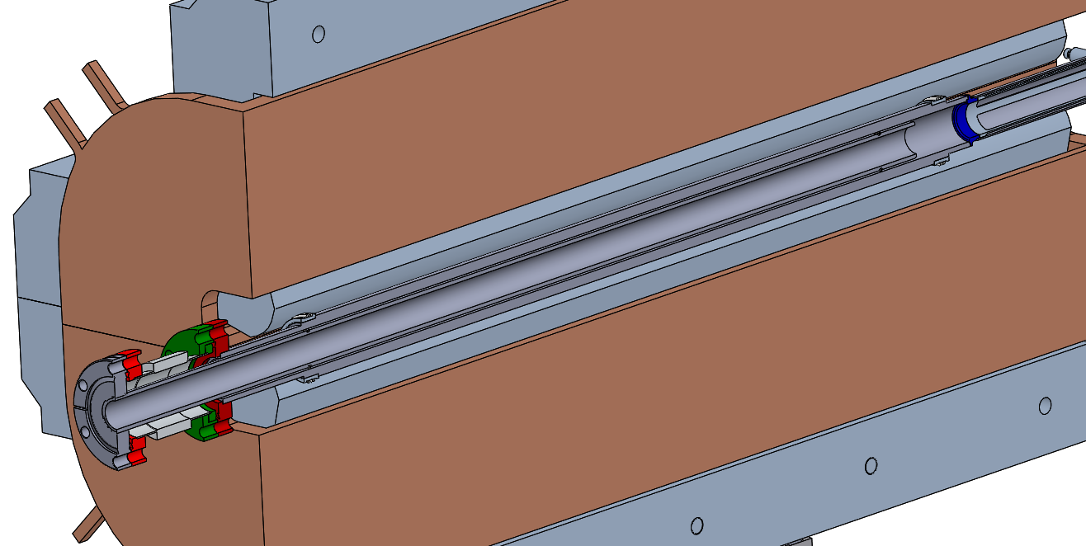
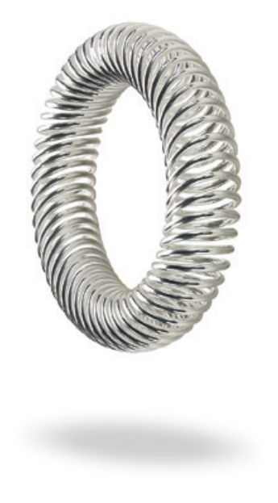
Aperture limiting inserts
18mm x 70cm aperture insert
Designed to be removable, replaceable
Fabricated from SS tube
Self-centering within the quad magnet chamber using coil springs
Double sided CF flange
Bal Spring canted coil spring:

