Slide 1
Lithium Oven Checkout
(Plus Schedule and Arrivals)
Christine Clarke
May 3rd 2022

Slide 2
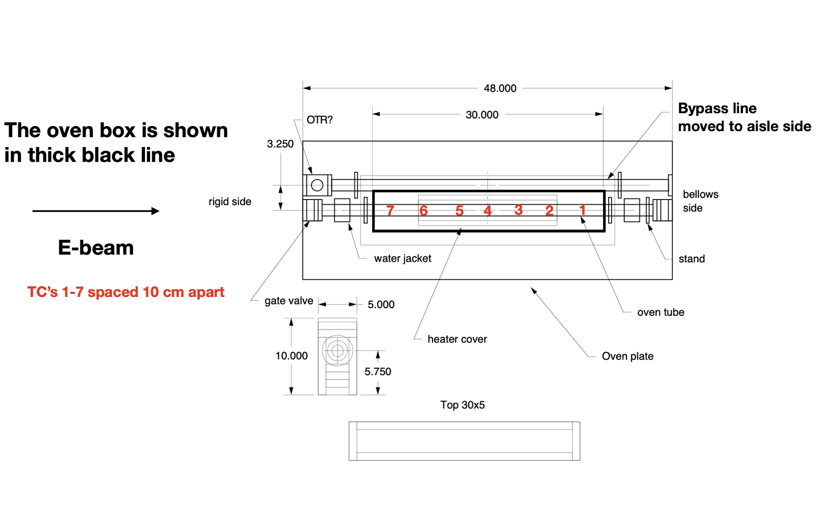
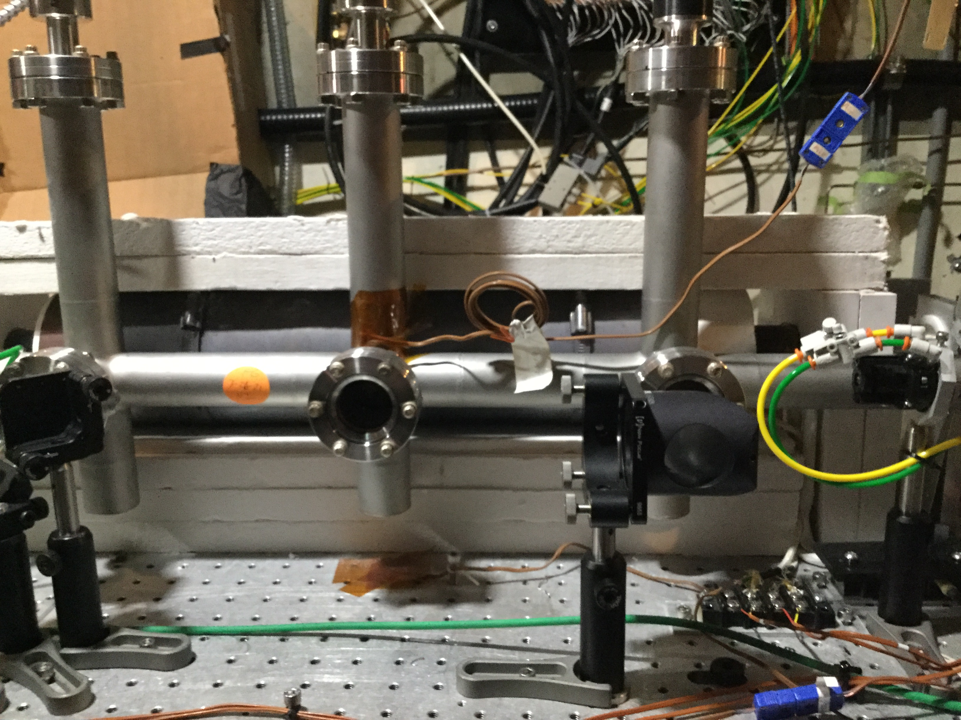
Introduction to Oven
https://drive.google.com/drive/folders/1Zx4V9V1z7fs-jBB2Zytv-ieNKolbR2HE?usp=sharing
From Ken Marsh:
More thermocouples (TCs) on Colorado Bypass Line, baseplate and on the upstream and downstream water jackets (not shown)

Slide 3
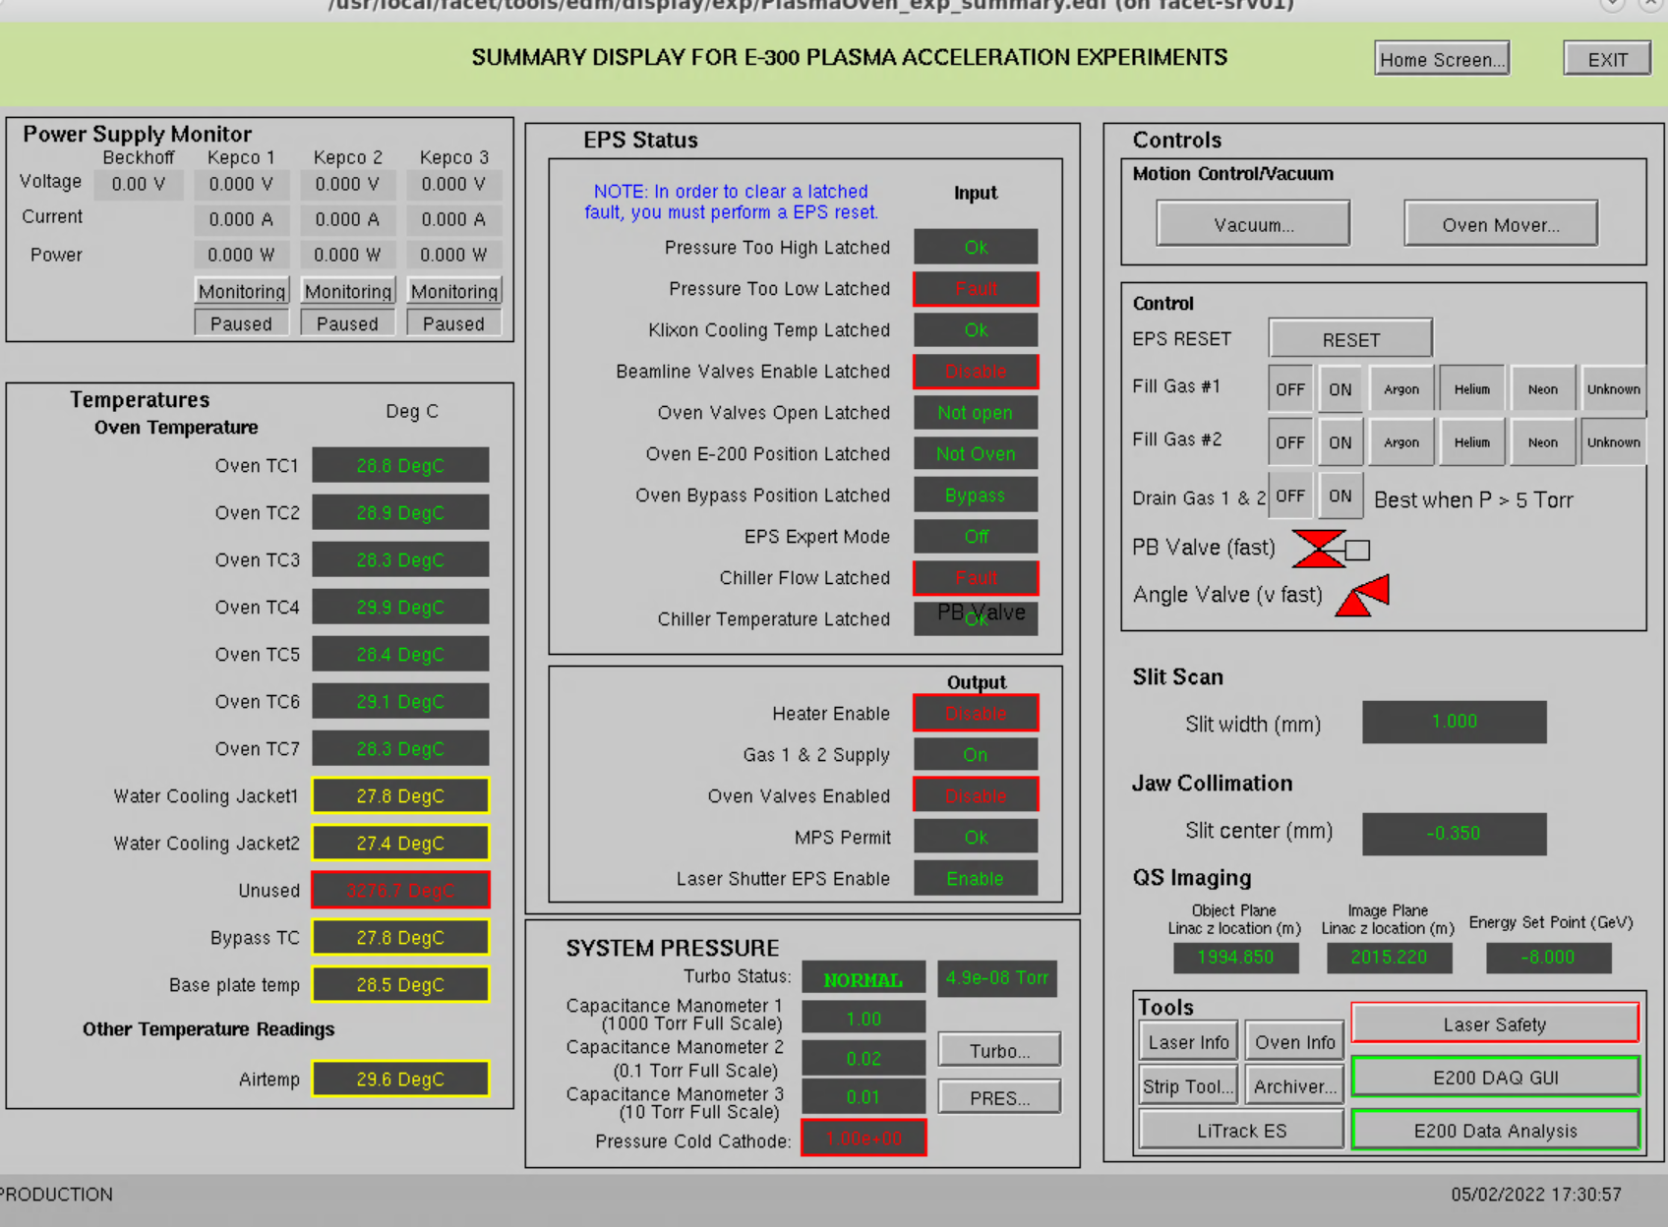
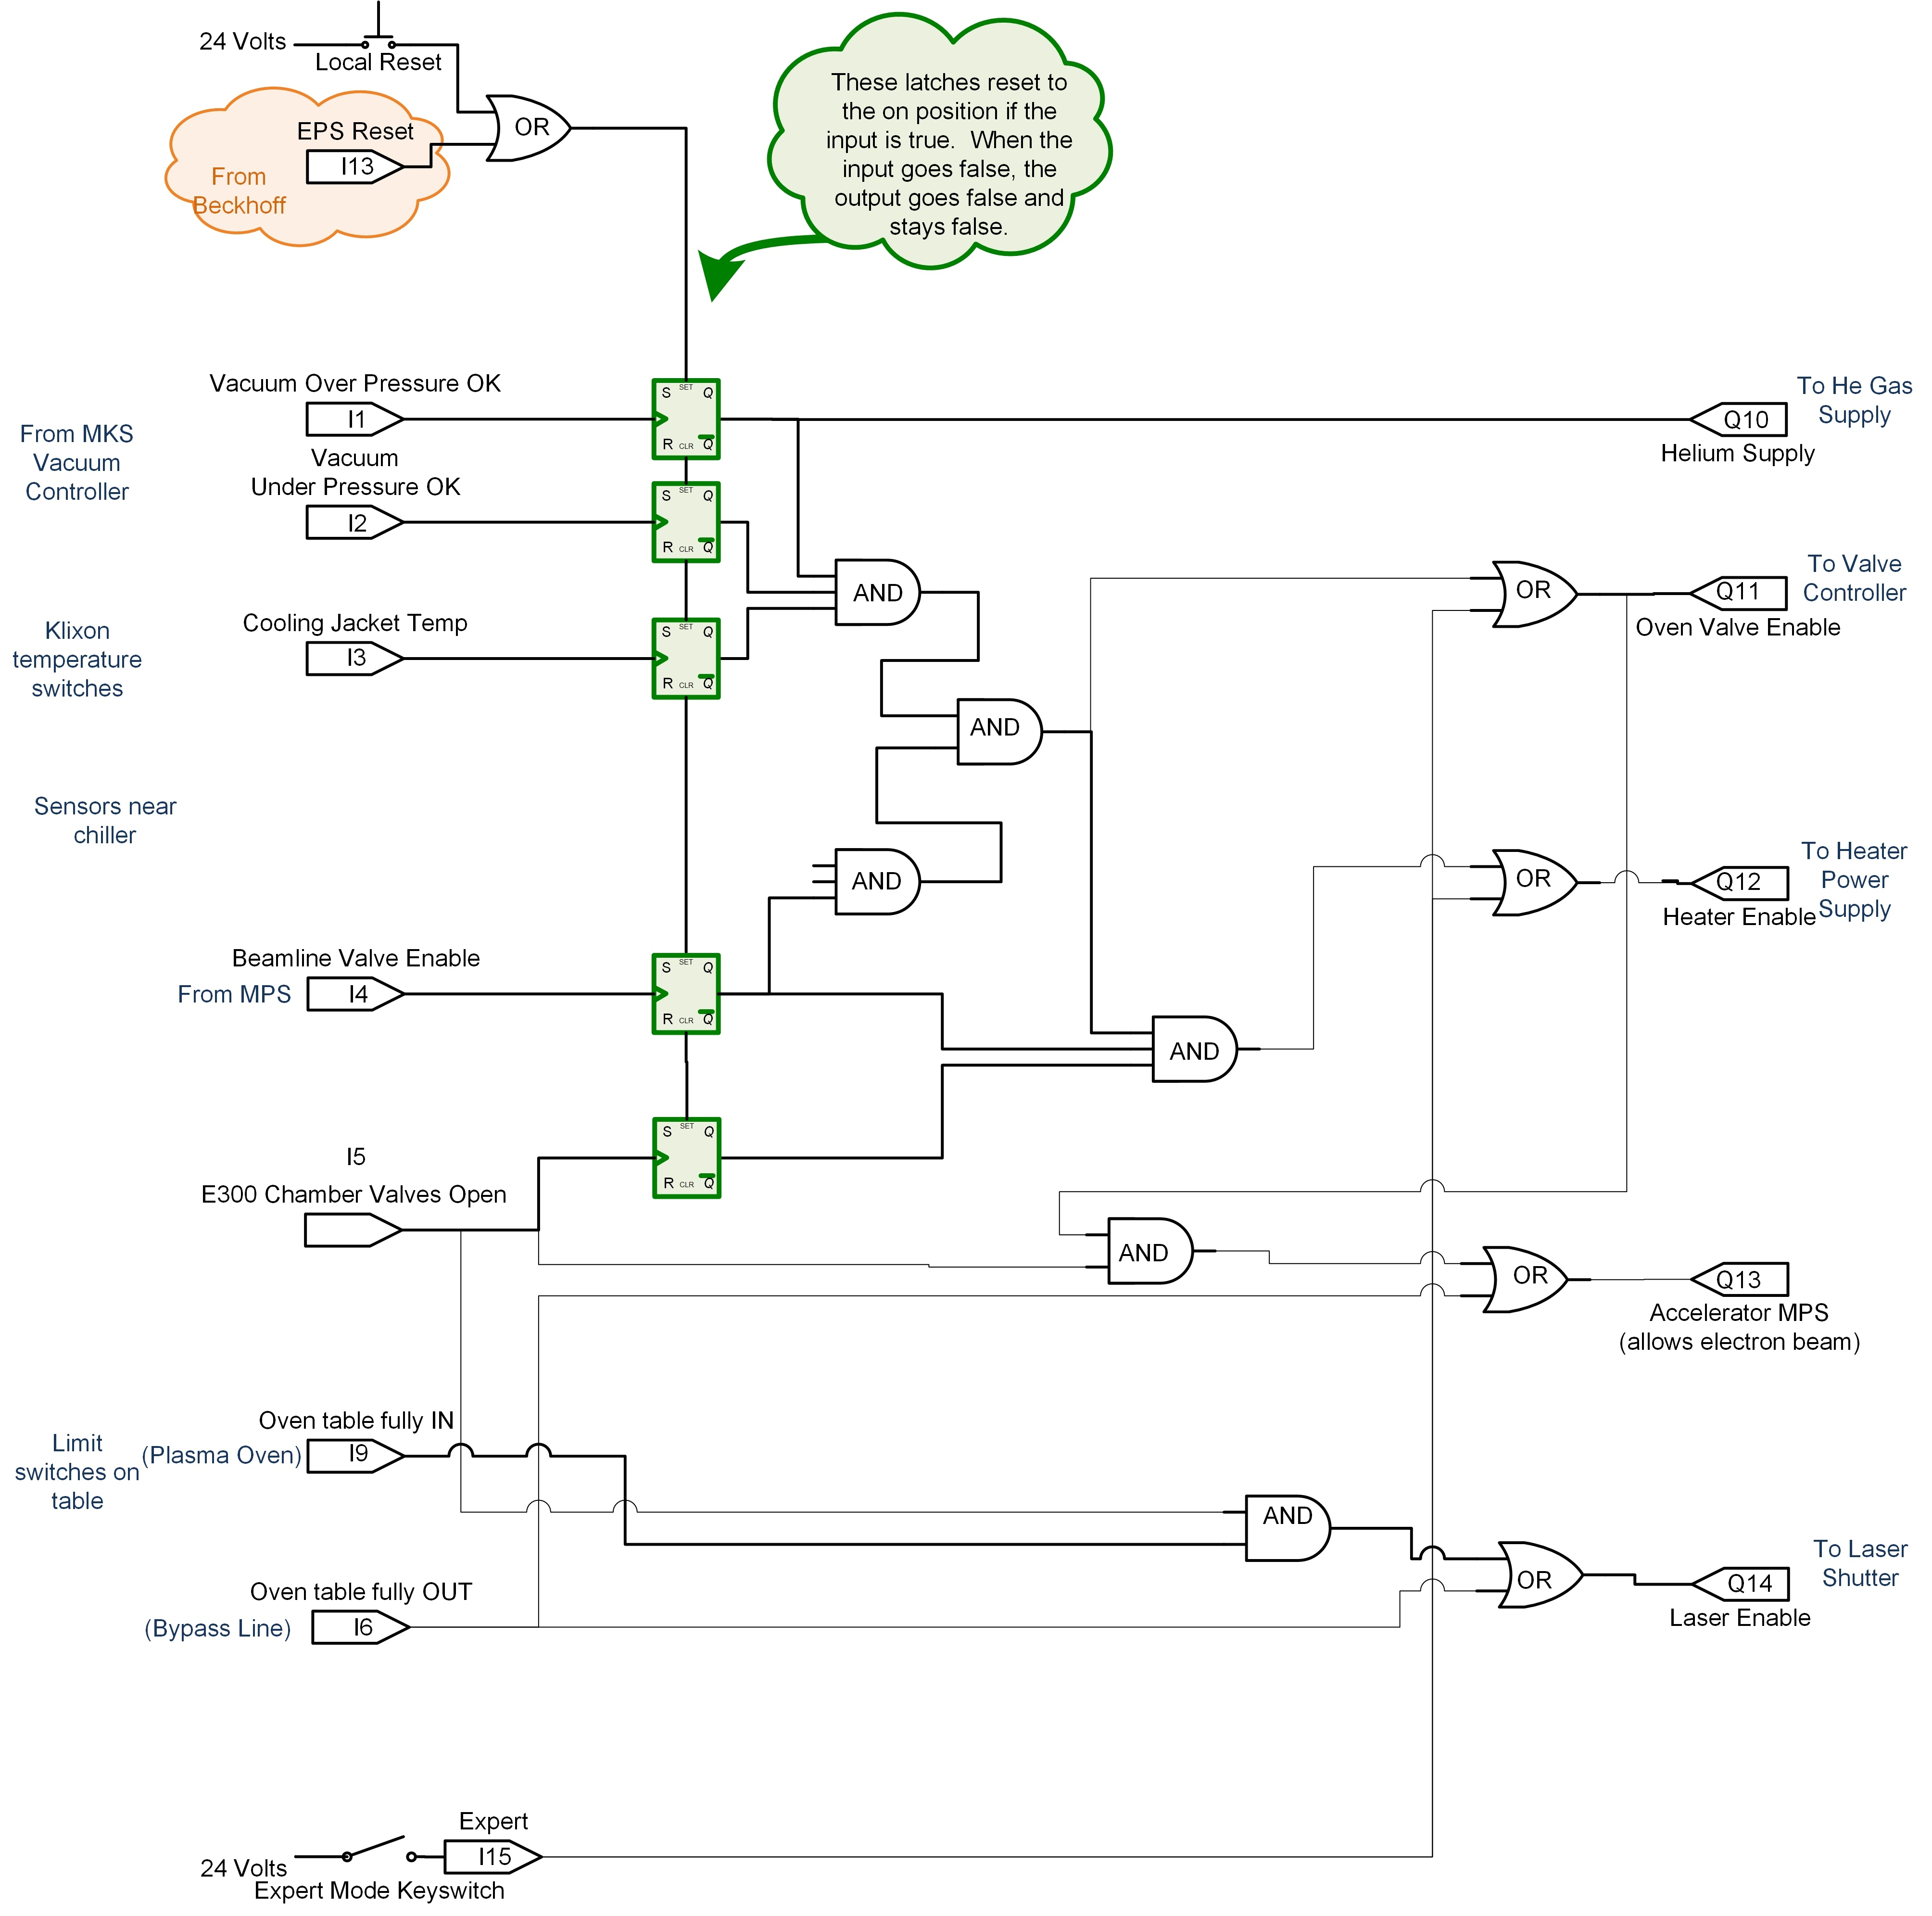
E-300 Oven in control system / Experiment Protection System
https://confluence.slac.stanford.edu/display/FACET/Experiment+Protection+System
EDM screen displays items relevant to oven operation
Of particular importance is the Experiment Protection System (EPS)
EPS interlocks protect oven from
Electron Beam or Laser Beam hitting bellows or oven gate valves
Pressure decrease e.g. from beryllium window breaking to vacuum
Pressure increase e.g. from leak to air
Any beamline fault will trigger EPS also
EPS is checked out prior to oven operation
We also perform helium leak test and rate of rise test on plasma beamline prior to oven operation
Thanks to a lot of hard work, we can get pressure rise ~ 10 mTorr/day

Slide 4
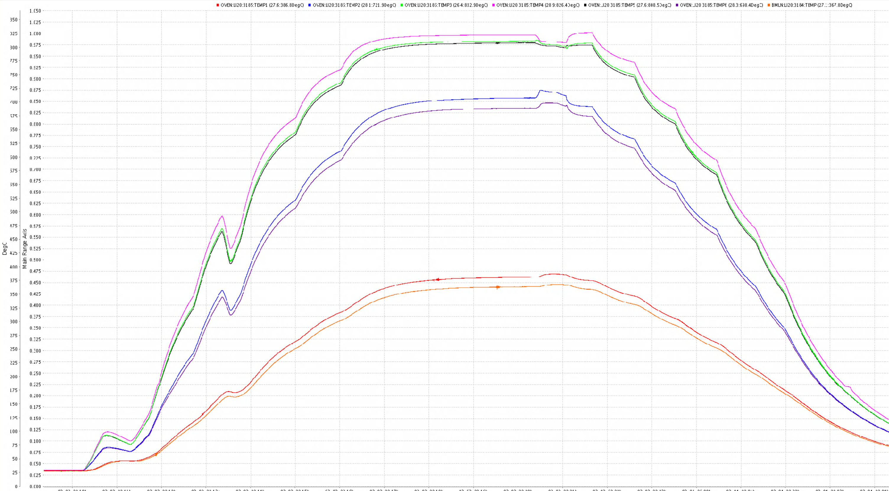
March 2022 Checkout (3/3/22)
Once in oven mode, we changed to a couple of other densities before cooling down (changing density takes ~1 hr)
Power to oven is raised in increments of 100 W hence the lumpiness
Beamline vacuum fault → EPS shut down oven, briefly cools down
Time to cool down was 6 hours + power decrease time = 12 hours in total. If we need to cool down an oven before a PAMM, advice is to start cool down at 6-8 pm.

Slide 5
Oven checkout summary (3/3/22)
Oven start up at 4 Torr to 575 W (3.5e16 cm⁻³)
Unexpectedly low temperatures on the TCs
Successfully got to oven mode
Possibly hottest point simply not where central TC was located
Different heat sinking for FACET compared to UCLA means a slightly different profile
Changed pressure to 3 Torr (2.7e16 cm⁻³)
Saw oven profile change to be longer and lower temperature (density)
Lowered power and increased pressure to 6 Torr (5e16 cm⁻³)
Saw oven profile change to be shorter and higher temperature/density
Issue seen in December did not recur
In December we saw a sudden and unprovoked change in profile

Slide 6
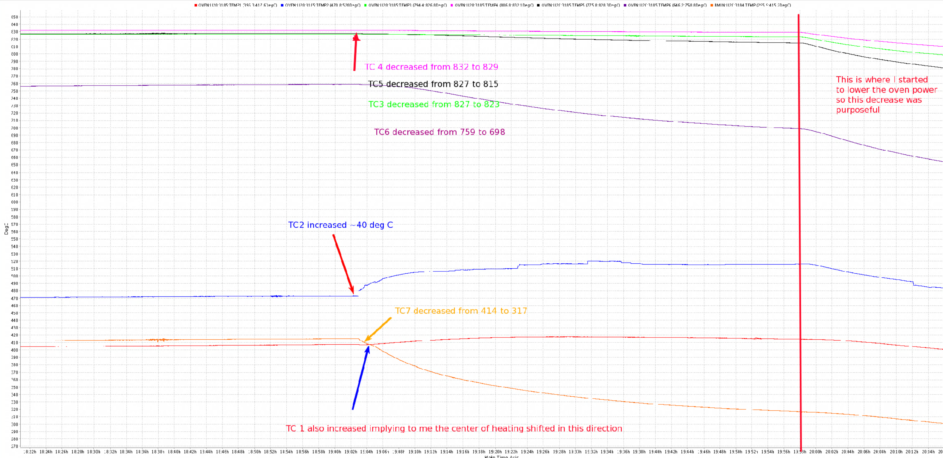
December 2021 Checkout
Checkout encountered a problem in December
Not sure what happened, could happen again?

Slide 7
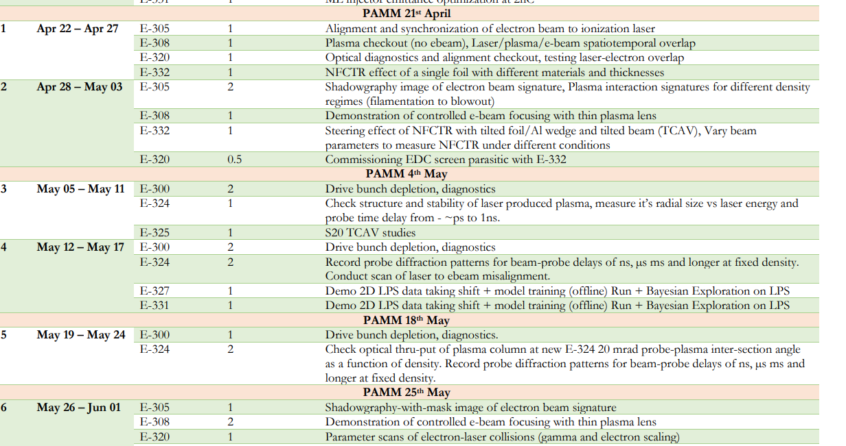
Schedule
We are approximately 2 weeks delayed from the published schedule
https://facet-ii.slac.stanford.edu/sites/default/files/FY22%20FACET-II%20User%20Run%20Schedule.pdf
In process of being schedule

Slide 8
Arrival/site logistics
New time users register and follow instructions: https://facet-ii.slac.stanford.edu/user-resources/registration
All users need to refer to arrival instructions: https://facet-ii.slac.stanford.edu/user-resources/arriving
Very important to share travel dates with me before coming (preferably 2-4 weeks before)
I review training and send notification of arrivals to VUE Center Admin (Azeb Amii) and FACET-II Admin (Nadya Smith)
Foreign Nationals need to pay attention to documentation requirements which includes a CV that shows no gaps
All users need to show proof of covid vaccination
Verify you have a computing account and it works
SLAC email is used to report close positive covid contacts or symptoms through Stanford Health Check website
Training includes on-site covid related practices (new course 100R)
Everyone is enrolled in our on-site covid testing program through company called Color and lateral flow tests are available

