Slide 1
FACET-II 2-Bunch Simulated Performance
Glen White

Slide 2
Overview
Accelerator configuration and 2-bunch start-to-end simulations
  Using Lucretia FACET-II electron beam model
BC20 “W” chicane
  Same as FACET (with XTCAV moved into FFS)
2-bunch tracking:
  Reminder of performance with double-pulsed configuration from gun shown previously
  Compare capability with “OG” FACET configuration: single pulse with ”notch” and “jaw” collimation inside BC20

Slide 3
Linac Bunch Compression
Double-Gun-Pulse Configuration
125 MeV
335 MeV
4.5 GeV
10.0 GeV
Φ=-19.2º
Φ=-38.35º

Slide 4
Sector 20 Beamline & Optics
BC20
FFS
SPECTROMETER
IP
Current FACET-II Sector 20 layout, matched for R56=+7mm, β*=50cm
3 families of sextupoles matched to minimize T566, & ε_{x}
FFS quads (5 families of magnet) matched for round beams at IP
R56 matching range = [-10:+10] mm
  significant operations time required ~1 shift
β* matching range = [2,100+] cm
  Tool available for online matching
  For smaller β* values (<50cm), need to also re-optimize sextupoles for smallest beam size

Slide 5
Start-to-end Tracking (2-bunch from photocathode)
Longitudinal Phase Space at IP
Drive
Bunch
Witness
Bunch
Δt = 600 fs

Slide 6
Start-to-end Tracking (2-bunch case)
Transverse Phase Space at IP (PENT element)
Drive Bunch
Witness Bunch
γε (Drive Beam)= 73 x 35 μm-rad
γε (Witness Beam)= 4.5 x 2.6 μm-rad

Slide 7
IP Waist Locations for Drive and Witness Bunch
Witness Bunch
Drive Bunch
Q0FF
“PENT”
Drive Bunch Waist Location
β^{Q},α^{Q}
β^{IP},α^{IP}
β^{D},α^{D}
(Sketch – NOT TO SCALE)
L*=2.58m
ΔW
ΔW_{x,y} = 22.8, 17.3 cm
 | α^{Q} [x,y] | β^{Q} [x,y] | α^{IP} [x,y] | β^{IP} [x,y] | α^{D} [x,y] | β^{D} [x,y]
Witness | 25, 13 | 67, 31 m | 0.13, -1.1 | 11, 41 cm | -2.3, 0.17 | 66, 20 cm
Drive | 5.1, 9.8 | 15, 28 m | 0.4, 0.6 | 65, 65 cm | 0.0, 0.0 | 56, 29 cm

Slide 8
Linac Bunch Compression
2 Bunch Notch Configuration
125 MeV
335 MeV
4.5 GeV
10.0 GeV
Q = 2 nC
Φ_{s} = 30º
Φ=-19.8º
Φ=-39.8º

Slide 9
BC20 Re-Match for Jaw+Notch 2-Bunch Config
BC20
FFS
SPECTROMETER
σ_{δ} / σ_{β} ~ 30 / % (γε=10μm-rad)
IP
CN2069 & CX2085
Compared with FACET-I, smaller head-tail energy spread, need to re-configure for larger R56 in BC20
  Optics re-matched for R56=+10 mm
  Adjust L1 & L2 rf phases to fine-tune 2-bunch results
Use notch & jaw collimators as indicated to generate 2-bunch profile

Slide 10
Start-to-end Tracking (2-bunch notch config)
Longitudinal Phase Space at IP (PENT element)
Δx=0.65mm
Drive
Bunch
Δx=1.1mm
Δx @ CN2069
Δx=1.1mm
Witness
Bunch
Δt = 500 fs , I_{pk} ~5/15 kA, Q ~330/820 pC
Φ(L1) = -19.8 deg ; Φ(L2) = -39.8 deg
Can trade: >I_{pk} for < Δt by adjusting Φ (L1&L2)

Slide 11
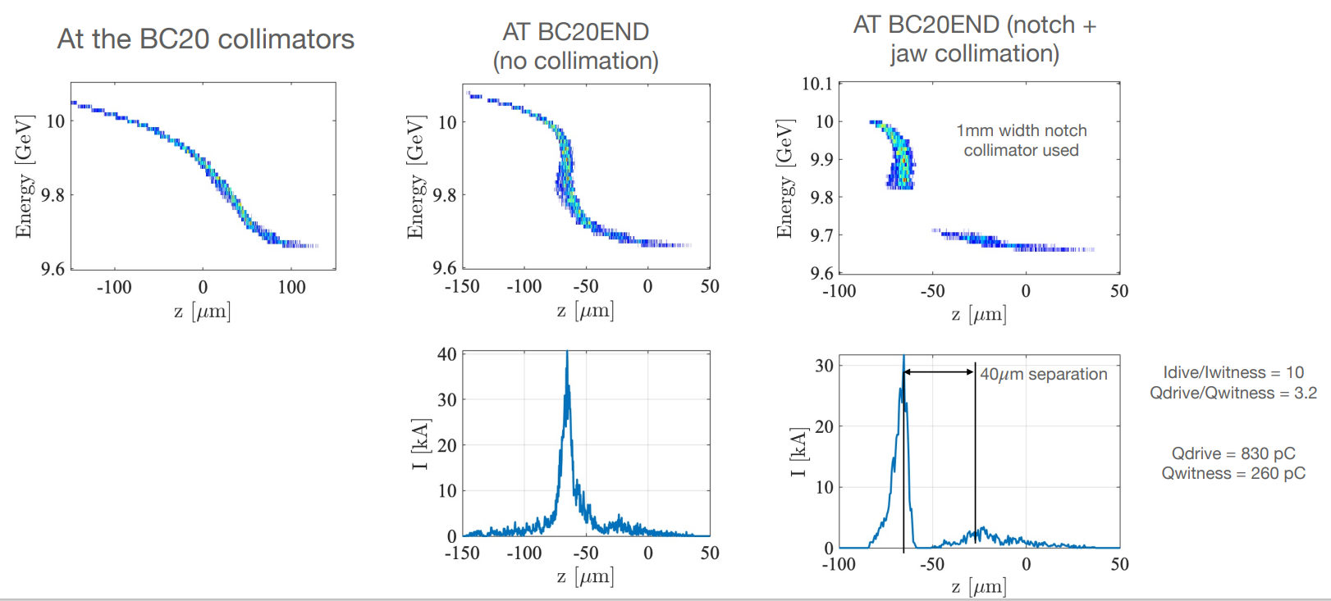
Start-to-end Tracking (2-bunch notch config)
Longitudinal Phase Space at IP (PENT element)
Simulation by C. Emma
Example of closer dz separation
(collimation of standard single bunch, fully compressed pulse) BC20 R56=7mm

Slide 12
Summary and Outstanding Simulation Work
Solution for double-pulsed beam from gun
  Δt=600fs, Q=500/1400pC, I_{pk}=8/16kA
Solution for BC20 notch configuration
  Δt=500fs, Q=330/820pC, I_{pk}=5/15kA
    Requires increasing BC20 R56 match = 10mm
  Δt=130fs, Q=260/830pC, I_{pk}=3/30kA
In all cases, need to re-optimize configuration after injector is commissioned @ 2nC and injector performance is known
Also, need to calculate FFS & BC20 sextupole re-match for witness bunch to optimize witness emittance & Twiss @ IP
Notch configuration possibly benefit from longer pulse from injector?
  Longer laser pulse
  Increase charge, tradeoff for larger transverse emittance?

