Slide 1







What Physics can we get from single bunch FACET II first run?
Chan Joshi
University of California Los Angeles
C Joshi, E Adli, W An, CE Clayton, S Corde, S Gessner, MJ Hogan, et al., Plasma wakefield acceleration experiments at FACET II
Plasma Physics and Controlled Fusion 60 (3), 034001
Work supported by DOE-HEP

Slide 2


FACET II PAC (ZOOM) Meeting OCT 26-29th 2020
E300 , Progress, Status and Plans for first Experiments in 2021
C. Joshi and M.J. Hogan (on behalf of E300 Collaboration)

Slide 3
1.1: What are the science goals: definition of success and target time for each goal
The Grand Science Goal is to reach the beam parameters needed of a single stage
of a future linear collider as far as FACET II infrastructure will allow.
1 Significant energy depletion of the drive bunch
with bulk of the particles fully energy depleted Year 1
2 Efficient (>30%)energy extraction from the wake by
the trailing bunch while close to doubling it’s energy Year 1 and 2
3Understand the conditions for optimum beam loading
to minimize the energy spread Year 2
4 Understand and optimize the beam matching for
emittance preservation at 10 micron or less level Year 2 and 3
5 Quantify the extent of transverse BBU or hosing instability Year 3
6 Perform preliminary experiments for next set of pressing issues Year 3

Slide 4
Experimental readiness
Experimental timeline: Feb. 2021- June 2021
Experimental design: Very similar to E200. Details of the high and low resolution spectrometers, EOS, positioning of the TCAV are different.
Date installation plan: The experiment will be ready to go when the Li oven is substituted in the place of the dummy tube in January 2021.
Ready for experimental safety review: Jan15th 2021
Ready for installation: January 5th 2021
Ready for commissioning: Feb. 15th 2021 once we settle on whether we will employ the Be foil barrier or go with differential pumping. beam requirements: During Feb. we only need the drive bunch to check out wake excitation, energy loss, drive bunch stability etc.
First science- beam requirements : Drive (1.5-2 nC, 20-30 KA) and trailing beam (0.5-0.6 nC , 10-12 KA) separated by 150 um with trailing bunch focused with a beta star of 5-10 cm.

Slide 5
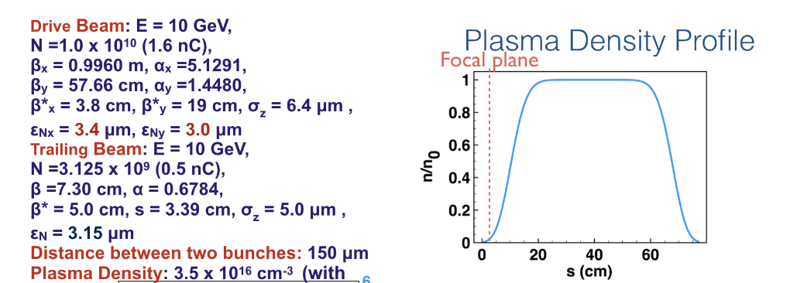
Ideal Beam Parameters Used in our PPCF paper Energy Doubling (10-20+ GeV) with <1% Energy Spread ,Pump Depletion and > 40% Pump to trailing bunch energy transfer efficiency

Slide 6
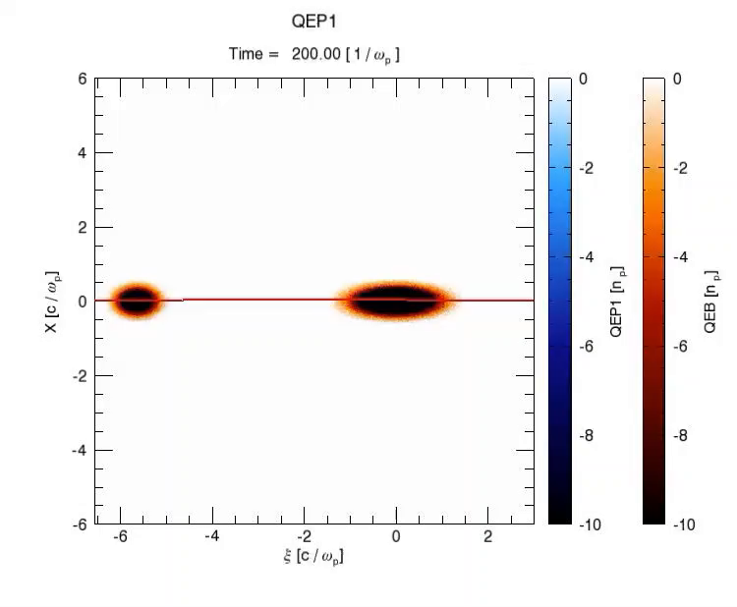
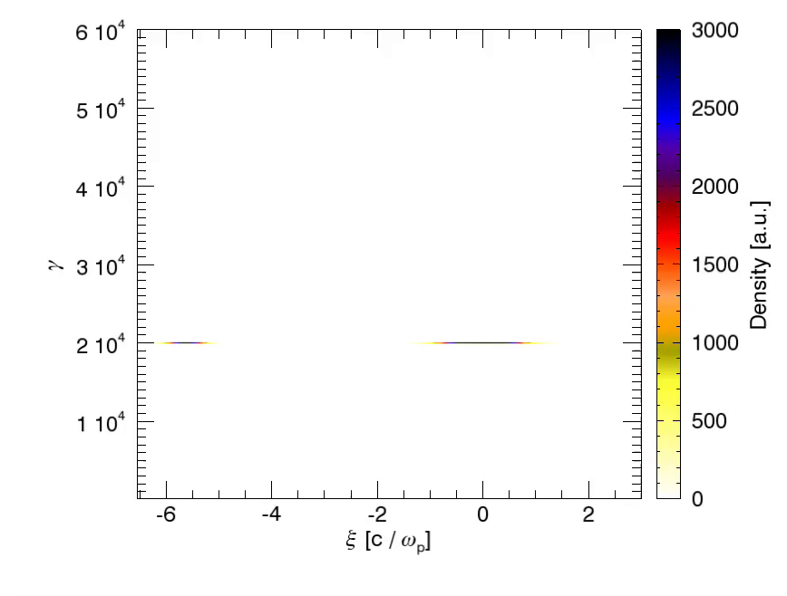
Two-bunch PWFA
Energy Doubling (10-20+ GeV) with <1% Energy Spread
,Pump Depletion and > 40% energy transfer efficiency
Plasma and beam density
with on-axis Ez line out
Beam Energy
Energy Doubling
Drive Bunch
Drive
Bunch
Trailing Bunch
Trailing
Bunch
Simulations by W. An UCLA, .Joshi et al. PPCF 2018

Slide 7
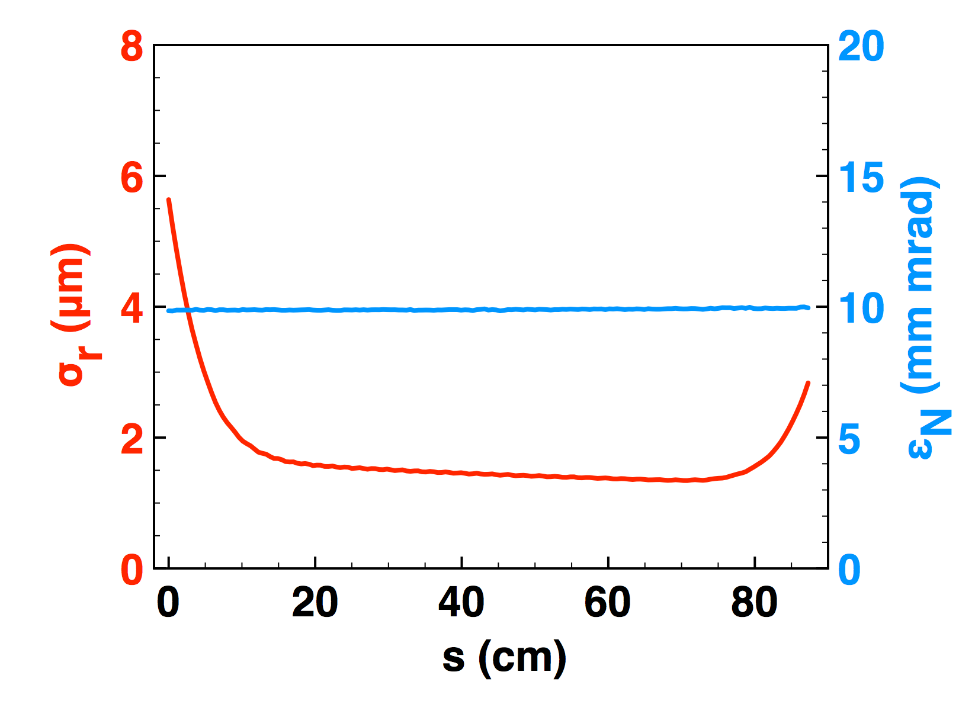
Two-bunch PWFA
Beam Matching in and out of plasma accelerator
And emittance preservation
Plasma
Ramp
Matched Beam in Plasma
Simulation Results: Weiming An

Slide 8
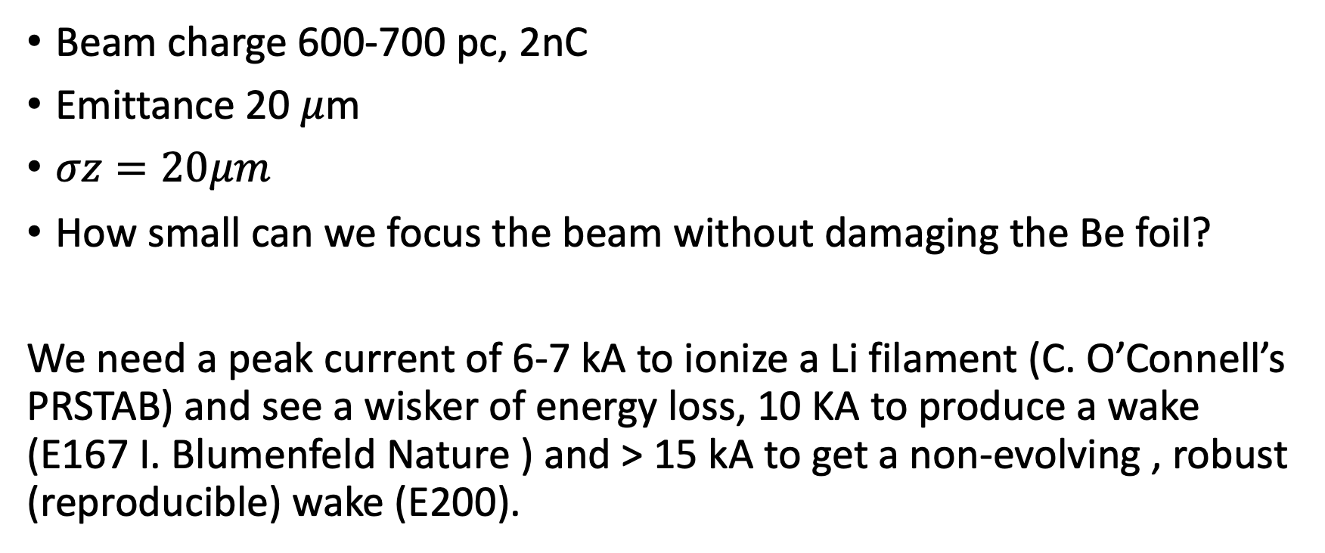
Beam Parameters for Single Bunch Expt
Beam charge 600-700 pc, 2nC
Emittance 20 $μ$m
$σz=20μm$
How small can we focus the beam without damaging the Be foil?
We need a peak current of 6-7 kA to ionize a Li filament (C. O’Connell’s PRSTAB) and see a wisker of energy loss, 10 KA to produce a wake (E167 I. Blumenfeld Nature ) and > 15 kA to get a non-evolving , robust (reproducible) wake (E200).

Slide 9

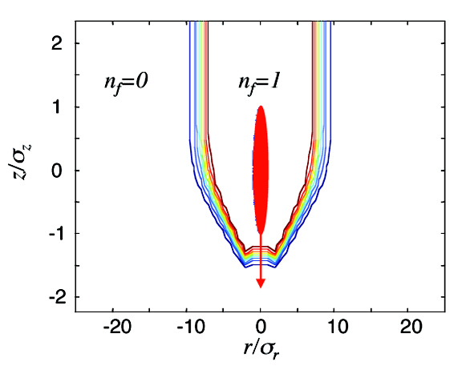
BEAM-IONIZED PLASMA
• Short bunch, E_{r}≈5.2×10⁻¹⁹N/σ_{z} σ_{r} (GV/m) > tunneling field (Kyldish, ADK)
Lithium vapor pressure curve
N=10¹⁰ e⁻, σ_{z}=σ_{r}=20 µm in Li
D.Bruhwiler et.al.PoP
P. Muggli

Slide 10
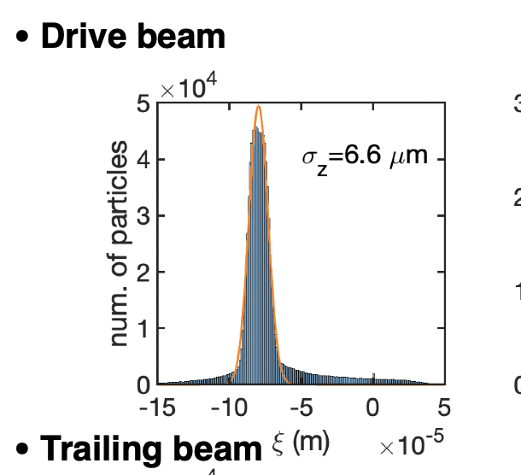
If the Be foil survives the beam tightly focused from the top to the bottom of the upramp
1 Does it ionize Li and form a wake throughout the oven?
2 How much energy does the bean lose while forming the wake?
3 Do the tail particles gain energy from the wake?
4 Any hosing of the beam evident on the spectrometer screen?
5 Beam matching to the plasma.
The best outcomes would be
1 We find plasma density-length product such that more than 80% of the bunch energy is transferred to the wake. Can a pre ionized plasma improve the energy transfer efficiency? How much?
2 Gross hosing of the beam occurs that is seeded by the longitudinal modulation of the drive beam and transverse displacement of the beam slices. (with simulations PRL) The obvious follow up experiment would have to be does laser-heater damp the transverse beam break-up?
3 We may be able to demonstrate matching. Need more simulations.

Slide 11
If the Be foil does not survive the beam tightly focused from the top to the bottom of the upramp
Then we have to seriously think about trying out laser ionization
The wake may very well be in the quasi-linear region (need simulations)
Characterized by low energy loss and energy gain. Relatively poor energy transfer efficiency to the wake.
The physics of quasi-linear electron beam produced per-say is interesting because positron acceleration may very well have to be done in such wakes.

Slide 12
My last Talk today

