Slide 1
Physics Limit of Ultimate Beams Workshop Summary
Mei Bai, SLAC
Frank Zimmermann, CERN

Slide 2
Physics Limits of Ultimate Beams Workshop
The Community Planning Meeting of Snowmass2021 once again shows the vibrancy of high energy physics in exploring the physics beyond standard model. It was, and still is, very impressive to see the variety of planned and proposed high energy colliders, which brings up a wide range of challenges in accelerator science and technology. Hence, the AF group in beam physics and education, in energy frontier and in advanced concept wished to join hands and hosted a series of Discussion Forums and invite the community to explore
Fundamental ultimate beams for various physics goals. In particular, for colliders, we wanted to understand the required luminosity scaling with energy. Other scaling laws for other quantities were welcome to be discussed.
Potential and feasibility of advanced concepts towards the ultimate physics limits, such as PeV beams yet low luminosity etc.
Giving the boundary conditions (see the next slide), identify the limits of beam performance, and brainstorm a roadmap/strategy forward

Slide 3
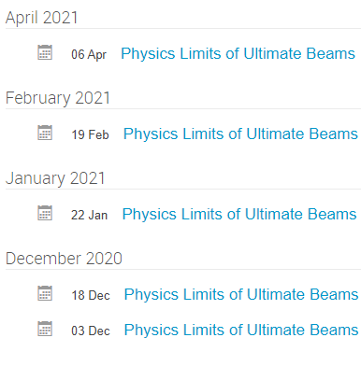
PLUB Workshop Series
A total of five zoom workshop sessions (joint with AF4 and AF6) were held between Dec. 3, 2020 and April 6, 2021. (https://indico.fnal.gov/category/1120/ )
Michael Peskin: Discovery physics of e+e- and gamma-gamma colliders
Allen Caldwell: Physics potentials with low luminosity super high energy colliders
Liantao Wang: desired ultimate beams for probing BSM physics at colliders: scale of required lumi vs. energy
Thomas Roser: Wishes from Acc Implementation task force: required inputs for your task
Vladimir Shiltsev: Overview of the achieved collider performance and scaling rules
Swapan Chattopadhyay: Ultimate beams and physics/accelerator technologies beyond colliders
Pisin Chen: Quantum Luminosity
Valery Telnov: Perspective of gamma-gamma colliders, physics potentials and limits
Tao Han: Physics opportunity with muon collider
Daniel Schulte/Mark Palmer: Muon Collider status and outlook

Slide 4
Lepton collider
Liantao Wang

Slide 5
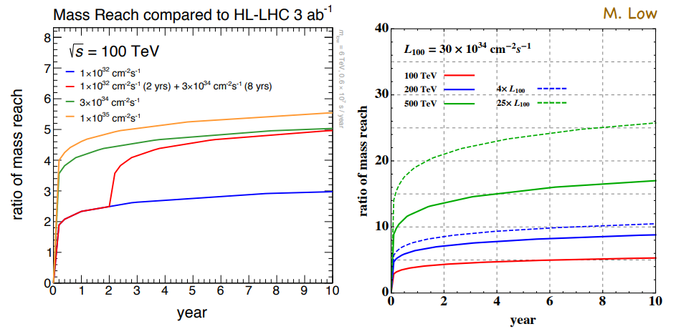
Hadron Collider
Liantao Wang
To understand the physics potential good to have a benchmark > 100 TeV, ideally, >> 100TeV
High luminosity at ${10}^{35}−{10}^{36}cm^{−2}s^{−1}$ can realize full physics potential

Slide 6
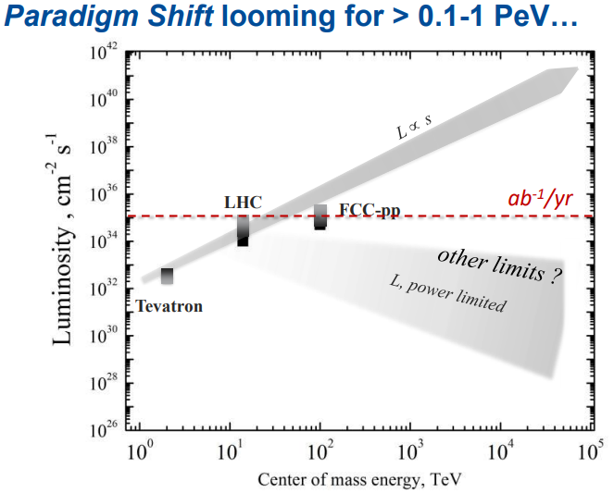
Achieved Collider Performance and Scaling Rules
Vladimir Shiltsev
Limits
Energy
Linear vs circular: $E_{e}<500 GeV{\left(\frac{R}{10km}\right)}^{\frac{1}{3}}$, $E_{μ}<600TeV{\left(\frac{R}{10km}\right)}^{\frac{1}{3}},$ $E_{p}<10PeV{\left(\frac{R}{10km}\right)}^{\frac{1}{3}}$
Circular accelerator: scale ~ available bending magnet. Current state of the art: 16 Tesla
Unstable particles: muons and $τ$-leptons
Gradient higher than 3 MeV/m and 0.3 MeV/m, respectively
Luminosity

Slide 7
Achieved Collider Performance and Scaling Rules
Vladimir Shiltsev
Limits
Energy
Linear vs circular: $E_{e}<500 GeV{\left(\frac{R}{10km}\right)}^{\frac{1}{3}}$, $E_{μ}<600TeV{\left(\frac{R}{10km}\right)}^{\frac{1}{3}},$ $E_{p}<10PeV{\left(\frac{R}{10km}\right)}^{\frac{1}{3}}$
Circular accelerator: scale ~ available bending magnet. Current state of the art: 16 Tesla
Particle lifetime: muons and $τ$-leptons
Gradient higher than 3 MeV/m and 0.3 MeV/m, respectively
Luminosity

Slide 8
Luminosity - Energy
Ideal Luminosity for head-on collision
$L=\frac{f_{rep}n_{b}N_{b}^{2}}{4πσ_{x}^{∗}σ_{y}^{∗}}=\frac{1}{4π}\frac{P_{wall}η}{γm_{p}c^{2}}\frac{N_{b}}{σ_{x}^{∗}σ_{y}^{∗}}$
Where, $P_{wall}$ is the wall-plug power and $η$ is the ratio of wall-plug power to beam. $σ_{x,y}^{∗}={\left(β_{x,y}^{∗}ε_{x,y}\right)}^{\frac{1}{2}}$
In the case of relativistic $σ_{x,y}^{∗}={\left(β_{x,y}^{∗}ε_{nx,ny}/γ\right)}^{\frac{1}{2}}$,
$$L=\frac{γ}{4π}\frac{P_{wall}η}{m_{p}c^{2}}\frac{N_{b}}{β^{∗}ε_{n}}$$
here, round beam is assumed for simplicity reason
New physics production cross-section
$$σ∼πα_{W}^{2}\frac{1}{E_{CM}^{2}}$$
for constant signal rate: $L≥\frac{5years}{time}{\left(\frac{\sqrt{s_{μ}}}{10TeV}\right)}^{2}2∗10^{35}cm^{−2}s^{−1}$
Can we keep L $∼γ^{2}?$
Further Increase beam intensity and reduce $β^{∗}$
extreme short and bright beam at IP

Slide 9
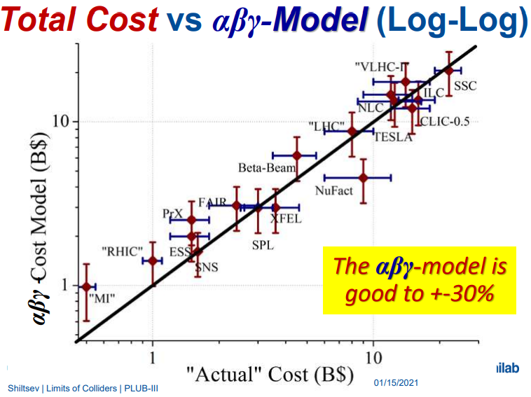
Total Cost, the $αβγ$ model
$$Cost=αL^{1/2}+βE^{1/2}+γP^{1/2}$$
Where, $L in units of 10km, E in units of TeV, and P in units of 100MWatt.$

Slide 10
Muon Collider
Tao Han presented the rich physics with muon collider for Higgs factory as well as multi-TeV collider for discovery
The recent review by the Laboratory Directors Group (LDG) for European Strategy Update has recommended targeted study on muon beams
In time for the next European Strategy for Particle Physics Update, the study aims to establish whether the investment into a full CDR and a demonstrator is scientifically justified
CERN is currently hosting the International Muon Collider Collaboration at a budget of 2MCHF per year for 5 years. The Scope is to explore two energy ranges,
3 TeV, if possible with technology ready for construction in 10-20 years
10+ TeV, with more advanced technology.
and define R&D path
Tao Han, Daniel Schulte, Mark Palmer

Slide 11
Unique challenges associated with Muon Collider
Daniel Schulte, Mark Palmer
Beam production: high power target, phase space capture
Beam cooling: Can we reduce the 6D emittance by a factor of $\sim {10}^{6}$ while preserving >10% of the initially produced muons?
Neutrino radiation, particularly challenging for 10+TeV

Slide 12
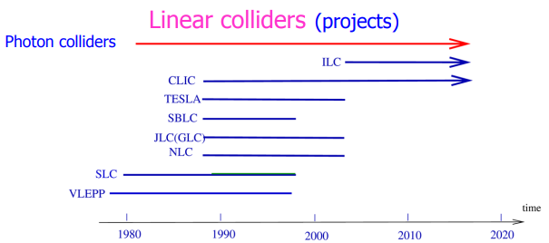
Photon collider
Being proposed back in the 1980s
V. Telnov
Peskin: Photons are fundamental particles, like electrons and muons, with only electromagnetic interactions. Thus, ideally, they can probe up to the nominal CM energy and can provide a clean environment for experimental observations.

Slide 13
Proposed Photon Colliders
M. Peskin, V. Telnov
X-FEL Compton scattering based gamma-gamma collider: Tim Barklow, Zhirong Huang, et al. and Emanuela Barzi et al, Snowmass21 LoI
Beamstrahlung of extreme short e-bunch based gamma-gamma collider: Sebastian Meuren, Glen White, Vitaly Yakimenko, and Michael Peskin, Snowmass21 LoI
C-b-$γγ$ Factory: $W_{γγ}=3−12 GeV$
Requires electron beam energy $E_{0}$ about 17-23 GeV for laser of $λ=0.5 and 1 μm$
A PoP proposal submitted to European X-FEL

Slide 14
Message from Swapan
For non-colliding beams, most are far from their quantum limits
Various limits for colliding beams
‘Beamstrahlung’, coherent pair creation and strong interaction QCD backgrounds, and spot size arising from the ‘Oide’ effect (statistical nature of emitted photons of synchrotron radiation arising from severe bending during final focus). These ‘radiative’ effects limit electron-positron linear colliders at a few TeV c.m. energy
Synchrotron radiation limitations for circular colliders
Hadron circular collider performance still largely limited by classical nonlinear dynamical phenomena of phase-space diffusion and particle loss due to very high order nonlinear resonances introduced by Coulomb interaction forces of intense beams in collision
Not yet at quantum limit, but reaches technical limit!

Slide 15
Message from Swapan
Higgs and neutrinos are important, yet small part of Nature’s canvas
Exploration of “early” and “dark” universe, symmetries and quantum gravity is also important
Re-orienting beam physics and accelerator technologies for emerging fields such as high precision quantum sensors

Slide 16
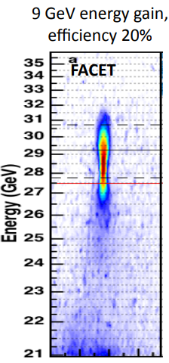
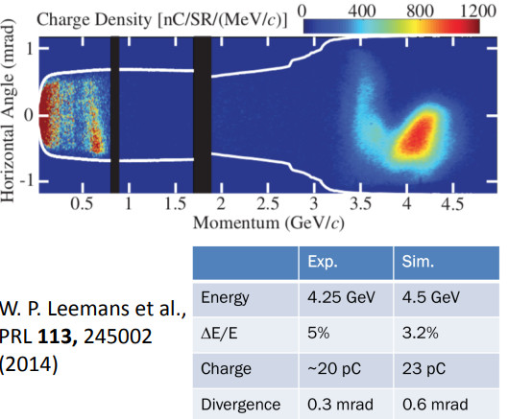
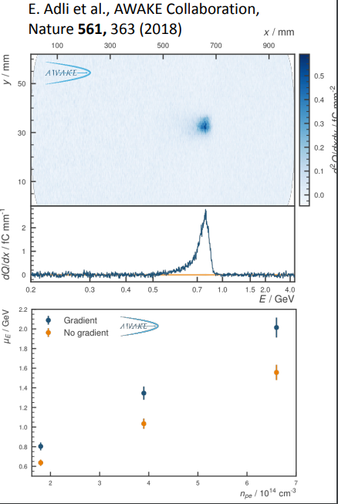
Plasma based Advance Acceleration
A. Caldwell
Laser driven
FACET
AWAKE
Current focus in the advanced acceleration community
Improve the beam quality at the exit of the advanced accelerator
Address high repetition rate
Encouraging development in high energy (~10J) and high repetition rate of 10kHz based on fibre laser technology
Staging towards TeV collider
Encouraging results from BELLA of external electron bunch injection and two-stage acceleration

Slide 17
Message from Alan Caldwell
Take what the technology can provide and explore a previously unexplored regime

Slide 18
from Alan Caldwell

Slide 19
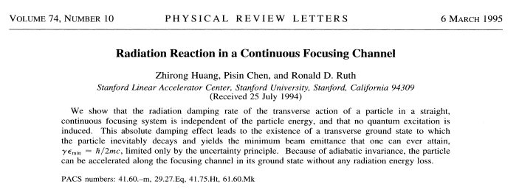
Quantum Luminosity: P. Chen
Absolute damping in electrostatic focusing channel can provide a path towards the minimum emittance limited by uncertainty principle, ie.
$γε_{min}=\frac{λ_{c}}{4π}$,
where $λ_{c}=\frac{h}{mc}$ is the Compton wavelength

Slide 20
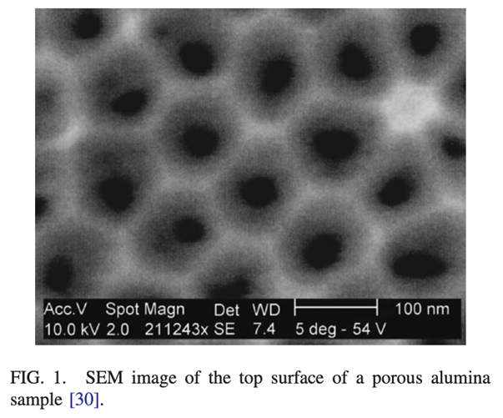
Quantum Luminosity: Chen
Possible path to reach the quantum luminosity
Crystal and Nanotubes
Highest possible acceleration gradient,
~TeV/cm.
Microscopic, compact
Quantum luminosity
$L_{c}=f_{rep}n_{ch}\frac{N_{c}^{2}\sqrt{KE}}{2πℏc}$
where $n_{ch} is number of channels.$
Studies so far:
Chen, Noble, “A Solid State Accelerator” (1987)
Chen, Nobel, “Channeled Particle Acceleration by Plasma Waves in Metals” (1987),
Tajima, Cavenago, “Crystal x-ray accelerator” (1987)
Zhang, Tajima et al., “PIC simulations…” (2016)
Chen, Huang, Ruth, “Channeling acceleration: A path to ultrahigh energy colliders”, (1995).
Chen, Noble, “Crystal channel collider: Ultra-high energy and luminosity in the next century”, (1998).

Slide 21
Luminosity - Energy
Beam power $P_{beam}=5\left(\frac{L}{{10}^{30}}\right){\left[\frac{ε_{n}βσ_{z}}{δ_{q}^{3}}\right]}^{\frac{1}{2}}$, where $δ_{q} is tolerable energy spread produced during interaction$
For 50 GeV SLC, $ε_{n}=3×{10}^{−3}cm$, $β^{∗}=1cm$, $δ_{q}=0.03$, and luminosity is $6×{10}^{30}cm^{−2}s^{−1}$
$To reach the \text{luminosity} \text{that} \text{scales} \text{with} \text{the} \text{square} \text{of} \text{energy}$for a 5 TeV beam, it corresponds to a beam power of $P_{beam}=10 GigaWatts!$
Requires disruptive development!
W.K.H. Panofsky, Technical Limits on Colliders for High Energy Physics

Slide 22
Summary
The exploration of new physics calls for future colliders in beyond 1 TeV lepton colliders, and 100 TeV hadron colliders. Both cases require luminosity in the range of ${10}^{30}cm^{−2}s^{−1} \sim$ ${10}^{36}cm^{−2}s^{−1}$
The conventional RF acceleration-based beams so far are not yet at the quantum limit, but are facing a lot of challenges that require substantial R&Ds
The ongoing plasma wake field acceleration or other disruptive acceleration technology could have the potential to reach the ultimate beams at the quantum limit
Continue the technology exploration
Need test facilities: see session on Tuesday morning
Need people: see session this afternoon

Slide 23
Message from us
Good news:
Enormous R&D topics for decades to come!
Challenges:
Overall funding in fundamental R&D are limited
DOE Office of Science funding:
FY21: $5.8B, HEP: $1.046B
FY22 (request): $7.0B, HEP: $1.06B
Need a vital path forward!
Prioritization
Outreach
Synergy with transformative fields

