Slide 1
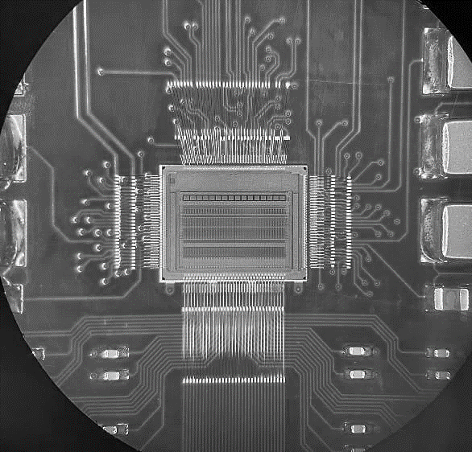
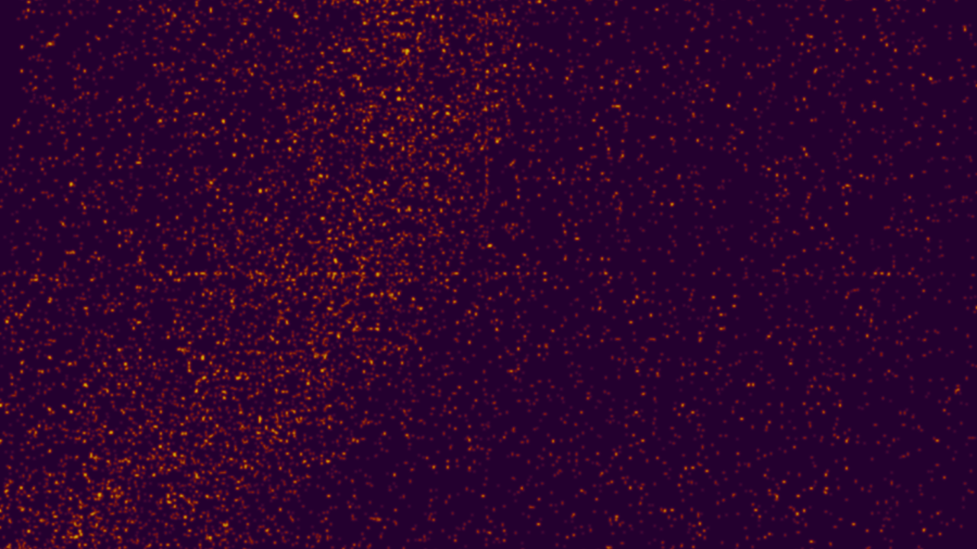
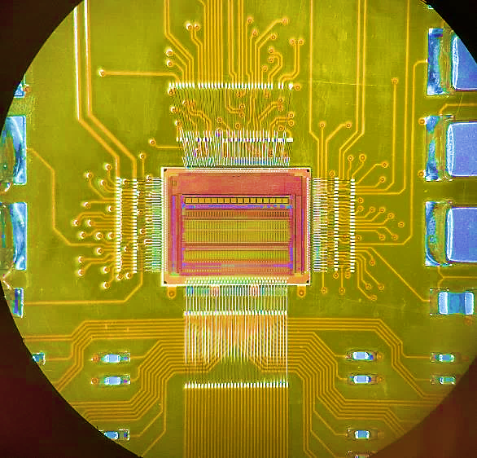


Analog Front-end for HEP
HEPIC Summer Week – Design Challenge
27 June 2022

Slide 2
Approach and Goal
The goal of this challenge is to gain some insights on the design and optimization of front-end preamplifiers for radiation detectors
Three teams: Team SLD, Team Mark-II, Team BaBar.
  Teams will work together over the next 3 days on the design of a preamplifier and present their results on Friday morning.
With a basic set of specification and constrains.
We will use a generic 180nm technology PDK
The design is open ended
  As you progress with your work you may discover new aspects that you want to address
It is a challenge but not a competition the goal on Friday is to learn from each other

Slide 3
Design Tasks
Let’s assume we want to design a front-end charge sensitive amplifier for a pixel readout.
Let’s assume that to optimize the noise in our chain we will used a 2nd order real pole shaper
The pixel input capacitance is 200fF
The sensor as a leakage current of -50pA per pixel
We want to accommodate a maximum signal of 30000 electrons
We can use maximum 4uA of current in the input transistor of the preamplifier
We can use a maximum peaking time for the filter of 40ns
We can tolerate a maximum ENC of 100e-

Slide 4
Question 1
Let’s chose a preamplifier architecture among the following three options:
VDD
VDD
VDD
VDD
In
Vld
In
In
Out
Vcc
Vcc
Vcc₁
Out
Vcs
Vld
Vgb
Vcc₂
Out
Vld

Slide 5
Question 1
Let’s chose a preamplifier architecture among the following three options:
Size the transistors to meet requirements (assume L for the input transistor slightly larger than minimum - 0.2um)
  You can use a source follower stage at the output of the amplifier if needed
  Maximize the open loop gain (how the 3 architecture compare?). Let’s see if we can get as high as 80dB
Close the amplifier in a feedback loop to form a Charge Sensitive Amplifier
  For simplicity you can use a passive feedback resistor of 250Mohm
Provide a full characterization of your CSA and your CSA + Shaper (transient, AC, noise, supply rejection)
  Set the shaper gain to 1
  Use ideal amplifiers for the shaper or a transfer function in your simulations

Slide 6
Question 2
Let’s try to understand how changes in the detector capacitance and the shaper time constants affect your design
Could we achieve similar results using a shaperless amplifier?
We will need to produce some relevant plots

Slide 7
Question 3 (optional)
Looking back at the ENC formula:
$ENC^{2}={\left(C_{in}+C_{ox}WL+C_{f}\right)}^{2}\left[\frac{1}{τ_{p}}γ\frac{4kT}{g_{m}}a_{w}+2π\frac{K_{ƒ}}{C_{ox}WL}a_{f}\right]$ $+\left(\frac{4kT}{Rf}+2qIleak\right)τ_{p}a_{p}$
Within the constraints of our problem and ignoring the limitation on the shaping time. This function has 2 variables:
The time constant
W which affects gm and gamma since they depends on the region the input transistor is biased
Assuming Rf infinite and noiseless, can you think of an analytical or numerical way to plot the ENC for the architecture and determine the optimal size of the input transistor and the filter time constant that minimize the ENC as a potential starting point for future designs?
There are several ways to do this, but it helps if you are familiar with EKV models.
Useful read:
  G. De Geronimo and P. O'Connor, "MOSFET optimization in deep submicron technology for charge amplifiers," IEEE Symposium Conference Record Nuclear Science 2004., 2004, pp. 25-33 Vol. 1, doi: 10.1109/NSSMIC.2004.1462062.

Slide 8
Let’s start
Remember this is meant to be a learning process!
  All questions are acceptable
  As we discover things:
    We can adjust our design strategies
    We can depart from the suggested solutions
    We can decide to ask ourself different questions
  Let’s have fun and see what we have on Friday

Slide 9
Team’s zoom areas
Team SLD - https://stanford.zoom.us/j/97237716682?pwd=WDNWS3RwaHlCQ2tMVVdFU3UwbzB3QT09
Team BaBar - https://stanford.zoom.us/j/96819034017?pwd=Nzcvc0prSFhzSFkwTkFTVFZvcGVIZz09
Team Mark-II - https://stanford.zoom.us/j/97732356943?pwd=SjZKcDZCSGJBSjZjeitUWW5YVGRXdz09

