Slide 1
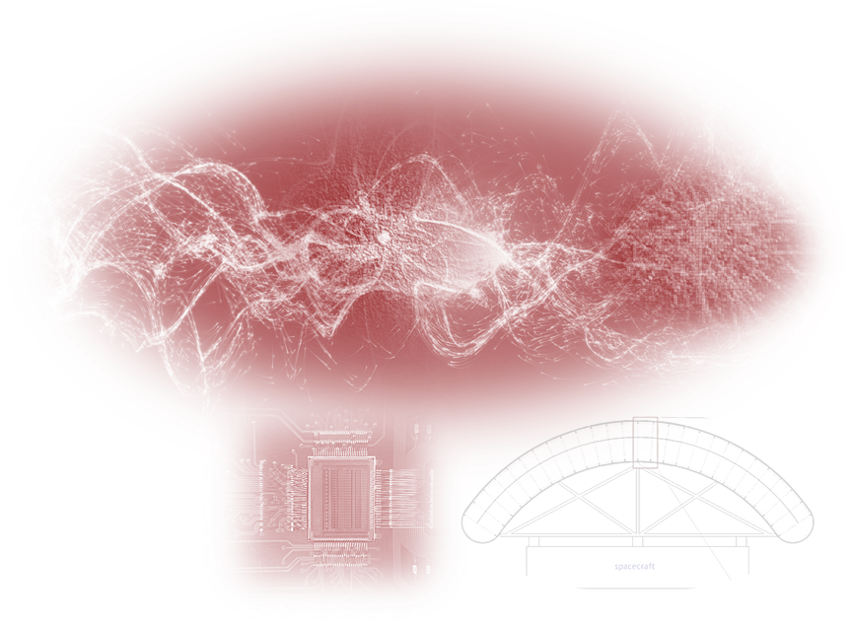
FPD-TID Detector RD Meeting
A Switched Power Pixel ASIC for a Dual Scale Charge Readout Concept
Aldo Pena Perez, Tom Shutt, Steffen Luitz, Bahrudin Trbalic, Dionisio Doering and Angelo Dragone
Date: 01/21/2021

Slide 2
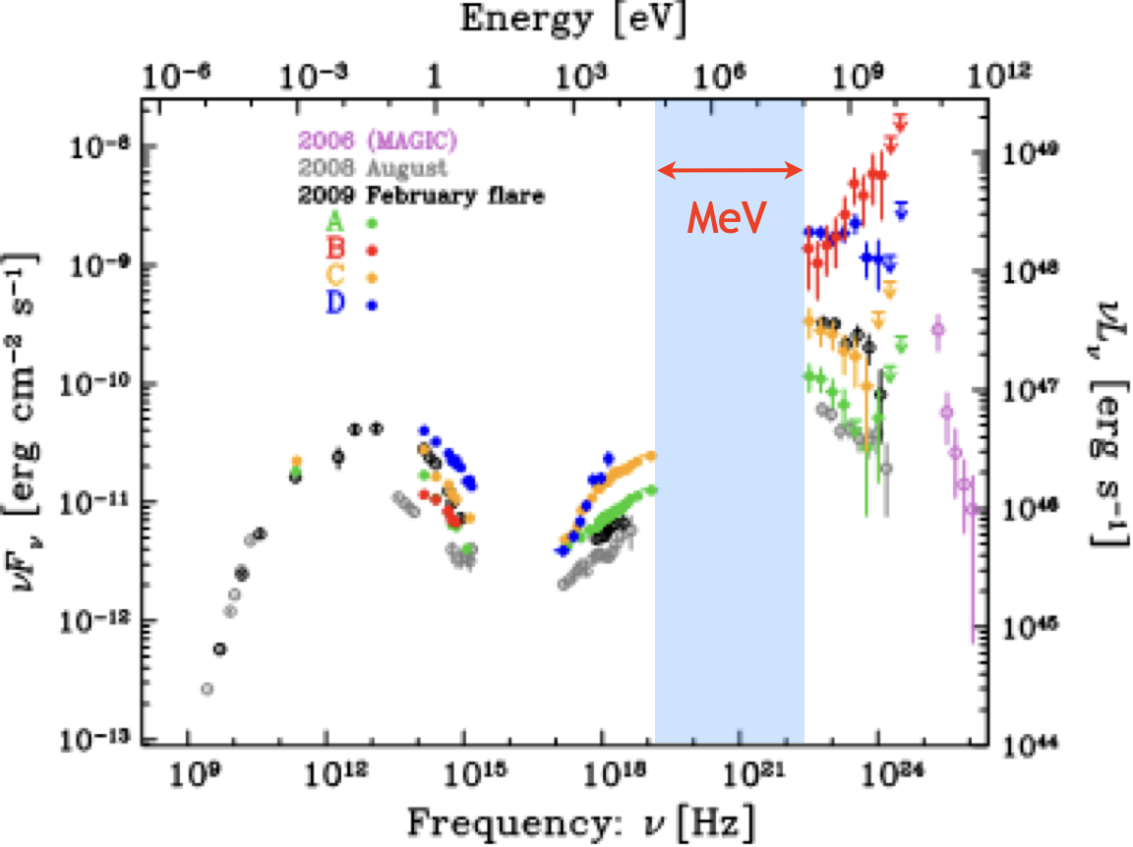
Astrophysical MeV Gamma Rays
MeV gamma ray sky largely unexplored
Rich set of sources: black holes, super-massive black holes, neutron stars, supernovae
Powerful multi-messenger probe
blazar 3C279

Slide 3
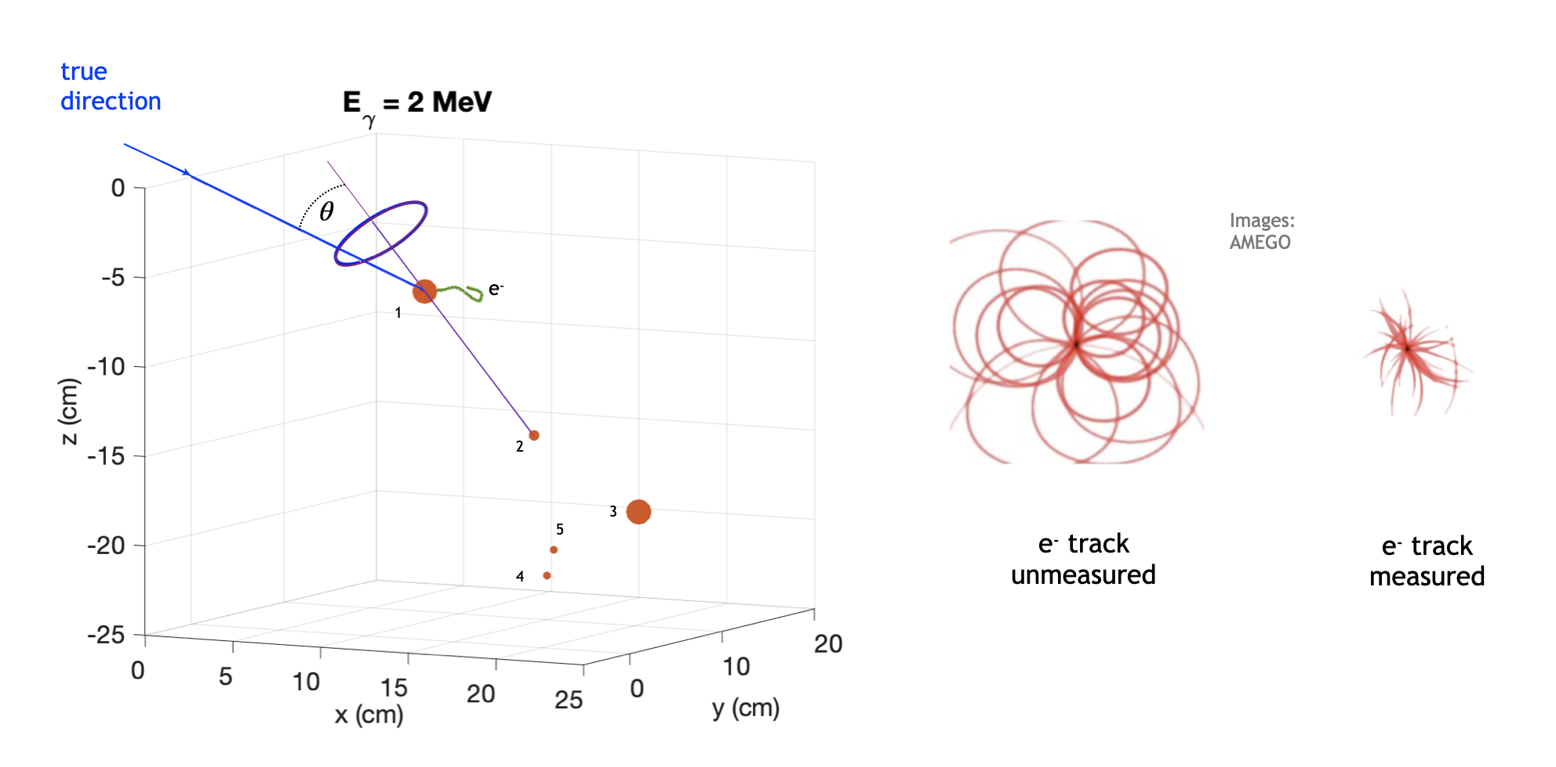
Compton Event Reconstruction

Slide 4
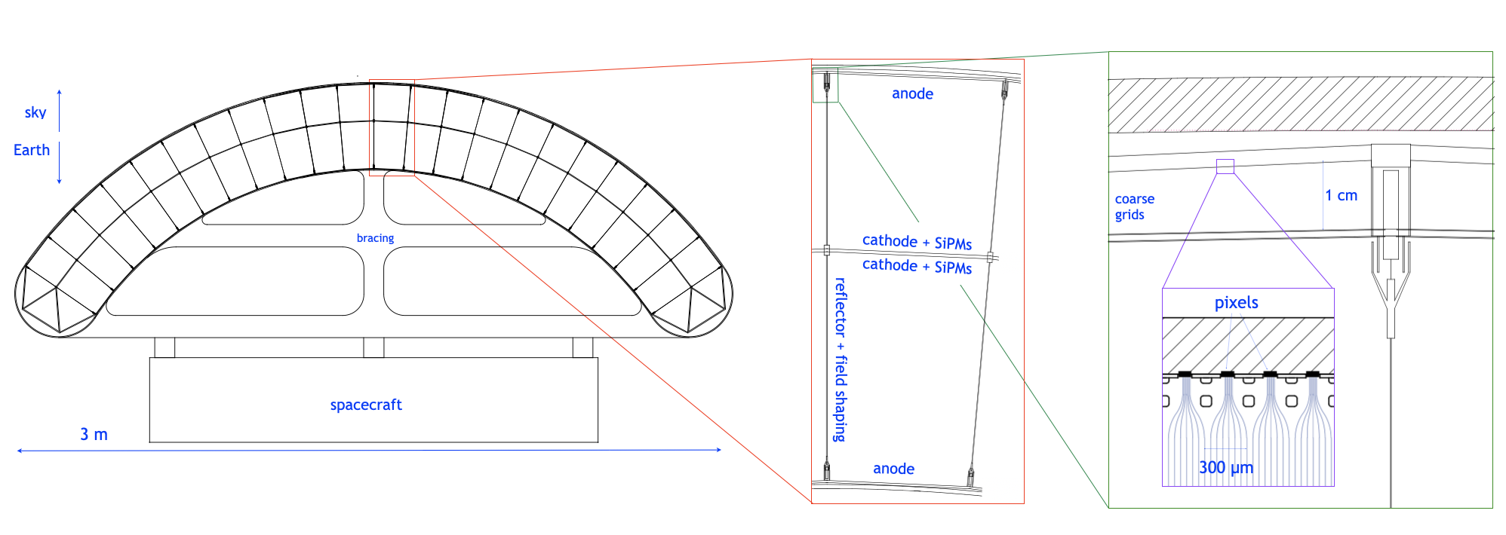
GammaTPC: A New LAr MeV Gamma Ray Instrument
Segmented TPCs in ~40 cm thick carbon fiber shell, LAr at ~120 K /12 bar
10 m², ~4 ton configuration shown.
Launch with Falcon 9 cheap: target Midex mission

Slide 5
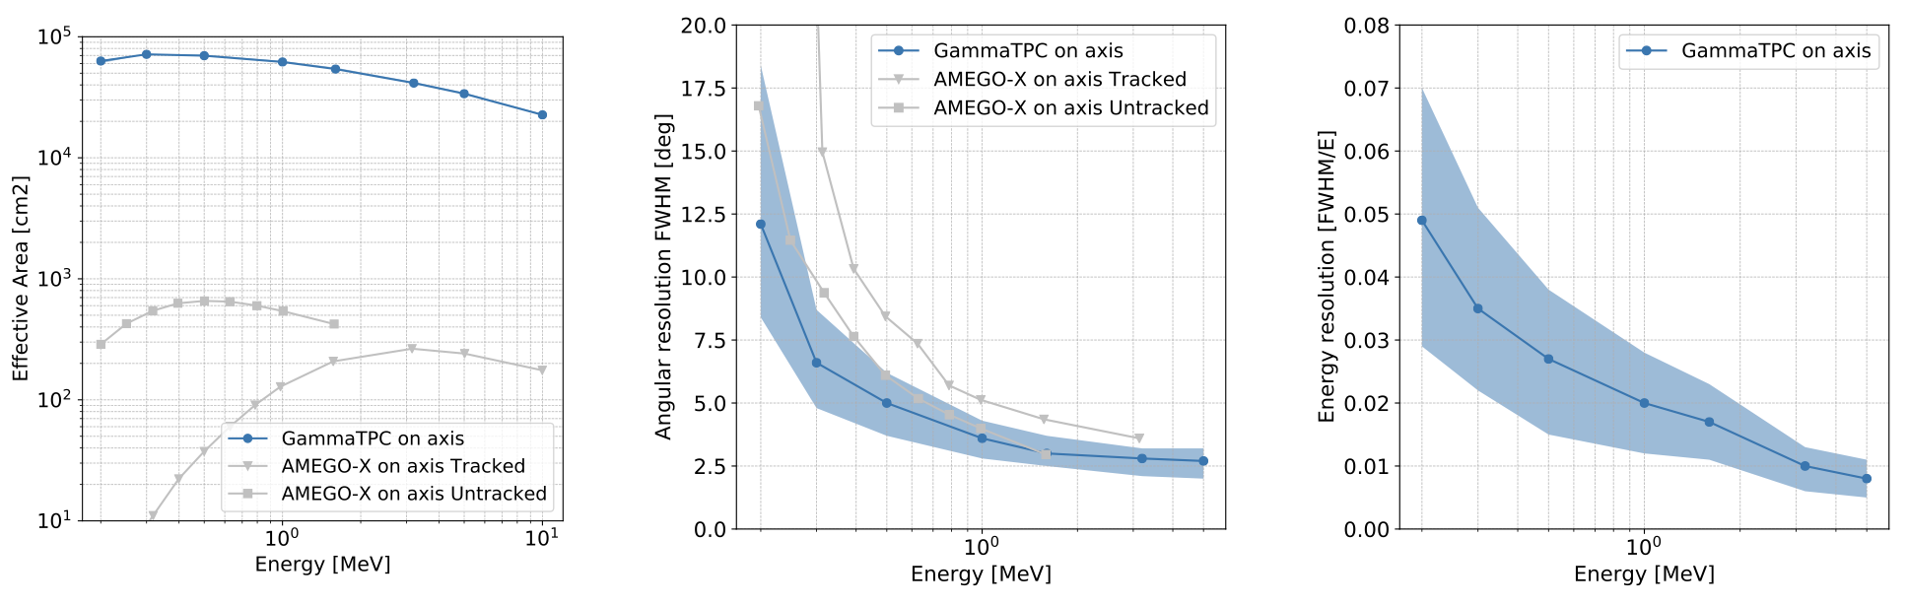
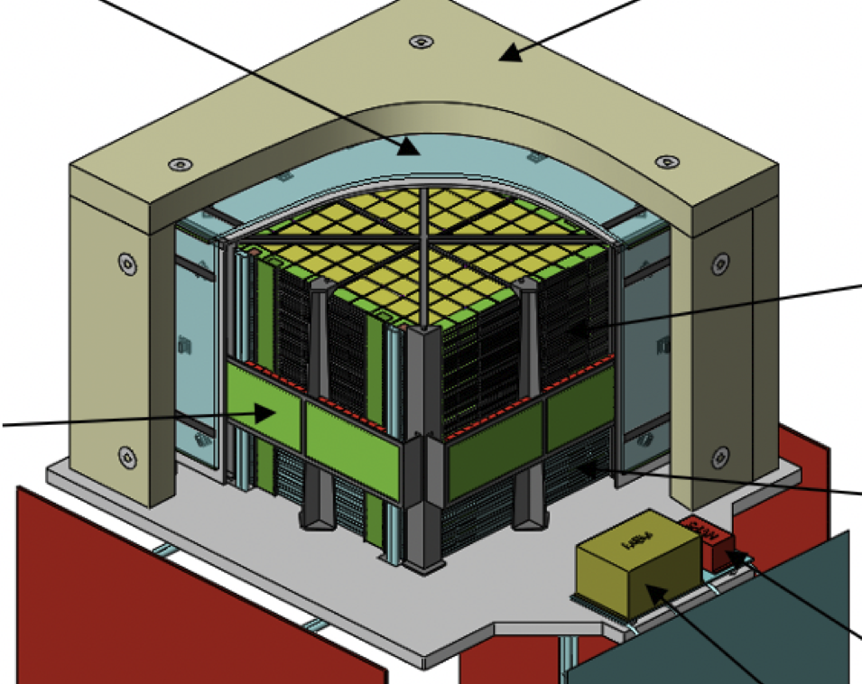
Tremendous Potential
Compare to AMEGO-X (Midex proposal)
  Si strips + CsI
Large effective area, a raw measure of collecting power
Good pointing, energy resolution
AMEGO - proposed Probe-class mission

Slide 6
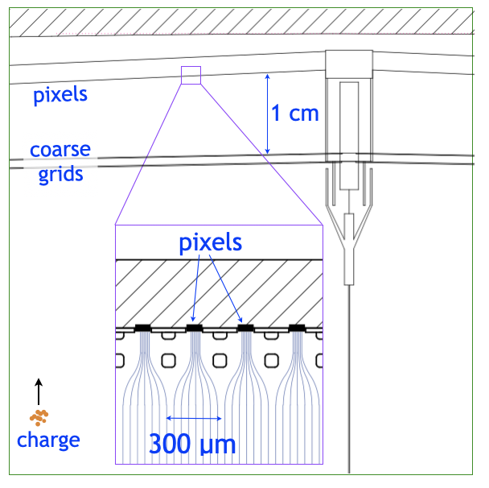
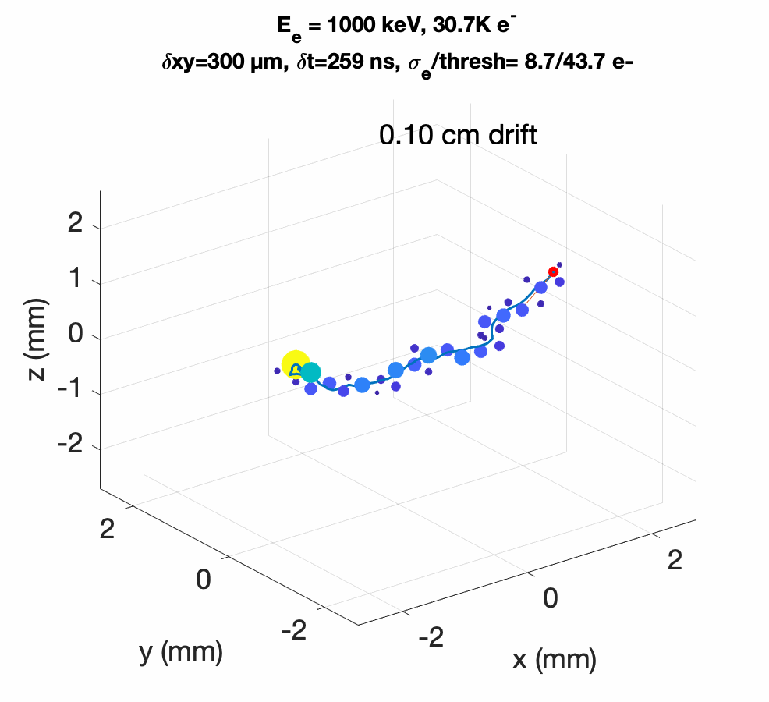
DSCR: Dual Scale Charge Readout
New architecture solves two problems: power, and charge loss due to diffusion
  cm-pitch coarse grid, followed by sub-mm pixels
  Coarse grid provides integral energy and trigger for pixels
Switched Power Pixel ASIC - SPPA

Slide 7
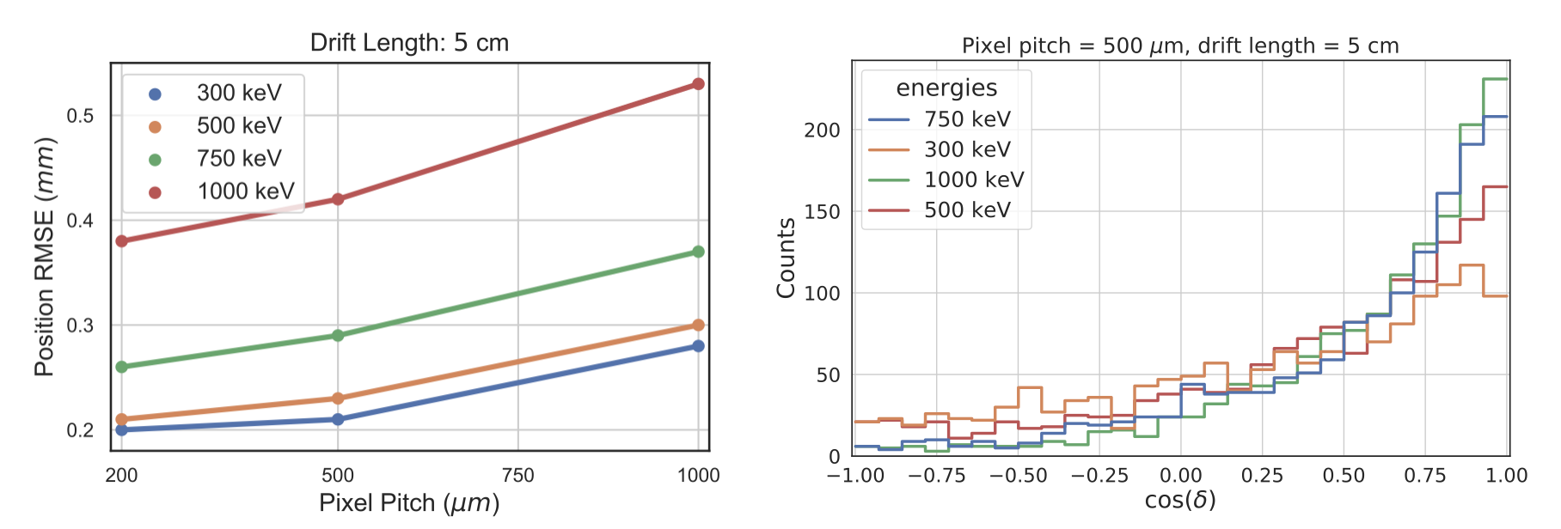

Electron Tracks are Well Measured
Track head location error
Initial track direction
ML to find head of track, and initial direction
Position resolution better than with 500 µm pitch Si strip
Initial direction likely exceeds all existing technologies

Slide 8
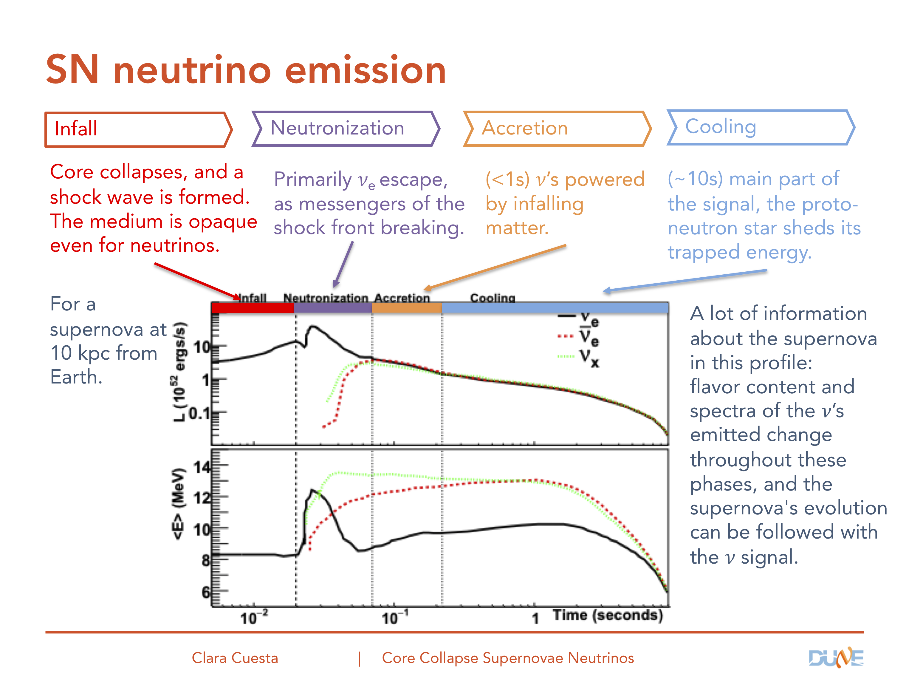
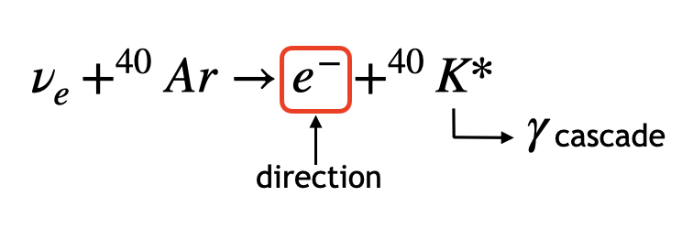
DUNE SN and Other Applications
Calibration of MeV galactic supernova neutrinos in DUNE
ßß decay track imaging in LXe
Medical imaging
Nuclear monitoring
Precision MeV physics?

Slide 9
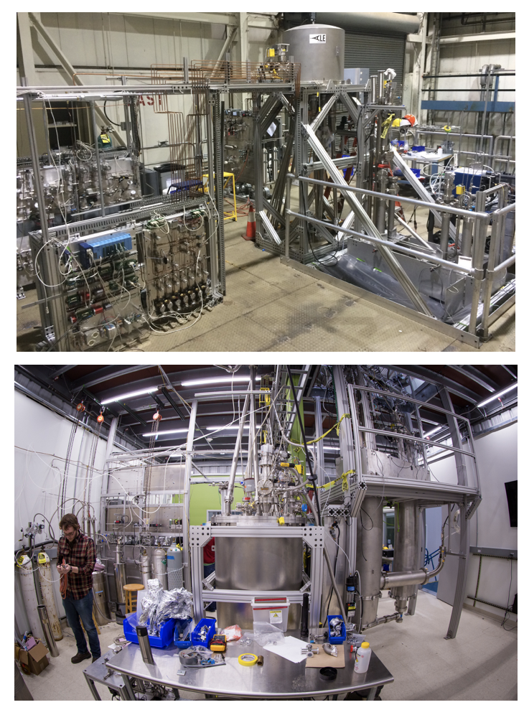
Overall Program
Charge readout is first development
LNTF: charge integral, track reconstruction. Use CRYO ASIC
Recent NASA (APRA) proposal
  Sims: E. Charles, N. Di Lalla, N. Omodei, A. Mishra, M. Buuck
LDRD (Yun-Tse Tsai + TS): light collection for DUNE SN neutrino calibration
Notes:
n

Slide 10
Initial SPPA Requirements
Pixel noise:
  Requirement: < 25 e- → Goal: 5 e-
Settling time:
  Requirement: < 10 μs → Goal: 2 μs
Power:
  Requirement: < 10 W/m² → Goal: 1 W/m²
Power/pixel off-state:
  Requirement: < 200 nW/pixel → Goal: 50 nW/pixel
Notes:
n

Slide 11
SPPA Design Strategy
Key development
  Low-noise cryogenic pixel architecture with fast power switching scheme
Approach
  Design will leverage previous ASIC developments by SLAC TID:
    Low-noise reticle-scale pixelated ASICs (i.e., ePix family, SparkPix-ED)
    SoC readout ASIC for noble liquid TPCs for neutrino science (i.e., CRYO ASIC)
    Developed custom models for cryogenic temperatures (i.e, LAr)
    Previous circuit solution for power switching (i.e., kPix) and low-leakage current

Slide 12
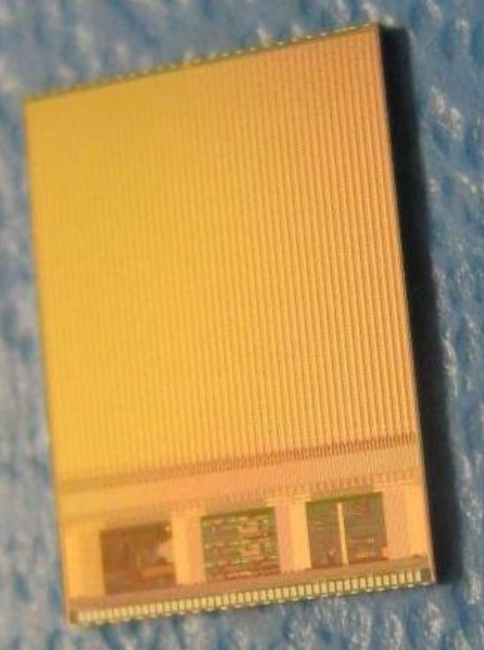

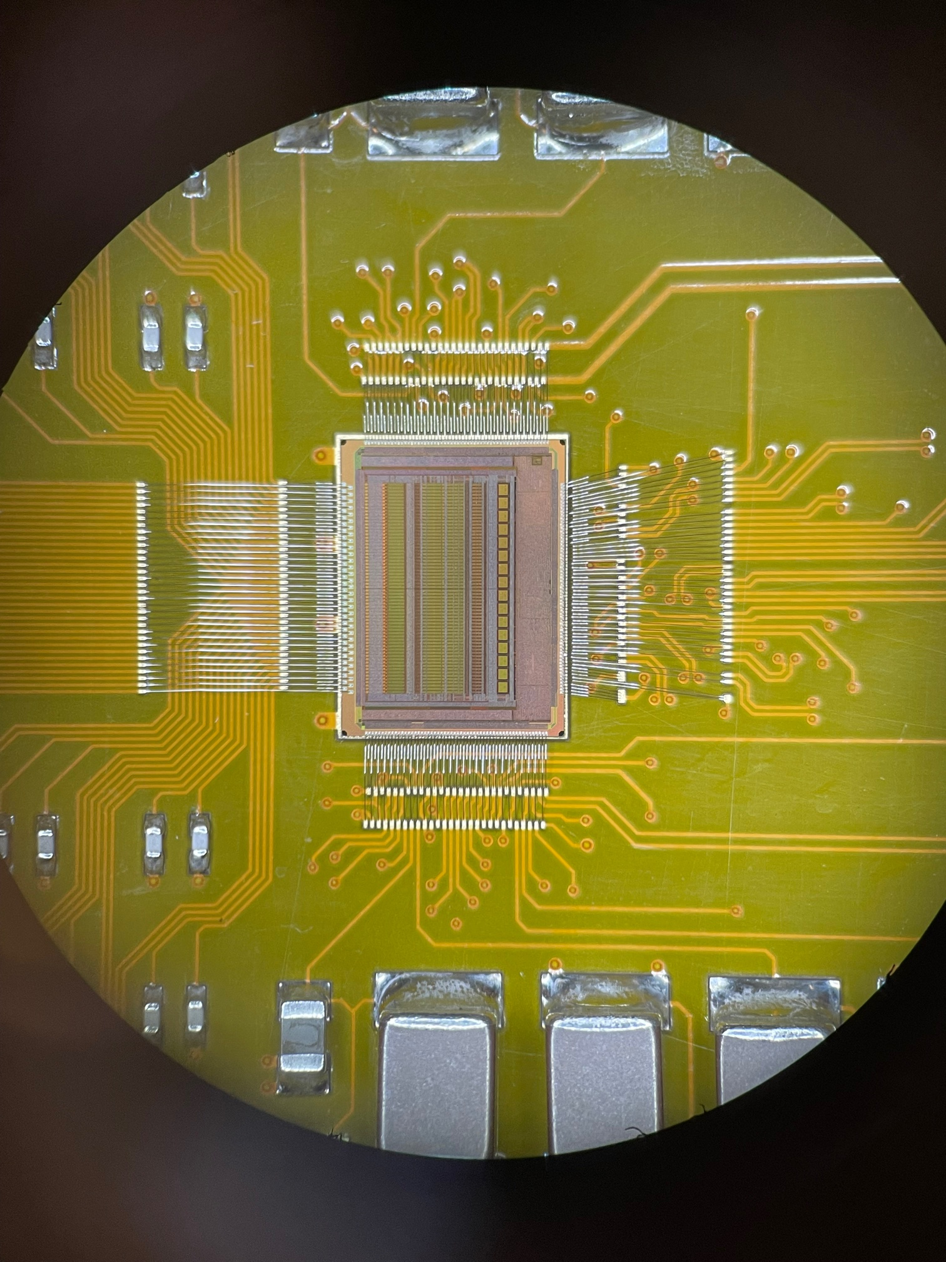
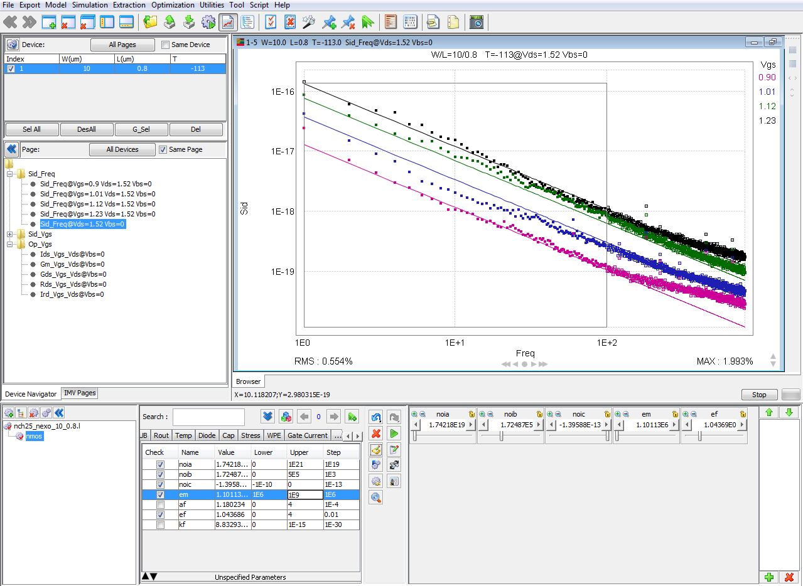
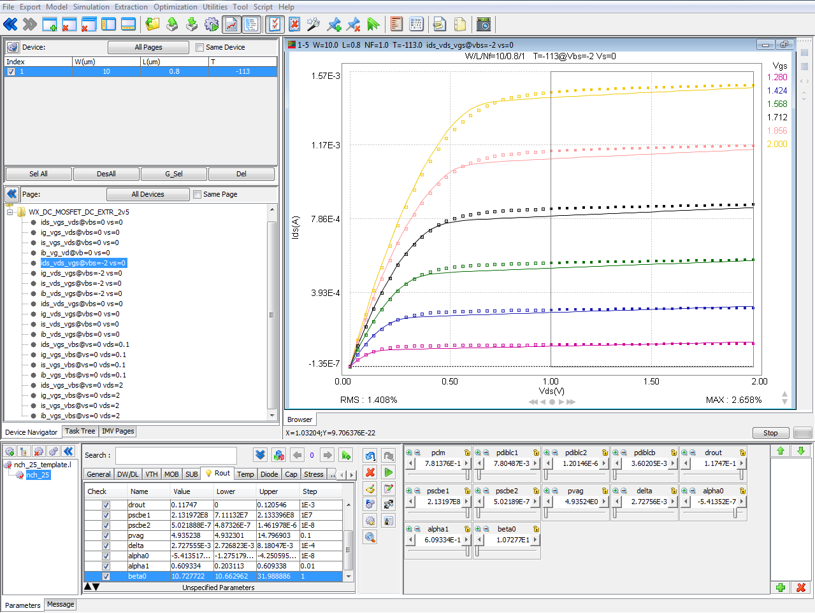
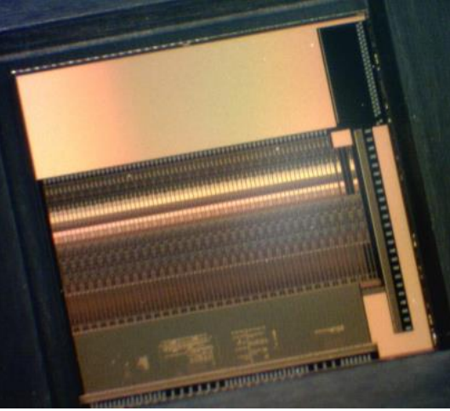
SPPA Design Strategy
  Approach
  This work will leverage previous ASIC developments by SLAC TID
Low-noise
performance
Cryogenic operation
Fast power switching
CRYO ASIC

Slide 13
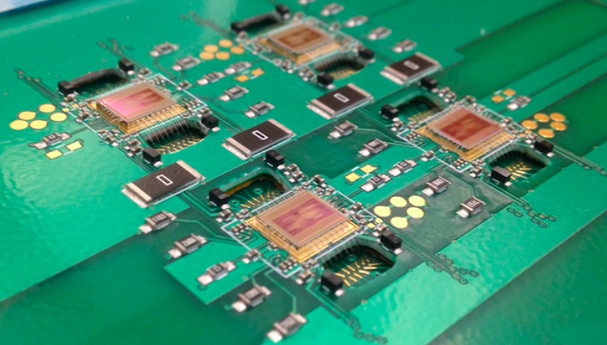
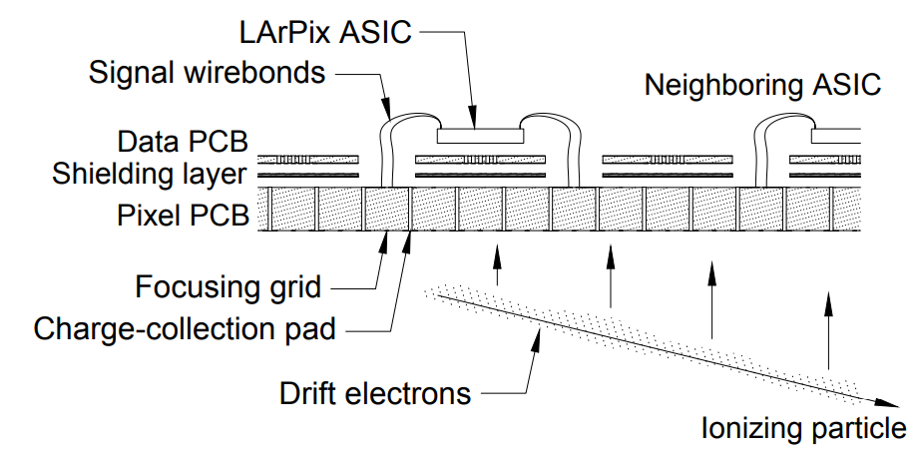
SPPA Design Strategy
  Existing technology
  Conventional systems such as LArPix [Dwyer 2018] use pads implemented on PCB with traces connecting them to electronics mounted on the backside
    The resulting extra capacitance of the pads and interconnections causes significantly higher readout noise (i.e., 500 e⁻) compared to the target of this work (< 25 e⁻)
    LArPix [Dwyer 2018]

Slide 14
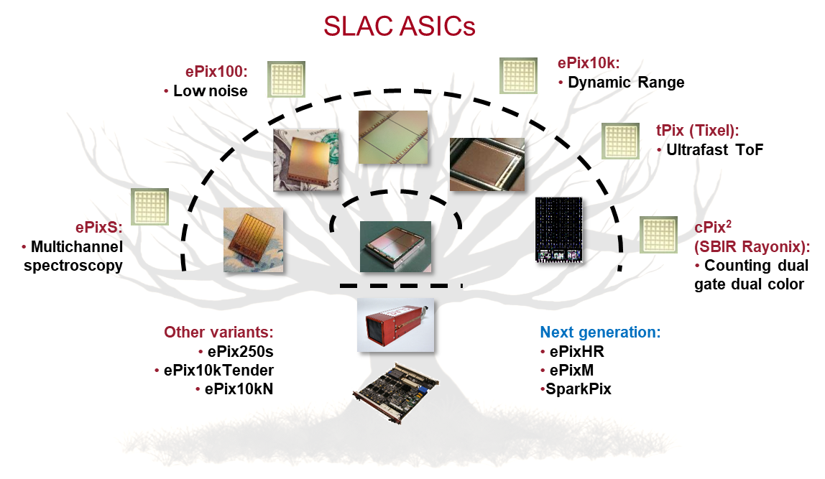
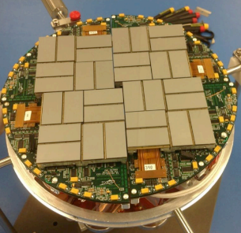
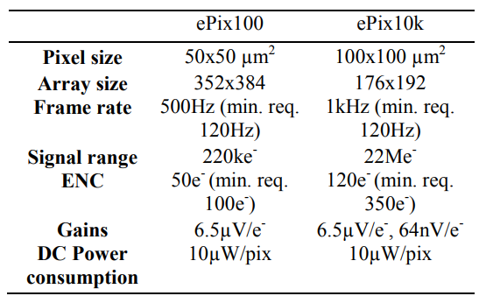
SPPA Design Strategy
  Pixel for low noise
  To mitigate extra noise due to interconnections, we propose to directly collect charges on the front side of a pixel
Example of SLAC reticle size ASICs
ePix Family [Dragone 2014]
    SLAC’s extensive expertise with reticle-scale ASIC designs [Dragone 2014]
    Noise optimization of the front-end electronics based on the system detector capacitance
    Target Noise: < 25 e⁻

Slide 15
SPPA Design Strategy
  Approach
  This work will leverage previous ASIC developments by SLAC TID
Cryogenic operation
Fast power switching
CRYO ASIC
Low-noise
Pixel-based architecture

Slide 16
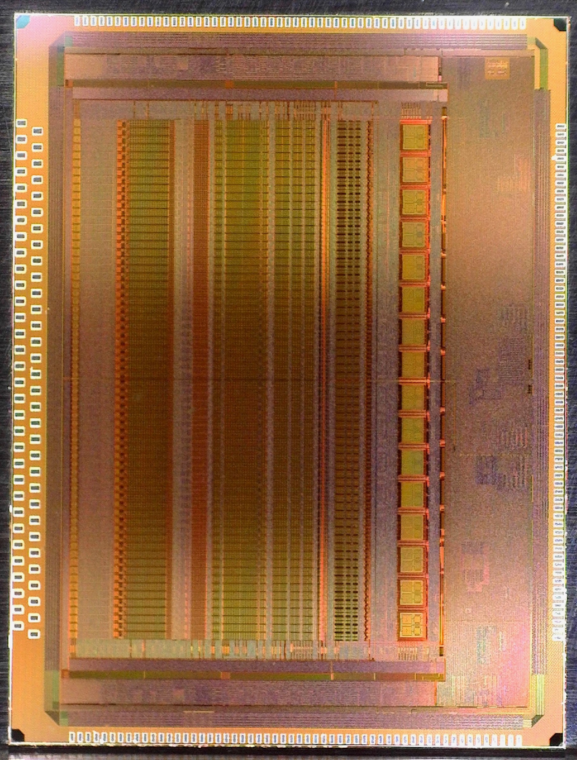
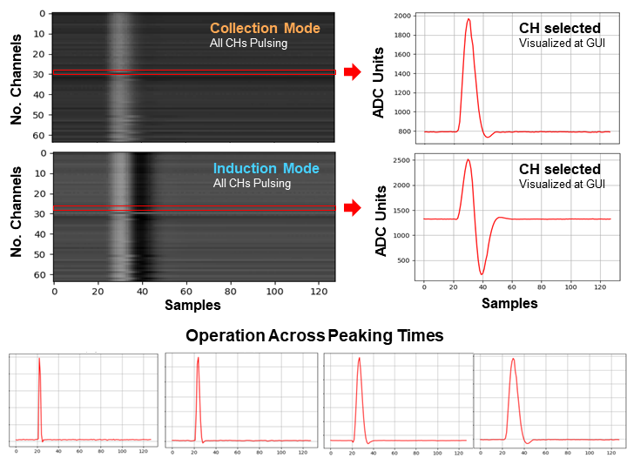
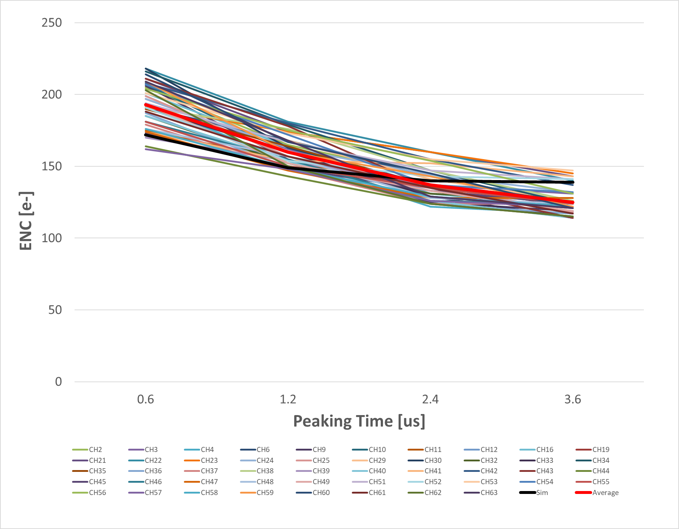
SPPA Design Strategy
  Cryogenic operation
CRYO ASIC
[Pena-Perez 2020], [A. Gupta 2020]
  This design will use as a reference the CRYO ASIC project
  [Pena-Perez 2020], [A. Gupta 2020]
    Aimed as readout ASIC for neutrino science: NEXO and DUNE
    Architecture with analog and digital functions (System-on-Chip) and minimal number of I/Os
    Optimized to operate across temperatures: 27°C, -113°C and -186°C
    Note: Sections of CRYO ASIC can be ported on this design due to technology compatibility
Full-Chip Performance at Cold (LN2)

Slide 17
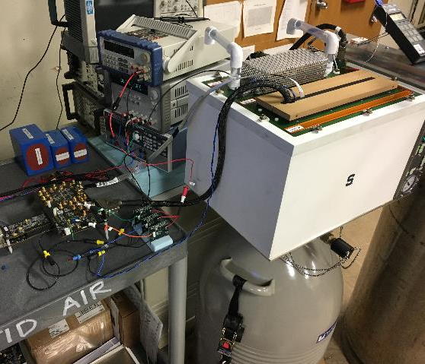
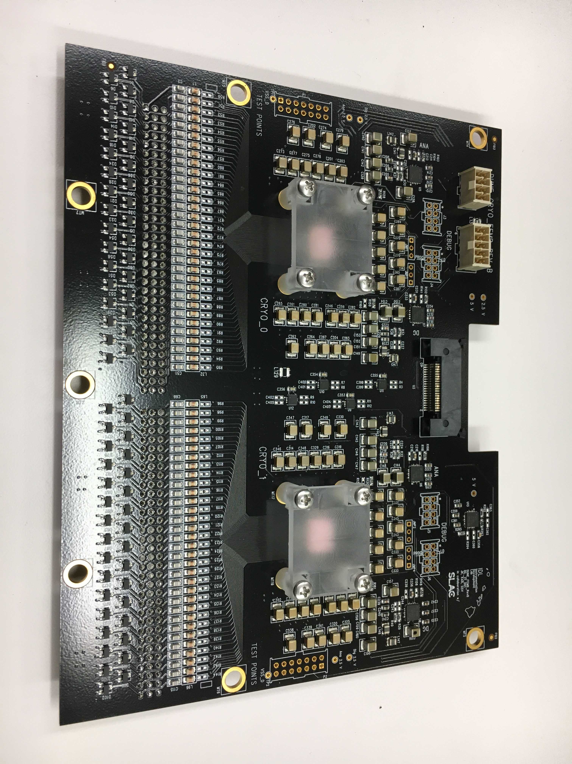
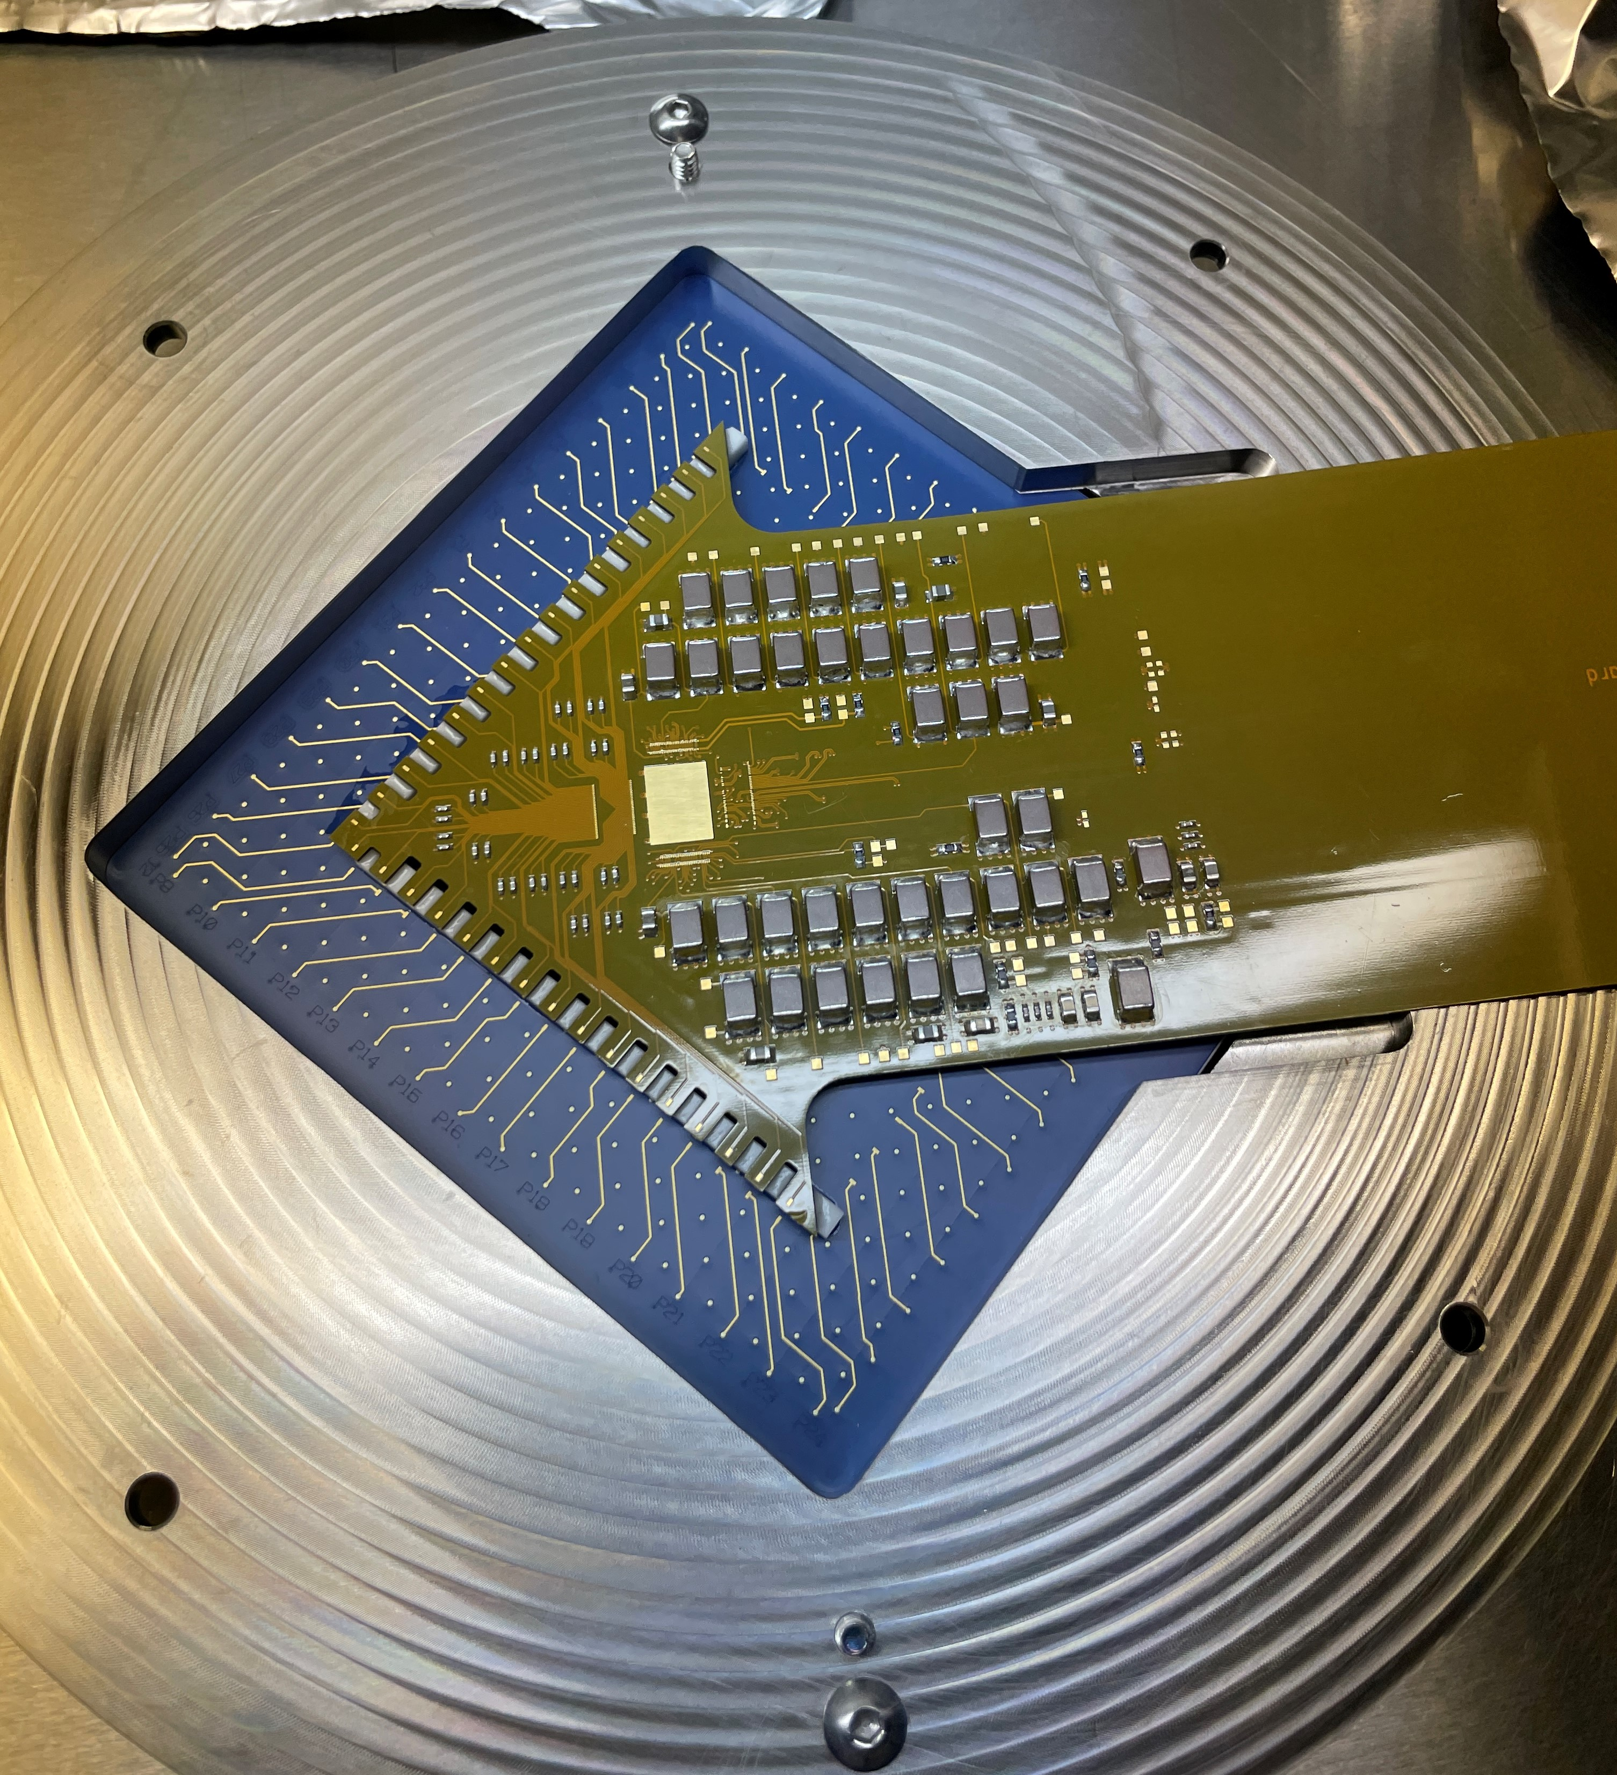
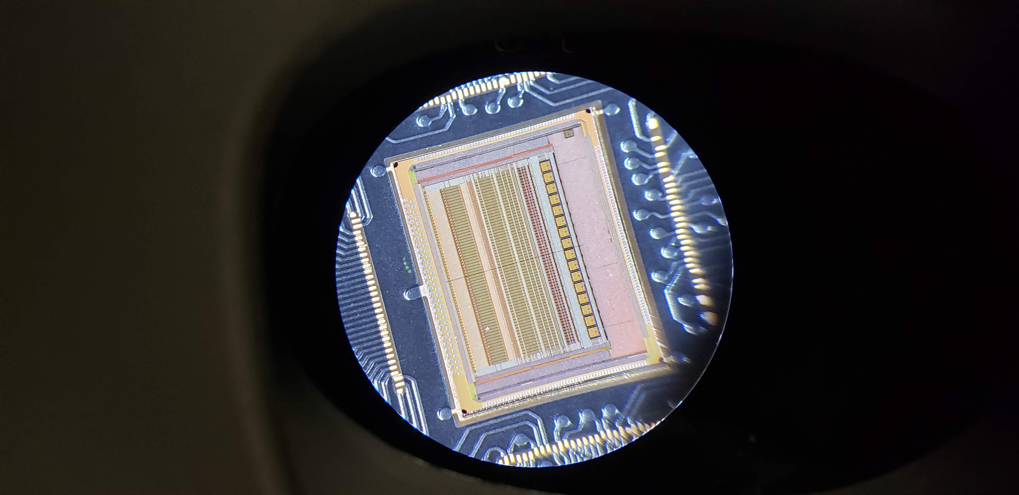
SPPA Design Strategy
  Cryogenic operation
  Dedicated cryogenic test benches used for chip characterization (SLAC and Stanford)
DUNE
Test bench setup at SLAC for LN2 temperature
nEXO
Test bench setup at Stanford for LXe temperature
(In progress)
Flexible Cold Board
Stanford Lxe TPC
Front-End Board
CRYO
Under Microscope
CRYO
Under Microscope

Slide 18
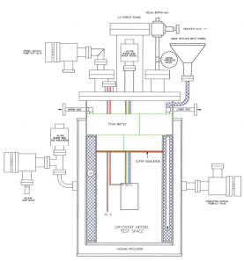
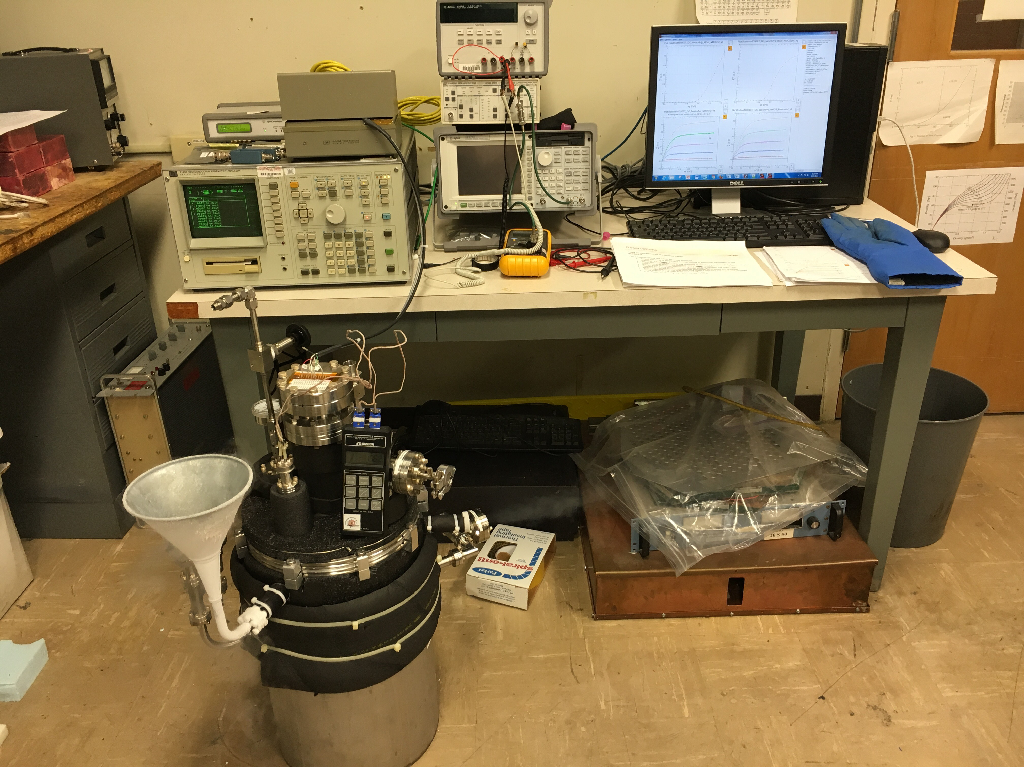
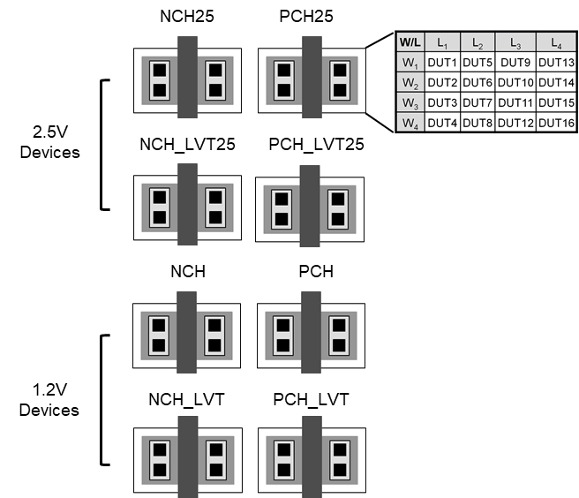
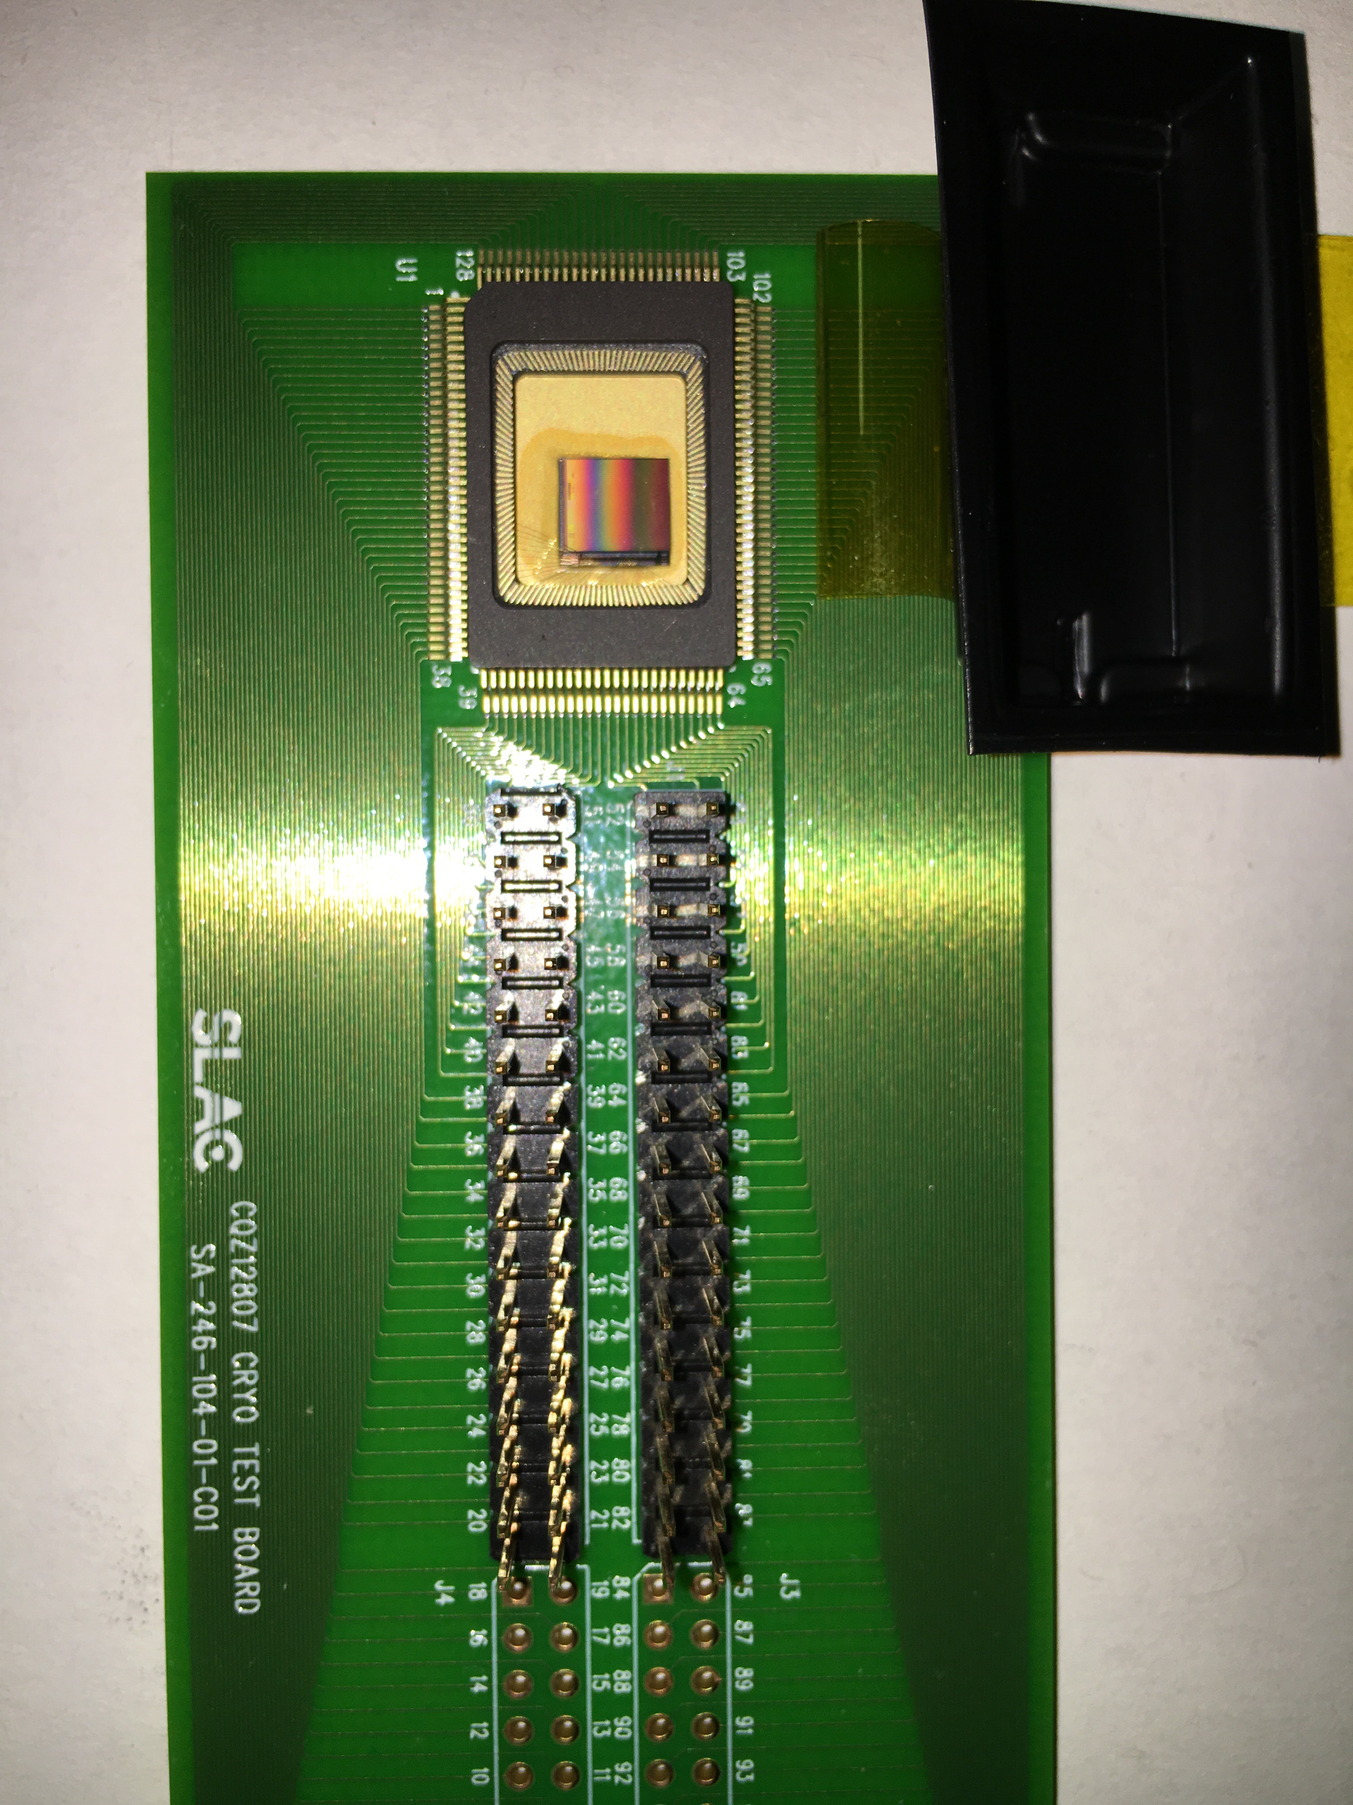
SPPA Design Strategy
  Cryogenic operation
  Validated cryogenic models in 130nm CMOS will be used for the chip design
    Developed at SLAC using a cryogenic test bench for device characterization at -113°C and -186°C
    Why we need cryogenic models? → Foundry models are only valid down to -40°C
Cryostat Vessel
Flow for DC measurements
Model SR570
Agilent 4145B
Agilent 35670A
DUT
Flow for noise measurements
Drawing: Courtesy of Bob Conley
Cryostat Vessel
(DUT is placed inside)
DUT with
devices
128 devices

Slide 19
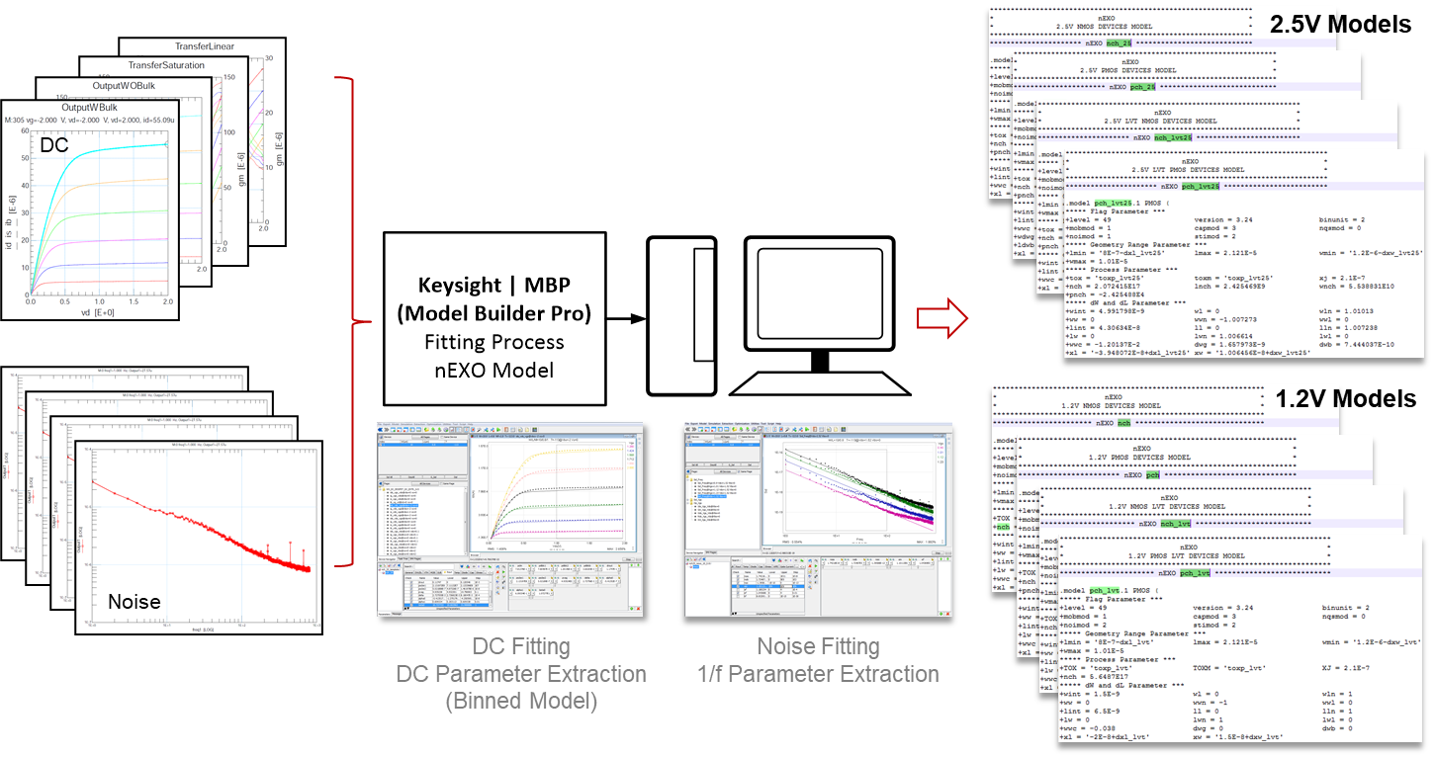
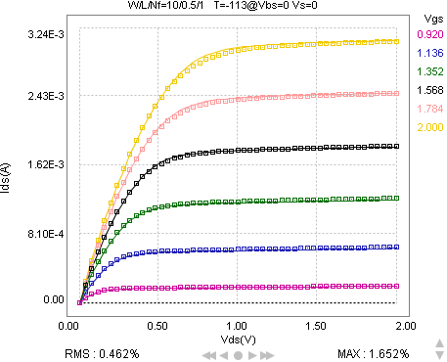
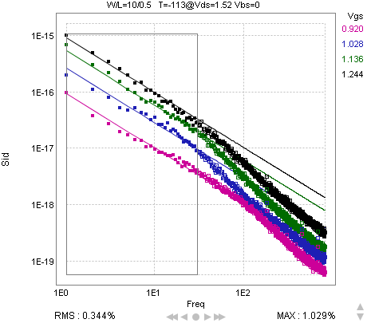

SPPA Design Strategy
  Cryogenic operation
  Sophisticated tools for fitting analysis and device modelling were used to create the models
    The cryogenic models support the same device portfolio as the models provided by the foundry
    CRYO ASIC was designed using these models
Example of measured waveforms at cold
Data vs model
Cryogenic Models
Parameter extraction flow
Ids vs Vds
Noise Spectrum

Slide 20
SPPA Design Strategy
  Approach
  This work will leverage previous ASIC developments by SLAC TID
Fast power switching
CRYO ASIC
Low-noise
Pixel-based architecture
Cryogenic Operation
Based on CRYO ASIC and cold models

Slide 21
SPPA Design Strategy
  Fast switching for low-power
    Challenge: power cycling scheme
      ASIC in off-state → “zero” power (<200 nW/pixel)
      When triggered by coarse signal → ASIC settles in < 10 μs
      Average power consumption < 10 W/m²
    Solution: switching mechanism
      Drives supply domains, bias circuits and core cells
      Concept is applied to power hungry circuits
      Coarse grid signal acts as enable/disable

Slide 22

SPPA Design Strategy
  Fast switching for low-power
    Challenge: power cycling scheme
      ASIC in off-state → “zero” power (<200 nW/pixel)
      When triggered by coarse signal → ASIC settles in < 10 μs
      Average power consumption < 10 W/m²
    Solution: switching mechanism
      Drives supply domains, bias circuits and core cells
      Concept is applied to power hungry circuits
      Coarse grid signal acts as enable/disable
Device flavors available
130nm CMOS
    Let’s keep in mind…
      Explore previous power pulsing techniques (i.e., kPix)
      Switch design with low leakage currents
      [Moise 2015], [Stanescu 2019]
      Careful choice of devices for the switching scheme
      Analysis of latency times on cells using the switching
      Power-on sequence to avoid large transients of currents
      Optimization for cryogenic operation
2.5V Devices
1.2V Devices
Nominal
Nominal
N-CH
P-CH
N-CH
P-CH
LVT
LVT
P-CH
N-CH
P-CH
N-CH

Slide 23
SPPA Design Strategy
  Approach
  This work will leverage previous ASIC developments by SLAC TID
CRYO ASIC
Low-noise
Pixel-based architecture
Cryogenic Operation
Based on CRYO ASIC and cold models
Power switching
Low-power + fast operation

Slide 24
SPPA Development
Initial Development
pixel readout
ASIC R&D prototype I
~5 mm x 5mm
ASIC R&D prototype II
Scaled version (~1cm x 1cm)
      Pixel architecture - preamplifier design
      Power switching scheme concept
      Goal: low-noise and low-power
      Funding: KA25 R&D program
      Pixel architecture - preamplifier design
      Power switching scheme concept
      Small array of pixels (10 x 10)
      Supporting circuitry with minimal functions
      Goal: prof-of-concept ASIC
      Funding: TBD (APRA proposal submitted)
      Full pixel architecture (preamplifier + filter + memory)
      Power switching scheme concept
      Matrix array of pixels
      Full back-end with sparse readout
      Goal: Base level ASIC for DSCR concept
      Funding: TBD (APRA proposal submitted)

Slide 25
  Backup Slides

Slide 26
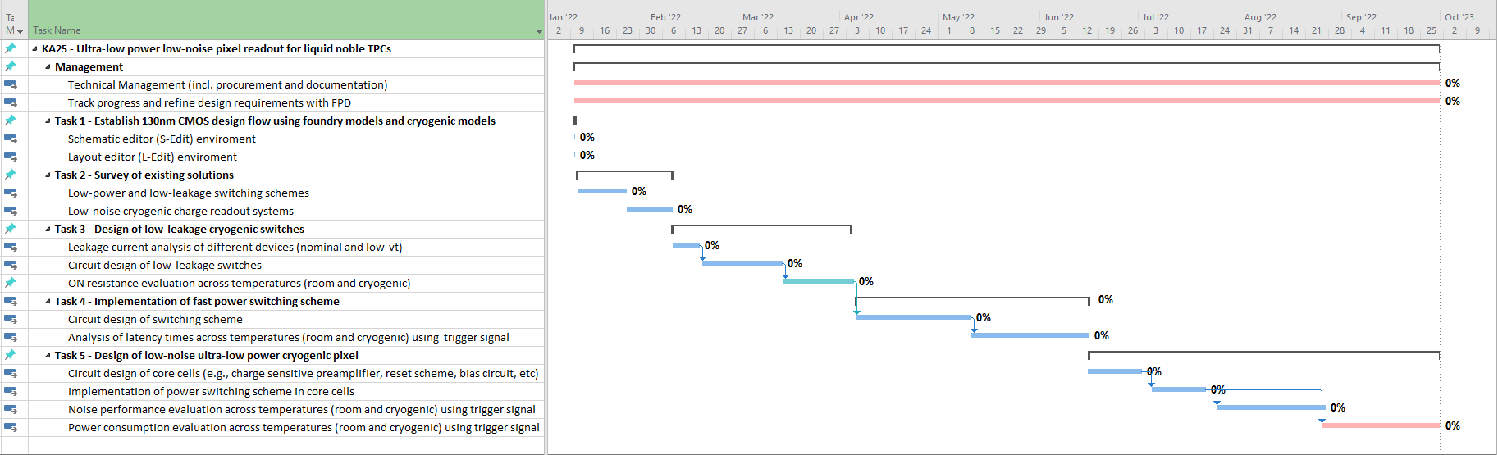
Timeline
FY22 target dates:
  KA25 project begins on Jan. 10th, 2022: 130nm design flow with cryogenic models is established
  January: Survey on existing solutions
  February – March: Analysis and circuit design of low-leakage switches
  April – June: Circuit implementation of power switching scheme including simulations across temperatures
  July – Sept.: Design of cryogenic pixel readout with switching scheme and performance evaluation across temperatures

Slide 27
Comparison of CRYO Specifications
TPC Experiment | DUNE |  |  |  | nEXO
CMOS process | 130nm |  |  |  | 130nm
Supply voltage | 2.5V (2V, 1V internal) |  |  |  | 2.5V (2V, 1V internal)
Input capacitance | 150pF |  |  |  | 40pF
Anti-aliasing filter | 5th order Bessel architecture |  |  |  | 5th order Bessel architecture
Peaking times | 0.6us, 1.2us, 2.4us, 3.6us |  |  |  | 0.6us, 1.2us, 2.4us, 3.6us
Gain settings | 6.0X (28.6mV/fC) | 3.0X (14.3mV/fC) | 1.5X (7.1mV/fC) | 1.0X (4.8mV/fC) | 6.0X (57.2mV/fC) | 3.0X (28.6mV/fC) | 1.5X (14.3mV/fC) | 1.0X (9.6mV/fC)
Max. input charge | 50fC | 100fC | 200fC | 300fC | 25fC | 50fC | 100fC | 150fC
Noise | ~500e- @ 3.0X and 1.2us |  |  |  | ~200e- @ 3.0X and 1.2us
Resolution | 12 bit |  |  |  | 12 bit
INL and DNL | ±1LSB |  |  |  | ±1LSB
Sampling frequency | 2MSPS |  |  |  | 2MSPS
Temperature | 87K (-186ºC) |  |  |  | 160K (-113ºC)

