Slide 1
Edge Data Processing
Ryan Herbst
TID Instrumentation
SLAC National Accelerator Laboratory
03/13/2023
‹#›

Slide 2
Outline
Scientific Motivation
Current Efforts For Edge Processing
FPGA
eFPGA in ASIC
Hardwired ASIC
DreamChip (Stanford Univ.)
SNL Framework
Overview
Status
Collaboration
Future Thoughts
‹#›

Slide 3
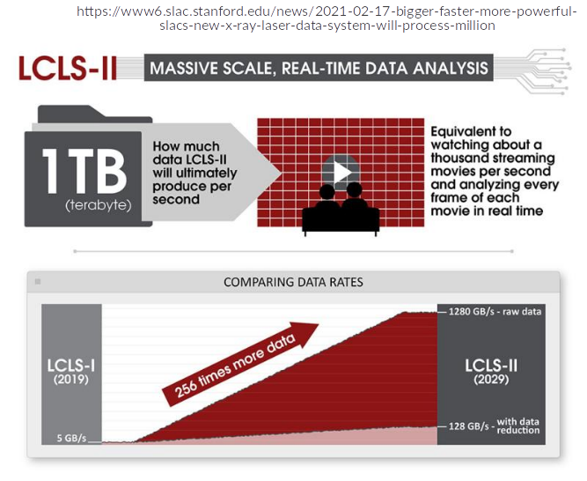
Scientific Motivation
Detectors developed for LCLS2 will generate data volumes many orders of magnitude greater than seen in LCLS
Pre-processing and data selection at the Edge will be a powerful tool in the overall data reduction effort at SLAC
While many groups are thinking about the algorithms to be deployed at the Edge, TID Instrumentation is working to provide the tools to deploy these engines in FPGAs and ASICs as close to the detector as possible.
This required a close partnership between data scientists and engineers to find the appropriate algorithm for each stage of system data flow

Slide 4
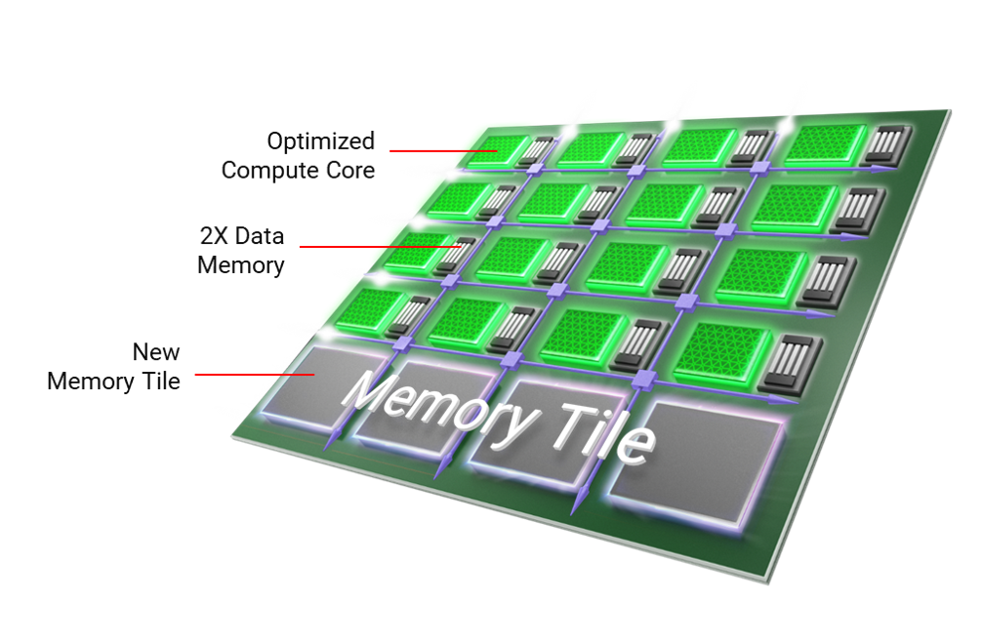
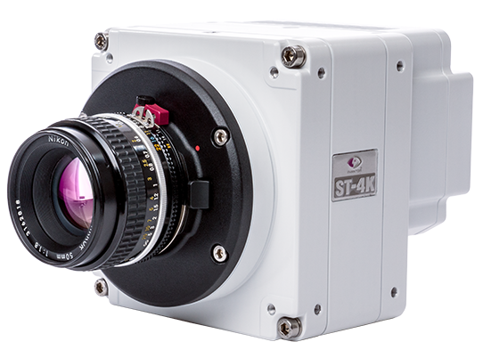
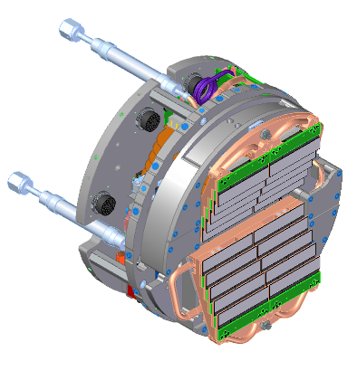
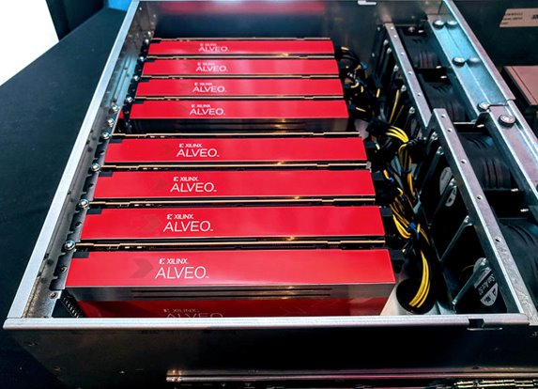
FPGA Deployments
SLAC is working on a general library to support AI inference deployment on FPGAs (SNL) as well developing HLS based data processing
Engines can be deployed close to the detector or at the edge of the Data Reduction Pipeline (DRP)
On detector FPGAs are the low hanging fruit for AI and edge algorithm deployments
Of course to get closer to the data source, ASIC deployments will be necessary…
See Lorenzo’s talk on SparkPix-rt (compression in ASIC)
Xilinx ACAP Core
Commercial Cameras
Second Stage Processing In PCIE FPGAs
Opportunity to couple RF processing & AI in ACAP + RF (Xilinx Roadmap)
Custom Detectors (ePix Family)

Slide 5
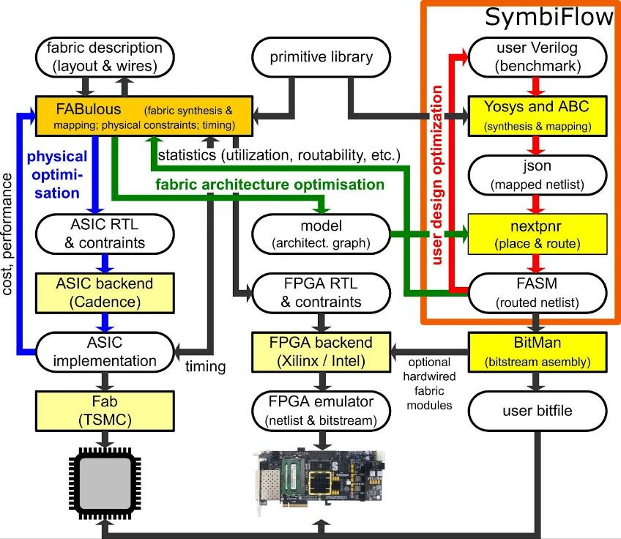
Automated data processing in ASIC/FPGA - FABulous
Goal is to move more data processing into the front-end ASIC devices
Often algorithms and data processing techniques must evolve which make ASIC deployment problematic
Custom ASICs need to support updatable data processing pipelines
Several popular FPGA architectures are becoming 20+ years old
Which means that original patents have expired
Includes Spartan-3 and Virtex-II FPGAs from Xilinx
In 2021, University of Manchester has started an open-source project called FABulous
an Embedded FPGA (eFPGA) Framework
Idea is that you put an “reconfigurable logic” in your ASIC design
SLAC is experimenting with this approach to determine it feasibility for front end data processing, both classical and ML based
‹#›

Slide 6
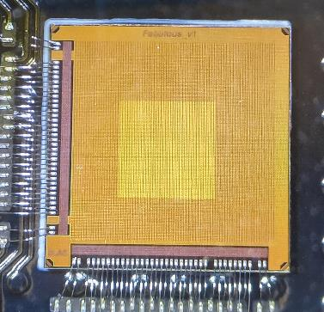
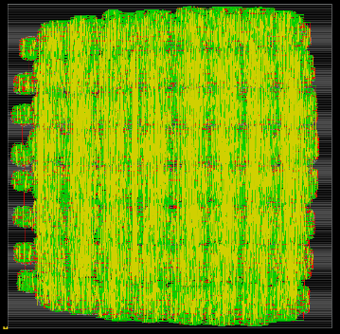
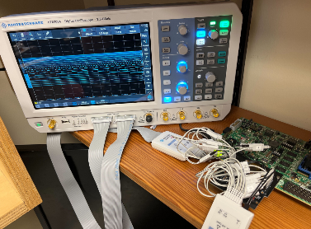
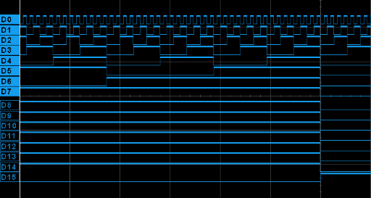
FABulous - Highlights
Simple example eFPGA design to tryout the framework
384 logic cells
128 registers
4 DSP slices
Submitted on TSMC 130nm MPW on May 15, 2022
ASIC wire bonded to an FMC carrier and eFPGA bitstream loaded from a Xilinx development board
Testing started Aug 20, 2022
ASIC+eFPGA functionality demonstrated
FY2023 fabulous KA25 is doing 28nm tapeout in July 2023
Increases gate density and provides radiation tolerance
Goal: get more familiar with the open-source framework and tools before implementing an eFPGA in a readout ASIC
Also determine where SLAC can contribute to this effort
GPIO
eFPGA Fabric
2 mm
Fabulous v1 ASIC
Floorplan of eFPGA fabric after Place&Route
Outputs from eFPGA (16b counter) probed with oscilloscope

Slide 7
DreamChip (Stanford Univ.)
Collaborative effort with Stanford’s Robust Systems Group
Partly funded through DOE-SC Microelectronics proposal (McIntyre, et all)
Goal is to develop a framework to optimize ASIC resources for a targeted envelope for AI & classic data reduction algorithms
Allows for re-synthesis and re-targeting of modified networks of a similar structure
Output is a ASIC core along with a parameterized compiler (HLS based) for synthesising towards the custom ASIC core
Large models and algorithms will utilize 3D integration, optimized inter-chip communication & low latency memory access
Input to the Stanford design flow will consist of a SLAC SNL based AI model currently targeted towards FPGAs
Optimized alternative to direct HLS -> ASIC design flow
DreamChip Development Flow

Slide 8
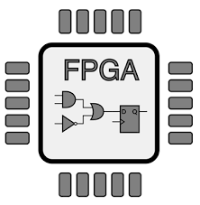
SLAC Neural Network Library (SNL) Goals
Provide a set of libraries to synthesize AI inference networks into FPGAs
Networks of a medium size,
10 - 20 layers, ~100s of thousand trainable parameters
Total end to end latency of 1uS to 10ms
Deep networks call for AI-specific ASICs, e.g. IPU or Groq, but FPGAs still ubiquitous at sensor
Pipelined implementations targeting a frame rate of 100kHz - 1MHz
Dynamic reloading of weights and biases that avoids re-synthesis
Support a Keras-like API for layer definition and configuration
Allow for a standard interface such as HDF5 for storing weights and biases
Allow for a modular approach with the ability to implement new and custom layers

Slide 9
Why Dynamic Weights & Biases?
Our SNL implementation is targeting scientific instruments which will continuously adapt to new data and changing environments
High speed training to supports this goal
Bias and weight updates in real time
Some AI-to-FPGA frameworks take the weights and biases as an input, pruning portions of the network structure to save resources
Re-synthesis is required for each new training set
Risk of the FPGA implementation failing due to increase resources usage, timing failures or massive change in internal interconnect structure
Large FPGA designs can take hours to days for the HLS -> synthesis -> place and route cycle to complete
This is a trade off between robustness vs. latency and resource usage

Slide 10
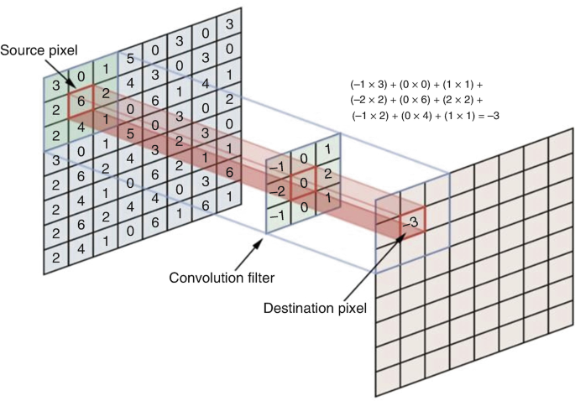
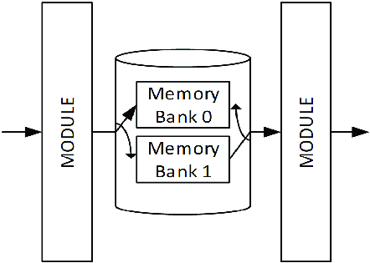
Why Streaming & pipelining?
Certain layer types work better with streaming based upon their data flow model
Convolution (2D & 3D) and pooling layers can process data as it arrives
Partial data is ready as each region of the layer completes
Pass to next layer can begin when indices reach roughly ½ the kernel dimensions
Other layers such as Dense fully connected need all of the input data to have arrived before output can begin… this suffers a high latency penalty
Idea is to trade off overall latency vs resources usage while maintaining high rate throughput
Data can be passed to next layer as each pixel is computed

Slide 11
SNL Usage
User defines layers using a collection of C++ templates that define each layer type and the associated activator for each layer
Current layer types:
Conv2D
MaxPooling
AveragePooling
Dense
Reservoir
Current activators:
LeakyRelu
Relu
Each layer interface matches closely to the Keras model
Allows user to use Keras documentation as a reference
Additional configurations are required to control the FPGA specific configurations

Slide 12
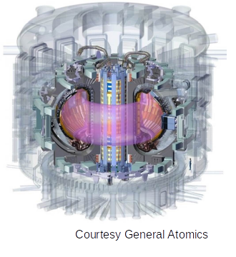
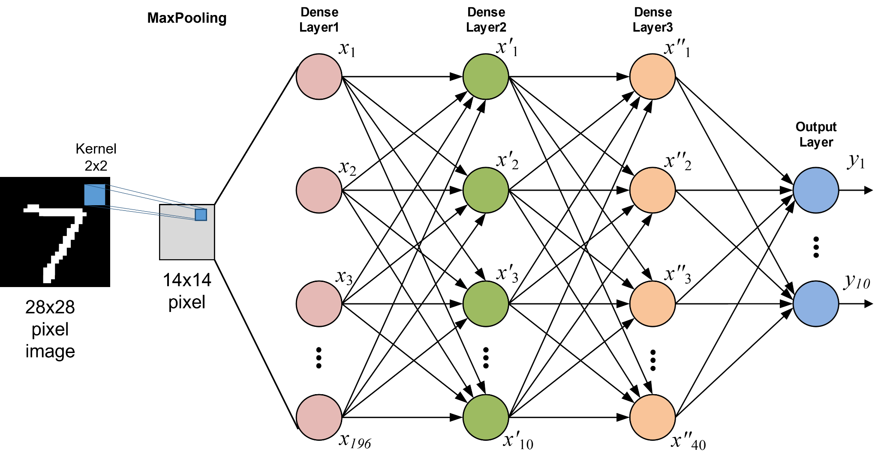
Example Use: BES Network
Initial example of a small fully connected network implemented as if a CNN (Dave Smith U. Wisc.)
Beam Emission Spectroscopy (BES) for tokamak disruption event identification (Edge Localized Mode - ELM)
Developed with intention of forecasting ELMs
The BES network consists of the following layers:
MaxPool2D
Dense with LeakyReLU activator

Slide 13
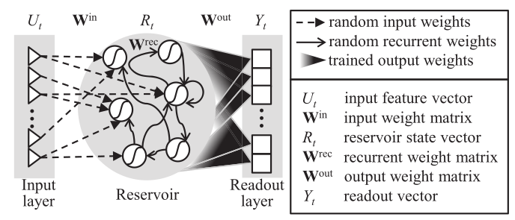
Example Use: Reservoir Networks
A Reservoir network consists of a deep pool of recurrently connected neural nodes which take state from both the input and neighbor nodes on each computation cycle
Input and internal weights and biases are assigned randomly
Only output values apply weights and biases to data from each internal node
Pros for FPGA deployment:
Less trainable parameters to download to the FPGA
Internal connections do not change with each training and so can be pruned and optimized
Cons for FPGA deployment:
Very large set of node interconnections
We have successfully deployed an example network
2 Reservoir layers with a large vector: ~1000 nodes
Results in large usage of DSPs and memory
Requires a very large FPGA to implement
High latency in the 100uS - 10mSec range
Azarakhsh Jalalvand et al. “Real-Time and Adaptive Reservoir Computing With Application to Profile Prediction in Fusion Plasma” IEEE Trans Neural Netw Learn Syst. 33(6) :630-2641 (2022)

Slide 14
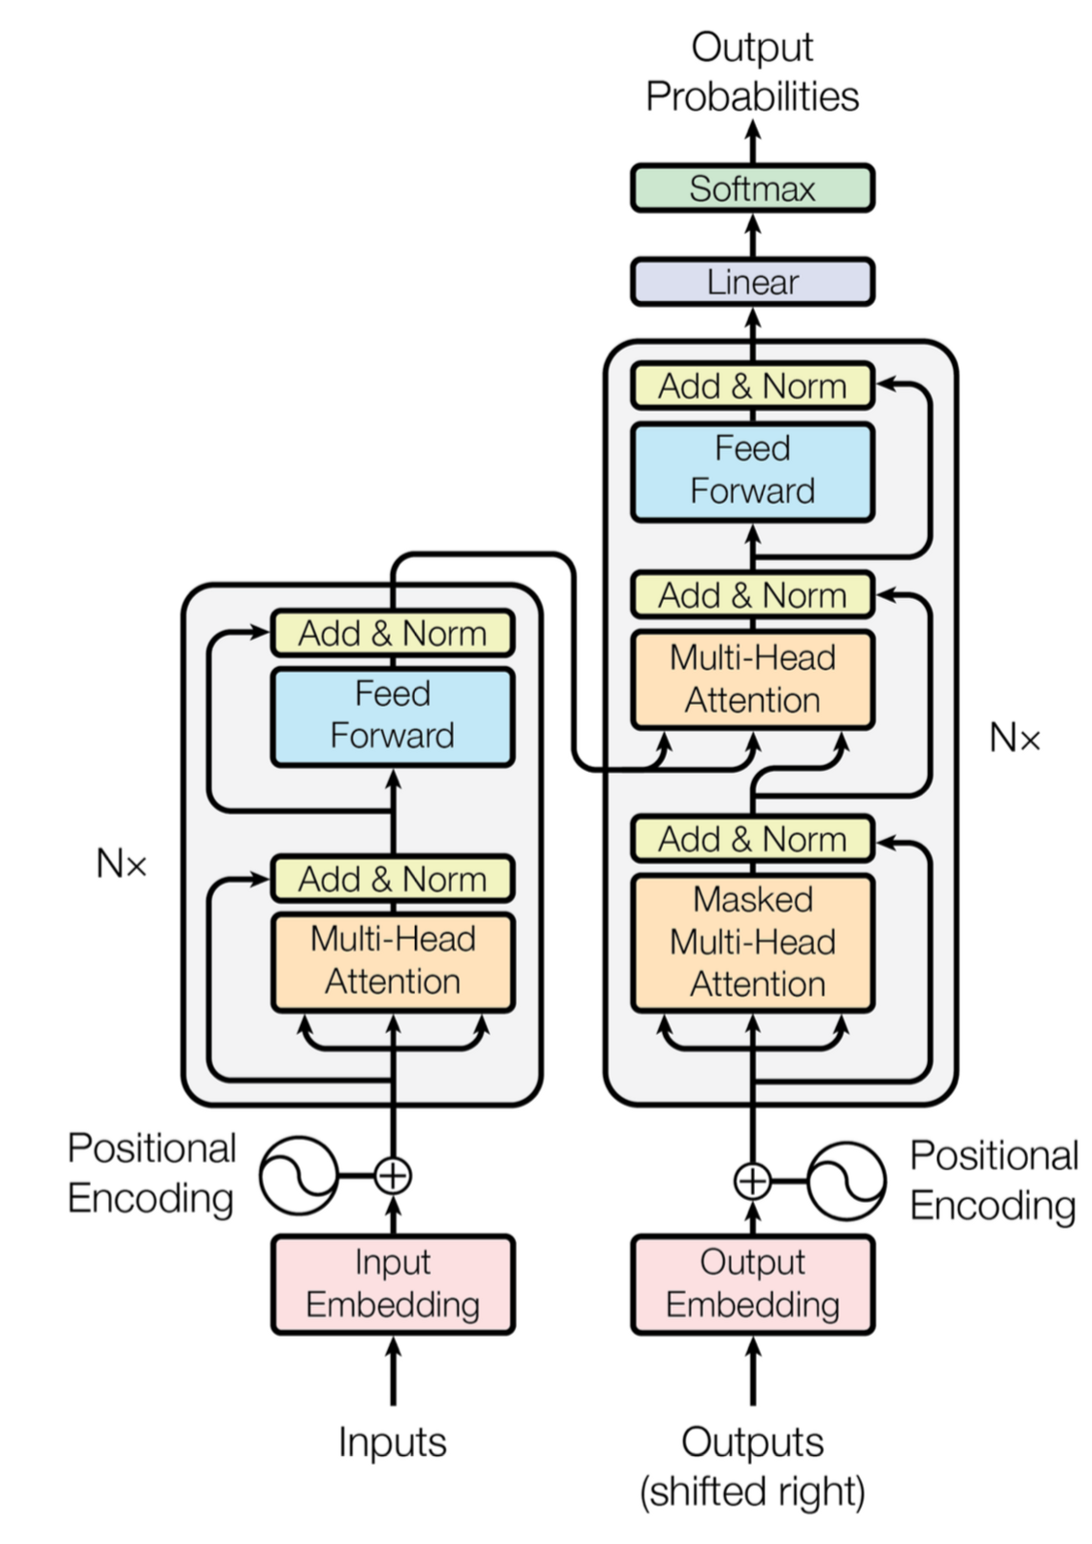
Example Use: Transformer Networks
Transformer networks
Conceptually similar to Reservoir networks
Targeted toward using less FPGA resources
Trainable parameters are contained in the dense feed forward blocks (looking into Hopfield networks to replace attention)
Remaining interconnects and static parameters require new interconnect types in SNL
Our current focus is to adapt SNL to support the deployment of these network types
Domain scientists and FPGA designers must work closely together to optimize design for FPGA deployment
Current workflows and models are very software oriented and should leverage the huge potential for FPGA specific enhancements

Slide 15
SNL Limitations
The user must be aware of some limitations when making use of the SNL framework
SNL is not a finished, polished product.
We are continuously developing, adding new features and improving the structures
Only a subset of the Keras layers and activators are implemented
New layers can be added in a well defined but tedious process
Some layer types and activators are not consistent with best FPGA data flow
We have not yet implemented quantization in the implementation
Future plans include this but need a clear understanding of overflow handling
End to end optimization of the layer structure is not implemented
We are looking to the Xilinx SLX design flow as a possible solution
We are very interested in collaborators
HLS experience needed!
Experience with targeted inference networks (not Gpt3!)
Notes:
Each layer can be optimized, but not the overall computation graph… yet…

Slide 16
Future Work & Conclusions
Continued development of SNL library
Looking for collaborators and HLS experts to assist in supporting more complex network structures
Continued development of HLS cores for edge DATA processing
Interest in approaches integrating custom front end ASICs with co-processing chiplets
(DreamChip, AI engines, FPGA dies, etc)
Interest in analog DSPs coupled with quantized digital AI engines
Accelerate the processing latency and footprint of DSPs in custom ASICs
Silicon Quantum Processors
Challenges
Tiled detectors and where data can truly be processed
Calibration, baseline subtraction and geographic corrections
Also provide opportunities for AI deployment
Potential opportunity for FW based event building
Network attached FPGAs coordinating data delivery
Boundary data passing for edge ML processing

Slide 17
Acknowledgement
Department of Energy, Office of Science
Office of Basic Energy Science
CookieBox detector: FWP 100498 (PI Coffee) “Enabling long wavelength Streaking for Attosecond X-ray Science”
EdgeAI for CookieBox: FWP 100643 (PI Thayer) “Actionable Information from Sensor to Data Center”
DOE High Energy Physics Detector R&D
Office of Fusion Energy Science
EdgeAI for Fusion Control: FWP 100636 (PIs Koleman, Coffee, Smith, Boyer, Schneider) “Machine Learning for Real-time Fusion Plasma Behavior Prediction and Manipulation.”
SLAC-LCLS Program Development (PI Kling) “LCLS Growth”
SLAC TID LDRD 21-007 (PI Herbst) “Edge ML for acquisition and analysis of data generated by ultra high rate detectors”

