Slide 1
Nanosecond imaging at LCLS with UXI detectors
Few Pico?
So far, this year, and the future
Philip Hart, Ulitima 2022 2023

Slide 2
Outline
Intro to UXI detectors
Past work with Icarus at LCLS
Ongoing science
Problems
Harder problems
Bright future

Slide 3
Local perspective (250ms frame rate)
350ps *10¹²
Magnitude/decade

Slide 4
... impractical setup

Slide 5
UXI collaboration and Icarus
Ultrafast X-ray Imager family of detectors from Sandia
…, Icarus, Daedalus, Tantalus, …
Icarus takes 4 frames in 8 ns (or longer)
25 um Si sensor, 25 um pixel pitch, 2.5x1.3 cm, 1 (10?) Hz, EMP hard, can see single photons at 6 keV, full well ~250 photons
GaAs sensors in packaging
Sensor/asic built at MESA (very not commercial process, high demand at Z machine, NIF, Omega)
Readout we use comes from LLNL -> integrated in DAQ
We have collaborated since 2017
We get sensors for expts, some input on new features
They get calibration data with LCLS beam + diagnostics
Several in house, in house + user experiments at LCLS
Detectors built with non-commercial process; imperfect
Spinoff company AHS developing commercial design
See talk tomorrow by Liam Claus
SBIR with Sydor to get features we want underway

Slide 6
Why do we want this?
The accelerator gives us four pulses down to 350ps separation
Burst mode imagers give us access to ns-scale science
E.g. shock propagation in materials, ICF implosion dynamics
XPCS (would work if we could run at 120 Hz) (will work when…)
Next UXI version designed to reach 500 ps; 300 ps possible
proposed SparkPixDelta would reach this (accumulation mode)
Multiple frames in a time scan on one pumped sample
Esp. valuable for low-rate optical laser expts that blow up targets
Gate away unwanted time-dependent backgrounds
100x time magnification with HSLOS (pulsed dilation tube, https://aip.scitation.org/doi/full/10.1063/1.5039648) to reach <30 ps science with split/delay etc.

Slide 7
Current “1-2” time structure for 4 pulses at LCLS
Icarus sensor
Readout board in fancy housing
Debye
Scherrer
8ns
(1+2)ns period just fits this pulse pattern. We spent a few minutes fine adjusting frame timing during last experiment

Slide 8
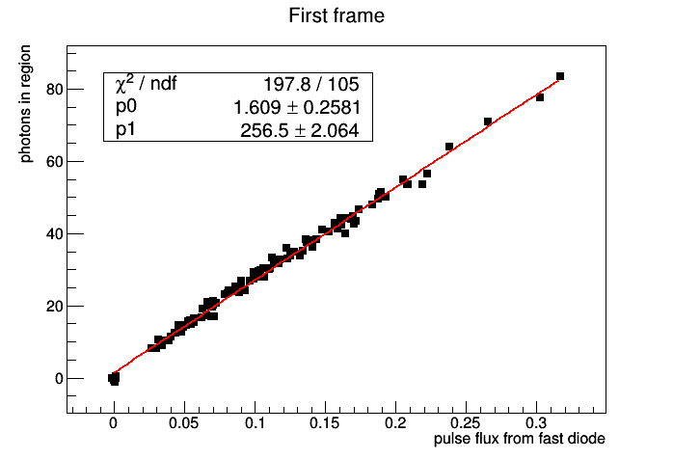
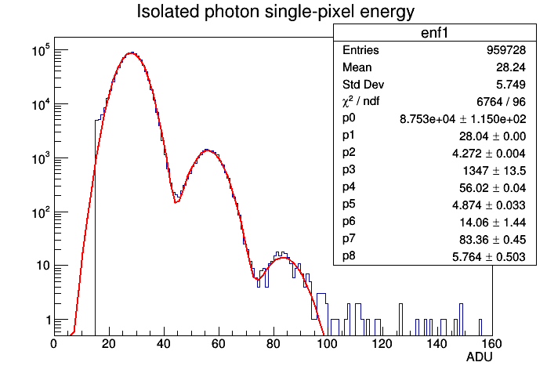
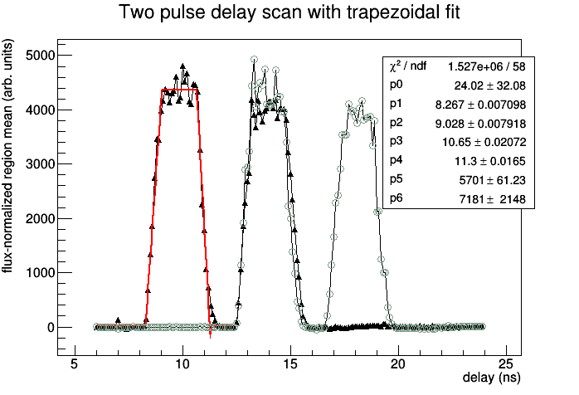
Highlights from “First x-ray test of the Icarus nanosecond-gated camera at LCLS” (doi: 10.1117/12.2520974), Hart et al.
Cold Cu
Hot Cu
Pump energy
Pumped frames

Slide 9
ICF void collapse: MEClv08 (above, XPCI, Nov 2020) MECx493 (below, direct illumination, 10ns flat top drive)
From Hodge et al., 2022
40x magnification at detector (25 um pixels) with Be CRLs

Slide 10
See Optics Express, “Multi-frame, ultrafast, x-ray microscope for imaging shockwave dynamics”, 2022
We combined the four-pulse bunch train at LCLS with the MEC optical laser as a drive to study void collapse for inertial confinement fusion. Hodge et al. extract the mass density of the target as the shock passes through and compare the propagation to a simulation of the development of hydrodynamic instabilities. Expected “jetting” is apparent. Shock wave is observed to split around the void.

Slide 11
Next expt: imaging laser powder bed fusion (3d metal printing) from 2-200ns – Leora Dresselhaus-Marais et al.

Slide 12
Later this year
Plan to extend study of shocked Si with 9 keV X-rays to shocked Ge with 17 keV X-rays
Requires GaAs sensor to achieve reasonable QE
UXI folks working on packaging challenges
Deploy Icarus sensor in vacuum (first for LCLS)
Demonstrate stability, ease of 4-pulse configuration
Requirement for user experiments in 2024
Si shock dislocations

Slide 13
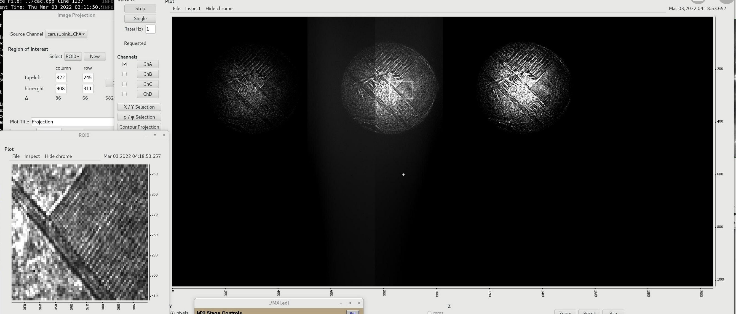
Problems just requiring work
Last expt.
Had some DAQ/controls instability
Setup involves a lot of discrete components (PS, delay gen.)
Trouble getting the X-ray pulses to lase consistently
Issues with laser table
Lack of fast monitoring feedback for tuning
Be (de)focusing X-ray lenses leave artifacts
White field

Slide 14
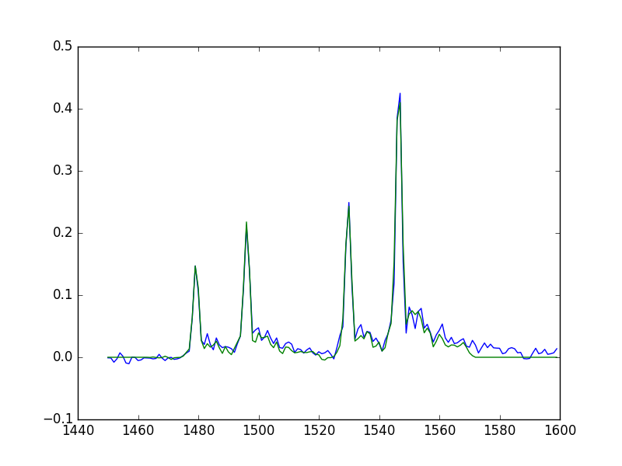
Laser table, beam monitoring improvements underway
Upgrade table components, motorize, expand
Add insertable, faster diode, better cabling for feedback
Allow tuning of multipulses independent of work in hutch
Fast diode trace from digitizer
with templated fit

Slide 15
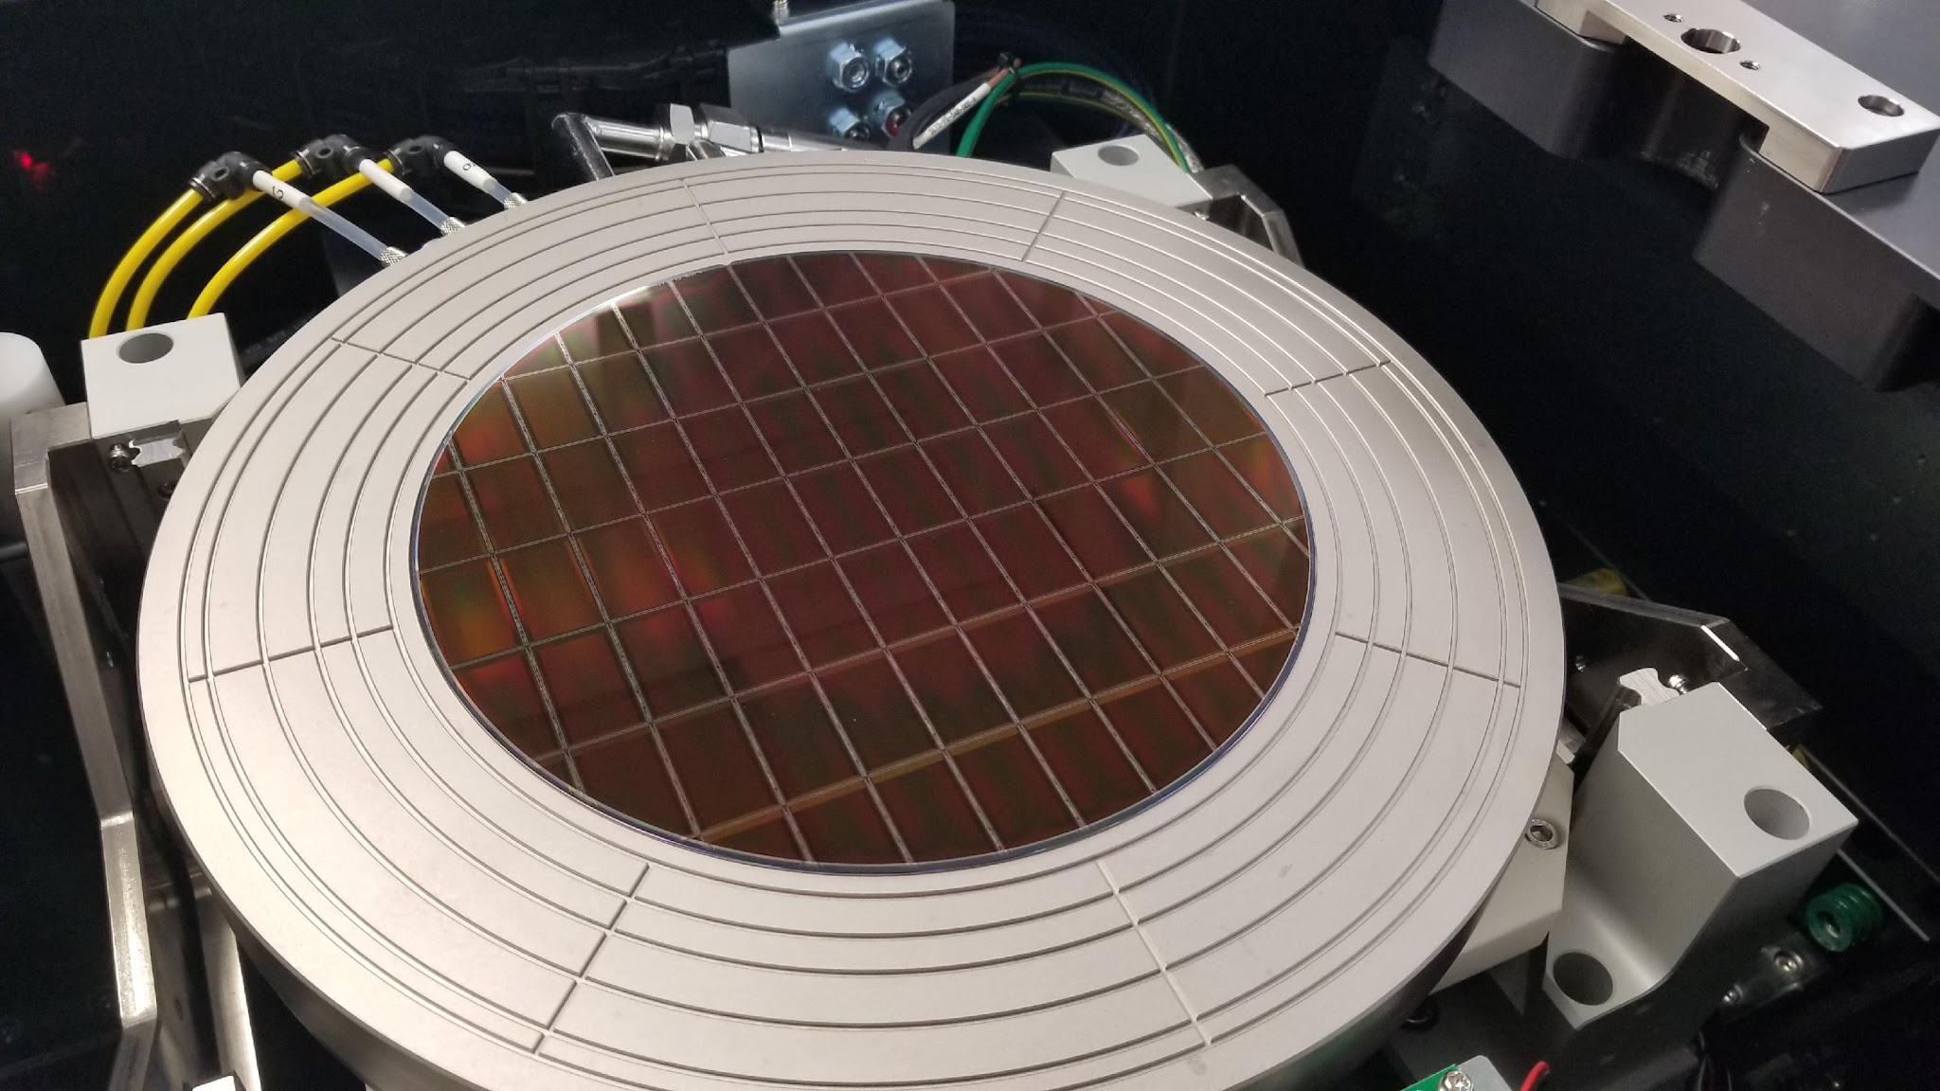
Tantalus is the first UXI ROIC designed in a commercial foundry
TowerJazz CA13SAV 130 nm process node
Designed as a test chip
5 different pixel variants
7 different oscillators
120+ Hz readout
500 ps integration time
Functional electrical testing completed
Next step is functional testing in radiation environment
Hybridization to demonstrate optical performance at speed
Iterate to implement a full array of optimal pixel variant
Requirement | Goal
Array size | 1024 x 512
Pixel size | 25 um
Number of frames | 4
Min Tint | 500 ps
Min inter-frame time | 500 ps
Timing skew | < 10%
Frame-Frame gain error | < 10%
Rep rate | 150 FPS
Full well | 500 ke⁻
Noise floor | < 250 e⁻
Dynamic range | > 60 dB
Slide from Liam Claus’s Ulitima talk
500*2 ps -> could run 700 ps bursts in
700 + 1400 + 700 ps pattern: 4 pulses in 2.8 ns

Slide 16
Challenges
Science motivations for
High QE, fast sensors
High Z materials in active development in UXI collaboration, many other places
See also e.g. talk tomorrow from Dominic Greiffenberg
Large area (8x8 cm**2) detectors with high (>85%) fill factor
Requires tiling (not currently abuttable) -> TSVs?
Easily available large #s of detectors
Stable, well-characterized cameras for precision science
Current UXI detectors suffer from ringing due to inductance
Related (?) cross-talk at high flux
Can’t be cooled
Smaller, larger pixel applications
More frames (16?)

Slide 17
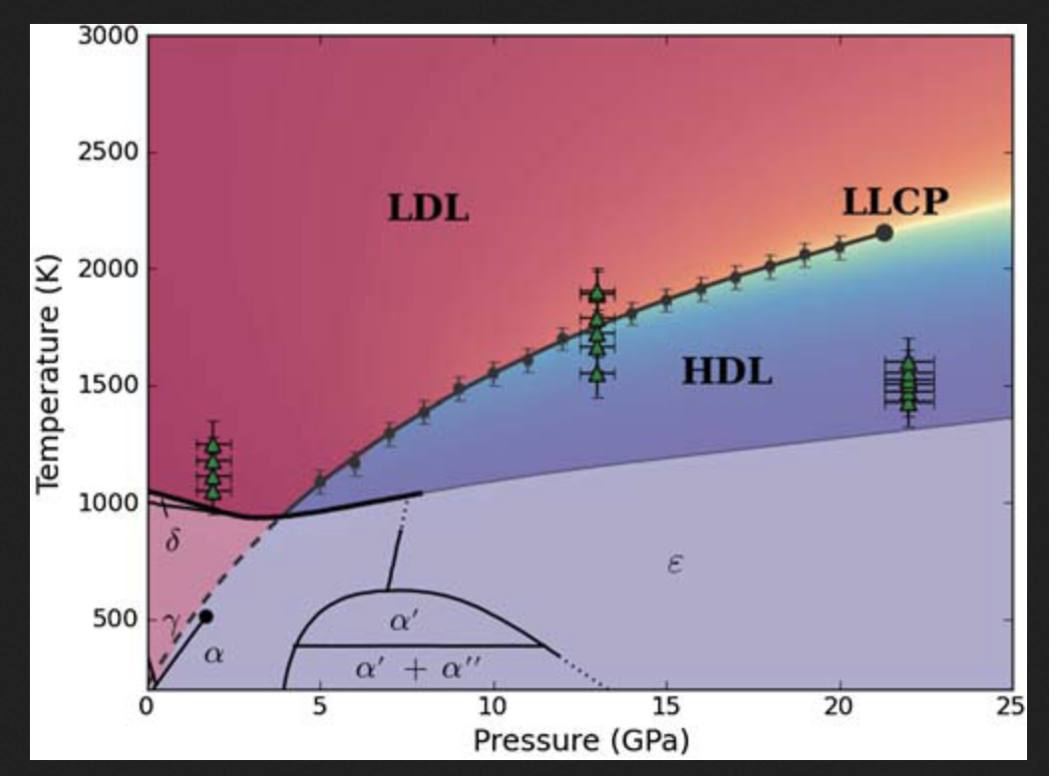
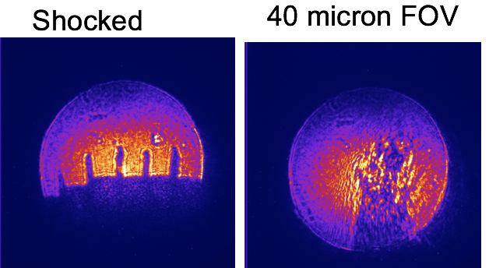
Ce liquid-liquid transition and ejecta at 25keV
Motivation
-liquid polymorphism is of great importance in understanding the nature and physics of liquids
-f-electron nature of a material – localization vs. deloc. of f-electron dictates material behavior
-liquid-liquid transition established as extension of solid Ɣ-α phase transition (e.g., Cadien et al., 2013)
-anomalous melt boundary
Goals
shock melt polycrystalline Ce and follow subsequent liquid-liquid transition on release using transmission-geometry XRD in co-linear shock propagation direction – X-ray probe
Image shock wave propagation in Ce in a transverse shock propagation direction – X-ray probe geometry to follow solid phase transformation to melt sequence; image ejecta formation; use XRD probe to spatially resolve phases in the jets
Why 25 keV is required: higher quality liquid diffraction to discern between coordination changes in the melt; imaging of higher Z, very reactive material !!
More than 4-fold extension of Q-range from 3.26$Å$⁻¹ at 5.6 keV to 14.53 $Å$⁻¹ at 25 keV – the only way to get reliable pair distribution functions
Can’t just make Ce foils thinner to achieve higher pressures or increase X-ray transmission – no passivation layer
Cadien et al., 2013
Slide from A. Gleason
Courtesy PI C. Bolme, 2017

Slide 18
Sensor issues – will physics allow us to get to 350ps and 25keV? (75 keV in 3rd harmonic?)
Transversal time of carriers is non-trivial at 1ns, 25um
25um, 50V -> 2*10⁴ V/cm -> 5*10⁶ cm/s for holes in Si
Flat distribution in depth -> 0.5ns spread in arrival at ASIC
Limits minimum gate width
Can do better at higher bias, cold: ~30-40%; or collect e⁻
Can also do better with new materials, e.g. GaAs
20um GaAs sensors expected next summer [2020]
QE for FEL hard X-rays is poor in Si at 25um
~0.5 at 6keV
New materials
Don’t care about leakage at least at sub-ns collection times
Important in many applications – collaboration is vital
This summer?

Slide 19
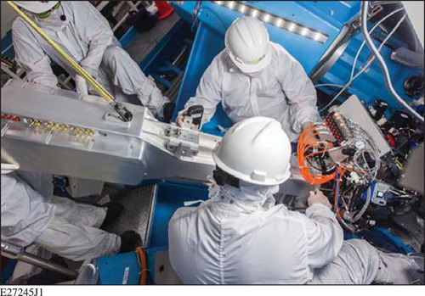
PS regime
Pulsed dilation tube (SLOS-TRXI, HSLOS) technology allows ~100x time magnification with good (~6 um) spatial resolution
Tech in use for ~ a decade at OMEGA, NIF
With Icarus, can image at 25 ps
If Tantalus can frame at 500 ps -> 5 ps regime?
Presumably challenging to fight timing jitter
Might need to sort through the data afterwards
Not a trivial undertaking to integrate

Slide 20
MEC-U (2028)
Everything at MEC but scarier: petawatt laser -> more EMP -> harder detectors farther away -> more pixels

Slide 21
The future is very exciting, but lots of work
Just some of the people/groups I’m working with who are doing the work:
UXI collaborators at Sandia, LLNL, Rochester
A. Carpenter, Q. Looker, M. Wood, on and on
Advanced hCMOS Systems
M. Sanchez, L.Claus, M. Dayton
At LCLS
MEC (E. Galtier, B. Nagler, HJ Lee, D. Khagani, G. Dyer)
Multipulses (FJ Decker, N. Burdet, S. Vetter)
Fast feedback (S. Möller, A. Halavanau)
DAQ (D. Damiani, M. Browne)
XCS (D. Zhu, M. Seaberg)
Users (A. Gleason, R. Sandberg, L. Dresselhaus-Marais, …)

