Slide 1
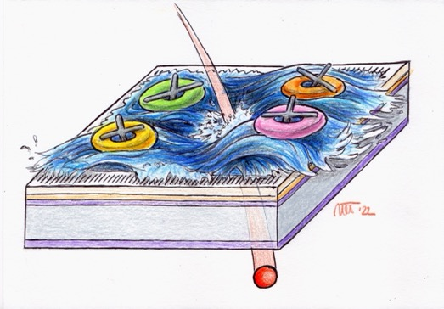
The power of gaining and sharing
Silicon sensors with internal gain and built-in charge sharing
N. Cartiglia, R. Arcidiacono
INFN Torino

Slide 2
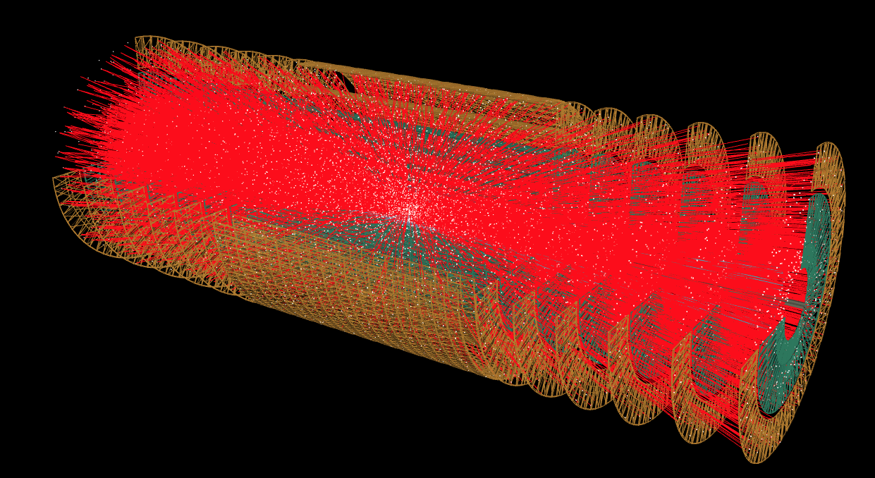
Outline
Requirements of future HEP experiments
First design innovation: low-gain avalanche diode
Second design innovation: resistive read-out
Resistive Silicon Detectors
  Experimental results
Conclusions and outlook

Slide 3
Requirements of future HEP trackers
Need very small pixels: about 50k pixels/cm²
Each pixel requires a lot of power
Spatial resolution ~ 5 μm
Temporal resolution ~ 10 ps
Very low material budget (sensor + elect. < 100 μm of silicon)
Very low power consumption (air cooling < 0.2 W/cm²)
The signal in thin sensors is very small
Good temporal resolution requires a lot of power per pixel

Slide 4
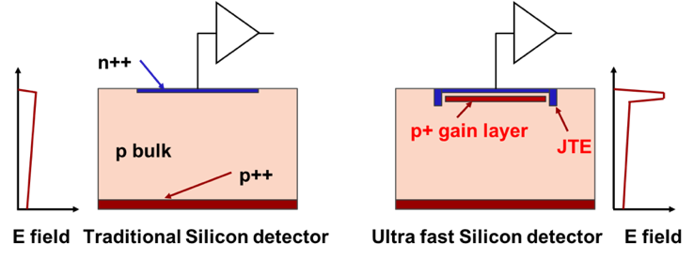
First design innovation: low gain avalanche diode (LGAD)
zoom
Drift area with gain
0.5 – 2 μm long
30-50 μm
Traditional Silicon Detector
Low-gain avalanche diode
The gain layer:
a parallel plate capacitor with high field
In LGAD, a moderately p-doped implant creates a volume of high field, where charge multiplication happens.
The low gain allows segmenting and keeping the shot noise below the electronic noise since the leakage current is low.
Low gain is the key ingredient to excellent temporal resolution

Slide 5
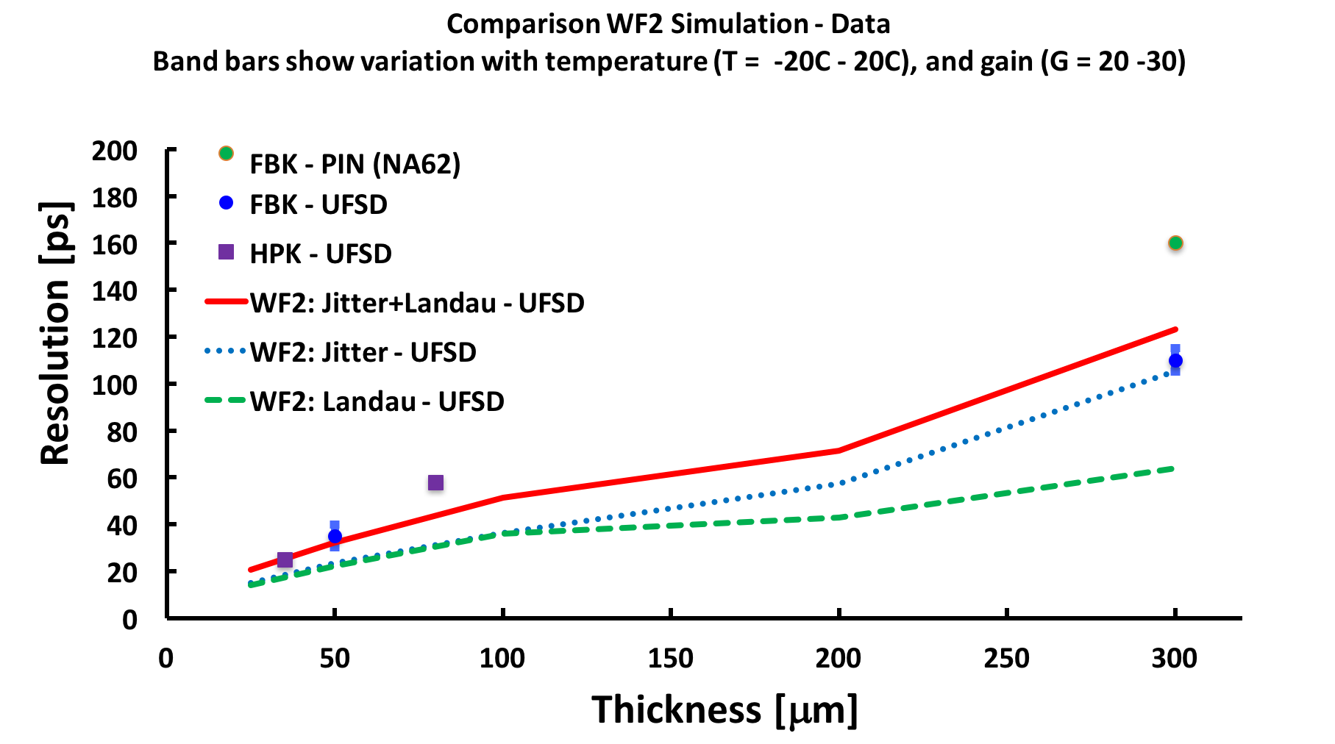
LGAD temporal resolution vs sensor thickness
Note: LGADs have an intrinsic resolution that depends on the thickness
Resolution without gain
LGAD
LGAD
Intrinsic LGAD
LGAD
LGAD
Intrinsic LGAD
Both CMS and ATLAS have opted for 50 μm thick LGAD,
(intrinsic time resolution of about 30 ps)

Slide 7
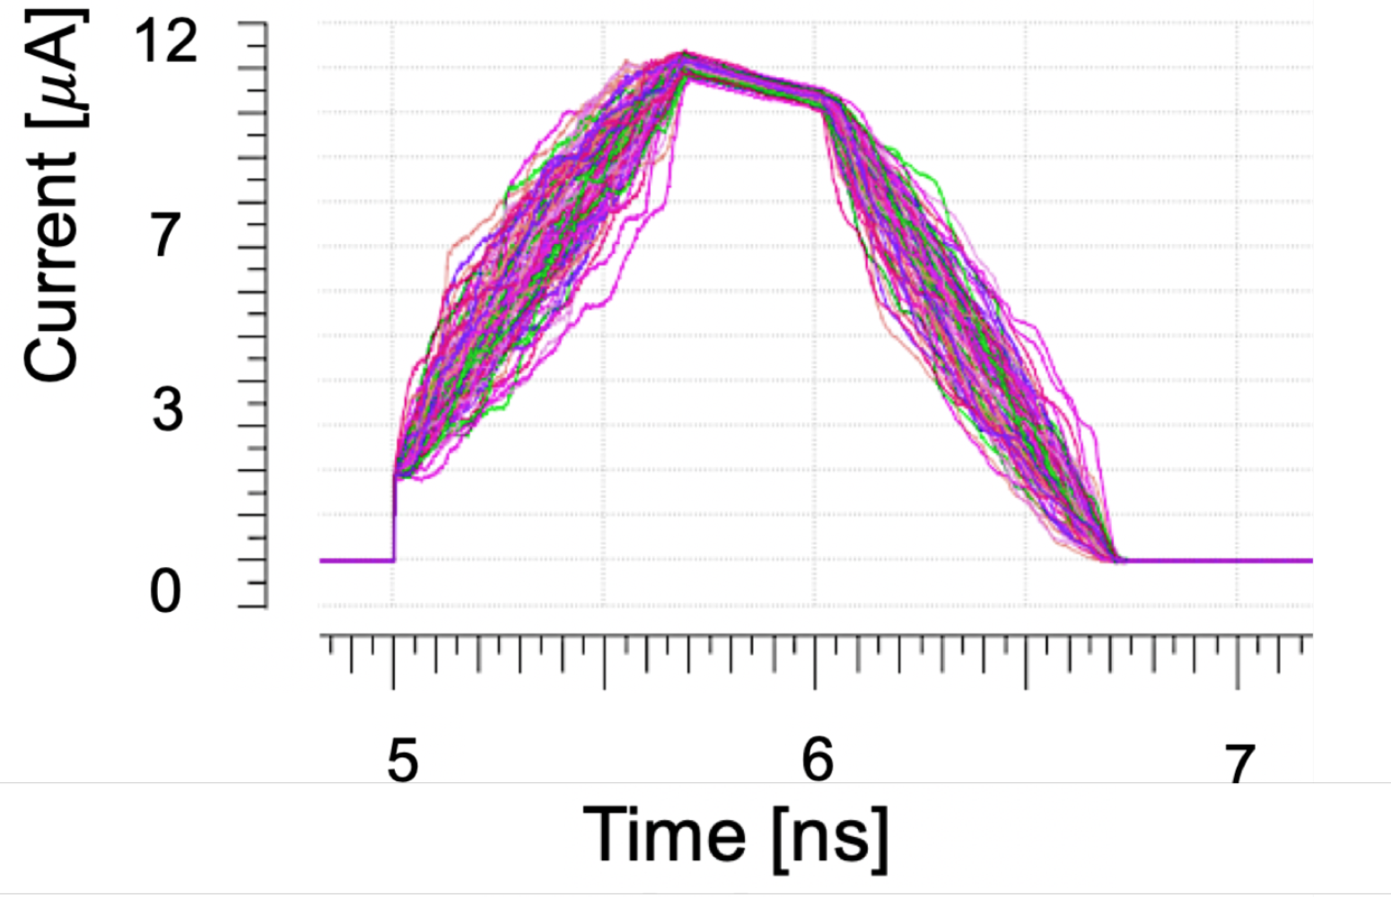
Intrinsic LGAD time resolution
Why LGAD have an “intrinsic” time resolution?
It is a combinatorial problem: how many different ways are there to produce a given amplitude summing up individual ionization clusters (imagine there is 1 cluster every 1 micron) ?
Intrinsic time spread
Permutations
Ionization clusters
Drift into gain region
+
+ + … =
50 micron thick ==> 50! Permutations…
10 micron thick ==> 10! Permutation
1 micron thick ==> 1 permutation, no temporal spread!

Slide 8

Interplay of power, pixel size, and electronics
The LGAD mechanism provides large signals, a fundamental component for achieving high temporal resolution.
However: when using small pixels, the power requirement/cm² is too high
Power will determine:
  The architecture of 4D tracking detectors
    how many layers will be 4D and how many will be 3D
  The pixel size and the temporal precisions.
Power
power

Slide 9

Second design innovation: resistive read-out
n⁺⁺
n⁺
$$σ \sim pitch/√12$$
-------------
+++++++++
-------------
+++++++++
^{p++}
p-bulk
Silicon detector with standard read-out
Silicon detector with resistive read-out
In resistive read-out, instead of many p-n diodes, there is a single diode.
The n-doped implant is resistive and acts as a signal divider
Very uniform Electric and Weighing fields
Signal sharing is the key ingredient to excellent spatial resolution

Slide 10
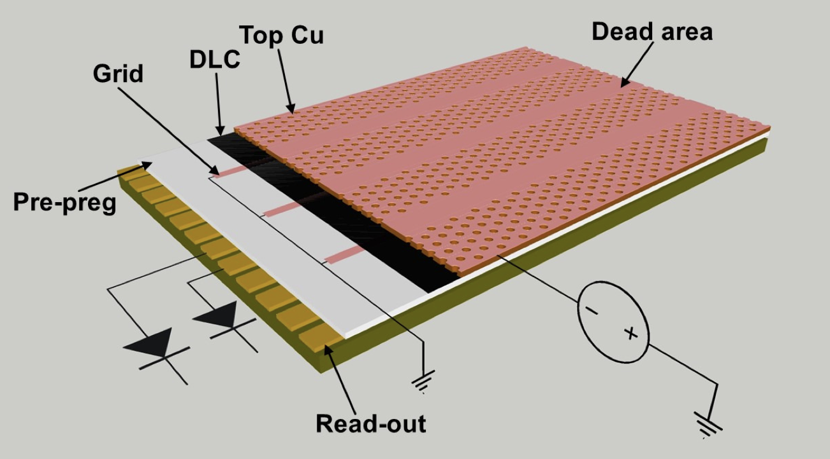


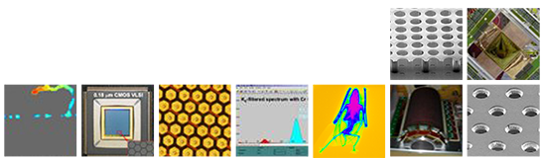
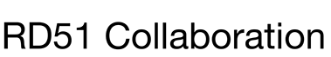
Some of the detectors containing resistive elements
We are working on extending the list of resistive detectors geometries that can be modelled. Some of the detector types will be used to benchmark the model.
  Fast grounding μ-Resistive-WELL
A incomplete list of resistive detectors:
Multi-gap Resistive Plate Chambers (MRPC)
surface Resistive Plate Counter (sRPC)
MicroCAT’s two-dimensional interpolating readout
μ-Resistive-WELL
Small-pad resistive MicroMegas
Resistive-strip bulk MicroMegas
Resistive PICOSEC MicroMegas Detector
4D Diamond Detector
Resistive Silicon Detectors (RSD)
Image taken from G. Bencivenni et al., Nucl.Instrum.Meth.A 958 (2020) 162050.

Slide 11
Resistive Silicon Detector (RSD)
n⁺
Gain implant
30-50 μm
^{p++}
p-bulk
Resistive Silicon Detectors
combine low-gain && resistive read-out
Note: RSD are also called AC-LGAD

Slide 12
Why RSDs are well suited for future experiments?
Innovation
Sensor property
Experimental feature
Continuous gain layer
100% fill factor
Uniform weighting field
Continuous cathode
Uniform carriers drift velocity
Resistive read-out
Reduced power consumption
Large pixels
Space for electronics
Signal sharing
Excellent spatial precision
Thin
Low material budget
Internal gain
100% efficiency
Large signals
Excellent temporal precision

Slide 13
RSD principle of operation in motion

Slide 14
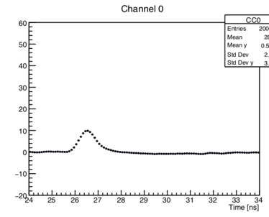
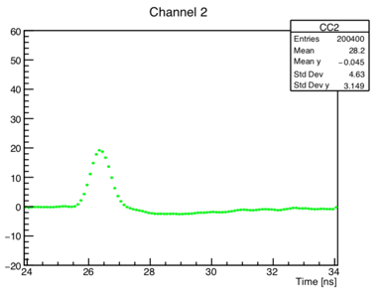
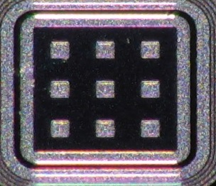
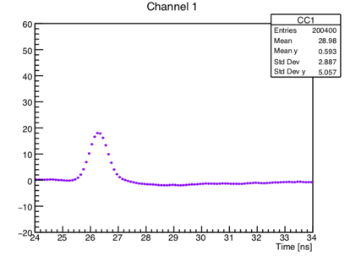
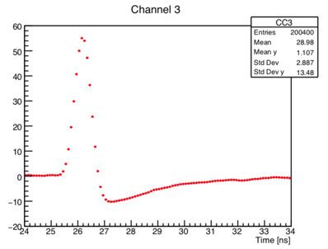
Example of signal sharing
P 1
Pad 1
60
40
20
0
-20
60
40
20
0
-20
Pad 1
Pad 2
Amplitude [mV]
50-mm thick RSD,
Gain ~ 20
0 2 4 6 8 10
0 2 4 6 8 10
1
2
60
40
20
0
-20
60
40
20
0
-20
Pad 3
Pad 4
3
4
Amplitude [mV]
0 2 4 6 8
0 2 4 6 8 10
Time [ns]
Time [ns]
The laser is shot at the position of the red dot: the signal is seen in 4 pads

Slide 15
Present RSD research paths
RSD (AC-LGAD)
DC-RSD
-+
-+
-+
-+
-+
-+
-+
-+
-+
-+
-+
-+
Cathode
E Field
E Field
Anode
This design has been manufactured in several productions by FBK, BNL, and HPK
This design is presently under development by FBK
The main advantage of the DC-RSD design is the ability to control the signal spread

Slide 16
FBK RSD productions
We have produced two RSD productions at FBK
RSD1 proved that the resistive read-out approach works
  Tune of production parameters such as n+ resistivity and AC-coupling parameters
RSD2:
  Optimize the fabrication parameters (resistivity, oxide, gain layer)
  Reduce as much as possible the metal area of the pads
  Design electrodes shape that would maximize the response uniformity obtained with the collected charge
    Use cross-shape electrodes

Slide 17
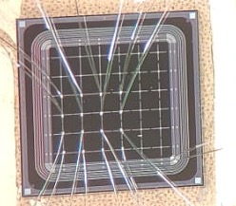
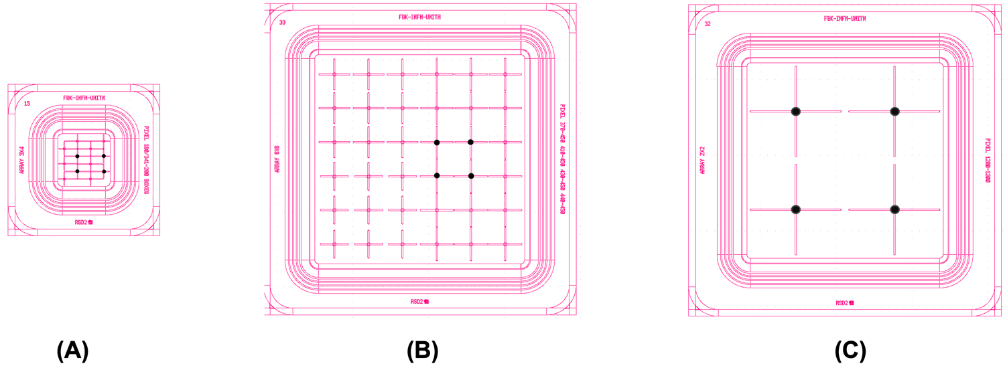
RSD2 sensors with cross-shaped electrodes
Pitch = 0.45 mm
Several geometries are exploded in RSD2, for example cross with different pitch and arm length: 200, 340, 450, and 1300 μm
200 x 340 μm²
Pitch = 450 μm
Pitch = 1300 μm

Slide 18
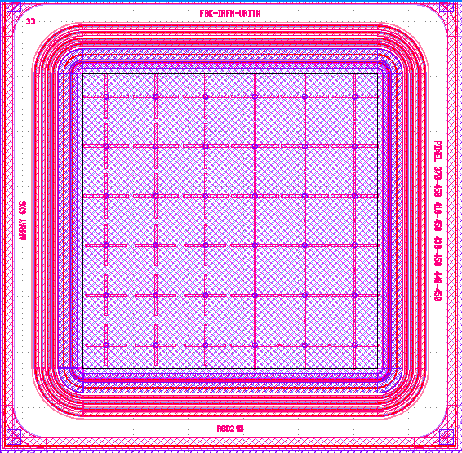
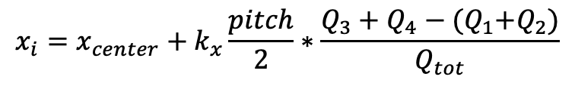
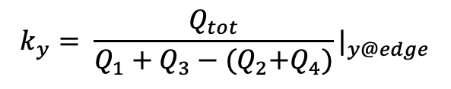
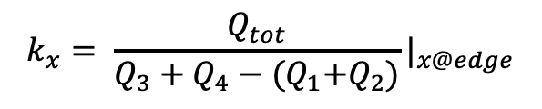
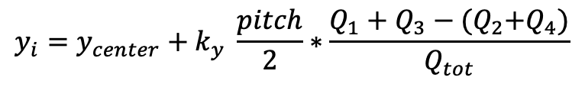
Position reconstruction using charge imbalance
The position is reconstructed using the charge imbalance among the electrodes positioned at the 4 corners
1
3
$$x_{i}=x_{center}+k_{x}\frac{pitch}{2}∗\frac{Q_{3}+Q_{4}−{(Q}_{1}+Q_{2})}{Q_{tot}}$$
2
4
$$y_{i}=y_{center}+k_{y} \frac{pitch}{2}∗\frac{Q_{1}+Q_{3}−{(Q}_{2}+Q_{4})}{Q_{tot}}$$
$$k_{x}= \frac{Q_{tot}}{Q_{3}+Q_{4}−{(Q}_{1}+Q_{2})}|_{x@edge}$$
$$k_{y}= \frac{Q_{tot}}{Q_{1}+Q_{3}−{(Q}_{2}+Q_{4})}|_{y@edge}$$

Slide 19
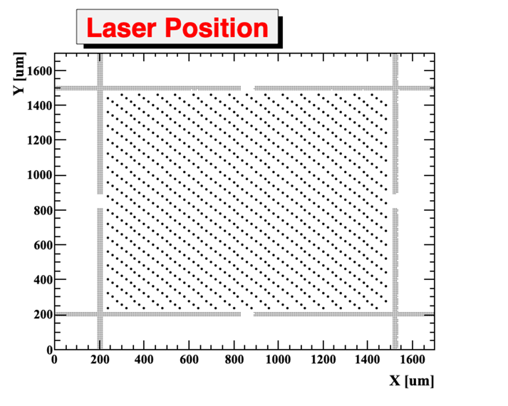
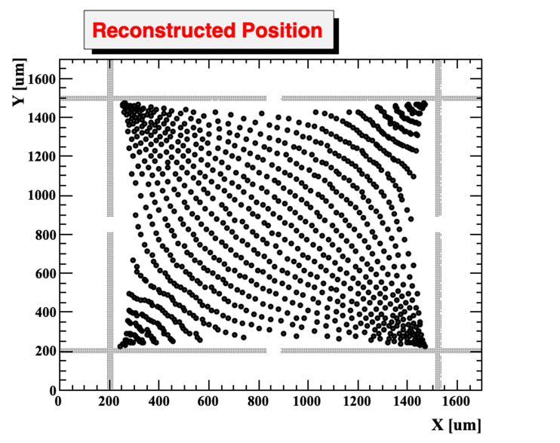
Evaluate the spatial resolution using laser TCT
Shoot the laser in a grid of points
Reconstruct the hit position with charge imbalance
First take-home result: even without any additional correction, the cross-shaped electrodes provide a fairly accurate position reconstruction
Second take-home result: near the pads, the reconstructed positions are systematically shifted with respect to true positions

Slide 20
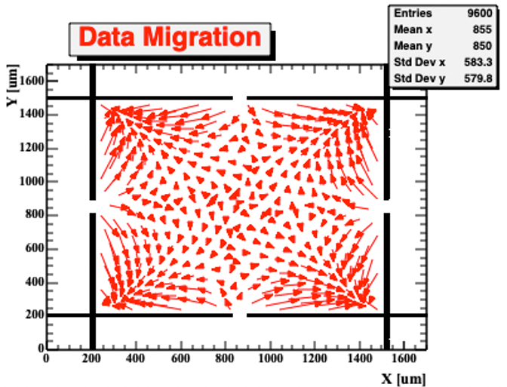
Correct the reconstructed position
Compute the migration map:
For each laser position, connect the true and reconstructed positions.
Laser Position
Reconstructed position

Slide 21
RSD2 spatial resolution
RSDs at gain = 30 achieve a spatial resolution of about 2-3% of the pitch size:
RSD:
1300 x 1300 mm²: σ_{x} ~ 40 μm
450 x 450 mm²: σ_{x} ~ 15 μm
Traditional standard pixel
1300 x 1300 mm²: σ_{x} ~ 920 μm
450 x 450 mm²: σ_{x} ~ 320 μm
gain = 30

Slide 22
RSD2 temporal resolution
The resolution depends mostly upon the signal size and weakly on the pixel size
RSDs at gain = 30 achieve a temporal jitter of about 20 ps
gain = 30

Slide 23
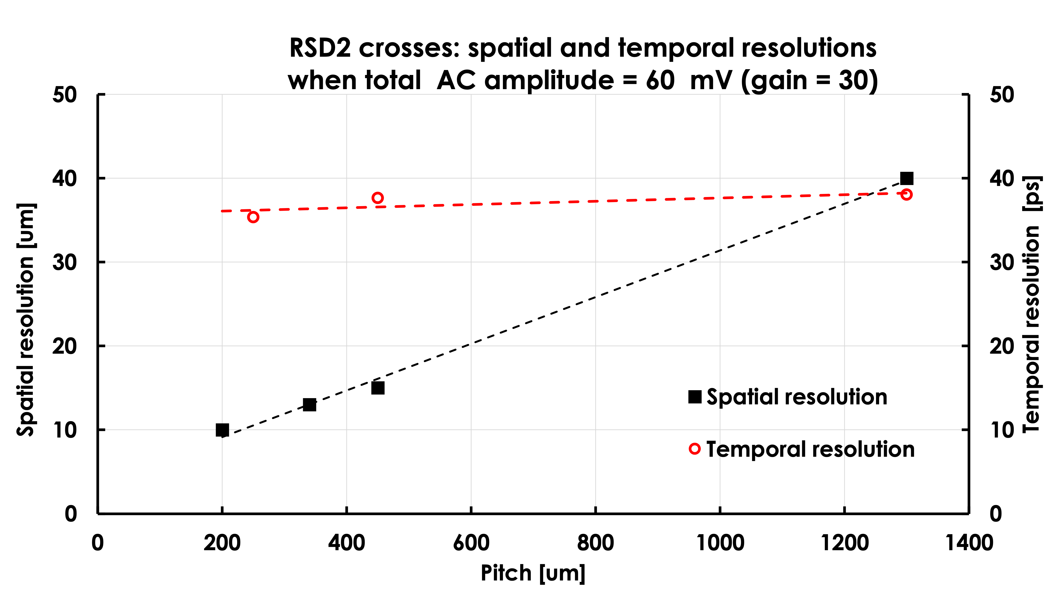
RSD2 performance summary

Slide 24
Final goal of RSD R&D: a completely new tracker
Pixel size
~ 25 x 25 μm²
Electronics
Pixel size
~ 250 x 250 μm²
~ 150 μm
Contacts
~ 50 μm
--
---
- --
+
++
+++
---
- --
++
+++
Resistive implant
Silicon bulk
Gain implant
Standard Tracker
LGAD-RSD-based tracker
The design of a tracker based on RSD is truly innovative:
It delivers ~ 20 -30 ps temporal resolution
For the same spatial resolution, the number of pixel is reduced by 50-100
The electronic circuitry can be easily accomodated
The power consumption is much lower, it might even be air cooled (~ 0.1-0.2 W/cm²)
The sensors can be really thin

Slide 25
Conclusions
The combination of internal multiplication and built-in charge sharing leads to the design of a new type of silicon tracker.
Resistive read-out && LGAD can be used both in hybrid and monolithic sensors
The pixel size can be quite large given the very good spatial resolution.
Limitations might be introduced by occupancy.
Spatial resolution depends upon ~ 1/gain, ~ 1/pitch, and ~noise
The temporal resolution is weakly dependent on the pixel size
Our laboratory measurements yield to (at gain = 30)
  a spatial resolution of about 3% of the pixel size
  a temporal resolution similar (but marginally worse) than that of standard LGADs

Slide 26
Acknowledgement
We kindly acknowledge the following funding agencies, collaborations:
RD50 collaboration
INFN - Gruppo V 4DShare project
INFN – FBK agreement on sensor production (convenzione INFN-FBK)
Horizon 2020, grant UFSD669529

Slide 27
Backup

Slide 28
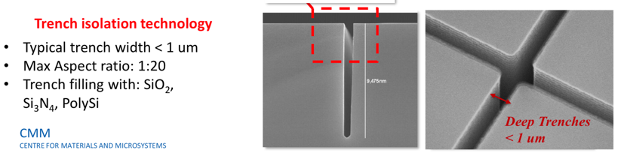
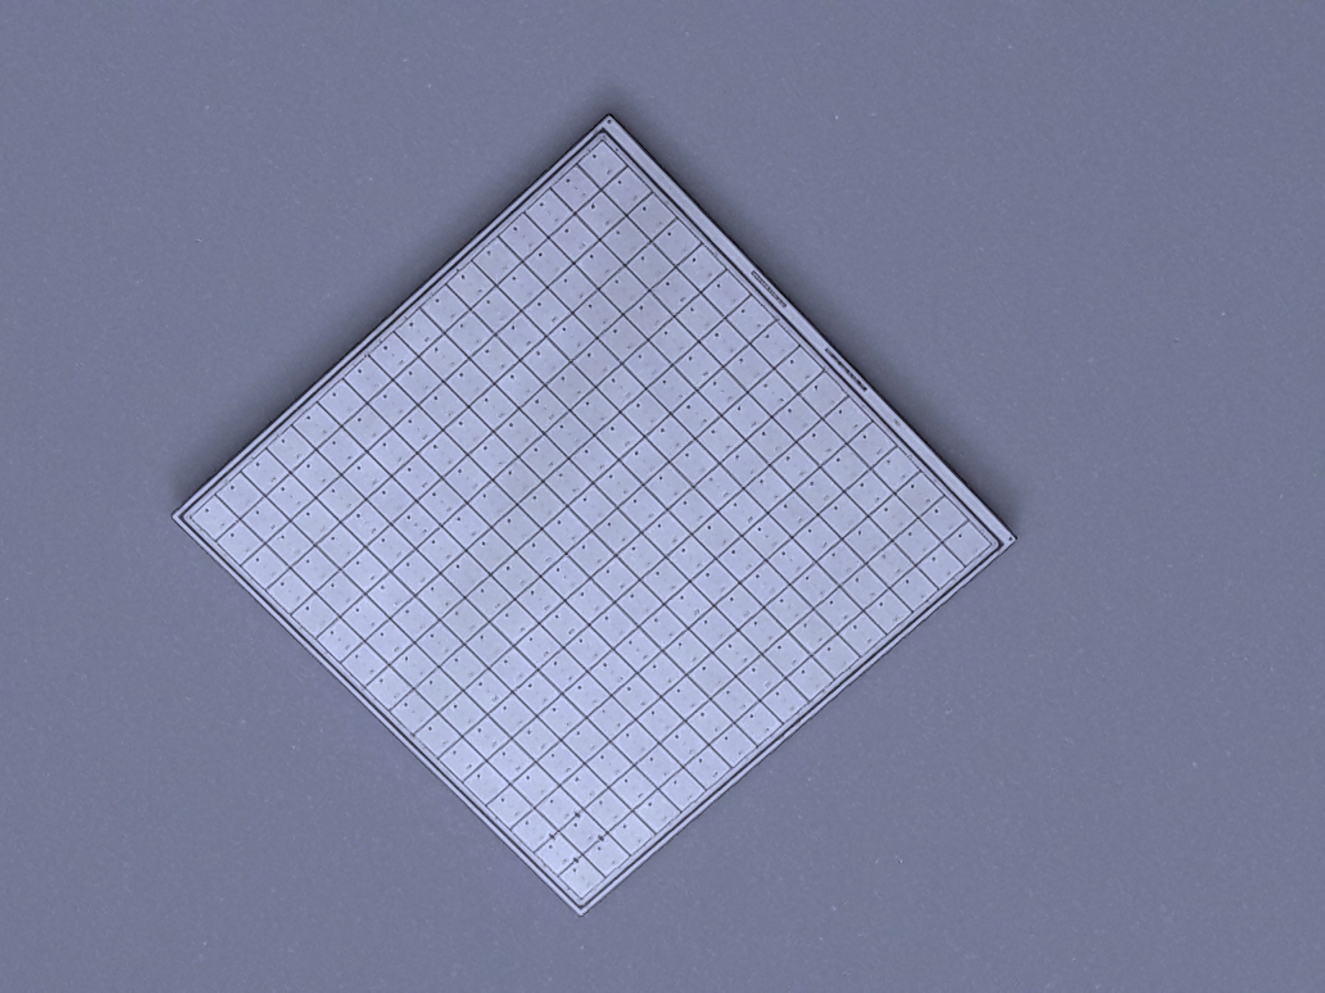
State-of-the art
Physicist
No gain area ~ 50 um
No gain area ~ 5 um
JTE + p-stop design Trench-isolated design RSD -- AC-LGAD
JTE/p-stop UFSD
CMS && ATLAS choice
Signal in a single pixel
Not 100% fill factor
Very well tested
High Occupancy OK
Rate ~ 50-100 MHz
Rad hardness ~ 2-3E15 n/cm2
UFSD evolution: use trenches
Signal in a single pixel
Almost 100% fill factor
Temporal resolution (50 μm) : 35-40 ps
High Occupancy OK
Rate ~ 50-100 MHz
Rad hardness: to be studied
RSD evolution: resistive readout
Signal in many pixels
100% fill factor
Excellent position resolution:
  ~ 5 μm with large pixels
Temporal resolution (50 μm) : 35-40 ps
Rate ~ 10-50 MHz
Rad hardness: to be studied
2.1 cm
HPK2
16x16 array

Slide 29
Reduced material budget
The active thickness of RSD sensor is rather small ~ 50 um.
There is a clear path leading to < 100 μm material:
ASIC
~1 μm glue
~150 μm
~50 μm
ASIC
25 um
~50 μm
50 um
ASIC
50 μm
25 μm
50 μm
Silicon beam
~200 μm
Thinned handle wafer:
  500 um ➔ 10-20 um
Thinned handle wafer:
500 um ➔ 10-20 um
Thinned active area:
50 um ➔ 25 um
50 ps ➔ 25 ps
Present design: no material budget optimization

Slide 30
Towards 100% fill factor: Trench Isolated LGAD
No gain
50-80 μm
No-gain region ~ 50-80 μm
➔ cannot use UFSDs for small pixels
oxide
Gain layer
p-stop
JTE
JTE
p bulk
V_{Bias}
Solution: use trenches for pad isolation
➔ No-gain region ~ 5 – 10 μm
No gain
5-10 μm
oxide
Gain layer
trench
trench
JTE
p bulk
V_{Bias}

Slide 31
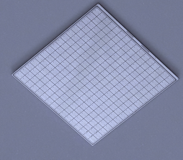
State-of-the-art: sensors for ATLAS and CMS
No gain
50-80 μm
oxide
Gain layer
p-stop
JTE
JTE
Epi p-bulk
Handle wafer
The ATLAS and CMS timing layers will use about 25 m² of UFSD sensors
Very well tested
Will be used up to ~ 2 E15 n_{eq}/cm²
Gain ~ up to 40 when new ==> up to 20 fC
Signal duration ~ 1 ns
Low noise
Rate ~ 50-100 MHz
Excellent production uniformity
Prototype of the final CMS sensor
V_{Bias}
2.1 cm
HPK2
16x16 array

Slide 32
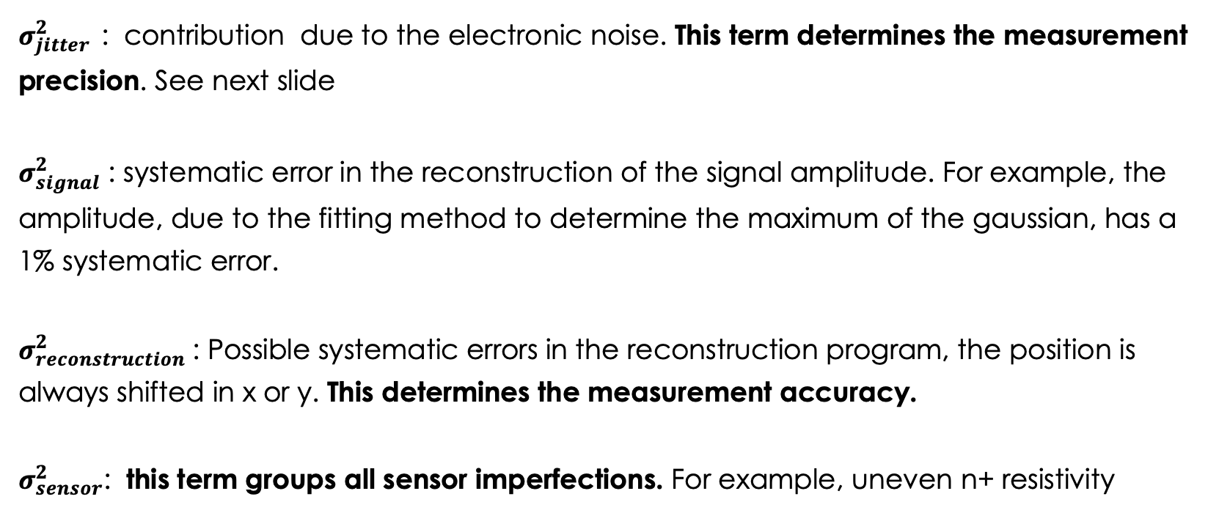
Hit position resolution
$$σ_{hit}^{2}=σ_{jitter}^{2}+σ_{signal}^{2}+σ_{reconstruction}^{2}+σ_{sensor}^{2}$$
$σ_{jitter }^{2}$: contribution due to the electronic noise. This term determines the measurement precision. See next slide
$σ_{signal}^{2}$ : systematic error in the reconstruction of the signal amplitude. For example, the amplitude, due to the fitting method to determine the maximum of the gaussian, has a 1% systematic error.
$σ_{reconstruction}^{2}$: Possible systematic errors in the reconstruction program, the position is always shifted in x or y. This determines the measurement accuracy.
$σ_{sensor}^{2}$: this term groups all sensor imperfections. For example, uneven n+ resistivity

Slide 33
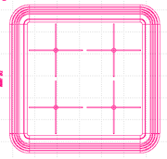
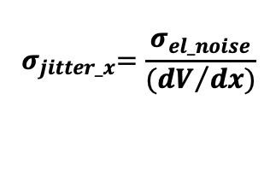
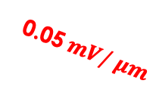
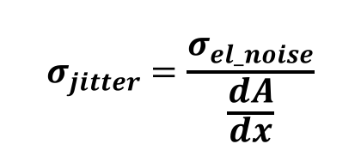
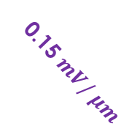


Spatial resolution: the role of jitter
The main component of the position resolution is the position jitter, defined as:
$$σ_{jitter}=\frac{σ_{el_noise}}{\frac{dA}{dx}}$$
Read-out pad
Imagine a system with a single read-out pad where a hit generates:
A signal of 100 mV when shot near a pad
A signal of 0 mV when shot at the opposite corner
Noise ~1 mV (as in our lab)
100 mV
0 mV
In this simplified system, the signal decreases by:
Pitch 1300 μm: 0.05 mV/μm
Pitch 450 μm: 0.15 mV/μm
100
$$σ_{el_noise}$$
Amplitude [mV]
0.05$mV/ μm$
$$σ_{jitter_x}$$
So, the jitter is:
Pitch 1300 μm: 1 mV/(0.05 mV/μm) = 20 μm
Pitch 450 μm: 2 mV/(0.15 mV/μm) = 7 μm
50
0.15 $mV/ μm$
$${ σ}_{jitter_x}=\frac{σ_{el_noise}}{{(dV}/{dx)}}$$
pitch: 450 μm
inter-pad: 1300 μm
0
0
500 1000 1500
distance [μm]

Slide 34
Irradiation effects
Irradiation causes 3 main effects:
Decrease of charge collection efficiency due to trapping
Doping creation/removal
Increased leakage current, shot noise
The main effect in LGAD is “acceptor removal”, i.e., the reduction of the gain implant doping
The electric field due to the gain implant decreases ➔ Compensated with higher bias
Main technique to decrease acceptor removal: carbon implantation in the gain layer
Carbon spoils the properties of silicon sensors.
However, in the right amount and only on the gain implant, it increases the sensor rad. resistance by a factor of 3
carbon implantation

Slide 35
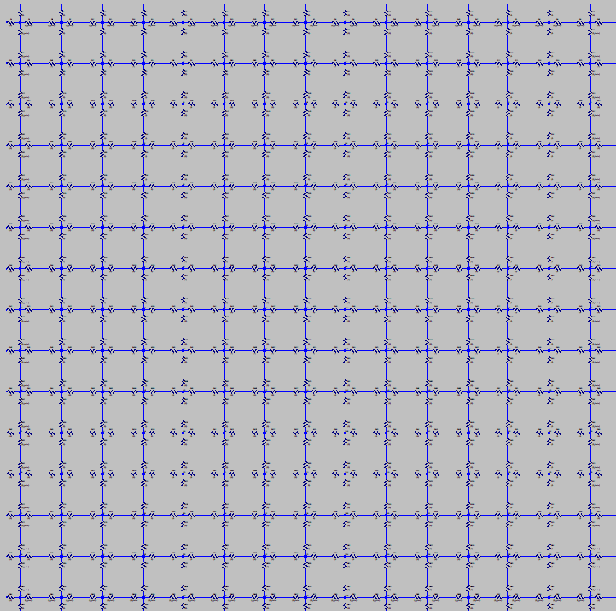
Limiting the signal spread to a single cell
Top view
AC pad
n+ contact
DC pad
oxide
---
--
++
+++
---
--
++
+++
resistive n+
inter-pad resistor
Crosscut
p bulk
gain implant
p bulk
p++
p++
RSD (AC-LGAD)
DC-RSD

Slide 36
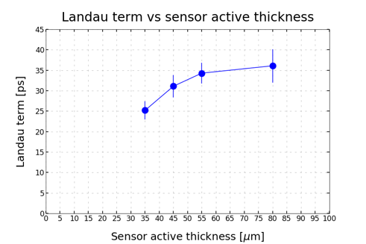
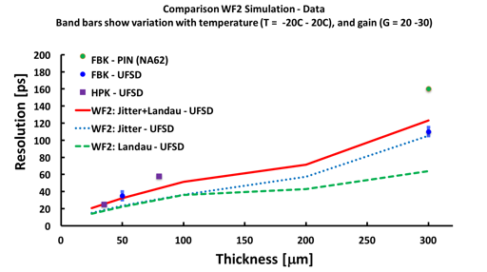
UFSD temporal resolution in thinner sensors
UFSD temporal resolution improves in thinner sensors:
==> reasonable to expect 10-20 ps for 10-20 μm thick sensors.
Be aware: very difficult to do timing with small signals… power consumption increases
Non uniform ionization:
Physical limit of UFSD sensors
FBK UFSD32 production

