Slide 1
Advanced accelerator future lepton collider opportunities
Mark Hogan*, John Power, Cameron Geddes*,
Pietro Musumeci*, Ralph Assmann*
*AF6 conveners
20 January 2022
1

Slide 2
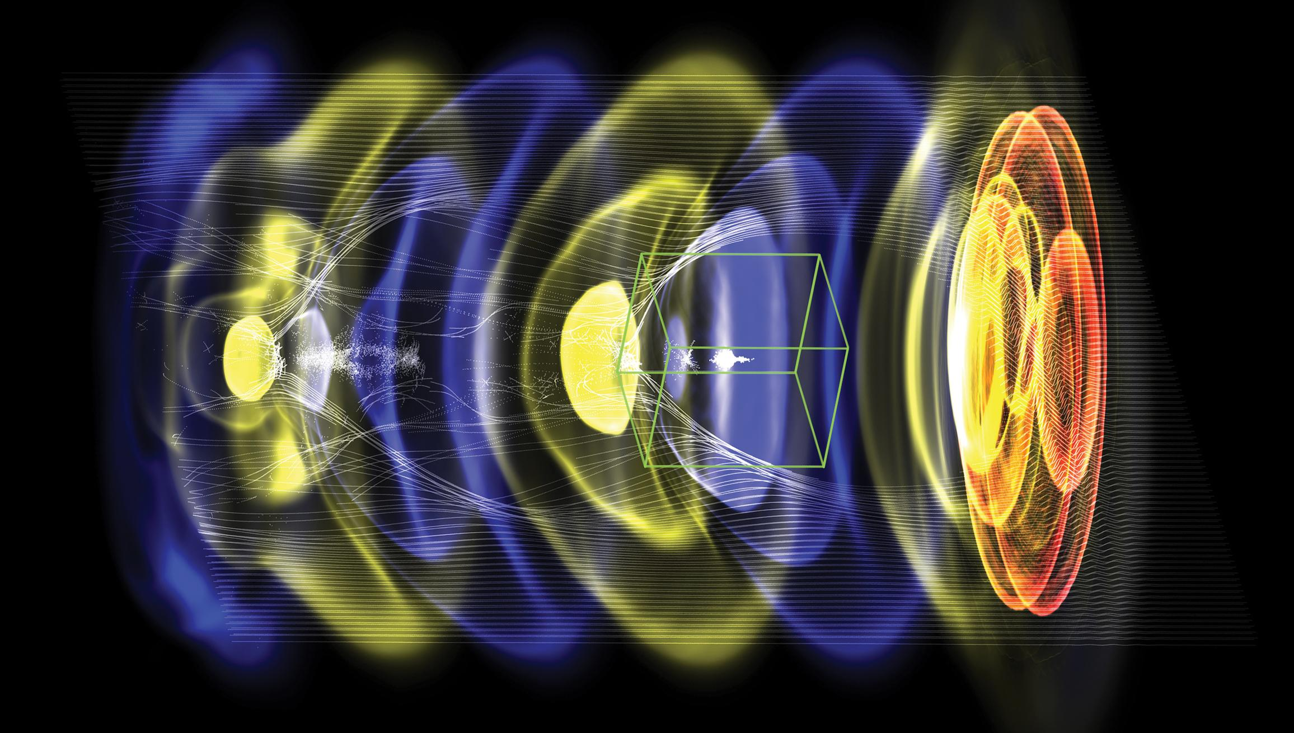
Advanced plasma and structure based accelerators:
High gradients offer potential from TeV to many TeV
Intense laser and particle beam driven plasmas or structures can circumvent current acceleration limits
Create: ultra-bright beams, fast cooling & focusing
CCC synergy: sources, focusing, facility extension…
Gradients 10 GeV/m & beyond, few TeV/km geometric
Site power: high wall-plug efficiency, high-luminosity/$
Rapid accelerator R&D progress in last decade
High brightness, 10 GeV-class energies, staging…
Compact colliders: polarized e+e-, gamma-gamma
Photon sources for applications in medicine, industry
Accelerator Frontier 6: established and new options
related:
International Committee for Future Accelerators
European LDG planning expert panel, report
Laser-driven plasma accelerator
(in quasi-linear regime)
Example: a laser or particle beam (red) drives a density wave (blue to yellow) in plasma, accelerating electrons (white) with fields of order 10 GeV/m
2

Slide 3
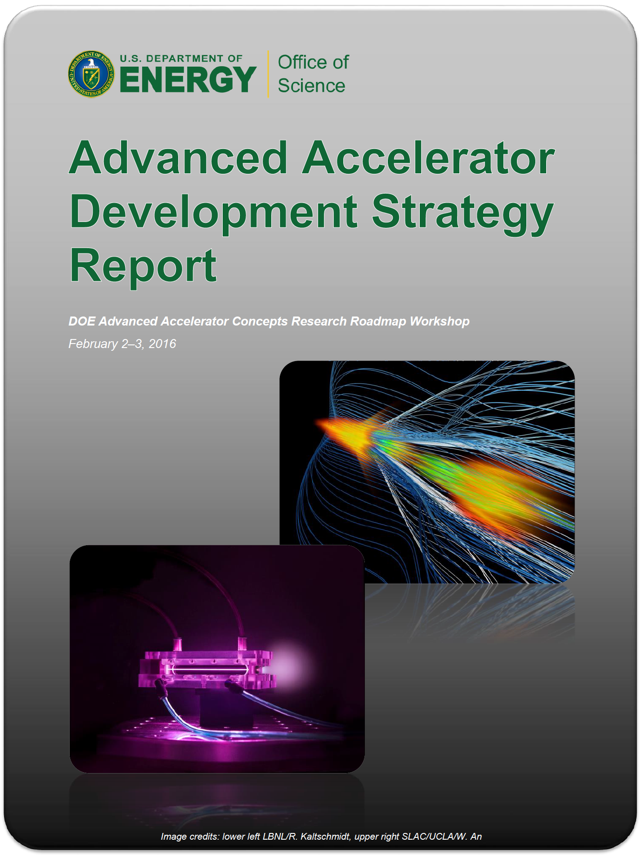
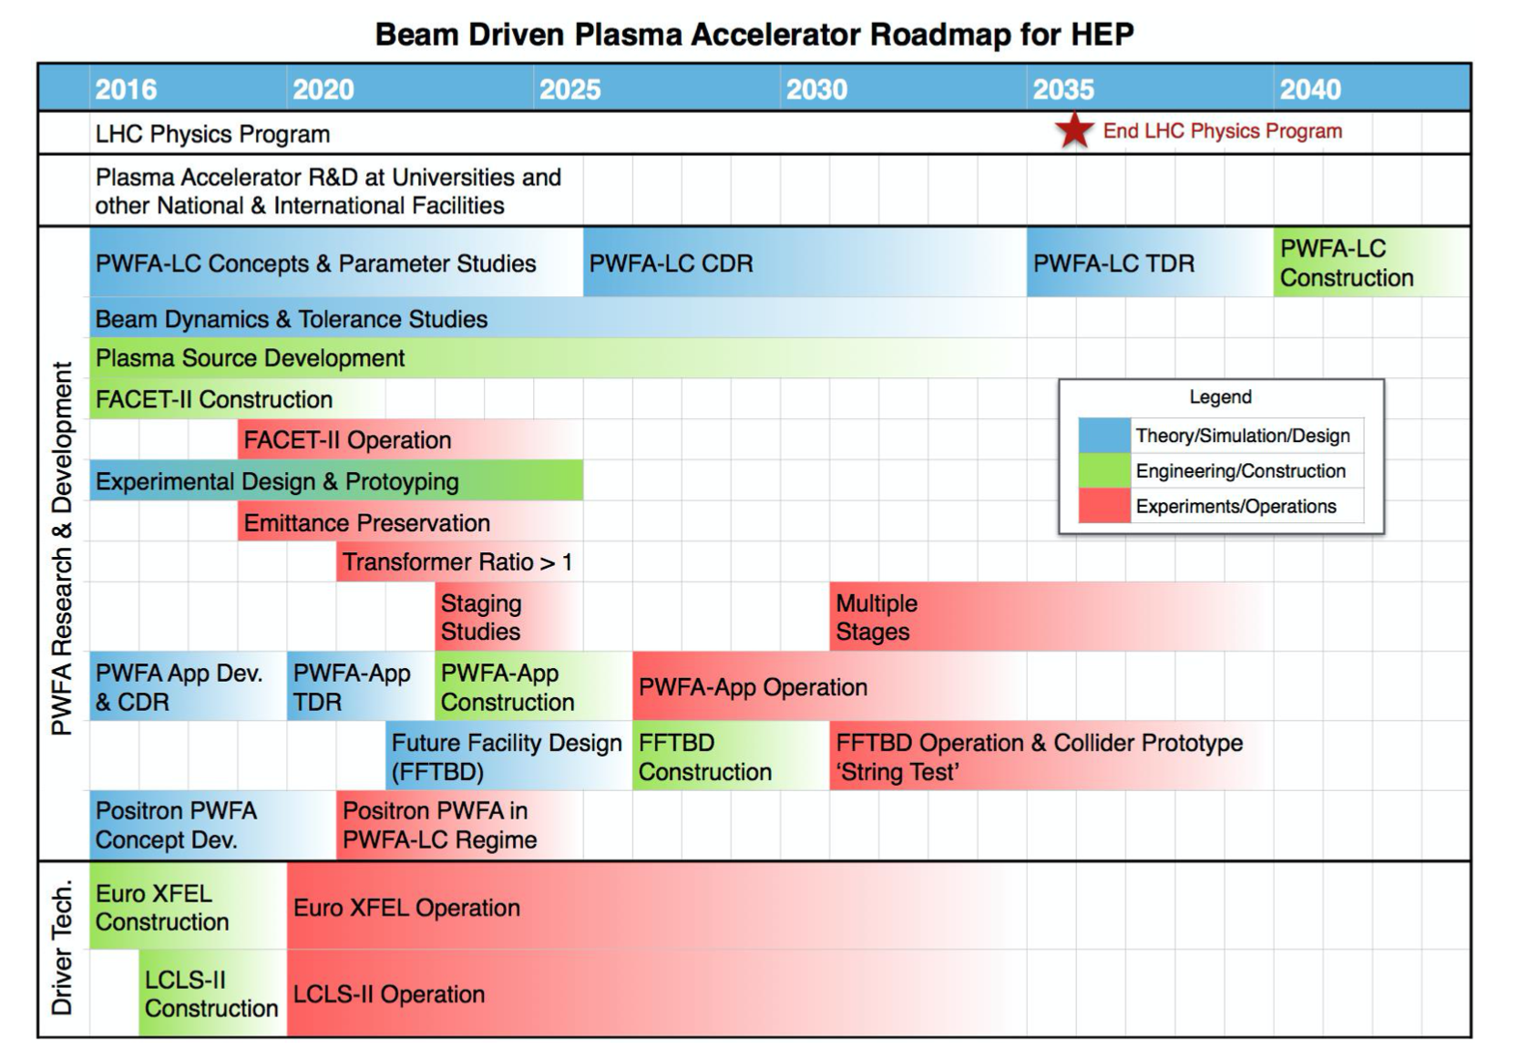
2016 Advanced Accelerator Development Strategy guides effort towards colliders, near term applications
Beam driven roadmap (example: similar for laser plasma & structures)
Parallel development of three methods mitigates risk
Laser-plasma wakefield (LWFA)
Beam plasma wakefield (PWFA)
Structure wakefield (SWFA)
Similar collider parameters
New ideas offer potential for even greater future performance: laser structures, nanoplasma, flying focus…
3
Technologies in R&D stage to date: now ready for integrated design study

Slide 4
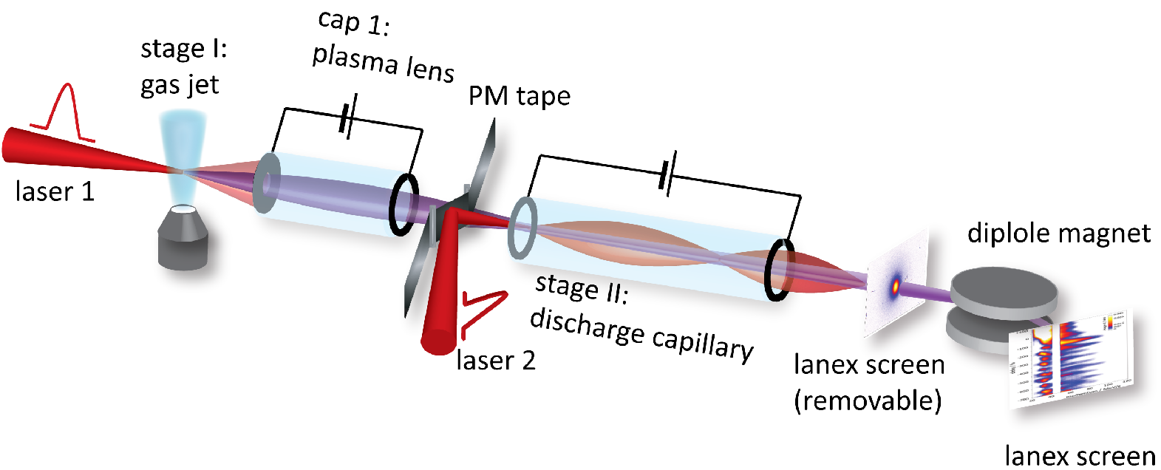
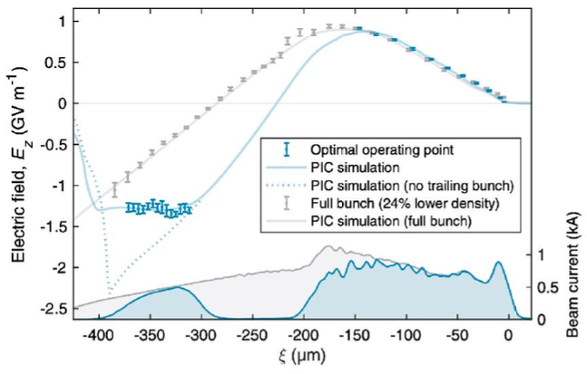
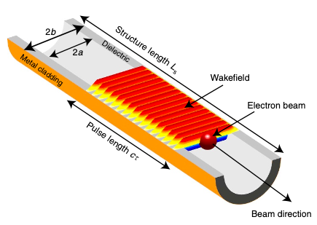
Rapid experimental progress since last Snowmass
LWFA 8 GeV energy gain in single 20 cm stage using PW laser (also: multi- GeV PWFA).
Proof-of-principle staging of LWFAs (~100 MeV energy gain) using plasma-based stage coupling
Optimized beam loading in PWFA enables uniform, high-efficiency acceleration.
Demonstration >1GeV/m gradients SWFA dielectric structures.
Demonstration 0.5 GW power SWFA structures.
FEL at 27nm (LWFA) and in (PWFA) demonstrate beam quality
A. J. Gonsalves et al. PRL (2019)
S. Steinke et al. Nature (2016)
42% transfer efficiency with 0.2% energy spread
GeV/m structure
B. O’Shea et al.
Nature Comm. (2016)
C. A. Lindstrom et al. PRL (2021)
LWFA: W. Wang et. al, Nature Vol 595 (2021)
4
Also: positron PWFA, hollow channels for low emittance growth, 0.1 micron emittance with path to nm-class…

Slide 5
Assessment of limits indicates potential for 15 TeV-class
AAC community has accessed potential limits of high-gradient linac technology
Shaped bunches can be used to efficiently accelerate beams without energy spread growth
Ion motion induced by dense beams can mitigate transverse hosing instability
Scattering in plasma mitigated by strong plasma focusing
Energy spread from synchrotron radiation in plasma limited by small beam emittances
Laser and beam energy recovery may be used for improved efficiency
Additional technical challenges require R&D
100’s of stages: Beam matching / coupling between including efficiency ≥ 99%
Small accelerating structures place challenging alignment and jitter tolerances
Plasma-based beam delivery system and final focus
Wall-plug power (operating costs) will limit energy reach of e+/e- linear colliders based on AAC
Beamstrahlung limits bunch charge and luminosity requirements increase required power:
Short beams and low emittance reduce power requirements (LOIs inc. 37, 190)
High gradients could enable practical energy recovery
AAC technology are capable of 15-TeV-class e+e- linear collider parameters
5

Slide 6
Collider potential to 15+ TeV, re-using near-term facilities
Similar parameter ranges accessible to each technology: coordinated example assembled
TeV-class established as part of 2016 AARD report, extended to 15 TeV
Documented in Snowmass LOIs & ref.’s including: 088, 216, 168
Next step for AF: integrated design study, self consistent and including tradeoffs
Sequence of collider options available to the 15 TeV class: polarized e+e- or gamma-gamma
New concepts continue to emerge that extend this potential
 | Components |  |  |  | Performance Parameters
Concept | Accelerator Technology | Beam source | Interstage Coupling | Beam Delivery | Effective Gradient | Energy | Luminosity | Efficiency | Power (no recovery)
ILC | SC RF | Damp. Ring | N/A | ILC BDS | 31.5 MV/m | 0.5 TeV | 2.7E34 |  | 240 MW
AALC | Plasma or Str. | Damping | Trad. mag. | Trad. BDS | 1 GeV/m | 1 TeV | 1E34 | 15% | 70-100 MW
AALC | Plasma or Str. | Damping | Mag. or Plasma | Trad. BDS | 1 or 10 GeV/m | 3 TeV | 3E34 | 15% | 185-315 MW
AALC | Plasma or Str. | Plas. cath.@nm | Mag. or Plasma | Trad. BDS | 1 or 10 GeV/m | 3 TeV | 1E35 | 15% | 200-315 MW
AALC | Plasma or Str. | Plas. cath.@nm | Plas. lens | Trad. BDS | 10 GeV/m | 15 TeV | 1E35 | 15% | 900-1100 MW
AALC | Plasma or Str. | Plas. cath.@nm | Plas. lens | Plas. lens | 10 GeV/m | 15 TeV | 5E35 | 15% | 900-1100 MW
Potential to re-use infrastructure of nearer-term LC (e.g. ILC, CCC) to enable many TeV
6

Slide 7
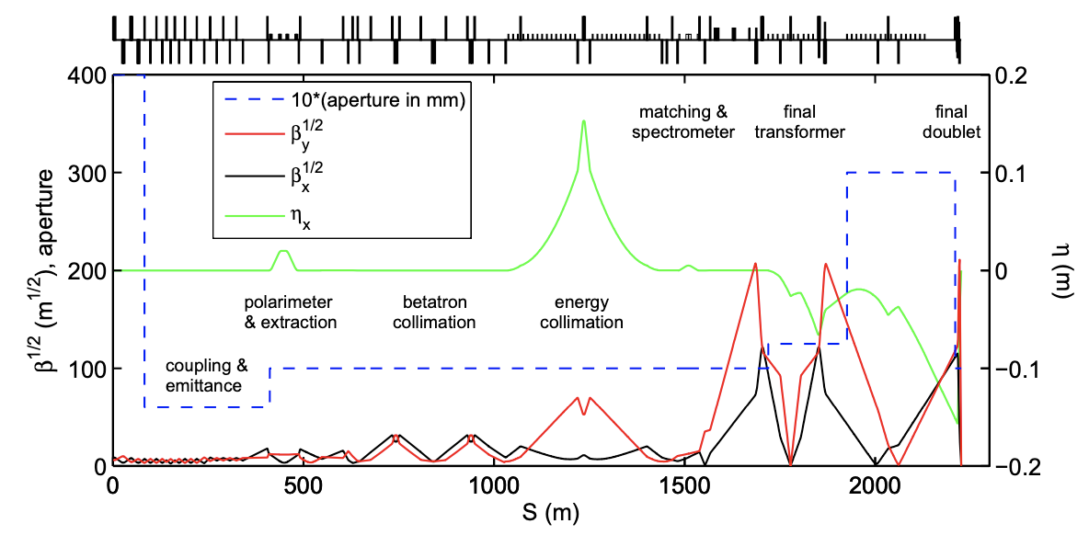
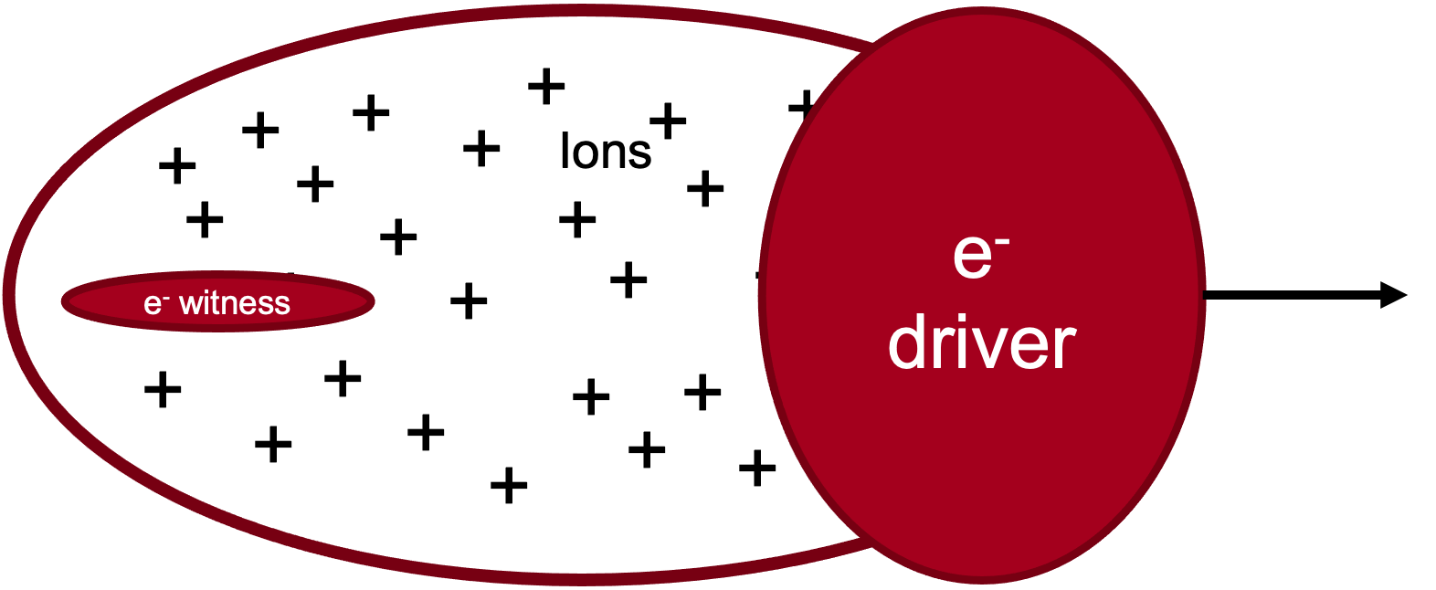
Interaction point beam delivery: strong focusing potential
A traditional BDS system contains diagnostic sections and collimation sections in addition to the Final Focus and Machine-Detector Interface.
Can we develop novel diagnostics (e.g. betatron radiation) to characterize the beam emittance?
Can we develop novel collimation schemes?
The Final Focus uses the local chromatic correction in the final doublet.
Can we employ novel chromatic correction techniques with shaped plasma lenses?
Can we reduce the beam spot using strong focusing from plasma lenses?
Bunch format: default evenly spaced 10-100kHz class (10-100µs), other formats possible
ILC BDS
Active Plasma Lens
Passive Plasma Lens
Potential to extend performance of nearer-term LC (e.g. ILC, CCC) & future AF6 concepts
7

Slide 8
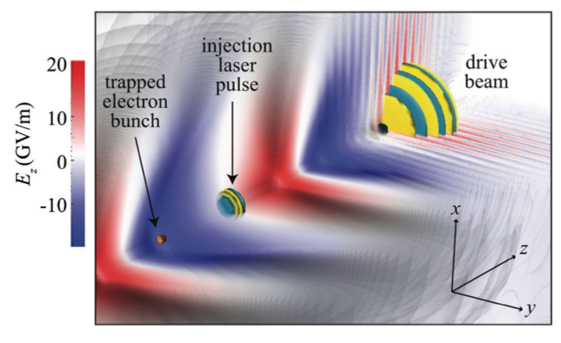
High fields enable ultra-bright sources
Conventional injector brightness constrained by transverse energy of emitted electrons and space charge forces
GeV/m plasma gradients transform electron brightness
Rapid acceleration + shielding reduce space charge effect
Primary limit due to transverse momentum
0.5 GeV/m gradients in SWFA Two Beam Accelerator gun
Rapid acceleration, ~10nm emittance
Ultralow dark-current
Control transverse momentum via ionization/structure
multi kA, 100 pC and 50 nm emittance beams, path to 10nm class directly from plasma injector
Reduces/eliminates cooling and conditioning needs
Positron sources via targets; polarization using undulators
Rapid acceleration, production, capture and cooling
Multi-beam control of emittance
Wakefield positron sources
Compact high-E and capture
e-
accel
High Z
e+
accel
Driver1
e-& e+
PWFA
Plasma lens
e-
e+
Driver2
Target or undulator
e.g. see Pietro’s talk Thursday Noon, AF7 workshop
Potential to extend performance of nearer-term LC (e.g. ILC, CCC) & future AF6 concepts

Slide 9
High fields enable energy recovery
Energy recovery linacs very successful but challenging for colliders due to gradient
Concept: use recycling pulse in high gradient structure to sweep up energy remaining
Particle beam energy (applicable to all colliders)
Wake energy, drivers (applicable to wakefields driven by beams and lasers in plasmas, structures)
Re-use pulses or recover energy in RF or PV systems
Potential for 2x or more reduction in energy use, extending physics reach
Detail: M. Turner, Snowmass CF workshop
Drive pulse
Witness bunch
Recycling pulse
Potential to extend performance of nearer-term LC (e.g. ILC, CCC) & future AF6 concepts

Slide 10
Beamstrahlung advantage possible via short pulse AAC colliders
Beamstralung parameter (mean field strength of beam normalized to Schwinger field):
Multi-TeV colliders (using short beams) operate at high beamstrahlung parameter Y>1
Average number of beamstrahlung photons per electron at IP:
G. Dugan, AIP Conf. Proc. 737, 29 (2004)
classical beamstrahlung
quantum beamstrahlung
Figure of merit: (luminosity)/(wall-plug power)
classical beamstrahlung regime (Y<<1):
quantum beamstrahlung regime:
Plasma-based injectors produce ~nm normalized emittance
AAC linacs accelerate short beams (tens of um)
Note: beam disruption typically negligible for ultra-short beams

Slide 11
Example: High-level parameters for e+/e- laser-plasma collider
Laser-plasma linear e-/e+ collider |  | 1 TeV | 3 TeV | 15 TeV
Beam energy | TeV | 0.5 | 1.5 | 7.5
Particle number (1E9) |  | 1.2 | 1.2 | 1.2
Beam power | MW | 4.4 | 13 | 65
Luminosity (1E34) | cm-2 s-1 | 1 | 10 | 50
Transverse. beam sizes at IP, x/y | nm | 50 / 1 | 10 / 0.5 | 4 / 0.25
IP beta function, β* | mm | 0.1 | 0.1 | 0.1
RMS bunch length | micron | 8.5 | 8.5 | 8.5
Repetition frequency | kHz | 47 | 47 | 47
Time between collisions | microsec | 21 | 21 | 21
Beamstrahlung photons/e- |  | 0.7 | 1.7 | 1.9
Length (2x main linac tunnel) | km | 0.44 | 1.3 | 6.6
Facility site power (2 linacs) | MW | 105 | 315 | 1100
Notes:
LWFA parameters:
1 um laser wavelength
10¹⁷ cm⁻³ plasma density
Note: one example, similar coordinated sets for beam driven and structure accelerators (with ITF)

Slide 12
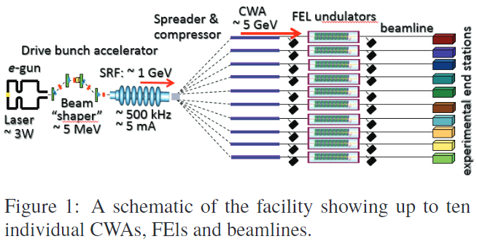
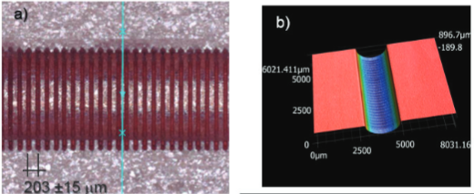
AAC facility next steps will advance technology
and test key remaining parameters
Circa 2025, anticipate high-level demonstrations at existing beam test facilities:
Laser driven staging of two 5 GeV-class cells with high efficiency @ BELLA
Beam driven demonstration of 10 GeV single stage with mm-mrad emittance, percent energy spread and high-efficiency @ FACET-II
Plasma repetition rate limits characterized @ FLASHForward, FACET-II
Demonstrate potential for intermediate applications (pre-collider)
500MeV SWFA demonstrator module @ AWA
Near term applications will establish technology, and benefit future colliders:
Compton MeV photons, FELs, nQED, injector…
societal benefit, increase HEP investment return

Slide 13
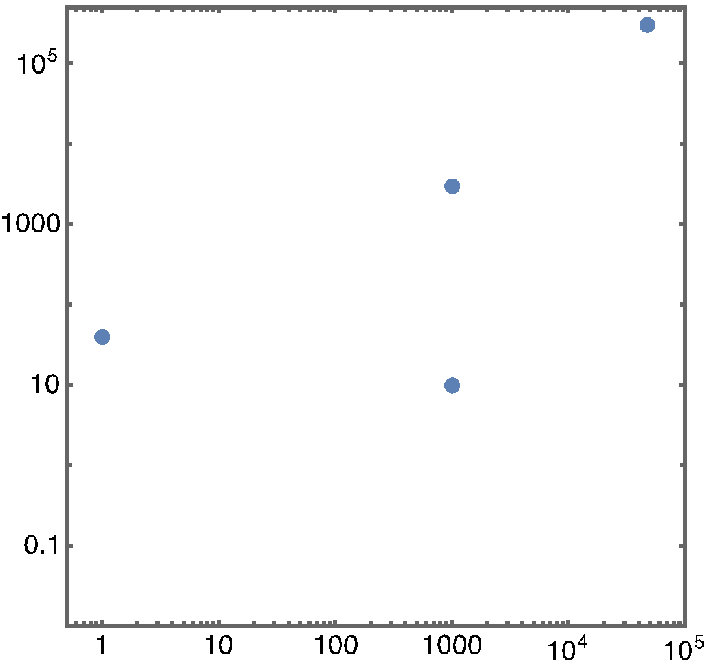
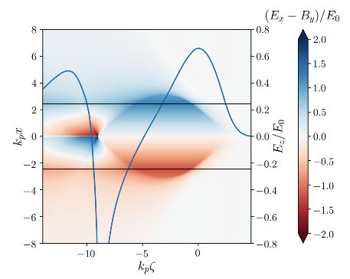
AAC facility next steps will advance technology
and test key remaining parameters
Rapid investment in Europe, Asia, incl. EuPRAXIA ($600M-class)
US R&D, facility base creates leadership opportunities
Positron acceleration R&D
Technical challenges: plasma acceleration of stable, high-quality e+ beams, with high efficiency (comparable to e-)
FACET-II upgrade: plasma-based positron acceleration experiments/tests (e.g., plasma columns or hollow channels)
Staging of two modules and multiple-driver/injector beams
BELLA 2nd beamline: staging; future positrons & injectors
High-average power and high repetition rate plasma accelerators:
Technical challenges: targetry at repetition rate, heat deposition and management (~kW/cm), structure durability
kBELLA project: kHz, J-class laser. Technology available; precision via active feedback, applications on collider roadmap
Integrated submodule of TeV SWFA design:
GW rf power generation and sustainable 0.5GV/m acceleration
Over 50% of RF-to-beam efficiency with shaped main beam.
3GeV demonstrator in AWA-II High-Energy Upgrade.
collider parameters
kBELLA
Average power (W)
BELLA
kHz LWFA
Bunches / sec
Wake excited in plasma column
e+ focusing and accelerating region
S. Dieterichs et al. PRAB (2019)
13

Slide 14
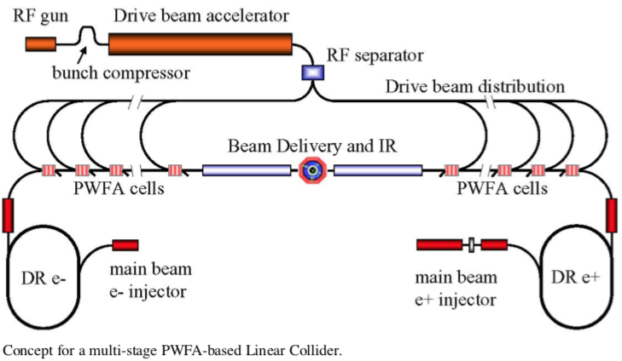
Beams from a CCC demonstrator facility could
be a important platform for AAC research
Potential CCC roles in AAC research:
Extend measurements for plasma recovery at ns vs µs spacing
Advanced Structure R&D: Cold dielectric structures @AWA
Advanced Structure R&D: Beam-driven THz structures @AWA
Shaping of beams
Compact beam driver technologies
Demonstration of compact staging technologies that scale to multi-TeV
See: C. Lindstrøm “STAGING IN HIGH GRADIENT WAKEFIELD ACCELERATORS”
https://cas.web.cern.ch/sites/cas.web.cern.ch/files/lectures/sesimbra-2019/casstaginglecture.pdf
A. Seryi et al., SLAC-PUB-13766
See: C.A. Lindstrøm et al., NIM Phys. Res. A 829, 224-228 (2016)

Slide 15
AF6: Contributed Papers & Interest Groups
Theme | POC(s)
PASAIG (multiple papers: PWFA, LWFA, SWFA) | E. Esarey, W. Mori, C. Schroeder, J. Power, C.Jing, N. Vafaei-Najafabadi
Laser Driven Structures | J. England
Nanostructure-nanoplasmonic accelerator | A. Sahai
(GARD) Beam Test Facilities | V. Yakimenko, J. Power
Laser Drivers | L. Kiani, T. Zhou
BDS/IP Issues for Advanced Concepts | S. Gessner
Near term applications of Plasma Acceleration | J. Van Tilborg and C. Emma
Novel Particle Sources | M. Fuchs
To other Topical Groups:
AF4 white paper integrating all elements of collider for plasmas/structures, possibly others (separate format)
AF1 facilities paper (John P, from GARD facilities paper)
AF7 Particle sources
AF7/AF3 polarized positrons (Pietro)
ITF input (input done, processing)
FNAL site filler, ILC extension using AF6 tech. CCC??
Applications/industry, computing, environment…
https://snowmass21.org/accelerator/advanced/start#white_paper_coordination
Notes:
Plasma and Advanced Structure Accelerator Interest Group

Slide 16
Advanced accelerators offer components and future colliders
Collider concepts indicate 15 TeV, beyond possible
Polarized e+e-
gamma-gamma
Organizing towards integrated design study
Efficiency advantages extend reach
Short beams – save power, reduced beamstrahlung
High gradients could enable energy recovery
Potential to re-use facilities of LC’s like ILC, CCC to reach (much) higher energies in the future
Injectors/focusing/components for CCC, others
Community planning of sequence of accelerators in readiness and capability is important to the field
e+e- and gamma-gamma to/beyond 15 TeV
Coordinated parameter sets available: Example- 15 TeV at 5E35 luminosity
CCC and AF6 technologies motivate inclusion of high-energy e+e- and 𝛄𝛄 signatures for EF
Theme | Point of contact
Plasma & advanced structures | E. Esarey, J. Power, V. Yakimenko, C. Schroeder, N. Vafei-Najafabadi, W. Mori
Laser driven structures | J. England
Nanostructure/plasma | A. Sahai
GARD beam test facilities | J. Power
Laser drivers | L. Kiani
BDS/IP issues | S. Gessner
Near term applications | J. van Tilborg & C. Emma
Novel particle sources | M. Fuchs
Additional information (links in file):
• CPM: Plasma collider limits, options
• AF6 page, and workshop
Contact: Cameron Geddes, Mark Hogan, Pietro Musumeci, Ralph Assmann
16

