Slide 1
Fermilab Linear Collider activity
Nikolay Solyak
Future US Colliders Workshop, January 18-21, 2022

Slide 2
Topics for discussion
Alignment / Tolerances / Vibrations
Beam Dynamics studies for ILC
NLC structures and RF Distribution
Beam line diagnostics (BPM)
Magnets

Slide 3
Fermilab experience in collider-related accelerator physics and technology:
Fermilab has vast experience and expertise in
Developing, fabrication and demonstration the best X-band accelerator structure for NLC.
NLC RF distribution system (couplers, pulse compressor, mode converter, extraction etc…)
Beam Line components development: example - high resolution BPM (ATF, CERN, LCLS-II)
High gradient magnets design: split SC magnet (adopted for LCLS-II), permanent magnets
Fermilab successfully adapted and developed DESY SRF technology building and testing the L-band ILC cryo-module, which performed the record acceleration gradient.
Extention of ILC technology to cw LCLS-II, developing advanced cavity processing technique, which allowed high quality factor; new cavity tuners; modified HP couplers, Cryo distribution system. ~20 CM’s delivered to SLAC.
Fermilab scientists have a vast experience in design of the high-power pulsed RF sources for NC colliders (collaboration with KEK and USA universities)
Beam physics including emittance preservation problems, wakes, HOMs, alignment; etc…

Slide 4
Lattice design and Beam dynamics studies for ILC
RTML and ML LATTICE Design
Initial Lattice design is mostly done by SLAC team,
Many modifications in TDR stage: DR injection/ extraction lines, Bunch Compressors, new extraction dump lines, curvature, matching, etc…
Beam Dynamics Studies:
- Misalignment/Vibration tolerances
Wakefields (LR and SR)
Coupler kick
Emittance preservation in RTML and ML, Effect of static misalignment, X-Y Coupling correction
Effect of dynamic errors:
Beam and beamline component jitter (magnets, RF fields/phase, etc..)
Stray magnetic fields
Ground motion
Development BBA algorithms for static and dynamic errors
1-2-1 correction, DFS/DMS; ballistic alignment, Dispersion Bumps
Simulation of dynamic Feed-back control
Start to end simulation (DR to IP)
Field emission, Dark current dynamic, Radiation and shielding in ML tunnel

Slide 5
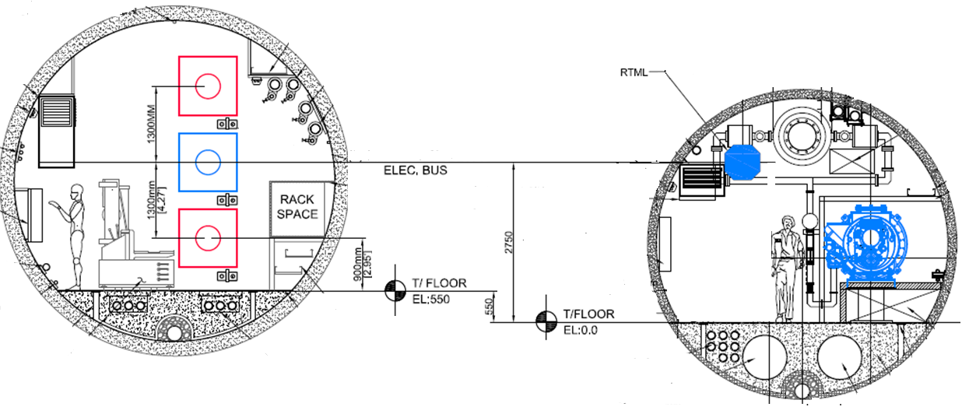
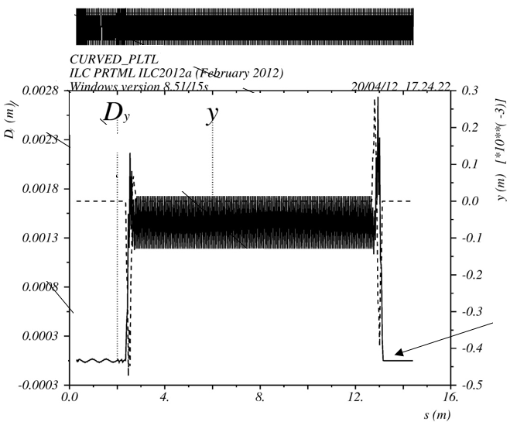
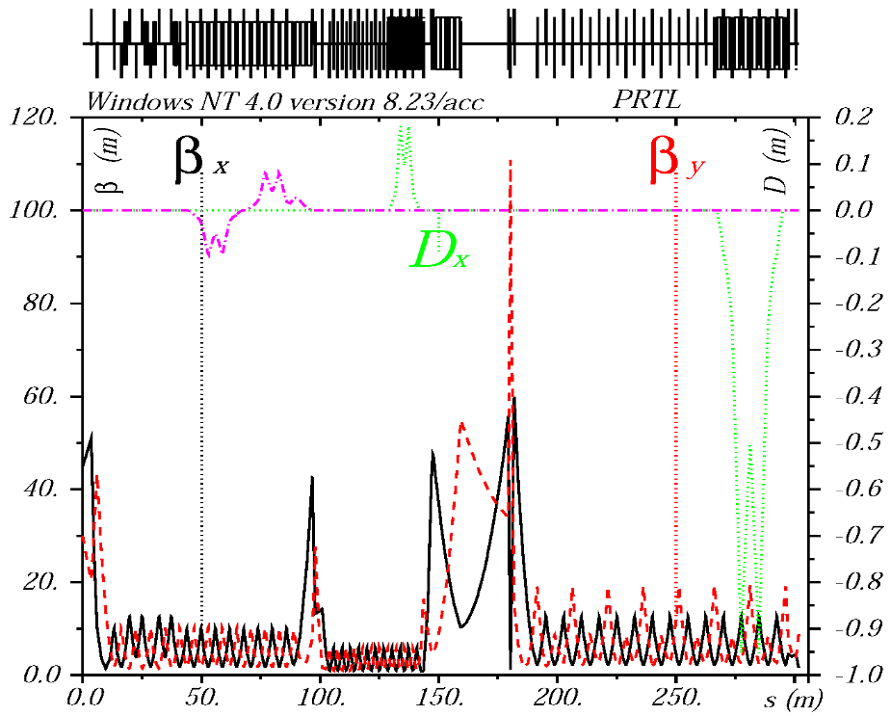
ILC RTML: Latest changes in central region (ERTL/PRTL)
Positron Merger/Splitter
e+
Many modification in RTML during TDR R&D:
Central area configuration
DR injection/extraction
Bunch Compressor (incl. different options: single or 2-stage)
Extraction Tune-up damping lines
Linac curvature
Diagnostics/collimation
Dog-legs, diagnostics
Etc…
e⁻
Matching results with MAD8:
curved PLTL beam line
e+
Earth curvature in return line
PRTL – positron line in central area

Slide 6
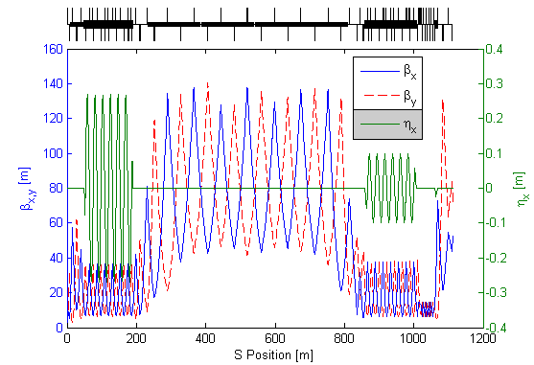
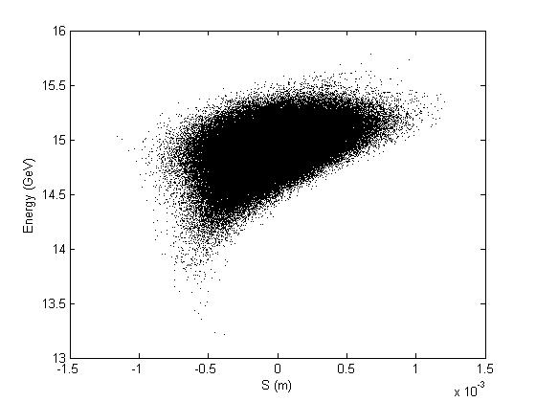
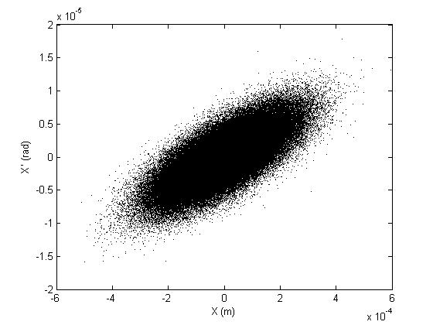
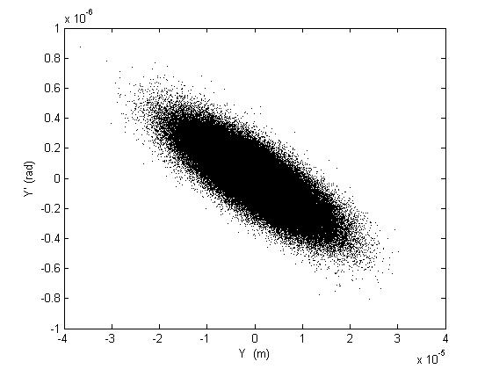
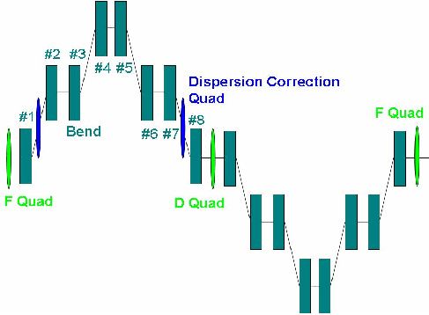
ILC RTML: latest changes in 2-stage BC (6 to 0.3mm)
Parameters:
Initial Energy: 5 GeV
Init norm. Emit. (H/V): 8e-6/20e-9 m rad
Gradient (BC1/BC2): 18.7/27.1 MV/m
Total Voltage (BC1/BC2): 465/11700 MV
RF phase (BC1/BC2): -115/-30 deg
R₅₆ (BC1/BC2): -375.8/-55.2 mm
Norm. Emit. growth (H/V): <0.75/<2.0 %
Final Energy: 14.91 GeV
RF1
RF2
Wiggler 1
Wiggler 2
One wiggler cell
Lucretia Simulations of ILC 2-stage BC
(S.Seletskiy/BNL)
MAD8 results for 2 stage BC optics:
New: alternative design of a single-stage BC (BC1S)

Slide 7
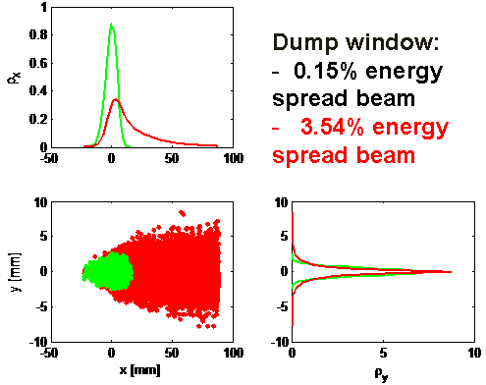
Twiss Parameters in BC and ML (TDR 2016 lattice file)
Extraction Line after BC1S:
BC + ML lattice design for curved linac
Designs for 3 Extraction Lines done.
Re-design EL after BC1S → first look
Example: Option with Strong collimation
Two collimators to protect the doublet and use dump with small window
Sections are well-matched.
No residual dispersion in main linac section.

Slide 8
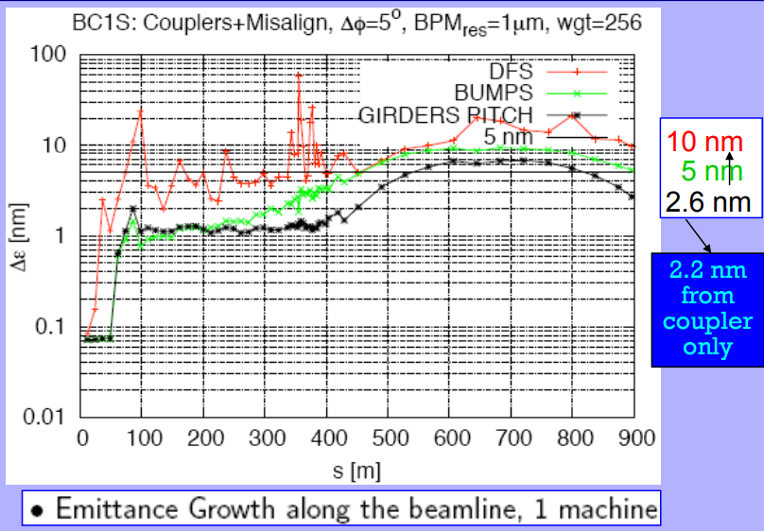

Slide 10
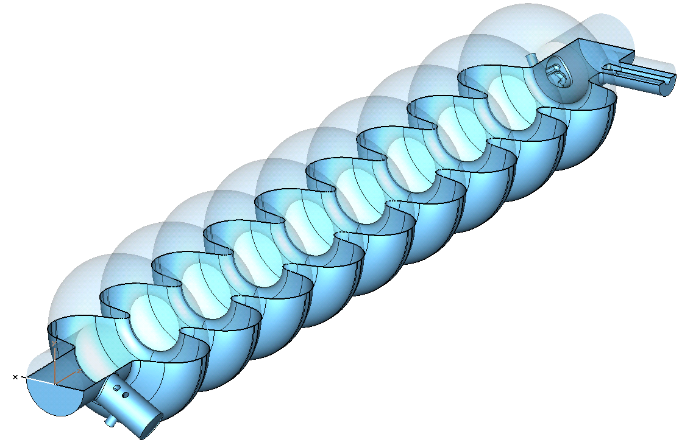
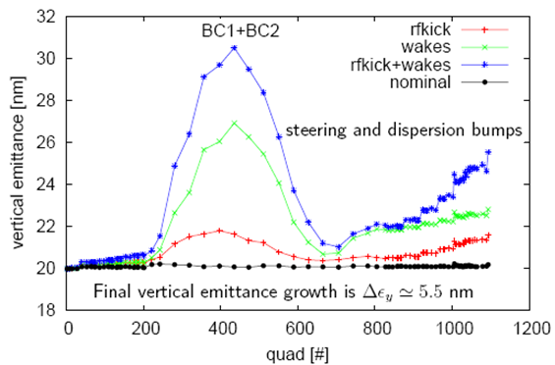
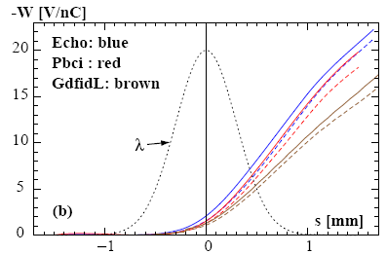
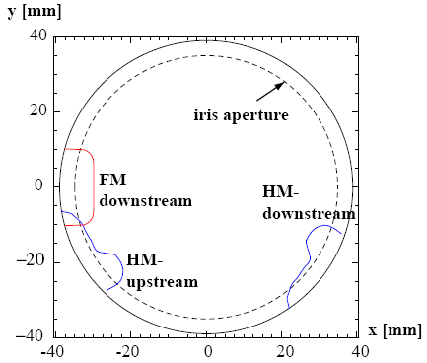
Simulations of Coupler Kick and Wakes for ILC
Downstream
HOM coupler
Main coupler
The couplers break the RF field symmetry and cause transverse RF kick and Wakes. Simulations: DESY/FNAL/SLAC
Total RF KICK (FNAL):
RF cavity
Coupler Transverse Wakefield
bunch shape
Upstream
HOM coupler
W_{x}(s)-solid,,W_{y}(s)-dashed for σ_{z} = 300 μm.
The profiles of the 3 couplers, as seen from the downstream end.
Notes:
10

Slide 11
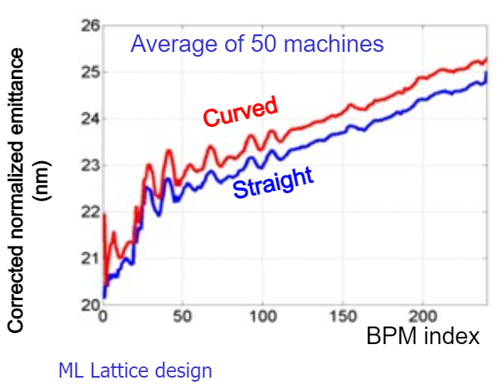
Emittance preservation studies
Effect of cavity wakefields in ILC ML
I.Zagorodnov, N.Solyak EPAC2006
Emittace growth in ML after BBA correction (1-2-1; DFS; dispersion bumps)

Slide 12
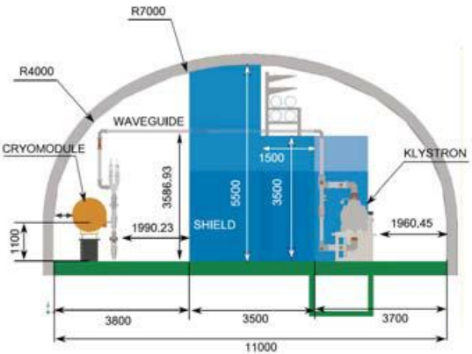
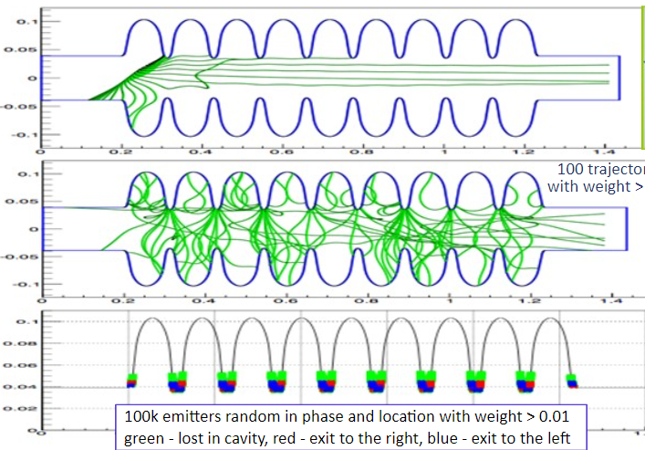
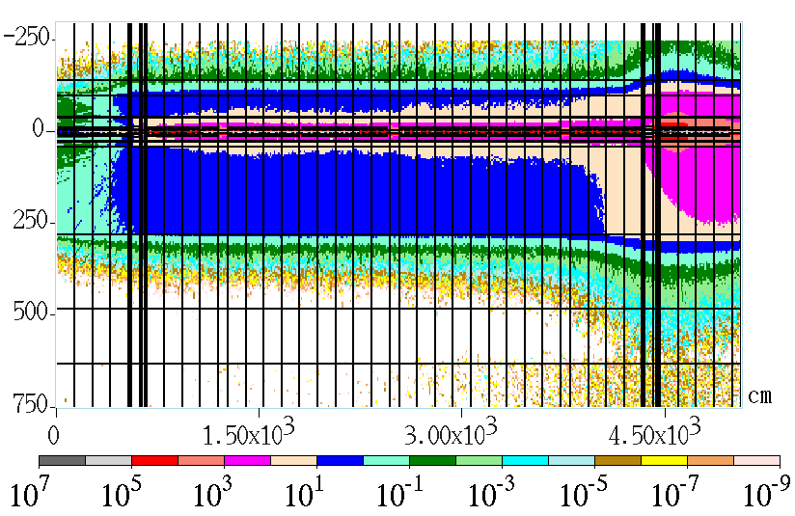
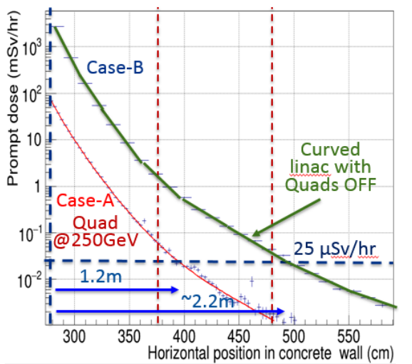
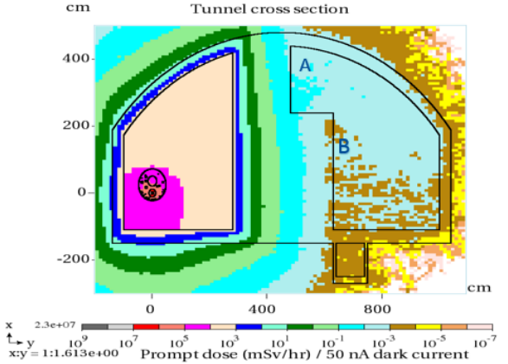
Field emission, Dark current and radiation in ILC tunnel
Dark Current and Radiation Shielding Studies for ILC Main Linac
N.V. Mokhov# , I.L. Rakhno, N.A. Solyak, A. Sukhanov, I.S. Tropin (Fermilab)

Slide 13
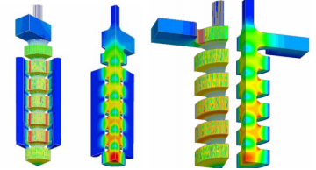
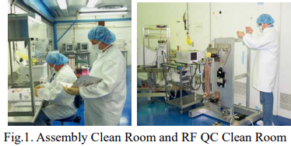
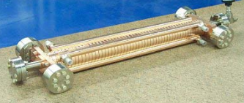
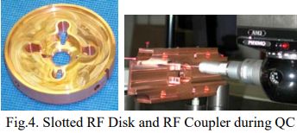
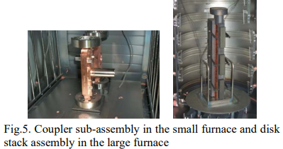
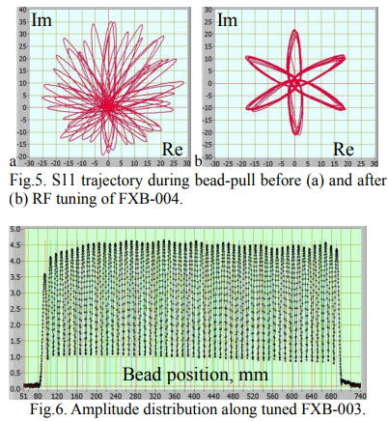
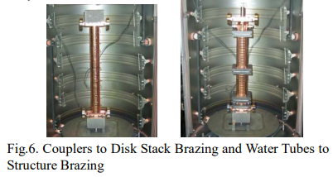
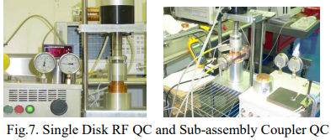
Fermilab contribution to NLC structure (design, fabrication, assembly, tuning)
DEVELOPMENT OF X-BAND ACCELERATING STRUCTURES AT FERMILAB T. Khabiboulline, T. Arkan, E. Borissov, H. Carter, D. Finley, C. Boffo, I. Gonin, G. Romanov, B. Smith, N. Solyak, Fermilab,
H and E fields in couplers and the first few cells.
FXC waveguide coupler and FXB “fat lip” coupler.
Best gradient achieved at SLAC tests
Girder studies

Slide 14
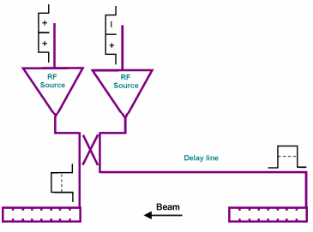
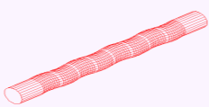
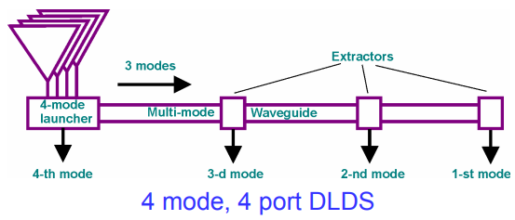
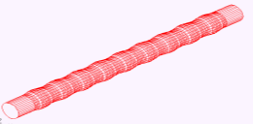
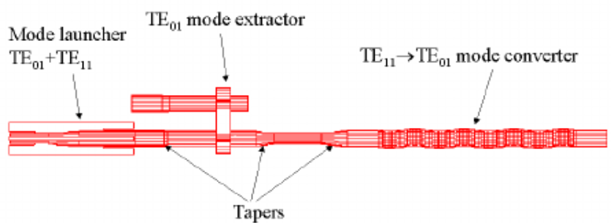
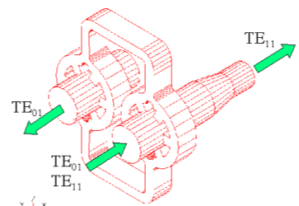
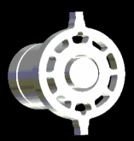
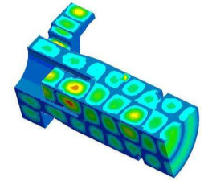
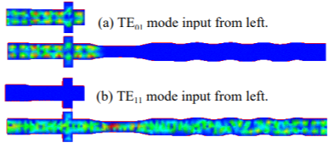
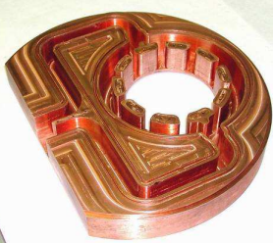
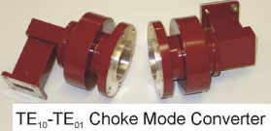
Contribution to NLC/JLC RF distribution/compressing system
J.Q. Wang, Y.H. Chin, S. Kazakov† , S. Yamaguchi and H. Tsutsui, Design of 2×2 DLDS RF components for JLC
TE₁₁ to TE₀₁ zigzag converter
TE₁₁ to TE₁₂ converter
2x2 DLDS pulse compressor
Mode extractors
TE₀₁
TE₁₁
TE₀₁-TE₀₂ launcher-extractor

Slide 15
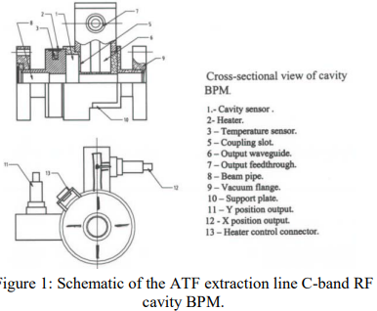
Beamline diagnostics: ATF/KEK high resolution BPM
The proposed CLIC and C^3 colliders requires very precise measurement of transverse beam position in order to preserve extremely low emittance during the beam transport through the ML
An energy chirp within the bunch train will be applied to measure and minimize the dispersion effects, which also requires high resolution (both in a time and space) of BPM along the beam-line.
Fermilab Read-out electronics:
Based on in-house developed analog & digital signal processing hard- and firmware. Implemented at the ATF damping ring (96 BPMs)
Demonstrated:
200 nm resolution (narrowband),
10 µm TBT resolution (broadband, ~400 nsec
Integrated calibration system
Modified versions to be applied for – Linac / transport-line button-style BPMs (electrons / hadrons) – Cavity BPMs, HOM signal processing, etc.
Developed by BINP (V.Balakin, N.Solyak, V.Vogel, P.Zhogolev) for ATF.
Installed at injection line.
Tested by SLAC/KEK/DESY/BINP collaboration.
Resolution 25nm. (M.Ross -2003)

Slide 16
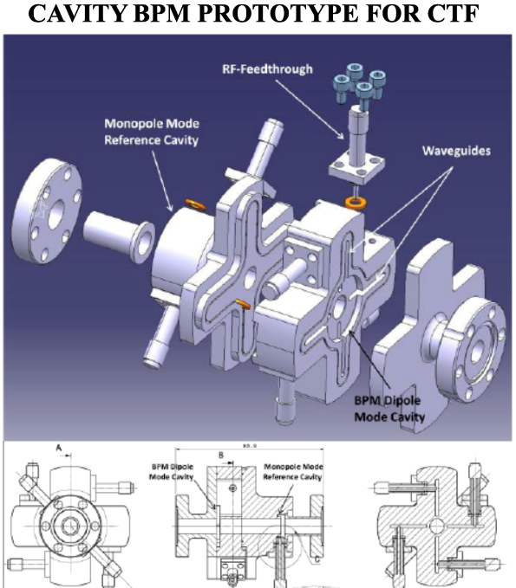
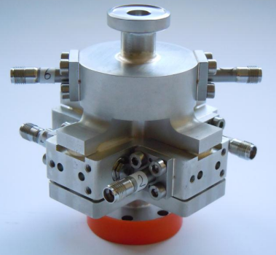
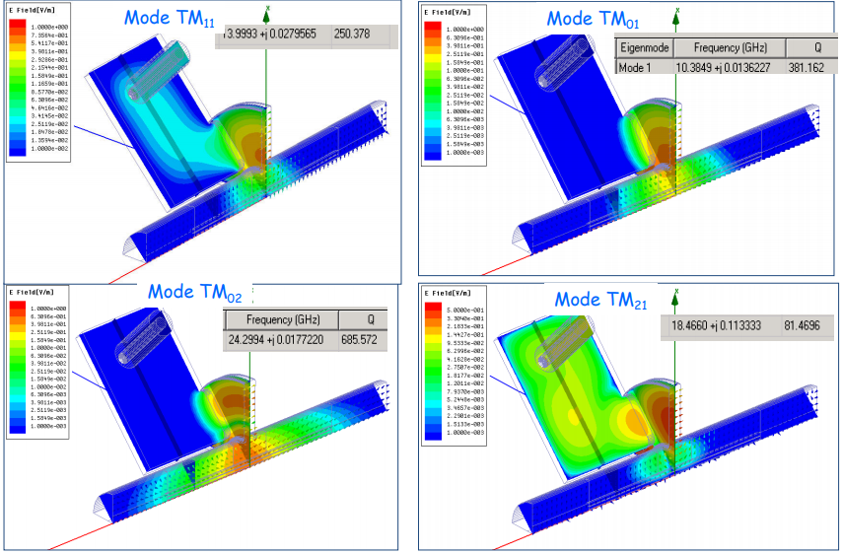
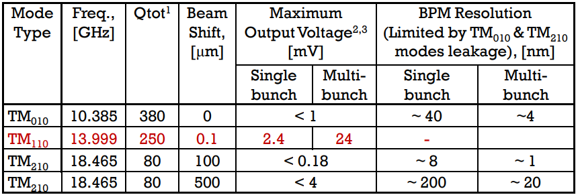
BPM R&D collaboration with CERN
X-band cavity BPM for CLIC/CTF3
Resolution < 50 nm (for 1nC)
Reference cavity included
Low Q
Work for single-bunch and multi-bunch
Designed by Fermilab
Built and tested at CTF/CERN
14 GHz and 15 GHz versions
Mode analysis (A.Lunin)
A HIGH RESOLUTION CAVITY BPM FOR THE CLIC TEST FACILITY* N. Chritin, H. Schmickler, L. Soby, CERN, Geneva, Switzerland A. Lunin, N. Solyak, M. Wendt# , V. Yakovlev,

Slide 17
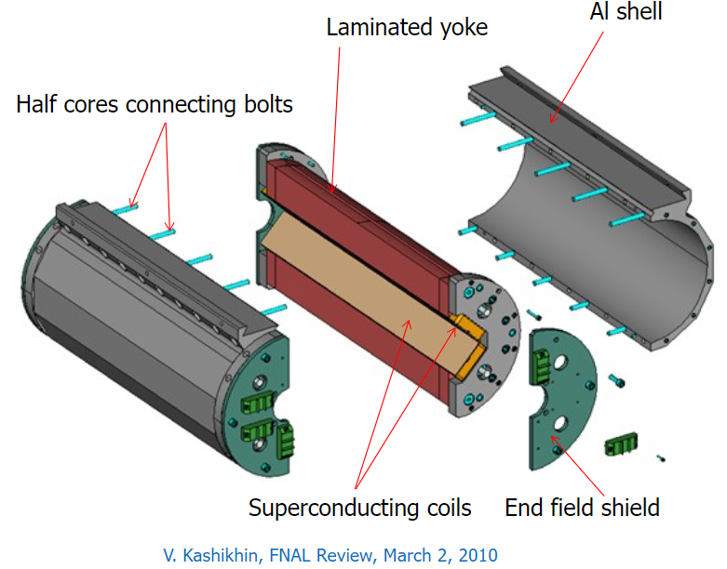
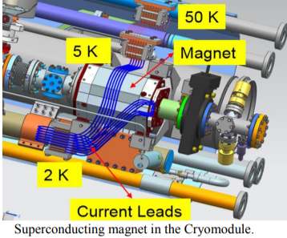
Advantages
No issues of magnet assembly with SRF cavities inside clean area.
Quad may be easily assembled and maintained w/o breaking the beam pipe vacuum.
Conduction cooling makes the magnet cryogen free
Simpler and straight forward magnet alignment with BPM inside CM.
Status
ILC prototypes built at FNAL and tested at KEK
Adopted for LCLS-II, shorter modified version. ~40 magnets successfully built and tested. LCLS-II-HE use same magnet
LCLS-II design

Slide 18
Permanent magnets Work at Fermilab (JamesT.Volk)
https://beamdocs.fnal.gov/AD/DocDB/0032/003254/002/Perm-magnet-wrk-%20FNAL.pdf

Slide 19
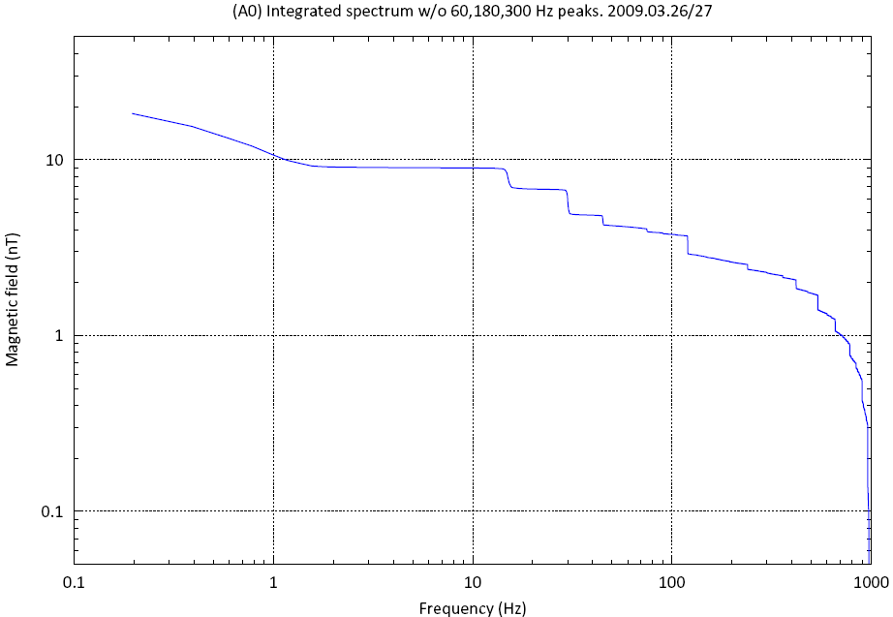
Stray field Integrated spectrum at A0
Very noisy place – Cryogenic, Vacuum, two klystrons, Tevatron shaft, etc.
Total integrated field ~9 nT (f >1Hz)
Only 60/180/300 Hz peaks are removed
15, 30 and 45 Hz (Linac & Booster) ~ 5nT
Other harmonics 120/180 /240Hz)~ 2nT
All the rest ~ 2 nT

Slide 20
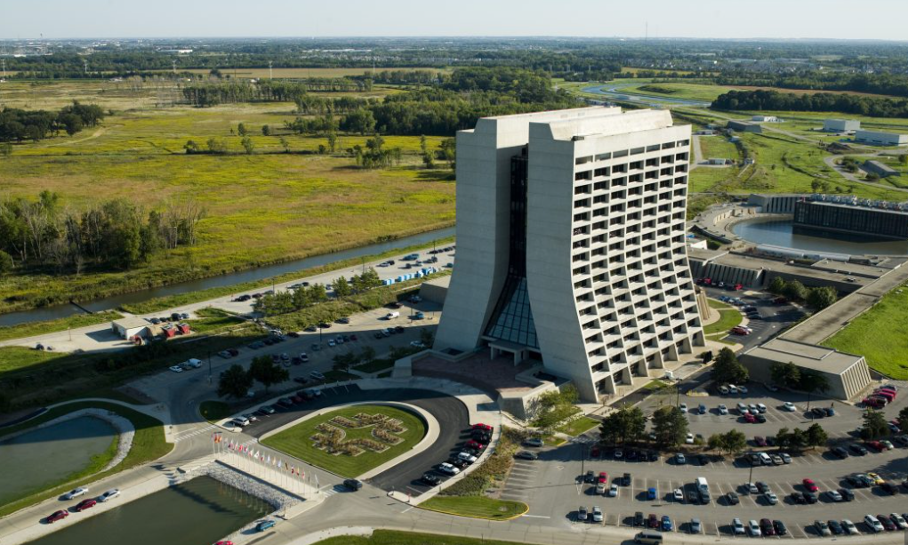
Thank you !

