Slide 1
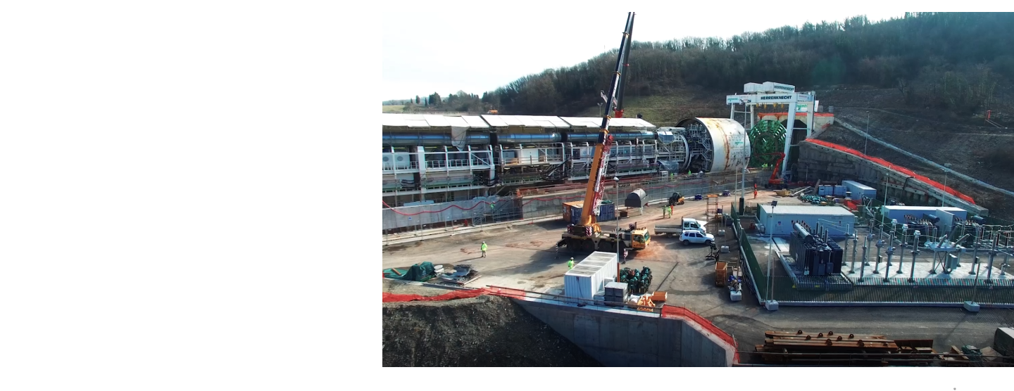
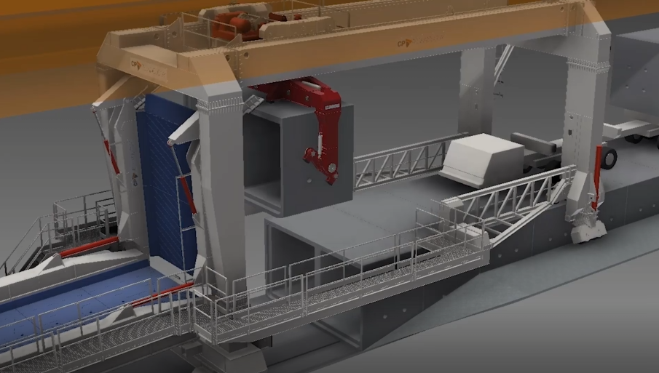
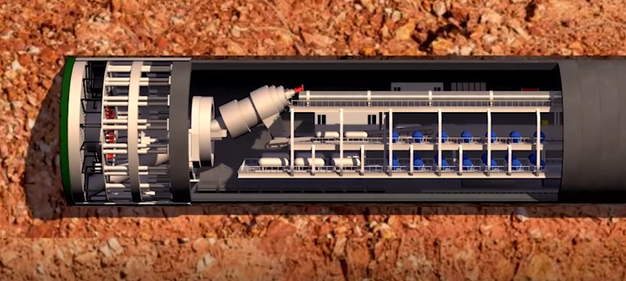
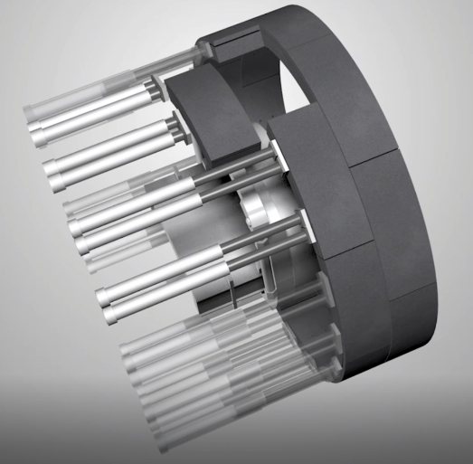
State-of-the-Art Tunnel Construction
Santa Lucia 8 km Tunnel – 16 m diameter boring machine – 3 yrs
Pre-fab concrete lining and service tunnel during excavation
Tunnel Boring Machine
Drop-In Service Tunnel
Tunnel Lining

Slide 2
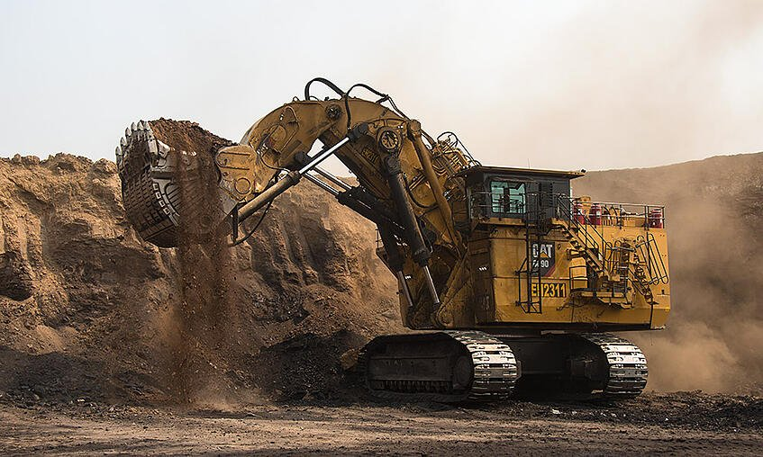
Cut/Cover Construction
At 8 km surface site becomes a possibility – limited locations could implement an energy upgrade
Could have significant cost / construction timeline impact
Was explored in the context of ILC
>10,000 tonnes/hour
https://agenda.linearcollider.org/event/5468/contributions/24008/attachments/19666/31204/LCWS-asner-v2.pdf

