Slide 1
FAST experience and opportunities
Sergey Belomestnykh
Future US Colliders Workshop, January 21, 2022

Slide 2
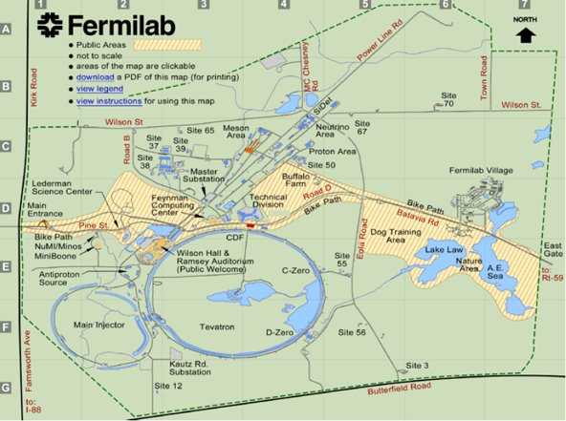
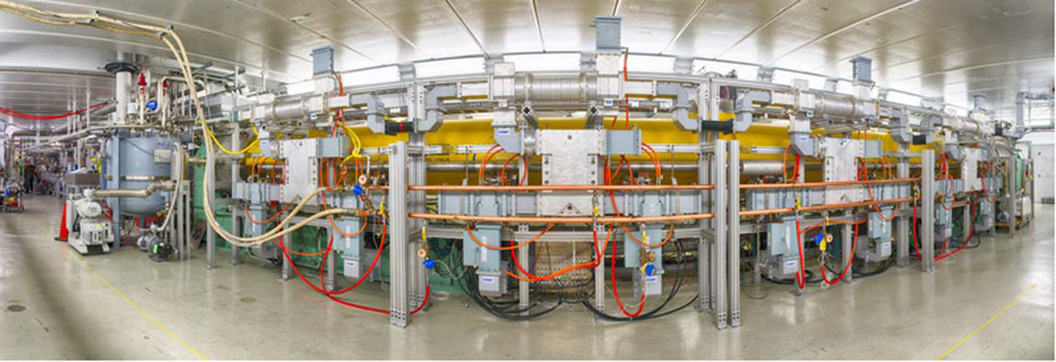
IOTA / FAST – Facility for Accelerator Science and Technology
The facility is supported by DOE/HEP GARD Program, not a DOE User Facility
Priority on Integrable Optics Test Accelerator (IOTA) experiments, hence IOTA/FAST
FAST SRF linac serves as an injector of e⁻ for IOTA and to provide beam for dedicated linac experiments
The facility is housed in the NML building, cathode preparation – at Lab 7
FAST
NML
Lab 7
The 1.3 GHz SRF cryomodule (CM2) installed in the IOTA/FAST facility

Slide 3
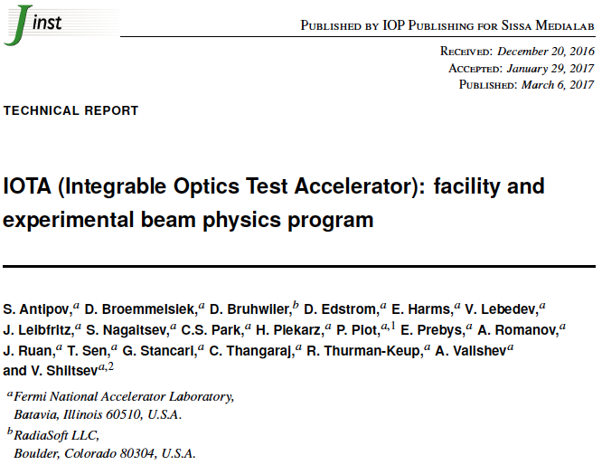
Facility layout
Originally, the SRF linac was envisioned as a facility to test and operate a full ILC “RF unit” with “ILC beam intensity”.
An RF unit consists of 3 ILC cryomodules driven by a single 10 MW klystron. Only one CM was installed.
ILC beam intensity is 3.2 nC/bunch @ 3 MHz in a ~1 msec long pulse (~3,000 bunches), with a 5 Hz repetition rate. The RMS bunch length is 300 μm.
Schematic layout of the IOTA/FAST facility (not in scale)

Slide 4
Electron linac
Parameter | Value
Beam Energy | 20 MeV – 300 MeV
Bunch Charge | < 10 fC – 3.2 nC per pulse
Bunch Train (Macropulse) | 0.5 – 9 MHz for up to 1 ms (3000 bunches, 3 MHz nominal)
Bunch Train Frequency | 1 – 5 Hz
Bunch Length | Range: 0.9 – 70 ps (Nominal: 5 ps)
Bunch Emittance at 50 MeV, 50 pC/pulse | Horz: 1.6 ± 0.2 μm Vert: 3.4 ± 0.1 μm
The electron injector includes
5 MeV electron RF photoinjector, based on DESY/PITZ design. The cathode preparation chamber built by INFN/Milano.
25-meter-long low energy (≤ 50 MeV) beamline includes 2 capture cavities (CC1 & CC2) and CM2
~100-meter-long high energy (≤ 300 MeV) beamline

Slide 5
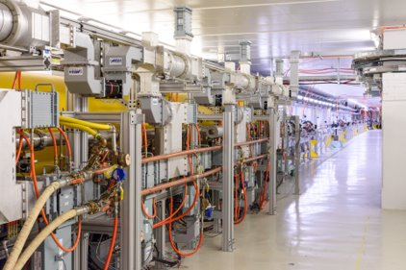
High energy beamline
CM2 has been commissioned, demonstrated an energy gain of > 250 MeV (ILC goal).​
Accelerated 500 bunches at 3 MHz maximum.​ Some conditioning will be done in the upcoming run for long bunch train. Need LLRF and laser upgrades for stable long pulse operation.
Space and time are available for linac-based
experiments.​
Some FAST linac instrumentation:
BPM​
Capable of doing bunch-by-bunch monitoring at 3 MHz ​
Charges from 50 pC to 3.2 nC with different gain setting​
Transverse profile monitor​ with live display
Longitudinal profile measurement​
Streak camera ​
Ceramic gap (non-interruptive)​
Charge measurement​
Faraday cup, Wall current monitor​
HOM detector with Capture Cavity and CM2

Slide 6
Example of experiments performed at FAST
Studies of excitations of dipolar short-range and long-range wakefields (HOMs) due to beam offsets in the accelerating cavities
Investigated beam steering offsets and possible emittance dilution by monitoring and minimizing effects in L-band, 9-cell TESLA SRF cavities CC1 and CC2
Two cavities allow localization of vertical effect to mostly second cavity using corrector H/V103 with HOMs minimized in CC1
Streak camera views the X121 and X124 OTR screens and provides 1 ps resolution, so multiple time slices in 4σ_{t}
HOM signals from cavity HOM couplers

Slide 7
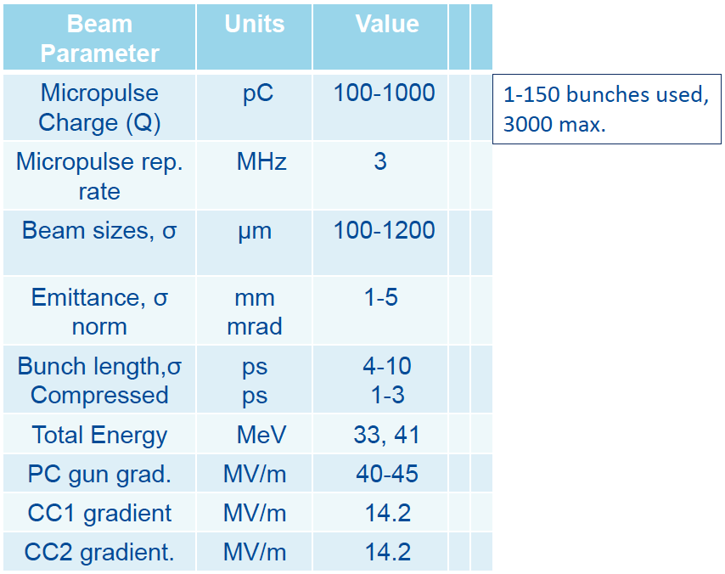
Electron beam parameters for studies

Slide 8
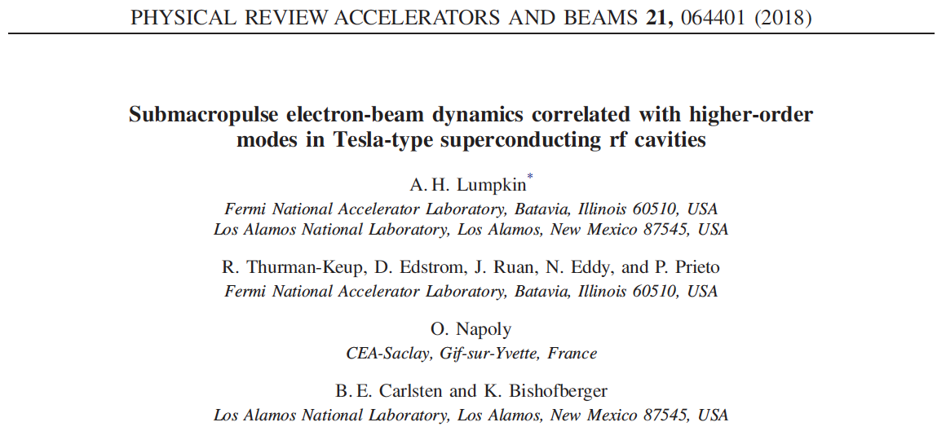
Results published

Slide 9
Thank you!

