Slide 1
Compact Accelerator Applications
US Future Colliders Workshop
Mark Kemp- 1/21/2022

Slide 2
Outline
Several accelerator applications workshops have been held by DOE
  Accelerators for America’s Future (2009)
  Energy and Environmental Applications of Accelerators
  Compact Accelerators for Security and Medicine
This talk is a very brief overview of some of the accelerator research needs articulated by these reports
  Many slides courtesy of Michael Fazio

Slide 3

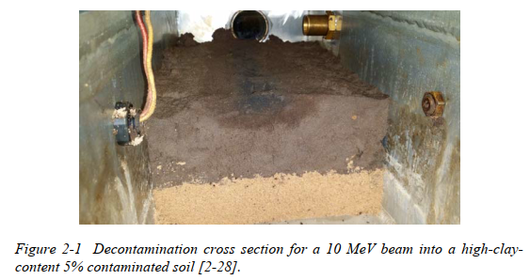
2015 Workshop: Energy and Environmental Applications
Held in 2015 with 40-50 experts in both E&E applications and accelerator technology
Chaired by Stuart Henderson and Tom Waite
“Barriers to significant commercial deployment of accelerator technology include cost, wall plug efficiency, reliability, regulatory approval, end user resistance”

Slide 4
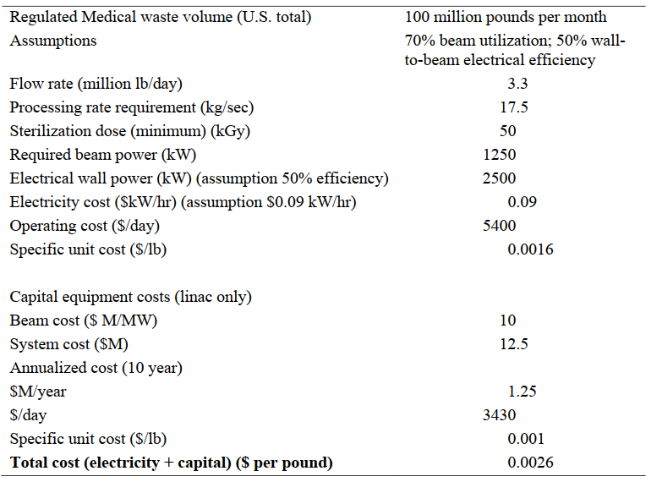
Energy and Environment Applications
Example Analysis
Radiation Processing
Water and Wastewater Treatment
Sludge or Biosolids Treatment
Flue Gas Treatment
Medical Waste
Environmental Remediation
Asphalt Treatment
Emerging Issues

Slide 5
Superconducting Systems for E&E
Wind Generators
Waste Separation
Superconducting Transmission Lines
Selected Near Term Research Needs
Gain understanding of demonstrate cryogen-free magnet systems
Develop magnet coils based on high temperature superconductors
Gain fundamental understanding of conductor performance and properties above 4K.
Conduct R&D on lowering the cost of flexible, long-length cryostats

Slide 6
Selected E&E Long Term Research Thrusts
Demonstrate high-current electron sources
Demonstrate high-power systems that are portable and capable of turn-key operation
Demonstrate 10MeV, 1MW class NCRF and SRF-based system capable of >50% AC-beam efficiency
  Must include all systems (cooling, RF, support systems, etc.)
Demonstrate full system capital costs of <$5-10/W
RF Sources: System efficiency >80% with a capital cost less than $3/W. Sources must also have long lifetime
SRF-linacs: Develop materials that have T_{c} > 16K

Slide 7
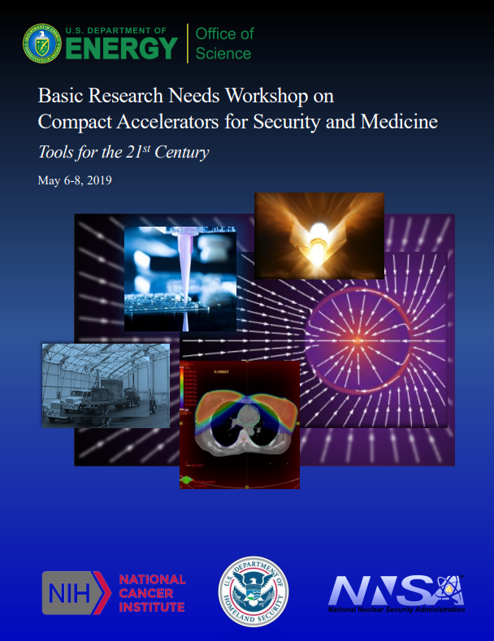
2019: Compact Accelerators for Security and Medicine
Held in 2019 with 112 attendees
Chaired by Michael Fazio and co-chaired by Suresh Pillai and George Laramore
“Today’s commercially available accelerator technology has fallen significantly behind the state of the art. Advancing and transferring state-of-the-art compact accelerator technology … can significantly enhance society’s ability to sense and control the world around us.”

Slide 8
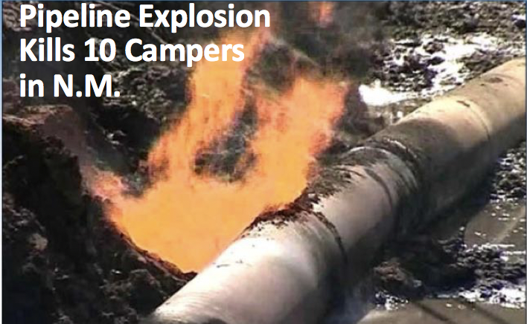
Motivation: Security Applications
Accelerators can provide non-isotopic, and thus less risky, sources of ionizing radiation
Non-invasive probing
  interrogation of geological media
  radiography for non-destructive testing & evaluation of structures,
  probing of cargo for contrabands such as narcotics, SNM, munitions, etc
Industrial radiation processing
  medical device sterilization & pharmaceuticals,
  food processing (for safety and quality)
  Phytosanitary & sterile insect technology
All of these applications are largely reliant on radioisotopes, thereby posing security risks from the possibility of these sources being diverted for nefarious activities.
Notes:
phytosanitary applications (to prevent the accidental introduction of insects and pests that could threaten agriculture) and equipment to rendering harmful insects sterile to control their population.
Cs137 Am-Be
Food irradiation in one form or another is currently taking place in over 60 countries. The major irradiated items are spices and food ingredients and cobalt-60 is the primary isotope used in the food irradiation facilities. These facilities range from very large capacity (~ 1 million curies) facilities as seen in the United States to relatively small facilities (100 kilo -300 kilo curie) facilities as seen in different regions of the world such as Myanmar and Sri Lanka.
A Cs-137 Source: Capsule (left); actual source (right) (Ref: Badruzzaman et al, SPE 123593, 2009)
Applicability & Reliability
Accuracy (±1 pu in porosity)
Operational compatibility (e.g.: logging speed ~ 1800 ft/hr)
Survivability (> 175⁰ C; > 25 kpsia; 1000G in LWD, etc.)
Acceptable cost: Develop, deploy, & use
Usable/affordable by players in a diverse industry?

Slide 9
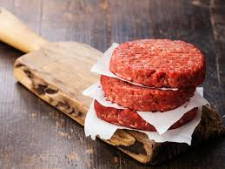



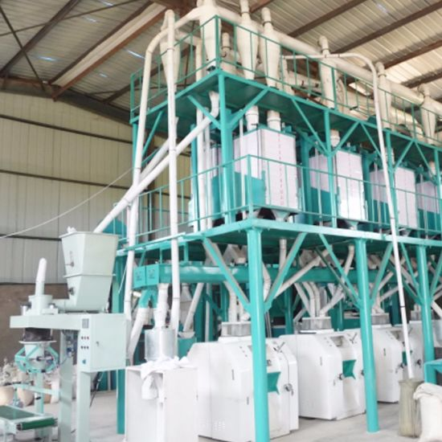



Accelerators/beams Enhance Food Quality & Safety
Farm to Flour – A Dreadful Journey…
As fresh as you can get!!!
Neither washed nor disinfected!
No validated kill step!
New trends and challenges!
Shima Shayanfar | General Mills Inc.

Slide 10
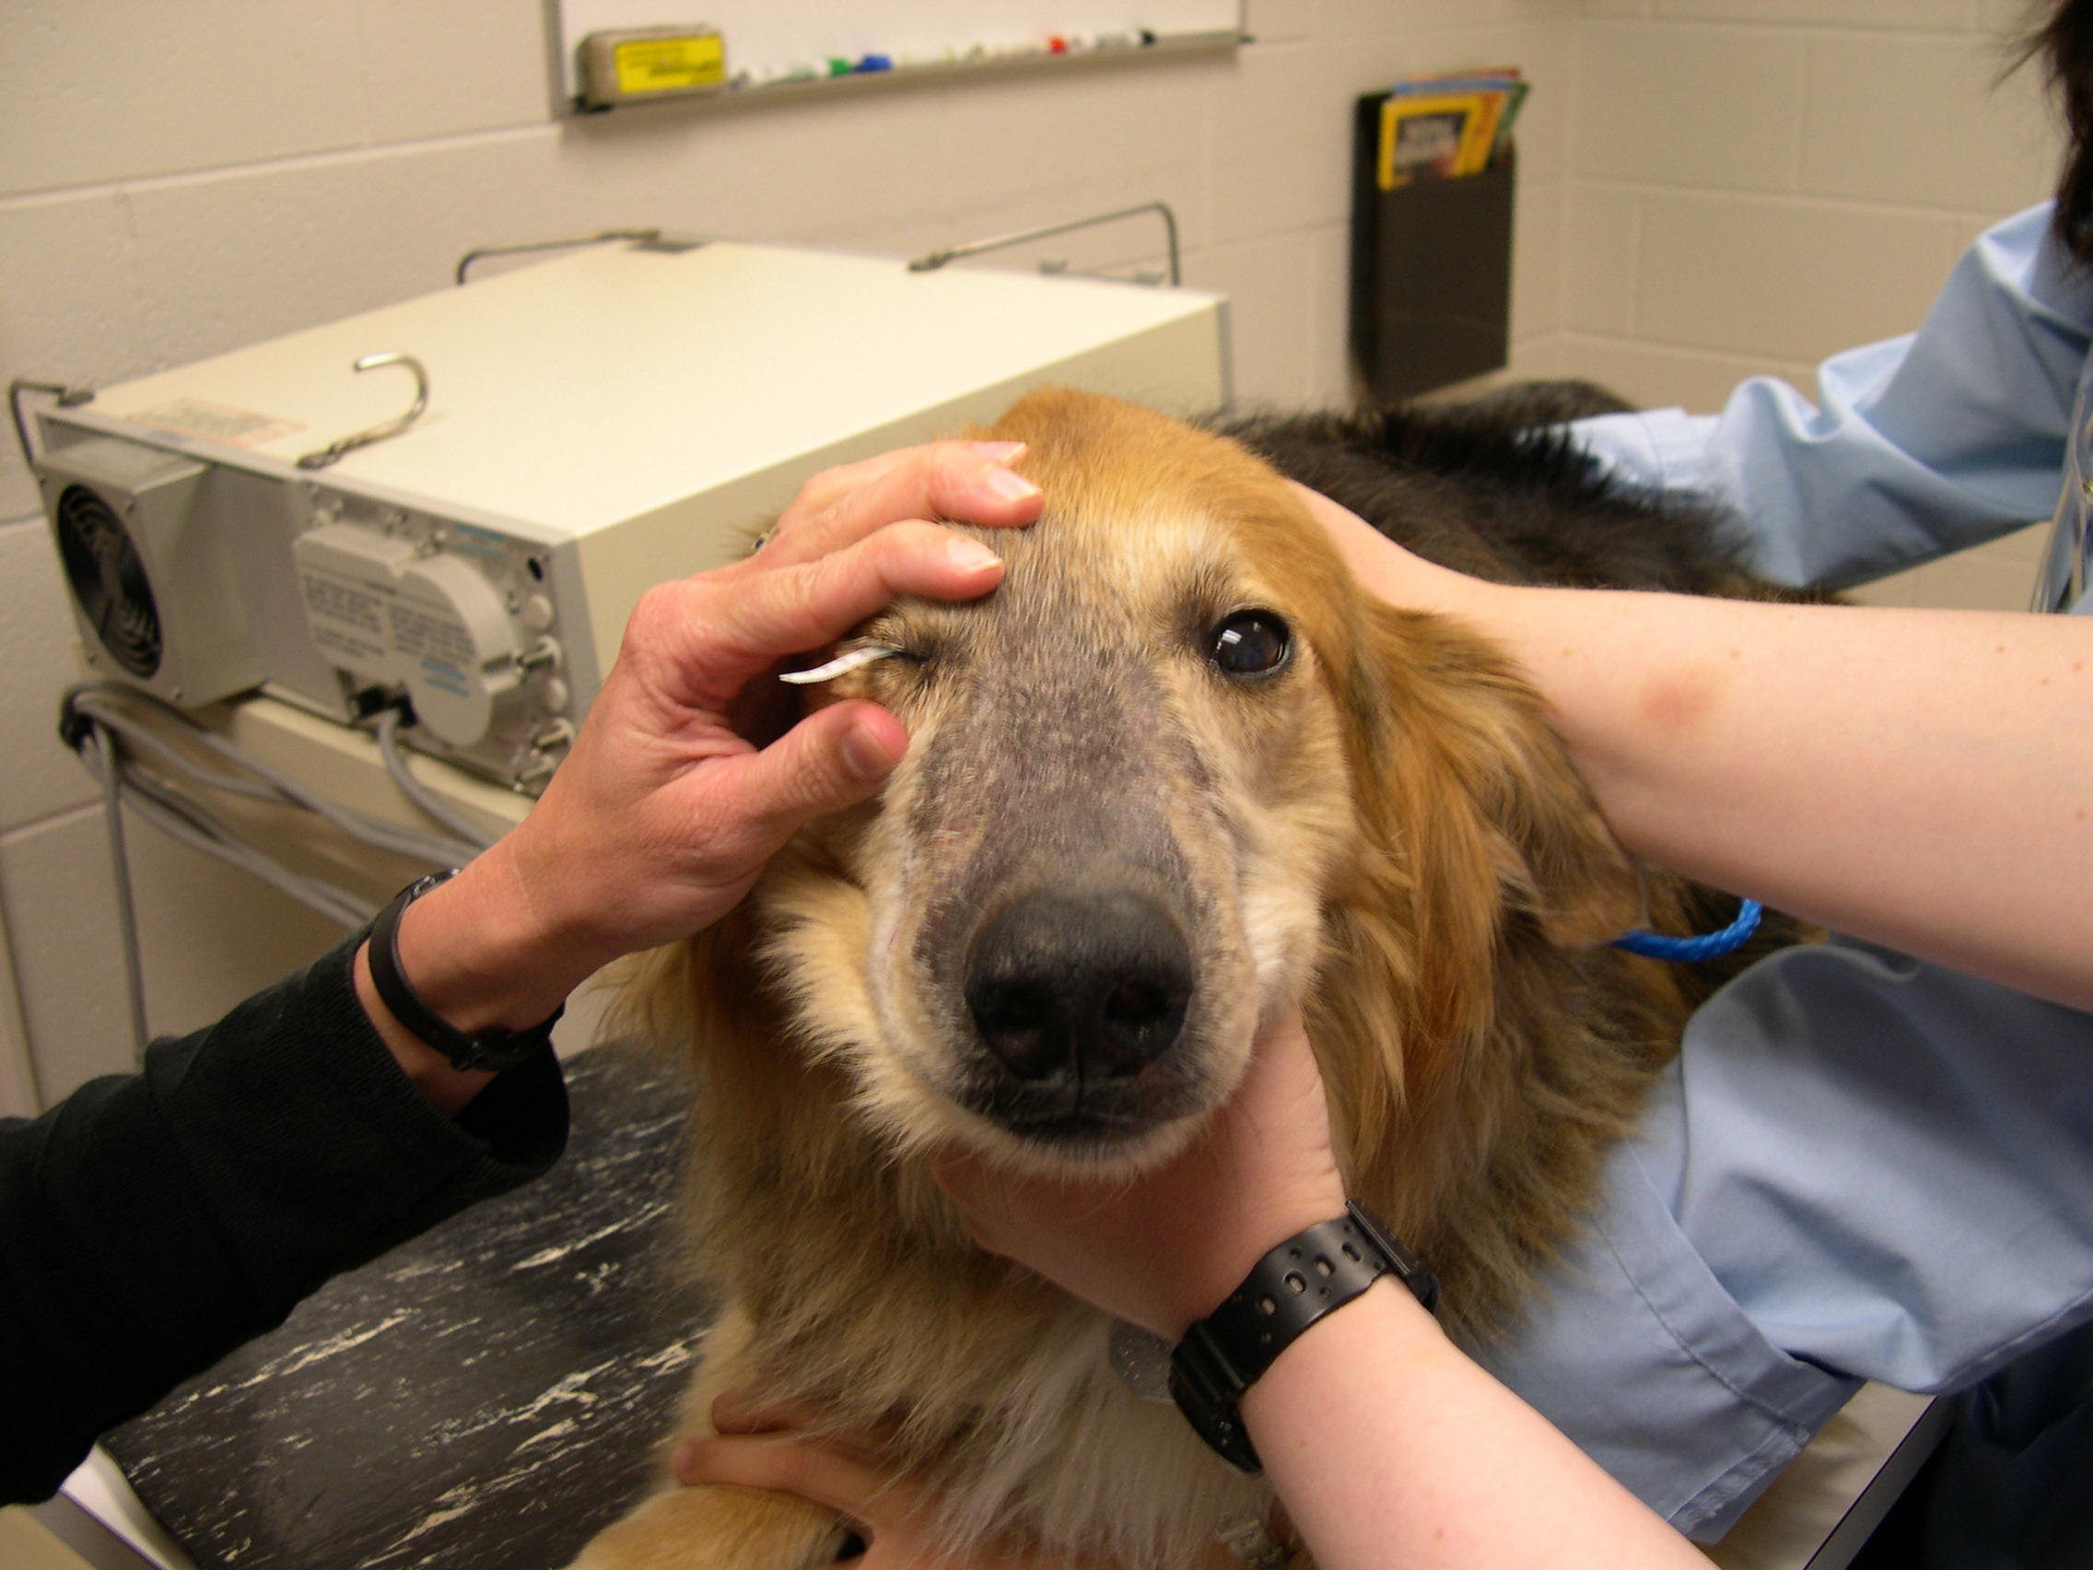
Motivation: Medicine Applications
New technologies allowing complexity of radiation therapy to be hidden from the user for greater access and quality globally
  Lack of medical physicists
  Power outages
New technologies for robust systems (i.e. low cost and with very high reliability)
New technologies to explore the power of radiation in biology
Global Incidence of cancer cases grows from 14M to 25M per year between 2012 and 2030.
Animal experience before human applications
Tumor between eyes - great test for Intensity modulated RT-
CT and treatment
Notes:
Medical treatment is third leading cause of death.
Canine nasopharyngeal tumors
Life expectancy <1 year
Conventional treatment usually causes severe ocular damage

Slide 11
Application Areas Determined to Need Innovative Solutions
  Replacement of radioisotopic sources by accelerator-based alternatives
  Ruggedized low-cost linacs for Low/Middle-Income Countries
  FLASH-RT and Very-high energy electron (VHEE) sources for radiotherapy
  Source-free brachytherapy (i.e. endoscopic particle accelerators)
  Portable monochromatic gamma-ray sources
  Compact neutron generators
  Many of these are applicable to both security and medicine

Slide 12
20 research themes, distilled to 5 Priority Research Directions
PRD 1: Revolutionize accelerator design to produce modular, interoperable, robust systems
PRD 2: Develop “Smart Accelerators” that produce expert results in difficult environments
PRD 3: See beyond present technological limits
PRD 4: Control effects and outcomes beyond present technological limits
PRD 5: Revolutionize the size to enable new and emerging applications
High-level S&T objectives that will guide R&D investment for 5-10 years or more
Transformative, changes the game, renders the impossible possible
Informs the scientific community, application community, and lawmakers about the process and findings of the workshop

Slide 13
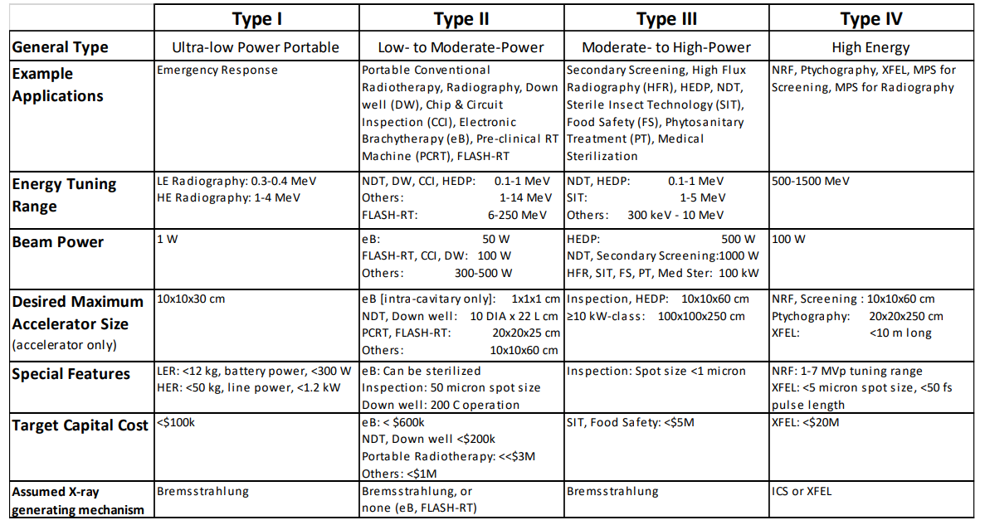

Slide 14
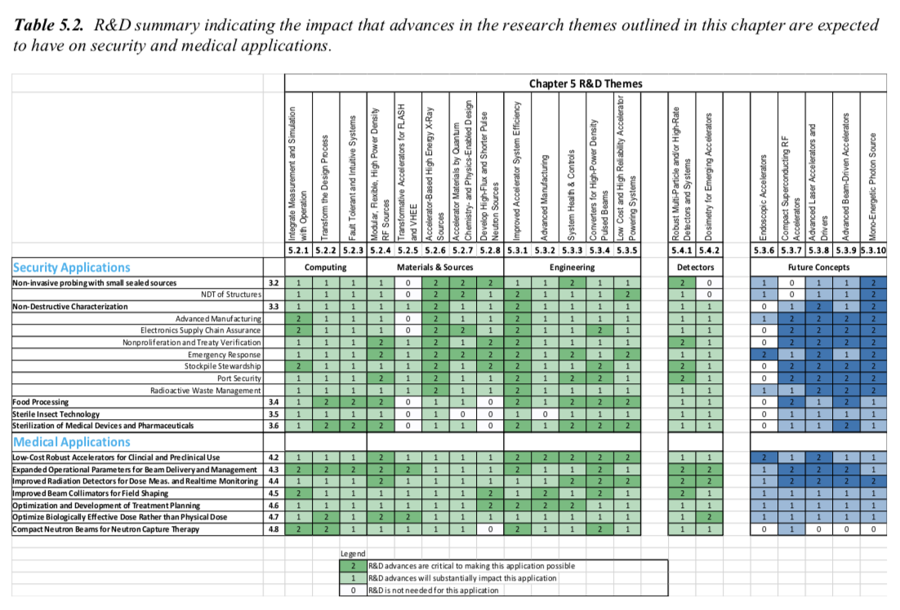

Slide 15
Short Term Research Themes

Slide 16
Backup

Slide 17
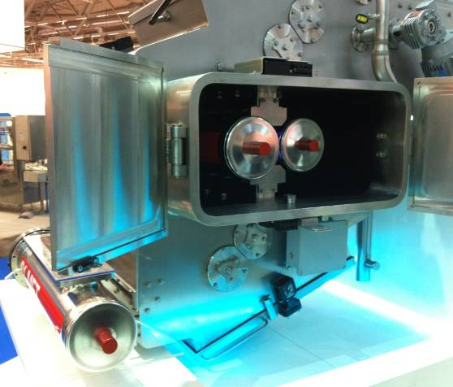
PRD 1: Hardware Focused System Co-design
Revolutionize accelerator design to produce modular, interoperable, easy-to-use, integrated, reliable, robust systems
Key Ideas
  Continuum of complexity management: hardware focus
  Component modularity, rapid interchangeability, strong commercial ecosystem leads to best of class systems
  Comprehensive integrated diagnostics
  Engineering standards promote
    Interoperable products
    Reduce costs
    Increase reliability
Key Questions
  When to co-design, and when to component optimize?
  Can engineering standards increase reliability and interoperability?
  Can system design facilitate autonomous dose delivery, ease of repair, and robustness for global use ?
In-house eBeam for aseptic packaging- Shima General Mills
Notes:
Automobile analogy in the 3rd world
Image: In-house low energy in-line eBeam for aseptic packaging (80-300 keV) (Shima plenary talk)
Key Questions embodied in PRD
When is end-to-end system co-design essential, and when is component optimization appropriate?
Can engineering standards be defined to increase reliability and interoperability? How can systems engineering ideas be incorporated into piece-part design to ease repair, shipping, inventories, manufacture, and recycling, to ultimately drive down costs and downtime?
Can affordable, ruggedized, compact accelerators be designed that facilitate autonomous dose delivery? Can they be built with sufficient modularity, ease of repair, and robustness for use around the world?
Key Ideas needed to realize PRD
This PRD is hardware focused and is part of the continuum of complexity management
Component modularity, rapid interchangeability, and a strong commercial ecosystem are needed to produce best of class systems
Engineering standards are needed to allow companies to develop interoperable products more efficiently, to optimize reproducibility and costs, to lower MTTR and increase MTTF

Slide 18
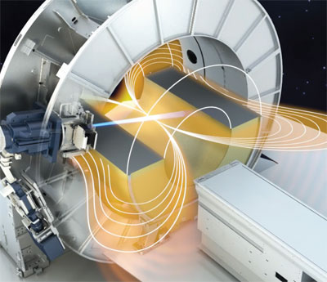
PRD 2: Smart Systems
Develop "Smart" Accelerators that require minimal technical expertise to produce expert results in any human-resource environment, with software robustness and fault-tolerance
Key Questions
  Can ML enabled systems provide:
    self-diagnosis?
    best outcomes?
    Real-time dose optimization
  How "autonomous" can accelerator-based systems be made?
  Can AI-based cybersecurity protect
    Accelerator control?
    Data system (patient)?
  Can engineering standards ensure interoperability of multi-vendor systems?
Key Ideas
  Continuum of complexity management: software focus
  Smart control systems
    Self-diagnose
    Self-repair
    Self-adjust
    Autonomous operation
  AI/ML-based system control and data management systems
  Build to upgrade (like B2)
  Auto-update of OS, like a smart phone
MRI-linac, integrated treatment-imaging concept (Welsh)
Notes:
Image: MRI-linac, integrated treatment-imaging concept (Welsh plenary talk)
Key Questions embodied in PRD
Can machine learning enable real time energy and dose optimization to provide the best quality data and outcomes, and provide early detection and self-diagnosis of needed repairs?
How "autonomous" can accelerator-based systems be made?
Can artificial intelligence provide appropriate cybersecurity protection of accelerator control and data storage systems? Can engineering standards be defined to ensure data systems interconnect and interoperate across subsystems and vendors?
Key Ideas needed to realize PRD
This PRD is software focused and is part of the continuum of complexity management
Autonomous operation through smart control systems that self-diagnose, self-repair, anticipate failures and self-adjust to maintain critical parameters as systems degrade
Artificial Intelligence and Machine Learning are key components of the system control and data management systems

Slide 19
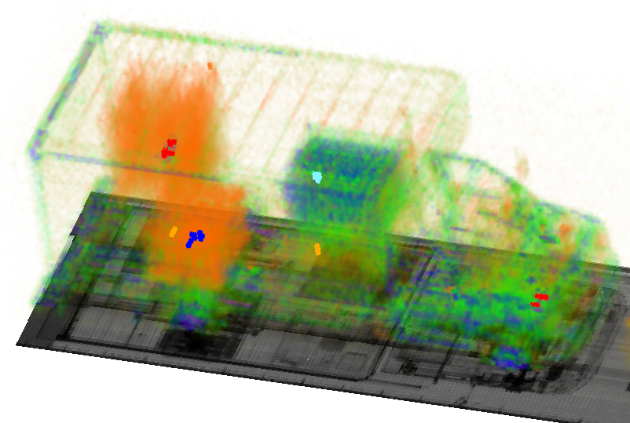
PRD 3: See Beyond Present Technological Limits
….with systems that provide more flux, controlled bandwidth, and improved detection for more accurate measurements and reduced collateral effects
Key Questions
  Is better imaging possible by closely integrating higher capability sources and detectors?
  How can detection algorithms speed & accuracy be improved?
  Can compact new sources of x-rays be developed that offer unprecedented monochromaticity, coherence, and tunability
  How can spectrum agility, bandwidth, coherence & polarization be controlled and exploited?
Key Ideas
  System R&D focus on the target properties
  Real-time imaging data-based system optimization
    Image analysis-based target motion correction
  Advanced detector technologies with expanded sensitivity, capability, ruggedness
Do we know enough to make a decision, rapidly?
Notes:
Image: Cargo scanning? (Vojtech plenary talk)
Key Questions embodied in PRD
Is better inspection and imaging possible with closely integrated, higher-capability sources and detectors?
How can detection algorithms be improved in speed and accuracy?
Can compact new sources of x-rays be developed that offer unprecedented monochromaticity, coherence, and tunability?
How can spectrum agility, bandwidth control, and coherence control be optimally exploited?
Can CT imaging simulations for X-ray sources with a range of energy spreads and energy-integrating detectors be developed?
Key ideas needed to realize PRD
Systems R&D must be focused on the specific properties of the target
Real-time analysis of imaging data to enable feedback and source adjustments to optimize image quality, reduce dose, and reduce shielding requirements
Advanced image analysis algorithms that handle complex target motion and other imaging challenges
New detector technologies with expanded sensitivity, capability, and ruggedness

Slide 20
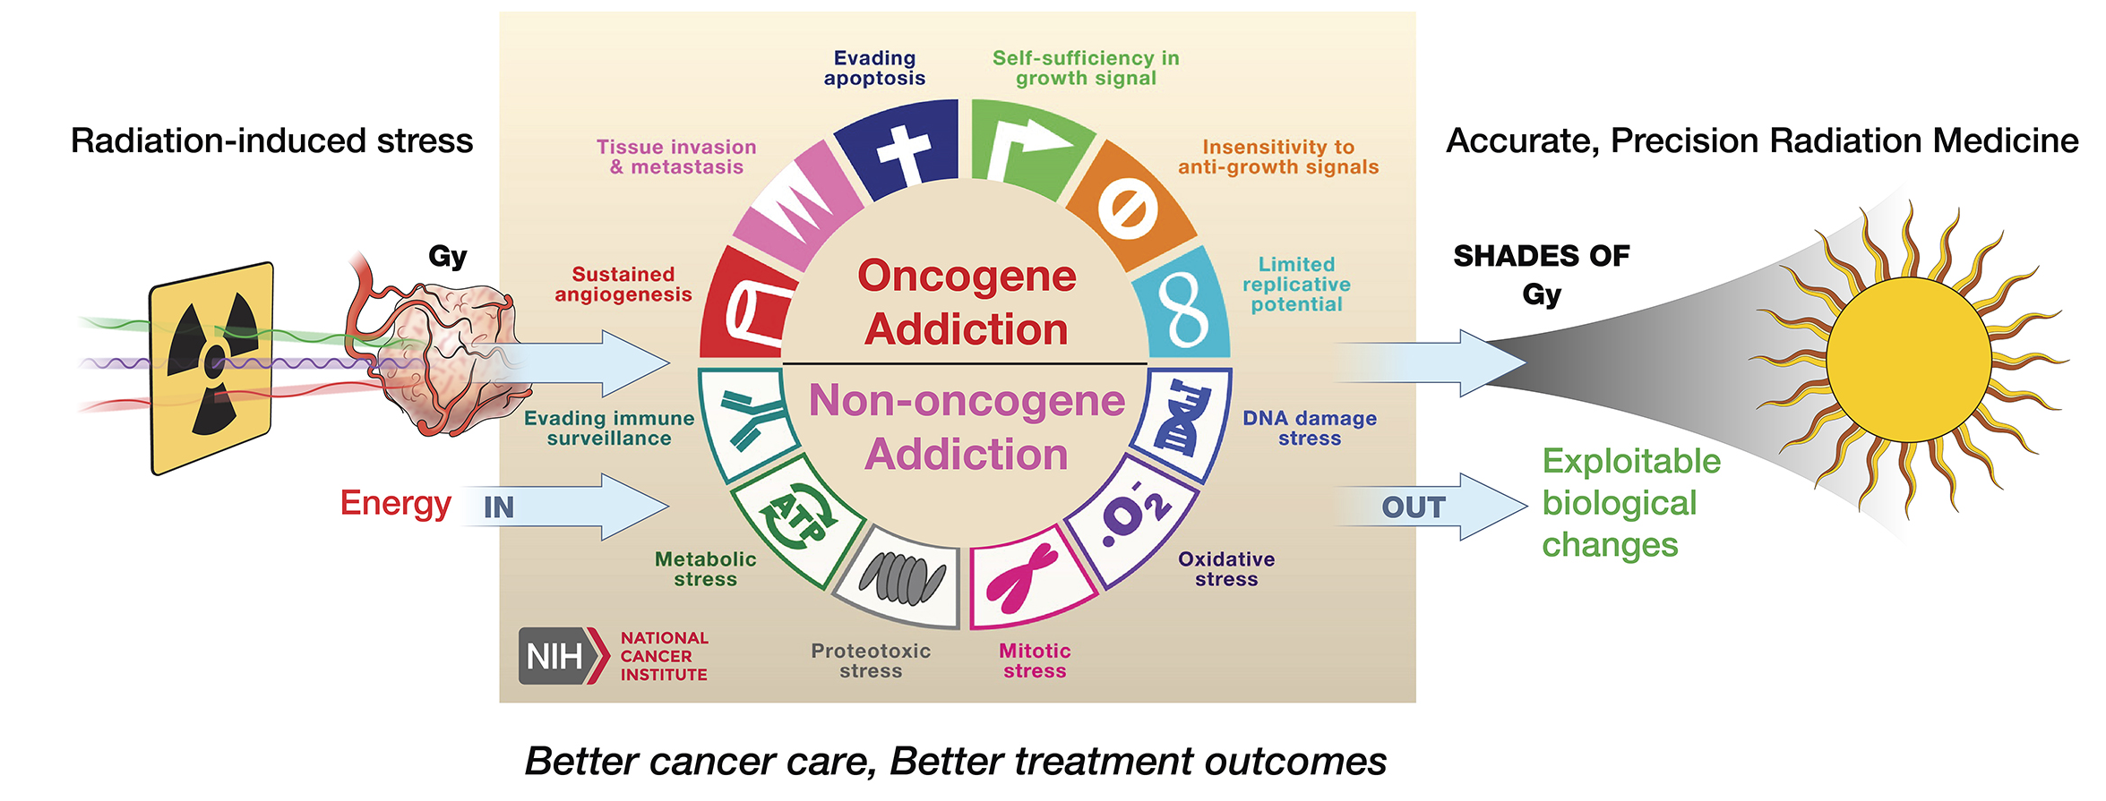
PRD 4: Control Effects & Outcomes Beyond Present Technological Limits
… with systems that provide more flux and better control of stability, spectrum, and dose for substantially improved capability and impact
Key Ideas
  Contextually optimize dose – spatial & temoral in real time
  Expand source/detector capability to enable new translational and clinical science, e.g. flash/VHEE
  System R&D focus on the target properties
Key Questions
  Can higher capability source/detectors/computing improve outcomes?
    Increase flux/efficiency?
    Reduce cost?
  Can energy spectrum and dose rate be optimized to reduce collateral damage?
  How to maintain accuracy at high dose rate?
  What advancements are needed for ultrahigh dose rate in a clinical setting?
  What radiobiology must be studied?
Notes:
Image: Biologic response to radiation (Coleman plenary talk)
Feedback on biological effect
Key Questions embodied in PRD
Are better treatment outcomes, better preclinical results, and better control of pathogens and contaminants possible with closely integrated, higher capability sources and detectors? How can the flux and efficiency of x-ray sources be increased? Can very low cost, high flux sources be developed?
How can energy spectrum and real time dose control be optimally exploited to reduce collateral dose?
How can dose rate be increased without sacrificing accuracy?
What new sources, detectors, and controls are needed to support ultrahigh dose rates in a clinical setting?
What radiobiology must be studied?
Key Ideas needed to realize PRD
Systems R&D must be focused on the specific properties of the target
Deliver beam/dose in a way that expands from physical dose optimization to contextually optimized dose (biologic dose for medical applications and other classes of dose for security applications)
Expansion of parameters for beam delivery and measurement to allow new translational science and clinical science (e.g. flash/VHEE)

Slide 21
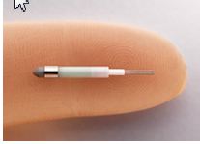
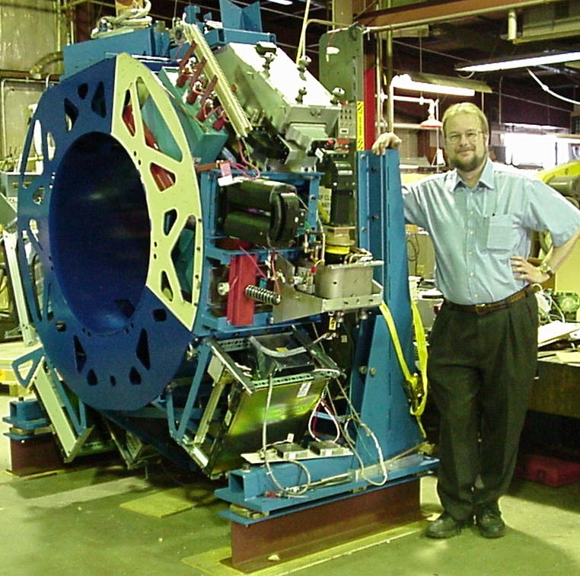
PRD 5: Revolutionize Size (aka Size Matters)
Revolutionize the size, making accelerators smaller to enable new and emerging applications, reducing cost and risk
Key Ideas
  Increase accelerator gradient and power efficiency
  Increase system power efficiency (“wall plug” to delivered beam)
  Advanced manufacturing and new materials
  Convert mechanical components to
    organic/chemical /biologic, or field based "components"
Key Questions
  What are the key SWaP drivers for the application?
  Can accelerators be miniaturized for:
    tight crawl spaces?
    Pipes?
    Boreholes?
    Endoscopes?
  Can accelerators be developed for hostile environments?
Prototype of TomoTherapy machine (x-ray and CT) and Xoft endoscopic x-ray source (50 keV)
Notes:
Images: Prototype of TomoTherapy machine (x-ray and CT) and Xoft endoscopic x-ray source (50 keV) (Welsh plenary talk)
Key Questions embodied in PRD
What are the key components that drive the Space, Weight, And Power requirements for each application?
Can accelerators be miniaturized to function in tight crawl spaces, in pipes, down boreholes, and on the end of an endoscope?
Can accelerators be engineered to provide accurate performance in hostile environments?
Key Ideas needed to realize PRD
Increased accelerating gradient and accelerator power efficiency
Increased wall plug to power source to accelerated beam efficiency through better sources and energy recovery
New manufacturing and material technologies to produce smaller, low-cost accelerator systems
Conversion of mechanical components to organic/chemical/biologic, or field based "components"

