Slide 1
Distributed Coupling Linac for High Charge Electron Bunches
Ankur Dhar, Mei Bai, Zenghai Li, Emilio Nanni, Mohamed Othman, Sami Tantawi, Glen White

Slide 2
Distributed RF coupling changes accelerator paradigm
RF power is coupled directly into each cell
Prevents the need for on-axis coupling
Full system design requires modern virtual prototyping
Linac scale simulation like ACE3P is important for this
Cells can instead be optimized for efficiency (shunt impedance)
Control peak surface electric and magnetic fields as well
RF Power
Beam
2

Slide 3
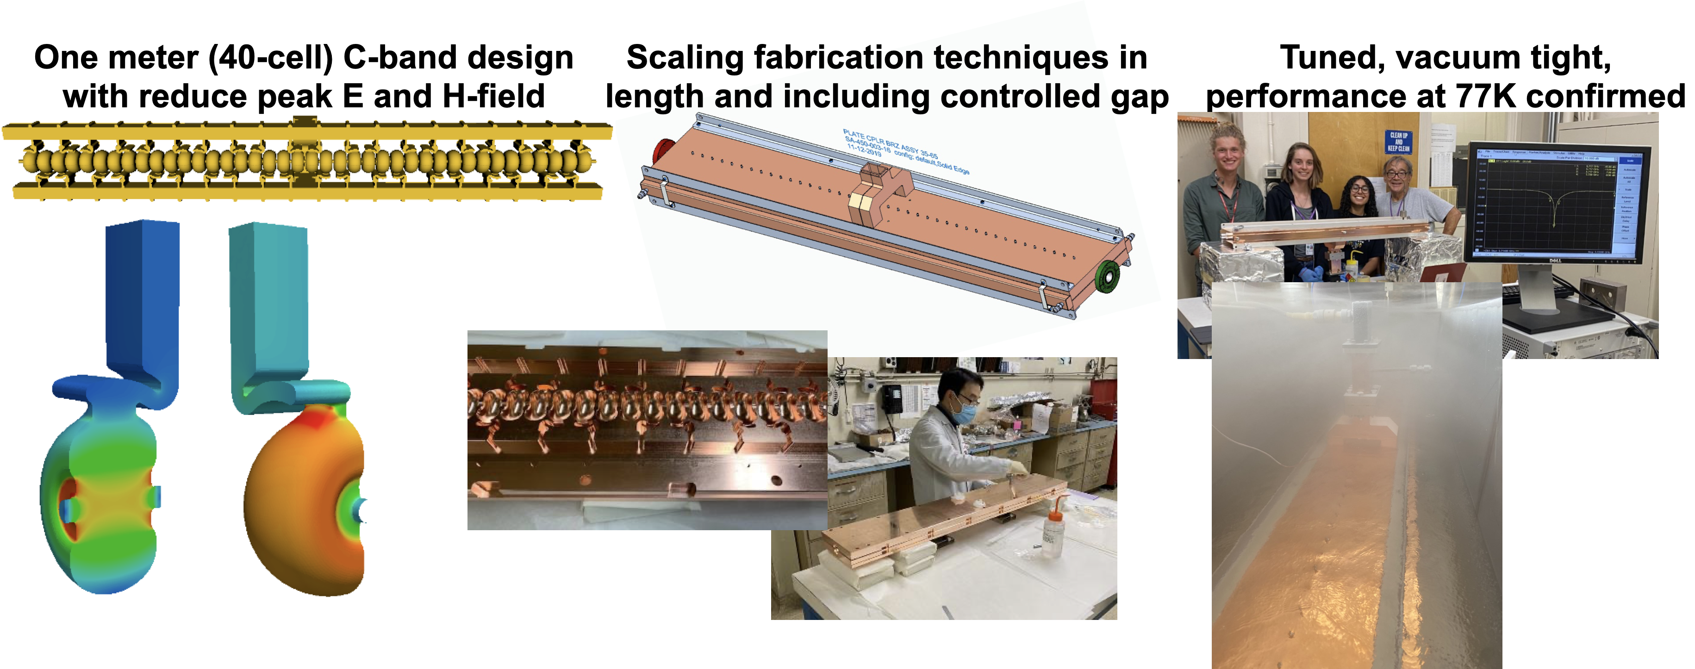
This architecture has already been applied to C-band
C-band structure for C³ has already been tested
Further details were discussed yesterday in Zenghai Li's talk
Applying this efficient design to high charge bunches could provide a pre-injector for colliders or FELs.
3

Slide 4
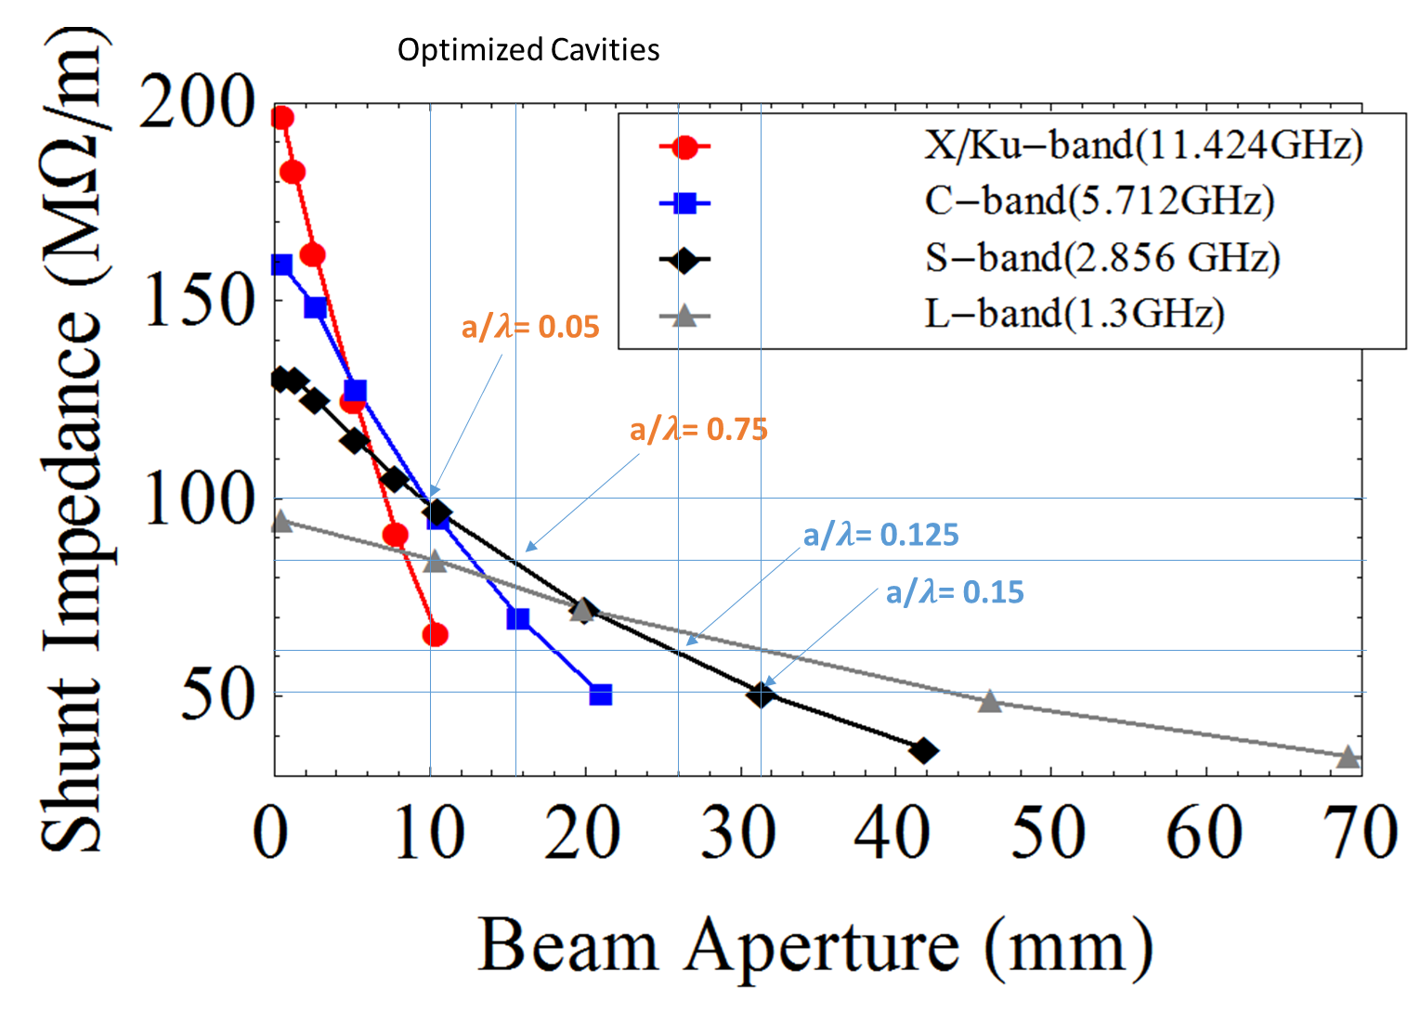
S-Band balances shunt impedance with aperture size
High charge bunches would require larger apertures
S-band provides significant larger aperture compared to C-band for a given shunt impedance
4

Slide 5
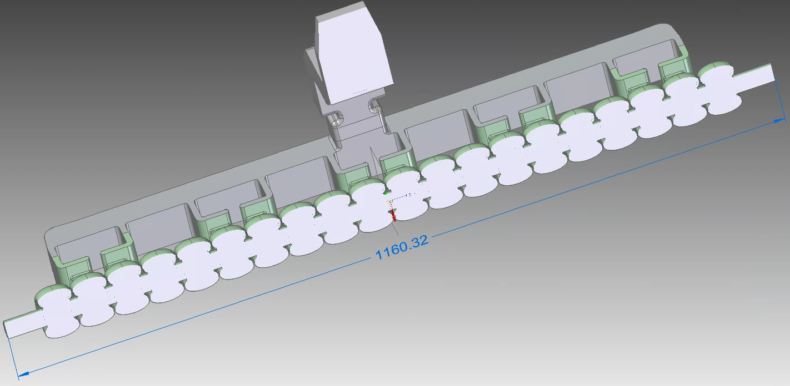
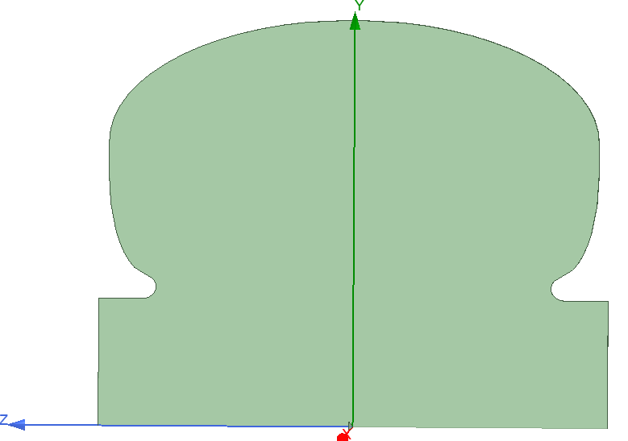
Design is underway for an S-band distributed linac
Scaled the C-band manifold by 2 to S-band dimensions
S-band cavities designed with aperture ratio λ/a=0.125
Cell:
$π$-mode
Shunt impedance: 60 MΩ/m
E_{max}/E_{a} = 3.4
Power Dissipated @ 16MeV/m = 221 kW
H_{max} @ 16MeV/m = 3.27e4 A/m
a=13.1mm
p=52.5mm
5

Slide 6
Comparing to EIC baseline shows better emittance
7nC (left) and 14nC (right) bunches were considered
Baseline design for EIC pre-injector was used as comparison for existing high bunch charge linac

Slide 7
Comparison of Technologies for EIC pre-injector electron linac
 | SLAC Linac 3 m structure | PSI Linac 4 m structure | Distributed Coupling 1 m structure | Cryo-Distributed Coupling [77 K] 1 m structure
Shunt Impedance [M$Ω$/m] a/$λ$ [radius/wavelength] | 51* 0.15-0.11 | 45-56⁺ 0.135-0.095 | 58 0.125 | 210 0.125
Power / Length @ 16 MeV/m [MW/m] / Power for 400 MeV [MW] in 25 m Min. 65 MW 5045 Klystron | 8.3 / 210 4 klystrons | 6.2 / 156 3 klystrons | 4.4 / 110 2 klystrons | 1.8 / 44 1 klystron
Achievable Gradient [MeV/m] Constant BDR Scaled from Pulsed Heating | 50 | 60 | 74 | 118
Power for 400 MeV in 8 m [MW] Corresponds to 50 MeV/m Min. 65 MW 5045 Klystron | 645 10 klystrons | 488 8 klystrons | 344 6 klystrons | 138 3 klystrons
*Equivalent Rs for SW of 31 M$Ω$/m due to TW power to load; ⁺Equivalent Rs 41 Modeled (38 Measured) PRAB 19, 100702 (2016)

Slide 8
This coupling structure provides efficient acceleration for large bunches
Higher performance than current baseline
Up to 14nC of bunch charge with low emittance
Would be useful as a pre-injector for C³ as well
Reduces number of klystrons required providing cost saving and redundancy
Could also provide a useful structure for proton beams or positron capture
8

Slide 9
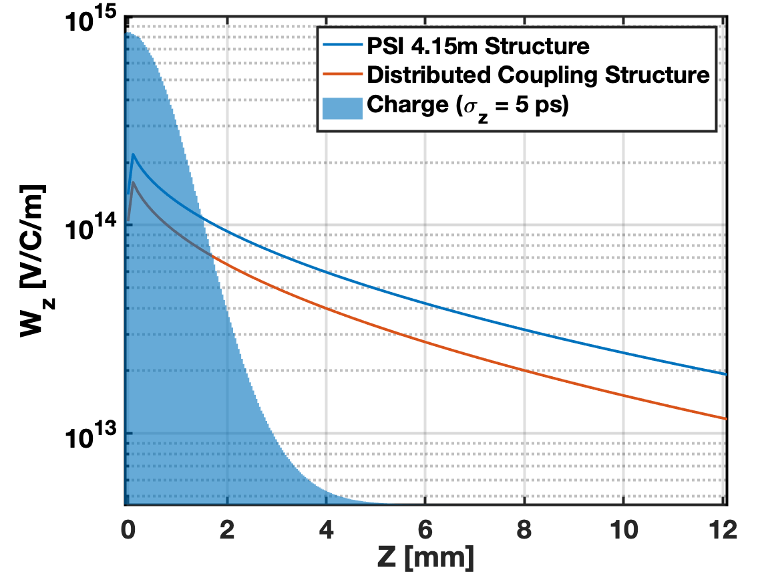
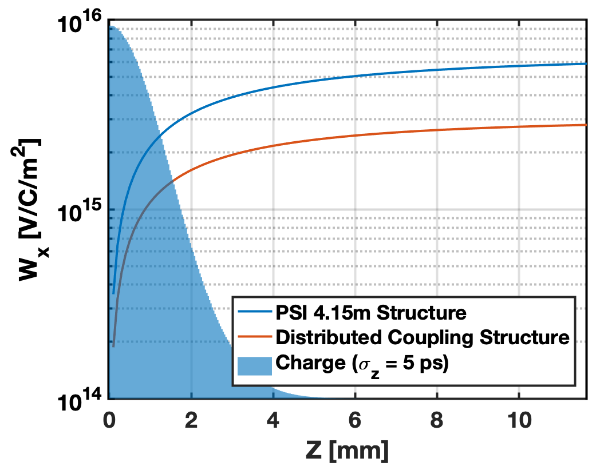
Wakefields
Longitudinal and transverse wakes used for tracking through accelerating structures*
*SLAC SLC 3 meter structure wakes in between DC and PSI

