Slide 1
Collider Industrialization
Jan 20, 2022

Slide 2
How do we scale up to production?
How do we integrate industry input into engineering of components?
What are best technologies to transfer to industry - rf source, electronics, structures, assembly, installation, test, R&D?
How do we position US industry for success?
How do we impact technologies in other areas?

Slide 3
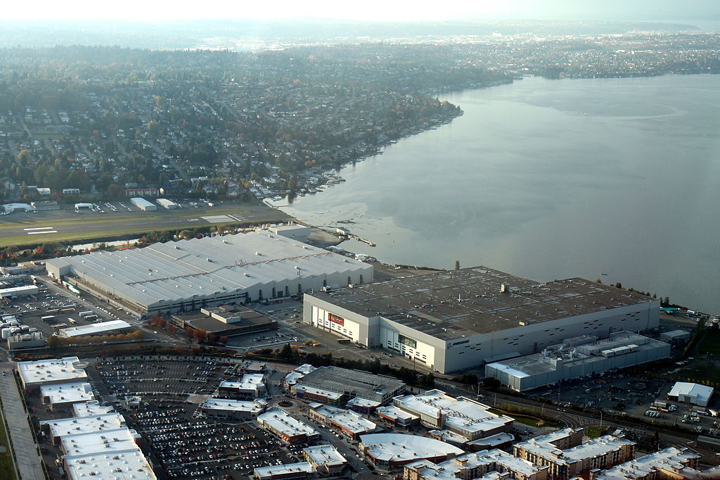
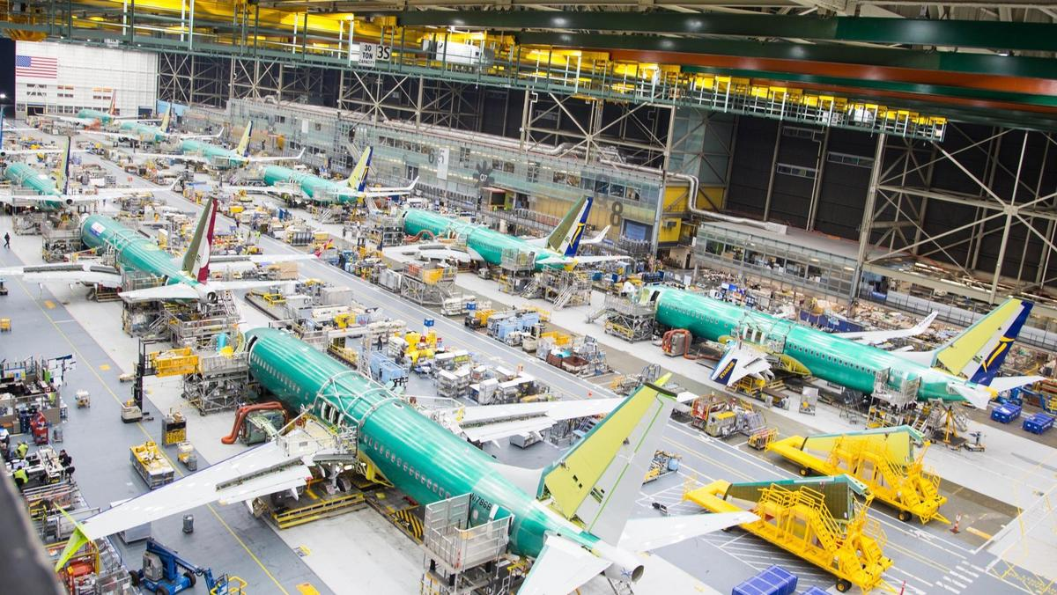
Industrial targets
Production rate @ 2030
400x 1 m structures
200x 65 MW klystrons,
50 cryomodules
Boeing: Estimated to produce 350x 737s in 2022
WW2 US aircraft production:
1940: 3,611
1944: 96,270 (2,600%)
1.1 million square feet Renton facility

Slide 4
Allied Industries
Important to understand from perspective of Capex/Opex, project management and skills pipeline
Oil and gas: large holes in the ground, politics (domestic, international)
Semiconductor: Vacuum systems, enormous capital investment, Tick-Tock delivery model
Aerospace: Complex electro-mechanical systems, gas consumption improvements drive new sales, cyclical industry, dual-use: defense and civilian
Nuclear: Long amortization periods, large installation, dual-use
Fusion: 20 years away, magnets + RF
Automotive: guaranteed demand, international competition, quality control/safety, cost per unit driven to bottom
What goods and services can be transferred to these industries?
Best: RF sources, electronics, vacuum engineering, precision engineering & mfg
Good: Structures, R&D
Okay: Assembly, installation
Promising Trends
VCs have appetite to fund deep-tech
Return of semiconductor fabrication to US
Cross-cutting technologies: 3D printing, AI, AR-assisted assembly
Accelerator physics is fundamentally ‘open-source’

Slide 5
Supply chain management
Development versus production contracts: cost-plus versus fixed costs
Design: build-to-print or collaborative process?
Talent pipeline: loss of knowledge, training programs, # pipefitters versus # PhDs
Domestic labor is major cost driver, Labs scientists have limited exposure too
Supplier redundancy, accountability and auditing
Realistic timelines for scale-up capabilities
Secure production site
Hiring/training
Equipment procurement & commissioning
Leaning out/improving process
Funding opportunities
SBIRs: require a tremendous domain expertise to be competitive
Support innovation, not invention
Validation and conditioning: Lab or industry?
3rd party arbitration
Parts suppliers versus integrators: who bears risk for failure?
Aero: OEM, Tier 1, Tier 2, MRO: certification and standards
JWST schedule and cost overruns? Northrup refused to $800M bill

Slide 6
Industrialization according to Elon
“I think designing a rocket is trivial. There’s tons of books. You read them. You understand equations. You design a rocket. The next step is you want to make one of those things. Making one of those and getting it to orbit is hard. The designing is not hard. The making of it is hard. The making of a production line that builds and launches many is extremely hard”
“We realized that the true problem, the true difficulty, and where the greatest potential is – is building the machine that makes the machine. In other words, it’s building the factory. I’m really thinking of the factory like a product.”
“So have the design and manufacture, and bring those up at the same time so that in the beginning your going to make a thing that you know is wrong, but you’re figuring out what’s hard to manufacture. That’s the real problem. So we brought up the starlink production line before we had the design finalized, which is actually the right thing to do. We discovered there are all these things in the design that were difficult to make, therefore we must change the design”
https://acquisitiontalk.com/2020/03/production-can-be-1000-harder-than-design-says-elon-musk/

Slide 7
Industrialization according to Elon
Elon’s Engineering Principles
Make The Requirements Less Dumb
The requirements are definitely dumb; it does not matter who gave them to you. It’s particularly dangerous when they come from an intelligent person
2. Try And Delete Part Of The Process
If parts are not being added back into the design at least 10% of the time, [it means that] not enough parts are being deleted.
3. Simplify Or Optimize
This is the most common error of a smart engineer — to optimize something that should simply not exist
4. Accelerate Cycle Time
You’re moving too slowly, go faster! But don’t go faster until you’ve worked on the other three things first
5. Automate
An important part of this is to remove in-process testing after the problems have been diagnosed; if a product is reaching the end of a production line with a high acceptance rate, there is no need for in-process testing.
https://acquisitiontalk.com/2020/03/production-can-be-1000-harder-than-design-says-elon-musk/

