Slide 1
RF Sources Industrialization Strategy
Future US Collider Workshop
Brandon Weatherford
Jan 20, 2022

Slide 2
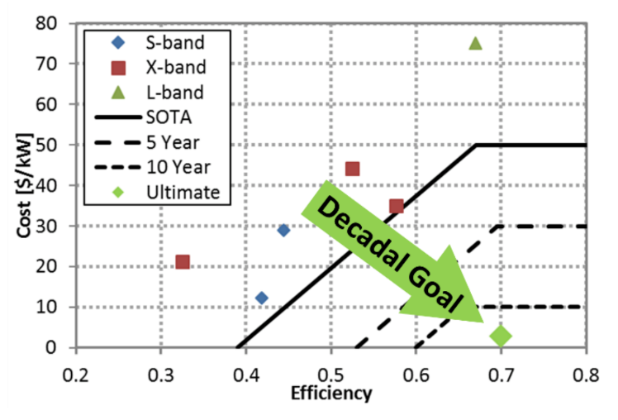
Reducing the cost of RF power
RF power is the main cost driver for any advanced accelerator facility
The invention of pulse compressors, superconducting structures, and two-beam accelerators were all motivated by the need to reduce RF power costs
DOE/HEP set a decadal goal of 70% DC-to-RF efficiency at $2/kW – an extremely difficult challenge at any frequency
*Radiofrequency Accelerator R&D Strategy Report

Slide 3
Optimization of the entire system – accelerator structure, modulator, and RF amplifier – is crucial
 | Efficiency | $/kW_{peak}
Commercial Modulator | 90% | $10/kW
SLAC ILC Marx | 88% | $40/kW
SLAC XL-4 Klystron | 40% | $20/kW
Common Household Cooker Magnetron | 65% | $13/kW
S-band Medical Klystron | 45% | $8/kW
Total System Goal* | 70% | $2/kW
RF Source
Modulators
RF Amplifiers
Research Thrusts @ SLAC
Research Objectives
Must increase total efficiency from 40% up to 70%, while decreasing cost by 10x
RF and Beam Physics
Low-Cost Systems
Novel Topologies
High Efficiency
Systems
Fabrication
Methodologies
*System goals come from the 2017 DOE RF Accelerator R&D Strategy Report

Slide 4
The demand problem for RF sources
MW-class RF sources are custom-designed, hand-built, and expensive
There are few commercially viable uses for high power klystrons
Short term (high cost): Build facility using existing commercial sources
Long term (cost reduction): Labs (not industry) drive improvements
Labs execute fundamental R&D in e- sources, additive, etc.
Labs drive applications for RF sources in commercial, medical, defense
Industry invests in mass production & cost reduction to meet new demand
Wants: Collider and future HEP facilities
Wants: $
Opposing Motivations
Funding Agencies
Industry
Gridlock
Needs: Minimum cost
Needs: Guaranteed market opportunity

Slide 5
Short-term production spin-up (if we can afford it)
Option 1: Design accelerator system around existing klystrons/modulators that have been built at scale
Could still (likely) be cost prohibitive
Option 2: If a new klystron is needed…
Order one tested prototype from multiple sources ASAP
Just as important as tube itself – this effort supports spinning up assembly processes, validating test infrastructure
Require a detailed business plan / estimate for at-scale production before prototype award
Upfront investment in companies to support automated testing of new tubes, low-touch labor manufacturing
How to share/standardize of assemblies across suppliers? Klystrons designed by labs + industry build-to-print?

Slide 6
Long-term cost/capability plan
New or existing klystrons may still exceed available $
To mitigate this risk, a long-term RF sources strategy – led by the labs – is needed to attack main cost drivers:
Electron sources:
Need alternatives to filament potted thermionic guns
Magnets:
How to simplify assemblies (standard sizes, PPM?)
Novel RF source topologies (relax focusing requirements)
Test labor:
Automation of tuning, hot testing, etc.
Upfront investment from public sector; company won’t build this infrastructure on their own $ unless its needed
Assembly labor:
Investigate areas where novel or high-throughput (i.e. automotive) manufacturing techniques are “good enough”

