Slide 1
C³ Diagnostics and Controls
Josef Frisch, SLAC Jan 18, 2022

Slide 2
Approach: Demo and Collider
Demo ~2026?
Small system, expect engineering to dominate controls / instrumentation costs
Use existing designs when suitable in order to reduce engineering costs
Concentrate engineering on subsystems with new or beyond state of the art requirements.
Collider ~2040
Large system, expect production to dominate control / instrumentation costs
Technology advances rapidly, delay detailed designs to take advantage of best available technology to reduce production costs

Slide 3
Instrumentation / controls underlying technologies
Radio frequency based:
Low level RF
Precision phase / timing distribution / arrival time monitors
Beam position monitors (cavity and stripline)
Triggering system
Profile Monitoring
Computation and data
Magnet Controls
Conventional control
Temperature monitoring
Slow motion control
Safety and machine protection
Other
Active mechanical feedback for structures
Laser controls
Bunch length spectrometers

Slide 4
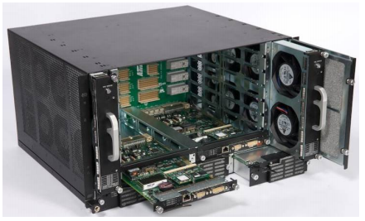
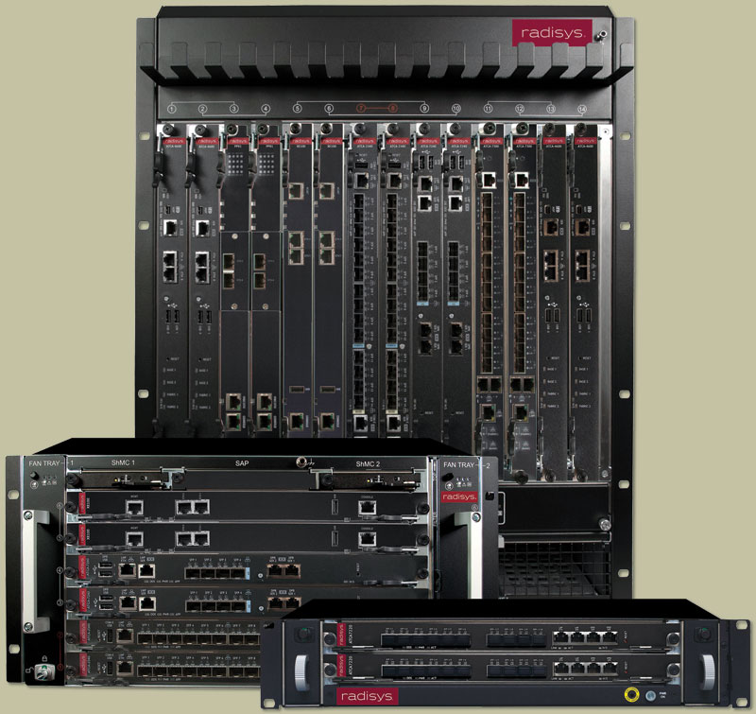
For DEMO: The ATCA Common Platform
Developed at SLAC for high performance distributed control systems
Based on the Advanced Telecommunications Computing Architecture (ATCA)
High density, backplane carries all global signals
ATCA Crate “shelf”
Standard hardware, SLAC application:
Available from 1 slot to 14 slot
Power supply with hot swap
Management
Networks
Cooling
Designed for high-reliability applications

Slide 5
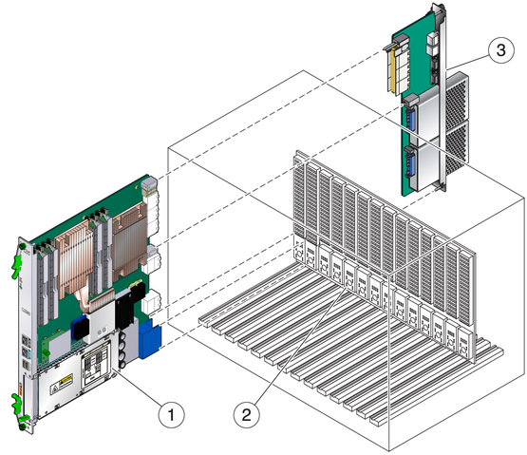
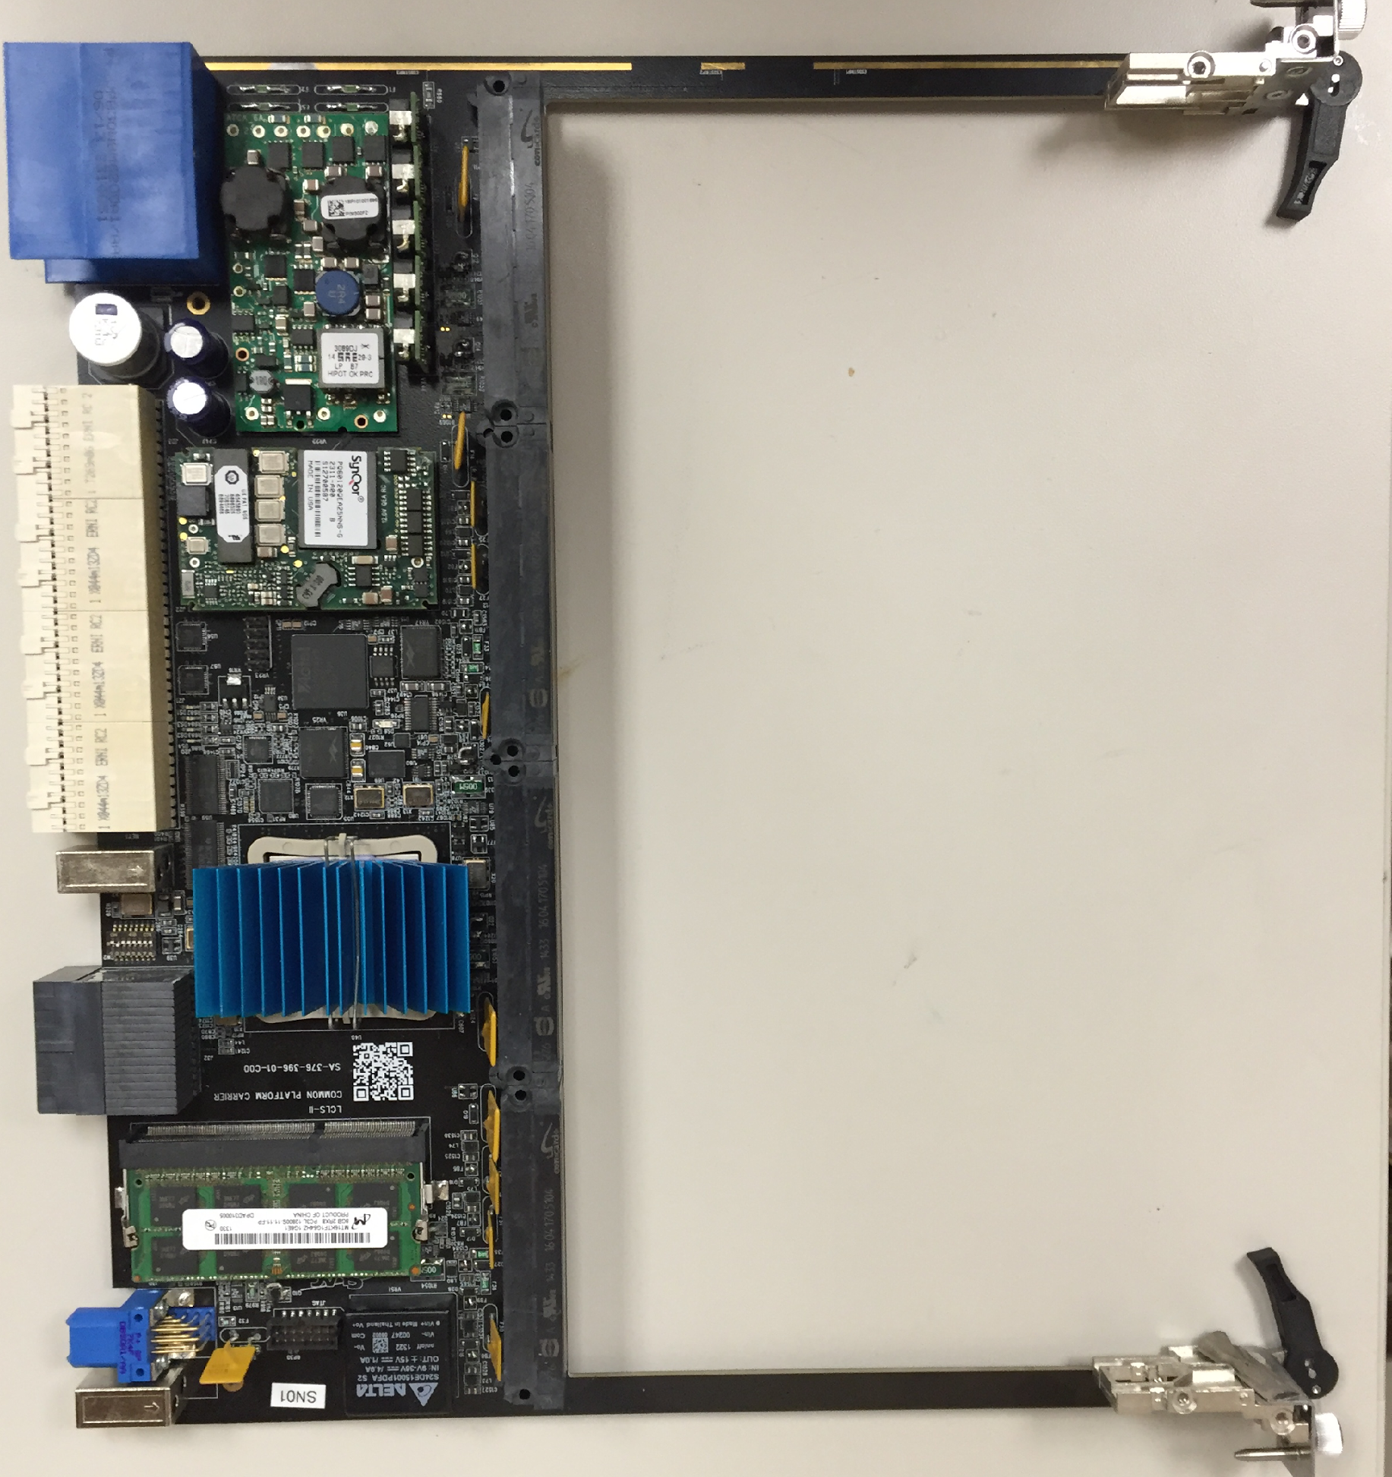
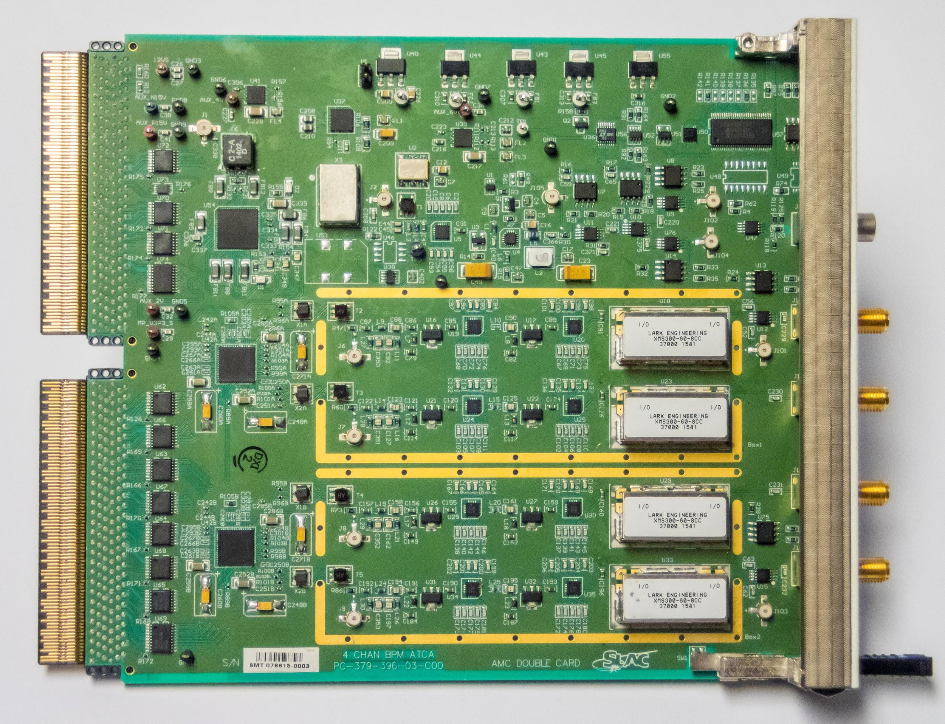
Common Platform
SLAC hardware and software application on ATCA
1: Carrier Card
2: Crate
3: RTM
Each carrier supports 2 AMC application cards
Carrier card: FPGA, memory, backplane connections
AMC cards: ADCs, DACs, high performance front end electronics
RTM: General purpose IO, extra networks, miscellaneous

Slide 6
ATCA / common platform backplane
Ethernet for data / control (10Gbit, 10/40 uplink)
IPMI
10G / 40G data
Timing data stream (3.7Gbit)
Machine protection / uplink (3.7Gbit)
MPS
Slot 1
switch
IPMI management network
Slot 2
payload
payload
Timing
All carrier cards can also serve as slot 2 nodes
For most applications, all networks are carried on the backplane, minimal external connections
payload
payload
Single cards can be used with rear transition module networking
payload
payload
payload
Crates available from 1 to 14 cards

Slide 7
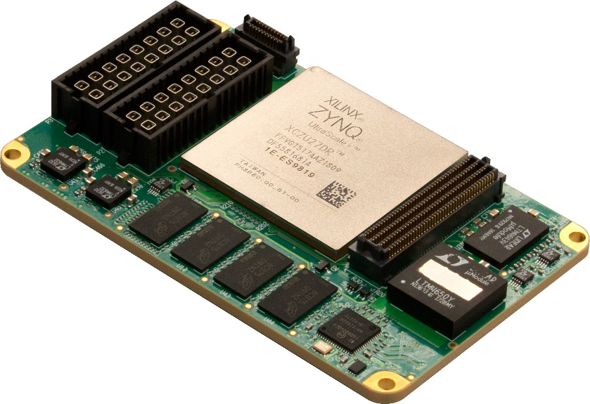
Platform for C³?
Difficult to predict technology > 10 years out, so concepts based on 2022 systems may change substantially
Xilinx RFSoC shown in Pentek module
2.4” X 4”
16X 2.5Gs/s or 8X 5Gs/s high performance ADC
16X 9.85 Gs/s high performance DAC
FPGA fabric: 4270 DSP slices
Quad-core ARM processor 1.33GHz
Dual core ARM redundant processor
Memory management and 8GB DDR4
Network and connectivity
This is an entire Data acquisition and control subsystem on a card
Stand-alone or as VPX 3U card (From Abaco systems)
Backend for LLRF, BPMs, etc.
Existing devices not quite able to directly digitize C-band with high performance, but that may be developed soon

Slide 8
C³ Parameters (for the purpose of instrumentation / controls)
System Length | Few Kilometers
Beam power | Few MW
Repetition rate | 120Hz
Bunch charge | 1nC
RF pulse length | <250ns
Bunch spacing | >2.5ns

Slide 9
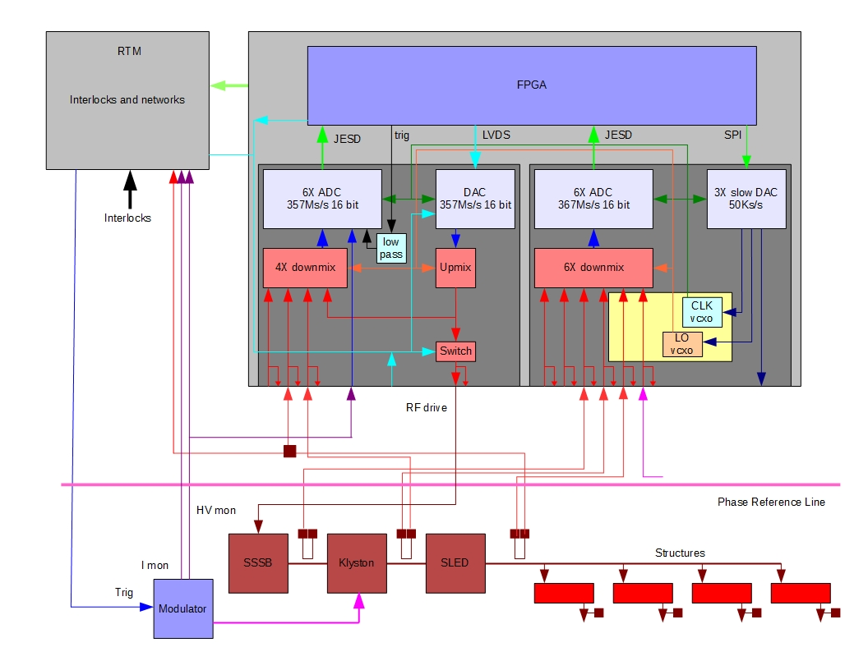
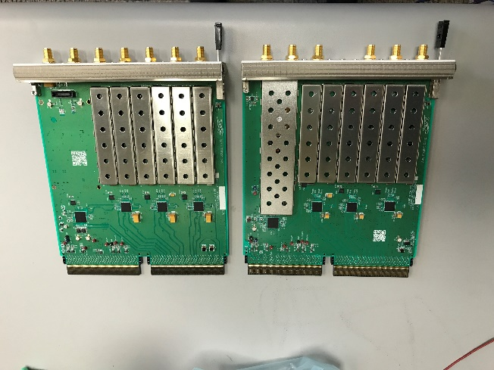
RF Systems: Low Level RF
Based on the SLAC “Mission Readiness” LLRF system – in production use on the Ultrafast Electron Diffraction experiment and demonstrated on the LCLS1 LINAC
S:AC “Common Platform” System
LCLS Implementation

Slide 10
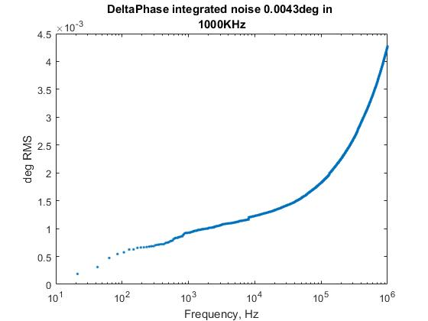
Performance
Receiver RF phase performance: 0.004 degrees RMS in 1MHz bandwidth at S-band
Receiver phase stability: 0.25 degrees S-band / degree C
Identical reference and
Transmitter performance: 0.015 degrees RMS in 1MHz bandwidth
Arbitrary RF waveform generation
SLED, frequency chirps, Ideal loading for standing waves structures etc.
Modification from 2856MHz to 5712MHz
Design is frequency flexible – daughter card defines operating RF and clock frequencies: Tested at 2856, 2805, 1400, and 476MHz
Existing mixer (LTC5551 / LTC5521) limited to 3.5GHz can be replaced with LTC5548 which works to 14GHz
Expect <0.01 degrees RMS readback noise and < 0.03 degrees RMS drive
Capable of inter-pulse feedback with ~500ns latency, but no performance gain observed on LCLS stations. RFSoC based system could operate with 200ns latency feedback

Slide 11
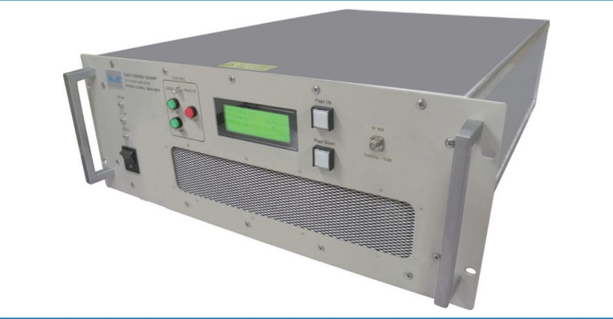
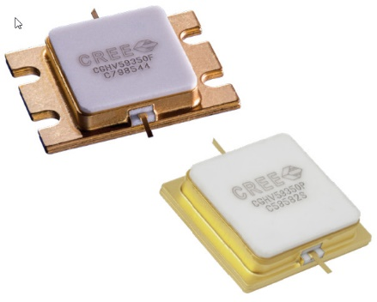
Low Level RF Sub-boosters
Typical RF drive to klystron ~1KW
Commercial rack-mount units available from various vendors
R&K –CA5712BW20-5959RP shown
800W peak at 5712MHz
<0.05deg RMS phase stability pulse to pulse
May be suitable for DEMO system
Compact GaN C-band pulse power amplifiers available that can be integrated into a ~1KW system
Wolfspeed CGHV59350 shown
Typical 470W output at 5712MHz
Suitable for C³ (possibly DEMO, depending on cost trade-off vs commercial rack-mount units)
Area of improving technology – expect better / cheaper in 2030

Slide 12
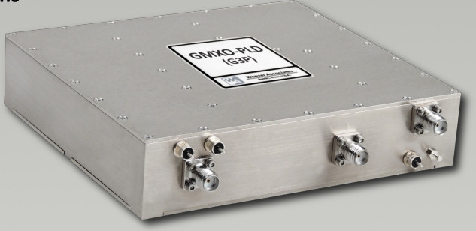
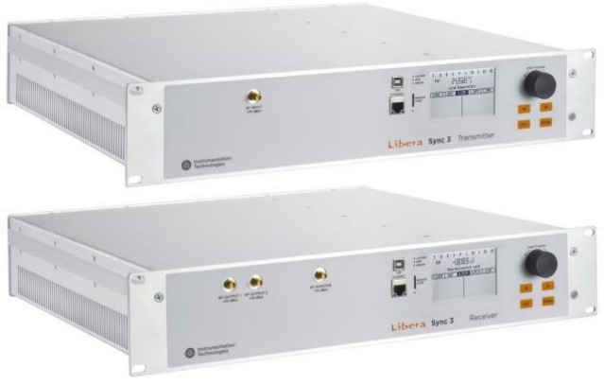
Precision phase distribution
Requirements similar to X-ray FEL facilities: LCLS2 requires ~100fs (0.2 degrees C-band) stability over ~4km
Master Source: Commercial oscillators, Wenzel GMXO shown
Broadband phase noise corresponding to 0.006 degrees RMS at C-band in a 10MHz bandwidth
1/f noise significant only below 1KHz (generally not important for accelerators)
Can be frequency locked to GPS
Long distance phase distribution: Both commercial and in-house designs exist
Libera Sync unit (used a PSI XFEL and planned for SLAC LCLS2)
<10fs (.02 degree) jitter. <0.02 degree drift over 10 degrees C temperature. (500M fiber).
SLAC / LCLS developing multi-km link with I-tech
For short haul (<100M) RF cable reflectometers can provide good stability. (LCLS / LCLS2)

Slide 13
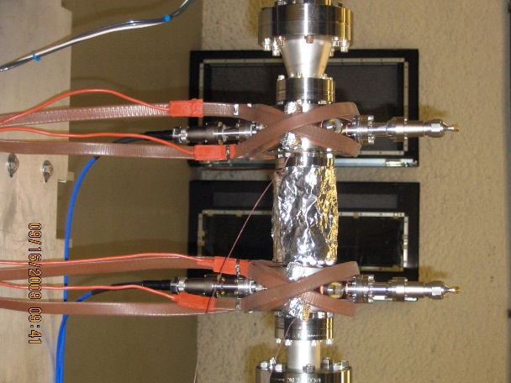
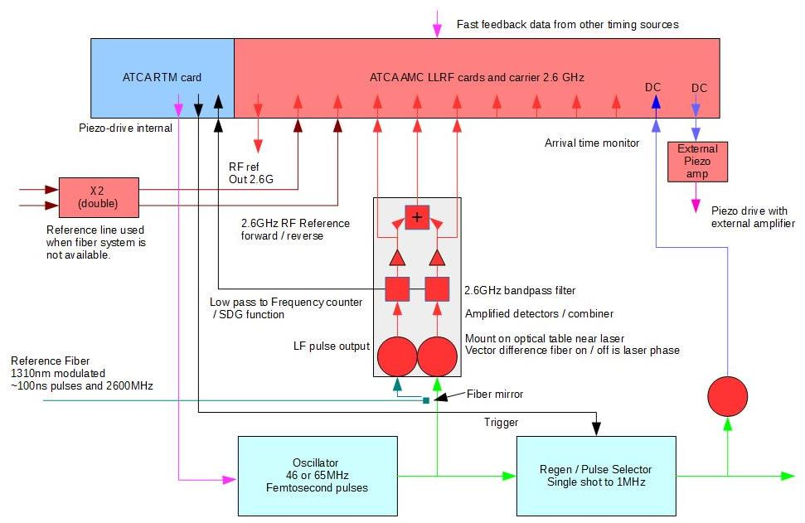
Precision timing
Beam arrival Time monitors
Use RF cavities
LCLS sees ~15fs noise, <50fs drift over 100 hours demonstrated
Can be used to measure beam vs RF time anywhere in the accelerator
Based on same RF hardware as the LLRF system
S-band arrival time monitor.
C³ would use C-band
Laser timing control
Laser photodiode and ringing filter
Phase detection with standard ATCA LLRF hardware
FPGA driven feedback to laser length control piezo
<50fs RMS jitter, < 100fs drift

Slide 14
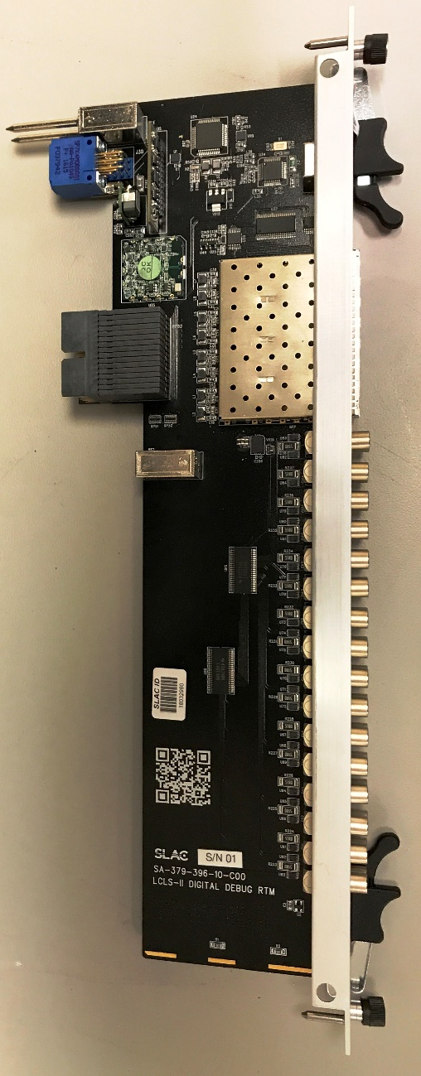
Triggering System
Clock and data distributed on fiber network
Telecom type fiber, ~few Gbit clock rate
All receivers count down from fiducial work to programmed delays
LCLS / LCLS2 system integrated with common platform hardware, firmware and software
Trigger receiver firmware integrated into all common platform hardware
10ps trigger jitter
Good timing stability (<<100ps) available using digital reflectometer. (used for LCLS2)
SLAC timing RTM

Slide 15
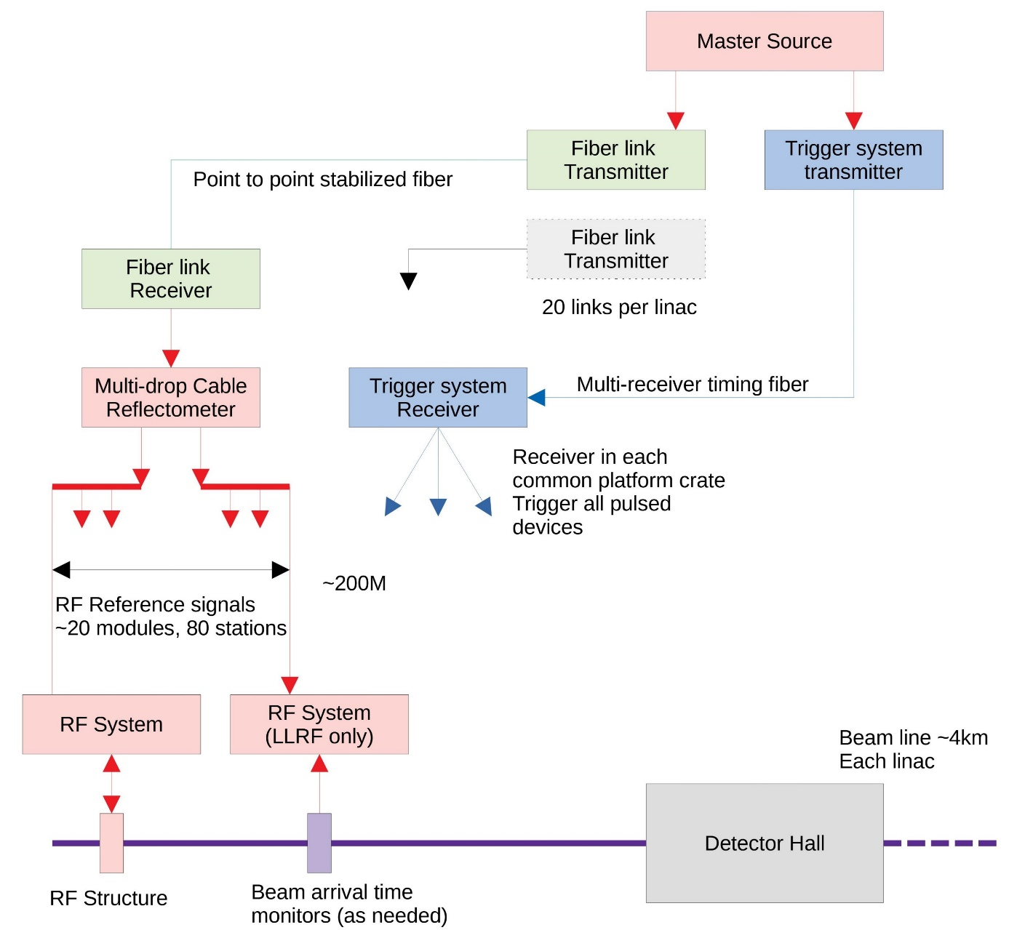
Precision Timing Overall
All systems phase locked to master source
RF phase reference provides ~10fs timing to precision devices
Trigger system provide <10ps triggers to all pulsed devices

Slide 16
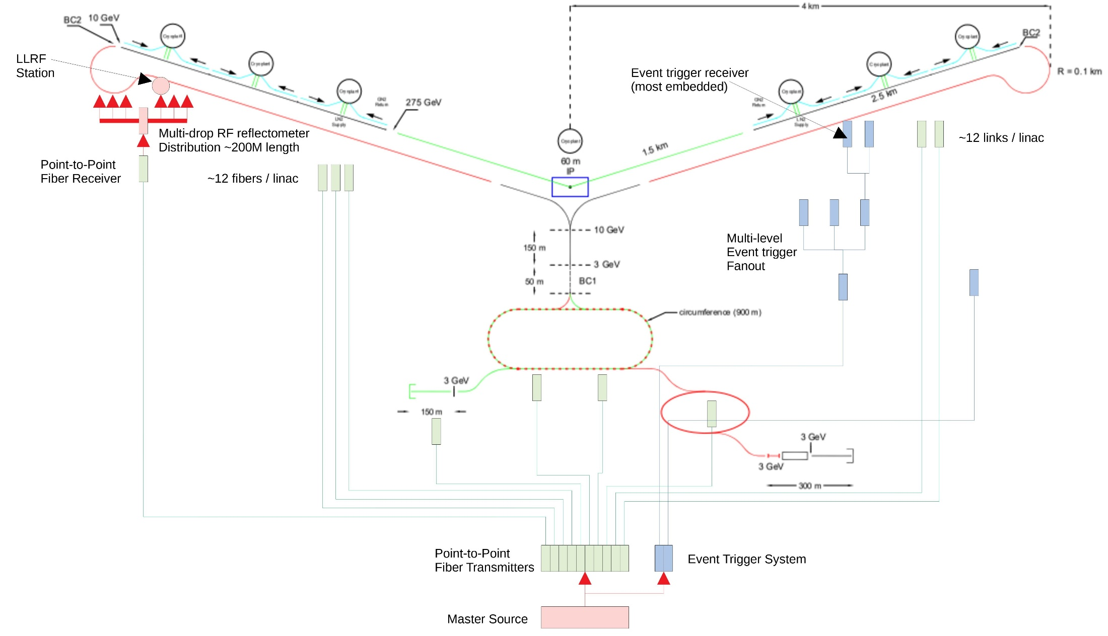
Timing layout for C³

Slide 17
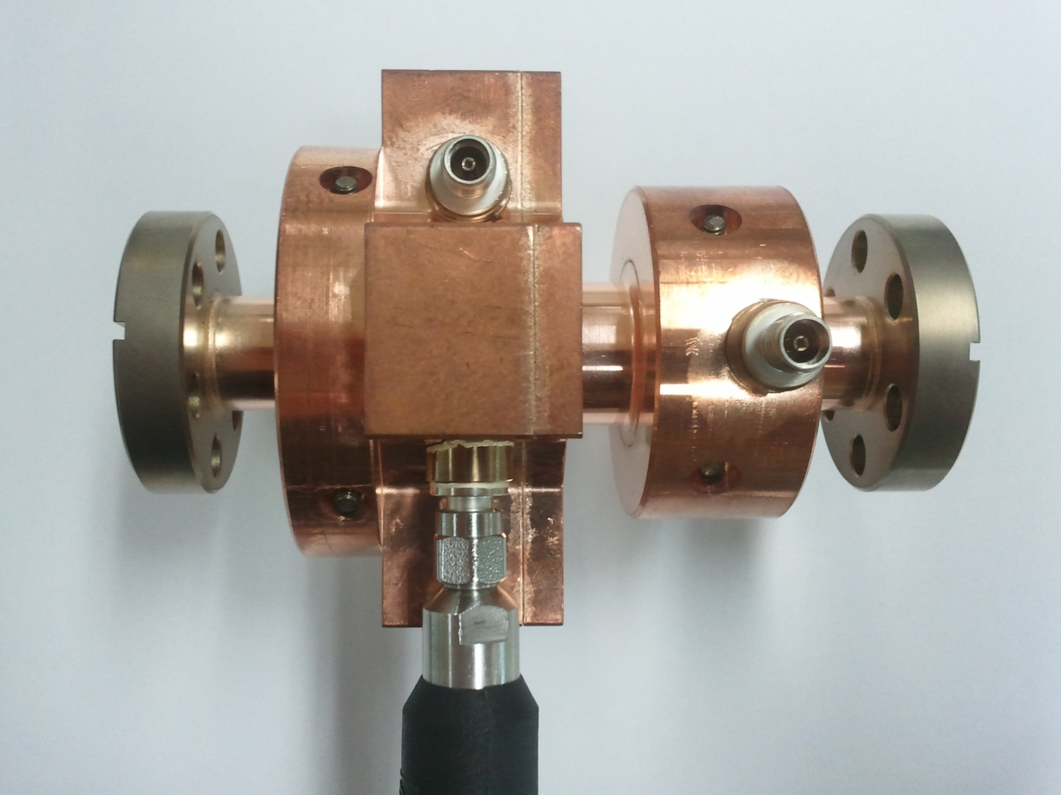
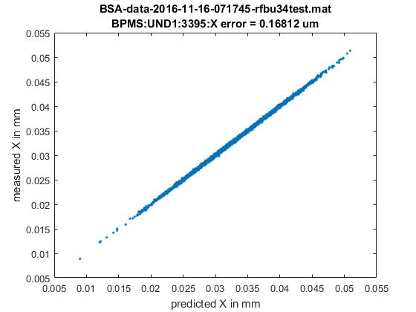
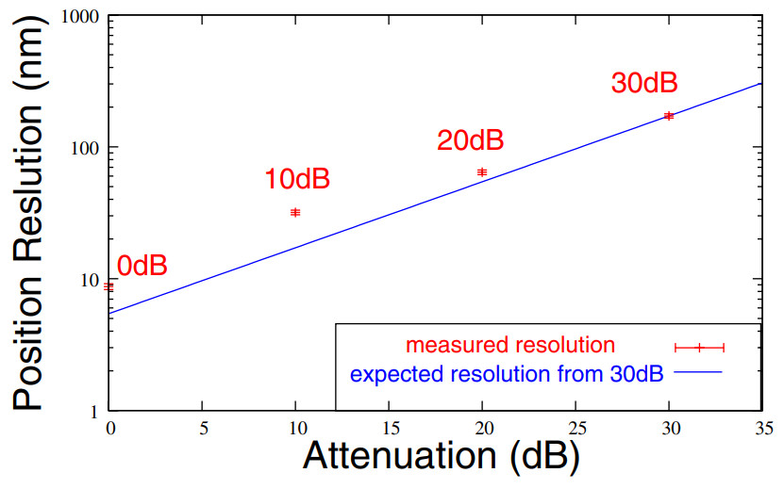
Beam Position Monitors
Stripline and Cavity BPMs both in common use on accelerators.
Cavity BPMs provide better noise due to higher coupling to beam
Cavity BPMs provide better offset stability due to operation near null
Cavity BPMs recommended for most parts of DEMO and C³
Cavity BPMs have demonstrated 10 nanometer resolution for low beam offsets, 1nC
Regular production operation at 250nm for ~50X devices on LCLS at 100pC
Yoichi et al, ATF Japan
Andrew Young, LCLS
170nm resolution

Slide 18
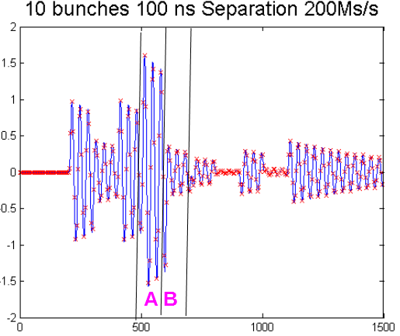
Beam position monitors and bunch spacing
Short bunch spacing (2.5ns) requires high bandwidth readout.
Note: Cavity decay time can be >> bunch spacing: it’s a linear problem to separate individual bunches.
SIMULATION
Glen White
Demonstrated with beam at ATF2 but not published
Design choice: BPM cavity resonant or off-frequency:
Resonant: Best overall train average position measurement
Off-frequency : Best single bunch resolution within train

Slide 19
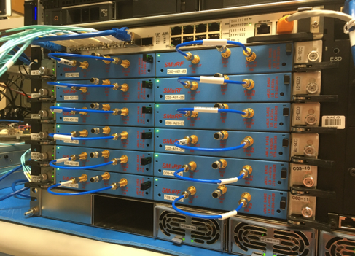
Beam Position Monitor Hardware
Cavities can be designed with same technology as cold accelerator structures.
Option to integrate BPM cavities into structure if desired.
Need high digitizing rate (>1.6 Gs/s) to cleanly separate bunches.
Beyond capabilities of existing SLAC LLRF readout (~10MHz bandwidth)
Can use existing “SMuRF” electronics with some modification and new firmware
Good application for RFSOC based readout (even for DEMO)
Single RFSoC card has 8X 5Gs/s ADCS, sufficient for 2X cavity BPMs.
Option of 16X 2.5Gs/s ADCs (5X BPMS) if higher density needed
Can use commercial RFSoC hardware – multiple options exist
Serves as demonstration of RFSoC technology in an application where firmware is not too complex. (can do processing in software).
SMuRF readout (for cryogenic detectors)
Each card is 8X 2.4Gs/s ADCs with signal processing

Slide 20
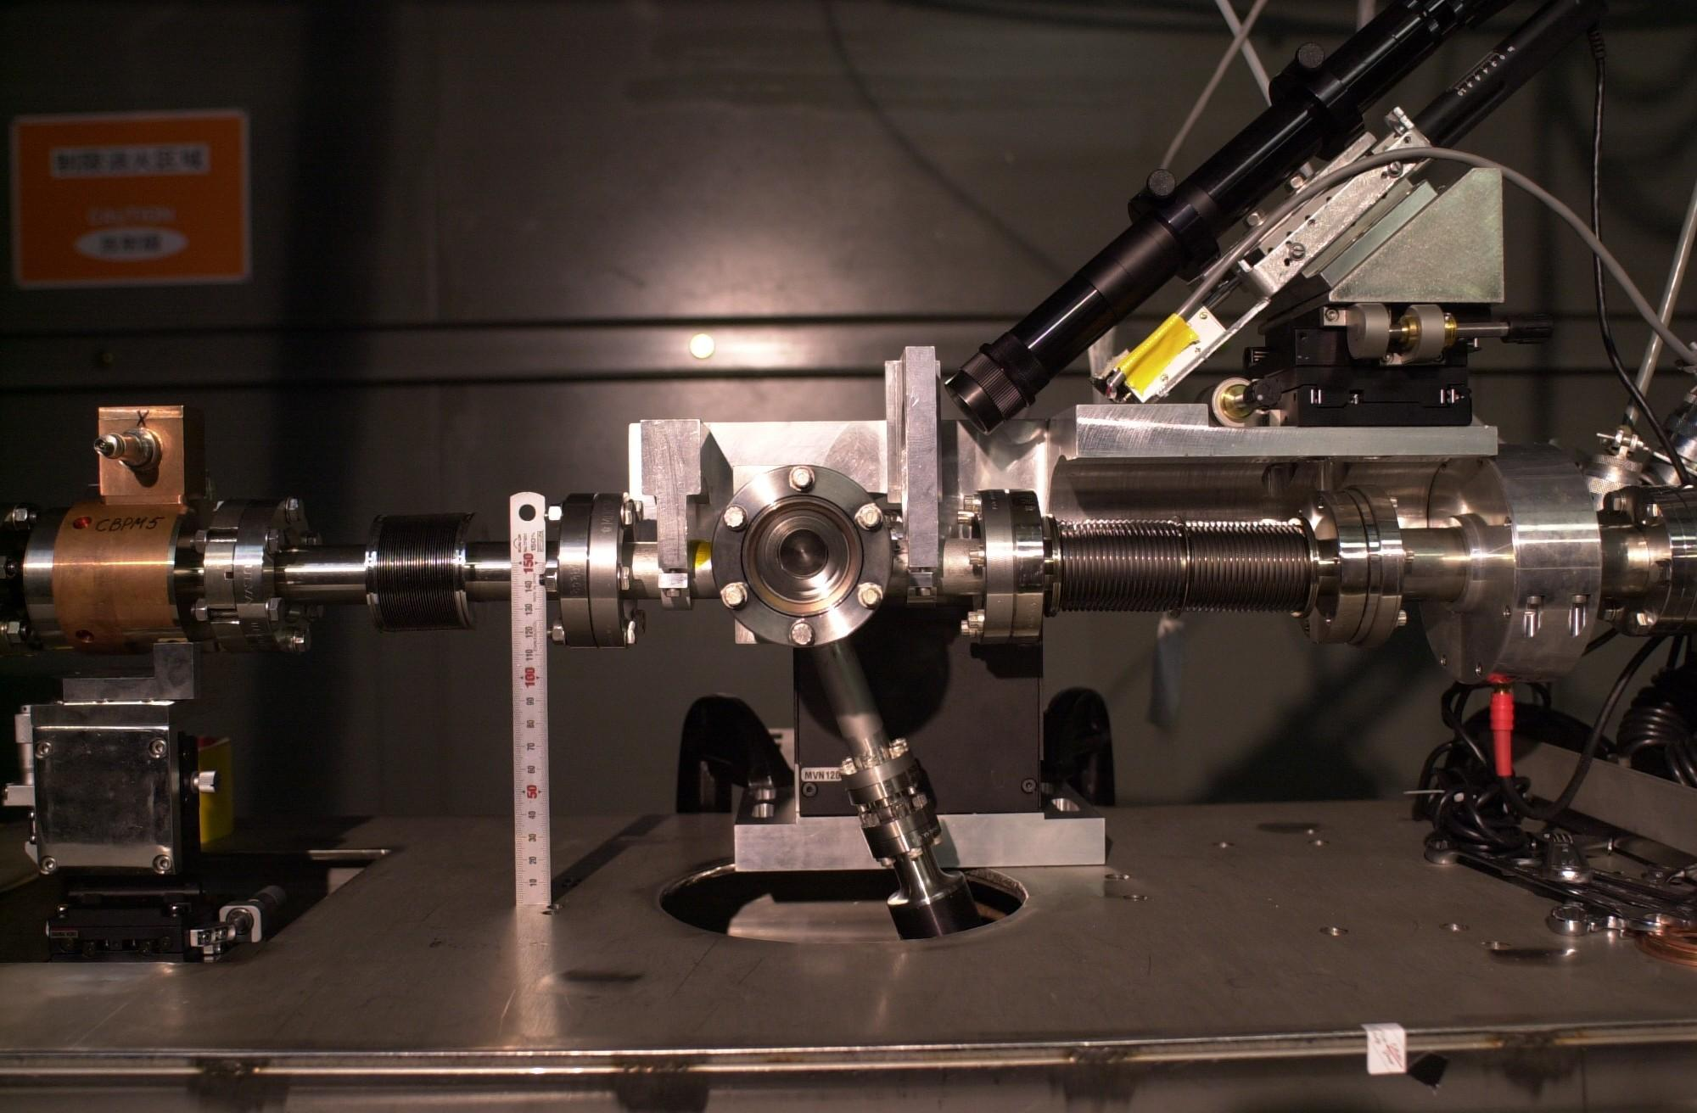
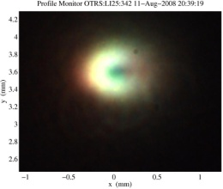
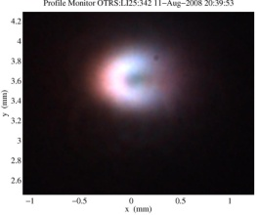
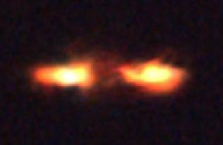
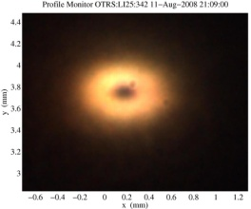
Beam Profile Monitors
OTR (Optical Transition Radiation) profile monitors for low longitudinal brightness beams (post damping ring)
~2um resolution OTR at ATF2 Japan
Coherent emission prevents OTR monitor use for high longitudinal brightness beams
Shop of horrors of OTR distorted beam images from LCLS

Slide 21
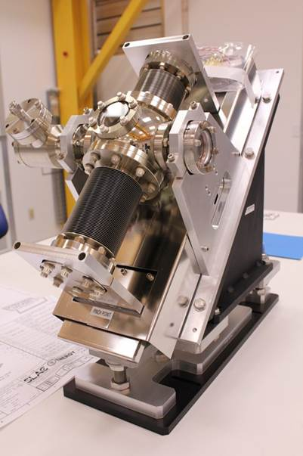
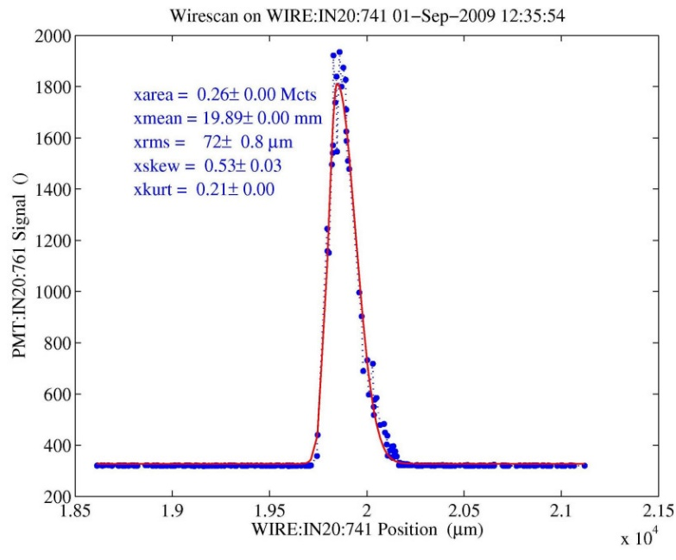
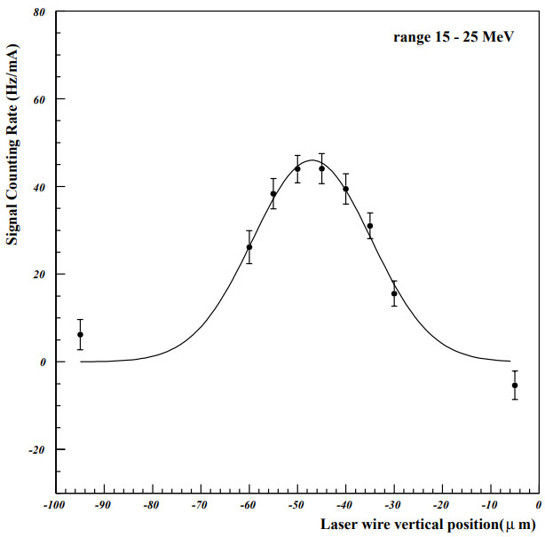
Wire Scanners
Provide integrated beam profiles even for very high brightness beams
Slow, integrated only, but no other demonstrated Technology when beam has optical micro-bunching
Will be destroyed by very high intensity beams.
SLAC LCLS
Injector
Laser wire scanners can operate with arbitrarily high-density beams, but are very complex
Saki et Al . Laser wire scan

Slide 22
Longitudinal Profile
LCLS
Transverse deflection cavity: The ultimate longitudinal measurement
Few femtosecond resolution
Spectrometer limited energy resolution
Operated like standard RF station, but with transverse cavity
But $$$$
Coherent emission spectrometers and power detectors provide lower cost and non-invasive qualitative measurements that can be used for feedback

Slide 23
Profile monitoring overall
Best technique depends on specific application
Low brightness, low density: (after damping ring)
Optical transition radiation
Possibly fluorescent screens in injector
High brightness, low density: Before damping ring
Wire scanners
High density: Laser wires (hope to avoid)
Longitudinal
Calibrated: Transverse deflection cavities
Uncalibrated, non-invasive for feedback: Coherent emission power / spectrometers

Slide 24
Beam Feedbacks
Beam based feedback greatly reduces drift requirements, especially for phase / timing
Low beam rate (120) Hz for C³ allows use of conventional networks
Train to train waveform corrections also possible – similar to Common Platform LLRF correction system
LCLS Longitudinal Feedbacks
gun
V₀
δ₀
σ_{z1}
σ_{z2}
Linac
δ₁
δ₂
δ₃
ϕ₁
V₁
ϕ₂
V₂
V₃
Linac
X
Linac
Linac
DL1
BC1
BC2
DL2
1 to 10 Beam Position Monitors (BPMs)
gun
LCLS Transverse Feedbacks
2 or 4 corrector magnets
example
Injector
L2
L3
LTU
Undulator
LTU Feedback : stabilizes beam for jitter frequencies < 10Hz @ 120Hz rep-rate

Slide 25
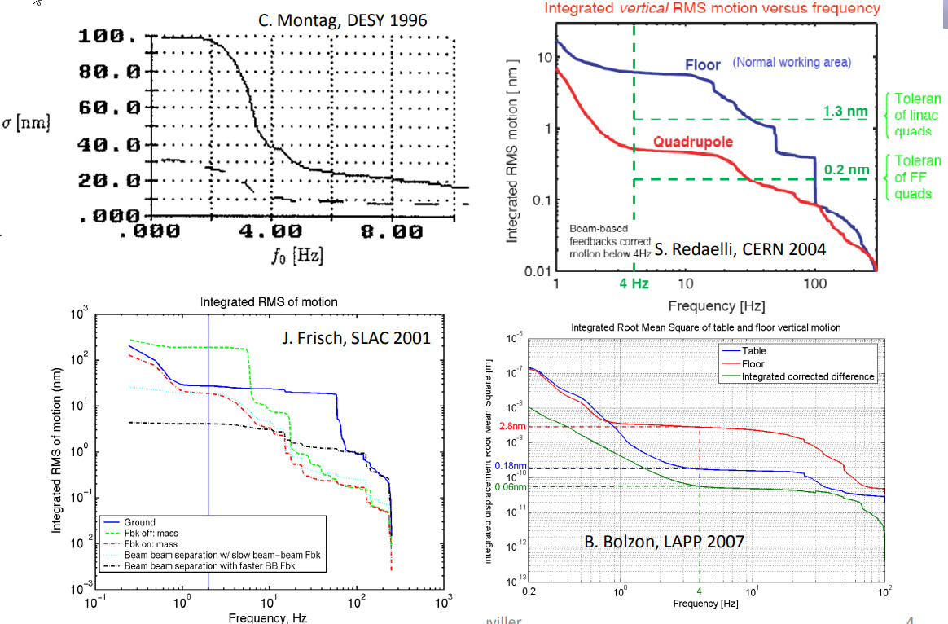
Vibration Feedbacks
Structure and magnet stabilization will require local feedback.
Measurement:
Capacitive position sensors
Compact interferometers
Algorithm
Control theory well understood for multi-DOF systems
Easily fits in modern FPGA
Actuators
For RF structures need high force
Probably Piezo actuators, but needs careful study
Work done on this for decades around the world

Slide 26
Miscellaneous Systems
Radiation Safety
Beam is high power (Lower than ESS) but otherwise conventional.
No new technology needed
Machine protection
No practical way to interrupt within a train, so this is a conventional 120Hz MPS system.
Beams similar to those run at SLAC during high power (E-158) experiments.
Magnet controls
Conventional
Temperature Controls
Operation temperature between typical “industrial” systems and low temperature cryogenics. Needs cost optimization but no new technology
Laser controls
Similar requirements to LCLS laser systems.

Slide 27
Network and Computation
Roughly 100Hz, X 100 Bunches X 10,000 fast readout devices = 10⁸Hz, or ~1Gbit total data rate
8 millisecond latency train to train
Needs good architecture, but not beyond normal state of the art.

Slide 28
Overall Controls / Instrumentation: Demo System
LLRF: Straightforward modification to SLAC mission readiness” system
Precision timing distribution:
Commercial stabilized links + LCLS / LCLS2 style timing will work
Existing beam arrival time monitors
Beam position:
Cavity BPMS will meet requirements but need new readout electronics: Either modify SMuRF or new RFSoC based
Beam Profile
Existing technology OTR, Wire scanners, laser wires, Transverse deflection cavities, depending on beam parameters in different parts of the accelerator.
Beam feedbacks - conventional
Safety Systems – conventional
Vibration feedback to stabilize structures and magnets
Needs development based on detailed requirements but considerable related work has been done at labs around the work
Controls / network infrastructure: Conventional

Slide 29
Overall Controls / Instrumentation: C³
With a TDR ~2030, there will likely be significant advances in ADC / DAC / signal processing hardware
If designed today, LLRF, BPMs, femtosecond timing would consist of:
RF front end, amplifiers, mixers LO generation
ADC/DAC/FPGA/CPU back end (like Xilinx RFSoC)
ADC / DAC can operate directly at 6GHz, but noise is too high fro accelerator applications.
Xilinx has announced it will integrate RF front ends into its “Versal” line of parts – with higher performance than RFSoC
No device specifications released.
Need to wait / see if the RF performance of the integrated parts meets accelerator level noise requirements without an external RF system.
The hardware proposed for the DEMO system would work for the full C³ and meet all performance requirements. Any changes are only for cost reduction

