Slide 1
C³ Cryogenic Concepts
Martin Breidenbach, Eric Fauve, Vincent Helion, Emilio Nanni, Marco Oriunno, Sami Tantawi, Caterina Vernieri
January 2022
C³ Workshop, Virtually SLAC

Slide 2
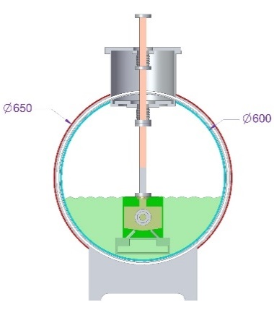
Fundamental Concept
Accelerator is under LN in a vacuum insulated cryostat
LN flows into page
Nitrogen vapor counterflows
Gravity drives LN flow
Pressure difference drives vapor
flow
Distributed re-liquifiers condense
the cold vapor.

Slide 3
Gravity
1 km laser straight SuperSector, normal to earth radius at midpoint.
Sagitta is 8 cm.
Bend angle between SuperSectors is 1.6x10⁻⁴ radians
Required dipole strength is 0.5 T-m for 1 TeV beam, ok for emittance growth.

Slide 4
Approach to a full scale machine, guided by the Science
Phase 1: 250 Gev total (125 x 125 GeV)
each linac ~2 km long
each linac cooling ~4.6 MW
3 cooling plants per linac, cooling run ~500 m
Phase 2: 550 GeV total (275 x 275 GeV)
each linac ~2.5 km long
each linac cooling ~5.7 MW
3 cooling plants per linac ?????
Phase 3: Higher energy, up to ~3 TeV total
Decision guided by results from Phase 2. 2050???
each linac ~13 km long
each linac cooling ~18 MW
10 cooling plants per linac

Slide 5
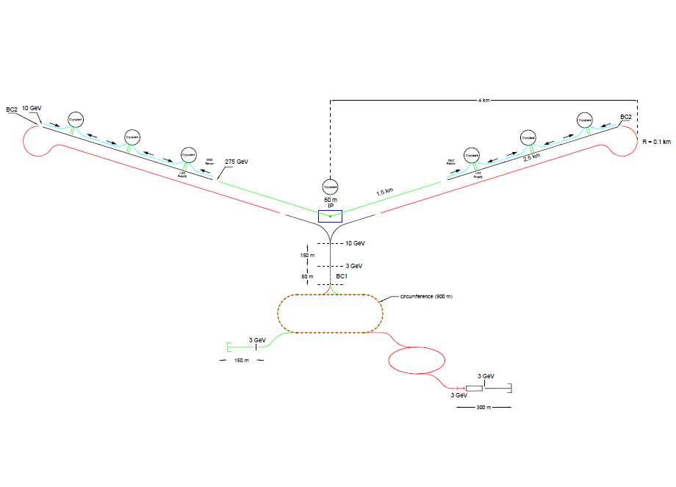
Concentrate on C³-550
Each 275 GeV linac:
Linac Length 2580 m
Linac Cooling Power 5.4 MW
3 Re-liquification plants
6 “Cryo-Runs”, each 430 m
0.9 MW/Cryo-Run
LN mass flow/Cryo-Run =
4.5 kg/sec
LN Volume flow = 5.6 l/sec
LN flow velocity =
0.05 m/sec = 0.2 km/hr
LN Inventory ~2.3 x 10⁵ kg

Slide 6
Cryostat Parameters
Inner radius 30 cm
LN height 25 cm
Area of LN 1115 cm²
Area of vapor 1712 cm²
Equivalent radius of
vapor area 23 cm

Slide 7
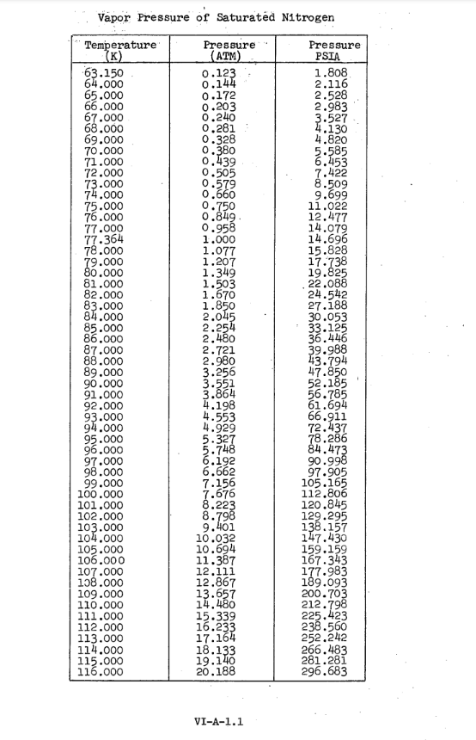
Gas Flow
Difficult to find tools that work with saturated cold vapor
Work above atmospheric pressure so compressor seals leak out.
79K ~ 1.2 bar

Slide 8
Gas Flow limit
Use program SF Pressure Drop 7.2
LN at 123 K
Mass flow of 8 kg/sec, 500 m, 25 cm radius pipe:
12 m/sec; pressure drop 36 mbar
turbulent flow
Need more cryo engineering!!!

Slide 9
CRYOGENIC Concept - Phase 3
Reduce for Phase 1 and 2
20x Refrigeration Plants 1.2 MW @ 80K ~Elec. 7 MW each
1x GN2 100 tons LN2 /day ~Elec. 2 MW each
ASU
0
1
2
3
4
5
6
7
8
9
0
1
2
3
4
5
6
7
8
9
9.4 km
9.4 km
20 x
1.2 MW @ 80K
Plant: 100 t/d
Plant: 100 t/d
225 m
225 m
0
1
2
3
4
5
6
7
8
9
0
1
2
3
4
5
6
7
8
9

Slide 10
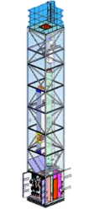
CRYOGENIC Process
LN2 REFRIGERATION PLANT
Centrifugal Compressor
?? Plants
1.2 MW @ 80K
Water
Turbine
~500 m
~500 m
Turbo-Booster
EFFICIENCY: ROM
Carnot: 30%
Machine: 50%
Overall: 15%
7 MW Elec. / plant
140 MW Elec. Total
LINAC

Slide 11
CRYOGENIC Process
LN2 PRODUCTION AND STORAGE
LN2 Plant function: (Air Separation Unit)
Process LN2 Inventory from Air
Compensate Leaks from Plants
Limit Impact of the Loss of 1 Plant
LN2 Storage Function:
Allow storage of LINAC Inventory
LN2 Lines:
25 km to distribute LN2 to each plant
Note: LINAC Inventory ~200m3 Liquid.
Plant: 100 t/d
Storage: 100 t
0
1
2
3
4
5
6
7
8
9
0
1
2
3
4
5
6
7
8
9

Slide 12
Downtime
Expect collider operation ~50% over a year
Expect to keep linacs cold, but no RF
Plan to insulate cryostat with vacuum + MLI, ~1.3 W/m²
Loss per Cryomodule ~25 Watts
Loss per SuperSector ~2.5 kW
Cool by venting Nitrogen and replacing LN; re-liquification plants shut down?????
C³-550 ~7500 l/day

Slide 13
Cryogenic Needs
Gain more confidence in the efficiency estimate.
Understand trade-offs related to plant scale vs number of plants.
Develop cost range.
Understand safety issues

Slide 14
Desired development strategy
Build a 2 raft prototype with a ~5 m cryostat and test
Build a ~2 GeV Demonstration Facility
Build C³

Slide 15
Power Breakdown
Power Breakdown | MW
Total Power | 247.5
Single Beam | 9
Total Beam | 18
Total RF | 42.4
Heat Load at Cryo Temp | 24.4
Electrical Power for RF | 84.8
Electrical Power Cryo Cooler | 162.7
Assumed refrigeration efficiency 15%

Slide 16
LINAC Characteristics
Parameters of the 2017 Point Design:
Center of Mass Energy = 2 TeV
Gradient = 0.117 GeV/m
Beam Power ~9 MW/beam
N2 Inventory = ~200 m³
Linac energy ~ 2x 1000 GeV
Linac length ~ 2x 9.4km (including 10% for instrumentation etc.)
Linac Thermal Load ~ 2x 12.2 MW @ 80K
🡪 ~25 MW @ 80 K over 25 km

