Slide 1
C³, the Cryomodule
Martin Breidenbach, Emilio Nanni, Marco Oriunno, Sami Tantawi, Caterina Vernieri
January 2022

Slide 2
Functionality
Provide stable support for accelerator sections and quadrupoles
Provide the “Cool” environment of ~80K
Provide alignment capability within and to adjacent cryomodules.
Provide feedthroughs for waveguides and other cables.
Provide the above safely and reliably
This is a discussion of the “Pre-Conceptual Design”
It is a search for showstoppers and problems
It is a search for manufacturability issues - 100’s are needed!

Slide 3
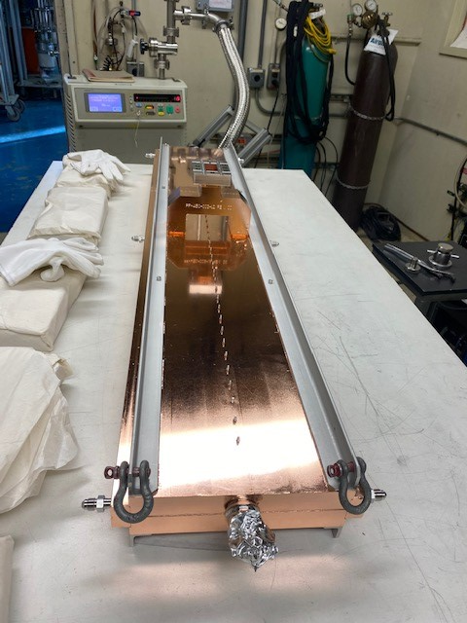
First brazed C-Band module

Slide 4
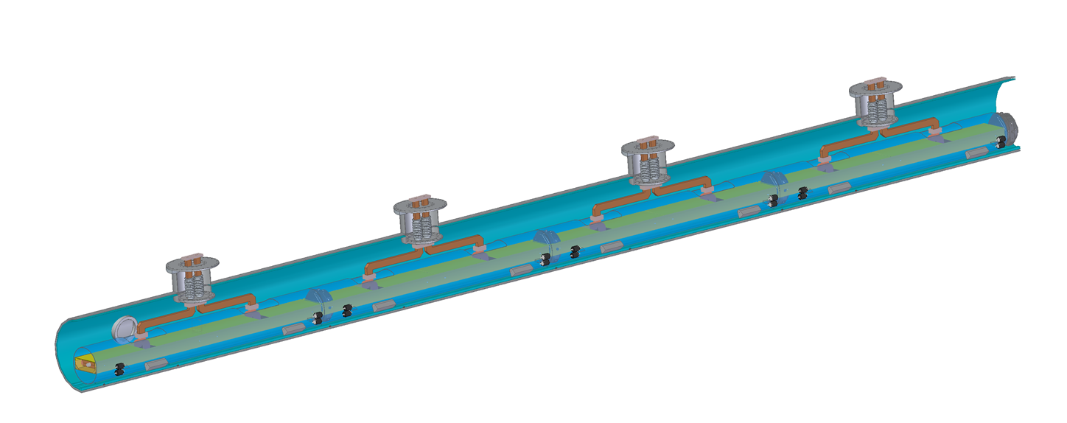
Stages
The basic mechanical building block is the “Raft”
2 accelerator sections + permanent magnet quad & BPM per raft
4 rafts per cryomodule, ~10 m
10 cryomodules per Sector, ~100 m
10 Sectors per SuperSector, ~ 1 km
The cryomodule

Slide 5
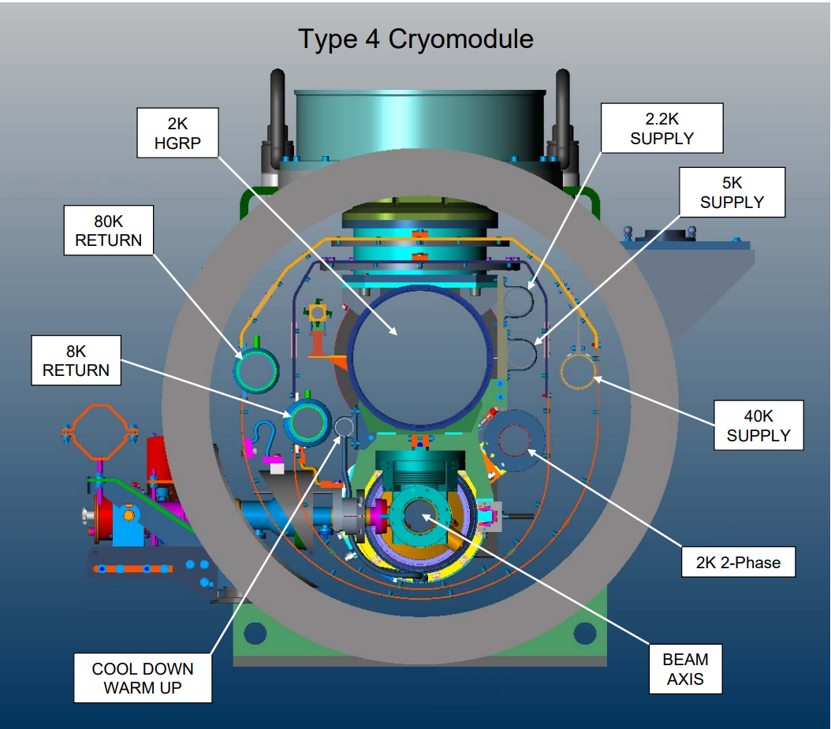
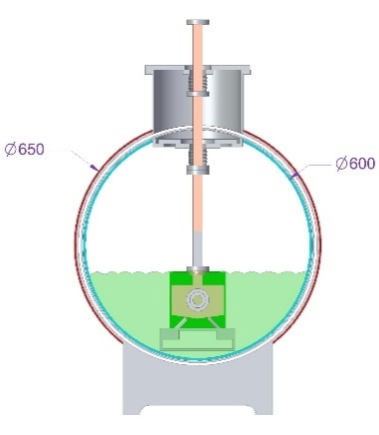
Comparison to ILC
~96 cm diameter

Slide 6
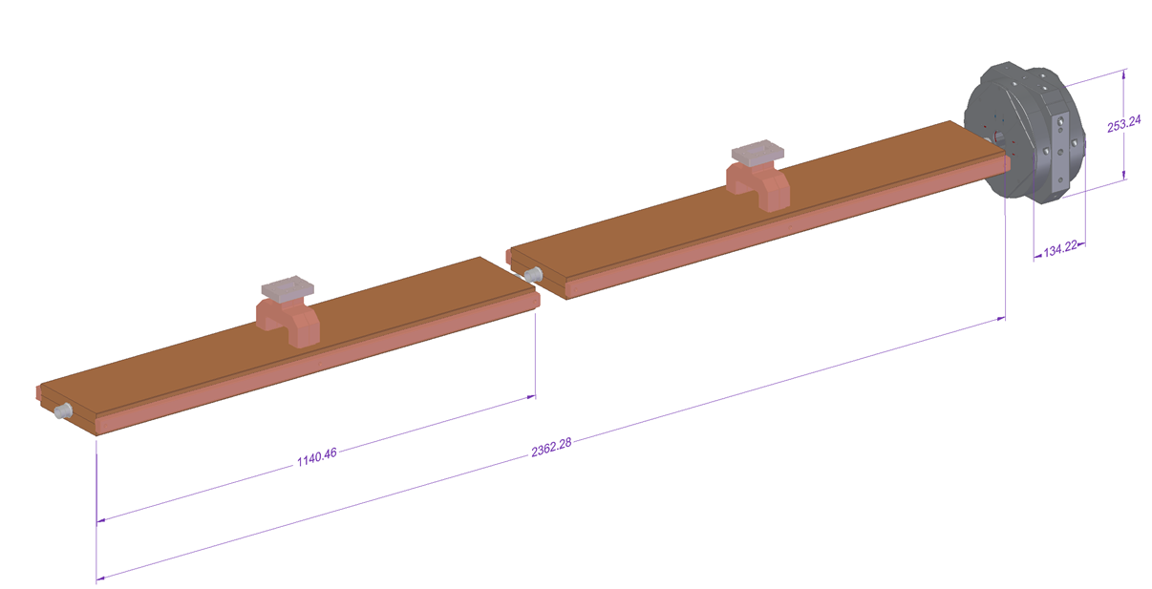
Raft Components
Permanent magnet quad
Tunable cold (final version)
Mechanically integrated cavity BPM in quad

Slide 7
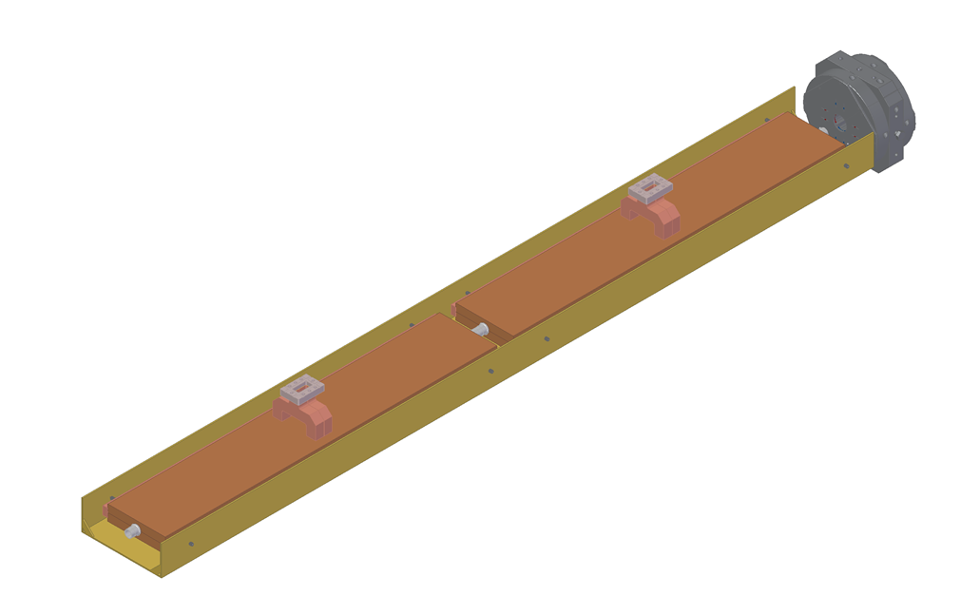
Raft
Raft channel will become a very open truss structure.
Each accelerator section is aligned with 5 d.o.f., with Z pinned by a ball at te midpoint
One waveguide feeds both manifolds. No load as in a travelling wave structure.
Expect flange to be welded.

Slide 8
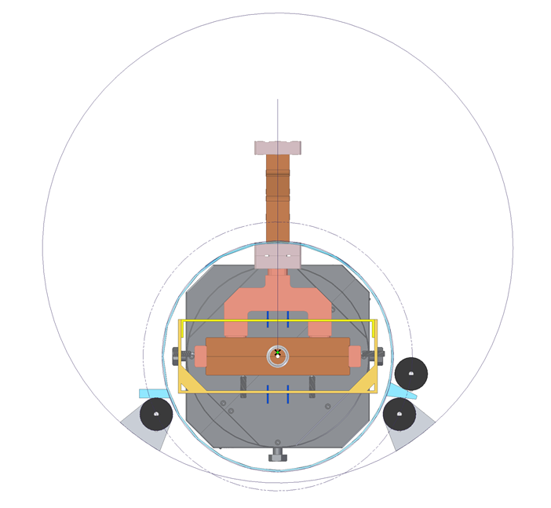
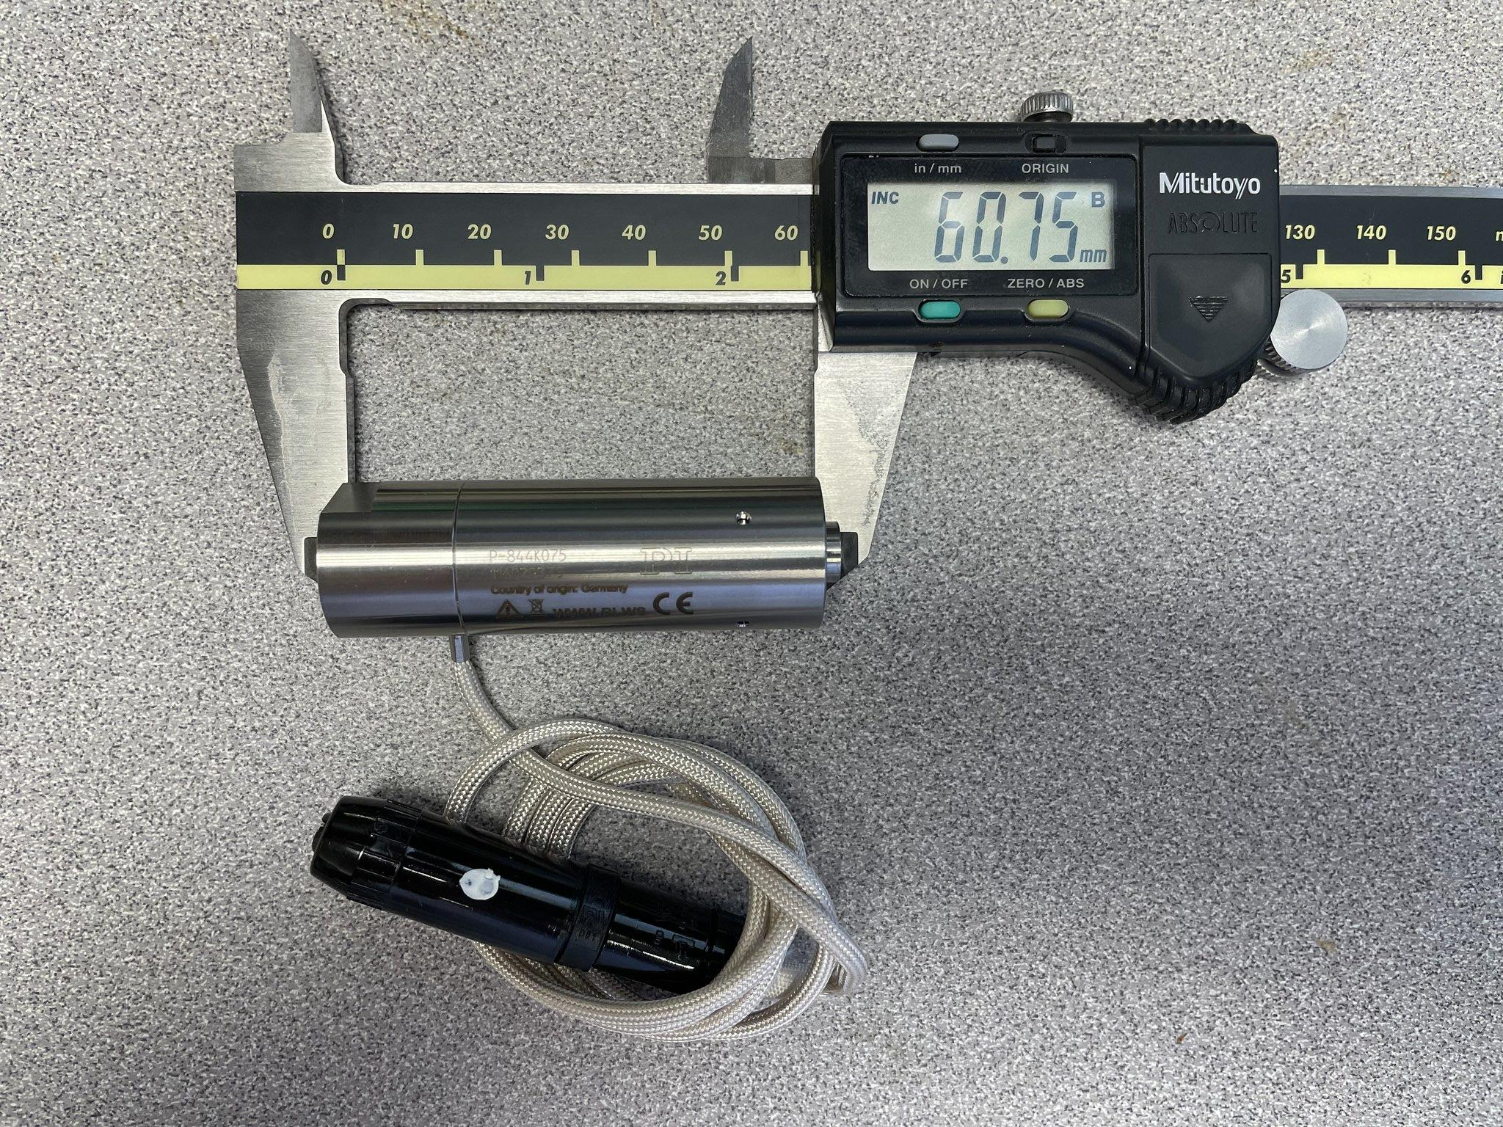
Raft Support
Present scheme:
Raft components statically aligned in raft (once)
Raft suspended by piezo transducers, range ~ 200 𝜇m, bandwidth ~100 Hz (???). Beam based alignment and feedback.
Transducer intermediate stage suspended by high resolution cryogenic motor jacks. Range ~2 mm, usage rare after initial alignment (earthquakes?). Motor unusual in that it can have short lifetime bearings and be dirty.

Slide 9
The Cryomodule
Inner cryostat (probably) 304 Stainless
Outer cryostat can be mild steel
Only 4 ports for waveguides and a few other cables.
Plan (hope?) to have only welded joints in cryostat - no bolted flanges or other connectors. Weld preps designed for “can opener” removal.
Note that Cryomodule fits in standard 40’ ISO container for transport.

Slide 10
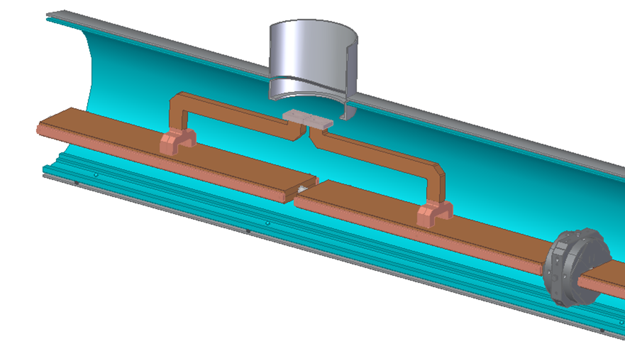
Waveguide Installation Concept
Rafts inserted

Slide 11
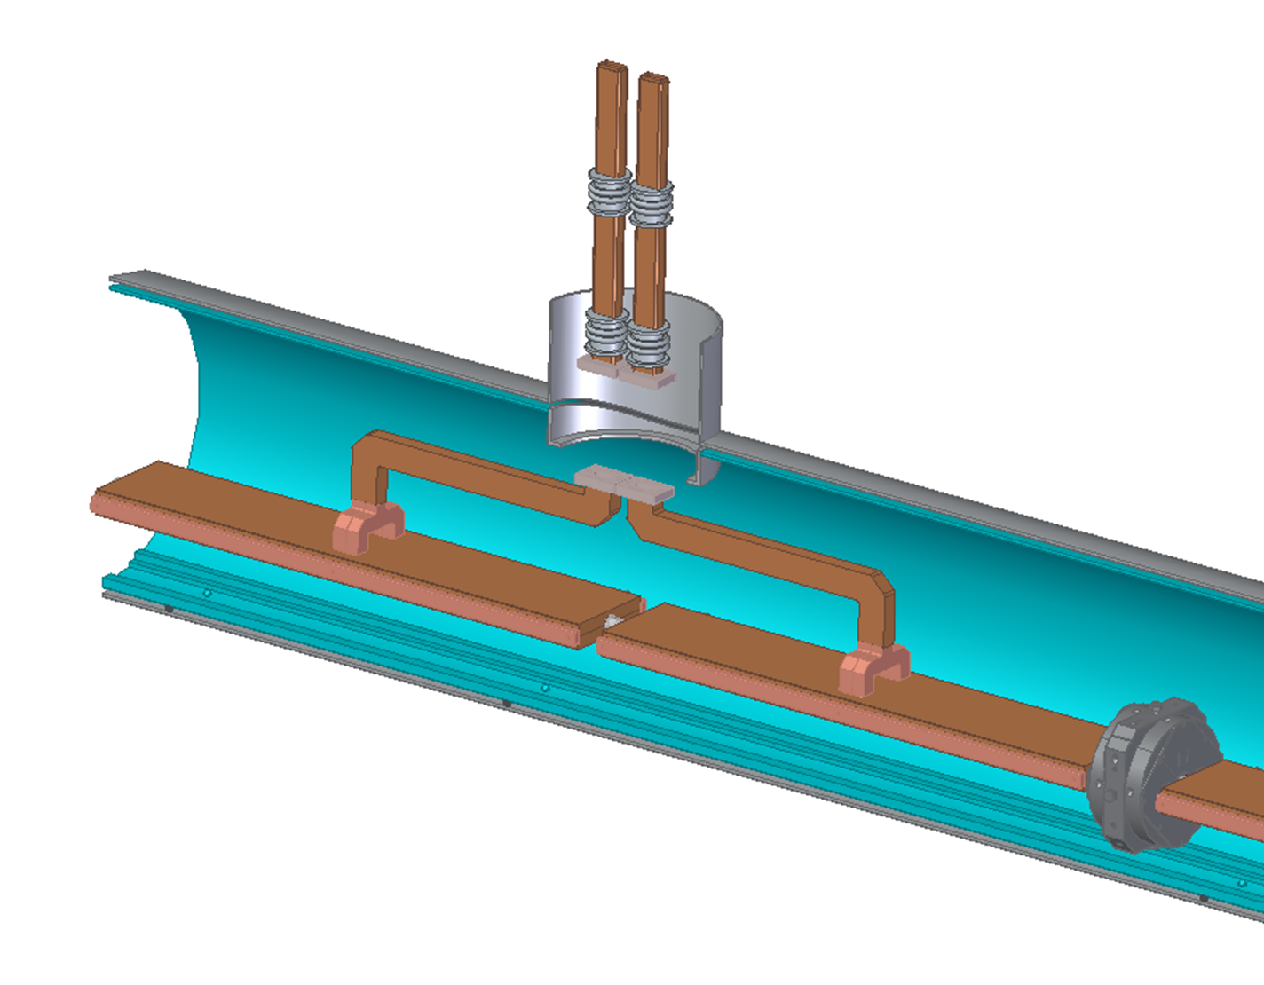
Transition waveguide assembly

Slide 12
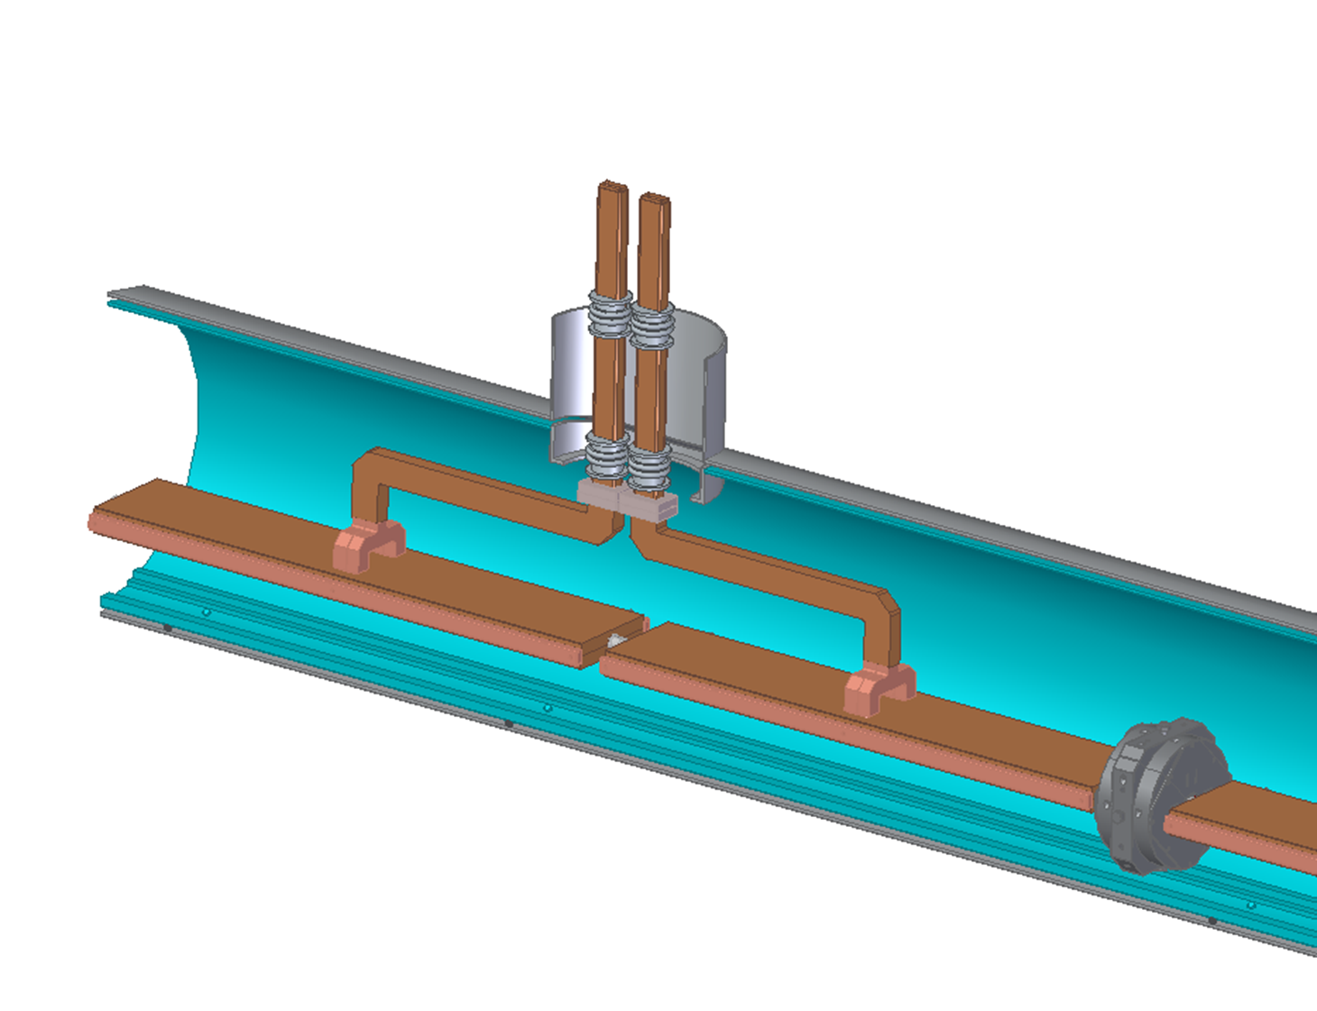
Connect (weld) waveguide flanges

Slide 13
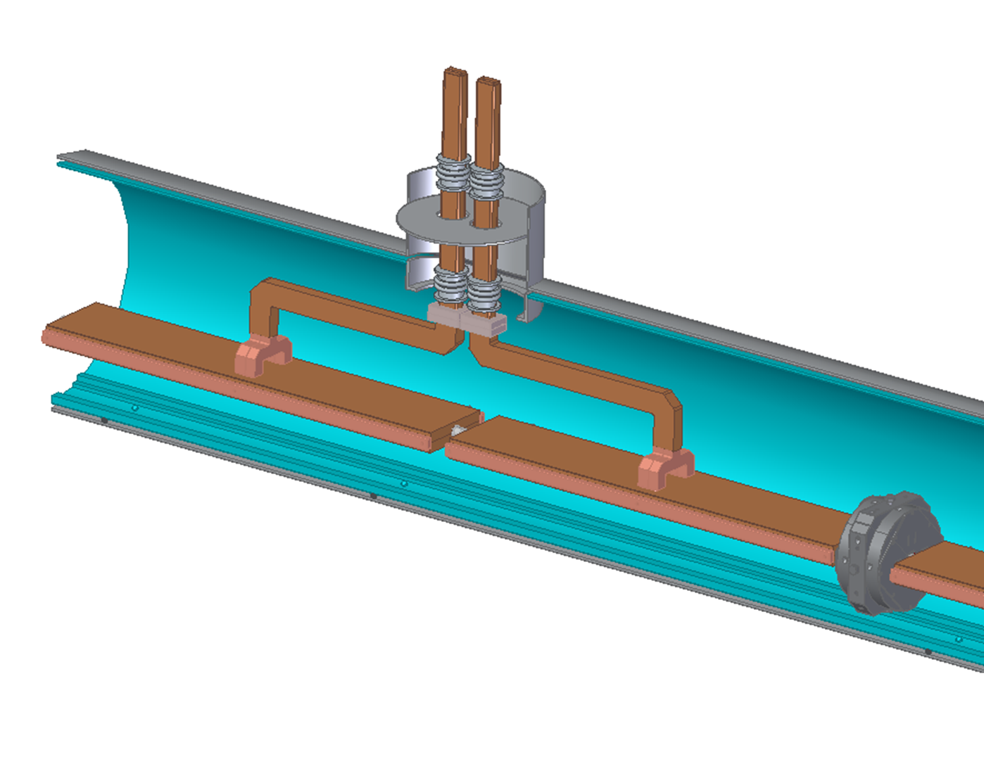
Bring up Cold Plate

Slide 14
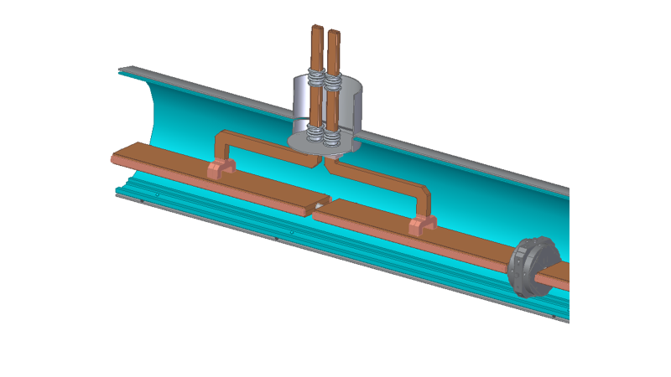
Weld Cold plate to seat and cold bellows flange.

Slide 15
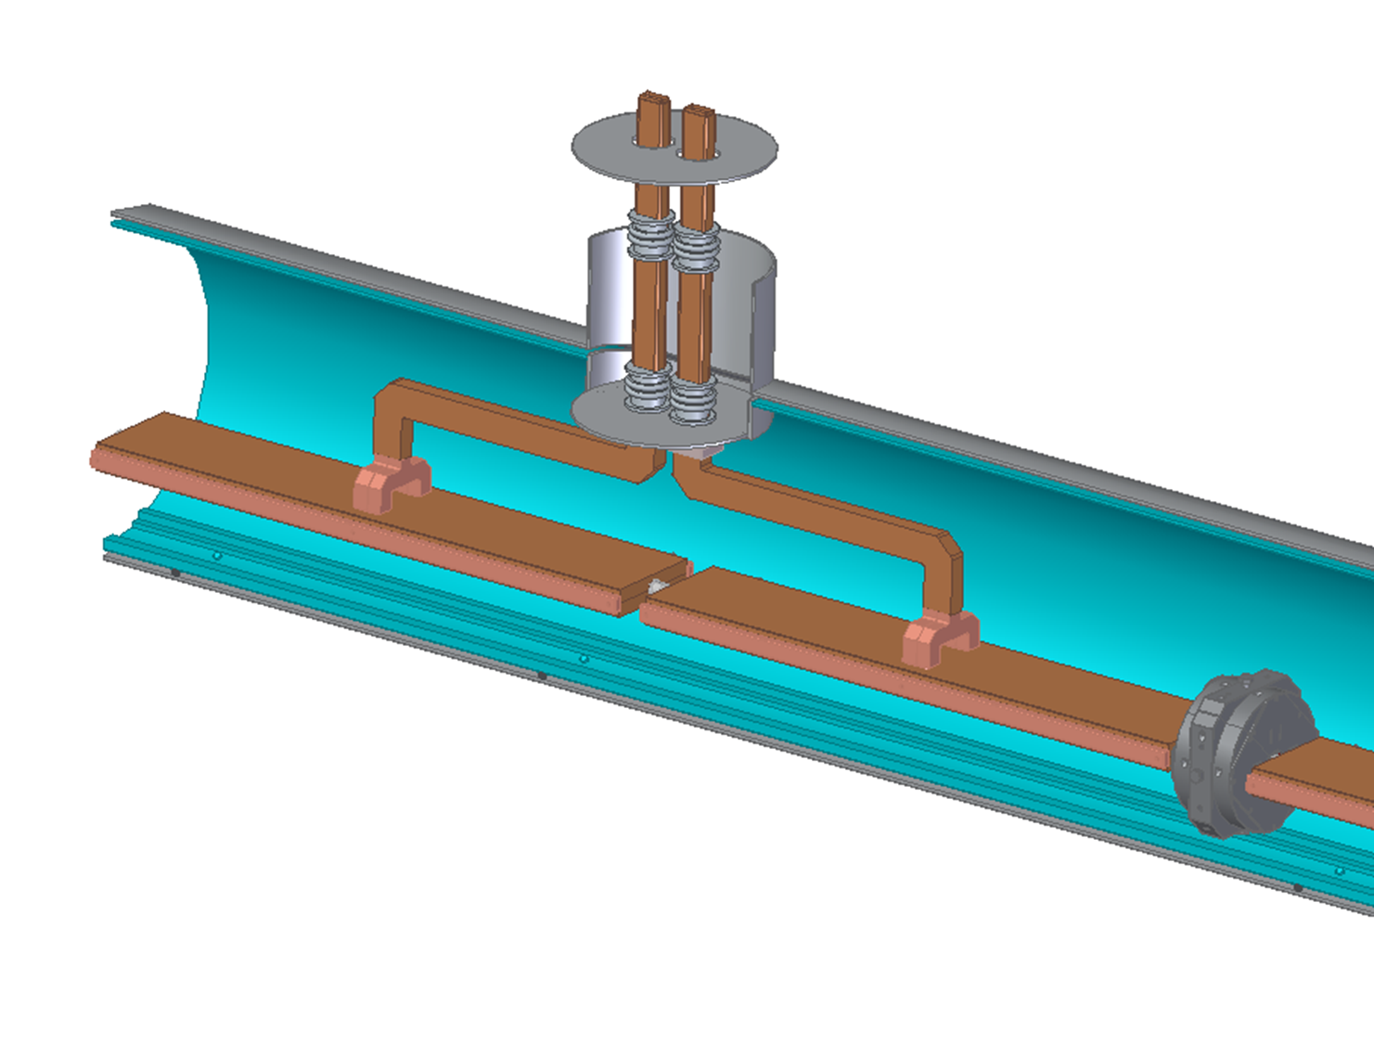
Bring up Warm Plate

Slide 16
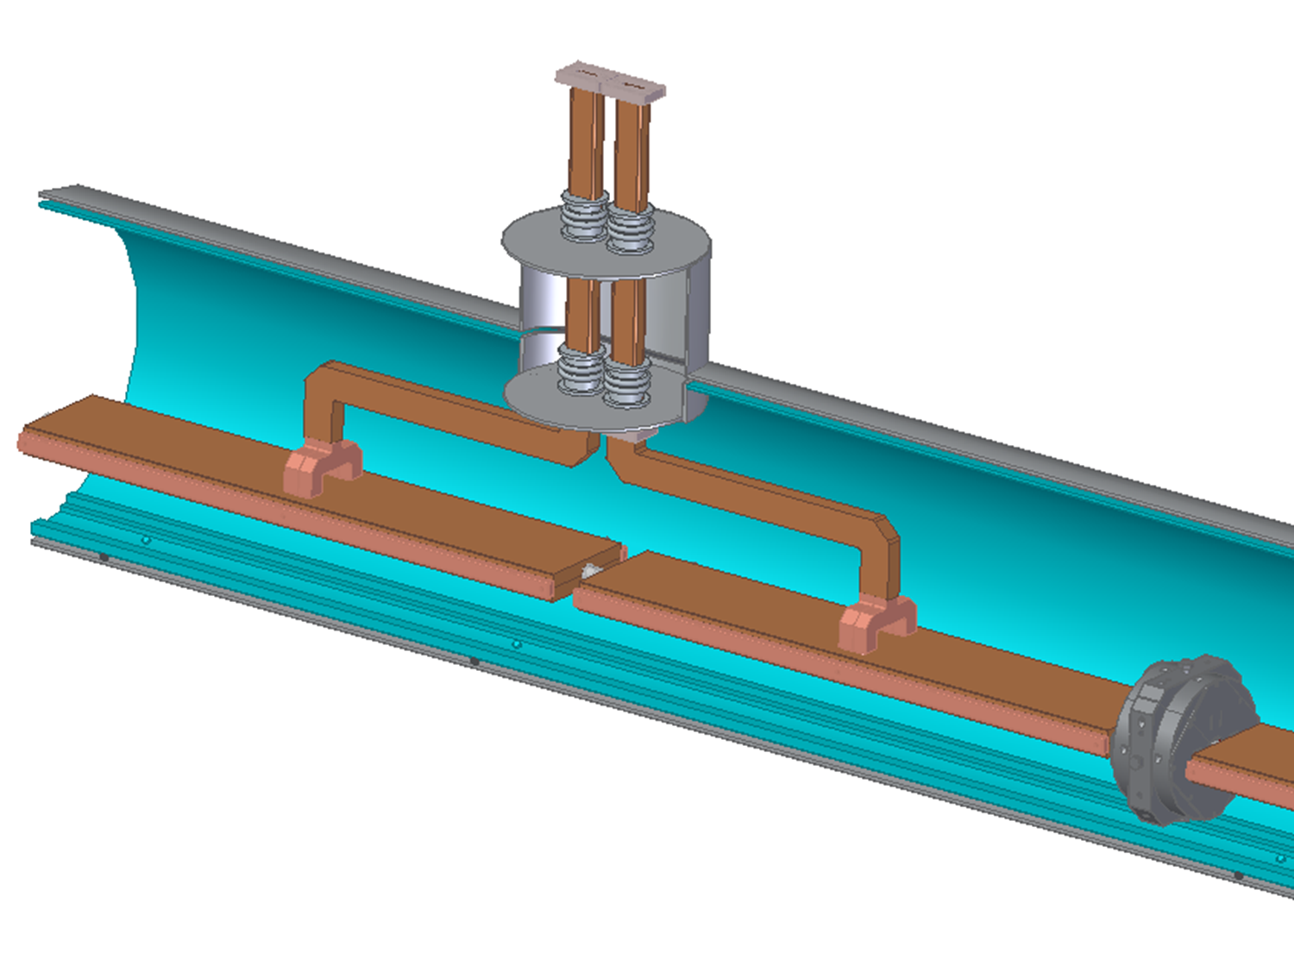
Weld Warm Plate

Slide 17
Thermal Contraction
Integrated contraction from room temperature to 77K:
Cu -0.31% SS 304 -0.29%
So 𝜟L between 1 meter of Cu and 1 meter of SS 304 is ~200 𝜇m
Accelerator is pinned in Z to raft at its midpoint
Accelerator sections separate by 200 𝜇m
𝜟L is taken by bellows
10 m SS inner cryostat contracts ~3 cm. Outer steel shell stays warm, so sliding support needed.
SS inner cryostat pinned in Z to outer shell at midpoint.
Cryomodules cold sections separate by 3 cm at ends.
𝜟L is taken by bellows

Slide 18
Thermal Loads
4 operational modes (so far!)
Gradient (Mev/m) | Power Dissipation (W) | RF Flat top pulse length (ns) | Pulse Compression | Comments | Power/Area W/cm² | Delta T Cu-Bulk LN (K)
70 | 2500 | 700 | N | C³-250 | 0.393 | 2.3
120 | 2500 | 250 | N | C³-550 | 0.393 | 2.3
150 | 3900 | 250 | N | C³-550 in 7 km | 0.614 | 2.5
120 | 1650 | 250 | Y | C³-550 | 0.259 | 2.1

Slide 19
Thermal Loads
Gradient (Mev/m) | Power Dissipation (W) | RF Flat top pulse length (ns) | Pulse Compression | Comments | Power/Area W/cm² | Delta T Cu-Bulk LN (K)
70 | 2500 | 700 | N | C³-250 | 0.393 | 2.3
120 | 2500 | 250 | N | C³-550 | 0.393 | 2.3
150 | 3900 | 250 | N | C³-550 in 7 km | 0.614 | 2.5
120 | 1650 | 250 | Y | C³-550 | 0.259 | 2.1
Nucleate boiling regime

Slide 21
Alignment
Raft = 2 accelerators + quad pre-aligned
Initial alignment by stretched wires
Dynamic Beam-Based alignment - lots of SLC experience
Wire alignment (Rather pre-conceptual):
Two wires in each cryomodule, alternately spanning two cryomodules (~20 m):
Taut wire Cryomodules

Slide 22
Wires, continued
4 capacitive quadrupole sensors (used by LEP) per raft.
2 attached to first accelerator, 2 attached to quad
measure X,Y, roll, pitch, yaw - no direct Z measurement
except for cavity phase
Needs work!

Slide 23
Vibrations
Initial study at SLAC with Cu slab ~accelerator size in open LN bath on pneumatically isolated table.
Fitted with cryogenic accelerometers for x, y, z, table y
Just beginning when COVID stopped everything.
First measurements with only 400 W internal heater.
Very important to continue this work, study bubble aggregation and related effects.
Consider contouring/coating exterior of accelerator to promote bubble migration

