Slide 1
Beam Delivery System for C³
Future US Colliders Workshop
1/18/2022
Glen White, SLAC

Slide 2
Overview
Review of BDS subsystems
Review of existing designs: ILC & CLIC
Discussion of design tradeoffs
  Example tolerance tradeoffs ILC vs. CLIC
“Compact” Higgs-factory C³ layout design
Discussion of options/requirements for C³ 550 GeV
γ−γ collider considerations
Energy scaling
Consider R&D topics / demo facility

Slide 3
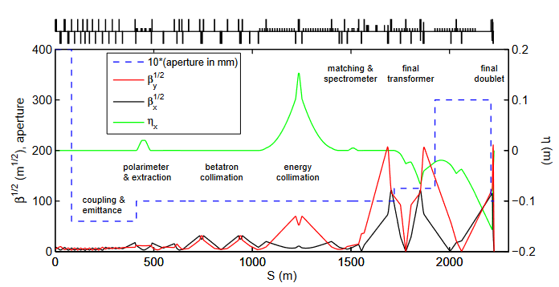
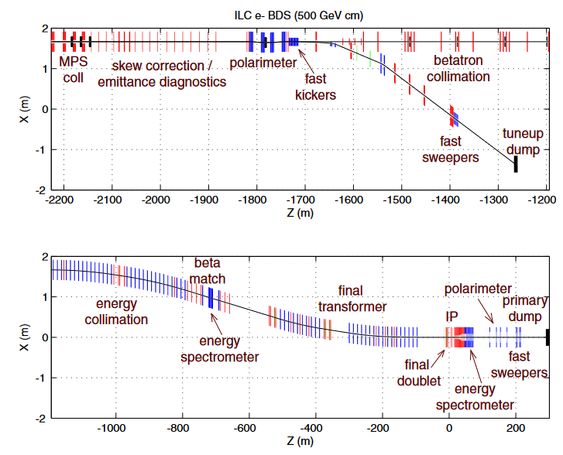
ILC BDS (TDR, 2013) E_{cm} 250 – 1,000 GeV
500 GeV Parameters
Layout for 1 TeV, decimate
magnets for operation at 500 GeV
L (cm⁻²s⁻¹) | 1.8 x 10³⁴
γε_{x} / γε_{y} (um.rad) | 10 / 0.035
β_{x}* / β_{y}* (mm) | 11 / 0.48
σ_{z}* (mm) | 0.3
σ_{x}* / σ_{y}* (nm) | 474 / 5.9
N | 2 x 10¹⁰
N_{B} | 1312
f_{rep} / Hz | 5
P_{beam} (MW) | 5.3
Length (m) | 2254
ILC BDS Design is very mature, result of decades of work, includes many engineering (detector implementation) considerations, errs on the side of low-risk, motivated from experience @ SLC

Slide 4
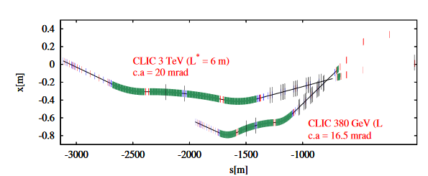
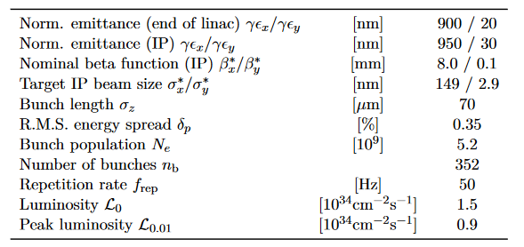
CLIC (PIP) E_{cm} = 380 GeV & 3 TeV
380 GeV Parameters
CLIC BDS design considerably more aggressive
  4X tighter focusing, L* = 6m vs. 4.1m for ILC (ξ_{y} increased 7X)
  Tighter alignment tolerances & more complex tuning
Shown to work in theory through start-to-end sims
FFS operation at increased chromaticity not yet proven experimentally (ATF2)
CLIC is a more compact & aggressive design with corresponding increases in risk

Slide 5
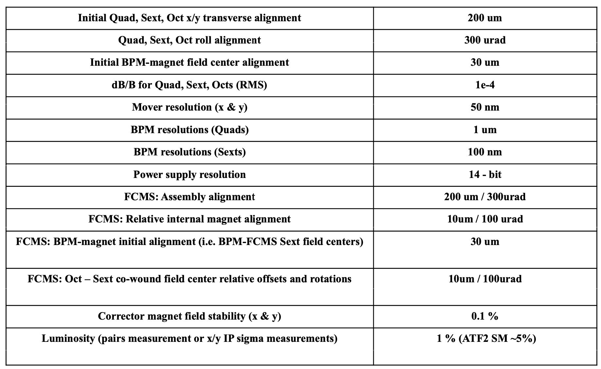
Tightening of Tolerances
ILC
CLIC
10 um
CLIC design requires order-of-magnitude increased precision for alignment & measurements
Collimation: 100X lower halo population assumed
  10⁻⁵ vs 10⁻³
Active magnet stabilization required
1 nm
20 nm
Pushed design manifests as tightened tolerances,
riskier operating assumptions

Slide 6
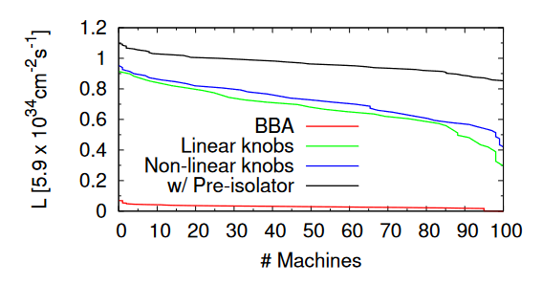
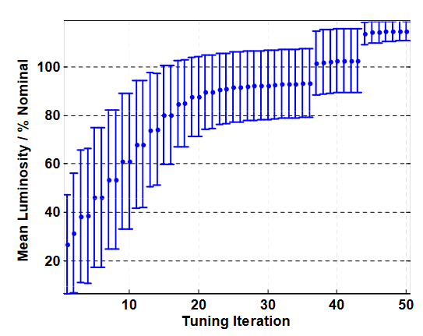
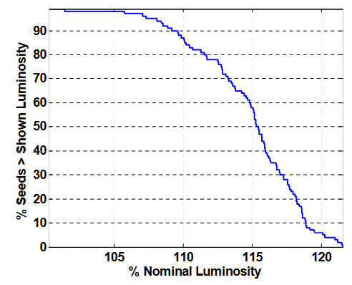
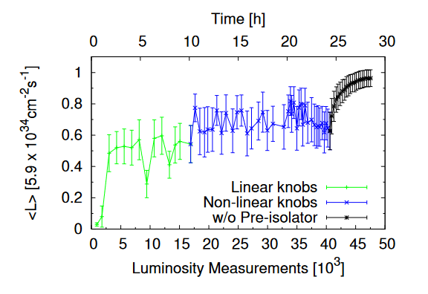
Beam tuning: ILC & CLIC
CLIC (3 TeV)
ILC (500 GeV)
t < 1 hour
https://agenda.linearcollider.org/event/2364/contributions/6540/attachments/4889/8239/ILC-LET2007.pdf
Higher chromaticity design takes longer to tune
Requires more non-linear tuning devices (Octupoles+)
E. Marin et al 2018 J. Phys.
: Conf. Ser. 1067 022014
Pushed BDS design requires more complicated, longer tuning process

Slide 7
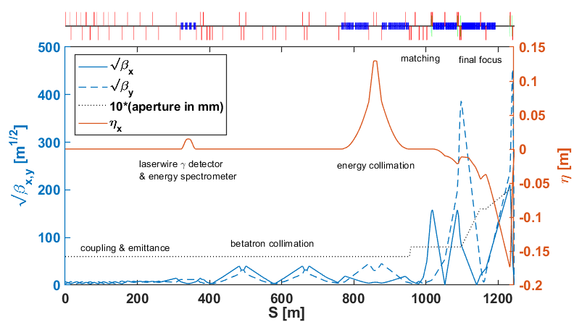
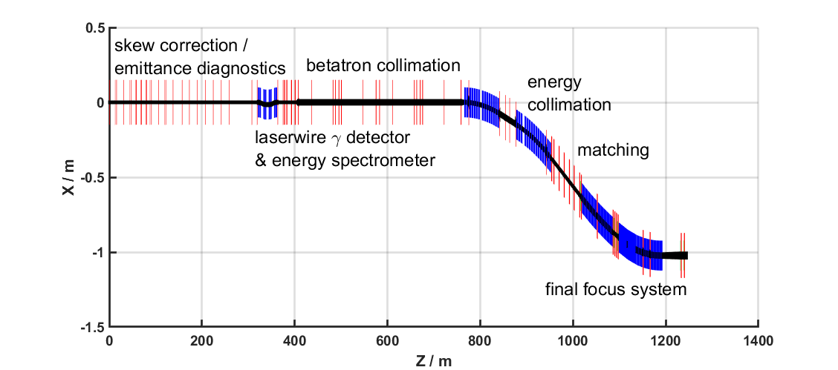
C³ BDS @ E_{cm} = 275 GeV
Max Beam Energy | 137.5 GeV
Length (S) | 1245.6 m
IP Beta | 12 x 0.12 mm
L* | 4.3 m
η’* | 7 mrad
γε_{x} / γε_{y} | 10,000 / 20 nm-rad
dE/E | 1E-4
N | 6.25E9
N_{b} | 133
crossing angle | 20
bunch length | 100 um rms
rep rate machine | 120 Hz
Re-design for short footprint
Start with ILC2016X lattice
Use NLC FFS design
Remove bend gaps and scale bends for 137.5 GeV
Remove u/s polarimeter
Re-matched
Options for further reduction?
Stronger lattice ($ opt)
Merge systems (e.g. COLL & Diag.)
Design challenge for C³: reduce length footprint

Slide 8
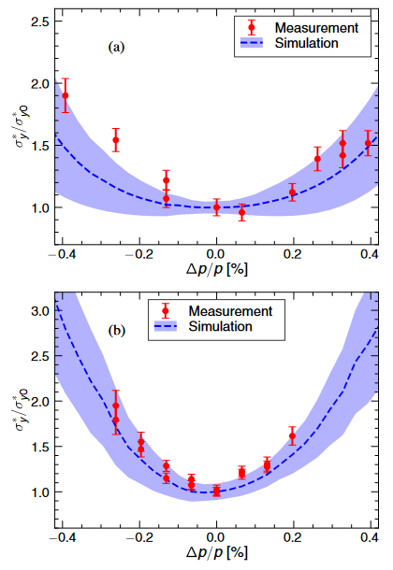
Options/Requirements for C³ @ 550 GeV
Achievable path length?
  1250-2000 m per side
  Work required to assess length/cost/risk tradeoffs
Implementation plan
  Take CLIC approach, build 275 GeV with tunnel space to build 550 GeV option later if want to start with min site footprint
  Decimate magnets like ILC if want ease of upgradability and stability in central region site design
Requirements:
  Emittance: min = CLIC ~ 1 x 0.02-0.03 um-rad
    Photo-cathode @ 0.1 x 0.1 um-rad?
  Energy stability / bandwidth
    Collimation system designed to handle up to 1 (1.3) % off-energy bunch for ILC (CLIC)
    Bandwidth for luminosity < +/- 0.5%
Energy bandwidth simulation & measurement for ATF2
ξ_{y} ~ ILC
ξ_{y} ~ CLIC
R. Yang et. al., Phys. Rev. AB,"24", 51001“ (2021)

Slide 9
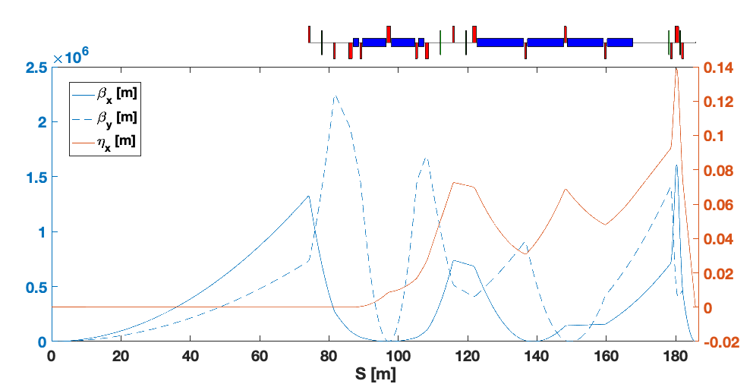
γ−γ Collider Considerations (Round Beam)
Following Raimondi-Seryi recipe for FFS design,
shown possible to construct optics with correct properties for round beams @ IP
Further considerations:
  Full tuning, S2E sims etc needed to assess tunability, tolerances, bandwidth etc + BDS integration
  Required IP focusing 3X increased beyond CLIC
  Integration with γγ source (gamma-focusing optics)
  Additional beams for IP deflection (beamstrahlung mitigation)
  Re-assess straight-ahead beam collisions
γ−γ Collider requires round-beam FFS optics with small β* (novel design required). Also interesting to consider for C³ with photocathode source.

Slide 10
R&D / Demonstrator Requirements etc
Resurrect S2E simulation capability to be able to assess design options
Application of modern ML/AI optimizers applied to tuning
  Can increase confidence in “pushed” designs, reduce tuning time
  Applied to luminosity monitoring system for online reconstruction of beam aberrations at IP: also helps with tuning accuracy and speed
Round-beam, small focus
  Optics designs & simulations reliable (FFTB & ATF2 worked)
    Always value added in test facilities, but obviously costly and time intensive
  FACET-II operates with round-beams (E=10 GeV, β*>5cm, σ_{z}<1um, Q<2 nC)
    Low-charge (<100pC), strong focusing demo here? (needs photo-cathode source & Sector 20 lattice upgrades at least)
  γ−γ collider: design with light optics & deflection scheme integration
If want to push ξ_{y} beyond ILC levels, demo of ability to manufacture and operate systems with increased stability requirements desirable
  ATF2 still operates with reduced schedule but needs serious investment to continue or expand

Slide 11

BDS Length Scaling with Beam Energy
ILC
CLIC
 | ILC E_{cm} = 1 TeV | CLIC E_{cm} = 3 TeV
FFS | 826 | 446
Bending Sections | 562 | 1250
Other | 866 | 1054
Total | 2254 | 2750
=> L ~ E^{7/10} (Original Raimondi/Seryi paper)
(ISR) => L ~ E²
L ~ E
( for fixed peak Dispersion)
An (entirely wrong) estimate of BDS length scaling with energy based on either ILC or CLIC baseline designs (Lumi ~ E)
Notes:
Changed bending section scaling from E^3 in previous version -> E^2 to reflect maintaining constant dispersion rather than constant bend angle which is more appropriate.

Slide 12
Summary
Mature designs exist for BDS systems E_{beam} 125 GeV – 1.5 TeV (ILC & CLIC)
  Significant effort in simulations & hardware tests over past 30 years
Trade-offs exist in design length and aggressiveness of beam parameters (e.g. β*,L*)
  Manifests as tighter, more complex diagnostics/correction hardware (higher-order magnets, <nm movers, BPMs etc) & more complex, slower tuning systems, limiting Lumi
  Complicated and time consuming to evaluate
  ILC levels of “difficulty” demonstrated, but not beyond (yet)
Caution recommended when designing for C³ if tempted to push very significantly beyond ILC parameters

