Slide 1
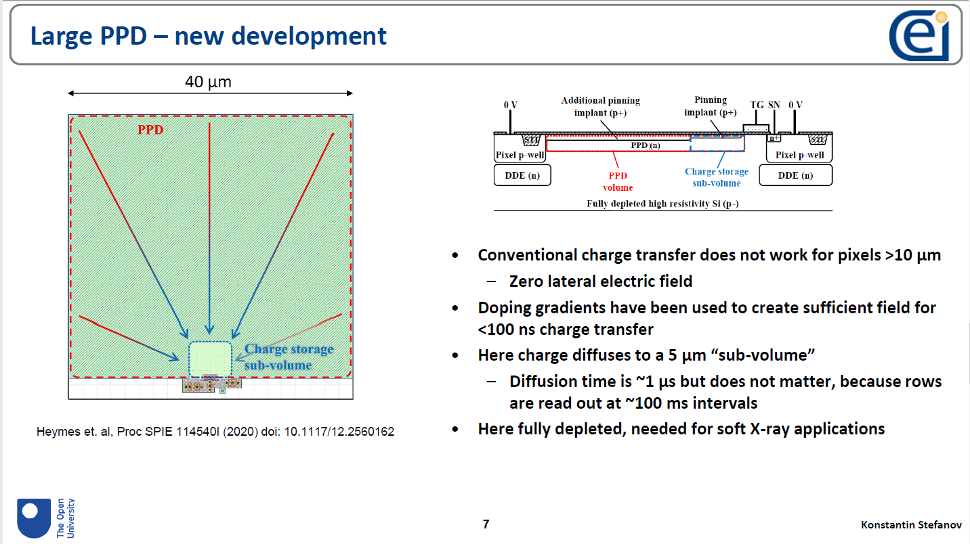
Details in Konstantin’s slides in Lorenzo Rota’s SiD CMOS meeting on Nov 11, 2021 https://indico.slac.stanford.edu/event/7000/

Slide 2
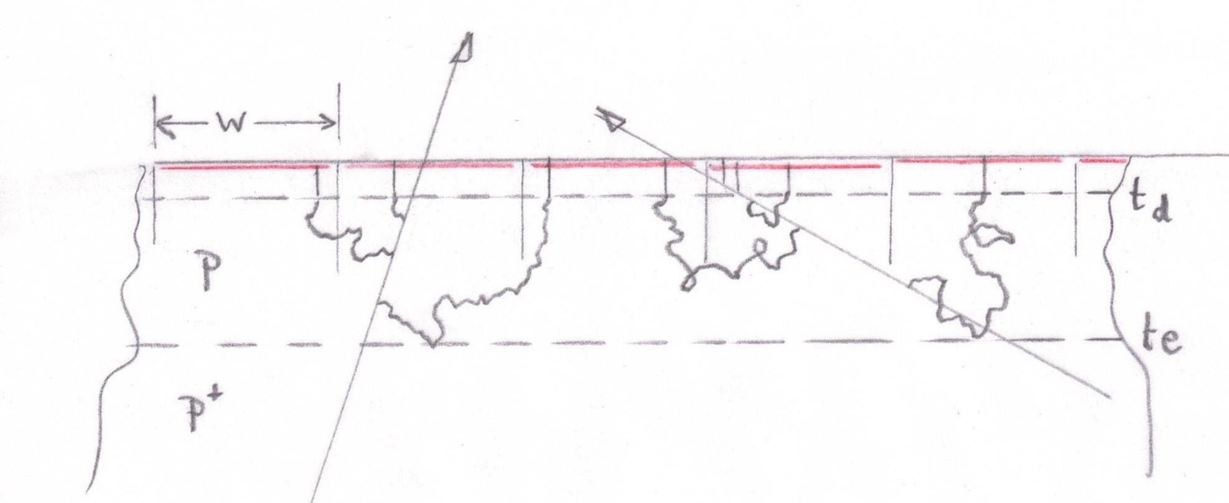
Pinned photodiode, full charge collection over pixel area
Device thickness ~100 μm (determined by mechanical design)
Epi layer thickness t_{e} ~50 μm (to be optimised)
Depletion depth t_{d} ~10 μm (to be optimised)
Pixel size 50 μm square (nominal)
Vary t and t to find optimal centroid detrmination, for incident angles 0 to ~60º
Second phase will be to study tracking performance with the suggested layout of tracking and timing layers. How compact can it be made?

Slide 3
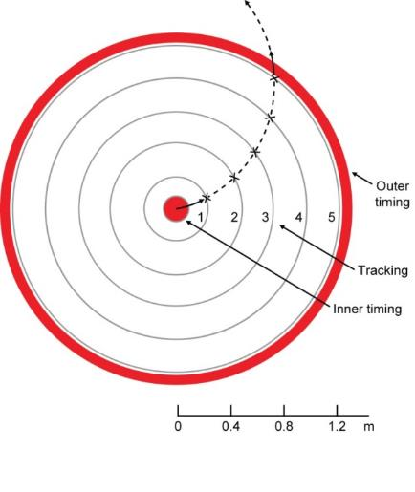
Highly transparency tracking system (≈3% X₀)
Featuring:
  Low mass tracking layers integrating through the bunch train
  Using timing information from the vertex detector and dedicated timing layers (pre-ECAL) for robust pattern recognition
The main challenge is to minimise power and hence material
Tracking layers:
  Air-cooled, power dissipation ~O(100 W)
  Sensors ≈100 μm thick, low mass support (≈0.6% X₀ per layer)
  Pixel size around 50 μm × 50 μm
Outer timing layers:
Outer timing layers
Vertex detector
Track reconstruction proceeds from mini-vectors in the timing layers, and proceeds inwards one layer at a time.
Note that even low-p_{T} tracks (curlers) deposit signals in the timing layers (endcaps), so permit clean reconstruction.
Products of long-lived decays (K⁰_{s} and Λ⁰ ) may be tricky.
Main questions: Will it work?
If so, can it be more compact?
3 closely spaced layers for redundancy
  Single bunch timing resolution (<554 ns)
  Material budget less critical
  Probably air-cooled, evaporative cooling if needed
  150 µm pixels
The vertex detector also provides single-bunch timing

