Slide 1


Skipper-in-CMOS
L. Rota on behalf of the Skipper-in-CMOS collaboration

Slide 2
Outline
Background: what are Skipper CCDs
Our project: from CCD to CMOS
Next steps: Skipper at 1 kfps & cryogenic temperatures

Slide 3
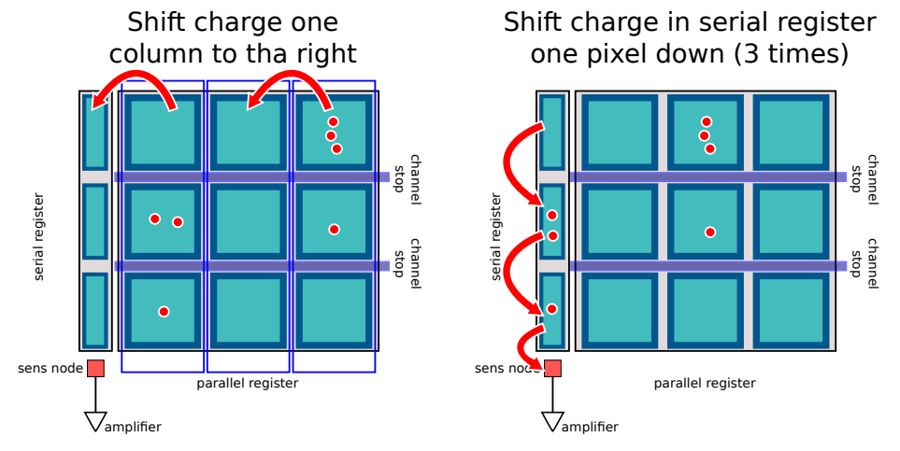
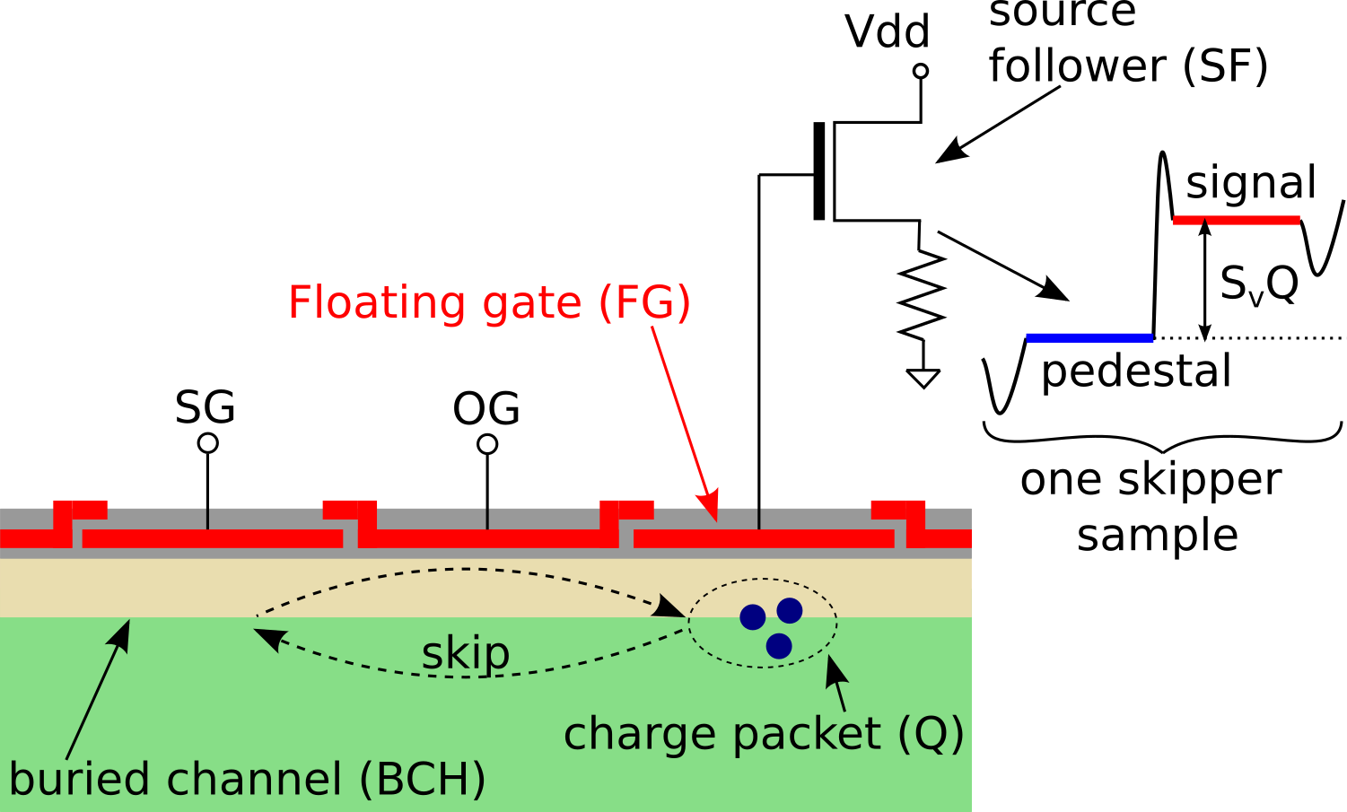
What is a Skipper CCD?
  CCD image sensor with non-destructive read-out at sense node
  Idea: reduce readout noise by means of multiple sampling
  Proposed in 1990 by Janesick et al. (doi:10.1117/12.19452)
Skipper feature
Ref: https://indico.cern.ch/event/782953/contributions/3515721/attachments/1889519/3115804/dpf_instrumentation_eca.pdf

Slide 4
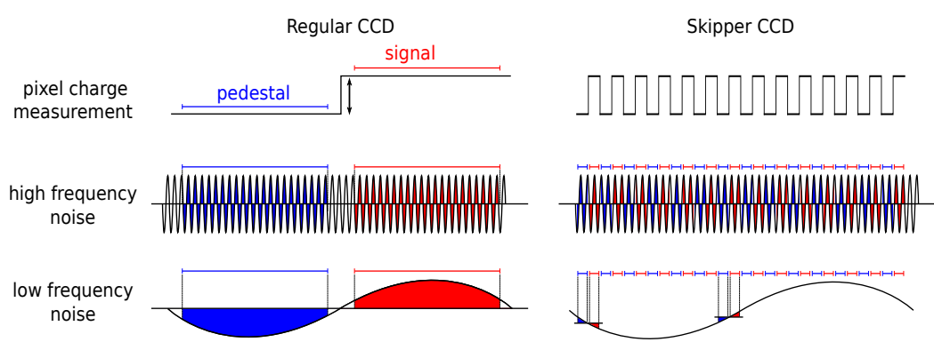
What is a Skipper CCD?
  Final pixel value is pix = avg(signal – pedestal), noise scales as √#samples
  Skipper readout is NOT the same as Correlated Multiple Sampling (CMS)
  Thanks to the non-destructive read-out, pedestal and signal are sampled close to each other → filter low frequency noise too!
Ref: https://indico.cern.ch/event/782953/contributions/3515721/attachments/1889519/3115804/dpf_instrumentation_eca.pdf

Slide 5
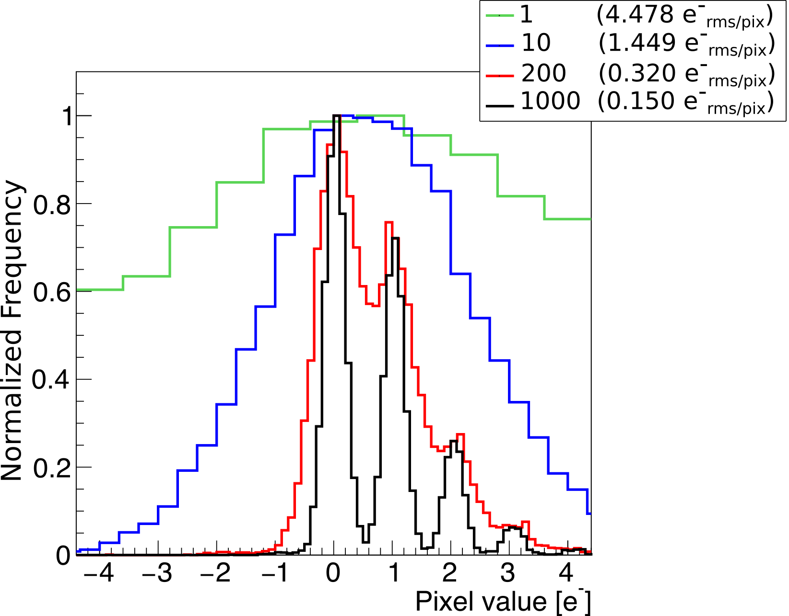
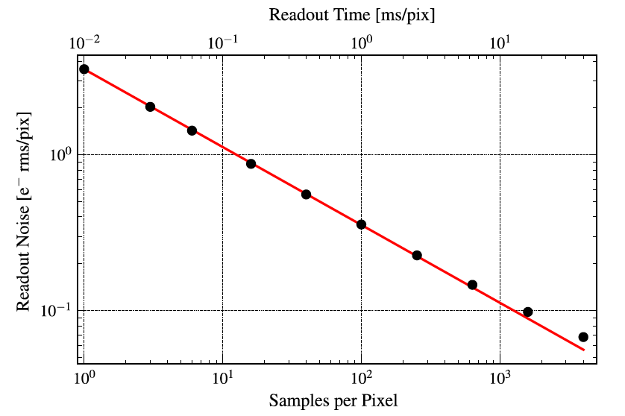
What is a Skipper CCD?
Slow!
Ref: https://indico.cern.ch/event/782953/contributions/3515721/attachments/1889519/3115804/dpf_instrumentation_eca.pdf

Slide 6
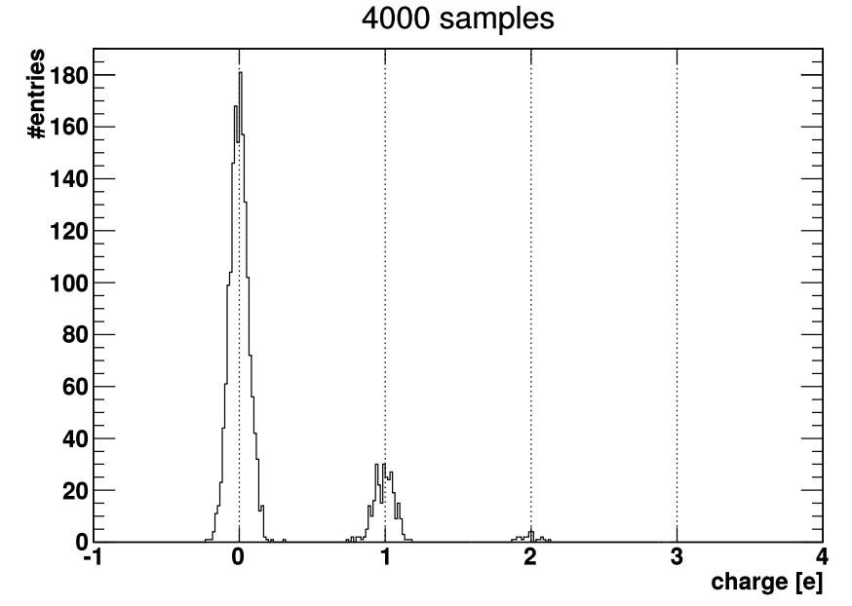
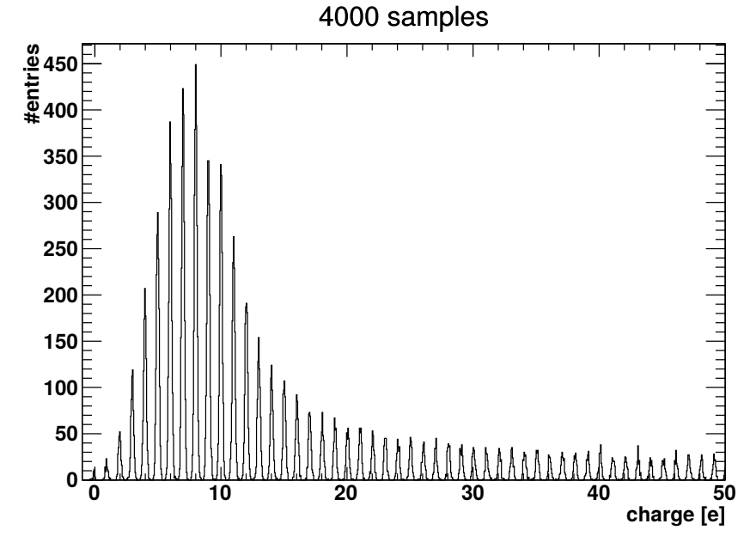
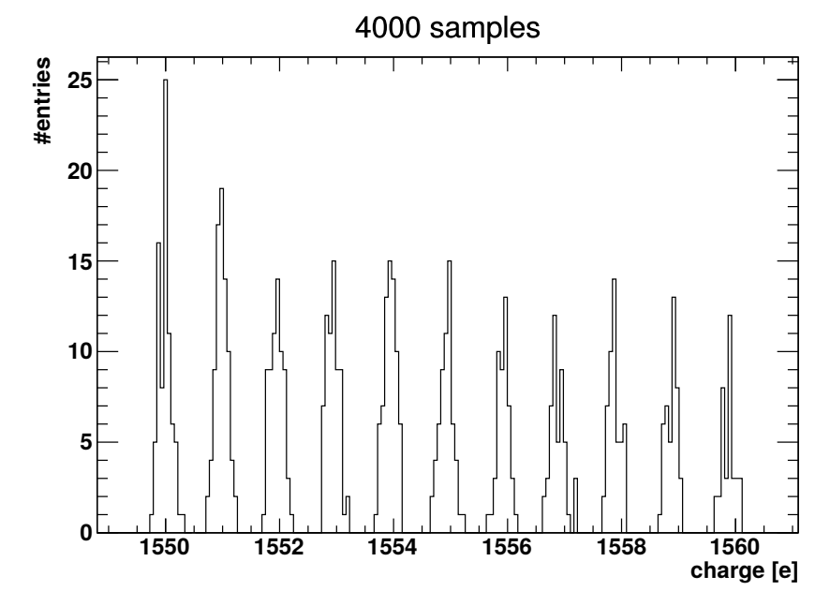
Skipper CCD
  Skipper-CCDs achieves:
    low-noise
    high dynamic
    good linearity
  Other devices, such as EMCCD, operate with very small DR
Ref: https://indico.cern.ch/event/782953/contributions/3515721/attachments/1889519/3115804/dpf_instrumentation_eca.pdf

Slide 7
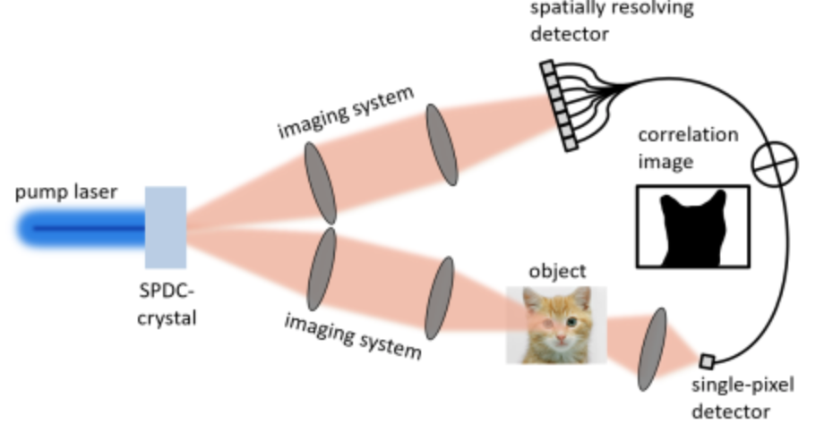
Applications
  Dark matter searches – direct
  Dark matter – indirect via astrophysics, stellar streams
  Coherent neutrino measurements (physics, security)
  Enables single-photon counting in visible band at near room temperature
  Astrophysics: adaptive optics, spectrographs – with kHz frame rates
  “Ghost” imaging in visible
  Ultra-soft x-ray (20 eV - 100 eV) imaging
*
* https://www.iap.uni-jena.de/Nano+_+Quantum+Optics/Setzpfandt+research+group/Research/Quantum+imaging+and+spectroscopy.html

Slide 8


CCD vs CMOS
  Skipper-CCDs are great, but:
  CCDs are slow: readout speed is main limitation
  CCD foundries are vanishing
  CCDs have no intelligence
  Instead, a CMOS imaging process offers:
  CMOS foundries – large volume, large wafers, dependable yield
  Complex circuitry and local intelligence
Skipper-in-CMOS project

Slide 9
Applications – case for dark matter (DM) detection
Low mass direct dark matter search require development of very large arrays of skipper-CCD sensors, arrays of 10⁴ silicon sensors
Integrated readout and signal processing
→ no commercial electronics next to the sensors
→ lower radiation background
→ lower power needs
→ lower cost for cryogenic equipment

Slide 10
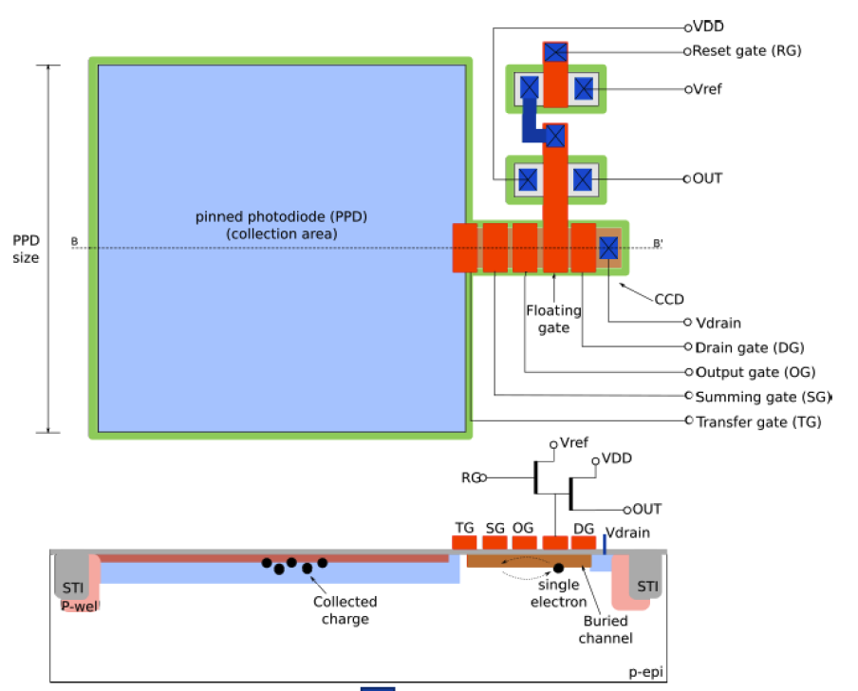
Introduction
Project: Skipper CCD in CMOS with Non-Destructive Readout
Pixel Technology:
  Pinned PhotoDiode (PPD) for conversion
    Much higher CvG than CCD (100uV/e- vs 3uV/e-)
    Low leakage
    Lower noise per measurement than CCD
  Skipper CCD for charge manipulation
    High charge transfer efficiency
    Enables NDR capability
    Enables noise averaging feature
  180nm CMOS process
    Readout parallelization capabilities
    Much faster readout time than CCD*
    Finer feature size
Future plans: back-side illumination to increase fill factor
Proposed Pixel: 4T with CCD
*Stefanov, K. D. (2020). Simulations and Design of a Single-Photon CMOS Imaging Pixel Using Multiple Non-Destructive Signal Sampling. Sensors , 20(7).

Slide 11
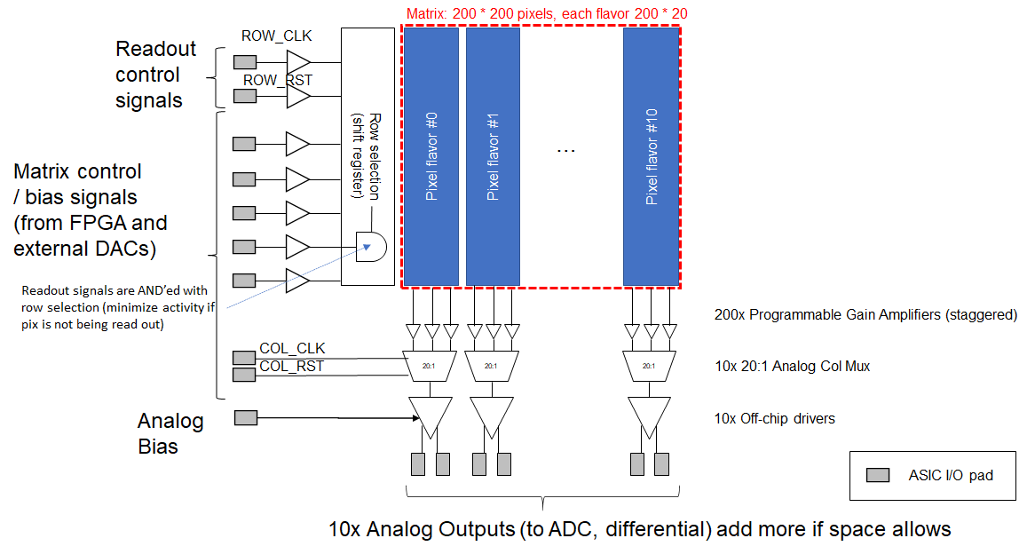
Skipper-in-CMOS ASIC
Main objectives of first prototype:
Design and Fabricate a CIS test chip
Demonstrate low noise capabilities for a single measurement (target < 2e- RMS)
Demonstrate photon counting with micro-second scale readout time capabilities
Fabricate and characterize pixel variations and AFE blocks: 1) Identify best structure and b) improve modeling
Process:
TowerJazz 180 nm CIS, 1.8V / 5V, FSI (this run) or BSI (future runs)
(FNAL) Benjamin Parpillon, Honghzi Sun, Shaorui Li, Juan Estrada, Farah Fahim
(SLAC) Lorenzo Rota, Aseem Gupta, Angelo Dragone, Christopher Kenney, Julie Segal
(Centro Atomico Bariloche) Miguel Sofo Haro, Fabricio Alcade
(Tower Semiconductor) Adi Birman, Amos Fenigstein

Slide 12
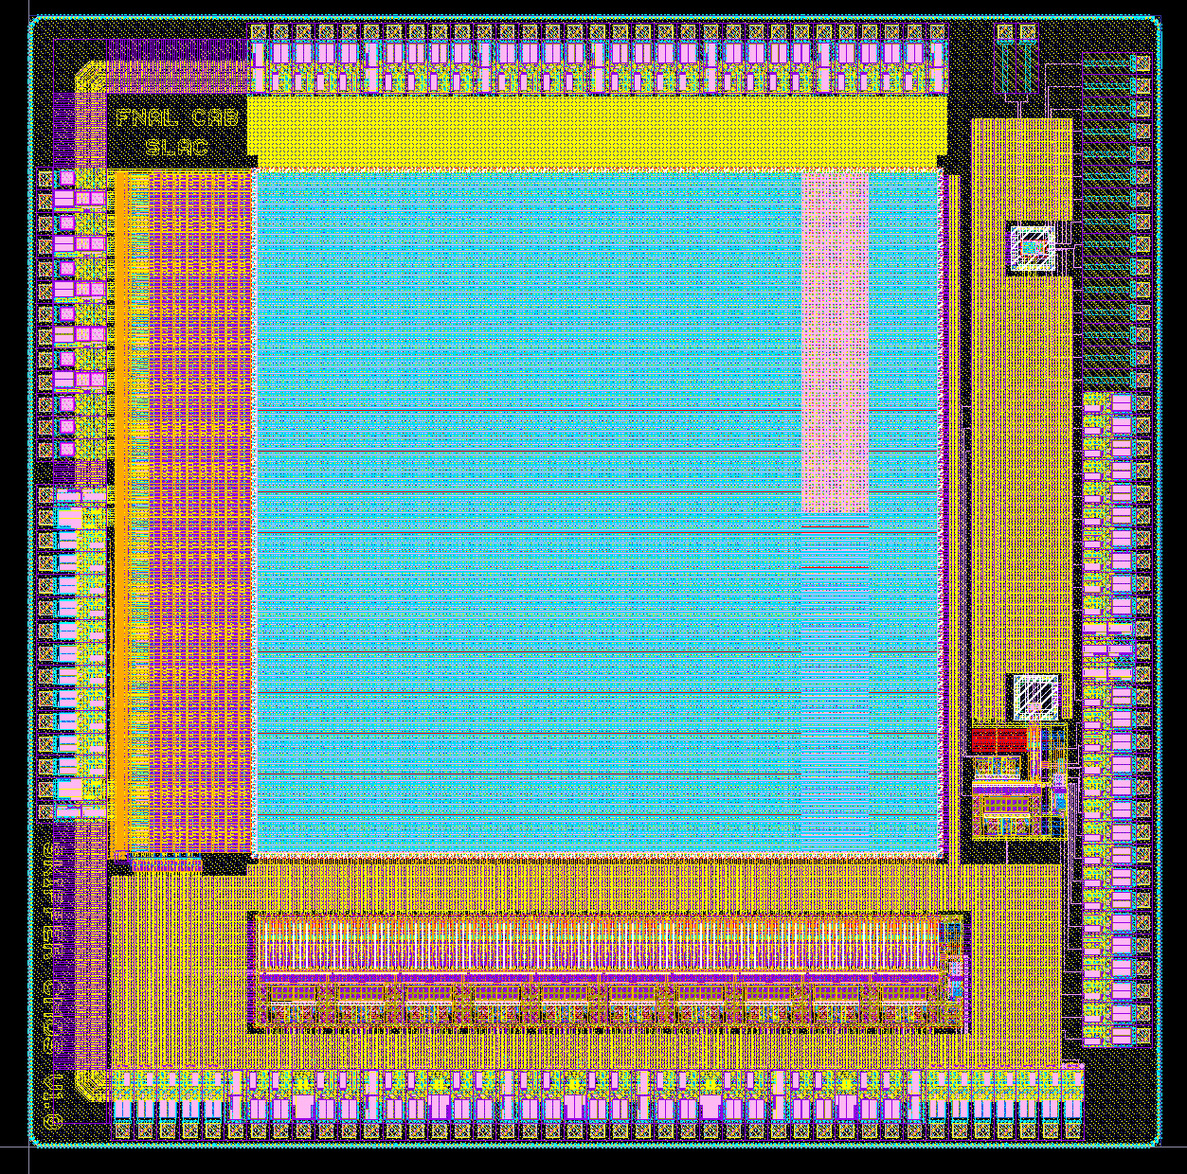
Top-level ASIC overview
MPW with front-side illumination
Size: 5x5 mm²
Active area: 3x3 mm²
Pixel design compatible with Back-Side Illumination (BSI, not for this run)
Test structures
Matrix Control Logic​
Pixel Matrix
200 x 200 pixels
15 µm pitch
3 mm
5 mm
3 mm
Analog Front-End

Slide 13
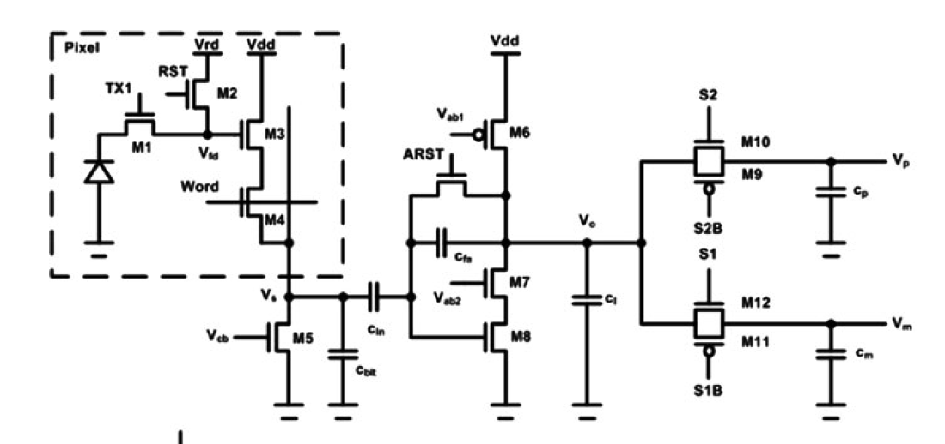
Front-end architecture
20:1 MUX/
Diff track and Hold
for CDS
Diff Driver
PGA
To off-chip ADC
Will perform readout, CDS and skipper operations
Column Current Source
  Architecture selected:
    Simple design
    Low noise
    Small pitch layout (15 um to match pixel)
    Fast readout ~us scale
    Gain tunable with Cin/Cfb capacitance ratio → high gain desirable in low light condition

Slide 14
Top-Level Timing Diagram
CDS is placed after the Column MUX: sample the baseline/signal of one pixel at a time
For each “Skipper” sample, both the baseline and the signal are sampled by the AFE
After N samples have been read-out, switch to next column (column MUX)
Frame-rate can be improved in future iterations by performing column-parallel CDS
Row
0
1
x 200
Col
0
1
x 20
19
0
…
Pix
Rst
Sig
…
Rst
Sig
Rst
Sig
Rst
Sig
Rst
Sig
AFE
x N
…
BLine
Signal
…
BLine
Signal
BLine
Signal
BLine
Signal
BLine
Signal
Skipper readout: N samples
ADC
(offchip)
Pix[0,0,0]
…
…
Pix[0,0,N-1]
Pix[0,1,0]
Pix[0,19,N-1]
Pix[1,0,0]
Indexing: [row, col, sample]

Slide 15
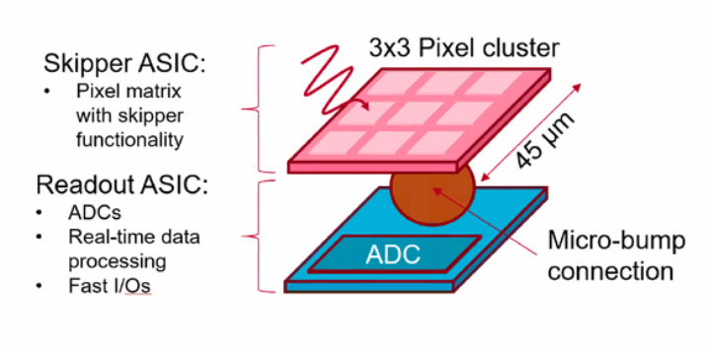
Outlook: FY22-FY24
Goal: increase frame-rate to ~1 kfps, study operation at cryogenic temp ~100 K
Novel architecture with 3D integration:
Increase parallelism of the system: x9 pixel cluster connected to an ADC
Skipper sensor will be flip-chipped, back-illuminated and bump-bonded to readout ASIC @ SLAC
Sensor will be thinned to hi-res epitaxial layer ~12 um
Readout ASIC in TSMC 65 nm: matrix of 10b ADCs and serializers to FPGA

