Slide 1
Simulation of the multi-view imaging system with differentiable ray tracing
August 2021

Slide 2
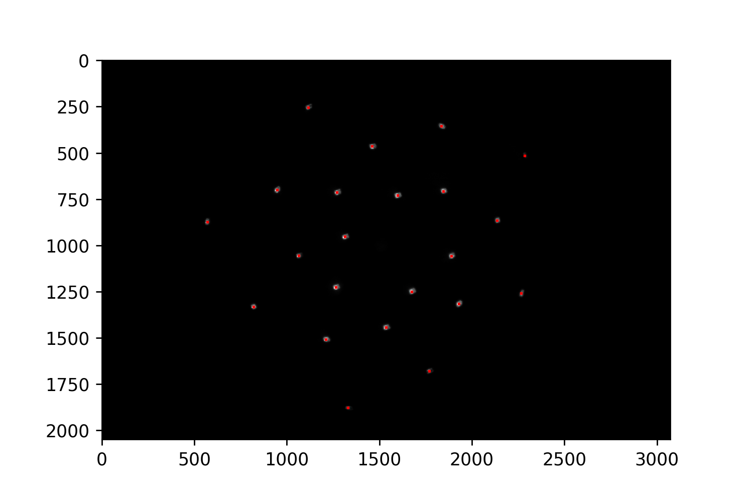
Gradient-based calibration
Simulator calibration on real data with gradient-based optimization
For now, only fitting for the normals
Target positions extracted with k-means clustering
Imaged point source perfectly matches the target for all mirrors (MSE loss is zero)

Slide 3
Ambiguity (1)
Perfect matching in those preliminary results that do not take into account:
Object offset
Mirror offsets
Lens & sensor offsets (orientations & positions)
This suggest that multiple solutions co-exist

Slide 4
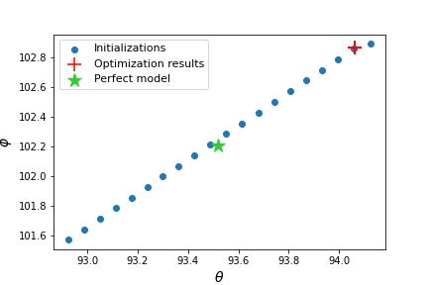
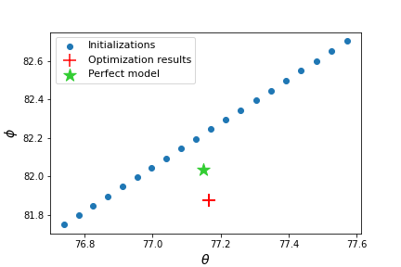
Ambiguity (2)
Multiple solutions co-exist, and yet…
… running the optimization algorithm with different initializations always yields the same results
Worse results
Mirror 1
Mirror 2
Mirror 18

Slide 5
Angular offset
What are the errors?
Let me nuance my previous analyses on tolerances
Beyond 1.1 degree, the principal rays do not make it though the numerical aperture (f-number$=\frac{f}{1.4}$) — but other rays do
Same analysis but with (f-number$=f$)

Slide 6
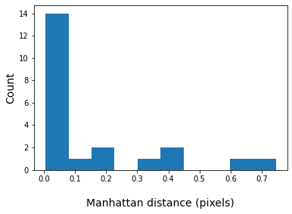
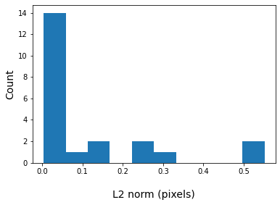
Circle of confusion
The point source is still imaged within ~1pixel

