Slide 1
Muon Collider
Challenges
Tor Raubenheimer

Slide 2
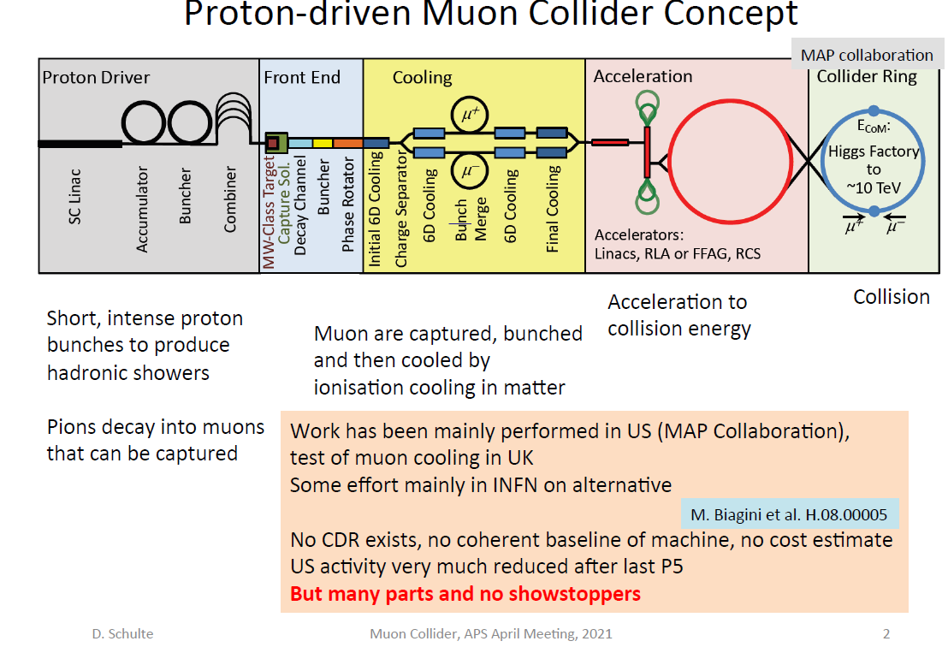
State of the Muon Collider Design
CERN/LDG initiated an
International Muon Collider
Collaboration. Develop a
CDR with funding of ~2M$
per year plus EU funding.
Focus on 3 TeV CM and
10+ TeV CM (reason to
choose a Muon Collider)
and explore synergy with
Higgs factories

Slide 3
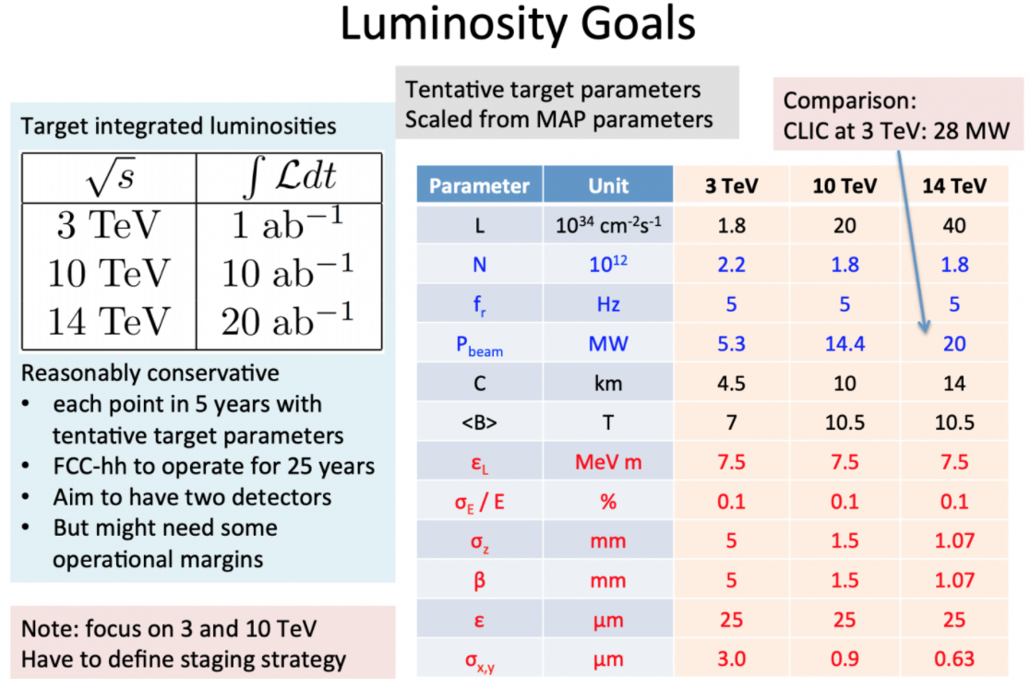
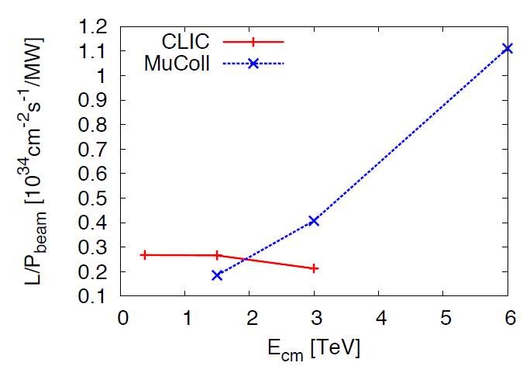
Example of parameters
AC power is roughly constant
as a function of CM energy
but luminosity increases

Slide 4
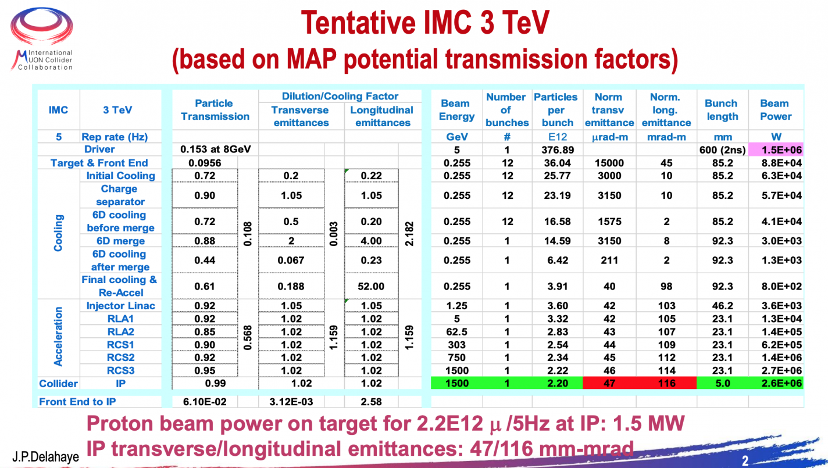
Example of parameters
Less optimistic than
previous parameters

Slide 5
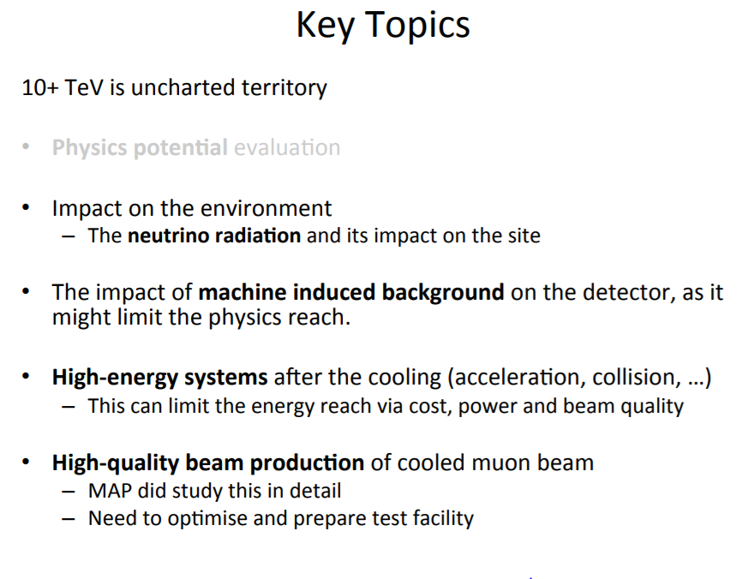
Challenges for Muon Collider
D. Schulte

Slide 6
Main Challenges for a Muon Collider
Neutrino radiation
Cost which can be driven by beam dynamics challenges
Cooling limitations → limits luminosity
Costs have not been estimated for Muon Collider. Mark Palmer guessed at ILC costs for Higgs factory while Vladimir Shiltsev estimates 70% of ILC. However, costs increase slowly with beam energy and multi-TeV is expected to be much less than ILC equivalent. Fabiola has requested a cost estimate of a 10 TeV Muon Collider.

Slide 7
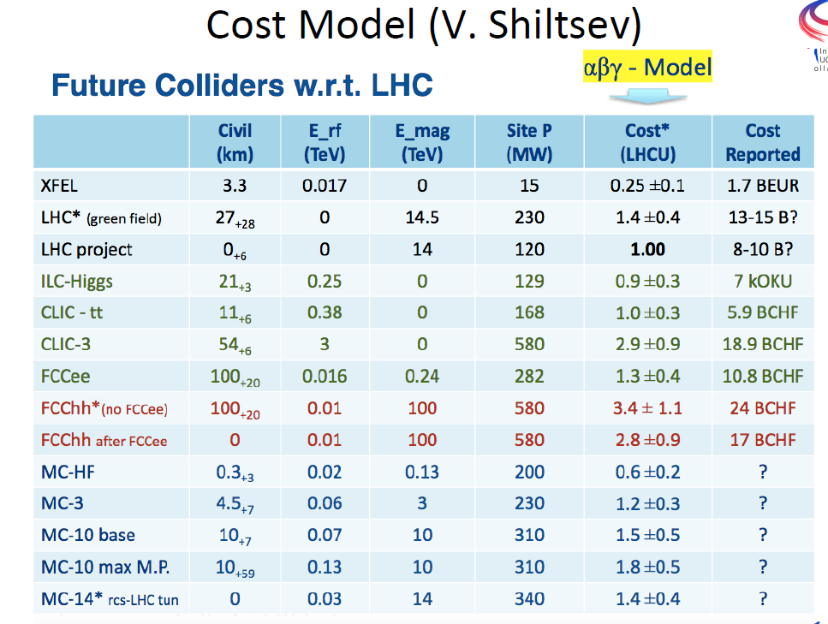
Cost Guesses

Slide 8
Beam Dynamics – no showstoppers but costly
Many challenging issues that may drive costs:
Collider rings probably OK – most significant review to date
RCS (60 to 1+ TeV) with counter circulating bunches:
  Lots of RF cavities
  Beam loading varies with RF cavity frequency and location
  Transverse BBU and Beam-Beam instabilities also important
Injector linacs (0.2 to 60 GeV):
  Planning to operate with SRF cavities to reduce peak RF power requirements BUT single bunch loading is ~25% and plan to accelerate μ+ and μ- bunches
  Single bunch BNS is ~1% > CLIC and approaching SLC
Cooling unknown effects may degrade or lengthen channels
  Collective effects in absorbers or between absorbers may reduce cooling efficiency

Slide 9
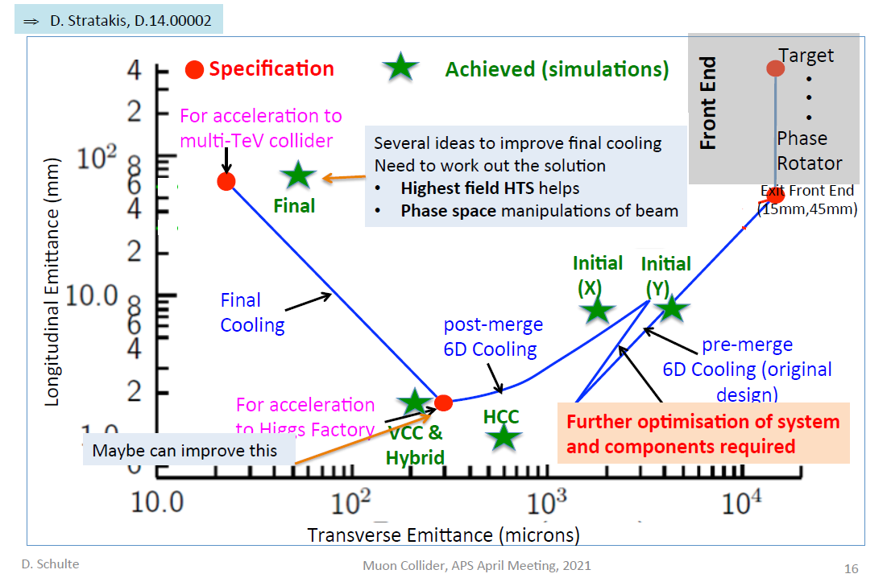
Cooling
Need 10⁶ 6D ε
reduction for baseline
3 TeV collider
Simulations with 30T
solenoids limited to
40 micron ε
Other options being
discussed including
quadrupole focusing,
higher acc. gradients,
phase rotations, …

Slide 10
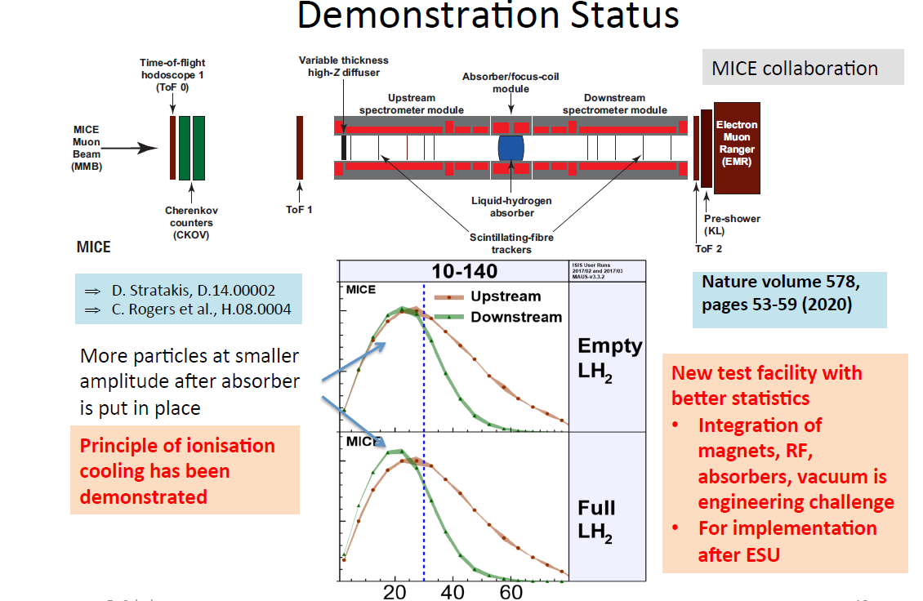
Cooling Demonstration – MICE
Measured single muons and observed that the number at large amplitude decreases while the # at small amplitudes increases as expected.
Roughly 10% Δε.
Only see this for large emittance beams with minimal discernable effect starting with ½ emittance.

Slide 11
Cooling Issues
Single stage single particle cooling demonstrated at MICE agrees with simulations.
Need approach to reach final values – critical for final ε.
Need confirmation of collective effects and demonstration of necessary magnetic fields – critical for final ε.
Acceleration with solenoidal fields was demonstrated but not at desired values – critical for final ε.
Challenging beam loading issues and tolerances – critical for final ε.

Slide 12
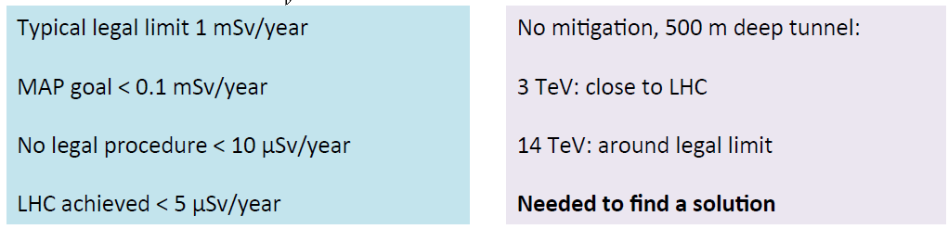
Neutrino Radiation
Driving issue for siting.
First challenge is induced prompt radiation from neutrino flux at the surface → go deep D to increase path length r = (2R_{earth}D)^{1/2} and decrease radiation intensity as 1/r² but strong scaling with r ~ E³.
Second challenge
arises from straights
where dn/dθ = γL/R x
dn/dθ_{arc} and at 3 TeV
this is a factor 20 worse → D 20x deeper for same reduction
Suggestions: buy land in front of straights (and don’t mis-steer), move beam in straights to increase angular spread, reduce # muons (better ε, stronger focusing, lower luminosity, …), move to Australian outback, …
D. Schulte

Slide 13
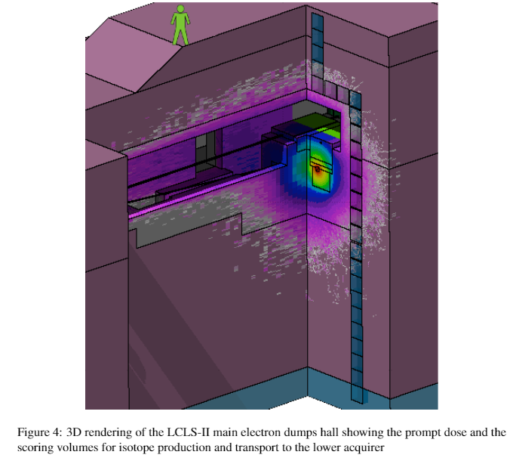
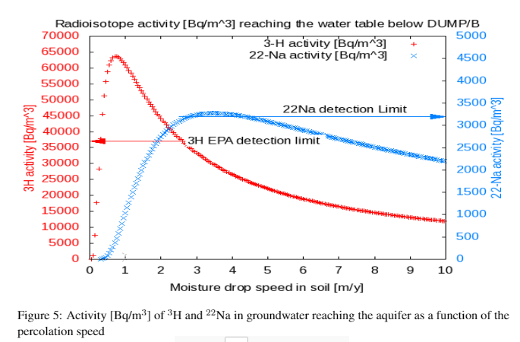
LCLS-II Tritium Production
Radiation dose into earth is
~1 mSv/hr, i.e. about 10⁴ higher
than allowable at surface from MC
(neutron flux is ~10¹² /cm²/yr)

Slide 14
Neutrino Radiation → ³H
Arises from production of radioisotopes generated by neutrino interactions. Mainly spallation of oxygen and silicon but depends sensitively on materials and concentrations depend on flow rates.
Neutrinos also generate radioisotopes at surface. To limit the resulting dose to 0.1mSv/yr → 100 meters deep and 30km path to surface.
Tritium in aquifer scales as 1/R² or about 10,000x higher than at surface but mm-thick layer and ³H concentration in the water also depends on flow.
PS. Limits in Australia are 100x looser than US.
Aquifer
Surface about 30 km
from the ring for 100 m
depth
750m radius at 3 TeV CM
1/γ
Few meters at 1.5 TeV

Slide 15
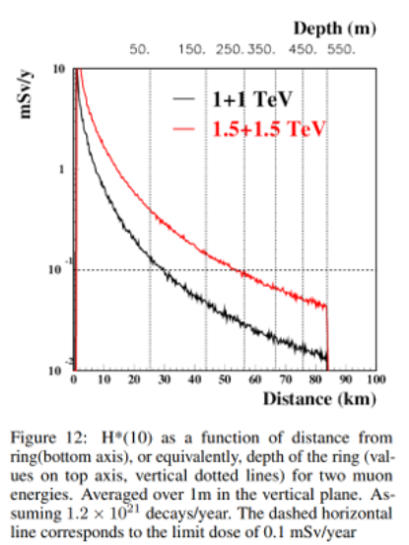
Neutrino Radiation
CERN group is worried about ²²Na as
well as ³H. Setting limits assuming 10%
leaching into aquifer but no further
dilution. After drinking then a does
>1 mrem/yr implying >1.8 Bq/kg.
Based on initial calculations, internal doses
remain well below these limits provided
surface dose can be controlled to be
below 10 mrem/yr.

Slide 16
Summary
Many technical challenges for a muon collider however no clear showstoppers
The main attraction is an upgrade path from the Higgs → 10+ TeV with the expectation of a reasonable cost and power growth
However the realistic timescale is well past a possible LC or FCCee
CERN is supporting ~50 FTE-yr for a 3 TeV design study to provide information for the next ESPP with another 1~3 ME in support from the EU
Opportunities to join in on accelerator or detector studies

