Slide 1


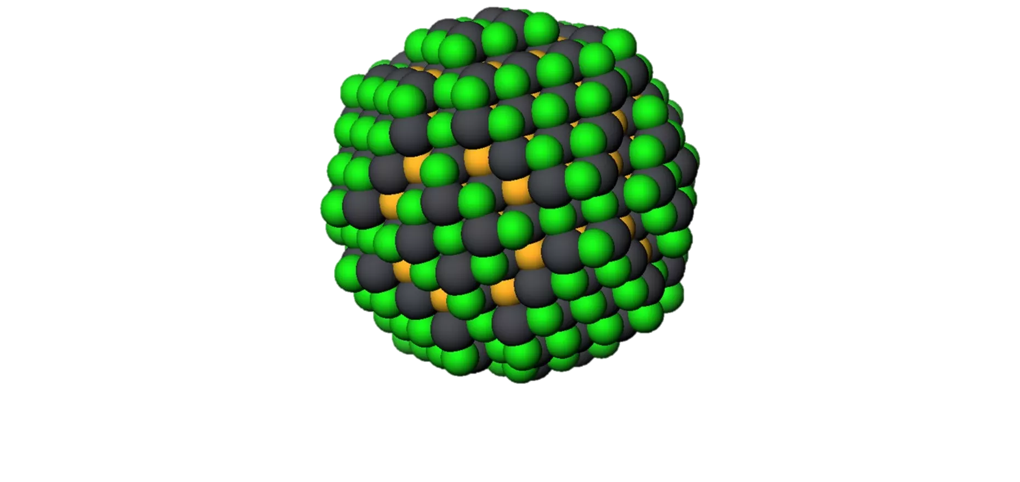
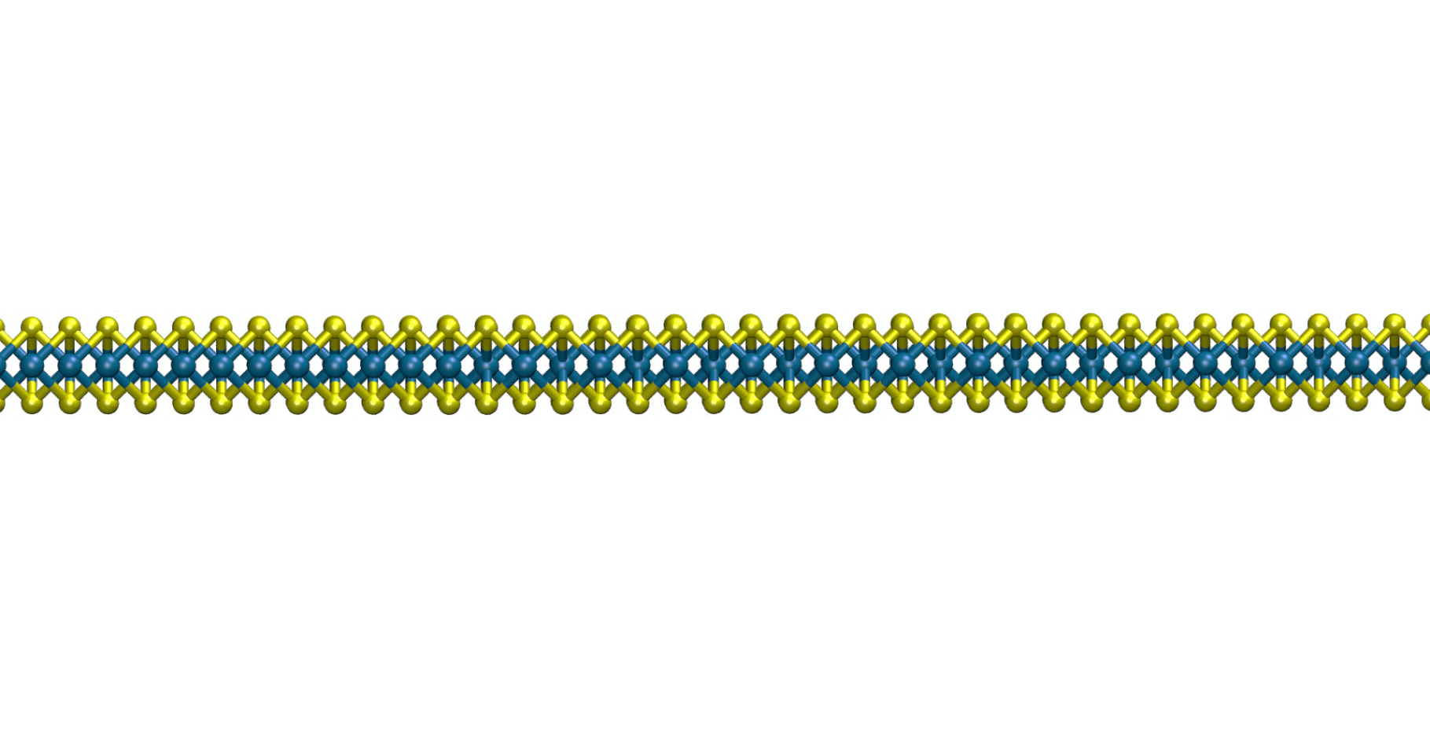
Tuning energy levels and energy flow in nanomaterials through the
external environment
Archana Raja
Feb 25, 2019
SLAC National Laboratory

Slide 2
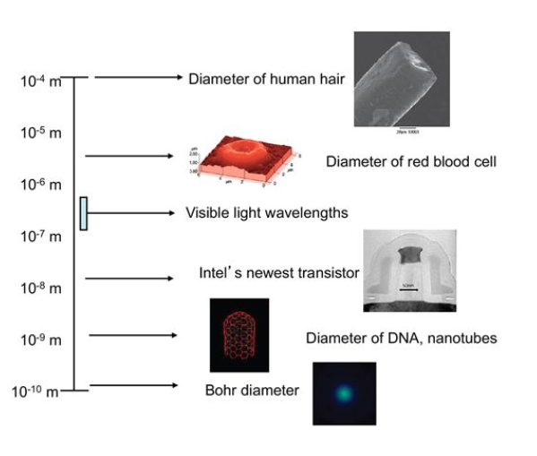
Sizes of things
Doug Natelson. Nanostrucutres and Nanotechnology.
Cambridge University Press (2015)

Slide 3

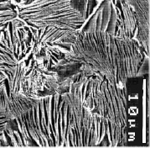
Nanotechnology in history
Roman goblet with stained glass containing gold nanoparticles
British Museum
Micro- and nanostructured steel in Japanese katana swords
Yasoi et al. ESOMAT (2009)

Slide 4
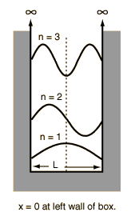
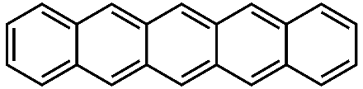


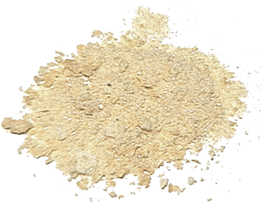
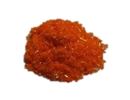
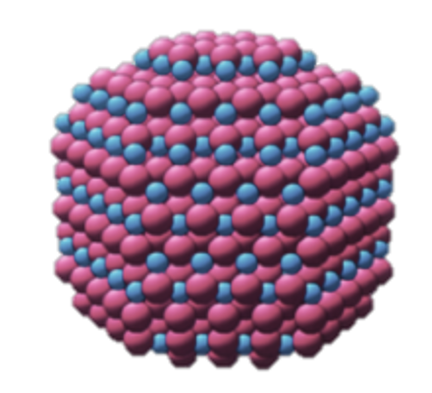
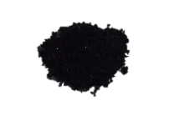
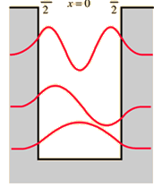
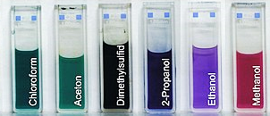
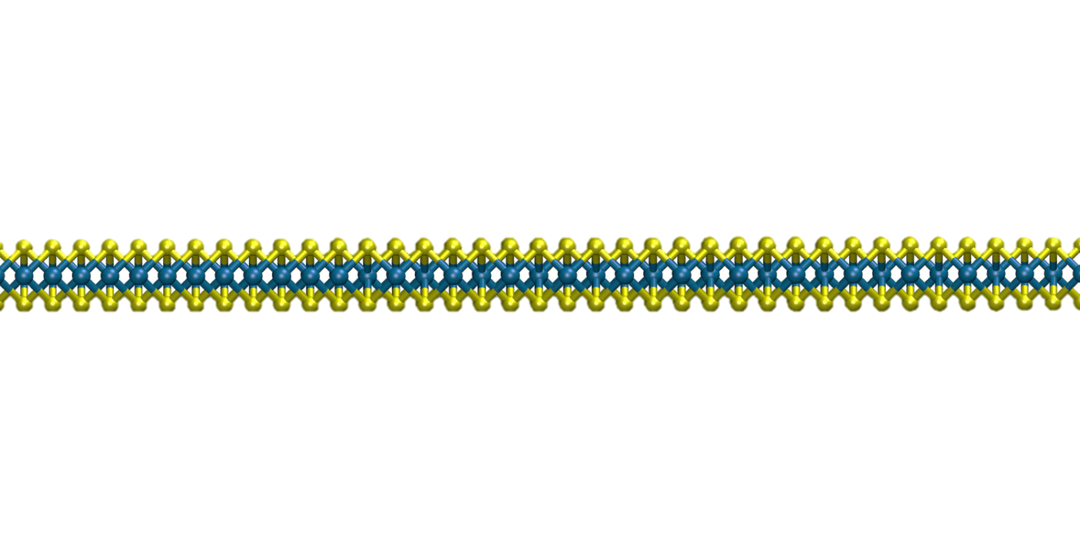
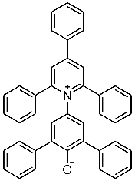
Physical phenomena at the nanoscale limit
Quantum picture
Molecular picture
Nanoscale limit
Structure & function
2 – 7 nm
L
Interactions
with the local
environment
<1 nm
{
in different
solvents
Monolayer transistor

Slide 5
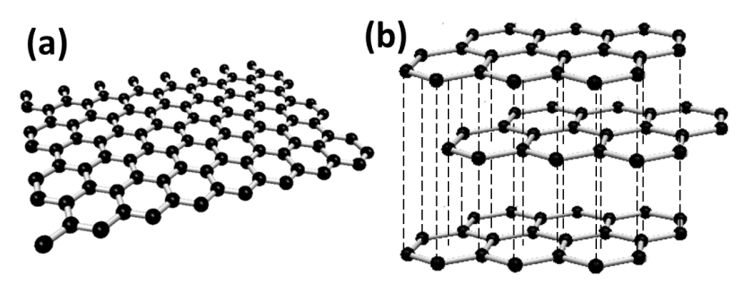
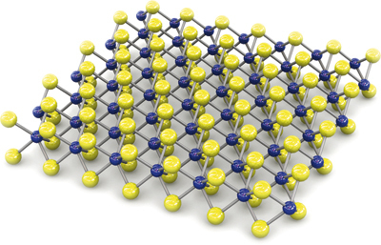
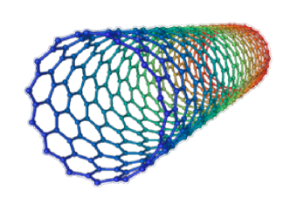
Nanoscale building blocks
0D quantum dots, fullerenes...
2D graphene
1D CNTs, nanowires...
Transition metal dichalcogenides
(TMDCs)
B. Radisavljevic et al., Nature Nano., 6, 147 (2011)

Slide 6
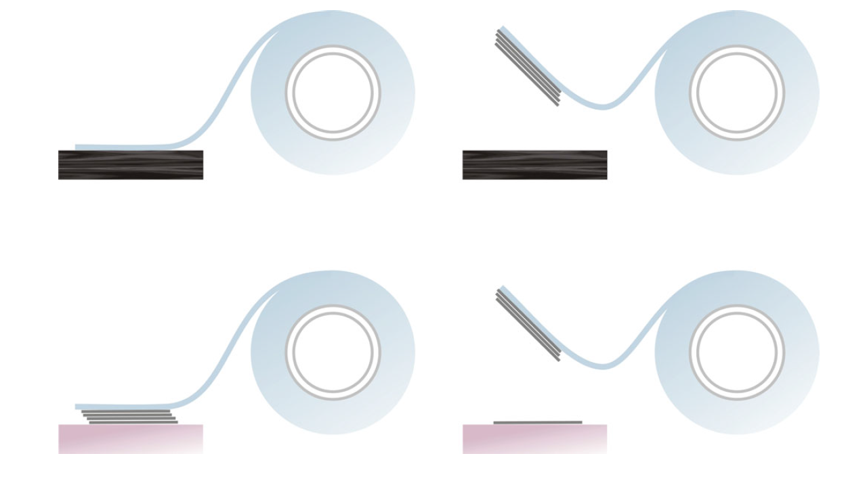
Micromechanical exfoliation of 2D materials
1 Bulk graphite, TMDC
2 Peel off a few layers
Substrate
Substrate
3 Place layers on substrate
4 Monolayer on substrate
Adapted from: K. S Novoselov, Rev. Mod. Phys. (2011)

Slide 7
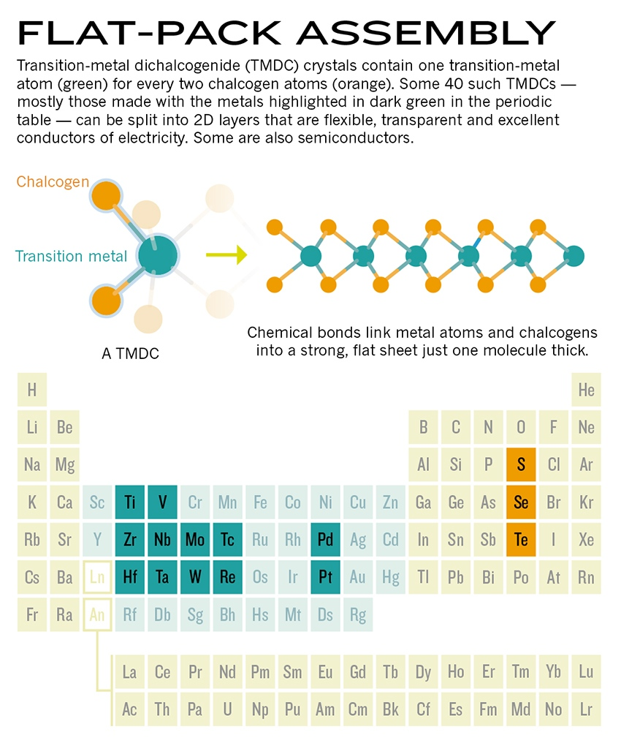
Library of 2D materials
Transition metal dichalcogenides
(TMDC)
Graphene: semimetal
BN: insulator
MoS₂, Mo_{x}W_{1-x}S₂, WS₂: semiconductors
NbSe₂: superconductors
CrI₃: semiconducting ferromagnet
Layered perovskites
Flexible atomic membranes, unique tunable optical and electronic properties!
Adapted from: E. Gibney, Nature (2015)

Slide 8
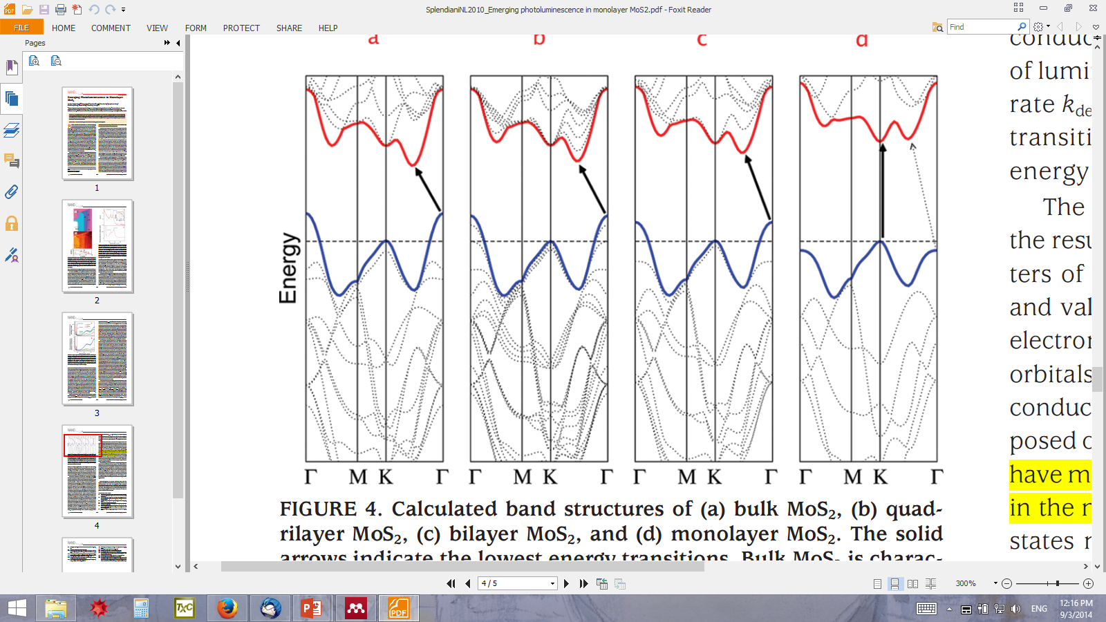
Dramatic light matter coupling at the monolayer limit
4L
2L
Bulk
1L
Optical image
Light emission
Brillouin zone
Monolayer
Monolayers are direct-gap semiconductors
Γ
k_{y}
M
K
Few layers
k_{x}
K.F. Mak et al., Phys. Rev. Lett. (2010)
MoS₂
Chalcogen
p orbitals
Metal
d orbitals
Chalcogen
p orbitals
A. Splendiani et al., Nano Lett., (2010)

Slide 9
Tuning nanomaterials using the local environment
Novel heterostructures for emergent physical phenomena
Atomically precise modulation of properties
Additional rotational degree of freedom: inter-layer twist
→ recent reports of superconductivity in twisted bilayer graphene, bilayer graphene on hBN

Slide 10
Today’s talk
Part I
Part II
E_{gap}
Coulomb engineering of the bandgap and excitons in 2D semiconductors
Energy transfer from quantum dots to 2D materials

Slide 11

Bandgap engineering
Conduction band
Conduction band
Conduction band
+ e/e repulsion
+ e/h
attraction
E
Valence band
Valence band
Doping
x
Alloying
Valence band
Strain

Slide 12
Bandgap engineering in 2D regime
“Coulomb engineering”
Conduction band
Conduction band
+ e/e repulsion
+ e/h
attraction
E
Valence band
Modify the environment,
not the material
x
Valence band

Slide 13
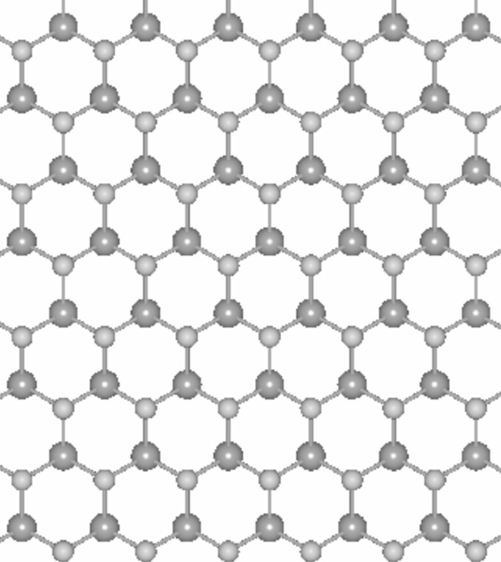
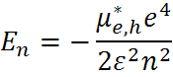
Excitons are a consequence of Coulomb interaction
Optical gap
Exciton
Bandgap
Free carriers
Optical absorption
Binding energy
Schematic
Effective mass
Energy
Charge
Bulk TMDC, GaAs QWs ~10 meV
Room temperature 25 meV
Hydrogen: 13.6 eV
Quantum number
Dielectric screening

Slide 14
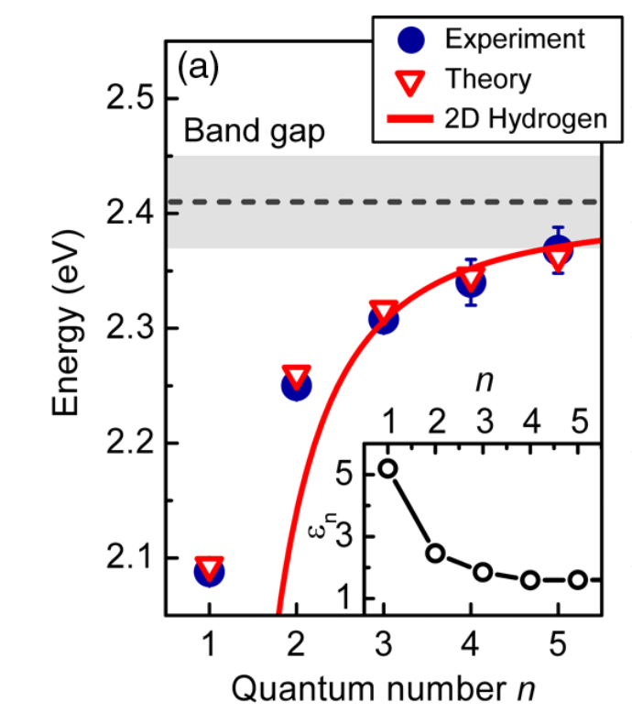
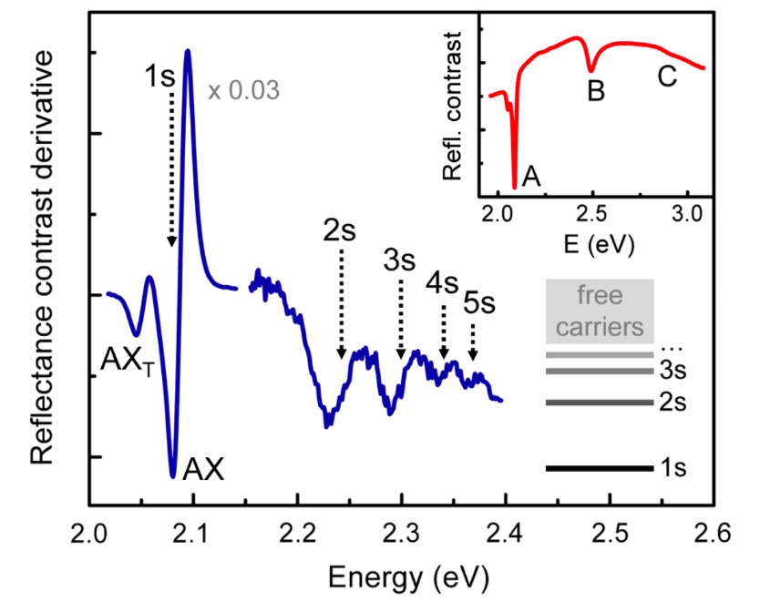
“Rydberg” spectroscopy of excitons:
non-invasive probe of the bandgap
A. Chernikov et al. Phys. Rev. Lett. 113, 076802 (2014)

Slide 15
“Rydberg” spectroscopy of excitons:
non-invasive probe of the bandgap
Optical gap
Exciton
Bandgap
Free carriers
t < 1 nm
Optical absorption
Binding energy
Monolayer TMDC ~ 500 meV
Bulk TMDC, GaAs QWs ~10 meV
Room temperature 25 meV
~500 meV
Schematic
Energy
N. S. Rytova et al., Proc. MSU, Phys., Astron. 3, 30 (1967)
A. Chernikov et al. Phys. Rev. Lett. (2014)
Z. Ye et al. Nature (2014)
M. M. Ugeda et al. Nat. Mat. (2014)
K. He et al. Phys. Rev. Lett. (2014)
…and many more
L. V. Keldysh et al., JETP Lett. 29, 716 (1979)
K. Tanaka et al., Phys. Rev. B 71, 045312 (2005)
P. Cudazzo et al., Phys. Rev. B 84, 085406 (2011)
T. C. Berkelbach et al., Phys. Rev. B 88, 045318 (2013)
D. Qiu et al., Phys. Rev. Lett. 11, 216805 (2013)

Slide 16
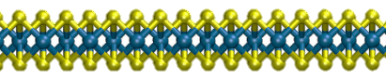
“Rydberg” spectroscopy of excitons:
non-invasive probe of the bandgap
Exciton
Ground state, 1s
Free electrons and holes at band-edge
Binding Energy ~ Δ₁₂
Bandgap = E_{1s} + Binding Energy
Energy
First excited state, 2s
2s
Optical absorption
Binding energy
Δ₁₂
Δ₁₂
1s
Schematic
Energy
Ground state

Slide 17

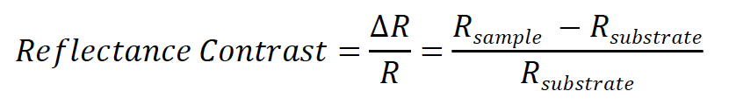
Experiment: absorption-type measurements
White light
Measurement
spot
WS₂
Spectrometer
3L
1L
Graphene
5 μm
Fused silica

Slide 18
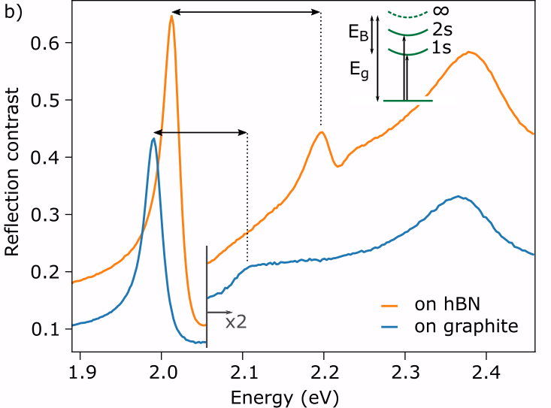
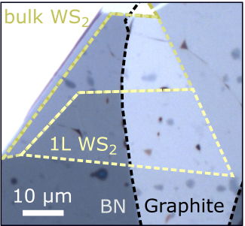
Monolayer WS₂ excitons in different
dielectric environments

Slide 19
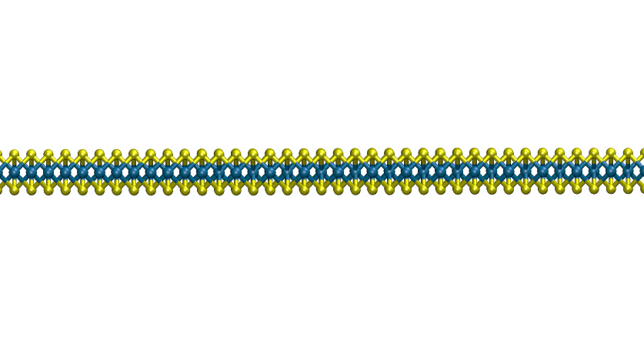
Nanoscale sensitivity of the exciton states:
Experiment-theory comparison
Experiment
Theory (QEH)
graphene
Supp. WS₂ (ES)
Supp. WS₂ / graphite (ES)
WS₂
Theory collaboration: Reichman group, Columbia University
Raja et al. Nature Commun., 8, 15251 (2017)
Also see: M. Rösner et al. Nano Lett. 16, 2322 (2016)

Slide 20
Nanoscale sensitivity of the bandgap:
Experiment-theory comparison
Bandgap
Exciton, n=1
graphene
WS₂
E_{B} = 290 meV
E_{B} = 120 meV
Theory collaboration: Reichman group, Columbia University
Raja et al. Nature Commun., 8, 15251 (2017)
Also see: M. Rösner et al. Nano Lett. 16, 2322 (2016)

Slide 21
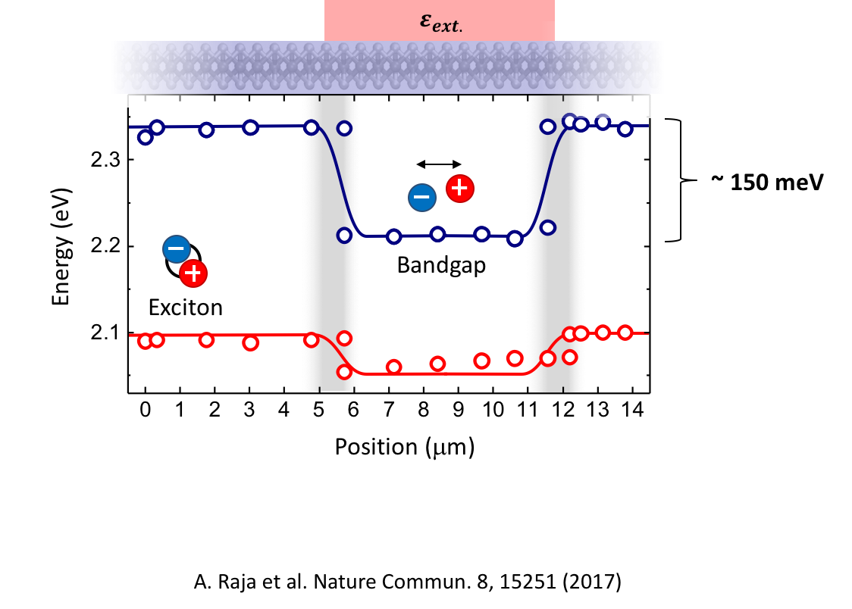
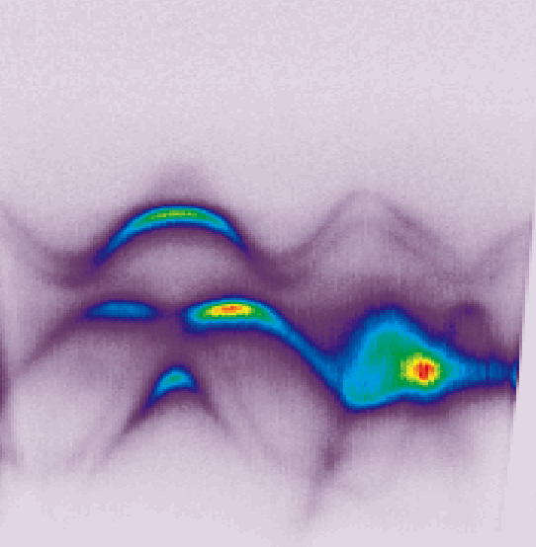
Dielectric in-plane heterostructure
Room temperature:
25 meV
ARPES collaboration with
Eli Rotenberg group at ALS,
LBNL
Raja et al. Nature Commun., 8, 15251 (2017)

Slide 22
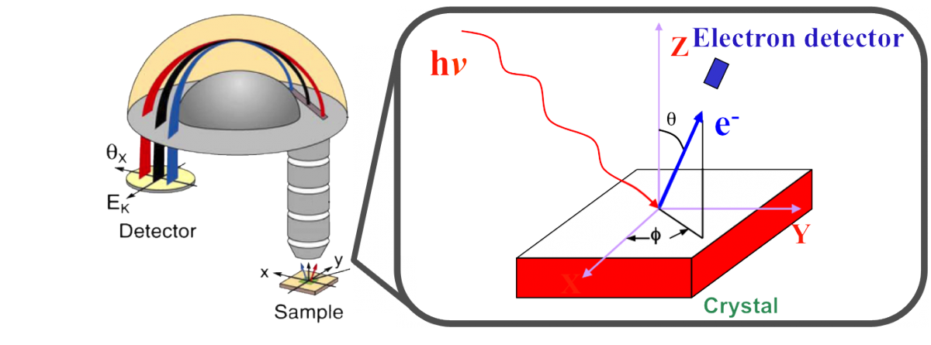
Angle resolved photoemission spectroscopy (ARPES)
ARPES measures electron momentum and energy
→ Dispersion of occupied electron states (valence bands)
ARPES at Lawrence Berkeley National Lab: 100 nm-10 µm spatial resolution
Image source: arpes.stanford.edu

Slide 23
Monolayer WS₂ excitons in different
dielectric environments

Slide 24
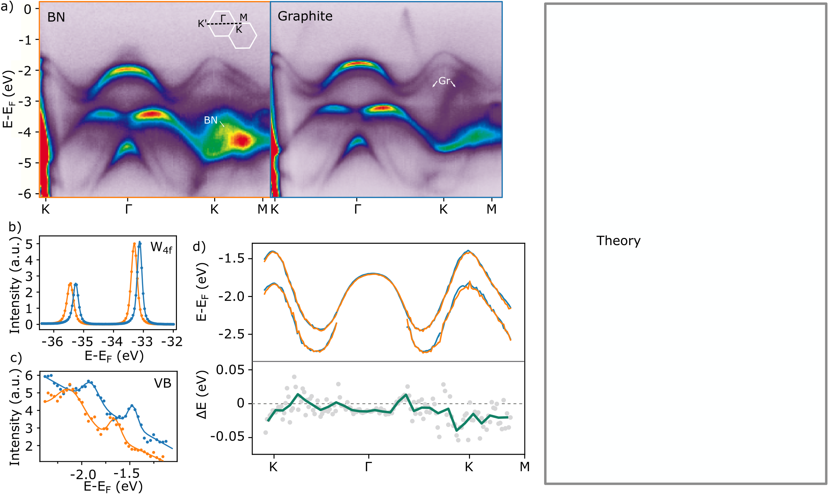
Band structure of monolayer WS₂ in
different dielectric environments
~100 meV
Chalcogen
p orbitals
Metal
d orbitals
Chalcogen
p orbitals
Raja et al. In preparation

Slide 25
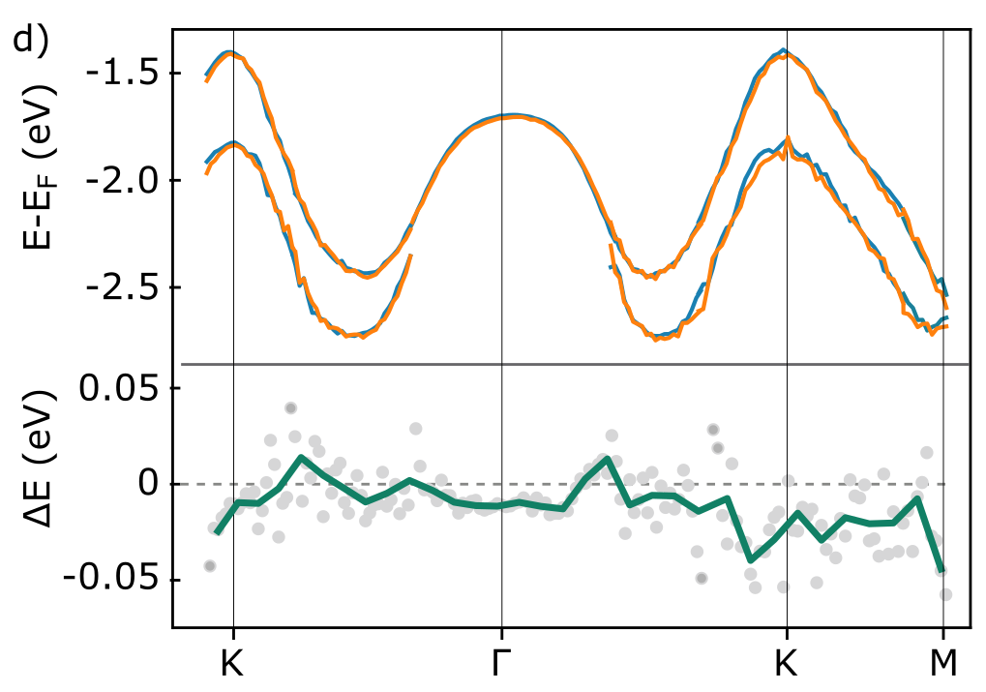
Band structure of monolayer WS₂ in
different dielectric environments
Data offset by
core-level shifts
Raja et al. In preparation

Slide 26
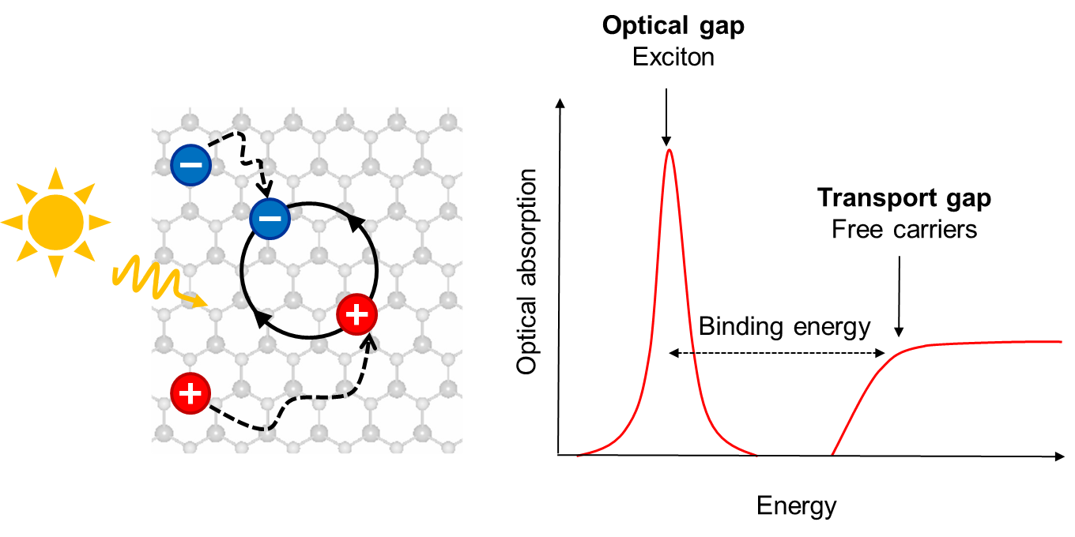
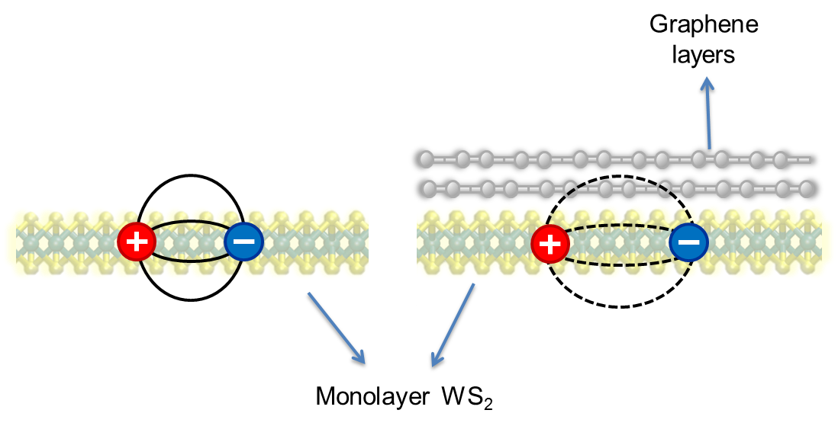
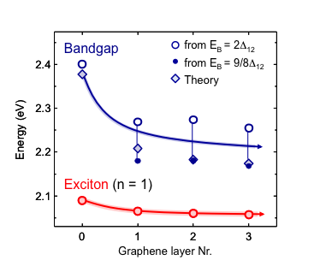
Summary Part I
2D semiconductor: strong Coulomb interaction
Screening of exciton states in 1L WS₂ → Reduction in binding energy
Tune band gap over 100’s of meV by engineering dielectric environment
Nanoscale sensitivity
Future directions: dynamics of tuning dielectric environment, length scale and types of heterojunction

Slide 27
Today’s talk
Part I
Part II
E_{gap}
Coulomb engineering of the bandgap and excitons in 2D semiconductors
Energy transfer from quantum dots to 2D materials

Slide 28
Non-Radiative Energy Transfer (NRET)
QD → 2D
Core-shell semiconducting quantum dots → highly tunable absorption, high quantum yield
-- localized carriers inside core
+
2D materials → excellent transport of charge carriers

Slide 29
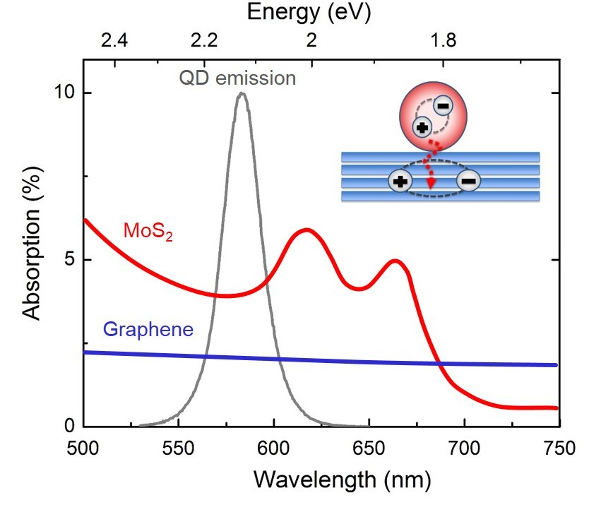
_
NRET from QDs to graphene and MoS₂
Core
CdSe
Shell
CdZnS
Distance
5.4 nm
Ligand
Layers of 2D material

Slide 30
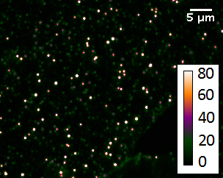
Single QD photoluminescence
SiO₂
Γ_{rad}

Slide 31
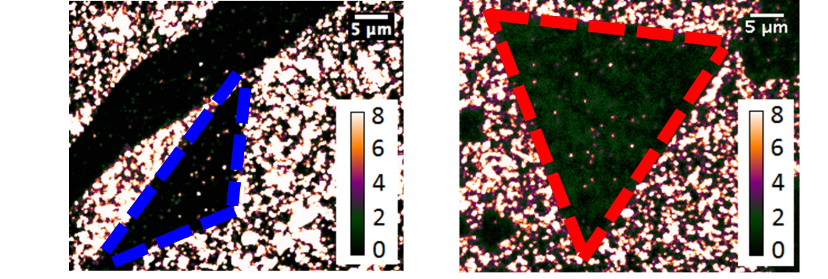
PL quenching: QDs on graphene and MoS₂
Graphene
MoS₂
Γ_{rad}
Γ_{NR}
10x decrease in PL intensity

Slide 32
_
Direct measurement of NRET rates
Time-resolved photoluminescence
via Time Correlated Single Photon Counting
Total PL decay rate ∼ slope
PL
time

Slide 33
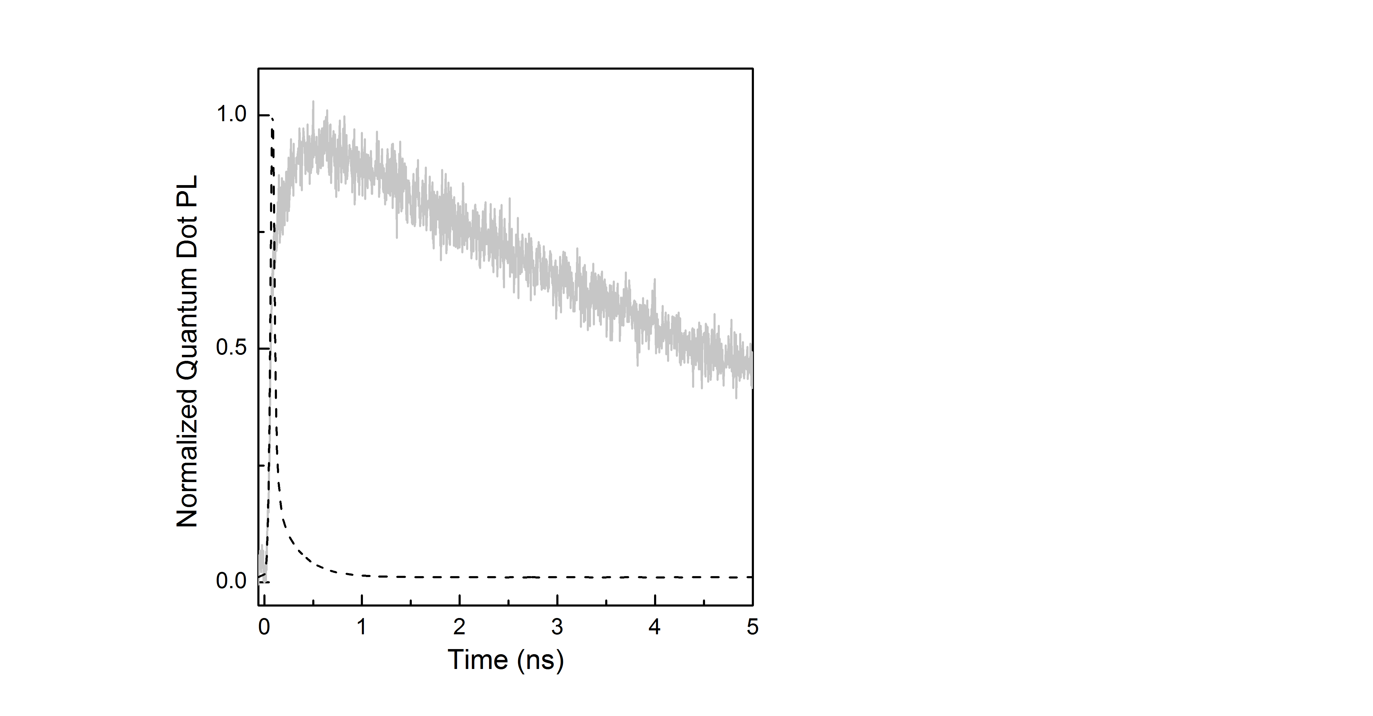
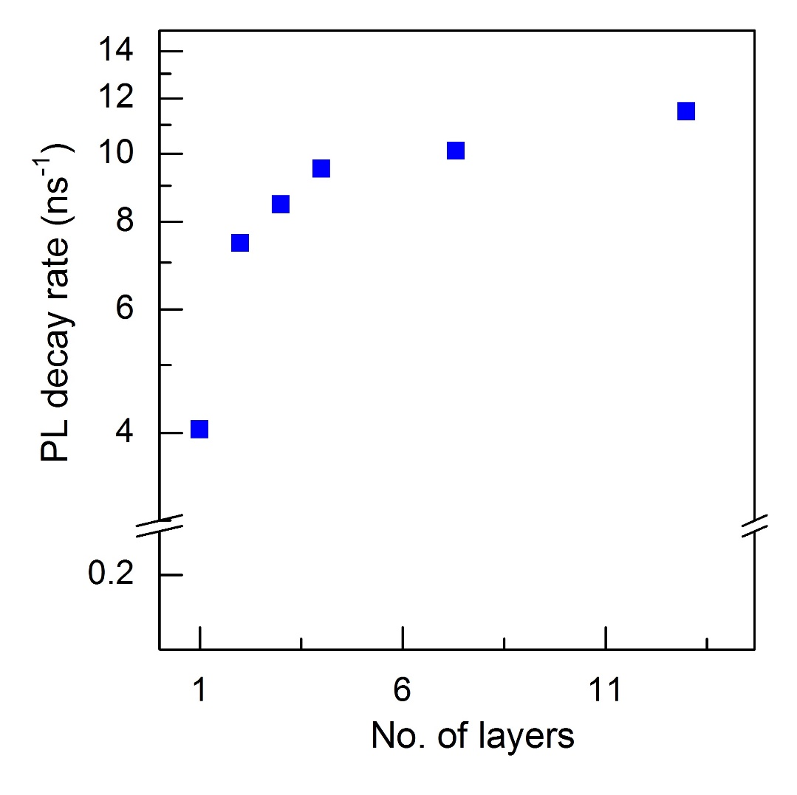
QDs on SiO₂ substrate
On SiO₂
Instrument response
On SiO₂

Slide 34
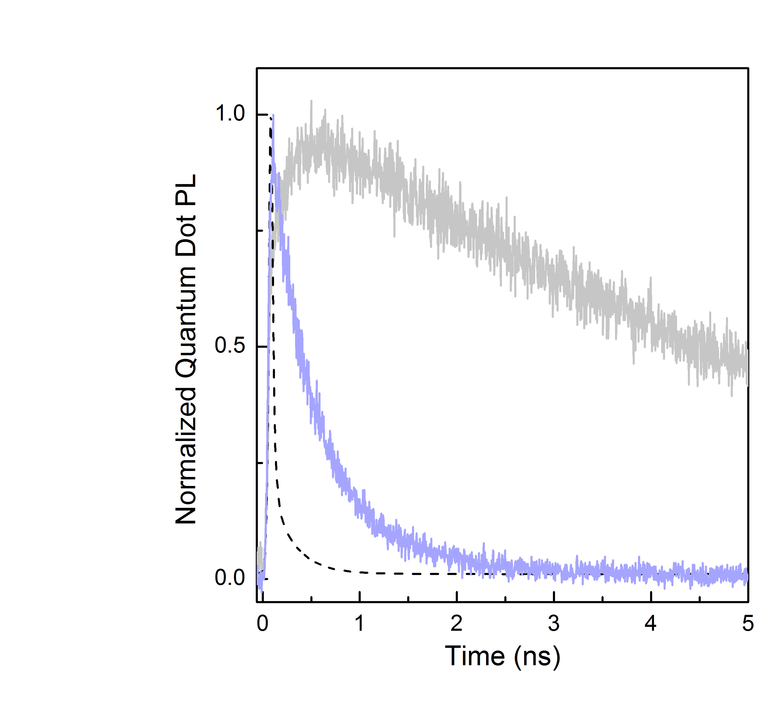
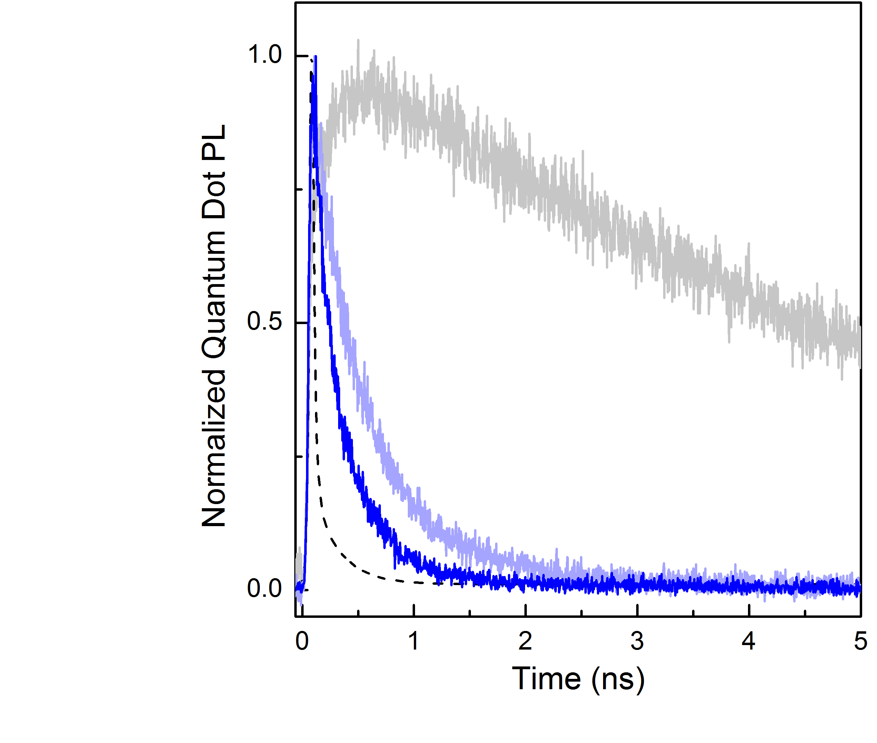
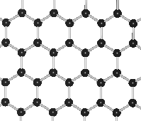
QDs on graphene
On SiO₂
On SiO₂
On monolayer graphene
Mono to bilayer graphene
On SiO₂
Rate ~ 1/Lifetime

Slide 35
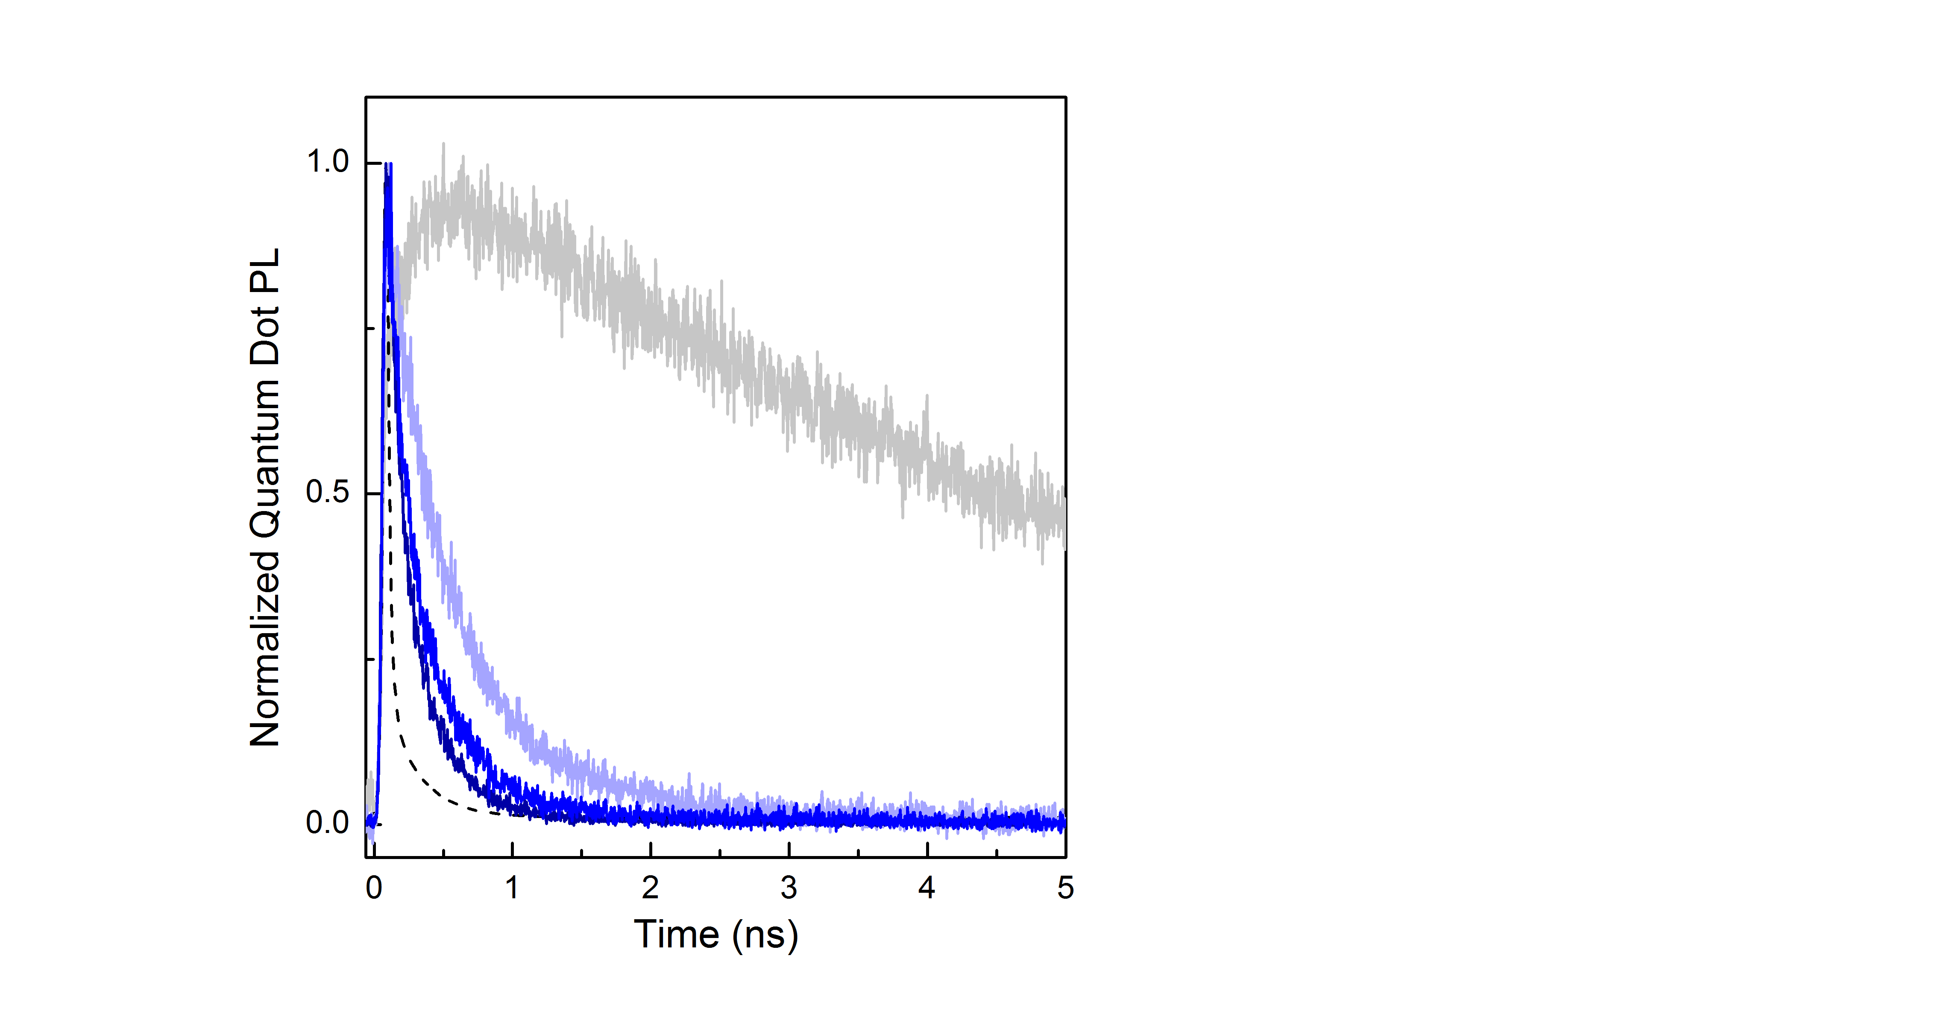
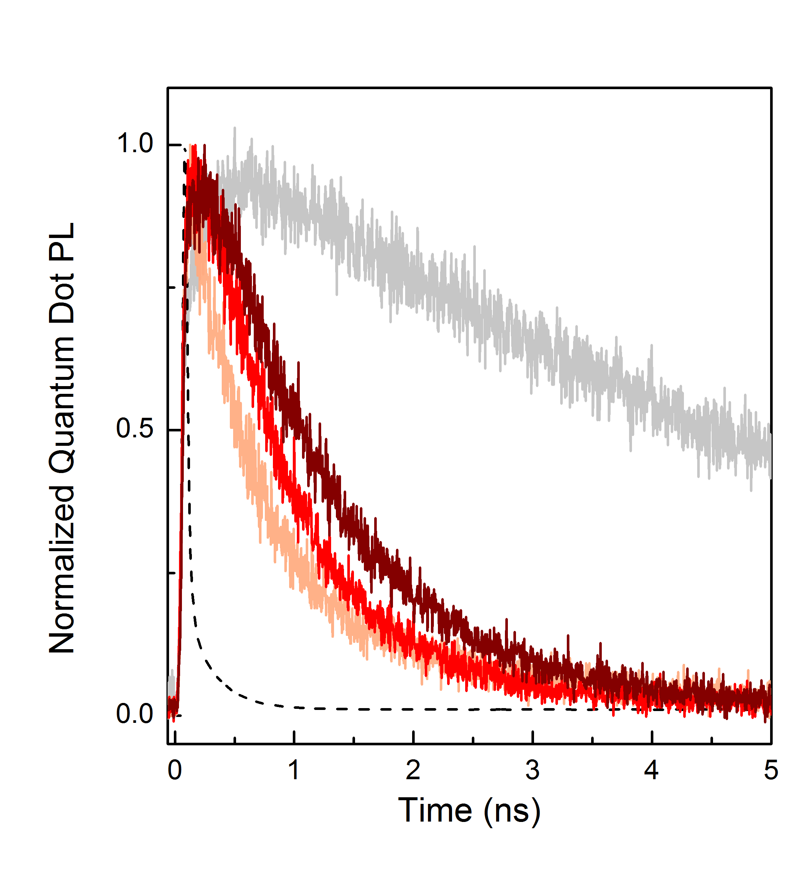
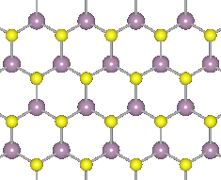
QDs on graphene vs. MoS₂
Increasing MoS₂
thickness
Increasing graphene
thickness

Slide 36
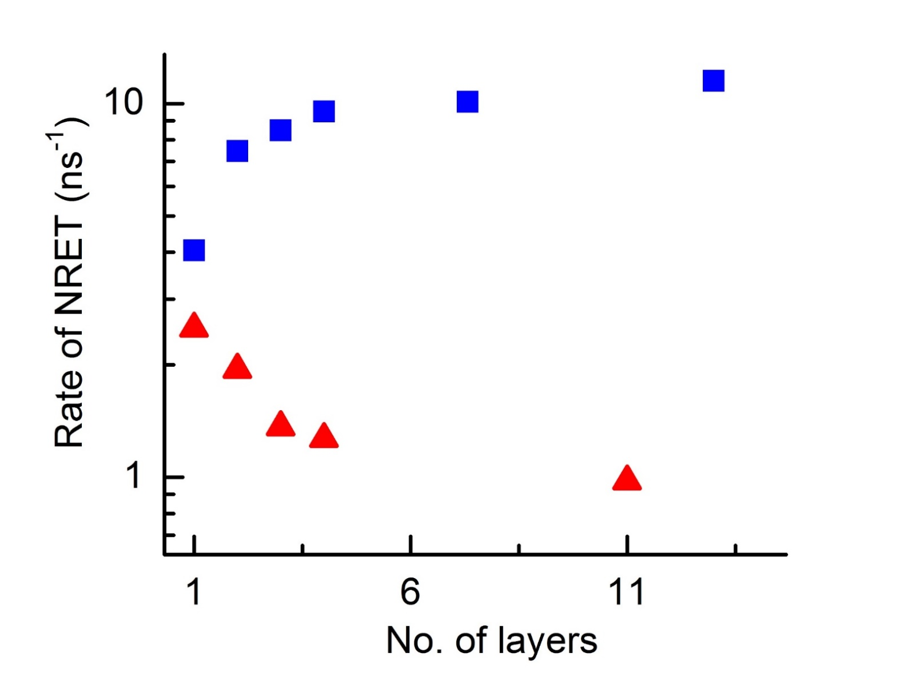
QDs on graphene vs. MoS₂
Graphene
MoS₂
Raja et al. Nano Letters 2016.
Also see: Prins et al. Nano Letters 2014, Chen et al. ACS Nano 2010

Slide 37



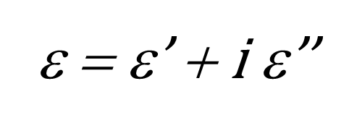

Absorption vs. Screening
Screening →
↓ E field
1
|E|
0
Energy transfer rate ∼
MoS₂
Graphene

Slide 38

NRET rates: experiment vs. theory
QD:point dipole, 2D:dielectric slab
Inputs: dielectric functions, QD size, acceptor thickness, decay rate in solution
No free parameters
Extendable for arbitrary 2D heterostructures
Theory collaboration:
Andrés Montoya-Castillo,
David Reichman
Chance, Prock and Silbey. Adv. Chem. Phys. 37, 1 (1978)
Gordon and Gartstein. J. Phys. Condens. Matter 25, 42 (2013)

Slide 39



Summary Part II
Efficient energy transfer QD → 2D
↑ no. of layers, energy transfer rate:
↑ to graphene
↓ to MoS₂
Dissipation vs. screening

Slide 40

Patterning electronic states and energy transport on an atomically thin canvas
Nanoscale lateral heterojunctions
Band gap
E
x

Slide 41

Proposed research at SLAC:
1. Electronic and structural dynamics of Coulomb Engineering
Tensile strain ~ 45 meV/%
Conley et al. Nano Lett. 13, 3626 (2013)
Raja et al. Nature Commun., 8, 15251 (2017)

Slide 42






Proposed research at SLAC:
1. Electronic and structural dynamics of Coulomb Engineering
Time-resolved optical spectroscopy
Ultrafast Electron Diffraction or LCLS
Tunable $ε_{ext.}$
(e.g.: MoTe₂)
Sub-bandgap
pulsed resonant
excitation
Bandgap of WS₂
WS₂
Lin et al. Nature Commun. 8(1) 1745 (2017)

Slide 43


Proposed research at SLAC:
2. Twisted 2D layers: Moiré excitons & non-equilibrium dynamics
condmat.physics.manchester.ac.uk/imagelibrary

Slide 44


Proposed research at SLAC:
2. Twisted 2D layers: Moiré excitons & non-equilibrium dynamics
θ
MoS₂ / WSe₂
Short pulse resets to
non-equilibrium structure
Ultrafast structural
dynamics
Longer pulse sets
equilibrium structure
Yu et al. Sci. Adv. 1701696 (2017)
Ultrafast optical
spectroscopy

Slide 45





















Acknowledgments
Tony F. Heinz
Louis E. Brus
A. Paul Alivisatos
Alexey Chernikov
A. Montoya-Castillo
Tim Berkelbach
Andrey Chaves
David Reichman
Ghidewon Arefe
James Hone
Jaeeun Yu
Lutz Waldecker
Eli Rotenberg
Aaron Bostwick
Chris Jozwiak
Roland Koch

Slide 46
Tuning nanomaterials using the local environment
Part I: Coulomb engineering of the bandgap and excitons in 2D semiconductors
Raja et al. Nature Communications, 8, 15251 (2017)
Part II: Transport of excitons across 0D/2D interfaces – dielectric screening and absorption
Raja et al. Nano Letters, 16(4), 2328 (2016)
archana.raja@berkeley.edu

Slide 47
Appendix

Slide 48


Engineering energy transfer: predictions
Energy transfer rate
Thickness (nm)
= 1 Graphene-like behavior
> 1 MoS₂-like

Slide 49

Energy transfer vs. Charge transfer
Peng et al. Nano Lett. 2011

Slide 50

Effect of the QD shell on NRET

Slide 51



Lateral confinement in the 2D plane
TEM image of colloidally synthesized MoS₂ quantum dots
Solution processed MoS₂
Liquid phase exfoliation: similar to bulk
Colloidal synthesis:
1 eV blue-shift
Optical Absorption
> 20 nm
< 10 nm
20 nm
2
3
4
2
3
4
Energy (eV)
Energy (eV)

Slide 52

Angle resolved photoemission spectroscopy (ARPES)
R. Schlaf, http://rsl.eng.usf.edu/

Slide 53

2D limit: solid state version of molecules
W. Liptay, ”Electrochromism and Solvatochromism”, Angew. Chem. (1969)

Slide 54

Theory predicts type II heterojunction
Rösner et al. Nano letters (2016)

Slide 55


Theoretical “road map”
E_{b} (meV)
20
< 25
100
10
8
200
6
ε_{Top}
300
4
400
2
TMDCs
SiO₂
hBN
graphite
500
1
1
2
4
6
8
10
20
ε_{Bottom}
ε_{Top}
WS₂
ε_{Bottom}

Slide 56

Fabrication: WS₂ & graphene

Slide 57

Atomic-force microscopy

Slide 58

Graphene-encapsulated WS₂

Slide 59

WSe₂ structures

Slide 60




Emerging applications
Electronics
Photonics and photovoltaics
transistor
Jariwala et al. ACS Nano 2014
Catalysis
lasers
Mak and Shan. Nature Photonics 2016
Deng et al. Nature Nano. 2016

