Slide 2
R&D for Warm/Cold Future Colliders Linacs and RF systems
Sami Tantawi
June 17, 2021

Slide 3
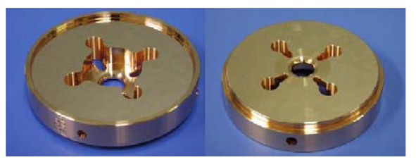
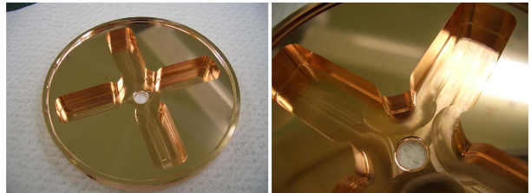
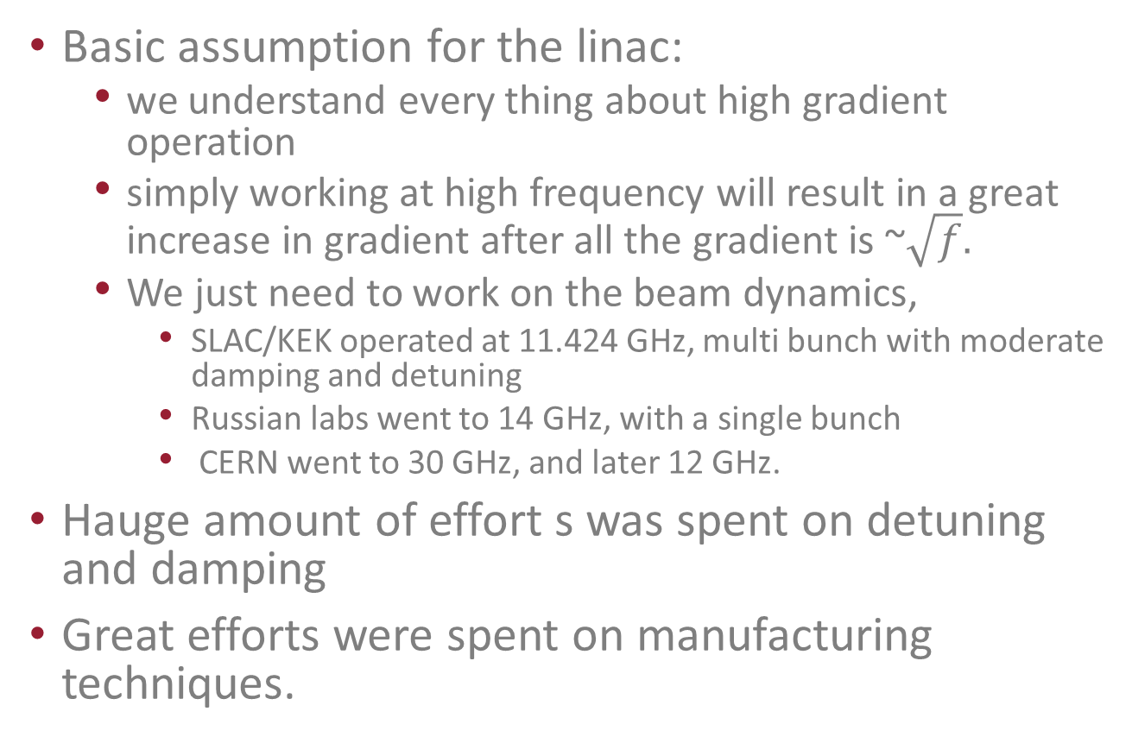
Historical progression and design philosophy for the linac
Basic assumption for the linac:
  we understand every thing about high gradient operation
  simply working at high frequency will result in a great increase in gradient after all the gradient is ~$\sqrt{f}.$
  We just need to work on the beam dynamics,
    SLAC/KEK operated at 11.424 GHz, multi bunch with moderate damping and detuning
    Russian labs went to 14 GHz, with a single bunch
    CERN went to 30 GHz, and later 12 GHz.
Hauge amount of effort s was spent on detuning and damping
Great efforts were spent on manufacturing techniques.

Slide 4
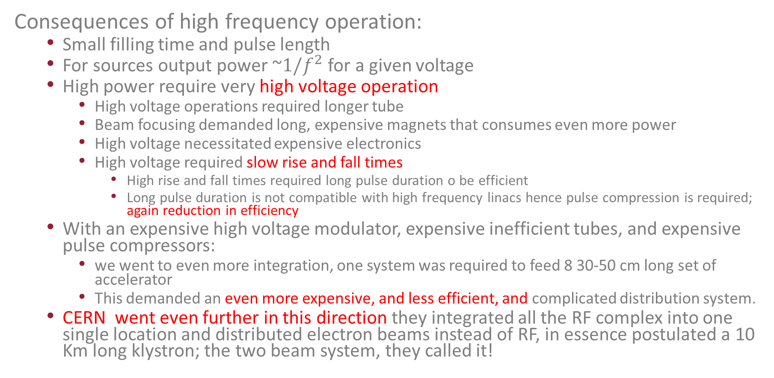
Historical progression and design philosophy for the RF system
Consequences of high frequency operation:
  Small filling time and pulse length
  For sources output power ~${1/f}^{2}$ for a given voltage
  High power require very high voltage operation
    High voltage operations required longer tube
    Beam focusing demanded long, expensive magnets that consumes even more power
    High voltage necessitated expensive electronics
    High voltage required slow rise and fall times
      High rise and fall times required long pulse duration o be efficient
      Long pulse duration is not compatible with high frequency linacs hence pulse compression is required; again reduction in efficiency
  With an expensive high voltage modulator, expensive inefficient tubes, and expensive pulse compressors:
    we went to even more integration, one system was required to feed 8 30-50 cm long set of accelerator
    This demanded an even more expensive, and less efficient, and complicated distribution system.
  CERN went even further in this direction they integrated all the RF complex into one single location and distributed electron beams instead of RF, in essence postulated a 10 Km long klystron; the two beam system, they called it!

Slide 5
Old Vision
Modulator
450 kV
RF Distribution Network
Pulse Compressor
RF Combining Network
To TW accelerators
  expensive high voltage modulator,
  expensive inefficient tubes,
  expensive pulse compressors
    To Reduce the cost more integration with high risk bottle neck very complicated RF combining and distribution system, one system was required to feed 8 30-50 cm long set of accelerator.
    This demanded an even more expensive, less efficient, and complicated distribution system.

Slide 6
My Vision: A very simple, modular system with an order of magnitude cost reduction for the accelerator complex.
60 kV Modulator
1-m long Standing wave structure
  Inexpensive relatively low voltage modulator
    Fast rise and fall times, hence no need for pulse compression
    Made of mass produced components
  Inexpensive and efficient RF source that works at extremely high perveance:
    Does not exist, Requires serious R&D
    We have many ideas on how to implement this using sophisticated combining network
  Novel standing wave accelerator structures
    Reliable high gradient operation
    High RF to beam efficiency that can compete even with superconducting accelerators
    My dream: a super conducting accelerator that has the same properties of anormal conducting one with much reduced thermal load.

Slide 7
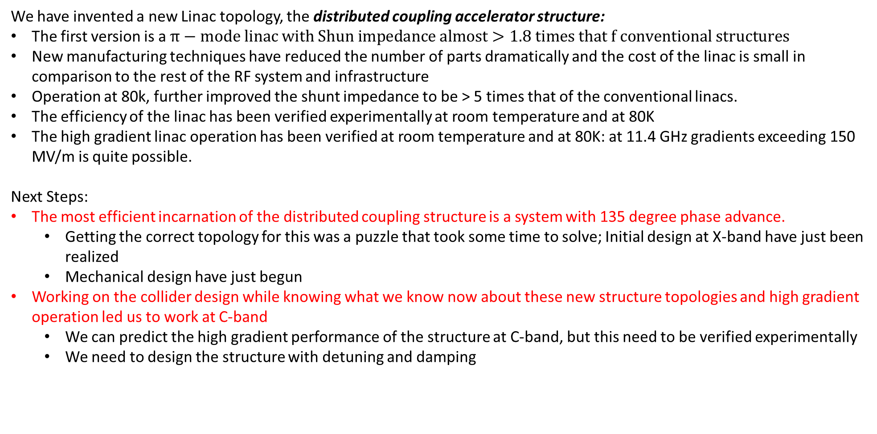
Linacs: Basic developments
We have invented a new Linac topology, the distributed coupling accelerator structure:
The first version is a $π−mode linac with Shun impedance almost>1.8 times that f conventional structures$
New manufacturing techniques have reduced the number of parts dramatically and the cost of the linac is small in comparison to the rest of the RF system and infrastructure
Operation at 80k, further improved the shunt impedance to be > 5 times that of the conventional linacs.
The efficiency of the linac has been verified experimentally at room temperature and at 80K
The high gradient linac operation has been verified at room temperature and at 80K: at 11.4 GHz gradients exceeding 150 MV/m is quite possible.
Next Steps:
The most efficient incarnation of the distributed coupling structure is a system with 135 degree phase advance.
  Getting the correct topology for this was a puzzle that took some time to solve; Initial design at X-band have just been realized
  Mechanical design have just begun
Working on the collider design while knowing what we know now about these new structure topologies and high gradient operation led us to work at C-band
  We can predict the high gradient performance of the structure at C-band, but this need to be verified experimentally
  We need to design the structure with detuning and damping

Slide 8
Linacs: Initial R&D goals, what do we need to demonstrate
  We need to design and build a collider ready linac with experimental varication of its operation
    135 degree phase advance
    Operational at C-band
    Detuned ( every single cavity is different in terms of the dipole resonance frequency)
    Damped with a material that retains it damping properties t a77K
    A geometry for the damping slots that does not deteriorate the fundamental operation efficiency by much while damping dipole modes up to 40 GHz.

Slide 9
RF sources: Basic developments
We have invented a new RF source topology, the modular multi-beam klystrons:
Goals
  No electro magnets
  efficiency > 65%
  Low cost
  Operating voltage ~ 60 kV
Developments to date:
  so far was purely experimental
  the first version suffered from many manufacturing problems
  3 more versions are in the pipe line, delyed mainly because of supply issues elated to cathodes ( Covid related)
We have other concepts in the pipe line:
  Distributed beam amplifier
    Limited by available simulation codes
    Limited by budgets
  Planer circular klystron
    Limited by budget

Slide 10
RF sources: Basic developments, Next Steps
    Modern simulation Codes for RF sources:
      We are working on the most difficult regime possible at low voltage, high current and periodic focusing magnets
      Current code are insufficient to verfy the designs let alone optimize it.
      Our developments so far have layed the foundations for a new FEM based codes with modern formulations that allow the use of nodal basis functions
      Much more work is needed to achieve an end to end simulation code, however, our developments to dates allows us to predict many subsystem response and allow for some geometry optimization
    Manufacturing techniques
      We need to apply similar technology to that of the linac to RF sources to reduce the part count and reduce cost
      We need to able to print the cathodes
      We need to be able to simplify the structure of the cathode and apply rf heating, again reducing the number of parts and cost

Slide 11
RF sources: Initial R&D Goals; what do we need to demonstrate
An experimental demonstration of a C-band modular multi-beam klystrons:
  demonstrate a C-band tube:
    High efficiency > 65%
    PPM focused
    Power > 1.25 MW/tube
  demonstrate the combining mechanism of 64 tubes, a new invention, the two dimensional Fouquet combiner ( we demonstrated 16 tube combiner)
  Demonstrate a fully integrated tube with 64 individually focused tubes under one vacuum envelope operating with efficiency > 65%.

Slide 12
Modulator: Basic developments, Initial R&D Goals; what do we need to demonstrate
We have developed a new Linac topology, the distributed Marx Bank:
First version operating at 60 kV achieved a rise time of ~ 100 ns
The device used only mass produced components
Fall time is rather large ~ 400 ns, but still reasonable
Peak power ~ 2.5 MW
Next Steps:
Demonstrate:
  100 MW unit
  Demonstrate an efficiency > 98%, or at least understand the efficiency limitation

Slide 13
System demonstration
60 kV Modulator
1-m long Standing wave structure
  Modulator, Klystron, Accelerator demonstration
    Demonstrate the total system efficiency
    Demonstrate high gradient performance
    Demonstrate Cost Reduction, or at least the potential for the cost reduction in mass production.
  A Few meter long with cryogenic modules
    Demonstrate the alignment mechanisms
    Understand vibrations
    Demonstrate the BPMs and their alignments
    Demonstrate the Quads and their alignments
  Zeroth order design for the collider

Slide 14
Resources
  Coherent vision for this program within the Lab

Slide 15
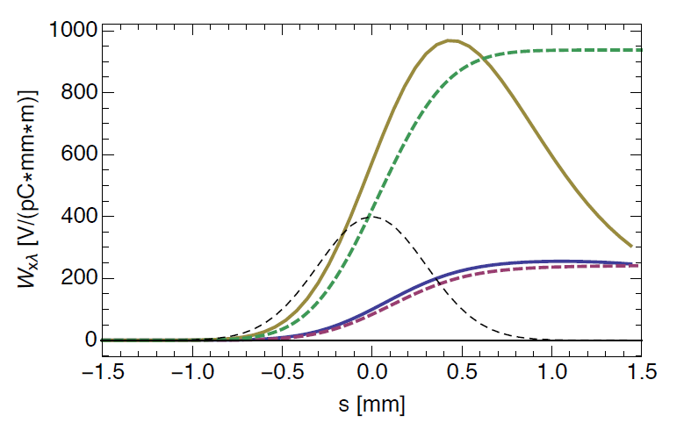
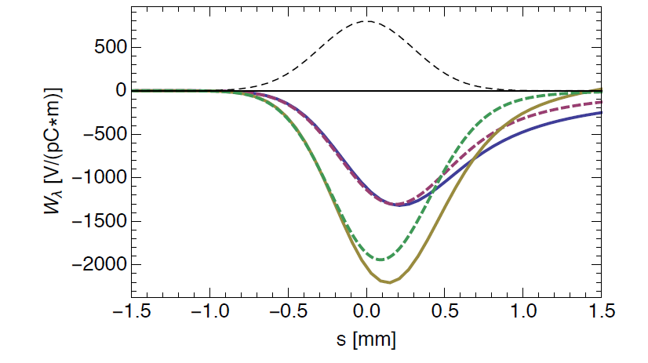
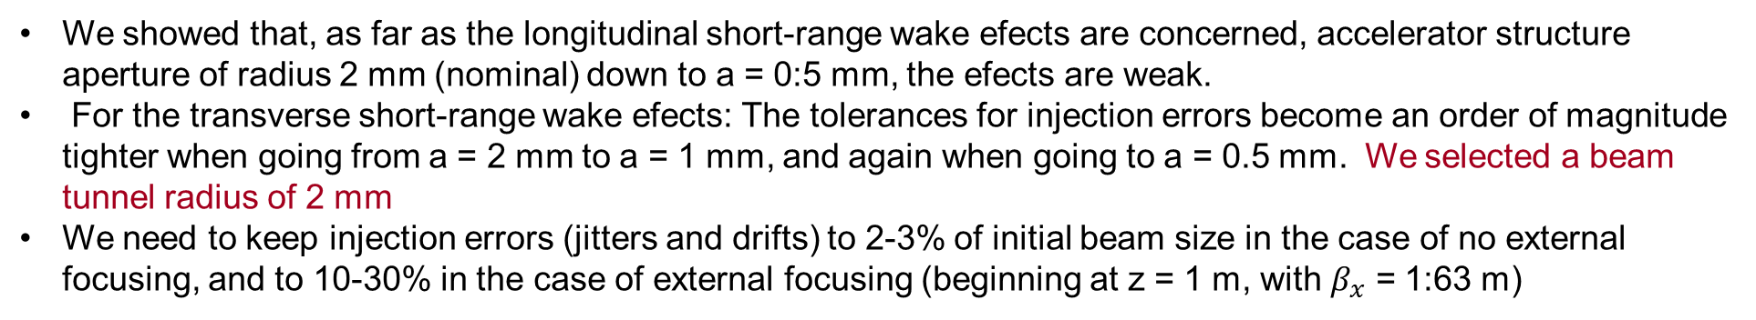
Short range wake field analysis dictates beam aperture size
Transverse Wakes
Longitudinal Wakes
Bunch shape
1 mm beam tunnel radius
2 mm beam tunnel radius
2 mm beam tunnel radius
1 mm beam tunnel radius
Bunch shape
ECHO wakes (solid) compared with model wakes (dashes).
We showed that, as far as the longitudinal short-range wake efects are concerned, accelerator structure aperture of radius 2 mm (nominal) down to a = 0:5 mm, the efects are weak.
For the transverse short-range wake efects: The tolerances for injection errors become an order of magnitude tighter when going from a = 2 mm to a = 1 mm, and again when going to a = 0.5 mm. We selected a beam tunnel radius of 2 mm
We need to keep injection errors (jitters and drifts) to 2-3% of initial beam size in the case of no external focusing, and to 10-30% in the case of external focusing (beginning at z = 1 m, with $β_{x}$ = 1:63 m)

Slide 16
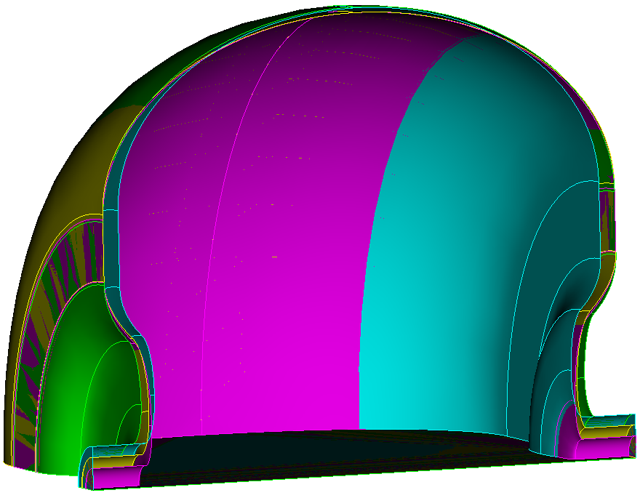
C-Band Cell Optimization
Maximized Shunt Impedance
Variation of cell profile if dipole detuning needed
a=2mm, t=1.5mm
a=1.5mm, t=1.5mm
a=1mm, t=1.5mm
a=2mm, t=3mm
a=2mm, t=2mm
a=2mm, t=4mm
a=2.5mm, t=1.5mm
dF1=4.2%

Slide 17
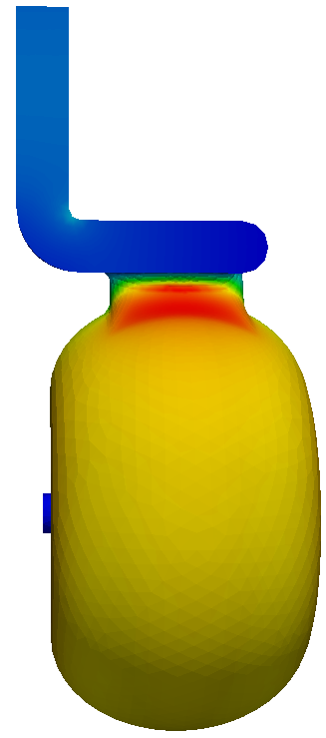
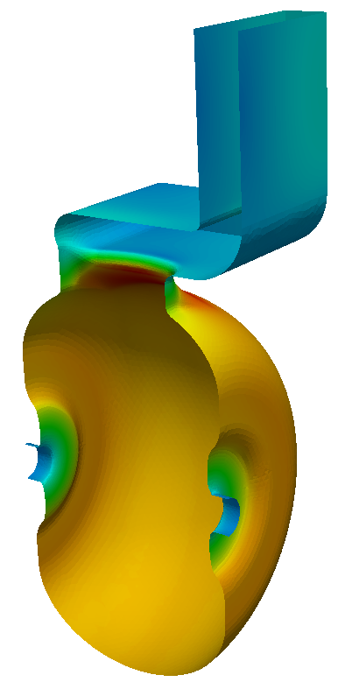
Coupling Iris Optimization
Coupling beta: 1.1
  Qext: 12600
Field enhancement: ~27%
Surface B field

Slide 18
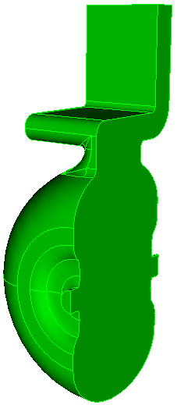
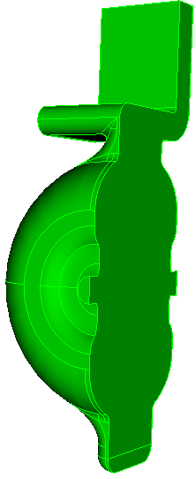
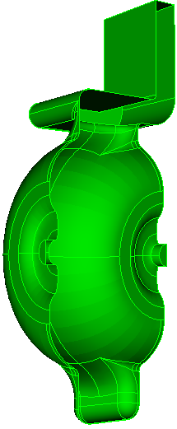
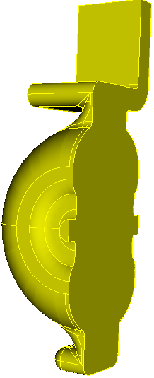
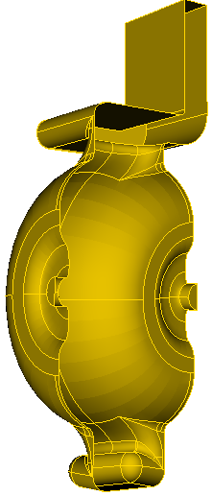
3D Field Symmetrization
dipole, quad calculated at 50MV/m
Single side coupling iris induce significant dipole and quad fields
Coupling hole summetrization and racetrack shape incorporated to minimize dipole and quad fields
Dipole
Quad
w/o symmetrization
✅
Dipole
Quad
V1-simple-stub
(not ideal cancellation)
V2-symm-stub
(good cancellation)
with symmetrization

Slide 19
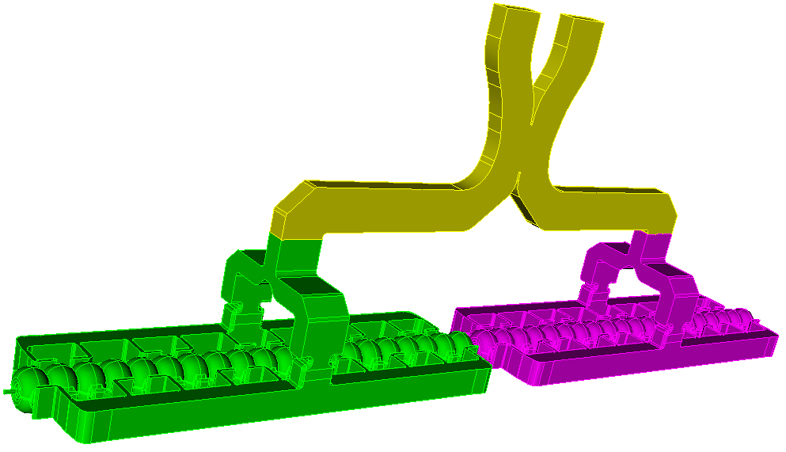



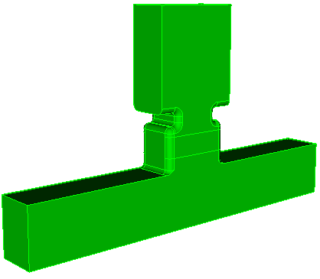

Waveguide Distribution system

Slide 20

5-feed Distribution Network
0
1
2
3
4
5

Slide 21
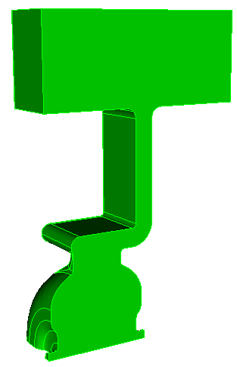
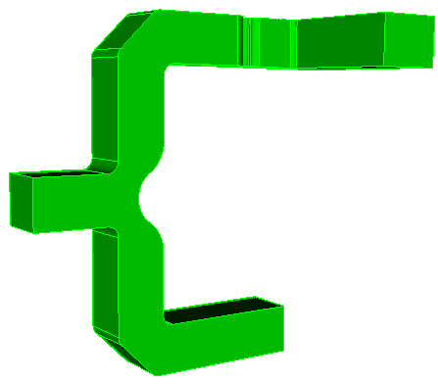
Relative Position Optimized
To avoid coke mode in waveguide junctions
Maximize sensitivity for cavity tuning
E-short when
all cells on this arm detuned
Port 1
Port 2

Slide 22
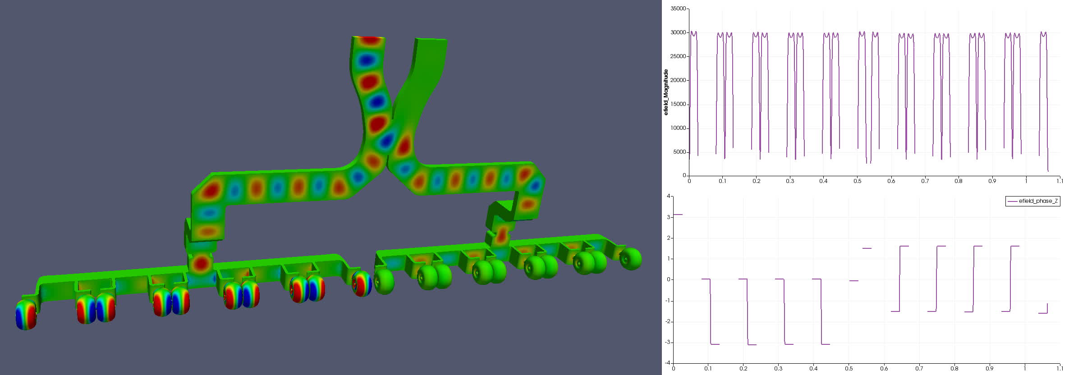
40cell 2-structure (top 20cell)
Half of 40-cell structure fed from one side of parallel waveguide
Showing the Ey field component

Slide 23
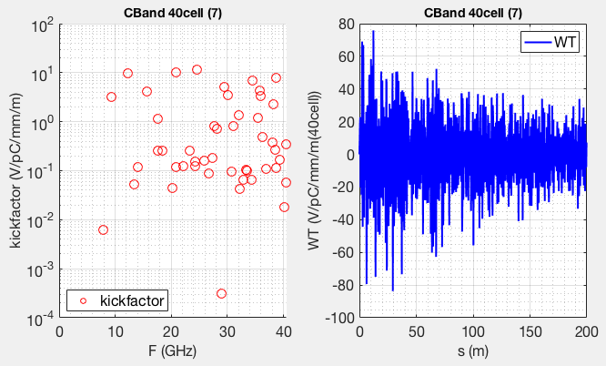
Long-range Wakefield Analysis
Linac will run at low bunch charge: 35 pC
Beam dynamics analysis being conducted to determine if detuning and damping would be needed
Dipole kickfactor of the CBand cell
Wakefield of 1-m structure of 40 identical cells

Slide 24
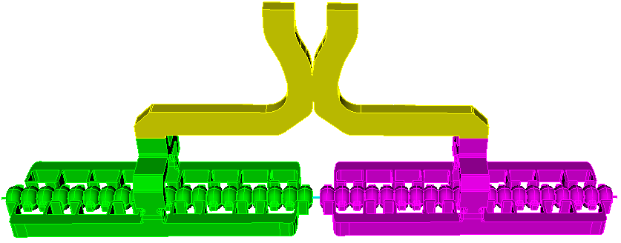
Preliminary IMPACT Beam Simulation
Initial phase space
phase space at end of linac
Linac: 8 x
Initial beam - exit of gun
  – RadiaBeam
Detailed studies in progress
  more realistic linac paramerters
  3D FIELD MAPS
  Long-range wakefield effect
Determine linac and final focusing alignment requirements
Beam profile

Slide 25
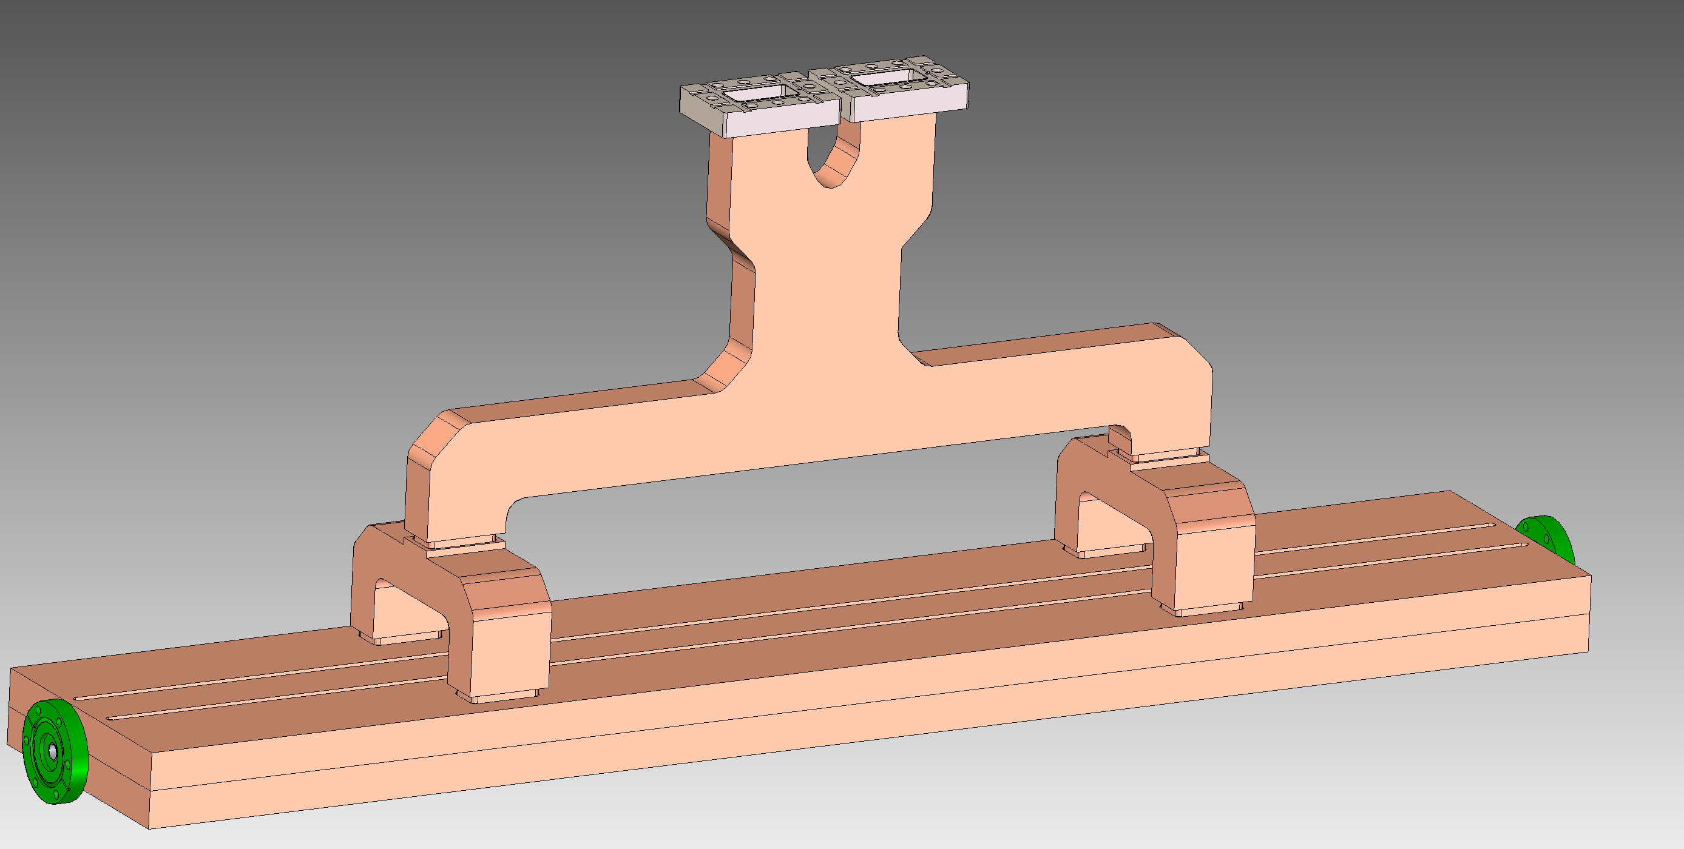
LINAC Assembly Mechanical Structure
Hybrid Splitter
RF Input
Tee Splitter
Beam Pipe
Coolant Channels (prospective)
Distributed Coupling Structure

Slide 26
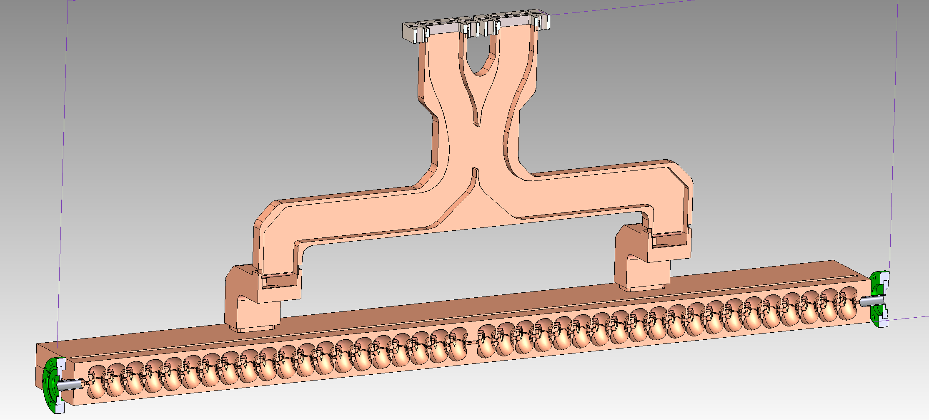
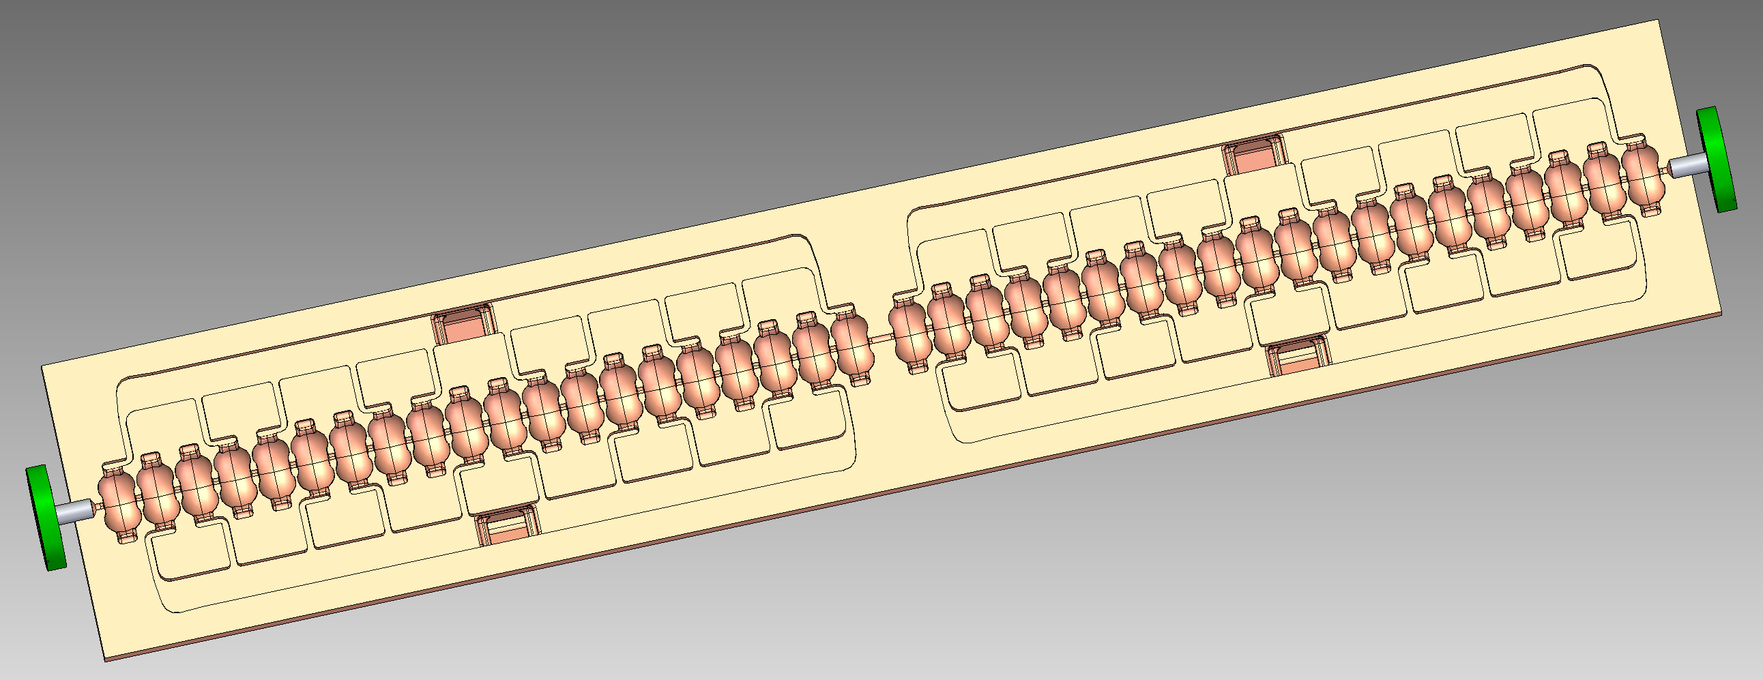
Distributed Coupling Manifold and Cells
40 Cell structure
4mm diameter beam pipe
Split-plate construction
High power distributed coupling manifold

Slide 27
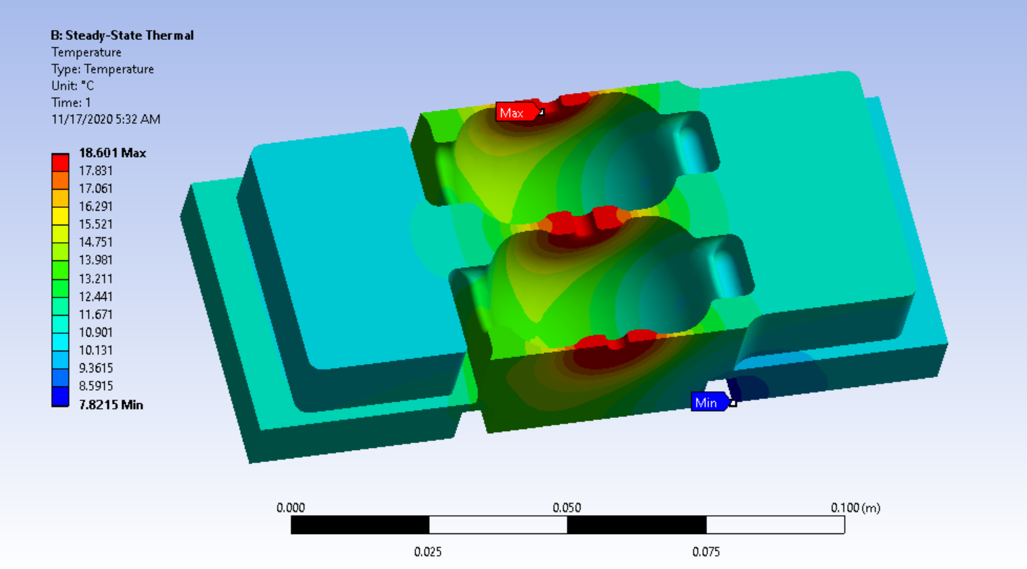
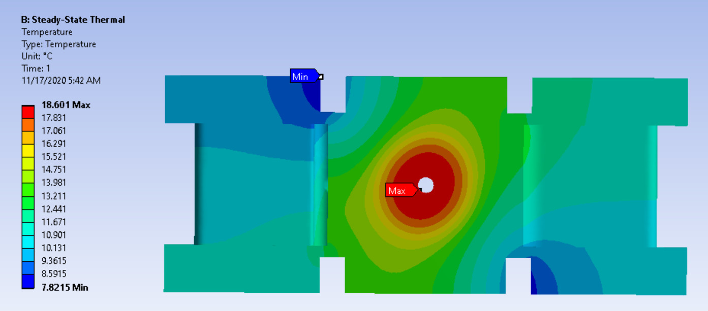
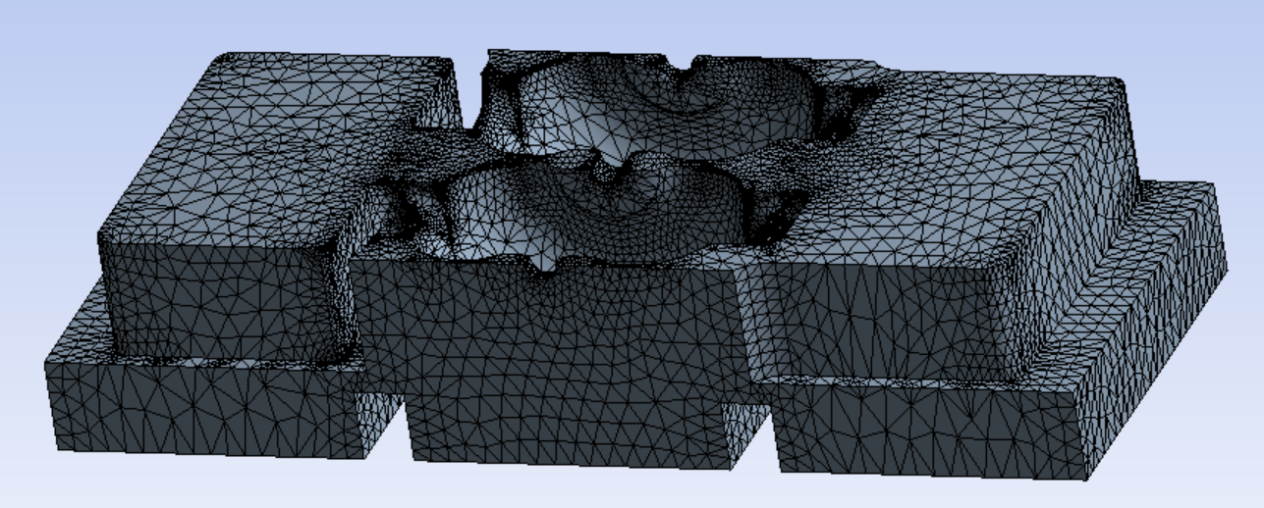
Initial LINAC Thermal Simulations
Operating Parameters:
  125W/Cell, 5kW / LINAC section
  ~7L/min flowrate
Results:
  18.6C Maximum rise
  10C coolant temperature increase
  2 Counter Flowing coolant channels to cancel thermal gradients, creating a thermal ‘quadrupole’

