Slide 1
Remarks on Higgs Factory Prospects
Su Dong

Slide 2
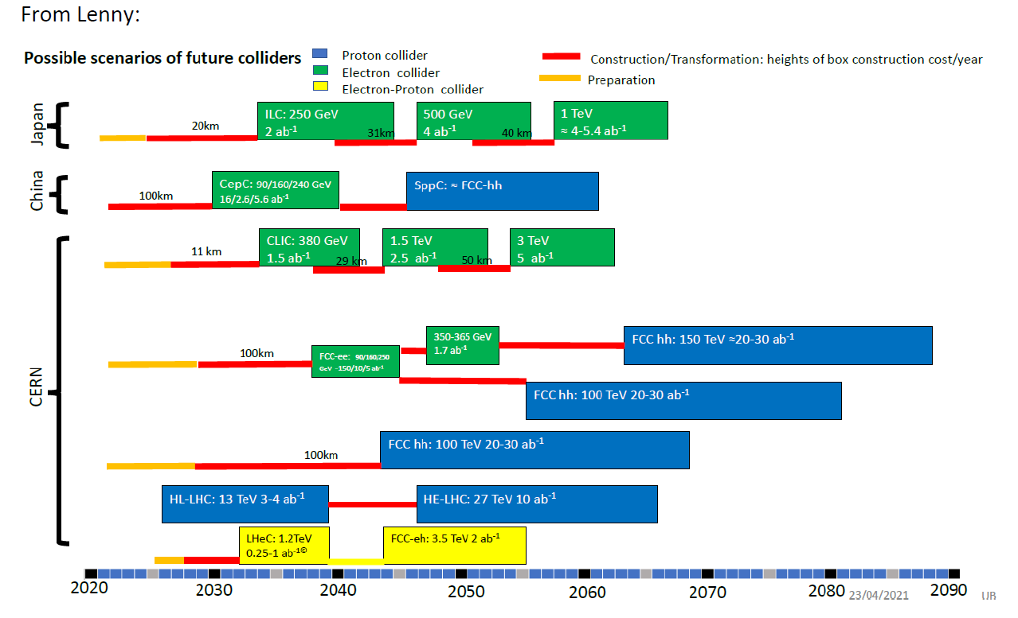
Known Projects
From Tor’s
Retreat slides

Slide 3
Difficulties with “Known” Projects
ILC:
Hosting attempt round 3, since 2004. Fell twice on cost.
Can “hosting” model with international partners contributing $1B level offshore cost each ever work ?
Costly green field site => more demand for extendable energy upgrade, but is 45-80 MeV/m 20+ year from now a justifiable upgrade ? Only additional 10-20km or replacing existing 20km ?
FCC-ee
6B$ 100km tunnel starting 2029, while HL-LHC still going ? Cost defense is mainly from reuse for FCC-hh later.
2039 Higgs factory physics starts is no longer a medium term future ? and HEP has a serial mono-rail EF future with CERN.
CEPC:
More likely to overcome finance hurdle and might start early ?
The cost hurdle is daunting in all cases. At (or >) limit of site size. Future colliders need to be on different trajectory for scalability.

Slide 4
Time Scale and Energy Upgrade
Higgs Factory should be in < ~15 year future to serve the medium time frame physics program – goal aligned in all regional future strategies.
Muon collider/ multi-TeV e+e- / 100TeV hh are for very different far future times scales so that we should avoid unrealistic bundling with Higgs factory. FCC-ee also too late ?
C3/XCC advantages:
Could be at more affordable range to change funding psychology completely. Lower political hurdle compared to ”known” projects.
Domestic program funding ceiling not as stringent as off-shore.
Reuse existing infrastructure or moderate new civil engineering should not carry the same baggage for “extendability” as ILC.
Once physics program going, buys time for higher gradient technology with e.g. PWAC. Upgrade more viable than new machine ?
Can still make sense in parallel to FCC-ee/CEPC ?
Put e+e- collider on a new technology trajectory.

Slide 5
Back up

Slide 6
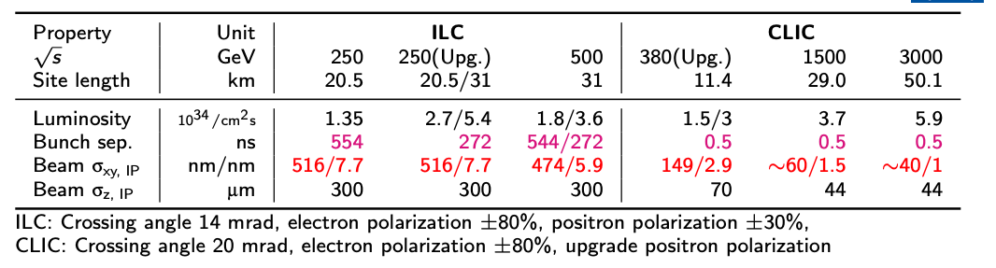
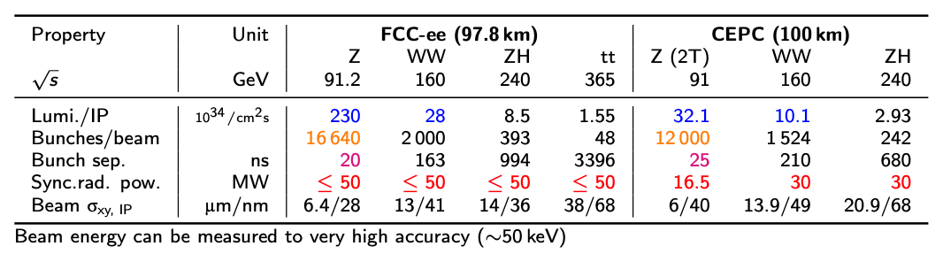
Accelerator Parameters

