Slide 1
Possible SLAC Contributions to the next Lepton Collider
Tor Raubenheimer, SLAC
SLAC HEP Retreat
May 25, 2021

Slide 2
Technologies for a Lepton collider
Conventional Linear Collider (SRF or NCRF)
ILC is the example; 2035 time-early for physics; CLIC or C3 is a few years latter.
Technology is probably limited to 1 or possibly a few TeV
Storage Ring (FCCee or SPPS)
Conventional technology and likely to work but expensive
Provides infrastructure for higher energy hadron collider
γ−γ Linear Collider
Potential to extend LC to high energy avoiding beamstrahlung;
Also potential for low energy Higgs factory;
Significant R&D on lasers, IP, MDI
Muon collider
Requires extensive R&D; neutrino radiation is a significant concern
Potential multi-TeV energy reach due to lack of beamstrahlung and compact size
Potential for lower costs although benefit unclear
Plasma Linear Collider
Unlikely to make sense for Higgs factory; short bunches may allow for multi-TeV collisions
Requires extensive R&D; positrons are a limitation.
Cost benefit unclear as it requires most LC subsystems and massive laser/e- drive beam

Slide 3
Thoughts on Technical Status
ILC is the obvious path although access to energies above 500 GeV are not clear
Develop upgrade routes to intermediate energies
FCCee provides a powerful Z- and Higgs factory but barely makes it to t-tbar. Of course, the tunnel can be reused for 60-100 TeV p-p collider
How important is the 500 GeV – few TeV range?
C³ / CLIC provides a cost competitive approach to an LC that probably scales more naturally to 1 TeV; both probably require additional “RF Unit” demonstration
Likely need other technology to go beyond 1 or 2 TeV
γ/γ might provide low-cost path to Higgs but significant technical issues remain
Muons may provide path to Higgs but more naturally suited to TeV-scale and perhaps multi-TeV facilities; many significant technical issues remain with early stage subsystem designs
Plasma may provide upgrade path for ‘conventional’ LC or perhaps green field LC but potential showstopper technical challenges remain and no design concept exists

Slide 4
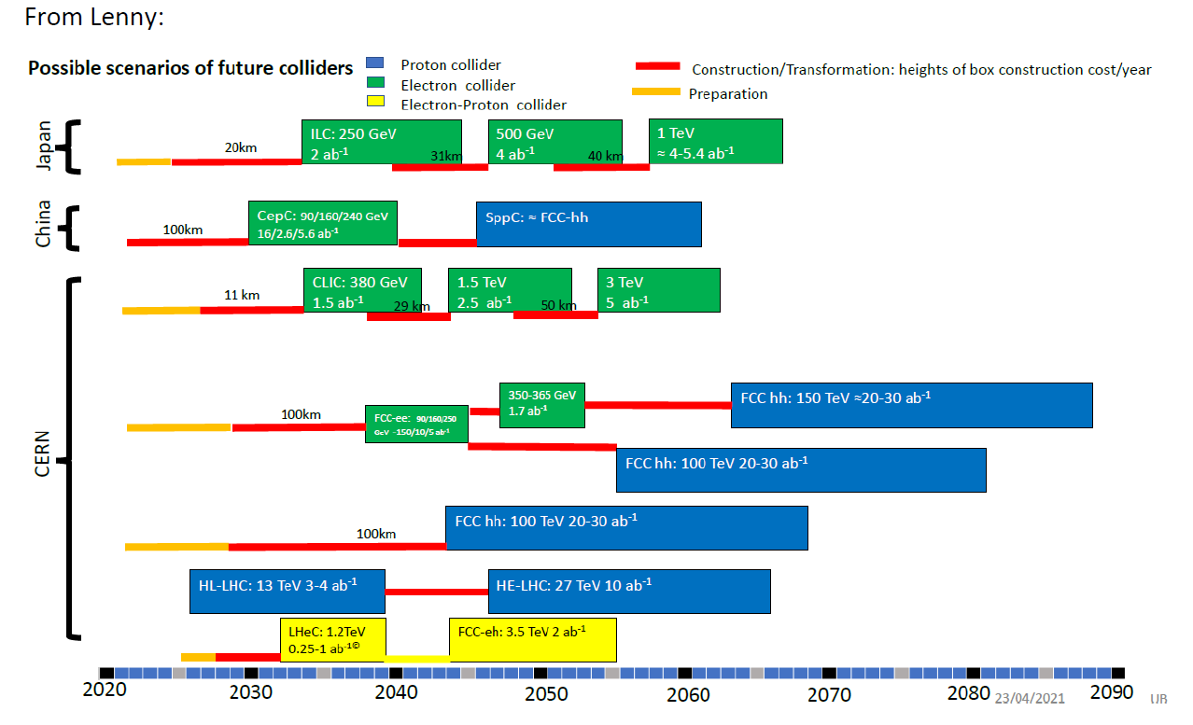
Project schedule from European Strategy for Particle Physics (ESPP)

Slide 5

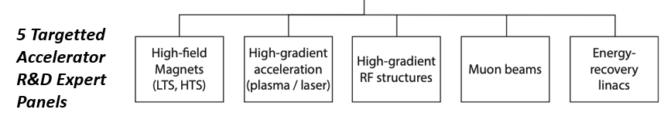
European Planning
Immediate outcome of ESPP → Accelerator R&D Task Forces reporting to Lab Directors Group (LDG) and CERN Council
Address the question of what are the most promising Accelerator R&D activities for HEP
In parallel, CERN is developing FCCee with detailed feasibility study for >100 Meuros
Snowmass AF participants are active on all the LDG panels

Slide 6
Timescales for a Higgs Factory and Assumptions (1/2)
Ignored China as do not know how to evaluate
HL-LHC will operate through 2040
ILC decision must happen ‘soon’ (before ESPPU in 2026, probably well before). If Japan makes a commitment to the pre-lab, they have made a commitment to the collider and the rest of the world will support ILC in some manner. Operation possible before 2040.
CERN will develop ‘feasibility’ study for FCCee for next ESPP (2026).
Planning to invest >100M$ to develop design
Broad support amongst European Lab Directors Group (LDG)
Have MOU with DOE HEP to collaborate on tunnel

Slide 7
Timescales for a Higgs Factory and Assumptions (2/2)
If ILC is not funded, CERN will try to push FCCee as this solidifies their future. FCCee will proceed if support ($ and politics) for the 100 km tunnel can be found.
Decision and funding probably takes two years after EPPS recommendation, e.g. 2028. Operation is possible on 2040 timescale.
US HEP is committed through ~2029 with LBNF/DUNE and will not get ahead of CERN. US will support FCCee if that is chosen.
Muon Collider design has ~2M$ CERN funding plus EU $ to develop CDR for ESPP
Will develop CDR concept along with TDR for demonstration facility
Fabiola has asked for cost estimate of 10 TeV collider presumably to compare with FCChh
If FCCee fails, CLIC and C3 could be next however there would also be an evaluation of a Muon Collider which is perceived to have potential for greater physics reach and lower costs. Timescale to decide between C3/CLIC and MC is 2030.

Slide 8
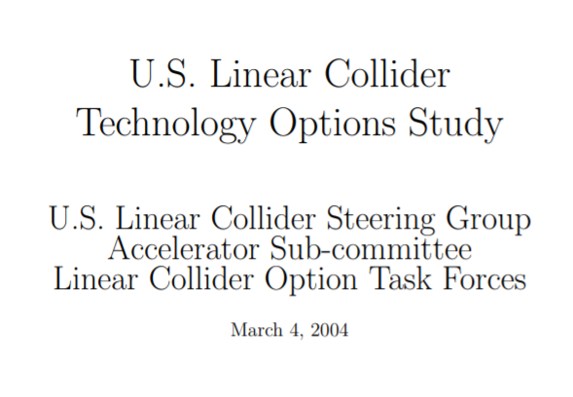
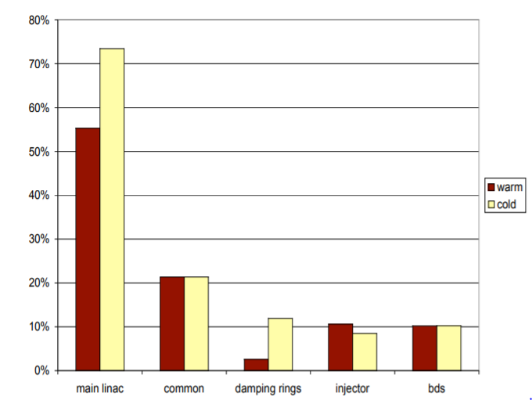
US Warm/Cold Comparison Study
Estimated 25% cost difference due to linac length and damping rings

Slide 9
Cold Copper Collider (C^3) RF Development
Add slide

Slide 10
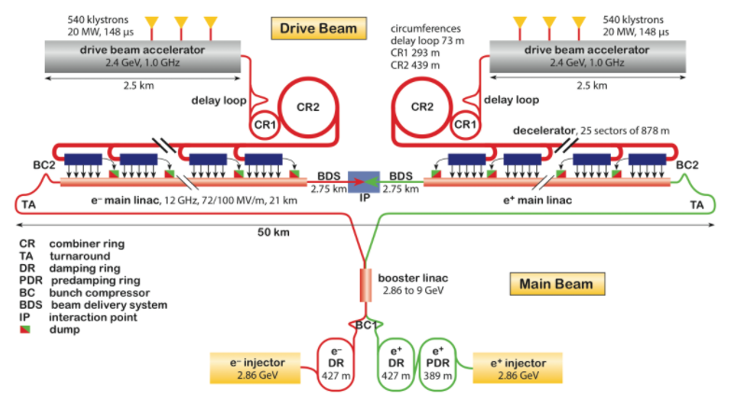
Cold Copper Collider (C^3) Concept (C^4)
Based on new RF system
Reuse CLIC or NLC concepts for Sources, Damping Rings, Bunch Compressor, and FFS
Eliminates the Drive Beam Complex
The “RF Unit” decreases from 1 km to 1 meter so easy to demonstrate and optimize for large scale production

Slide 11
Potential of Cold Copper Collider (C^3) Technology
C^3 is a ‘conventional’ linear collider that can utilize much of what we have learned in developing NLC and ILC. The difference is the RF unit which needs clear demonstration.
C^3 has the potential to reduce the ILC cost by ~50% (TBC) due to lower acceleration costs AND lower injector, damping ring, and bunch compressor costs.
Demonstration of a C^3 RF system could be done as part of an expanded Beam dynamics/RF/Plasma test facility at SLAC that might be funded partly as a test facility and partly as technology development → few GeV linac.
SLAC has lost many of the accelerator systems people that would be needed to develop C^3, FCC, and MC. It is also hard to engage project managers and engineers due to a plethora of projects. Perhaps this is an opportunity to engage additional people.

Slide 12
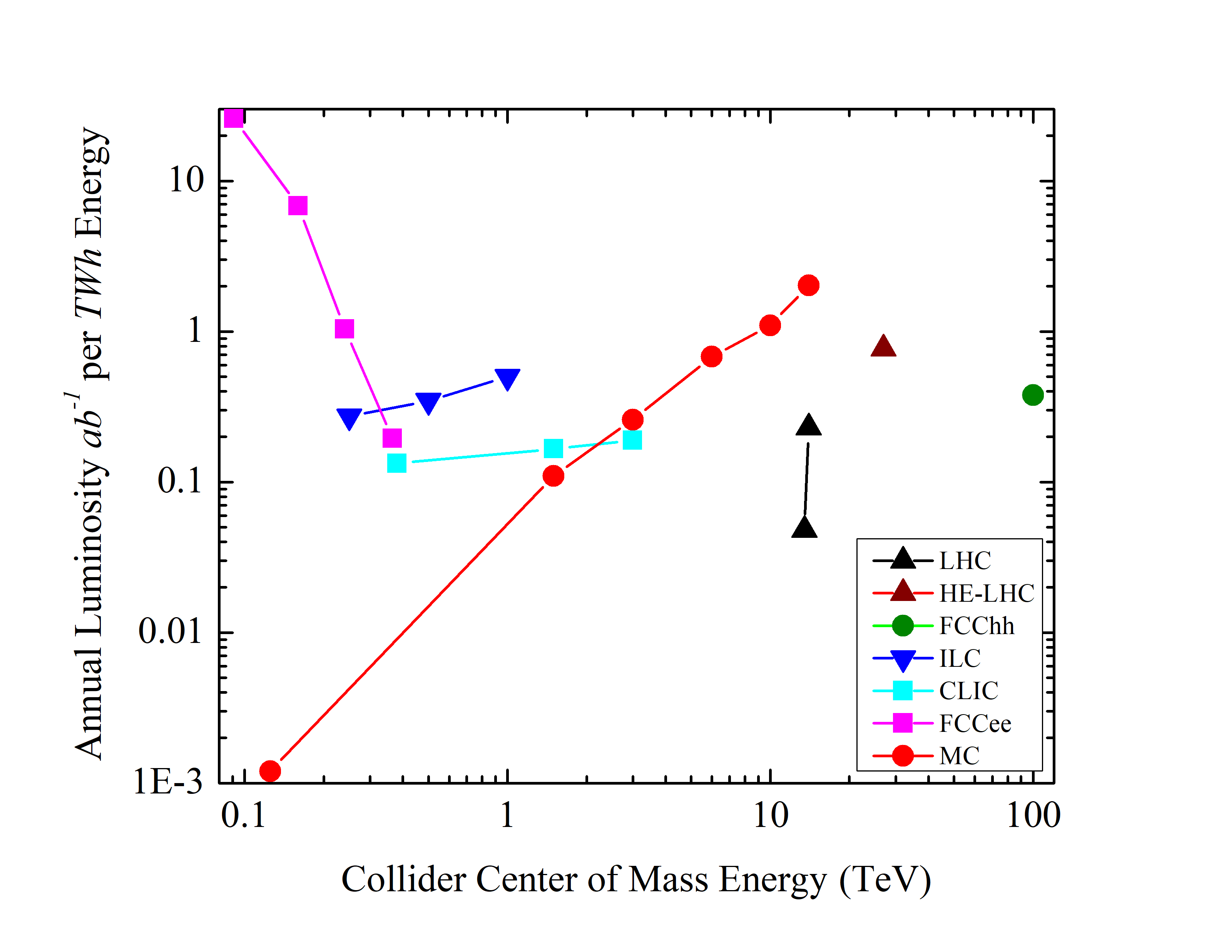
Potential for a Muon Collider

Slide 13
International Muon Collider Design Effort
Comments

Slide 14
What can SLAC do?
Develop CDR and RF test facility for C^3
See comments on previous page
Get involved in FCCee
There are a number of technical and coordination roles that we can fill including optics development, injector development, collimation, beam control, diagnostics, …
Get involved in the MC
Right now there is the perception that the MC provides a cost-effective path to the TeV-scale. The US MAP program did not find any showstoppers for a 1.5 TeV collider and suggested options to enable a 10 TeV MC. The European effort is taking this further with significant engagement from HEP laboratories in Europe and the US
SLAC could contribute to many fundamental beam physics issues, many RF challenges, and many systems level issues

Slide 15
Decision Tree towards a Higgs Factory
ILC Funding 2021-2023
FCC Tunnel possible 2026-2028
Consider C3/CLIC/MC 2028 - 2030
Build ILC; Good for 500 GeV. Decide about TeV-scale: LC, MC, or FCChh later
Build FCCee; decide about TeV-scale later
Select technology based on R&D status and costed design studies. Presumably, low-cost ILC, C^3, CLIC, MC along with γγ options. Ideally, want technology to cover Higgs → Tev-scale.
If we want C^3 to be a consideration, we need to develop a CDR and an RF test facility on the 2028 timescale. In many ways, C^3 much is further along than MC as there is 100’s M$ in test facilities that have demonstrated many essential sub-systems however RF unit needs demo however we also need to illustrate access to TeV-scale and impact of technology.

Slide 16
Plasma Collider
Plasma offers high gradient acceleration but requires very severe tolerances and probably cannot accelerate positrons
2010 PWLC Cost study found linac subsystem was 30% of ILC dominated by drive beam transport system assuming 0$ for plasma accelerators and drive beam dumps. At best, a factor of 2 lower than ILC costs but scales like CLIC.
Plasma could offer path to multi-TeV collisions via very short bunch lengths however short bunch lengths do not benefit Higgs Factory.

Slide 17
SLAC Opportunities on Plasma Collider
Europe LDG is driving a study of PWLC – real focus on applicability to HEP
SLAC will do critical demonstrations as part of FACET-II to hopefully understand:
energy transfer efficiency,
generation of beams with small energy spreads,
emittance preservation.
Maybe positrons but γ−γ option avoids that
Many of these topics could also be studied much less expensively in 3D simulation. Additional studies are needed for “engineering” issues such as tolerances, plasma stability/heating, beam dumps, … Some of these are showstoppers.

Slide 18
Comments on Plasma
At this point, I do not see PWFA/LWFA impacting the path toward a Higgs factory. Many fundamental (potential showstoppers) remain:
Plasma efficiency – how much energy can be extracted
Emittance preservation
Positrons
Polarized sources or matching of external sources
Plasma heating
All of these are listed in the 2009 FACET proposal but remain outstanding.
Most could be addressed with a dedicated simulation effort for a fraction of what has been invested in the US experimental program but then will require demonstration of the challenges.
Cannot see how this any impact on 2030 timescale except, perhaps, as an upgrade path

Slide 19
Summary: What can SLAC do to engage in the next Lepton Collider?
Get involved in FCCee
There are a number of technical and coordination roles that we can fill including optics development, injector development, collimation, beam control, diagnostics, …
Develop CDR and RF test facility for C^3
Well matched to SLAC expertise and will augment program. Test facility is 100M$ scale.
Get involved in the MC
Right now there is the perception that the MC provides a cost-effective path to the TeV-scale. The US MAP program did not find any showstoppers for a 1.5 TeV collider and suggested options to enable a 10 TeV MC. The European effort is taking this further with significant engagement from HEP laboratories in Europe and the US
SLAC could contribute to many fundamental beam physics issues, many RF challenges, and many systems level issues

