Slide 1
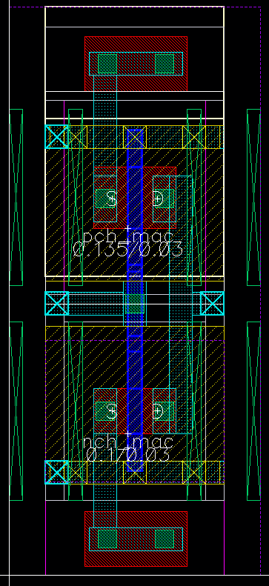
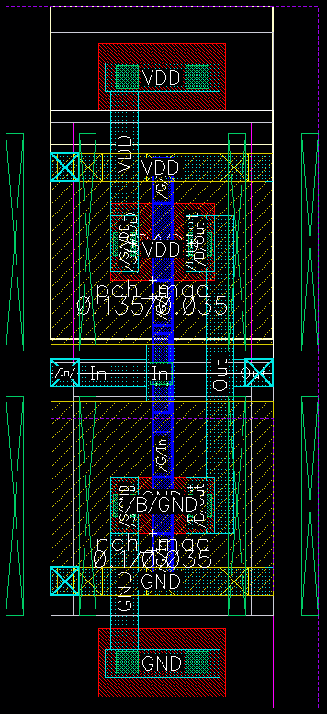
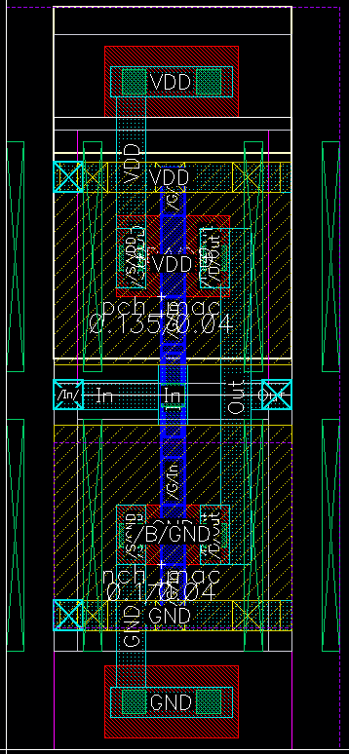
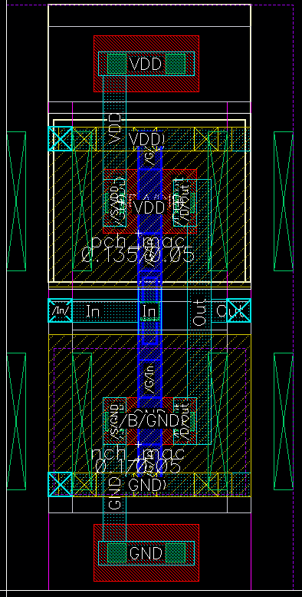
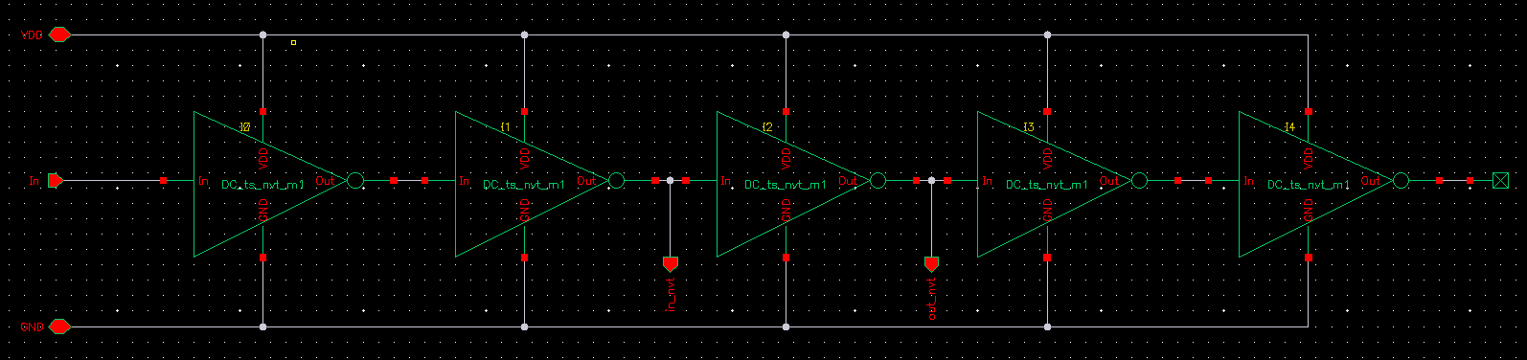
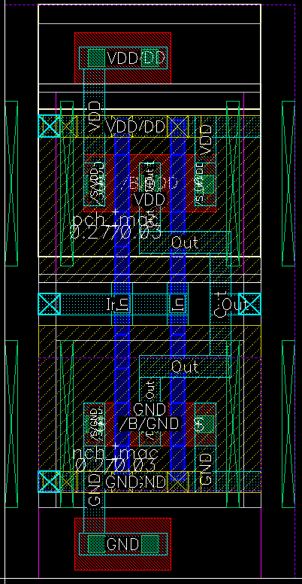
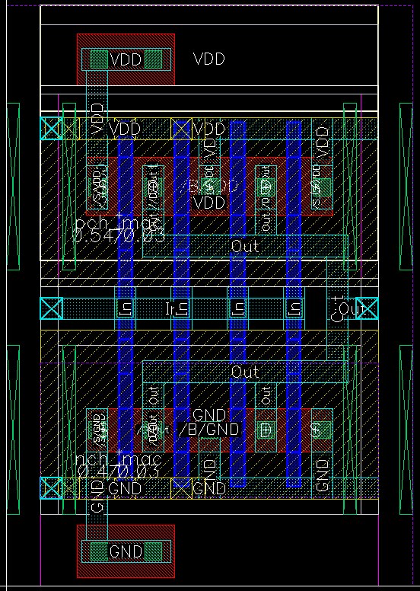
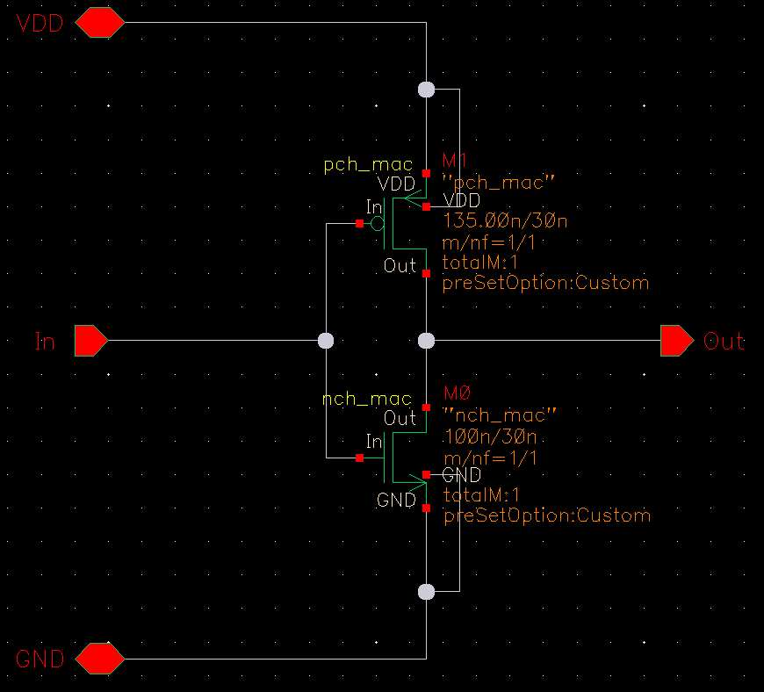
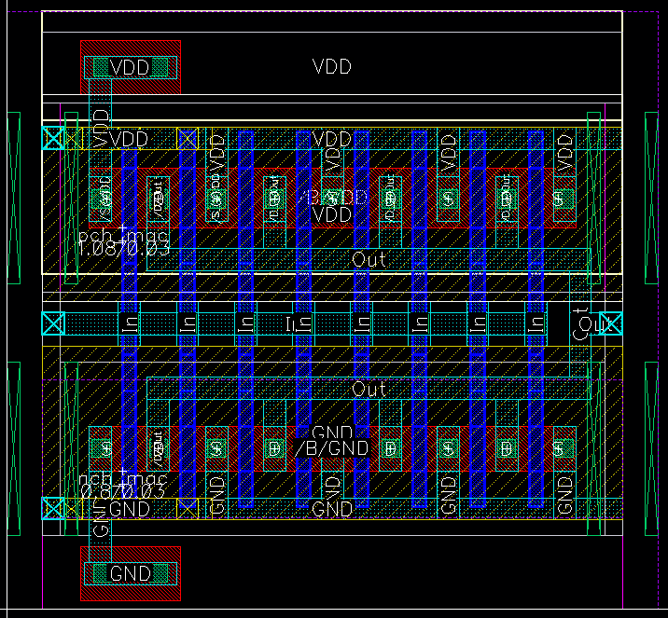

Test Structures
Delay Line Test Structure:
L=30n
L=35n
L=40n
L=50n
Nf=1
$t_{p}$ - Cell Propagation Delay
Nf=2
Nf=4
W=135n
Nf=8
W=100n

Slide 2
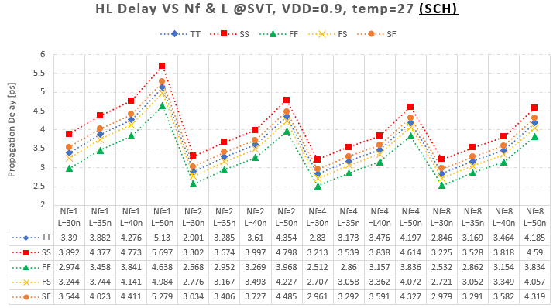
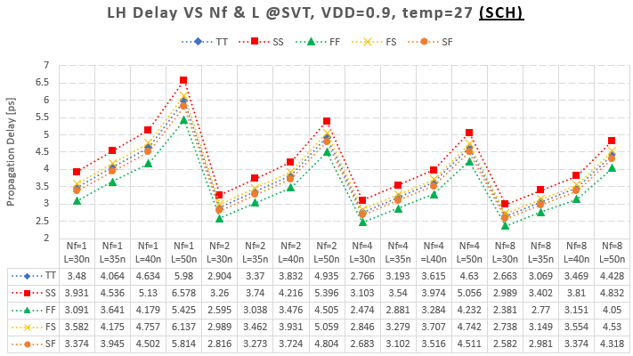
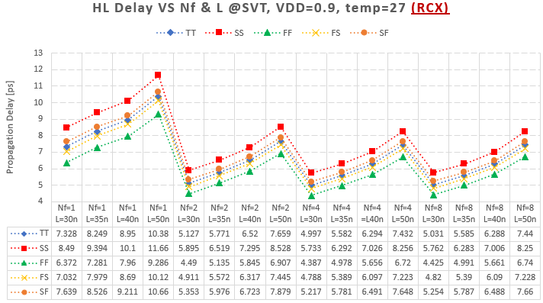
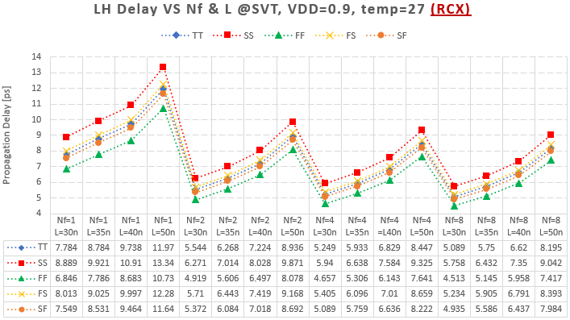


Propagation Delay: HL / LH
50%
50%
$$t_{pHL}$$
50%
50%
$$t_{pLH}$$

Slide 3
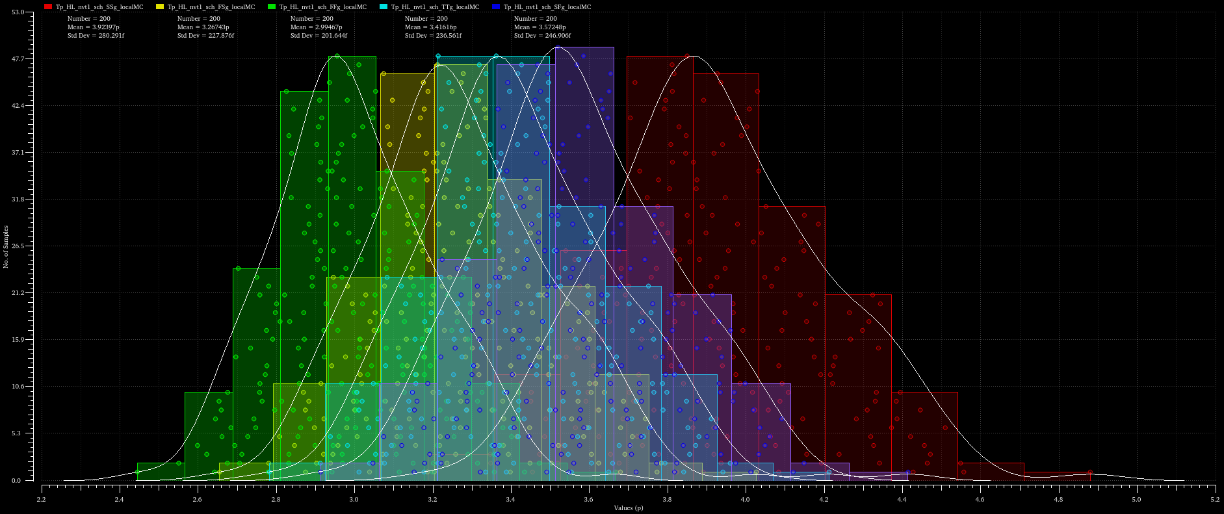





Propagation Delay – Monte Carlo
VT = SVT, Nf = 1, L = 30nm, VDD = 0.9V, temp = 27°C, Edge = HL, View = Schematic
$$σ_{TT}=236.6fs$$
$$σ_{SS}=280.3fs$$
$$σ_{FF}=201.6fs$$
$$σ_{FS}=227.9fs$$
$$σ_{SF}=246.9fs$$

Slide 4
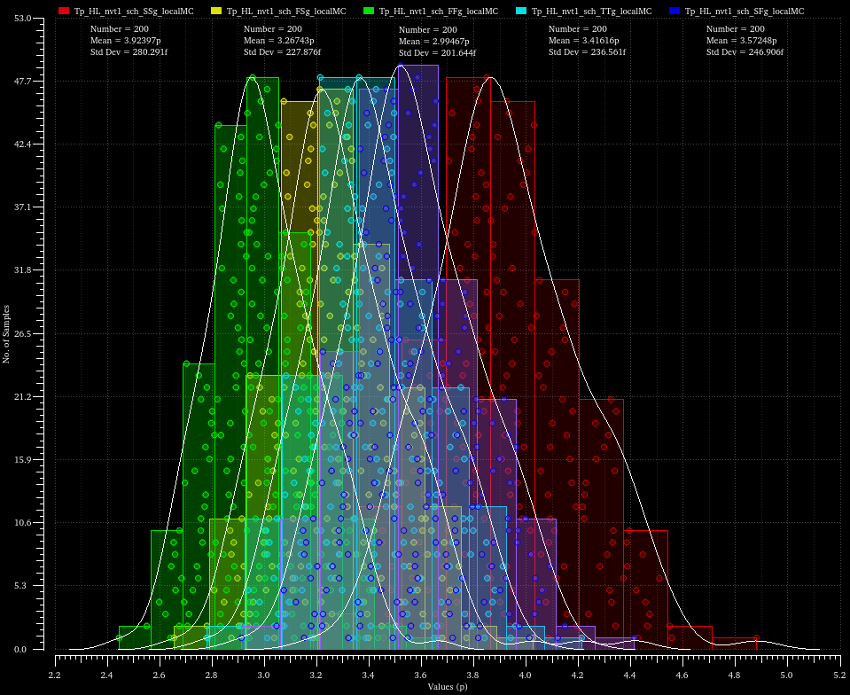
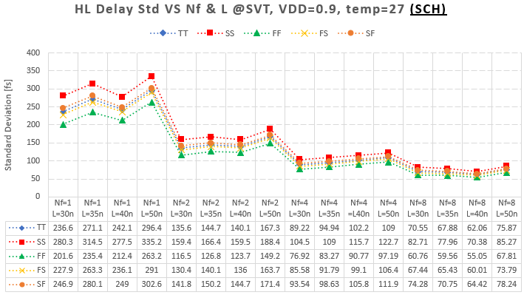
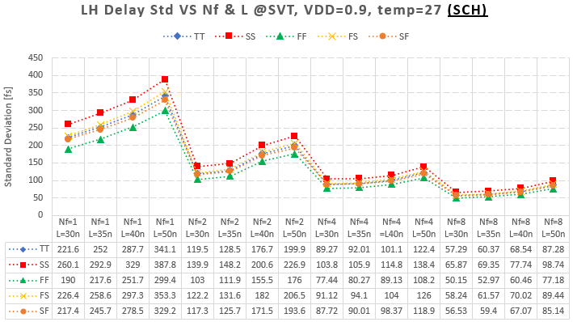
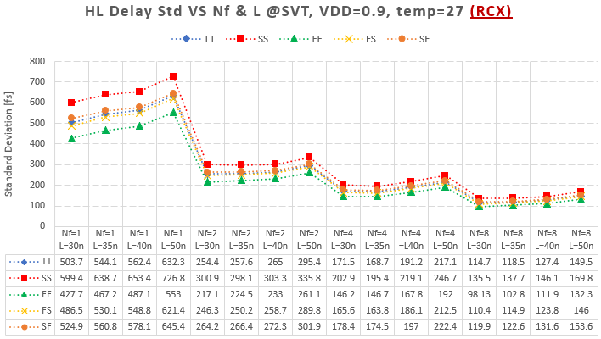
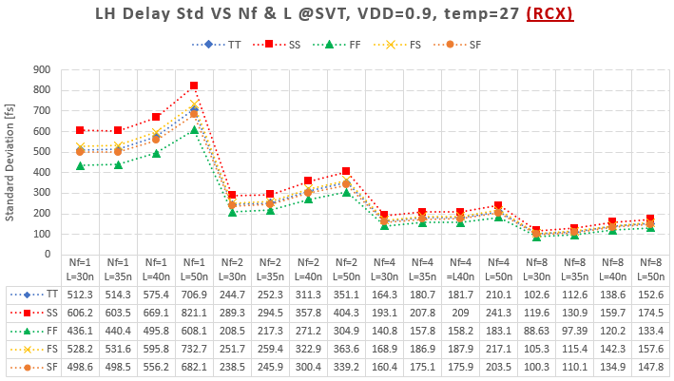

Propagation Delay – Monte Carlo: HL / LH
50%
50%
$$t_{pHL}$$
50%
50%
$$t_{pLH}$$

Slide 5
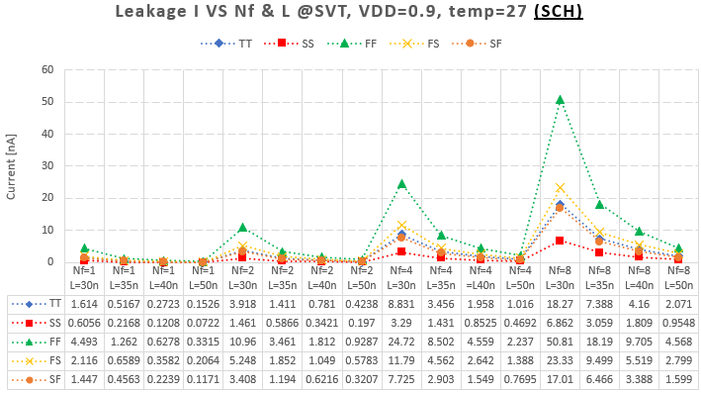
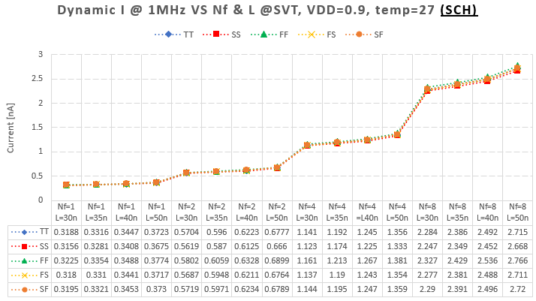
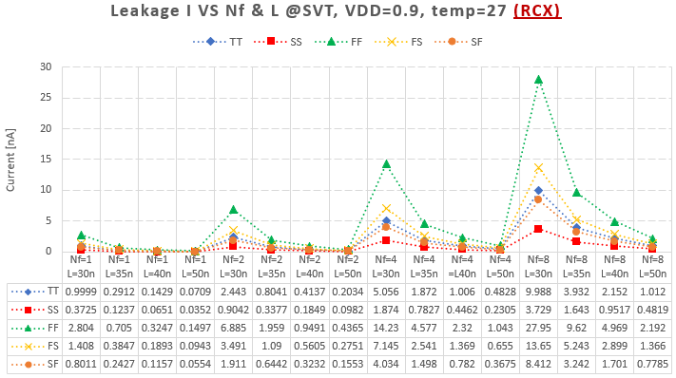
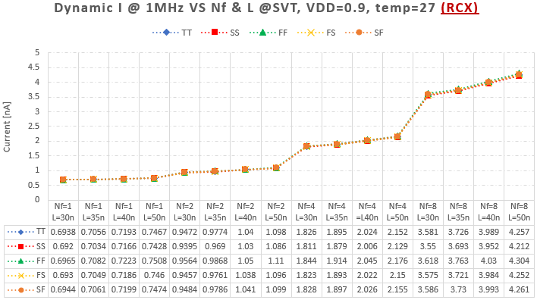
Current Consumption: Leakage / Dynamic@1MHz

Slide 6
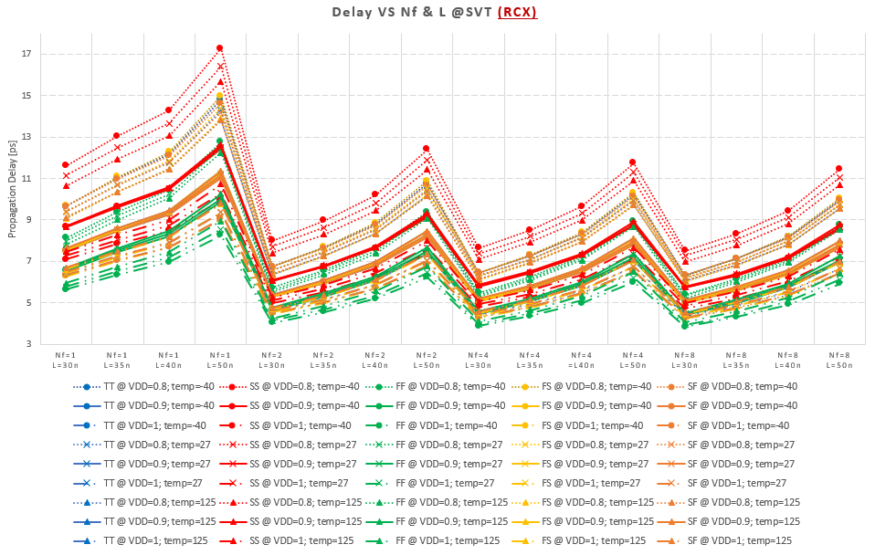

SVT VS corners, VDD, temp
$$t_{p}= \frac{t_{pHL}+t_{pLH}}{2}$$

Slide 7
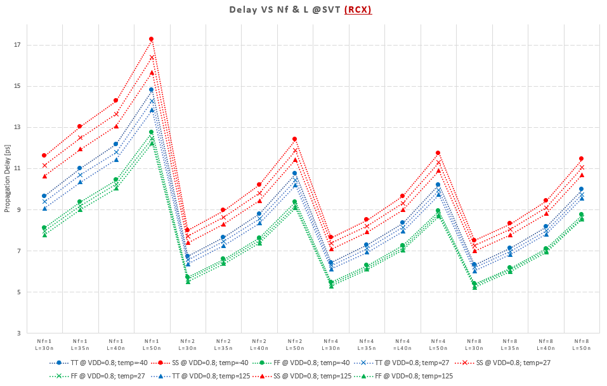
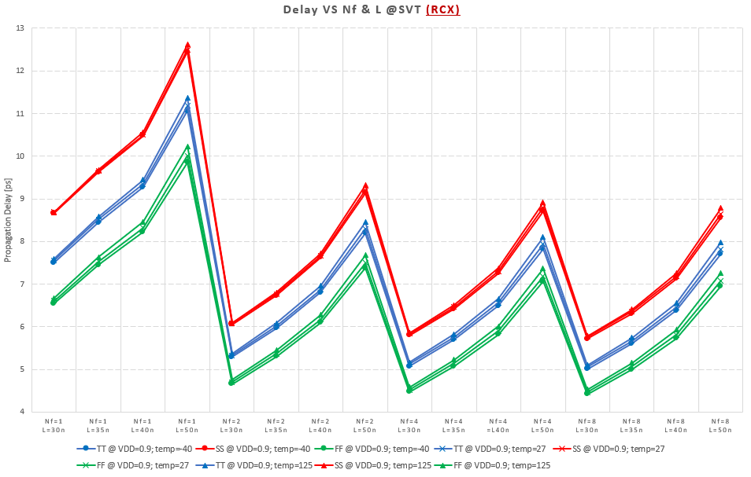
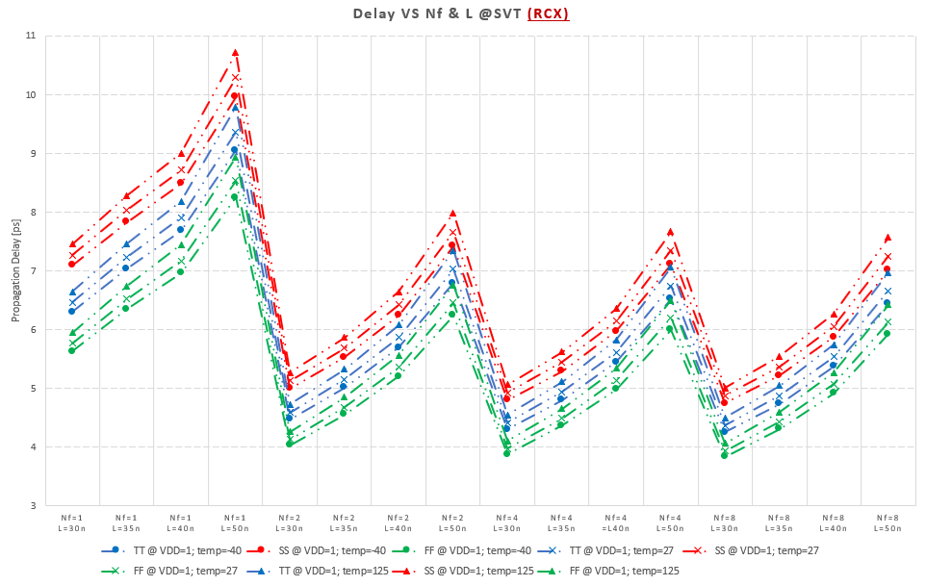
SVT VS corners, VDD, temp
VDD = 0.8V, TT, SS, FF
VDD = 0.9V, TT, SS, FF
FS and SF are nearly identical to TT
Very small delay variation with temperature (especially at VDD=0.9V)
At VDD = 0.8V, the delay is higher for lower temperatures (?)
VDD = 1V, TT, SS, FF

