Slide 1
Roadmap for SLAC participation in a global e+e- collider
Tor Raubenheimer

Slide 2
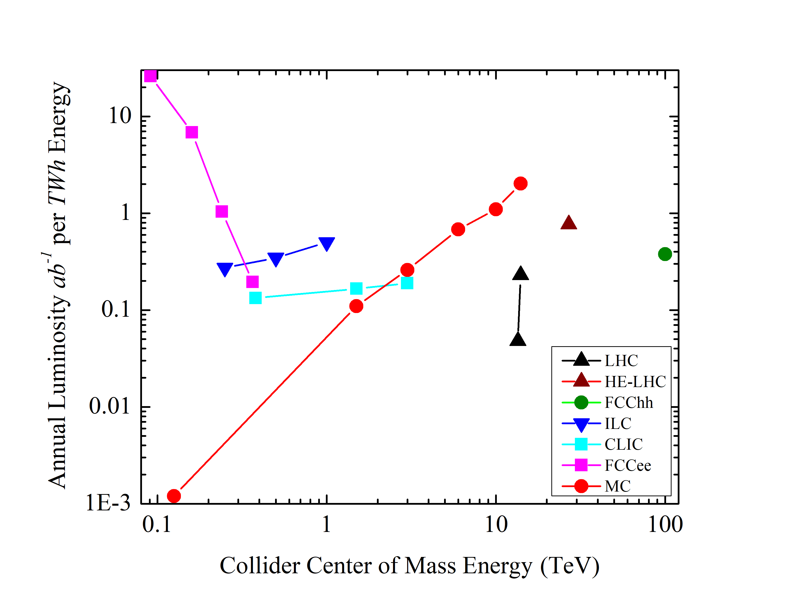
Goal:
Develop a precision
Higgs factory with a
path to higher energy
collisions

Slide 3
Technologies for a e+/e- collider
Conventional Linear Collider (SRF or NCRF)
  ILC is the example; 2035 time-early for physics; CLIC or C3 is a few years latter.
  Technology is probably limited to 1 or possibly a few TeV
γ−γ Linear Collider
  Potential to extend LC to high energy avoiding beamstrahlung;
  Also potential for low energy Higgs factory;
  Significant R&D on lasers, IP, MDI
Plasma Linear Collider
  Unlikely to make sense for Higgs factory; short bunches may allow for multi-TeV collisions
  Requires extensive R&D; positrons are a limitation.
  Cost benefit unclear as it requires most LC subsystems and massive laser/e- drive beam
Storage Ring (FCCee or SPPS)
  Conventional technology and likely to work but expensive
  Provides infrastructure for higher energy hadron collider
Muon collider
  Requires extensive R&D; neutrino radiation is a significant concern
  Potential multi-TeV energy reach due to lack of beamstrahlung and compact size
  Potential for lower costs

Slide 4
Thoughts on Options
ILC is the obvious path although access to energies above 500 GeV are not clear
  Develop upgrade routes to intermediate energies
FCCee provides a powerful Z- and Higgs factory but barely makes it to t-tbar. Of course, the tunnel can be reused for 60-100 TeV p-p collider
  How important is the 500 GeV – few TeV range?
C³ / CLIC provides a cost competitive approach to an LC that probably scales more naturally to 1 TeV
  Likely need other technology to go beyond
γ/γ might provide low-cost path to Higgs but significant technical issues remain
Plasma may provide upgrade path for ‘conventional’ LC but huge technical challenges remain
Muons may provide path to Higgs but more naturally suited to TeV-scale and perhaps multi-TeV facilities and huge technical issues remain

Slide 5

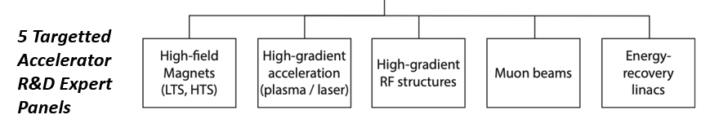
European Planning
Immediate outcome of ESPP → Accelerator R&D
Task Forces reporting to Lab Directors Group
(LDG) and CERN Council
Address the question of what are the most
promising Accelerator R&D activities for HEP
In parallel, CERN is developing FCCee with
detailed feasibility study for few 100 Meuros
Snowmass AF participants are
active on all the LDG panels

Slide 6
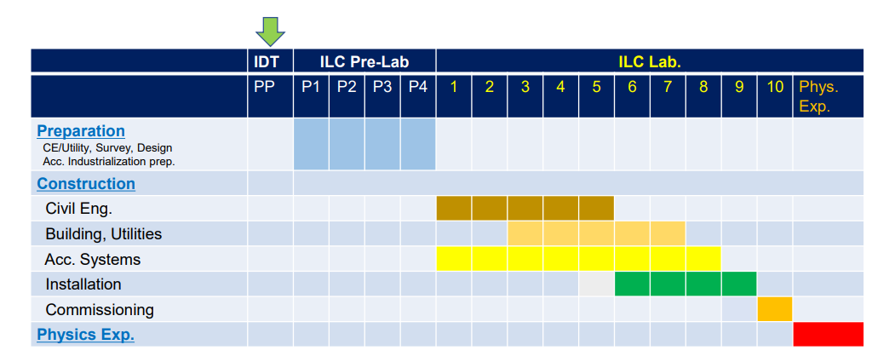
ILC Schedule – collisions 2035 time early
Need Japanese approval to engage global community. ILC Pre-Lab is aimed
at addressing concerns from Japanese government. Cost is a limitation but …

Slide 7
SLAC Opportunities on ILC
SLAC could take significant roles in ILC whether on DR, FFS, or even SRF
  Many of the required resources will be built up by BES although BES may also have other plans such as LCLS-X
  Would require additional engineering and support staff
  Hard to know how the rest of the world will engage
  Unlikely to see engagement without significant contribution from Japan
I don’t think there is much to do until we see commitment from Japan

Slide 8
Cold Copper Collider (C³)
Concept that could reduce ILC cost by replacing RF system and taking advantage of pulse structure for less costly subsystems
→ 30 to 50% cost savings could be possible
SLAC can take a leading role by:
  Technology demonstration (for Snowmass?)
  ZDR for concept with cost scaled from ILC and CLIC
Big efforts but hard to see how community could take seriously without

Slide 9
XCC or Sapphire
XCC is a γ−γ version of C3. Roughly ½ cms energy for further cost reduction. Might fit on SLAC site. Requires R&D for high power FEL, IP, and MDI.
Like C³ SLAC would need to take a leading role in the linac technology and the FEL.
Sapphire is a γ−γ collider based on recirculating linac. Many of the same challenges plus high current SRF system.

Slide 10
Plasma Collider
Plasma offers high gradient acceleration but requires very severe tolerances and probably cannot accelerate positrons
2010 PWLC Cost study found linac subsystem was 30% of ILC dominated by drive beam transport system – assumed 0$ for plasma accelerators and drive beam dumps
Plasma could offer path to multi-TeV collisions via very short bunch lengths. Short bunch lengths do not benefit Higgs Factory.

Slide 11
SLAC Opportunities on Plasma Collider
Europe LDG is driving a study of PWLC – real focus on applicability to HEP
SLAC will do critical demonstrations as part of FACET-II to hopefully understand:
  energy transfer efficiency,
  generation of beams with small energy spreads,
  emittance preservation.
  Maybe positrons but γ−γ option avoids that
Many of these topics could also be studied much less expensively in 3D simulation. Additional studies are needed for “engineering” issues such as tolerances, plasma stability/heating, beam dumps, …

Slide 12
FCCee
The US has an MOU to contribute to the design.
SLAC can contribute to development but no leading role
  Overall coordination; beam optics; collective effects; injector
CERN is trying to engage US community in developing an quasi-FDR for the next European Strategy mtg
  CERN seems very committed to exploring this option
The timescale is thought similar to ILC but $$$.
I think the risk is lower than ILC and the luminosity at low energy is higher

Slide 13
Muon Collider
Lots of progress toward a Muon Collider study
  International MC Collaboration has 300+ people now
  US MC Forum has ~100 people
Europe LDG is driving a study of Muon Collider along with Plasma and other technologies
Many opportunities for SLAC engagement:
  Lots of NCRF systems → SLAC expertise
  Challenging MDI → Opportunities
  Detector ??

