Slide 1
4D Detectors
Bojan Markovic, Angelo Dragone
04/14/2021

Slide 2
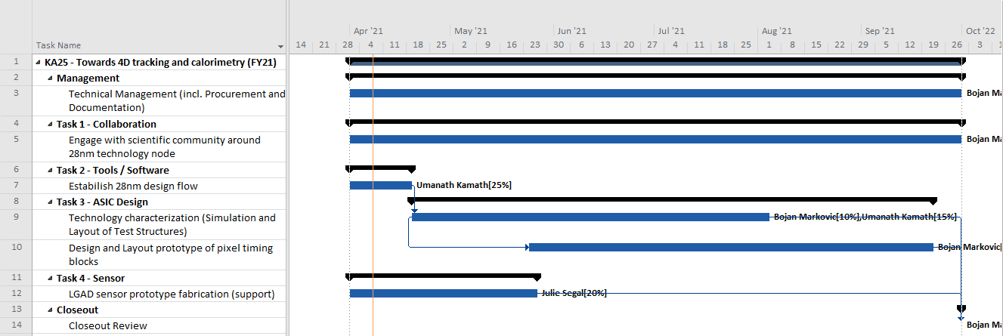
KA25 - Timeline
FY21 Target Dates:
  Start of April: Project Started
  Second half of April: 28nm design flow established
  June: Preliminary study and evaluation of technology timing properties
  End of May / June: Start of design of prototype pixel timing blocks
  September: Pixel timing block preliminary design ready
  LGAD sensor prototype fabrication completed

Slide 3
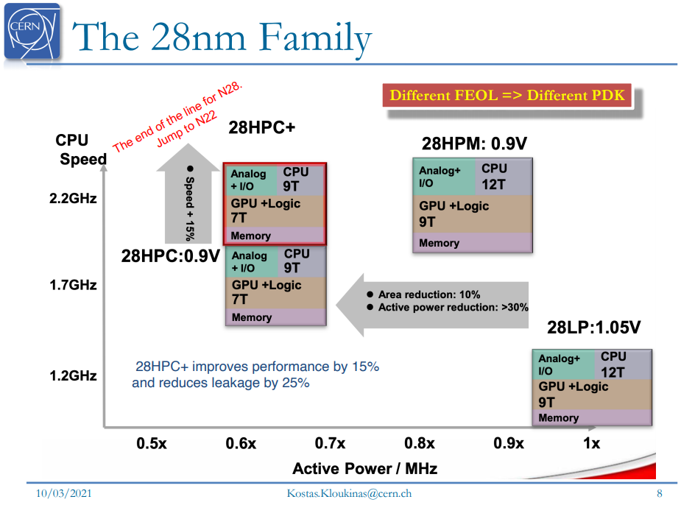
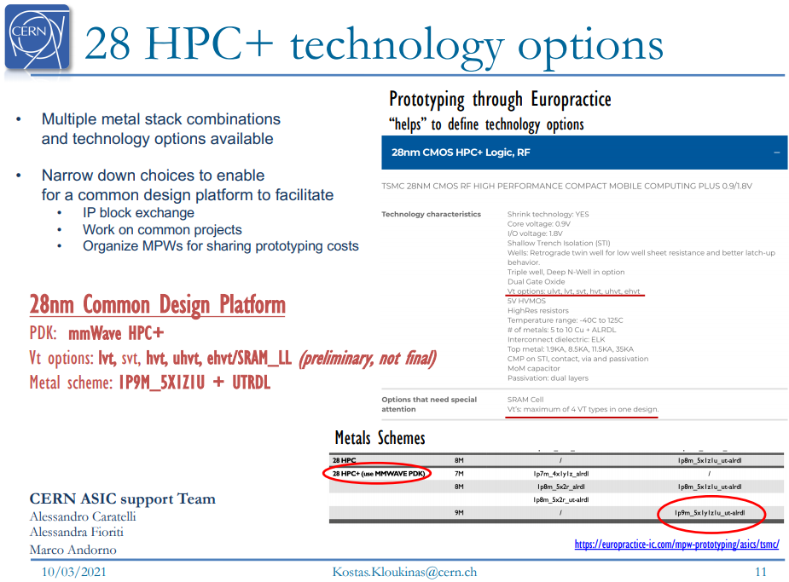
28nm CMOS - Technology Options
Kostas Kloukinas, CERN

Slide 4
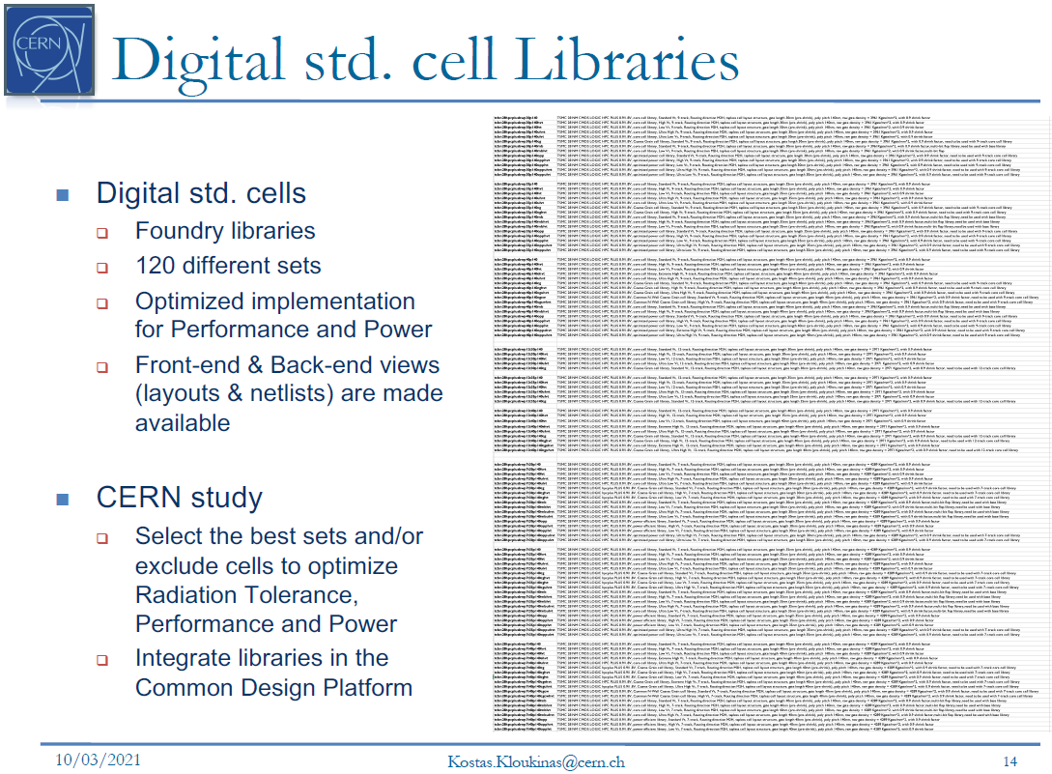
TSMC 28nm HPC+

Slide 5
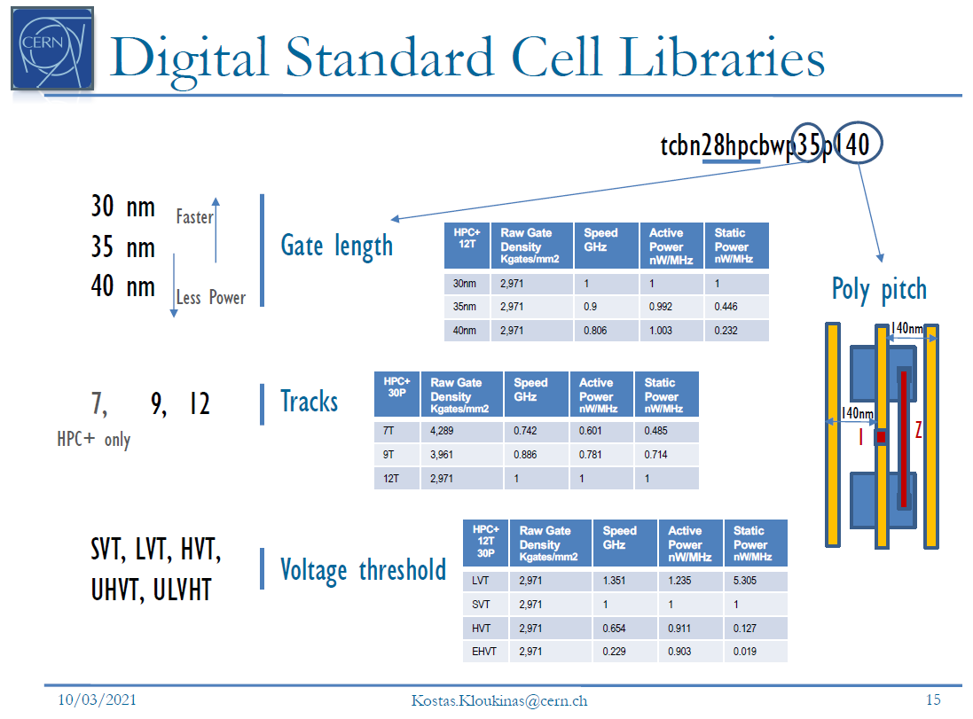
TSMC 28nm HPC+

Slide 6
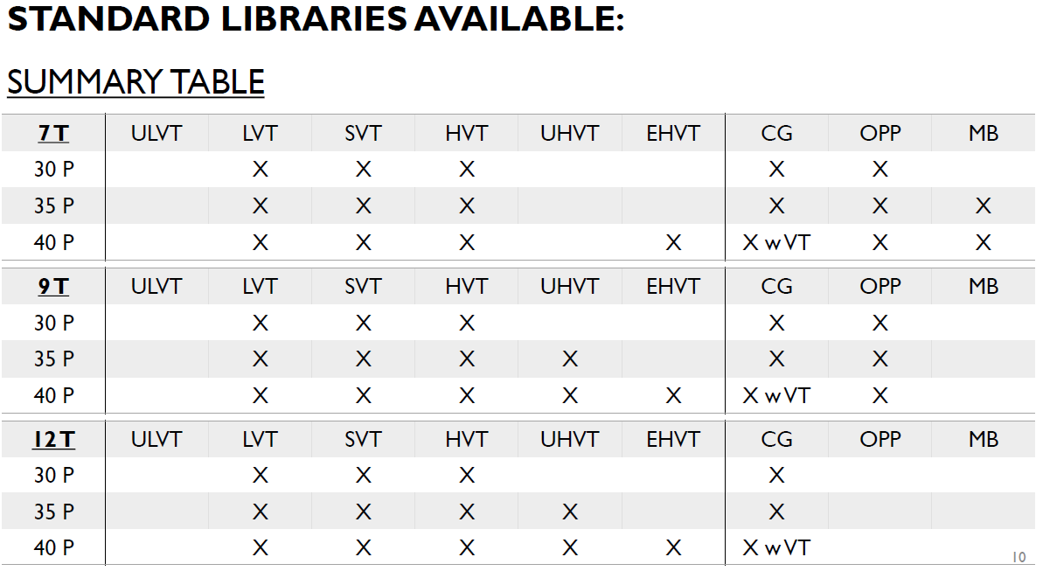
TSMC 28nm HPC+
15 libraries chosen
(220GB packed; 786GB on disk)

