Slide 1
Time-resolved Resonant Inelastic Soft X-ray Scattering for Dynamics in Functional Materials
Kristjan Kunnus
PULSE Institute
SLAC National Accelerator Laboratory &
Stanford University
Panofsky seminar, 21.02.2019

Slide 2
Outline
Excited states dynamics in metal complexes and X-ray spectroscopy to track electrons in molecules
What are the forces governing the dynamics of electrons –potential of Resonant Inelastic X-ray Scattering (RIXS)
Opportunities of time-resolved RIXS at SLAC

Slide 3
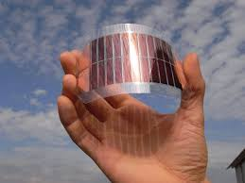
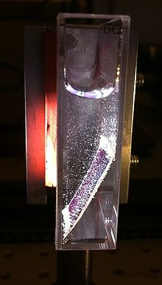
Motivation: harnessing solar energy
Functional materials can be used to convert solar energy to electricity and chemical fuels.
Light to electricity
Light to fuels
Dye-sensitized solar cell
Photocatalysis
Hydrogen evolution
from Canton, et al. J. Phys. Chem. Lett.4, 1972 (2013).
Challenge: How to design materials that can efficiently capture, transform and utilize solar energy?
Notes:
Sun is a infinite source of energy and converting that energy to usable forms is very desirable.

Slide 4

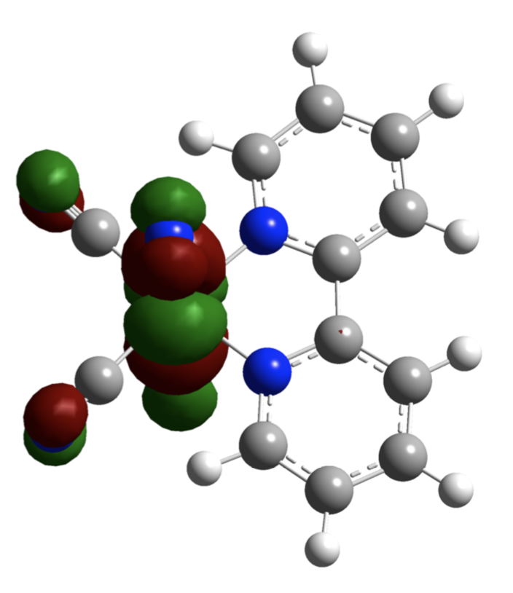
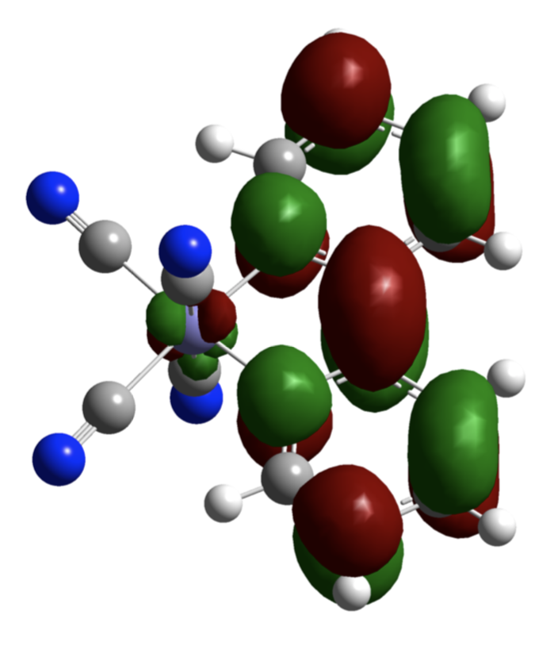
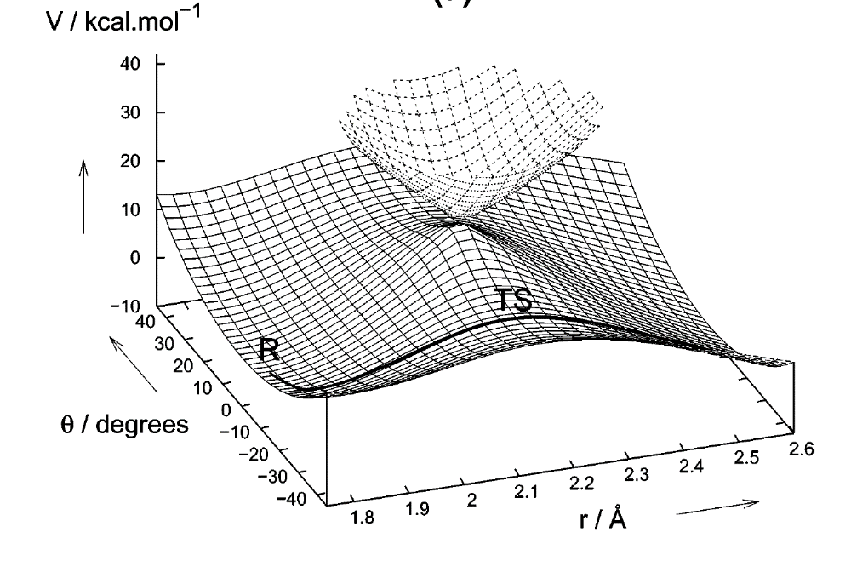


Photoinduced processes are governed by electronic excited states dynamics
Light interacts with electrons – electronic excited states.
h$υ$
Light absorption redistributes electrons.
Excited state dynamics.
h$υ$
Electron transfer
Distribution of electrons determines chemical properties.
Different from ground state chemistry –
dynamics between electronic states.
Scientific challenge: Understanding and controlling excited states dynamics.

Slide 5
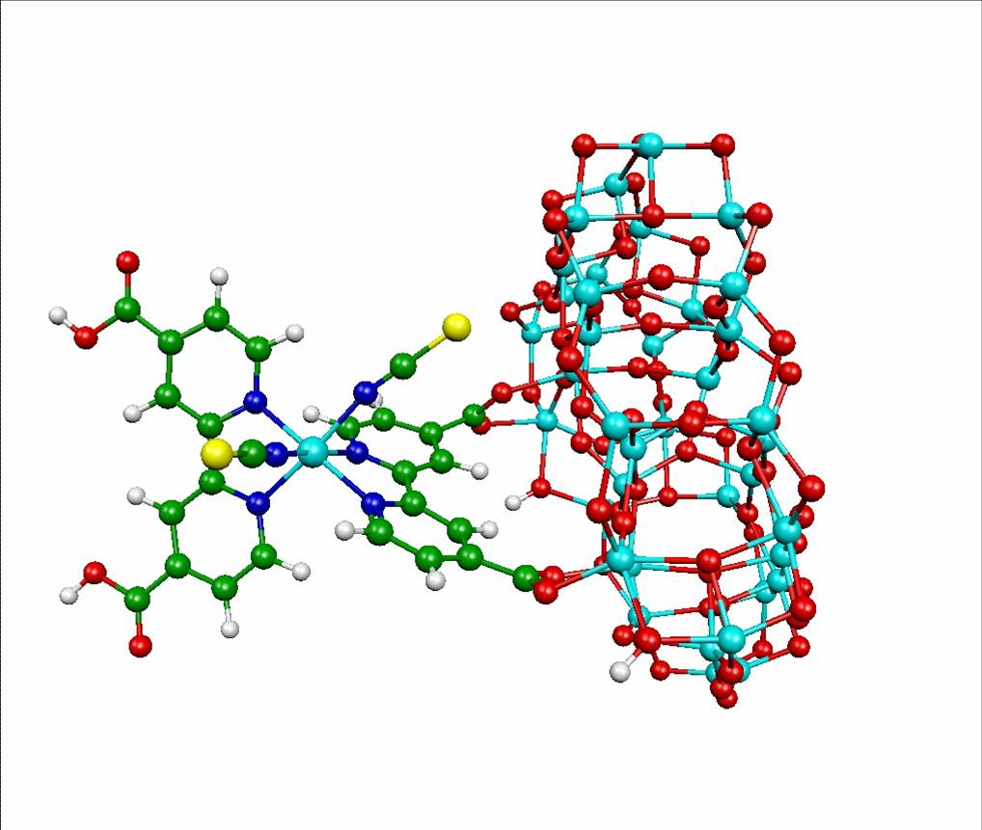
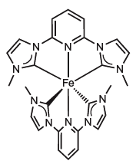
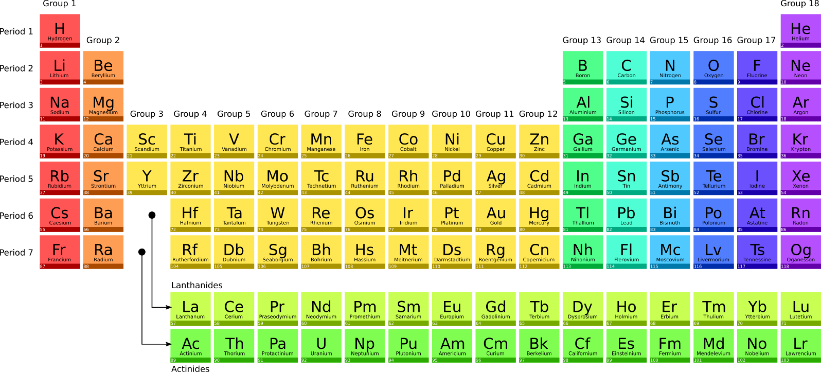
Transition metal complexes as photosensitizers
Photosensitizer complex – molecular unit capable to absorb light and subsequently donate or accept electrons.
e⁻
Good light absorber.
Transition metal complexes:
Metal center
organic ligands
d-block metals
Organic
ligand

Slide 6
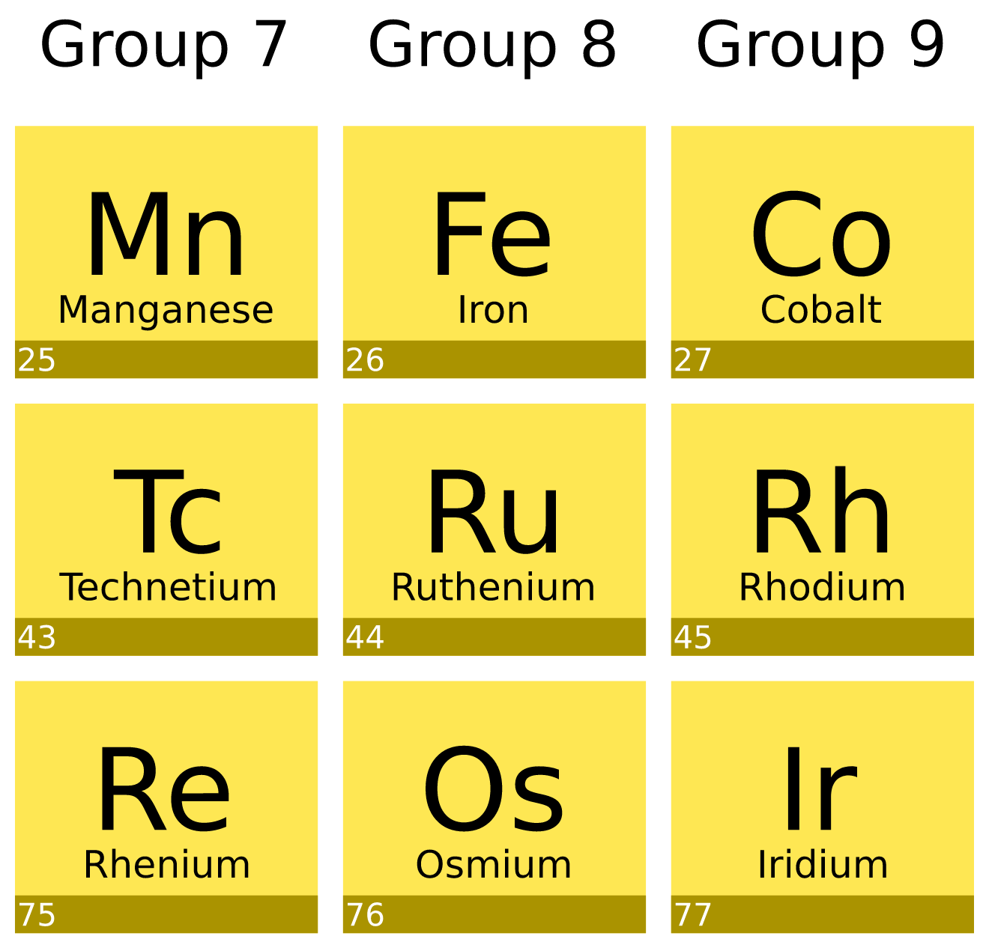
Making photosensitizers inexpensive
Conventional Ru-based molecular photosensitizers are efficient, but expensive.
pyridine
[Fe(bmip)₂]²⁺
bmip = 2,6-bis(3-methyl-imidazole-1-ylidine)-pyridine
carbene
What happens when this molecule absorbs light?
Could one use inexpensive 3d transition metals, e.g. Fe?
Liu et al., Chem. Commun., 49, 6412 (2013)
Harlang et al., Nat. Chem. 7, 883 (2015)
Chabera et al., Nature 543, 695 (2017)
Chabera et al., J. Phys. Chem. Lett. 9, 459–463 (2018)
Kjaer et al., Science 363, 249–253 (2019)
Notes:
strong ligand field, optical data

Slide 7
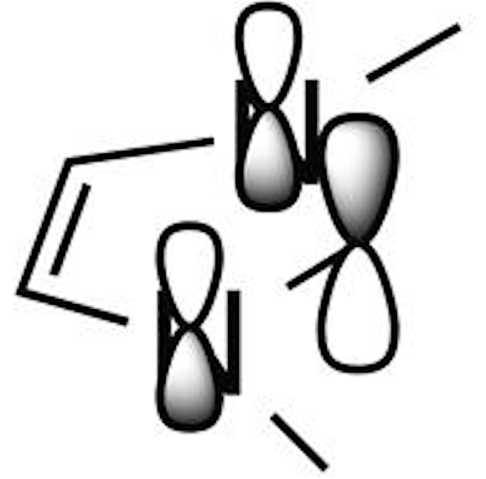


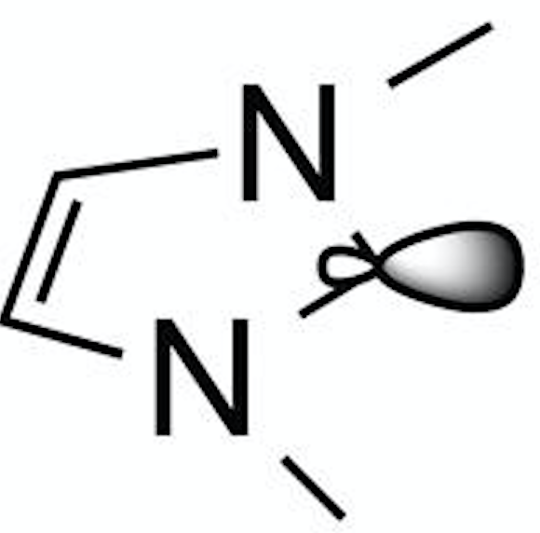
Electronic structure of transition metal complexes
Valence orbital structure of a metal complex
Ligand
unocc.
Fe 3d-shell
Ligand
occ.
Interaction of metal and ligand orbitals – covalent mixing.

Slide 8
Electronic structure of transition metal complexes
Valence orbital structure of a metal complex
Ligand
unocc.
Metal-centered (MC) states
Fe 3d-shell
Low energy
Optically dark
Not redox active
Ligand
occ.
Interaction of metal and ligand orbitals – covalent mixing.

Slide 9
Electronic structure of transition metal complexes
Valence orbital structure of a metal complex
Ligand
unocc.
Metal-to-ligand charge-transfer (MLCT) states
Fe 3d-shell
Higher energy
Optically bright
Redox active
Ligand
occ.
Interaction of metal and ligand orbitals – covalent mixing.

Slide 10
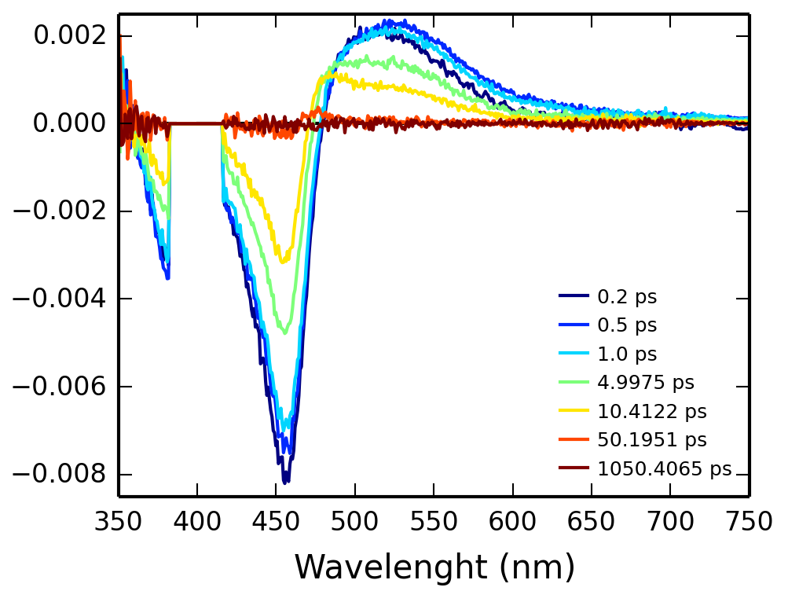
Excited state dynamics in transition metal complexes
MLCT
MLCT population dynamics?
Role of MC excited states?
Time scales?
?
MC
400 nm
?
UV/vis transient absorption experiments inconclusive:
ground state recovery with 10 ps.
?
Ground state
Data: T. Harlang

Slide 11
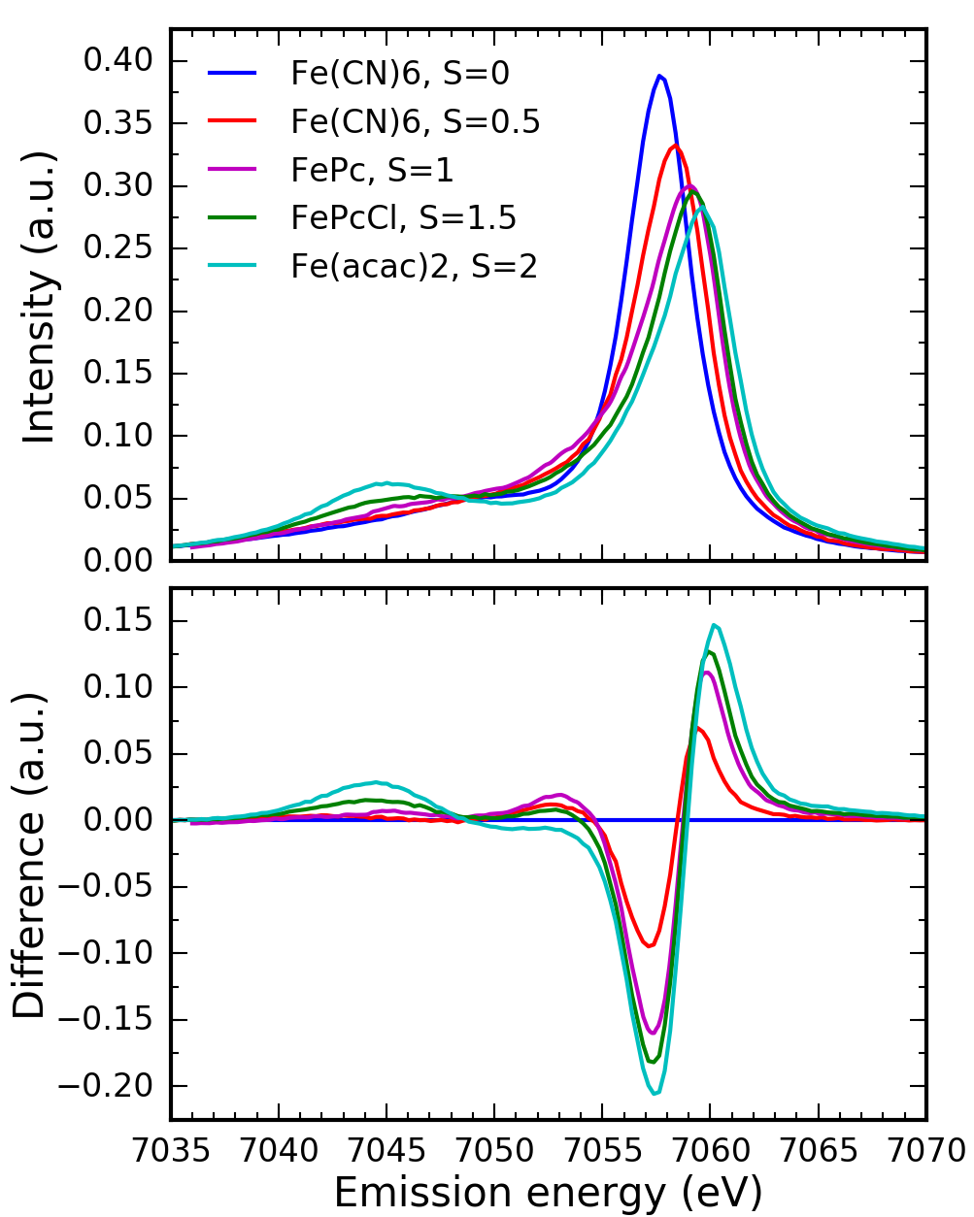
Measuring excited state populations with hard X-ray emission spectroscopy (XES)
Fe 3d
Fe Kβ_{1,3} XES
Fe 3p
Fe 2p
Ground state
Kβ_{1,3}
MLCT
Kα
MC
Fe 1s
Kα and Kβ XES is sensitive to occupation of Fe 3d orbitals.
Peng et al., J. Am. Chem. Soc 116, 2914 – 2920 (1994).
Glatzel, Bergmann, Coord. Chem. Rev. 249, 65 – 95 (2005).
Vanko et al., J. Phys. Chem. B 110, 11647 – 11653 (2006).

Slide 12
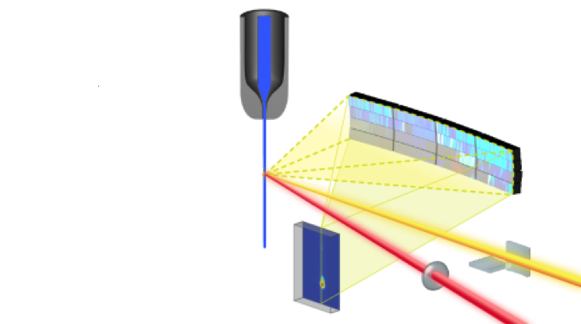
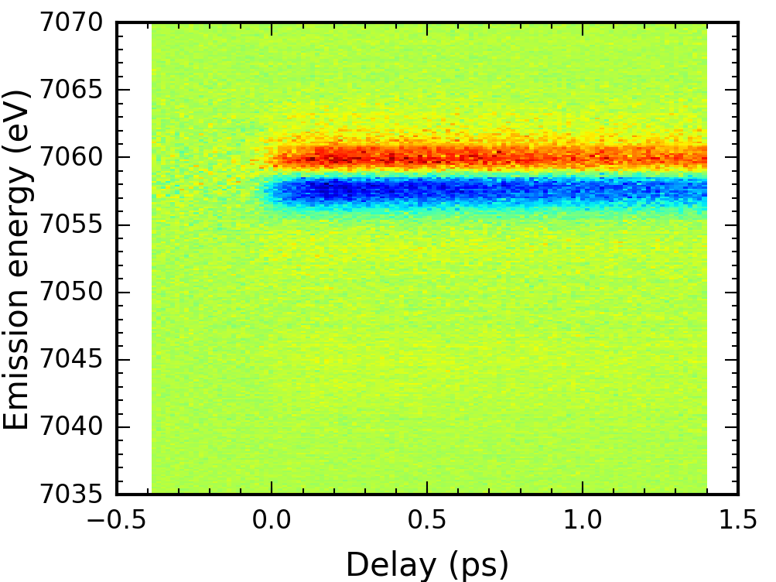
Tracking population dynamics with X-ray spectroscopy
Pump-probe XES at the XPP/XCS beamline at the LCLS:
Fe Kβ XES
X-ray
8.5 keV
Fe Kβ XES
laser
400 nm
Fe Kα XES
Alonso-Mori et al. Rev. Sci. Instrum. 83, 073114 (2012)

Slide 13
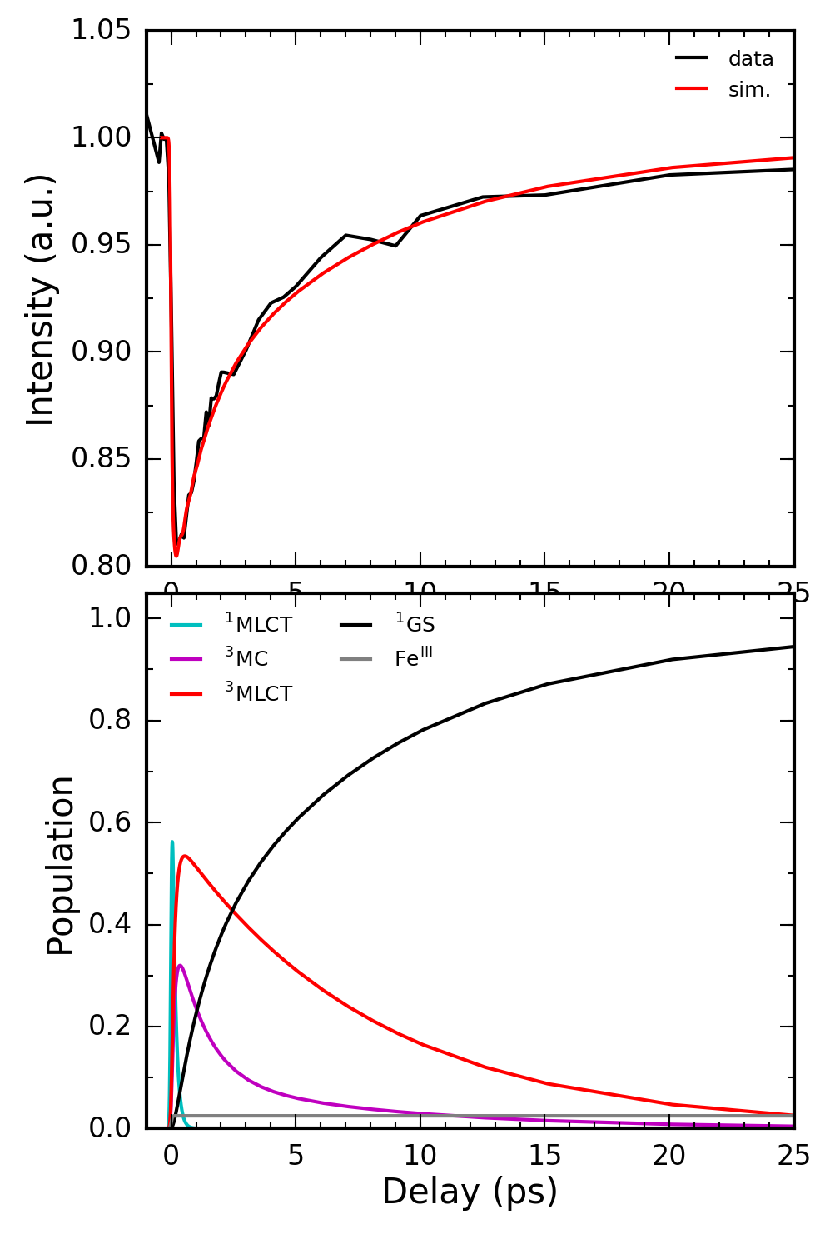
Kβ XES results – population dynamics
MLCT
130 fs
40%
Kβ XES
7056.0 eV –
7058.5 eV
8 ps
60%
MC
400 nm
1.2 ps
Ground state
We have determined what happens, but can we answer why?

Slide 14
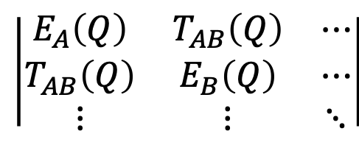
What determines transitions between electronic states in molecules?
Hamiltonian: what are the energies and the couplings between the relevant electronic states?
$$\left|\begin{matrix}E_{A}\left(Q\right) & T_{AB}\left(Q\right) & ⋯ \\ T_{AB}\left(Q\right) & E_{B}\left(Q\right) & ⋯ \\ ⋮ & ⋮ & ⋱\end{matrix}\right|$$
A
B
A
T_{AB}
B
Q – nuclear coordinates (bond lengths, angles)

Slide 15
Resonant Inelastic X-ray Scattering
Valence orbitals
Final states:
Valence excited states!
Small lifetime broadening.
A
~1 eV
B
RIXS
E_{transfer} = ħω_{in}-ħω_{out}
Core orbitals
Intermediate states:
Core-excited states
Element specific
Local
100 –
1000 eV

Slide 16
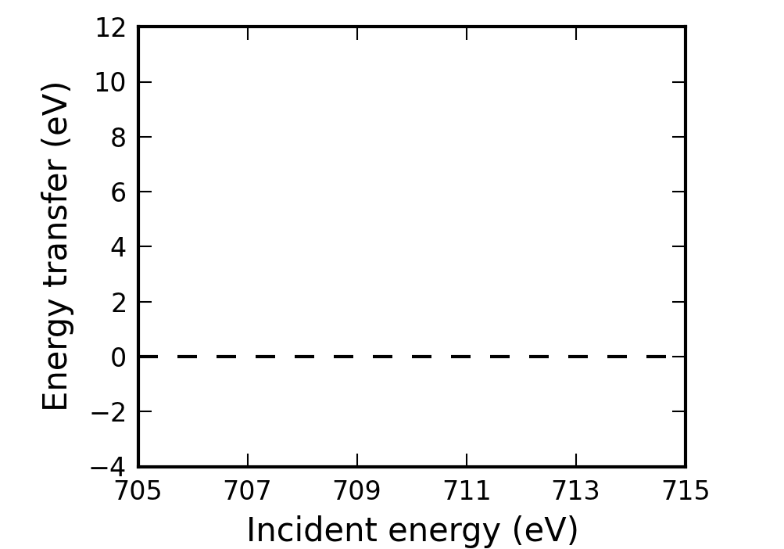
Metal L-edge RIXS of coordination complexes – probing MC states and ligand field
Fe 2p3d RIXS:
Fe 3d
Fe 3d
MC
Fe 3d
Fe 3d-shell
Ligand field
E_{transfer} =
ħω_{in}-ħω_{out}
Direct probing of MC states
MC states energies dependent of ligand field (coordination) and 3d electron-electron interactions
MC states optically dark!
Dipole allowed:
2p -> 3d
Fe 2p

Slide 17
Metal L-edge RIXS of coordination complexes – probing LMCT states and donation
Fe 2p3d RIXS:
Fe 3d
L occ.
LMCT
Fe 3d
MC
Fe 3d
Fe 3d-shell
E_{transfer} =
ħω_{in}-ħω_{out}
Ligand
occ.
Direct probing of LMCT states
Covalent interaction between Fe and occupied ligand orbitals (donation)
Fe 2p

Slide 18
Metal L-edge RIXS of coordination complexes – probing MLCT states and back-donation
Fe 2p3d RIXS:
L unocc.
Fe 3d
LC
Ligand
unocc.
L occ.
LMCT
MLCT
Fe 3d
MC
Fe 3d
Fe 3d-shell
E_{transfer} =
ħω_{in}-ħω_{out}
Ligand
occ.
Direct probing of MLCT and LC states
Covalent interaction between Fe and unoccupied ligand orbitals (back-donation)
Fe 2p

Slide 19
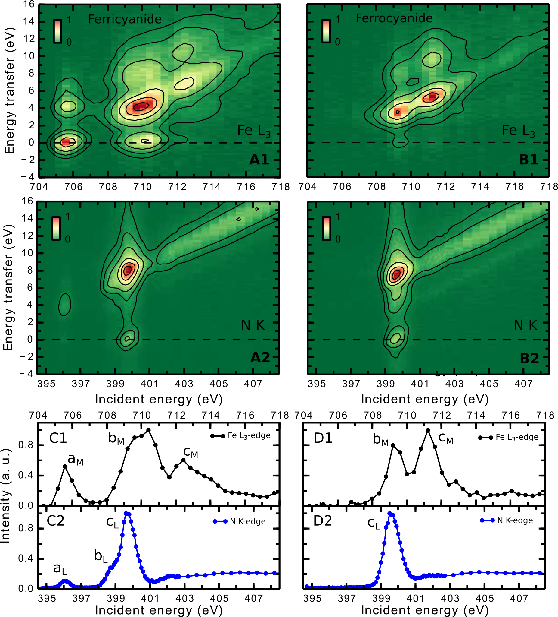
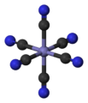
Metal L-edge RIXS studies of coordination complexes: [Fe(CN)₆]^{3-/4-} in water
[Fe(CN)₆]^{3-/4-} aqueous solution:
Fe L-edge and N K-edge RIXS: probing covalency in different oxidation states.
Fe³⁺ 3d⁵
Fe²⁺ 3d⁶
Kunnus et al., J. Phys. Chem. B 120, 7182 (2016)

Slide 20
Time-resolved RIXS – probing electronic couplings responsible for electron transfer
Fe 2p3d RIXS:
L unocc.
Fe 3d
L occ.
Ligand
unocc.
Fe 3d
Fe 3d
L unocc.
Fe 3d-shell
Ligand
occ.
Fe 2p

Slide 21
Time-resolved RIXS – probing electronic couplings responsible for electron transfer
Fe 2p3d RIXS:
L unocc.
Fe 3d
L occ.
Ligand
unocc.
Fe 3d
Fe 3d
L unocc.
Fe 3d-shell
Ligand
occ.
MLCT excitation creates hole at the metal
New XAS resonance
Fe 2p

Slide 22
Time-resolved RIXS – probing electronic couplings responsible for electron transfer
Fe 2p3d RIXS:
L unocc.
Fe 3d
L occ.
Ligand
unocc.
Fe 3d
Fe 3d
L unocc.
Fe 3d-shell
Ligand
occ.
Mixing of electron at the ligand with unoccupied metal orbitals
New anti-Stokes RIXS feature
Intensity redistribution between metal and ligand XAS resonances due to mixing
Fe 2p

Slide 23
Time-resolved RIXS – probing electronic couplings responsible for electron transfer
Fe 2p3d RIXS:
L unocc.
Fe 3d
L occ.
Ligand
unocc.
Fe 3d
Fe 3d
L unocc.
Fe 3d-shell
Ligand
occ.
Electron transfer from ligand to metal
The anti-Stokes RIXS feature moves in energy transfer
Intensity redistribution between metal and ligand XAS resonances due to occupation change
Fe 2p

Slide 24
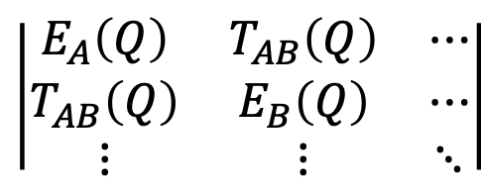
Time-resolved RIXS – orbital specific mapping of transient electronic couplings
L unocc.
Fe 3d
L occ.
$$\left|\begin{matrix}E_{A}\left(Q\right) & T_{AB}\left(Q\right) & ⋯ \\ T_{AB}\left(Q\right) & E_{B}\left(Q\right) & ⋯ \\ ⋮ & ⋮ & ⋱\end{matrix}\right|$$
Fe 3d
Fe 3d
L unocc.
Sensitivity to mixing of orbitals at different atomic sites enables to track interactions facilitating electron transfer
Direct measurement of valence excited state energies
2p3d RIXS at 3d transition metal L-edges
1s2p RIXS at ligand K-edges
Ligand-to-metal and metal-to-ligand electron transfer, metal-to-metal electron transfer

Slide 25
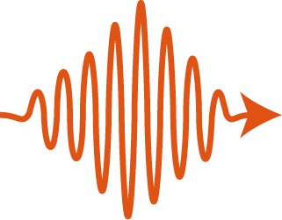
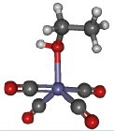
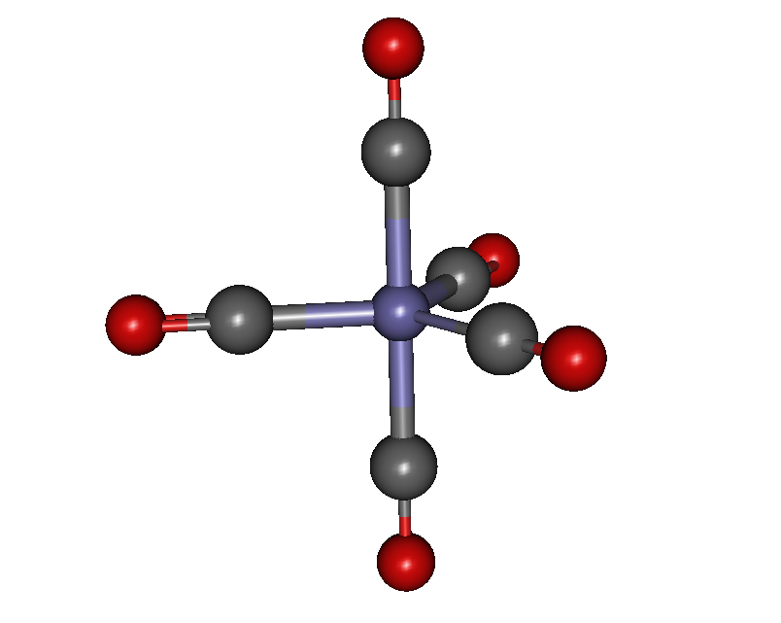
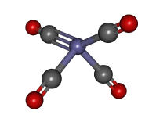
Time-resolved soft X-ray RIXS at LCLS – current state-of-the-art
-CO
+EtOH
Fe L₃-edge RIXS
Probing of the local MC final states
Local MC states highly sensitive to coordination (ligand field) and 3d orbital populations
Wernet, Kunnus et al., Nature 520, 78 (2015).
Kunnus et al., Structural Dynamics 3, 043204 (2016).
Kunnus et al., New J. Phys 18, 103011 (2016).

Slide 26
Time-resolved soft X-ray RIXS at LCLS – current state-of-the-art
-CO
+EtOH
Fe L₃-edge RIXS, 705 – 715 eV (0.5 eV bandwidth)
300 fs time resolution
1 eV energy resolution
Highly concentrated sample: 1M
Large sample volumes (liters), flow rates 1 ml/min
Count rate at the strongest resonance: 500 cts/s
Total measurement time: 20 h (5 ps delay range)
Incident photon flux: 1e10¹² ph/s, 120 Hz (60 Hz)
Wernet, Kunnus et al., Nature 520, 78 (2015).
Kunnus et al., Rev. Sci. Instrum. 83, 123109 (2012)

Slide 27
Time-resolved soft X-ray RIXS – opportunities at LCLS-II
LCLS
120 Hz
LCLS-II
up to 1 MHz
At least 1000-fold increase in incident photon flux (no pulse energy trade-off up to 300 kHz)
Soft X-ray undulator: 250 – 1600 eV
First light 2020 (Cu-RF, 120 Hz), first SC-RF experiments 2021
Increased photon flux will be transformative for time-resolved RIXS!
Orbital specific mapping of transient electronic couplings.
Probing spin-forbidden final states at metal L-edges
Low concentrations and limited sample quantities

Slide 28
Summary
Photoinduced functional properties of molecules are determined by dynamics at and between electronic excited states.
Time-resolved RIXS measures directly energies of valence excited states and maps electronic couplings governing transitions between electronic states.
L unocc.
Fe 3d
L occ.
Fe 3d
Fe 3d
LCLS-II will enable investigations of phenomena with time-resolved RIXS that are currently not feasible and that will be unique in the world.
L unocc.

Slide 29
Thank you!

