Slide 1
Roadmap for SLAC participation in a global e+e- collider
Tor Raubenheimer

Slide 2
Outline
ILC and other conventional LC approaches
γ−γ options: XCC or Sapphire
Plasma collider
FCCee or SPPS
Muon collider
Assume the next collider will be a Higgs Factory

Slide 3
Technologies for a e+/e- collider
Conventional Linear Collider (SRF or NCRF)
  ILC is the example; 2035 time-early for physics; CLIC or C3 is a few years latter.
  Technology is probably limited to 1 or possibly a few TeV
γ−γ Linear Collider
  Potential to extend LC to high energy avoiding beamstrahlung;
  Also potential for low energy Higgs factory;
  Significant R&D on lasers, IP, MDI
Plasma Linear Collider
  Unlikely to make sense for Higgs factory; short bunches may allow for multi-TeV collisions
  Requires extensive R&D; positrons are a limitation.
  Cost benefit unclear as it requires most LC subsystems and massive laser/e- drive beam
Storage Ring (FCCee or SPPS)
  Conventional technology and likely to work but expensive
  Provides infrastructure for higher energy hadron collider
Muon collider
  Requires extensive R&D
  Potential multi-TeV energy reach due to lack of beamstrahlung
  Potential for lower costs

Slide 4
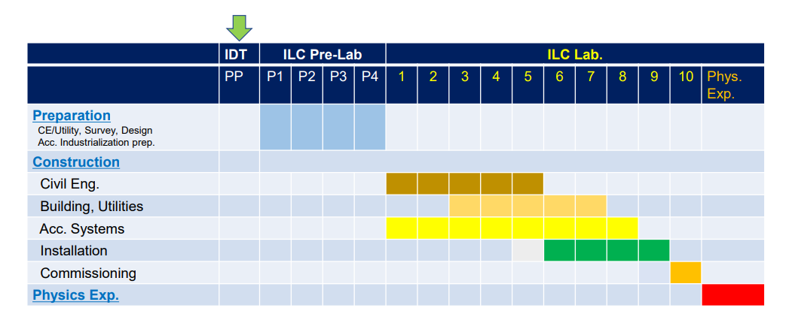
ILC Schedule – collisions 2035 time early
Need Japanese approval to engage global community. ILC Pre-Lab is aimed
at addressing concerns from Japanese government. Cost is a limitation but …

Slide 5
SLAC Opportunities on ILC
To be filled out!
What can we contribute to ILC:
RF – no engineering but is there a role that we would like? CMRF.
MDI – effort needed – will have role in planning phase and can decide from then
BDS – crab cavity maybe; would need magnet people.
DR/BC – design for lower emittance, shorter bunches in DR? Kicker.
S-2-E simulation coordination, deck management, new tools, ML/AI operations tuning
e- → Jlab/BNL maybe SRF gun tech → flat beam transformer? CMRF.
e+ -- in need of serious work; conventional; undulator; rf undulator
Are there tests that are needed?
E+ source target, capture, undulator (rf), crab cavity, DR kicker, construction beyond R&D
What about other LC options?
THz? C^3? What about multi-TeV? Oide? Luminosity? Muons? Yunhai 14 TeV.

Slide 6
Cold Copper Collider (C^3)
Concept that could reduce ILC cost by replacing RF system and taking advantage of pulse structure for less costly subsystems → 30 to 50% cost savings could be possible
(see Warm/Cold comparison study 2002/2003)
Add pictures

Slide 7
SLAC Opportunities on C^3
SLAC would need to build string test (few GeV) at ~200M$ and develop design concept to engage broader community
Can take advantage of some CLIC development/community
If C^3 is to go forward, SLAC probably must take leadership role and work toward a CLIC/C^3 collaboration

Slide 8
XCC or Sapphire
XCC is a γ−γ version of C^3. Roughly ½ cms energy for further cost reduction. Might fit on SLAC site. Requires R&D for high power FEL, IP, and MDI.
Like C^3 SLAC would need to take a leading role in the linac technology and the FEL.
Sapphire is a g-g collider based on recirculating linac. Many of the same challenges plus high current SRF system.

Slide 9
Plasma Collider
Plasma offers high gradient acceleration but requires very severe tolerances and probably cannot accelerate positrons
2010 PWLC Cost study found linac subsystem was 30% of ILC dominated by drive beam transport system – assumed 0$ for plasma accelerators and drive beam dumps
Plasma could offer path to multi-TeV collisions via very short bunch lengths. Short bunch lengths do not benefit Higgs Factory.

Slide 10
SLAC Opportunities on Plasma Collider
Europe LDG is driving a study of PWLC
SLAC will do critical demonstrations as part of FACET-II to hopefully understand:
  energy transfer efficiency,
  generation of beams with small energy spreads,
  emittance preservation.
  Maybe positrons but γ−γ option avoids that
Many of these topics could also be studied much less expensively in 3D simulation. Additional studies are needed for “engineering” issues such as tolerances, plasma stability/heating, beam dumps, …

Slide 11
Storage Ring
Can contribute to development but no leading role in main ring
    Contribute to ring design with optics, IR, collective effects
    Maybe role in diagnostics and controls
    Potentially big role in detectors
    Potentially big role in e+/e- injector chain (X-band linac)
The timescale is thought similar to ILC with similar cost
CERN is committed → significant effort to develop TDR for next European strategy study and is trying to engage the US

Slide 12
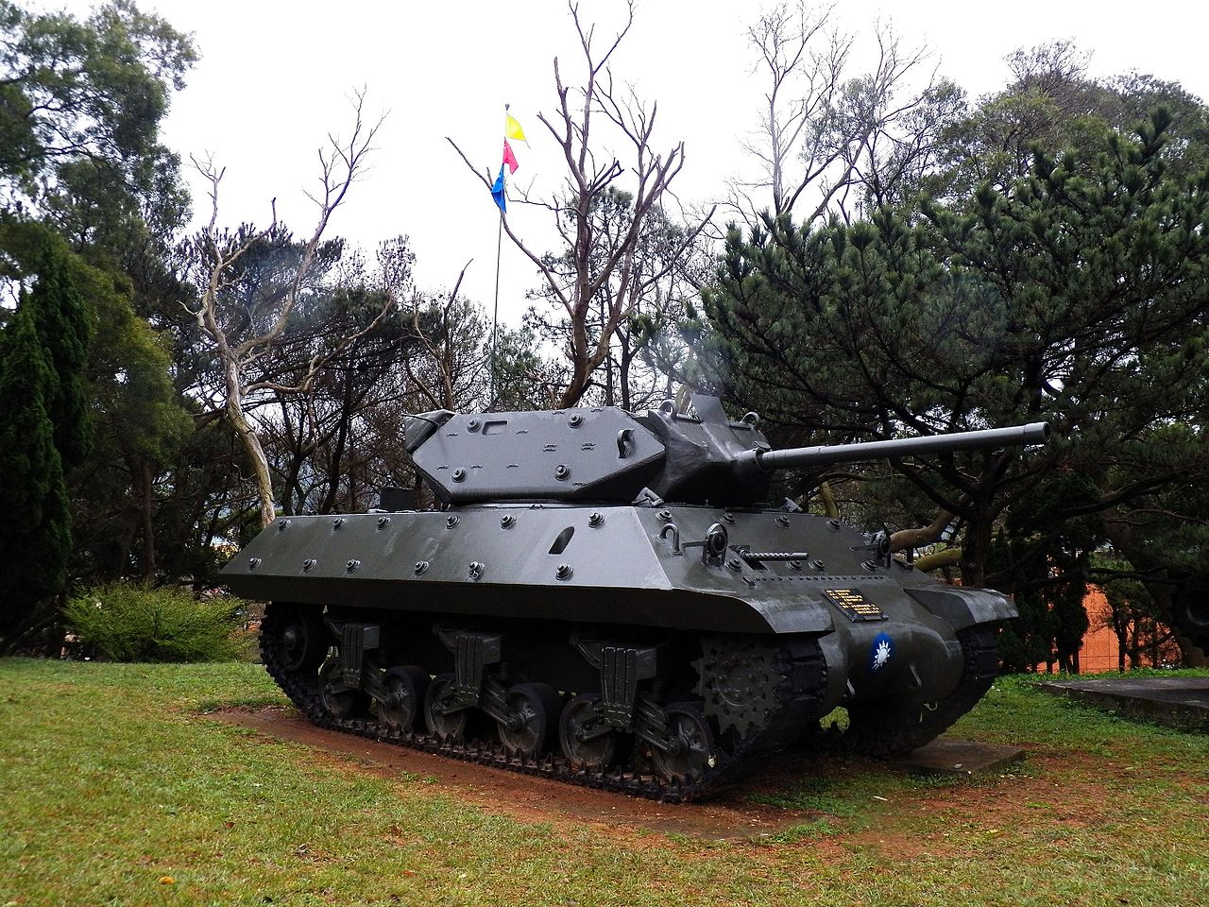
Muon Collider
Has potential to scale to high energy with low $/GeV although likely a high initial cost
Europe LDG is driving a study of Muon Collider
Lots of NCRF systems → SLAC expertise
Challenging MDI → Opportunities
Hardened detector → maybe not.

