Slide 1
Beyond the Standard Model (BSM): Higgs II
Nausheen R. Shah
nausheen.shah@wayne.edu
49th SLAC Summer Institute 2021
Wednesday Aug 18, 2021

Slide 2
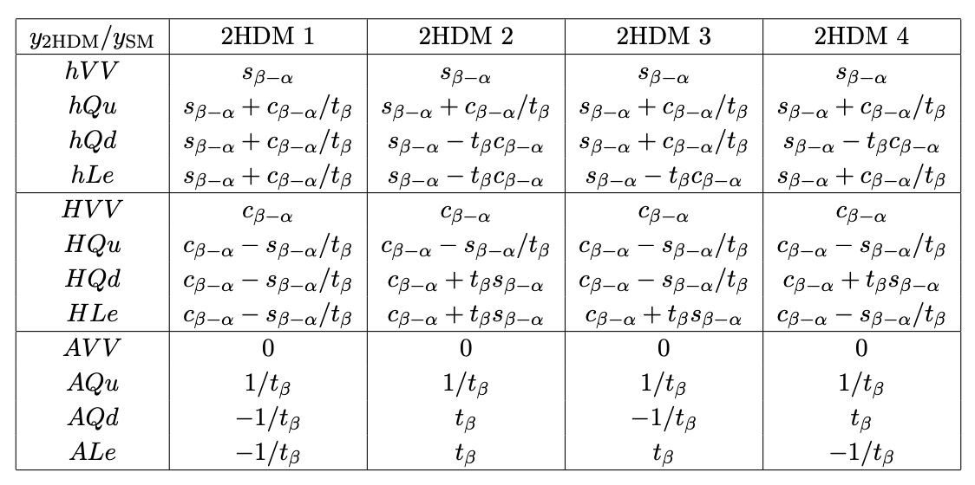
Reminder: 2HDM Types
SM-Like Higgs: h₁₂₅
c_{𝛃-𝛂} << 1, s_{𝛃-𝛂} ≈ 1
G. C. Branco, P. M. Ferreira, L. Lavoura, M. N. Rebelo, M. Sher, and J. P. Silva, ‘11
Fermion couplings:
- Misalignment
- tan 𝛃
Differences at large tan 𝛃,
Similar at tan 𝛃 ~ 1

Slide 3
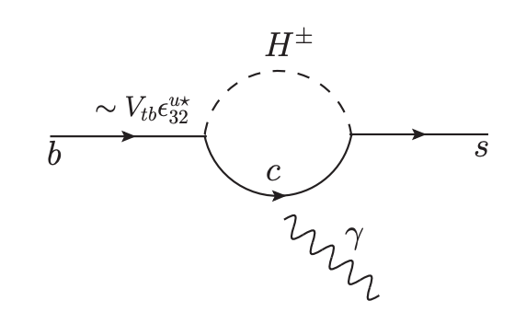
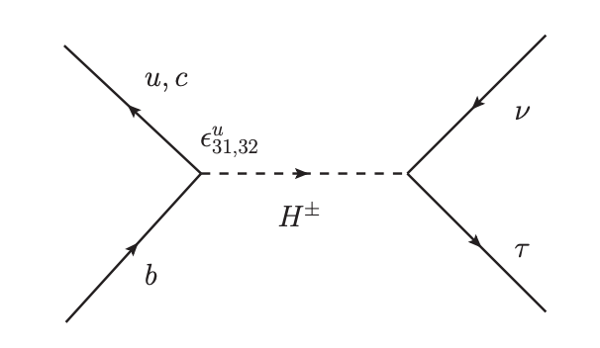
Other Flavor Observables?
For eg:
Sensitive to Charged Higgs contributions
Stringent constraints in m_{H}±, tan 𝛃 plane
Caveat: Additional non-Higgs sector particle content could cancel contributions.

Slide 4
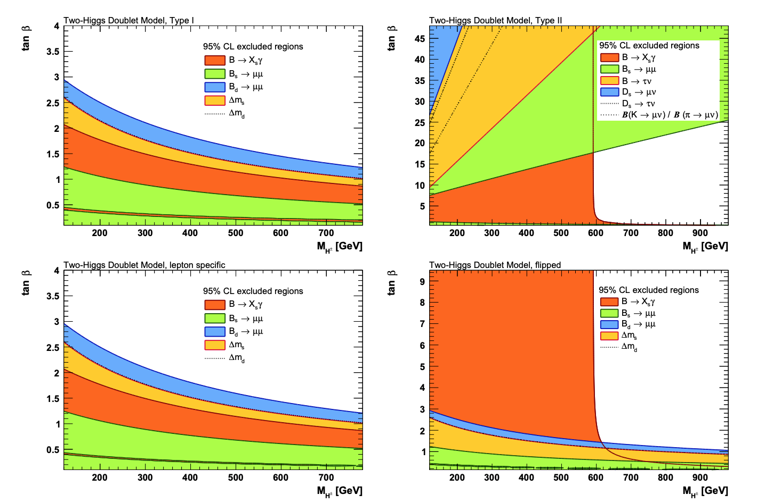
Charged Higgs
GFitter, ‘18

Slide 5
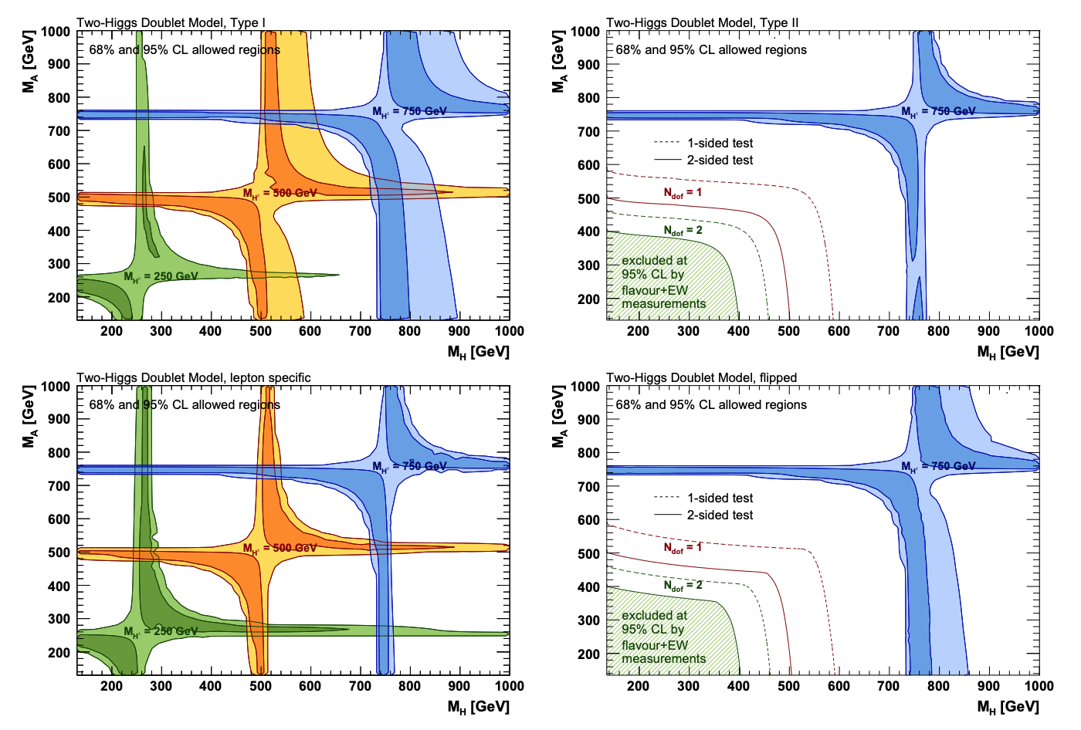
All Together: Charged Higgs
h₁₂₅ coupling strength measurements, Flavor observables,
Muon anomalous magnetic moment, EW precision data.
GFitter, ‘18

Slide 6
…And what
about
CP?

Slide 7
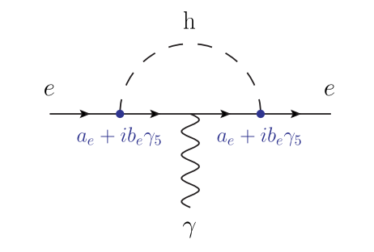
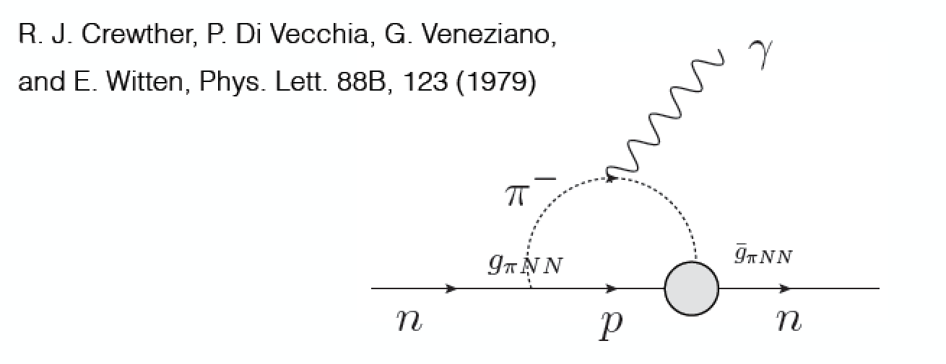
$$H+i A$$
CP – even
CP – odd
Both in same doublet → If allowed phase rotation mixes them: CPV (Baryogenesis?)
$$\overline{fL}fRH$$
$$\overline{fL}γ5fRA$$
CP properties defined by coupling to fermions.
Strong constraints from EDMs.

Slide 8
What Now?
Empirical agreement with SM
No deep answer to the puzzle of the SM fermion masses or mixings
Pieces of the puzzle → Ingredients for THE UV theory.
Parametrize our Ignorance

Slide 9
Playing with the Bosons:
Simplest Story
Add Singlet.

Slide 10
SM Higgs + Complex Singlet
V. Barger, P. Langacker, M. McCaskey, M. Ramsey-Musolf, and G. Shaughnessy, 08
SM potential
H-S mixed terms
S + i A
Equivalent to 2 real fields
Simplify:
Z₂ symmetry for S → no odd powers
U(1) symmetry eliminates complex coefficients.
Singlet potential
Break U(1) and Z₂ softly:
Mass for A, cold Dark Matter candidate
No domain walls
Electroweak phase transition

Slide 11
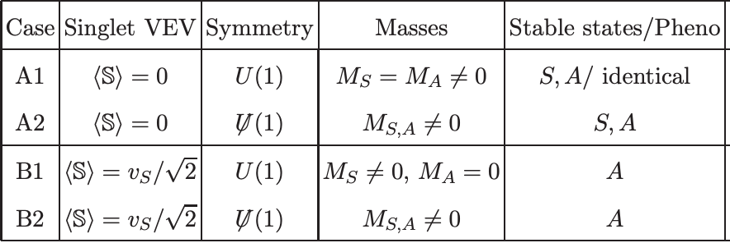
V. Barger, P. Langacker, M. McCaskey, M. Ramsey-Musolf, and G. Shaughnessy, 08
Global Minima
Minimize potential
Diagonalize Mass matrix: Physical masses and couplings (mixings).

Slide 12
Choose CP conservation:
<y> = 0, <x> = v_{s}, <h> = v
Trade m² and b₂ in terms of vevs.
Alignment: Should be small.
But, less constrained than
Doublet mixing
h_{SM} x y

Slide 13
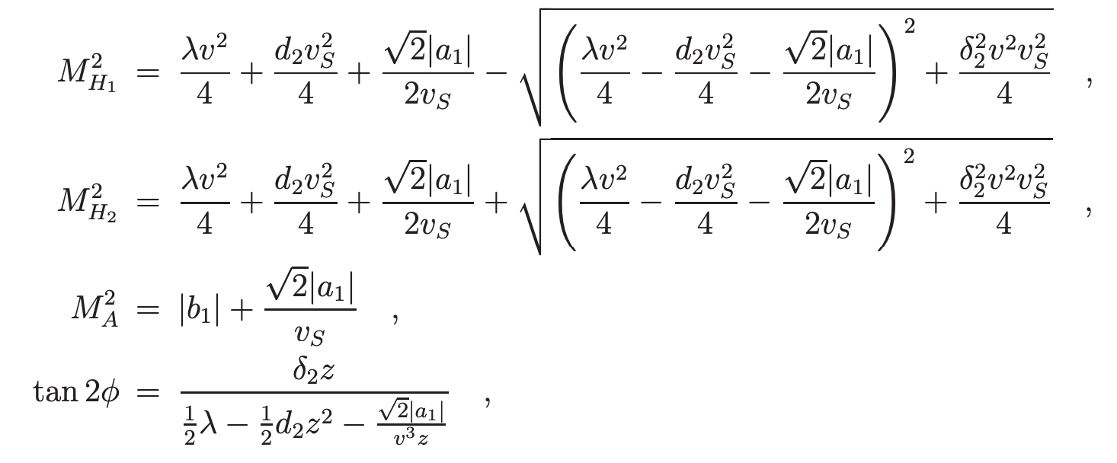
V. Barger, P. Langacker, M. McCaskey, M. Ramsey-Musolf, and G. Shaughnessy, 08
Universal reduction of h₁₂₅ couplings to all SM particles: ɸ ∝ 𝜹₂.
Possible decays into S S and A A if kinematically accessible
May be invisible if A stable DM.

Slide 14
Not so simple Story
Add Doublet.

Slide 15
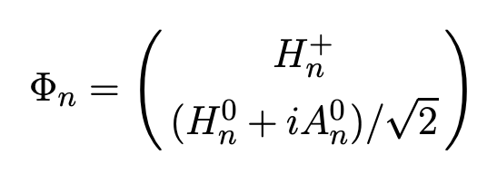
2HDM
SM-potential like terms
Mixing terms
Haber and Hempfling, ‘97
Fermion coupling basis
CPV?
Potentially Complex
𝜆₅ , 𝜆₆ , 𝜆₇ , m₁₂²
Assume real for now: CPC

Slide 16
2HDM
Haber and Hempfling, ‘97
FCNC → 0
𝜆₆ = 𝜆₇ = m₁₂² = 0
Soft breaking m₁₂² ≠ 0
Define mixing: 𝛂

Slide 17
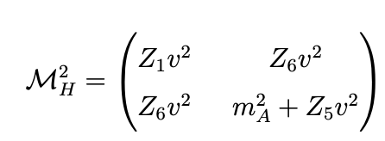
Higgs Basis
SM-Like Higgs: h₁₂₅
c_{𝛃-𝛂} << 1, s_{𝛃-𝛂} ≈ 1
Z₁v² ~ (125 GeV)²
Z₆v² controls mixing
m_{A} ~ mass of heavy Higgs

Slide 18
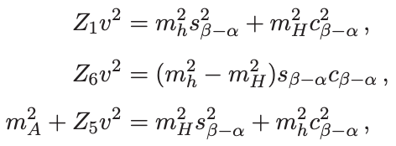
Physical Parameterization
H. Haber, O. Stal, ‘15
Quartics COMPLETELY ARBITRARY:
Parameters of our ignorance.
Recast in terms of physical masses and mixing angles:
{m_{h125}, c_{𝛃-𝛂} , tan 𝛃, m_{H}, m_{A}, m_{H+}, m₁₂²}
May inadvertently violate unitarity and perturbativity for quartics.
Better: “Hybrid” parameterization
{m_{h125}, c_{𝛃-𝛂} , tan 𝛃, m_{H}, Z₄, Z₅, Z₇}
From EW precision + flavor → either A or H ~ degenerate with H⁺⁻

Slide 19
Alignment!
Z₁v² ~ (125 GeV)²
Z₆v² controls mixing
m_{A} ~ mass of heavy Higgs
Alignment w/o decoupling
Decoupling
MUST
be small
Governed by EMPIRICAL observation of SM-like h₁₂₅

Slide 20
Alignment ?
Carena, Haber, Low, Shah, Wagner, ‘14
4 possibilities for EXACT alignment Z₆ = 0:
Exact symmetry of theory:
Eg. Exact Z₂ symmetry -- Inert Higgs Doublet Model: Z₆ = 0
See Chapter 1.3 of D. M. Asner, T. Barklow, C. Calancha, K. Fujii, N. Graf, H. E. Haber, A. Ishikawa and S. Kanemura et al., arXiv:1310.0763 [hep-ph].
Symmetry of scalar potential, broken by Higgs-Yukawa interactions:
Eg. CP3 or SO(3) Higgs Flavor symmetry
m₁₁² = m₂₂², 𝛌₁ = 𝛌₂ = 𝛌₃ +𝛌₄ +𝛌₅ m₁₂² = 𝛌₆ = 𝛌₇ = 0
Generally not respected by Yukawa interactions
P. M. Ferreira, H. E. Haber and J. P. Silva, ‘09
P. M. Ferreira and J. P. Silva, ‘10
Accidental global symmetry of scalar potential, broken by gauge and Higgs-fermion interactions.
Eg. Custodial symmetries: SO(5) global symmetries
m₁₁² = m₂₂², 𝛌₁ = 𝛌₂ = 𝛌₃, m₁₂² = 𝛌₄ = 𝛌₅ = 𝛌₆ = 𝛌₇ = 0
Deviations via loop effects.
P. S. Bhupal Dev and A. Pilaftsis, ’14
P. Sikivie, L. Susskind, M. B. Voloshin and V. I. Zakharov, ‘80
Accidental choice of scalar potential parameters, not governed by symmetry.
Generic 2HDM, MSSM, NMSSM
Haber and Gunion, ‘03, M. Carena, I. Low, N.R.S. & C. Wagner, ‘13, A. Delgado, G. Nardini & M. Quiros, ‘13, N. Craig, J. Galloway & S. Thomas,‘13, P. Dev, A. Pilaftsis ‘14, M. Carena, H. Haber, I. Low, N.R.S. & C. Wagner ‘14 & ’15
etc ....

Slide 21
Insights from Alignment
v, h
x
H h₁₂₅ h₁₂₅
H Z Z
H W⁺ W⁻
A Z h₁₂₅
H
h
Couplings (Decays!) suppressed by alignment
Direct searches at LHC in these channels:
Complimentary probe of h₁₂₅ ~ SM-like nature!

Slide 22
COMPLICATED Story
Add 2HDM+S.

Slide 23
Higgs Potential?
Arbitrary: 27 parameters!!
M. Carena, H. Haber, I. Low, N.R.S., C. Wagner, ’15
S. Baum & N.R.S., ‘18
Minimize + Diagonalize Mass matrices
H h₁₂₅ h
A a
H⁺⁻
Singlets couple to DM?
🥺…

Slide 24
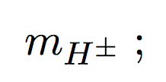
Physical Higgs Parameters
S. Baum & N.R.S., ‘18
Re-parameterize 27 parameters of Higgs potential: more physically meaningful
known!
~ Degenerate!
Small!
~O(vevs)

Slide 25
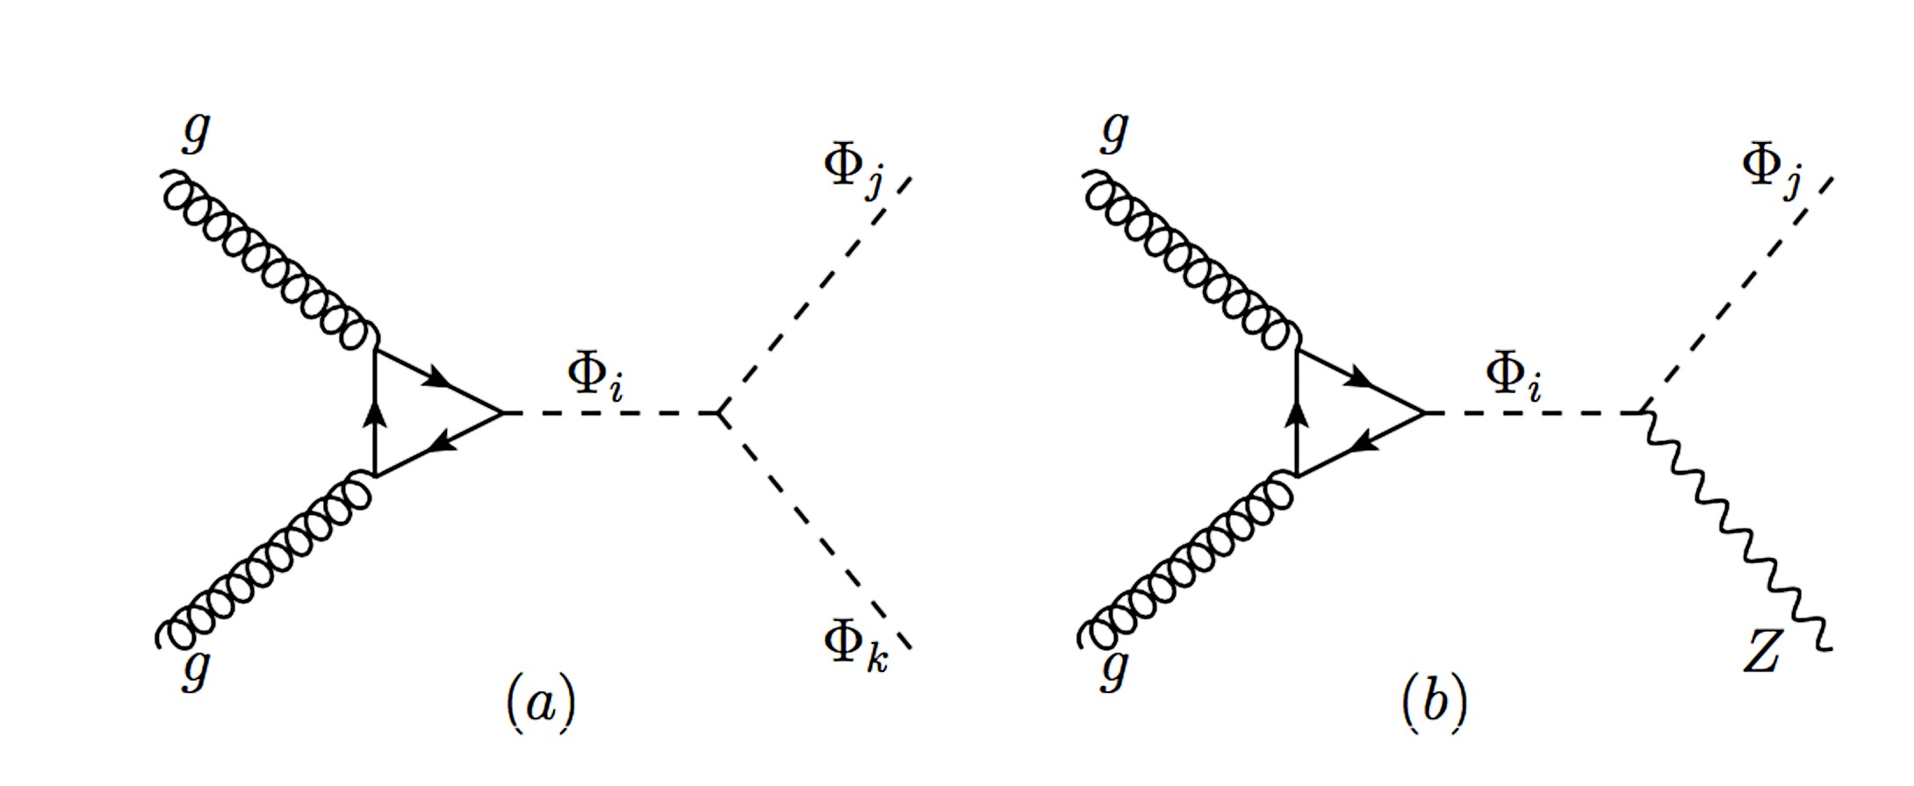
New Pheno ?
Cascade decays due to presence of extra states:
Eg: H_{NSM}➔ h H_{SM} or H_{NSM} ➔ a Z
H_{NSM} ➔ WW/ZZ/H_{SM} H_{SM} or A ➔ Z H_{SM} suppressed due to alignment
Di-Higgs:
g_{Φi Φj Φk}
g_{Φi Φj Z} ~ C_{NSM}^{i} C_{NSM}^{j}
{h, a} can decay visibly (depending on mixing with doublets) or invisibly (DM).

Slide 26
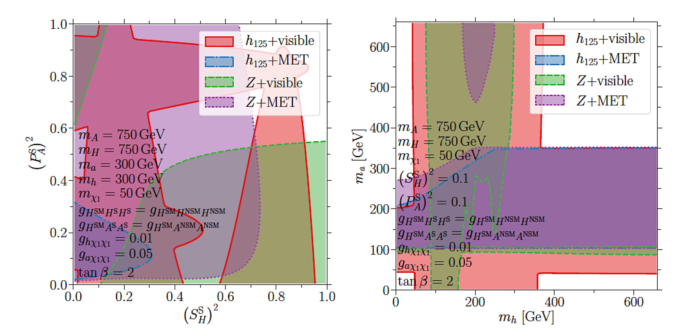
See the Cascades!!
S. Baum & N.R.S., ‘18
If either m_{a} or m_{h} > 350 GeV, can decay predominantly to tt.
Could be hidden in h₁₂₅ tt?

Slide 27
And a
TWIST:
CP Violation.

Slide 28
CP Violation?
v e^{i𝜃}
→ H e^{-i𝜃}
No CPV!
R. Boto, T. V. Fernandes, H. E. Haber, J. C. Roma ̃o, and J. P. Silva, ‘20
Start with REAL potential
Y₃, Z₅, Z₆, Z₇ → Complex after rephasing!
→ Family of Higgs bases
Physics CANNOT depend on choice of basis!!
CP is conserved if and only if:

Slide 29
Who is WHAT: H₃, H₂, H₁?
Define CP properties of a state via fermion couplings:
$$\overline{fL}fRH$$
$$\overline{fL}γ5fRA$$
Mass eigenstate mixed state → angular distribution of decay products
CP Violating DECAYS from CPV in the Higgs potential:
Need non-zero misalignment
Compare decays, for eg: H₃ -> Z H₂/H₁, H₂ H₂/H₁ H₁
Single CPV decay: H₃ -> H₂ H₁

Slide 30
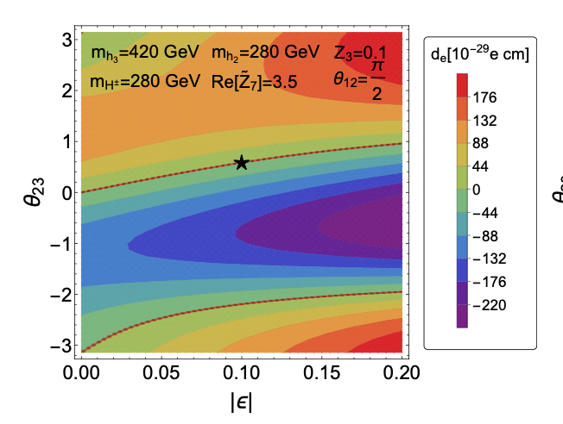
Electron EDMs
Apart from CPC
Cancellations between contributions
(Also gauge boson loop)
ACME Collaboration, ‘18
Possibly ~3 x 10⁴ events
H₃ -> H₂ h₁₂₅ -> 3 h₁₂₅
With 3000 fb⁻¹
I. Low, NRS, X.-P. Wang, ‘20

Slide 31
A Plethora of Higgs

Slide 32
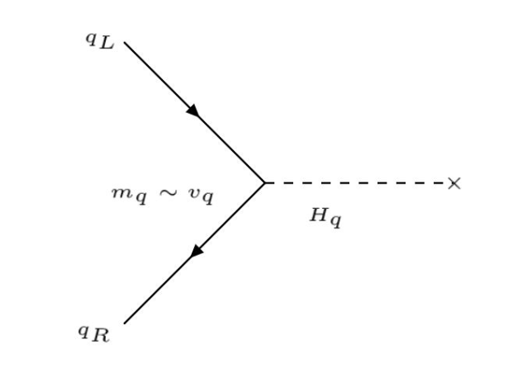
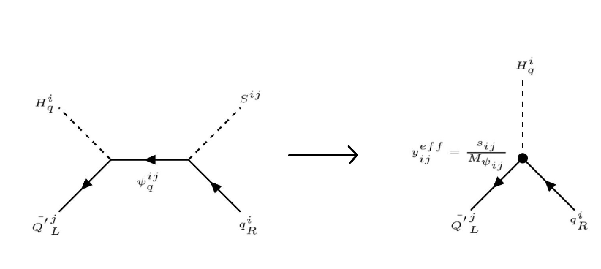
Private Higgs
R. Porto & A. Zee ‘07
A private Higgs for every SM fermion!
Plus additional singlets
“Scalar” see-saw mechanism:
Hierarchy y_{q} → v_{q} ~ v_{SM}³/M_{Hq}²
h₁₂₅ = H_{t}, v_{SM} = v_{t}
Preliminary, B. Bhatacharya, S. Jayawardana, NRS
Assume symmetry structure.
Additional singlet scalars and fermions
--> Generate pattern of vevs (fermion masses) and fermion mixing.

Slide 33
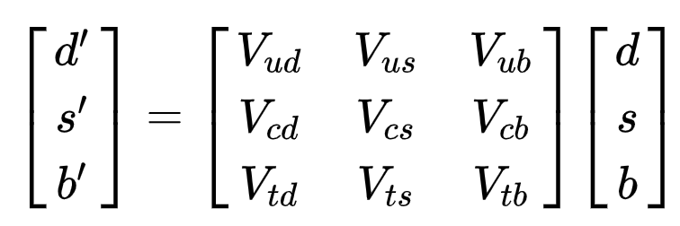
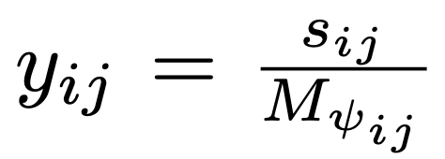
Quark Mixing in PH: CKM Matrix
V_{CKM} = U_{L}† D_{L}
{U_{L}, D_{L}} define admixture of weak eigenstates in mass eigenstates:
unknown 3x3 rotation matrices.
No way to extract U_{L} and D_{L} independently in SM.
Only information about product (V_{CKM}) from flavor changing processes.
Choosing U_{L} = 1, can interpret:
IF v_{q} = m_{q}
=> {U_{L}, D_{L}} = Y_{eff {u,d}}^{PH}
Preliminary, B. Bhatacharya, S. Jayawardana, NRS

Slide 34
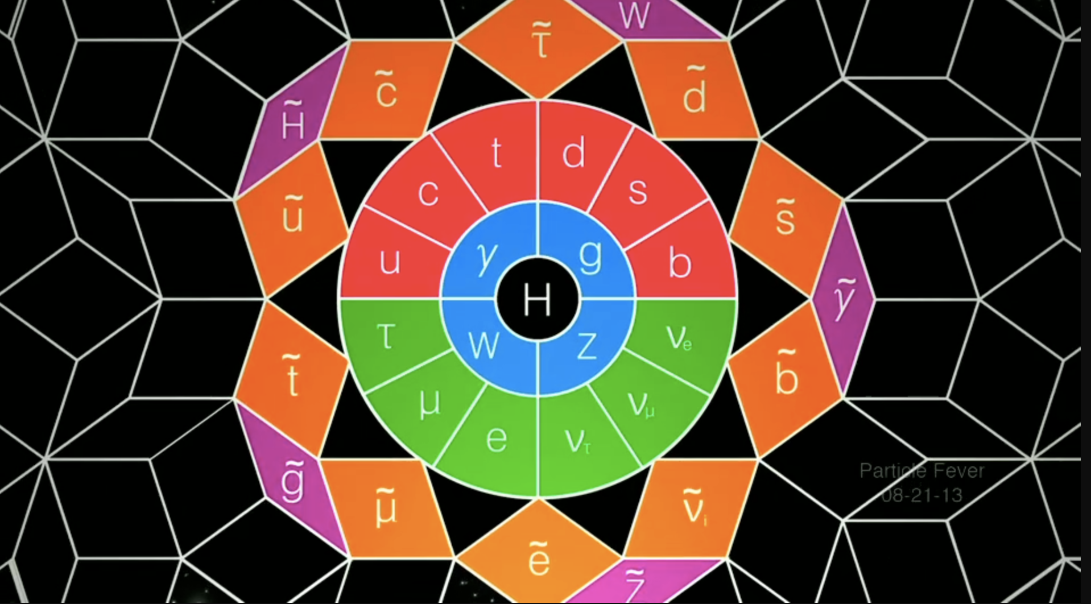
Notorious Supersymmetry
“Particle Fever” – The movie

Slide 35
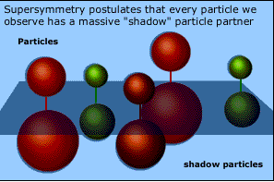
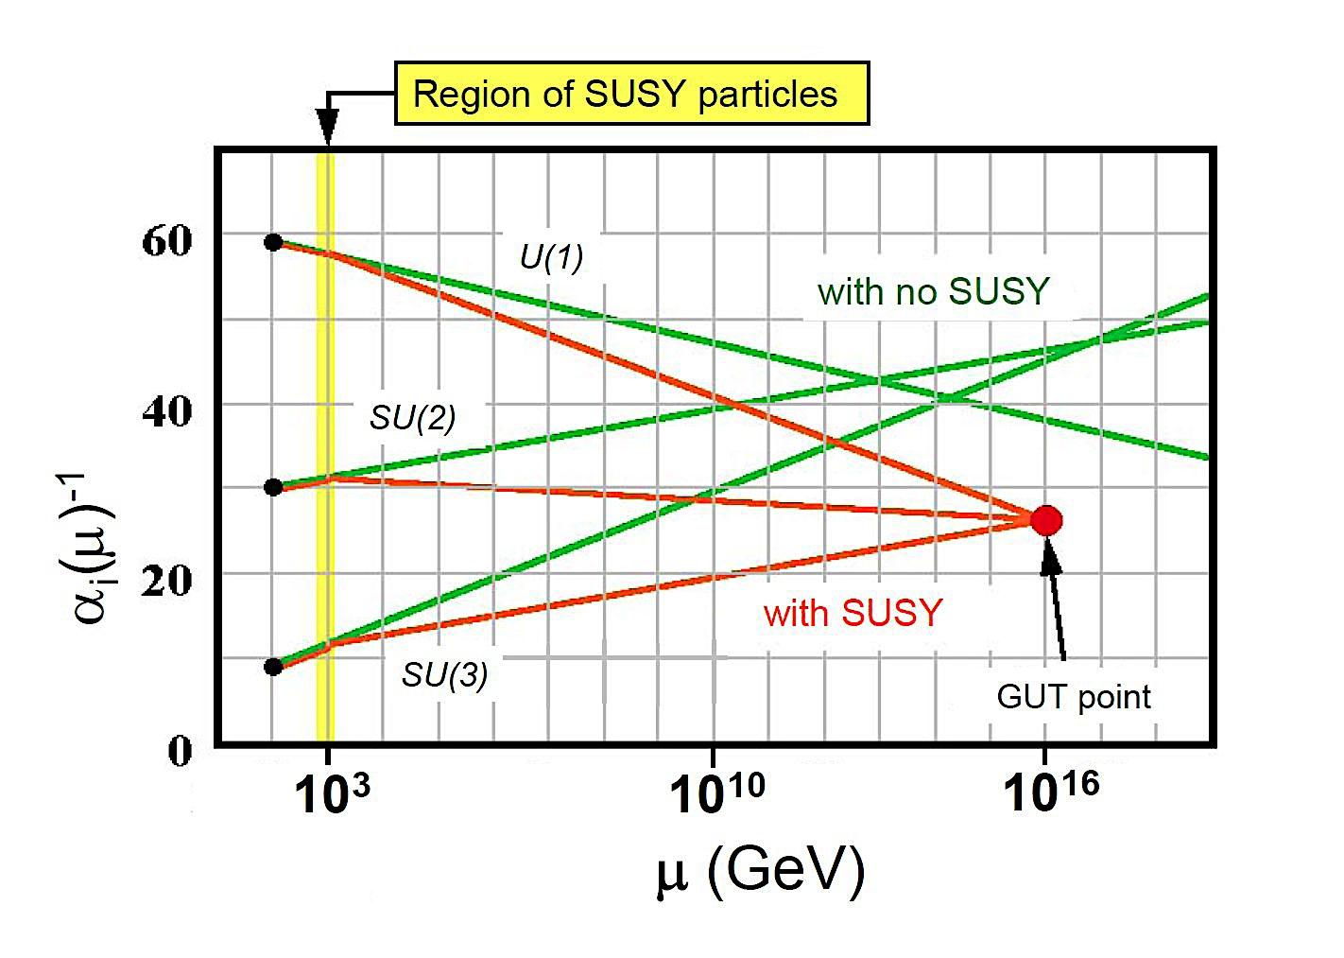
Supersymmetry:
Explains hierarchy between the EW scale and the Planck/unification scales.
Generates electroweak symmetry breaking (EWSB).
Allows unification of electroweak and strong forces at energies ~10¹⁶ GeV.
Provides a good dark matter candidate: The Lightest SUSY Particle (LSP)

Slide 36
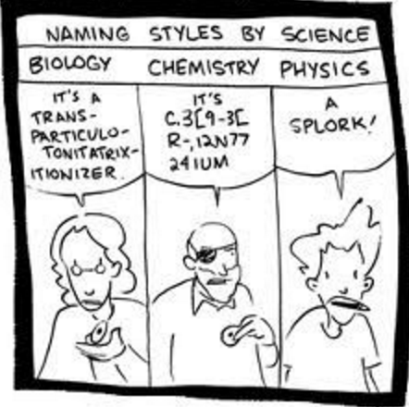
Minimal Supersymmetric SM (MSSM).
For every fermion there is a boson of equal mass and couplings and visa versa.
‘s’particles and ‘inos
No new couplings.
SUSY has to be broken.

Slide 37
Type II 2HDM: Higgs Mass = 125 GeV.
λ_{i}
H. Haber and J. Gunion, ‘03
Quartics without quantum corrections related only to SM couplings.
Higgs mass bounded by m_{Z} at tree-level.
91 125
Need large radiative corrections.

Slide 38
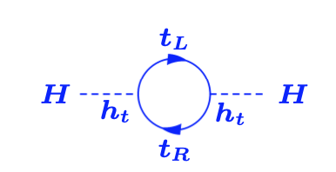
Fine Tuning: SUSY Cancelations!
Top quark contribution:
Complex scalar (STOP) contributions :
Quadratic divergences CANCEL if EQUALITY of couplings.
Residual (mass dependent) logarithmic contributions remain

Slide 39
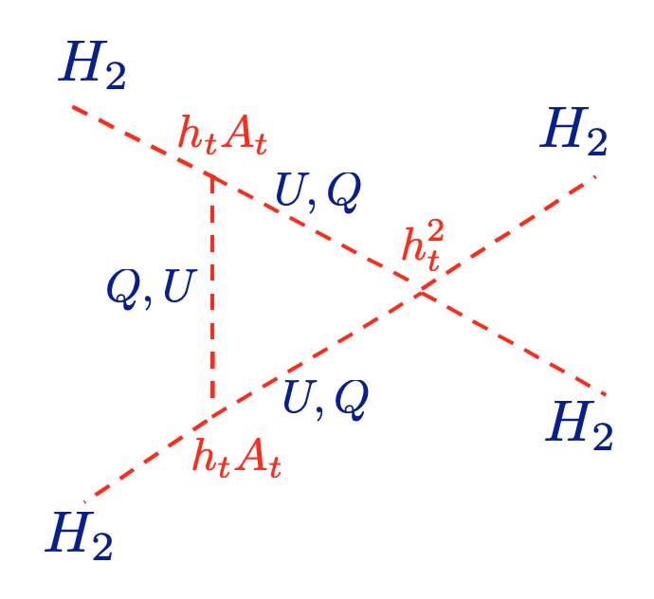
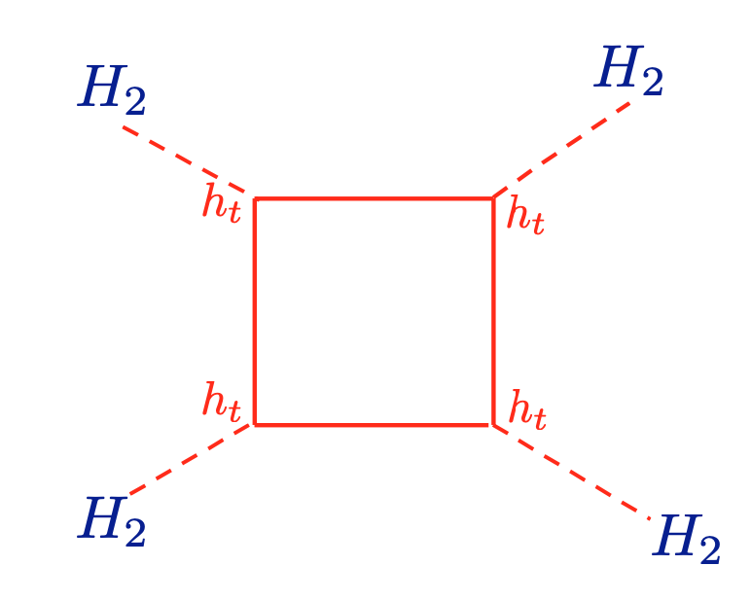
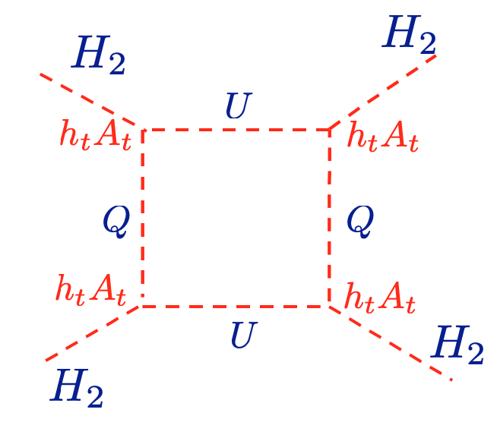
Stop + top Quartic Contributions!
Carena, Espinosa, Quiros, C.Wagner, ’95,96

Slide 40
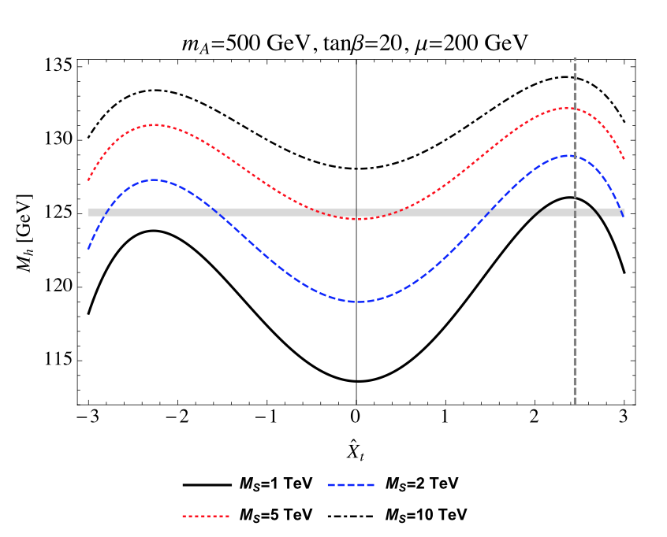
Fine Tune or Not??
Stop masses ~ few TeV
Lighter Stops demand large splitting between left- and right-handed stops.
G. Lee, C. Wagner, ‘15

Slide 41
Higgs Mass = 125 GeV.
λ_{i}
H. Haber and J. Gunion, ‘03
Quartics without quantum corrections related only to SM couplings.
Higgs mass bounded by m_{Z} at tree-level.
91 125
Need large radiative corrections.
…Or something else?

Slide 42
Something else: NMSSM Higgs Sector
2 Doublets (H_{u}, H_{d}) + Singlet (S)
Singlet couples only to Higgs Sector.
vevs: (H_{u}, H_{d,}, S ) =( v_{u}, v_{d}, v_{S} =μ/ λ)
3 CP-Even Higgs bosons:
Mixing between all three (H_{u}, H_{d} and S).
2 CP-Odd Higgs bosons:
Mixtures of “MSSM” m_{A} and singlet.
Charged Higgs bosons
Singlino mass: 2 κ μ/λ
m_{A}
m_{a}/m_{hS}

Slide 43
NMSSM: 125 GeV Higgs Naturally!
M. Carena, H. Haber, I. Low, N.R.S., C. Wagner, ’15
Alignment (No-Mixing):
Well Known
125 GeV Higgs
Tree-level contribution to Higgs mass from λ.
λ ~ 0.65-0.7
Low tanβ
Light Stops

Slide 44
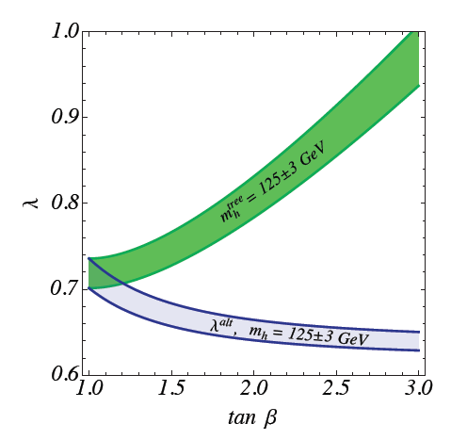
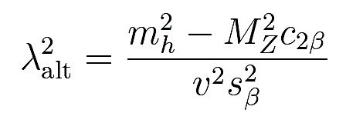
SM-Like Higgs Naturally!
Perturbative up to GUT scale.
λ_{max} ~ 0.7, κ_{max} ~ λ/2
Not so well known:
Excellent Alignment (very little mixing)
M. Carena, H. Haber, I. Low, N.R.S., C. Wagner, ’15
M. Carena, I. Low, N.R.S, C. Wagner, ‘13
Originate dynamically from Higgs
compositeness at the GUT scale?
N. Coyle, C. Wagner, ‘19

Slide 45
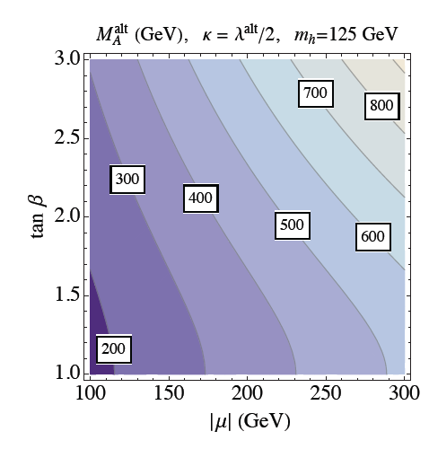
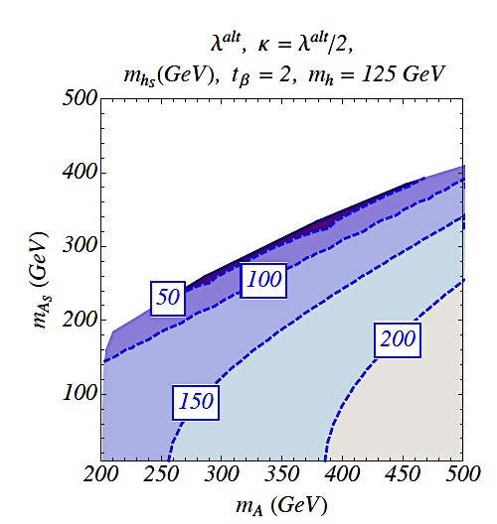
Singlet Alignment
M. Carena, H. Haber, I. Low, N.R.S., C. Wagner, ’15
CP-even/odd singlet
masses anti-correlated
h₁₂₅ = H_{SM}
LIGHT SPECTRUM
Singlino: 2 κ μ/λ ~ < μ

Slide 46
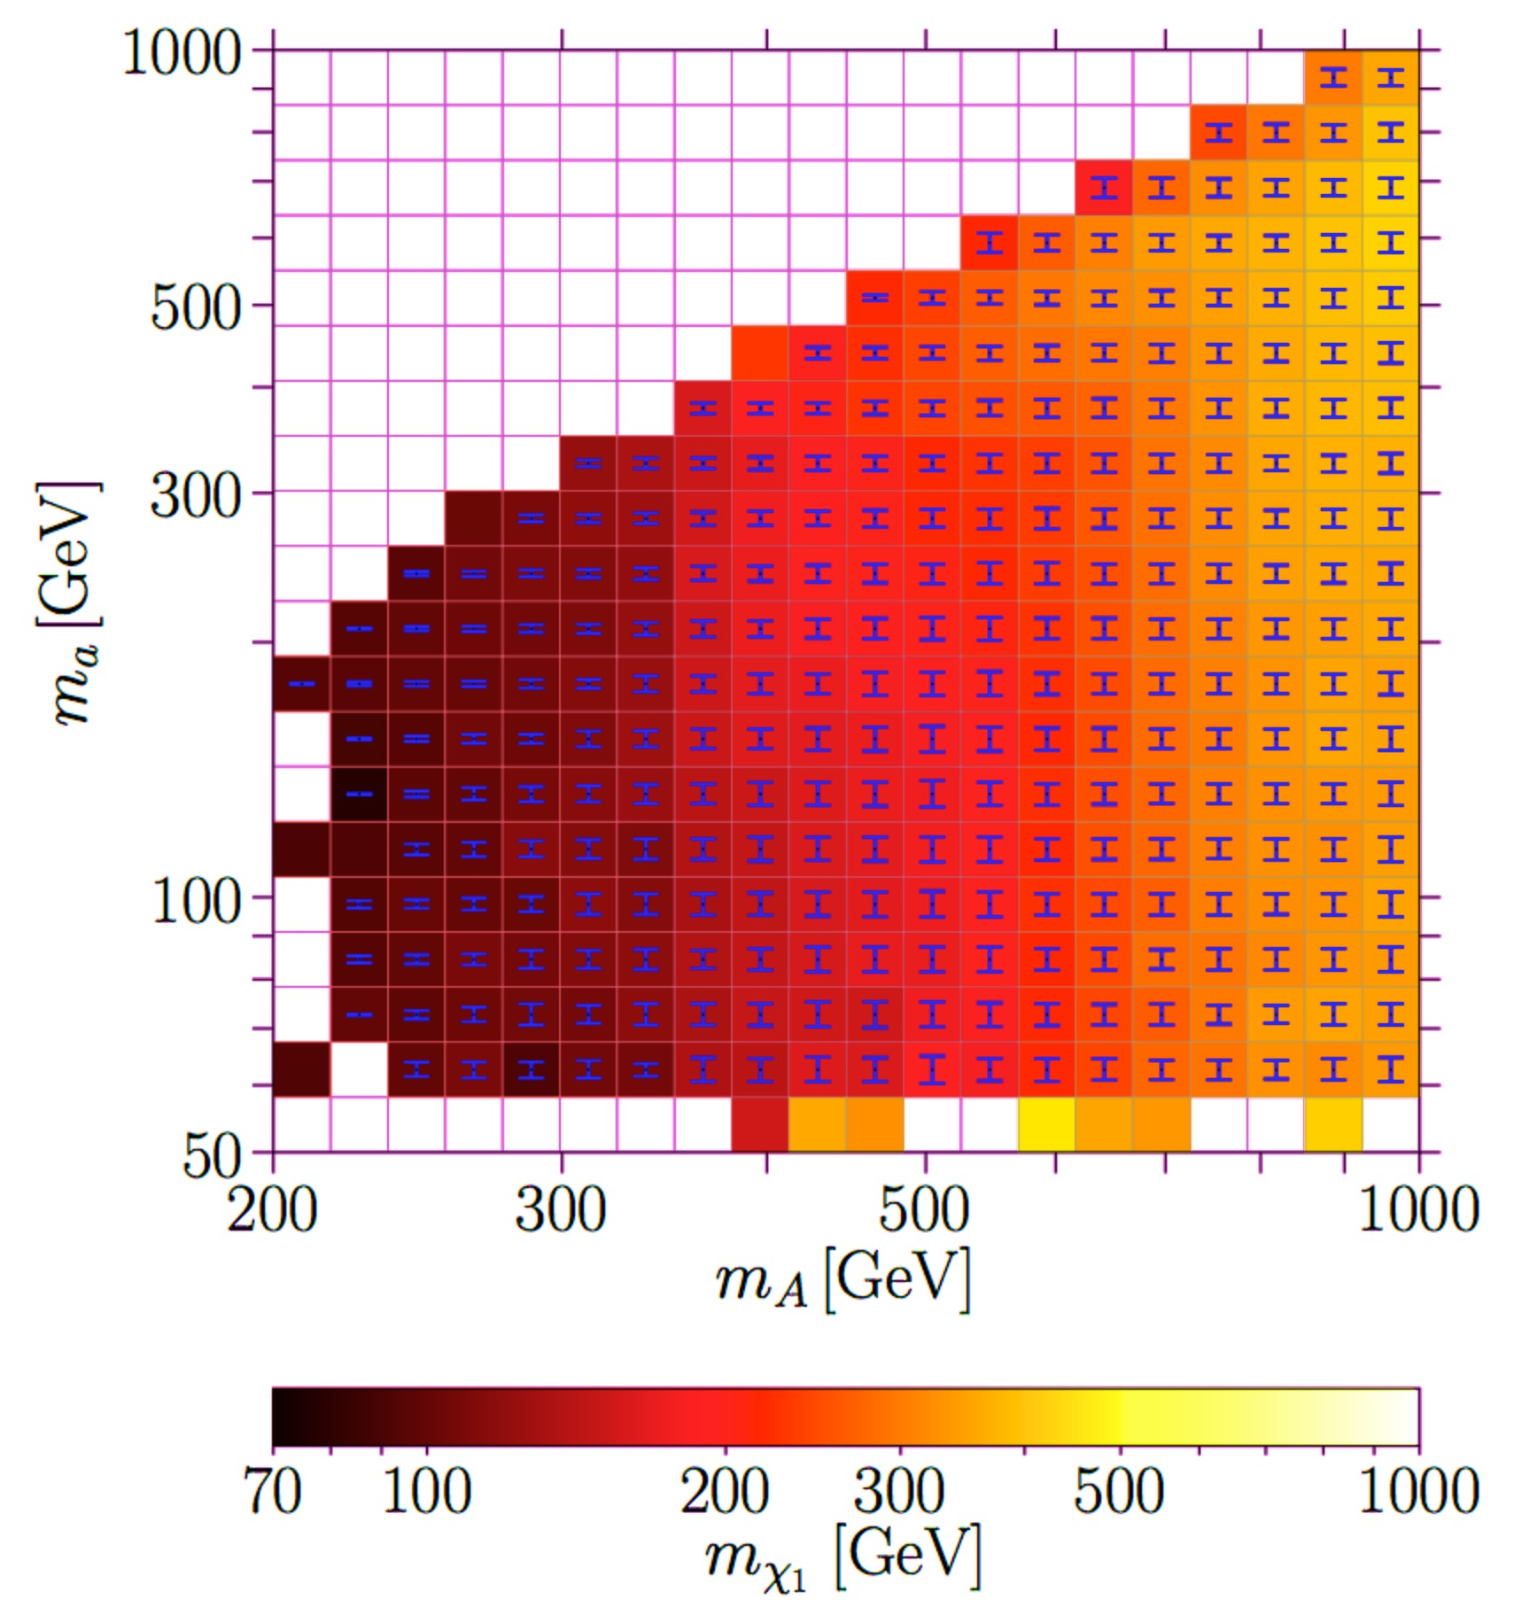
SM - like h₁₂₅: Mass Correlations!
S. Baum, N.R.S, K. Freese, ‘19
NMSSMTools scan with consistent h₁₂₅ pheno

Slide 47
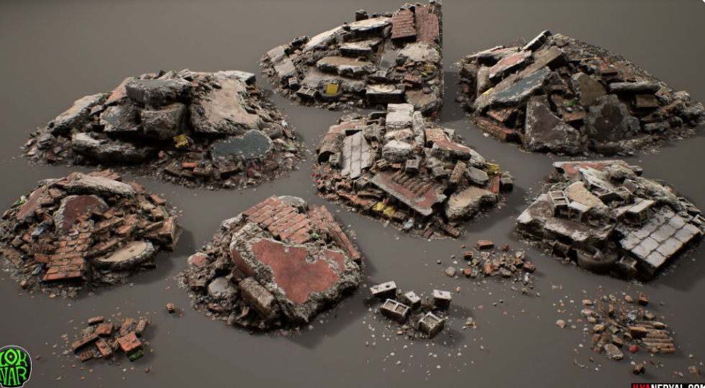
FUN
TIMES
https://www.pinterest.com/pin/334744184798019537/?d=t&mt=login
AHEAD!

