Slide 1
Beyond the Standard Model (BSM): Higgs I
Nausheen R. Shah
nausheen.shah@wayne.edu
49th SLAC Summer Institute 2021
Tuesday Aug 17, 2021

Slide 2
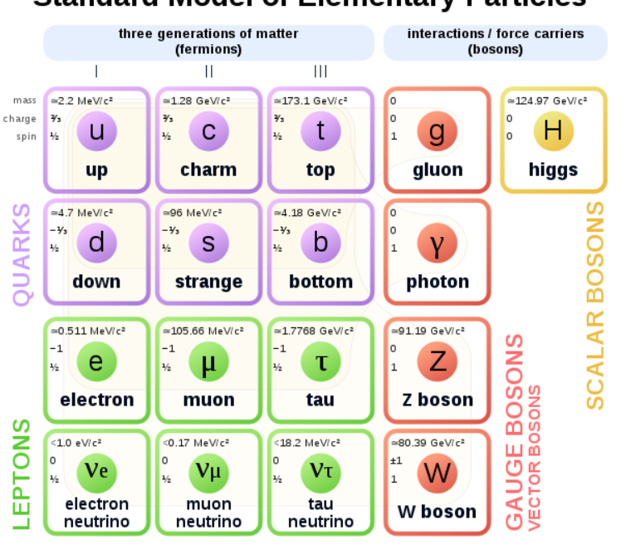
The Beloved Beautiful (& EMPIRICAL) Standard Model
3 generations of matter
SU(3)_{C} x SU(2)_{L} x U(1)_{Y}
WHY????
What is Dark Matter?
https://en.wikipedia.org/wiki/Elementary_particle
Notes:
Emprical

Slide 3
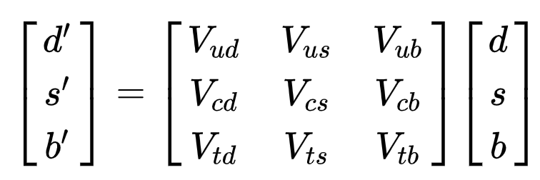
Quark Mixing: CKM Matrix
V_{CKM} = U_{L}† D_{L}
{U_{L}, D_{L}} define admixture of weak eigenstates in mass eigenstates:
unknown 3x3 rotation matrices.
No way to extract U_{L} and D_{L} independently in SM.
Only information about product (V_{CKM}) from flavor changing processes.
Choosing U_{L} = 1, can interpret:

Slide 4
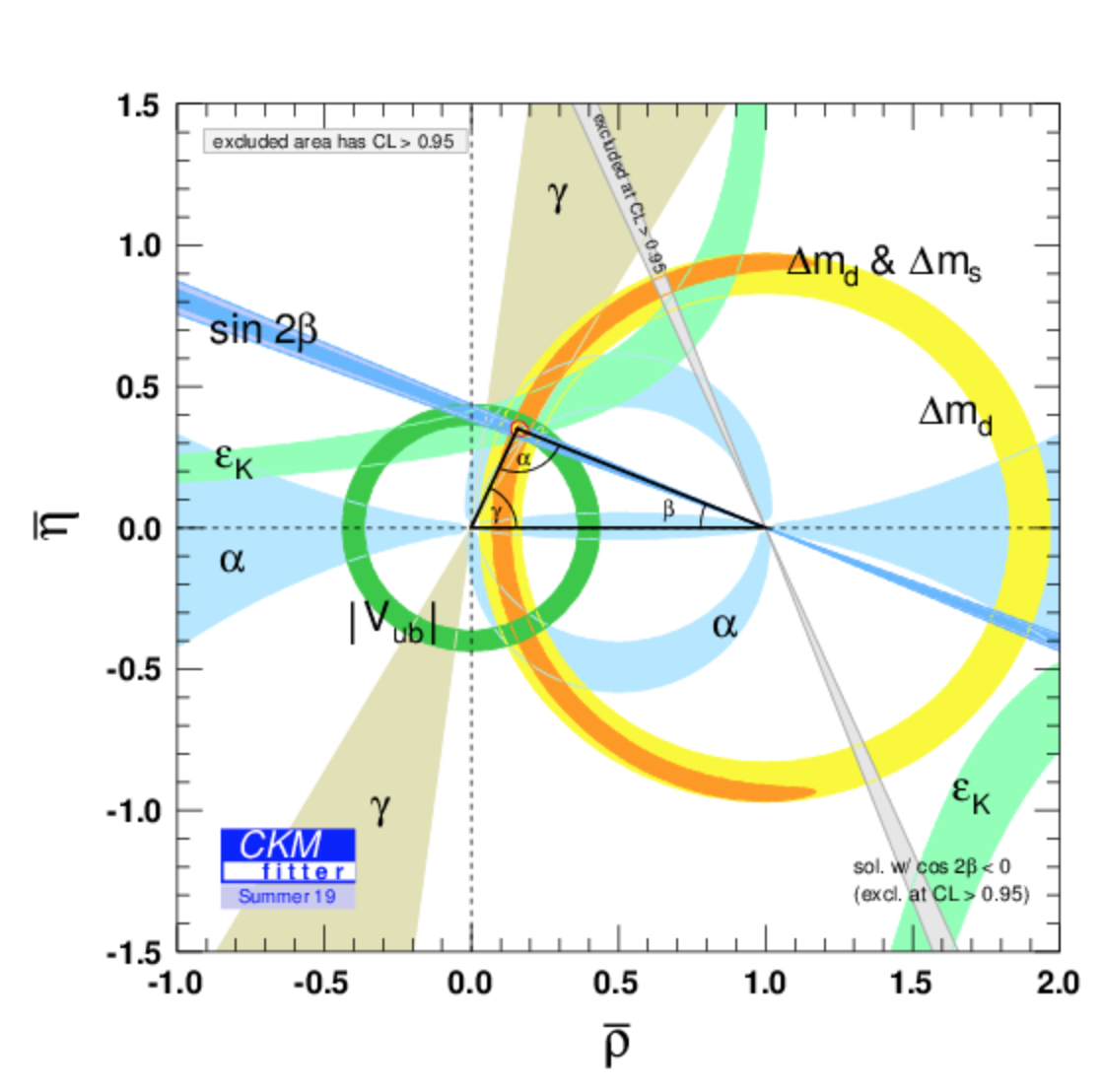
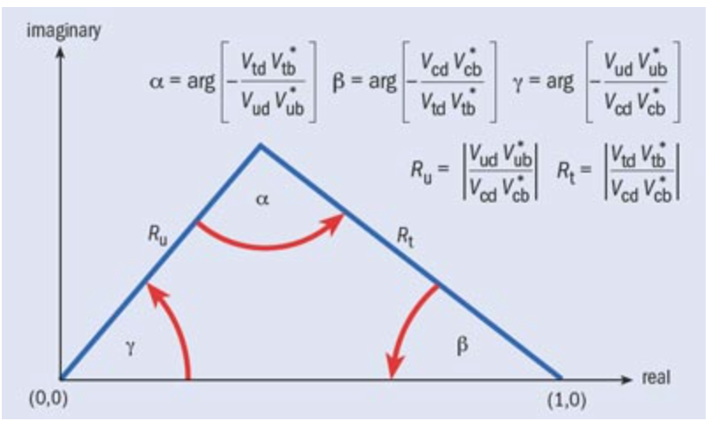
Unitary SM V_{CKM}
http://ckmfitter.in2p3.fr/www/results/plots_summer19/png/rhoeta_large.png
https://physicsworld.com/a/a-triangle-that-matters/
Experimental measurement:
https://en.wikipedia.org/wiki/Cabibbo%E2%80%93Kobayashi%E2%80%93Maskawa_matrix
V_{CKM} = U_{L}† D_{L}
Much smaller!
Is there something special about the 3rd generation??

Slide 5
The Beloved Beautiful (& EMPIRICAL) Standard Model
Non-Minimal
Unnatural
Arbitrary Content
Arbitrary Masses
Arbitrary Mixings
Arbitrary Higgs Mechanism
https://en.wikipedia.org/wiki/Elementary_particle

Slide 6
The Beloved Beautiful (& EMPIRICAL) Standard Model
Only Left handed fermions charged under the weak SM gauge group.
Fermion and gauge boson masses FORBIDDEN by symmetry.

Slide 7
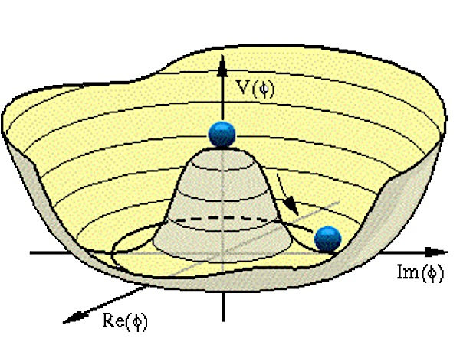
Whatever gives rise to fundamental particle masses has to break electroweak symmetry (EWSB).
The Higgs Mechanism.
Spontaneous Breakdown of the symmetry:
SU(2)_{L} x U(1)_{Y} → U(1)_{EM}
Vacuum becomes source of energy
= a source of mass
< H⁰> = v
A scalar (Higgs) field is introduced. The Higgs field acquires a nonzero value to minimize its energy.
Masses of fermions and gauge bosons proportional to their couplings to the Higgs field:
M_{Z,W} = g_{Z,W} v
m_{t} = h_{t} v
m_{h}² = λ v²
v = 246 GeV

Slide 8
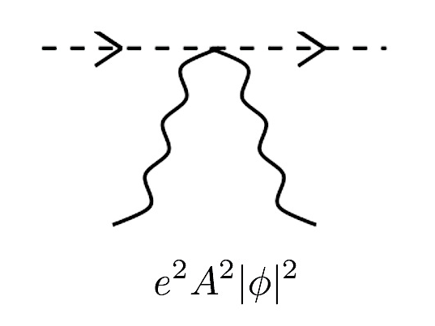
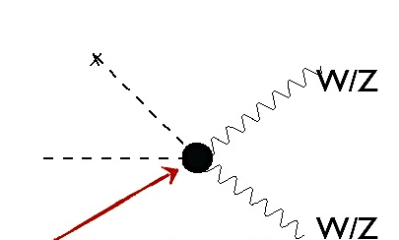
Is it THE Higgs?
How do scalars interact with gauge bosons?
v
h
h
h
h
v
W/Z
W/Z
W/Z
W/Z
We have seen that the Higgs couples to W/Z, with approximately the right strength!!
v
v
W/Z
W/Z

Slide 9
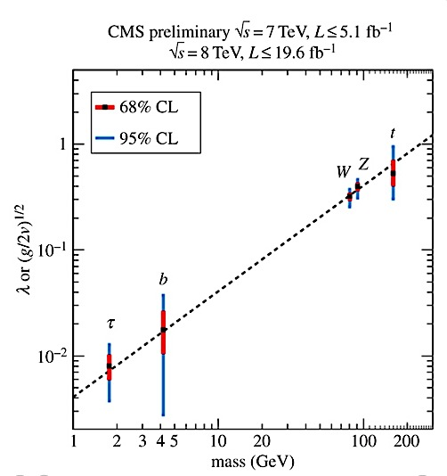
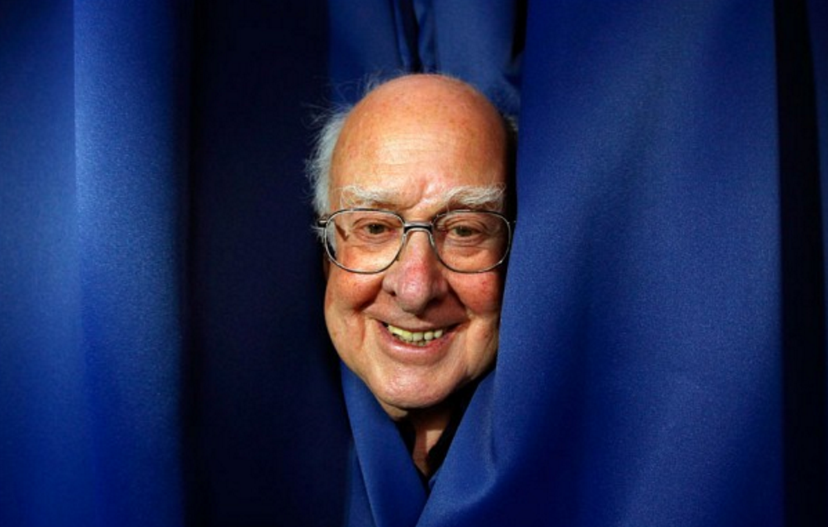
SM-Like Higgs!
Higgs generates masses
of the SM particles!
P. Higgs:
“My first paper was rejected because it was not relevant for phenomenology”

Slide 10
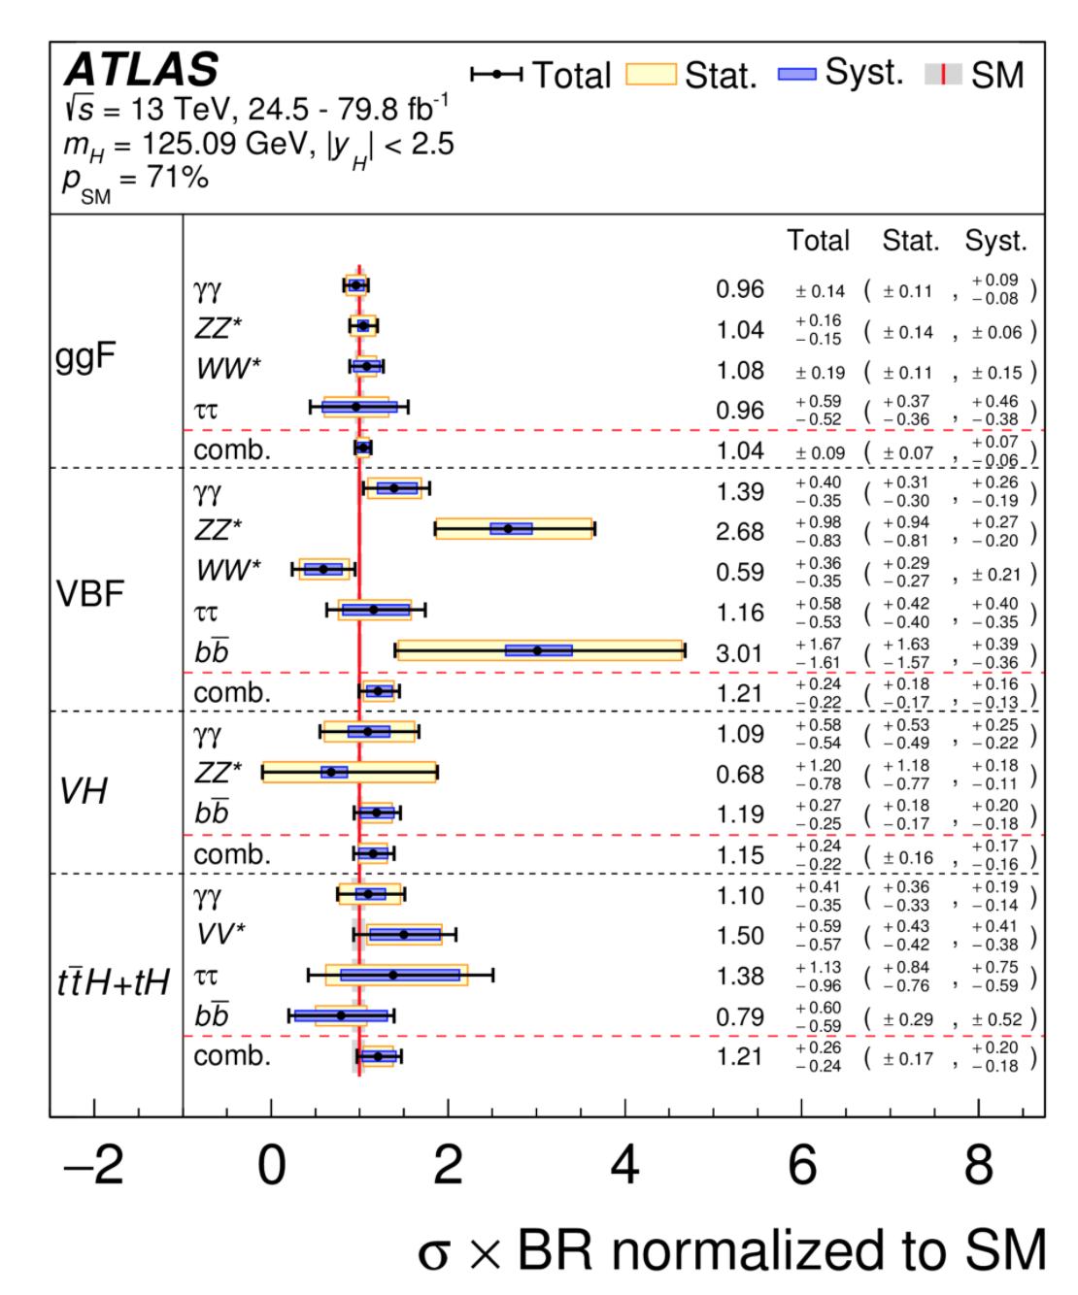
Still large uncertainties in couplings…
but compatible with SM expectations.
Observed Higgs
Production x Branching Ratios
as a ratio to SM expectation

Slide 11
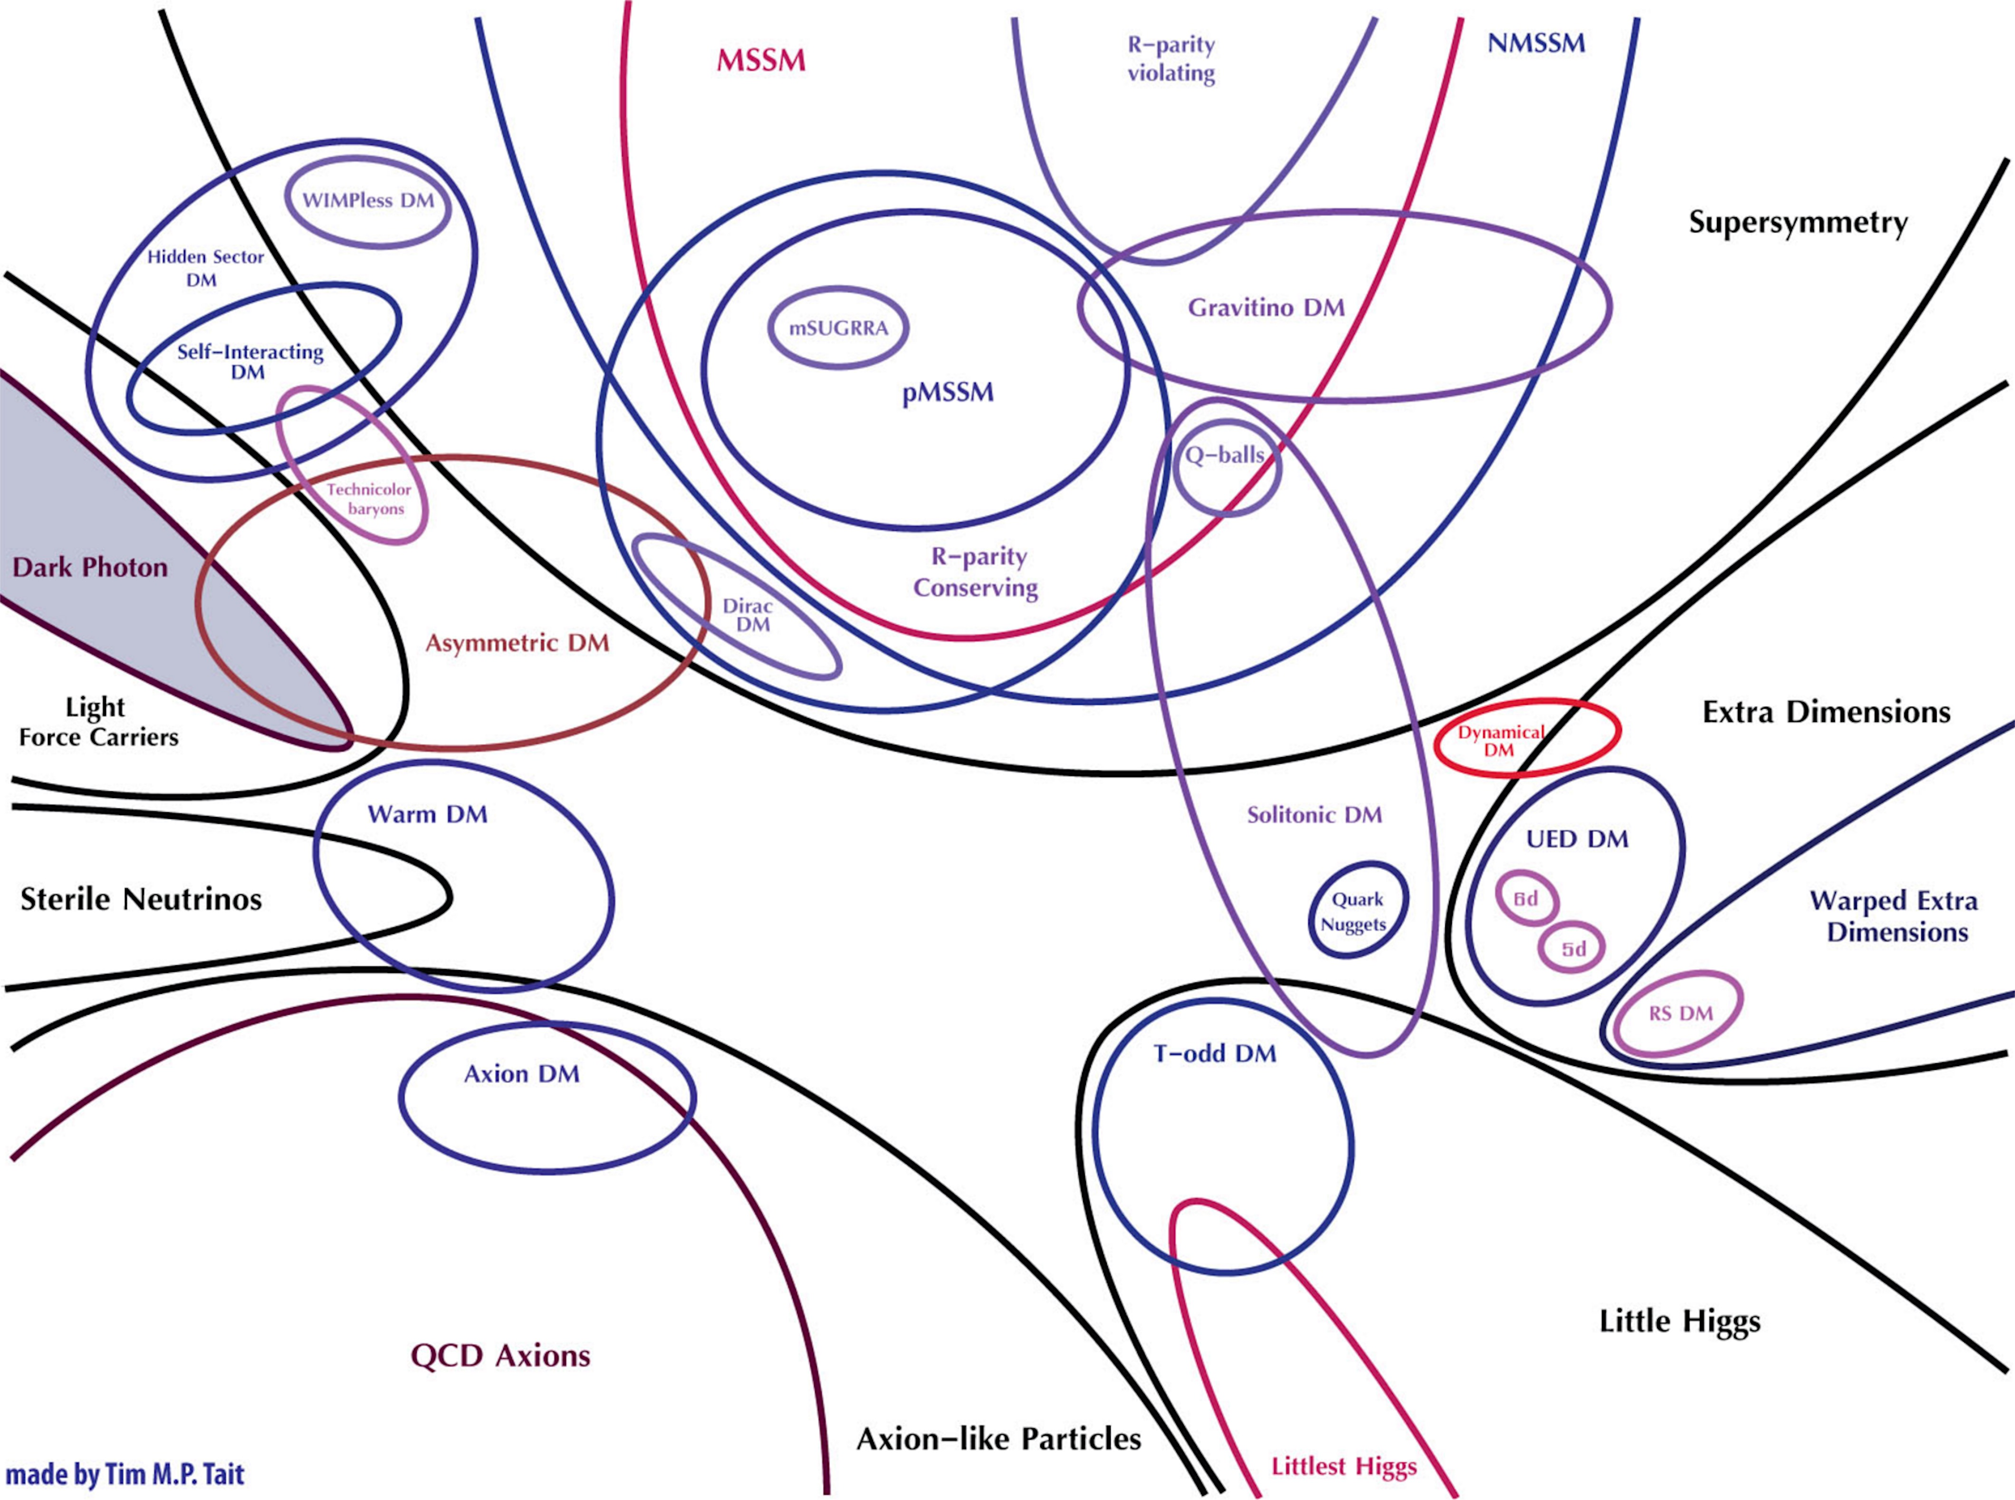
???

Slide 12
UV Symmetries?
UV Structure?
Fine-Tuning ?
Prediction?
Accidental?

Slide 13
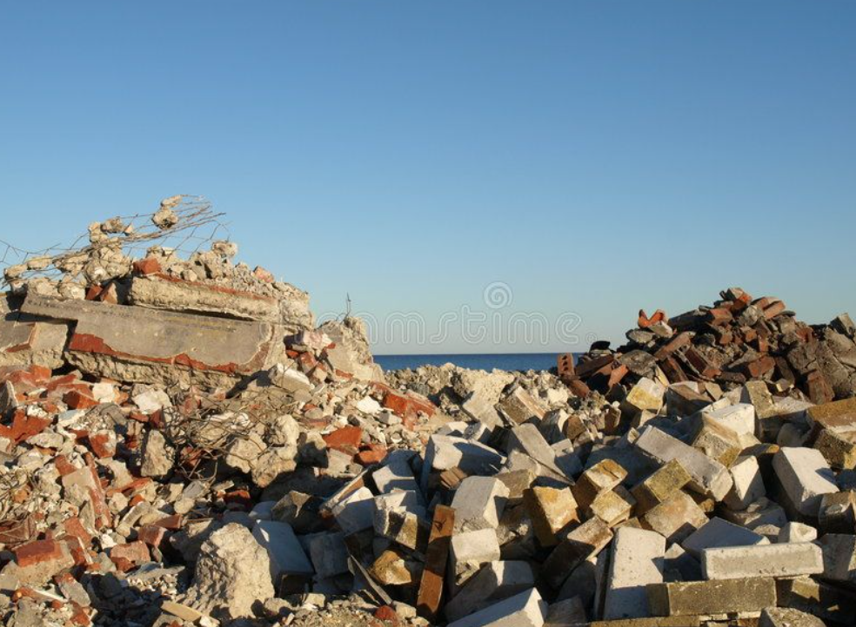
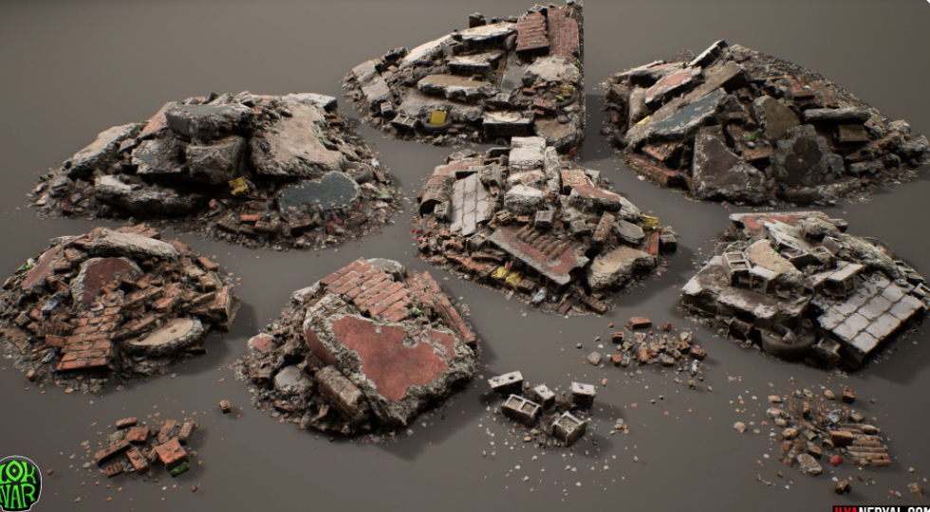
https://www.pinterest.com/pin/304978206018018128/
https://www.pinterest.com/pin/334744184798019537/?d=t&mt=login

Slide 14
Beyond the
Standard Model
with the Higgs.

Slide 15
SM Higgs is a Doublet
The Higgs FIELD is a two component weakly charged doublet.
h is the neutral particle we think we have observed at the LHC: h₁₂₅
v is the SM vev: 246 GeV.
G^{+/-} and G⁰ are “eaten” by the W and Z gauge bosons to give them mass.
$$H\text{SM}\text{=}\left({G^{±} \atop \frac{1}{\sqrt{2}}}(h+v+iG^{0})\right)$$
Why do we want more???

Slide 16
More Doublets??
The Higgs vev generates the SM fermion masses
Large Hierarchy!!
Maybe because different Higgs vevs generate different masses?
This is what happens in Supersymmetric (SUSY) Models
SUSY requires AT LEAST TWO Higgs Doublets!
Maybe there are multiple extra dimensions?
Different Higgs Doublets get different vevs due to different warping in ED
Consider a model of two Higgs doublets as a case study: 2HDM

Slide 17
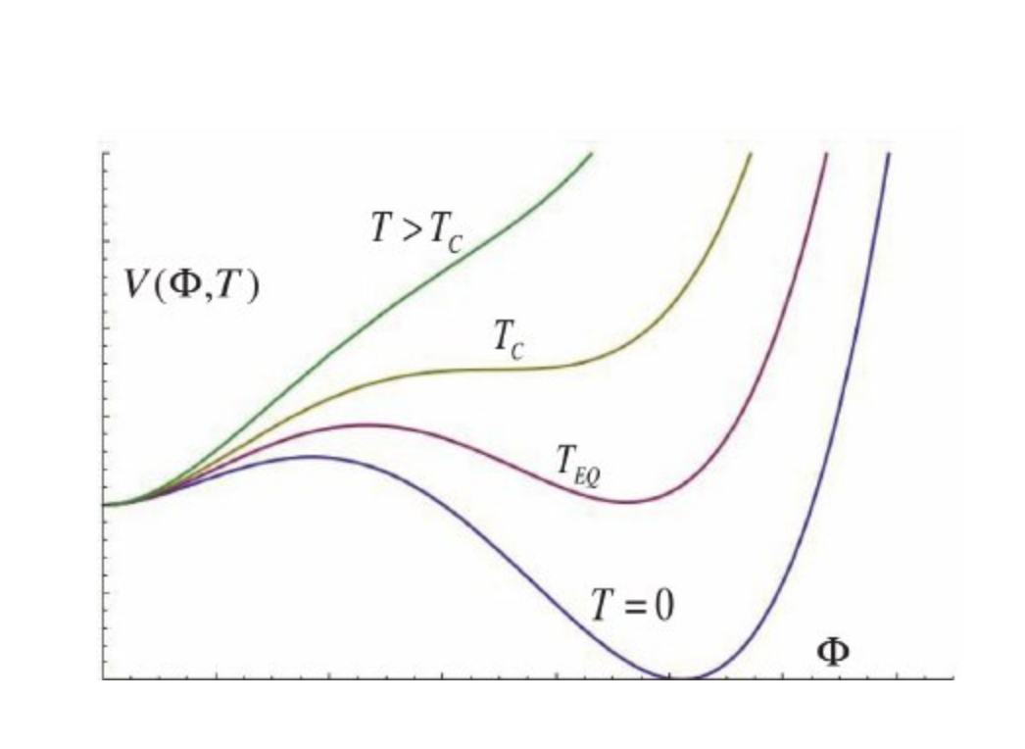
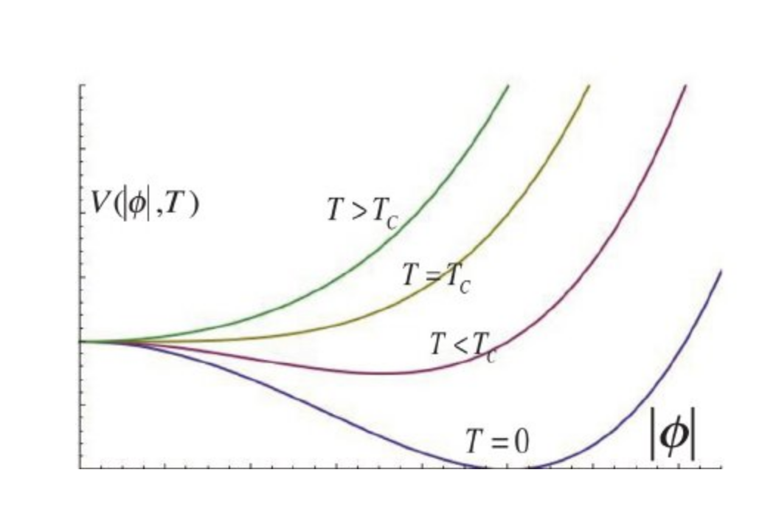
Dark Higgs??
Scalar with no electric, weak or strong charge = SM Singlet S
Dark Matter has no electric or strong charge.
Singlets as Portal to Dark Matter?
Singlets as Dark Matter Candidates?
Matter-Antimatter asymmetry? Baryogenesis!
As the Universe cools down, Higgs field develops a vev.
For successful Baryogenesis, need first-order phase transition.
SM: Roll over
Singlets can make it happen!
Consider 2HDM + S Higgs sector

Slide 18
But we
SEE
a SM-like Higgs!

Slide 19
2 Higgs Doublet Model (2HDM).
In SUSY Need 2 Higgs doublets:
H_{u} – Couples only to up-type quarks
H_{d} – Couples only to down-type quarks and leptons.
m_{A} ~ m_{H}
tan β = v_{u} /v_{d}
5 Physical Higgs bosons:
CP-Even: h, H
CP-Odd: A Charged Higgs: H^{+,-}

Slide 20
SM-Like Higgs.
246 GeV
v sin² β
<H>
<h> ~ <H_{SM}>
v cos² β
SM: Only 1 Higgs which then acquires a vev and leads to EWSB.
<H_{d} > = v cos β
<Η_{u} > = v sin β
⇒ <H_{SM}> = v
<H_{NSM}> = 0
This is what we want!
Lighter (h) is 125 GeV SM-like Higgs.
Additional states can exist!
SM-like HIGGS
Additional States can be light!
ALIGNMENT
Haber and Gunion, ‘03, M. Carena, I. Low, N.R.S. & C. Wagner, ‘13, A. Delgado, G. Nardini & M. Quiros, ‘13, N. Craig, J. Galloway & S. Thomas,‘13, P. Dev, A. Pilaftsis ‘14, M. Carena, H. Haber, I. Low, N.R.S. & C. Wagner ‘14 & ’15
etc ....

Slide 21
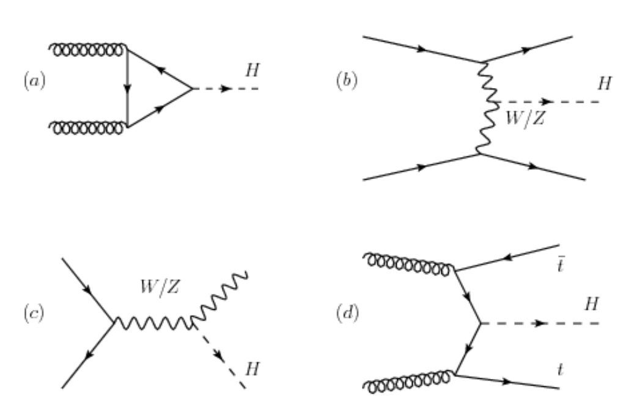
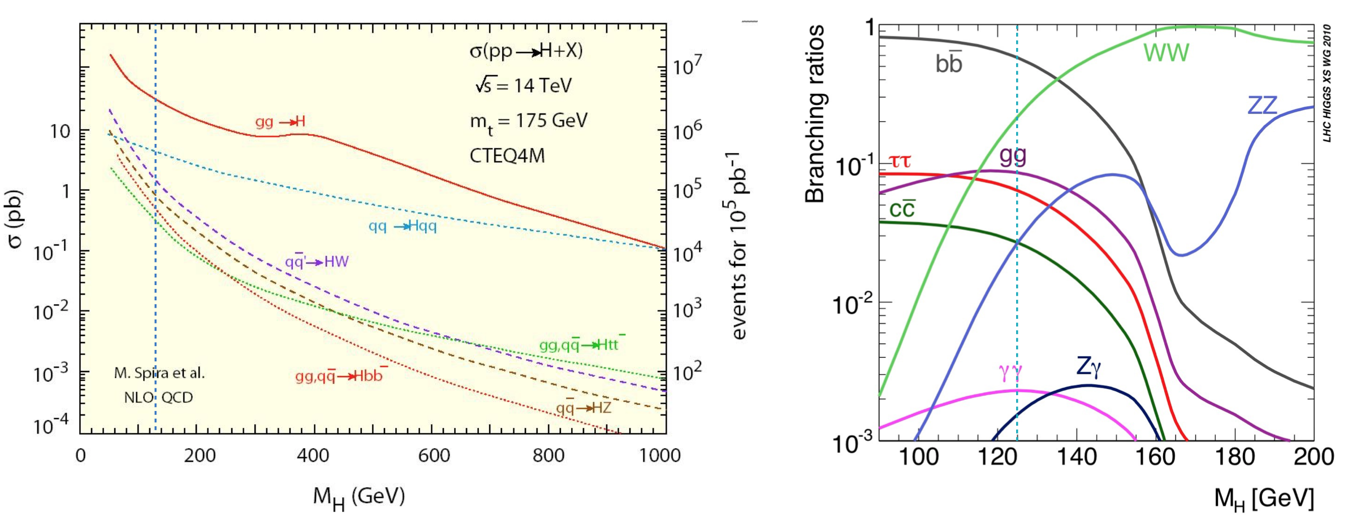
Singlets vs. Doublets??
How are they produced?
How do they decay?
Later

Slide 22
…And it has a
Mass
of 125 GeV!

Slide 23
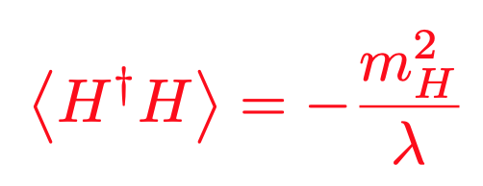
Only know location of minimum (vev)
Only know local curvature (mass)
S
$$Higgs MASS2=−4 mH2$$
y_{s}
H
H
NEGATIVE mass parameter (m_{H}²).
NO additional symmetry if Higgs massless.
NOTHING protects Higgs Mass: UNSTABLE under quantum corrections.
→ Quadratic divergences!

Slide 24
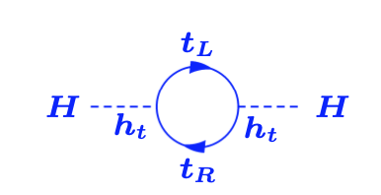
Fine Tuning?
Top quark contribution:
Complex scalar contributions:
Need to CANCEL LARGE contributions to produce physical Higgs mass
of 125 GeV!!

Slide 25
…And there
are
EW Precision tests!

Slide 26
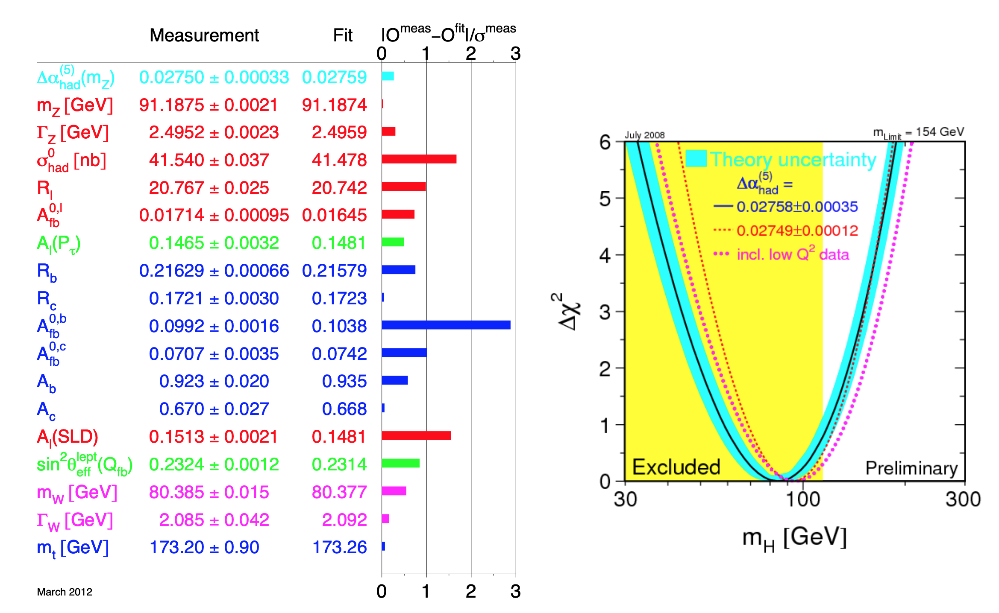
LEPEWWG ‘12

Slide 27
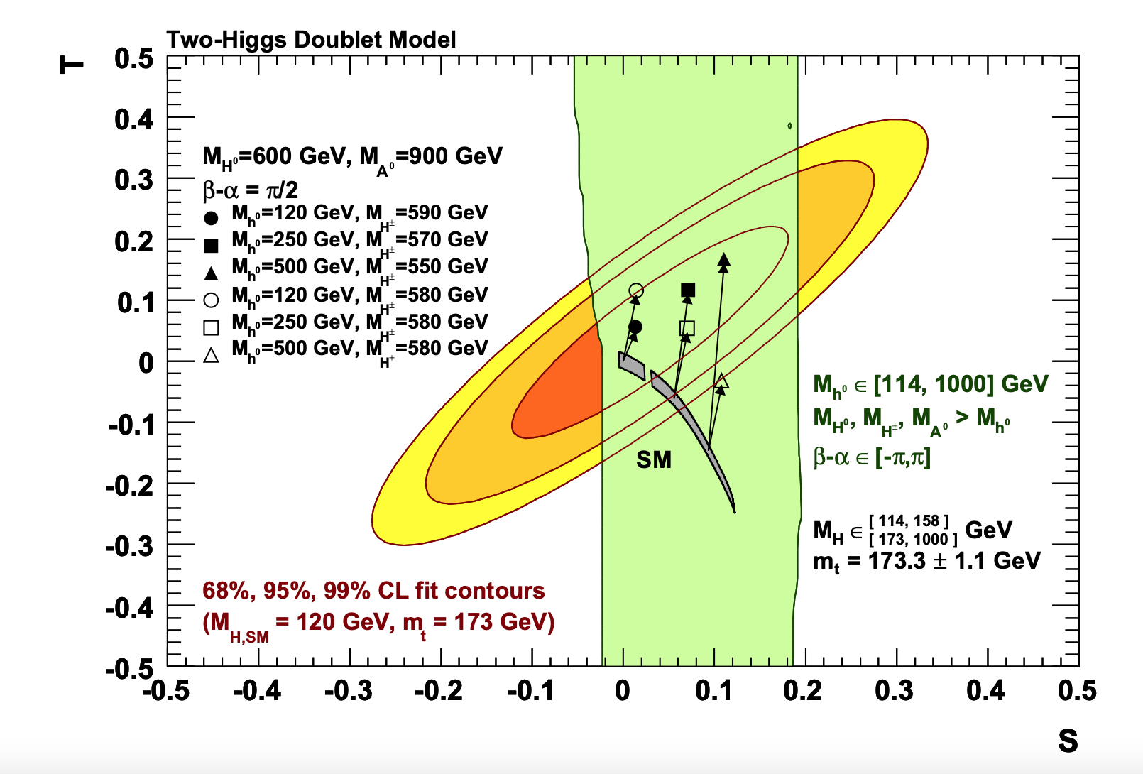
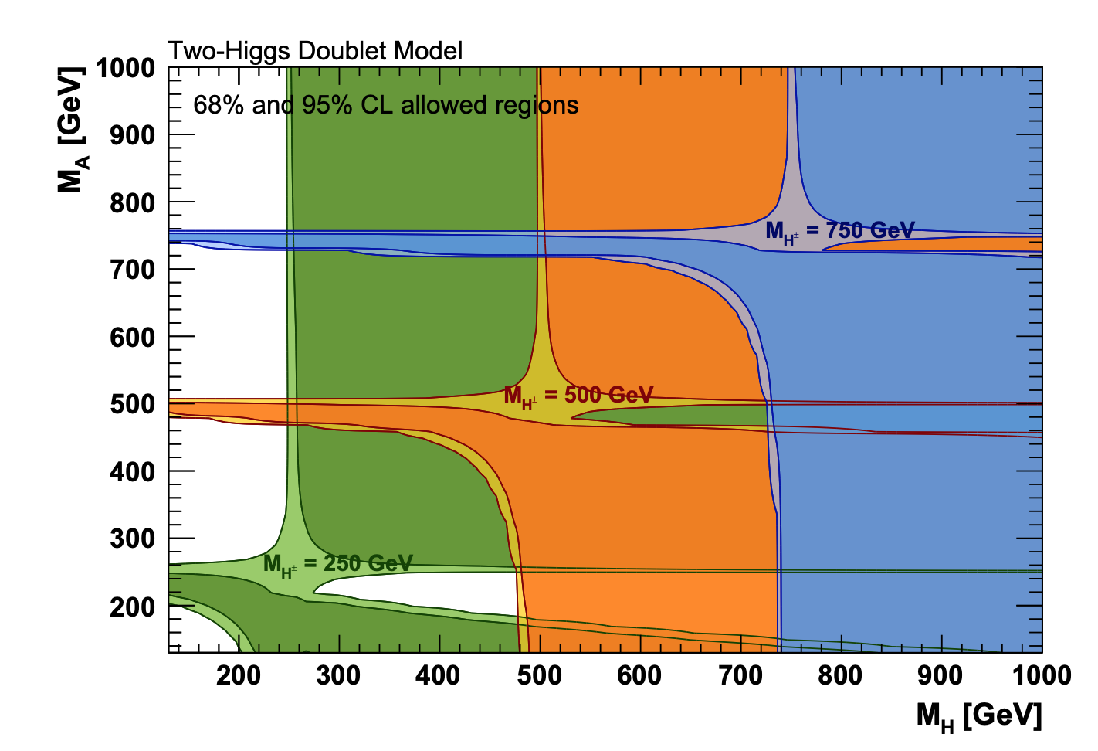
Additional Higgs bosons can contribute to EW precision observables.
T:
Difference between new physics contributions of neutral and charged current processes at low energies, i.e. sensitive to weak isospin violation.
S:
New physics contributions to neutral (charged) current processes at different energy scales
U:
Only sensitive to W mass and width.
GFitter, ‘18
2 mass states ~ degenerate

Slide 28
…And what
are
Fermion Couplings?

Slide 29
FCNC: Flavor Changing Neutral Currents
No FCNC at Tree-level in SM (GIM mechanism):
Y_{d} and Y_{u} can be diagonalized independently.
2HDM:
X₁ and X₂ generally CANNOT be diagonalized simultaneously!
FCNC

Slide 30
FCNC: Flavor Changing Neutral Currents
Suppress tree-level FCNC:
For eg: Assume X₁ and X₂ have particular relations -- Minimal Flavor Violation (MFV) ansatz.
FCNC suppressed by small SM masses and mixing angles.

Slide 31
FCNC: Flavor Changing Neutral Currents
Forbid tree-level FCNC:
Assume ONLY ONE X₁ or X₂ non-zero: Types of 2HDM
G. C. Branco, P. M. Ferreira, L. Lavoura, M. N. Rebelo, M. Sher, and J. P. Silva, ‘11
Impose (softly broken) Z₂ to allow only certain couplings
Z₂ unbroken → Other Higgs does not acquire vev OR couple to fermions: INERT Doublet
Can have VERY different phenomenology

Slide 32
246 GeV
d = 1
u = 2
<H>
<h> ~ <H_{SM}>

Slide 33
Eg for Type II: CP-Even Higgs Bases
Interaction basis: (H_{u}, H_{d}, S)
H_{u}: Couples only to up-type fermions
H_{d}: Couples only to down-type fermions
S: Only couples to Higgs
<H_{u}> = v_{u}
<H_{d}> = v_{d}
t_{β} = v_{u}/v_{d}
<S> = v_{s}

Slide 34
CP-Even Higgs Bases
Interaction basis: (H_{u}, H_{d}, S)
H_{u}: Couples only to up-type fermions
H_{d}: Couples only to down-type fermions
S: Only couples to Higgs
“Extended” Higgs basis: (H_{NSM}, H_{SM}, S)
H_{NSM}: (down, up, V) = (y_{d} t_{β}, y_{u}/ t_{β}, 0)
H_{SM}: (down, up, V) = (y_{d}, y_{u}, g_{hVV})
<H_{u}> = v_{u}
<H_{d}> = v_{d}
t_{β} = v_{u}/v_{d}
<S> = v_{s}
Only SM state couples to WW or ZZ!!
<H_{NSM}> = 0
<H_{SM}> = v

Slide 35
CP-Even Higgs Bases
Interaction basis: (H_{u}, H_{d}, S)
H_{u}: Couples only to up-type fermions
H_{d}: Couples only to down-type fermions
S: Only couples to Higgs
“Extended” Higgs basis: (H_{NSM}, H_{SM}, S)
H_{NSM}: (down, up, V) = (y_{d} t_{β}, y_{u}/ t_{β}, 0)
H_{SM}: (down, up, V) = (y_{d}, y_{u}, g_{hVV})
Mass basis: (H³, H², H¹)
H^{i} = S_{i}^{NSM} H_{NSM} + S_{i}^{S} H_{S} + S_{i}SM H_{SM}
<H_{u}> = v_{u}
<H_{d}> = v_{d}
t_{β} = v_{u}/v_{d}
<S> = v_{s}
<H_{NSM}> = 0
<H_{SM}> = v

Slide 36
CP-Even Higgs Bases
Interaction basis: (H_{u}, H_{d}, S)
H_{u}: Couples only to up-type fermions
H_{d}: Couples only to down-type fermions
S: Only couples to Higgs
“Extended” Higgs basis: (H_{NSM}, H_{SM}, S)
H_{NSM}: (down, up, V) = (y_{d} t_{β}, y_{u}/ t_{β}, 0)
H_{SM}: (down, up, V) = (y_{d}, y_{u}, g_{hVV})
Mass basis: (H₃, H₂, H₁) (H, h, h125)
H_{i} = S_{i}^{NSM} H_{NSM} + S_{i}^{S} H_{S} + S_{i}SM H_{SM}
<H_{u}> = v_{u}
<H_{d}> = v_{d}
t_{β} = v_{u}/v_{d}
<S> = v_{s}
<H_{NSM}> = 0
<H_{SM}> = v
CP-odd mix similarly:
A_{i} = P_{i}^{NSM} A_{NSM} + P_{i}^{S} A_{S}

Slide 37
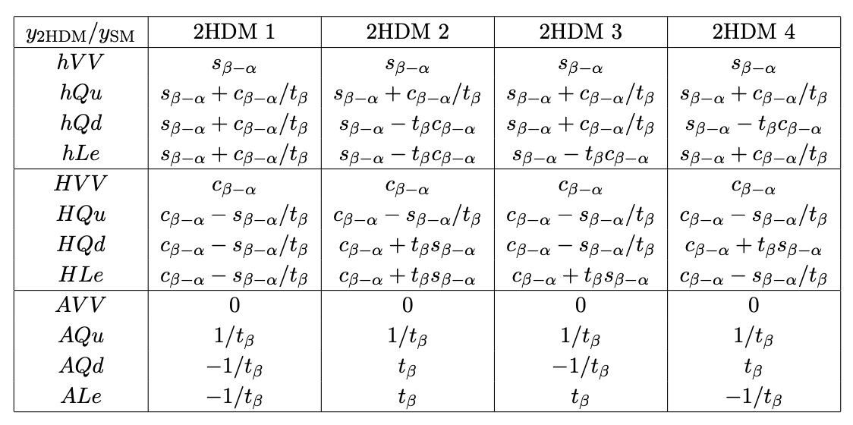
Mixing Angles
Fermion basis: “Z₂ basis” → Mass basis: 𝛂
G. C. Branco, P. M. Ferreira, L. Lavoura, M. N. Rebelo, M. Sher, and J. P. Silva, ‘11
Z₂ basis → Higgs basis: 𝛃
Higgs basis → Mass basis: (𝛃- 𝛂) ~ (𝛑-𝛆) -- Alignment
Fermion couplings to Mass eigenstates depend on 𝛂 and 𝛃
N. Craig, J. Galloway, S. Thomas, ‘13

Slide 38
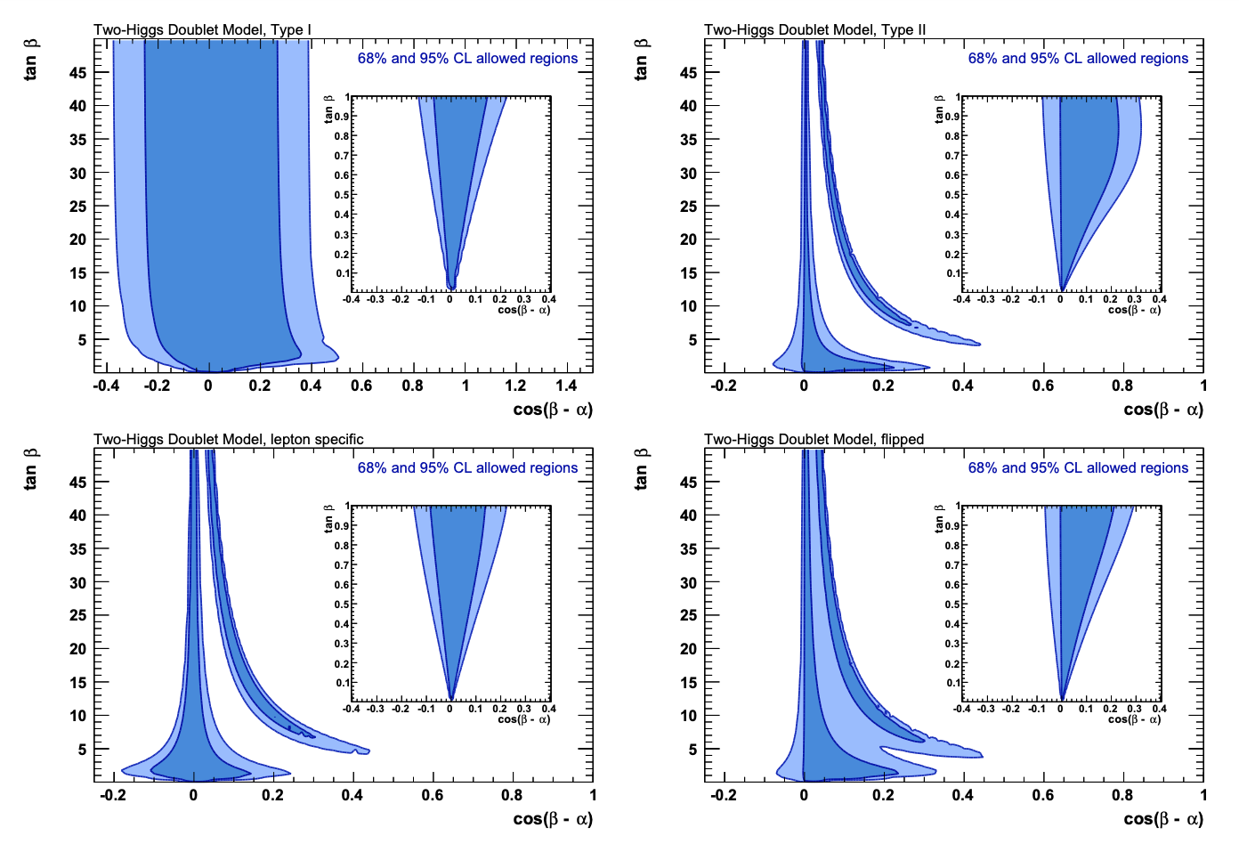
Misalignment?
G. C. Branco, P. M. Ferreira, L. Lavoura, M. N. Rebelo, M. Sher, and J. P. Silva, ‘11
c_{𝛃-𝛂} << 1, s_{𝛃-𝛂} ≈ 1
GFitter, ’18

Slide 39
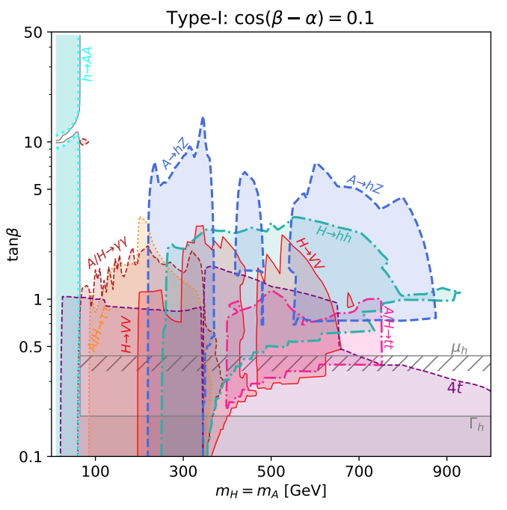
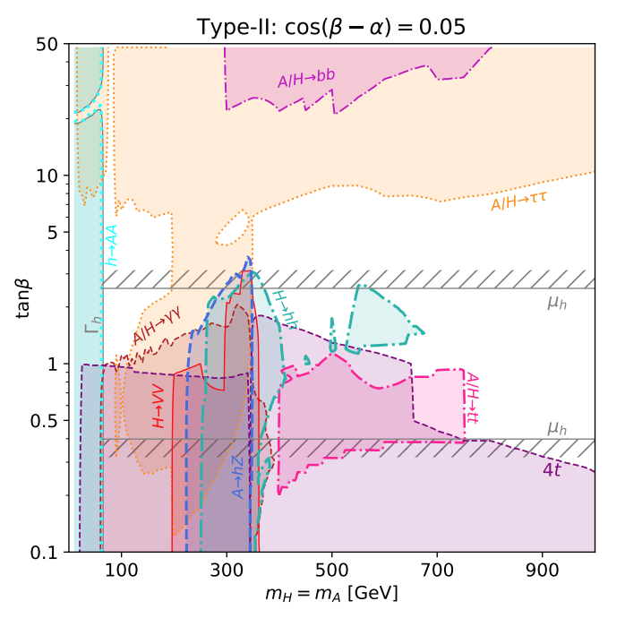
Direct Searches: LHC
How are they produced?
How do they decay?
Depends on mass spectrum, model type,
Misalignment (𝛃- 𝛂) and tan 𝛃.
Degenerate mass spectrum
F. Kling, S. Su, Wei Su, ‘20

