Slide 1
Differentiable Ray Tracing Simulator
Maxime Vandegar, Michael Kagan
January 2021

Slide 2
Plan
Build a simulator of the MAGIS optical system.
Insights:
Early insights about the system.
e.g. what is the impact of noise, quantum efficiency, …
Ability to test different systems.
e.g. different lenses, numerical apertures, …
Inference:
High-fidelity model of the projection operator that can be used at inference time.
$Α(x)=b$.
End-to-end differentiable.

Slide 3
Approach
Sample light rays from the atom cloud and model their interactions with the system (physically based rendering).

Slide 4
Approach
Sample light rays from the atom cloud and model their interactions with the system (physically based rendering).

Slide 5
Next steps
Finish the extension of the simulator to 3D.
Complexify the system (noise, quantum efficiency, …).
3D reconstruction & design of experiments.

Slide 6
Backup slides

Slide 7
JAX
Written in JAX (Autograd & XLA).
Autograd:
Automatically differentiates native Python and Numpy code.
Main purpose: gradient-based optimization.
XLA:
Compiles and runs programs on GPUs and TPUs (fused operations).
Functional programming paradigm.
Numpy (Python library) like syntax.
Automatic parallelization & vectorization.
Differentiability could also be used for design optimization.

Slide 8
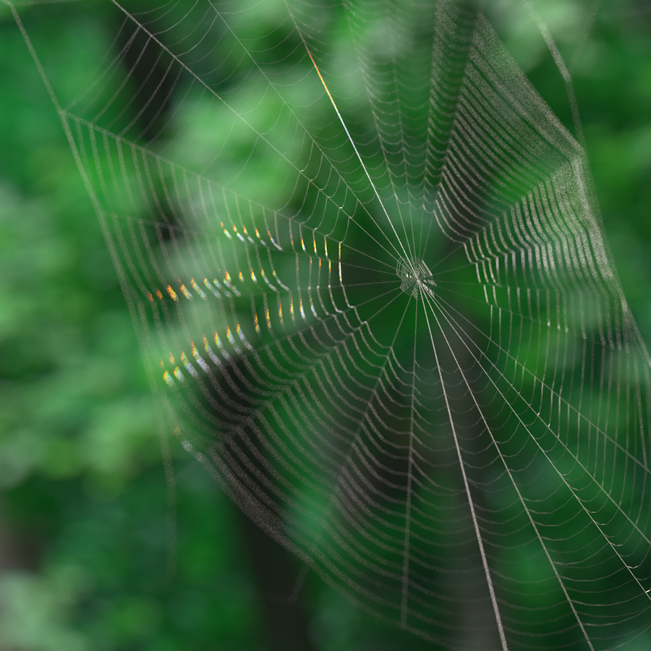
Physically Based Rendering (1)
Computer graphics approach that render images by modeling the behaviour of light rays in the real world.
CS348B: Zach DeVito implemented a system for automatic spider web generation and then simulated wavelength dependent refraction through the web's threads.
Credits: https://graphics.stanford.edu/courses/cs348b-competition/cs348b-09/

Slide 9
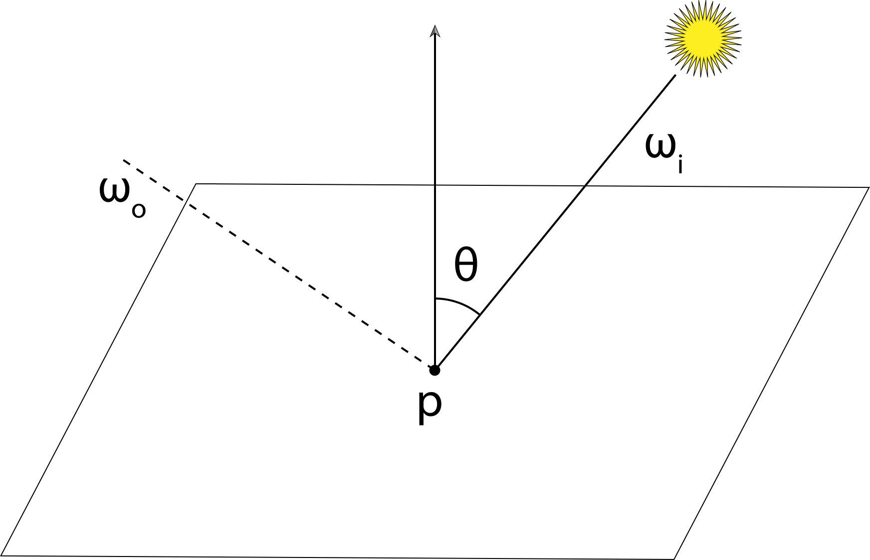
Physically Based Rendering (2)
Sample light rays from the camera and trace them until they hit a light source.
Model the interaction of light rays with materials.
Need to find which object in the scene a light ray will intersect first.
$𝒪\left(N\right) where N is the number of objects in the scene.$
Not computational efficient.
Can be improved with exact or approximated algorithms.
We know exactly the setup.
Intersections can be computed in $𝒪(1)$.
Credits: Physically Based Rendering: From Theory To Implementation. Matt Pharr, Wenzel Jakob, and Greg Humphreys.

