Slide 1

Toward a strange tagging at e+e- colliders
Tomohiko Tanabe (KEK)
November 24, 2020
©Rey.Hori

Slide 2
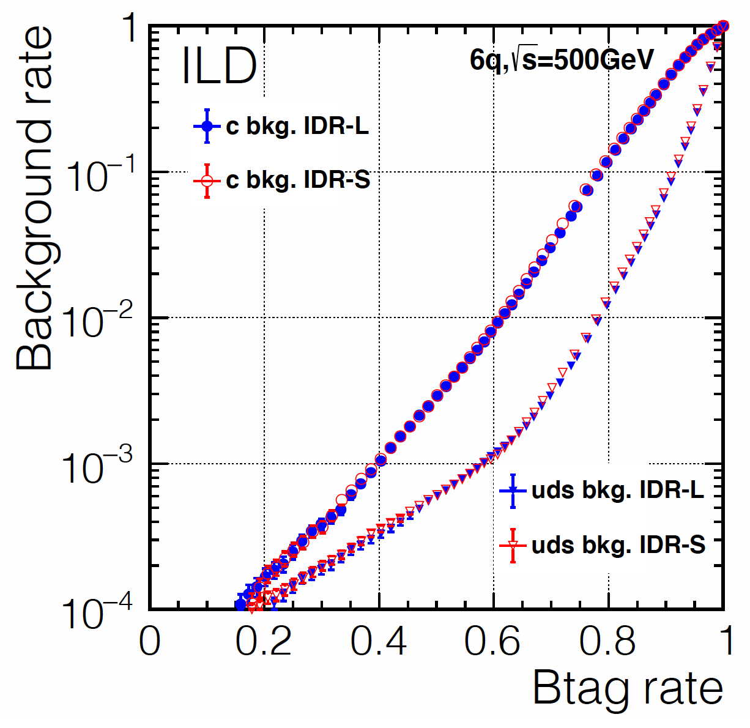
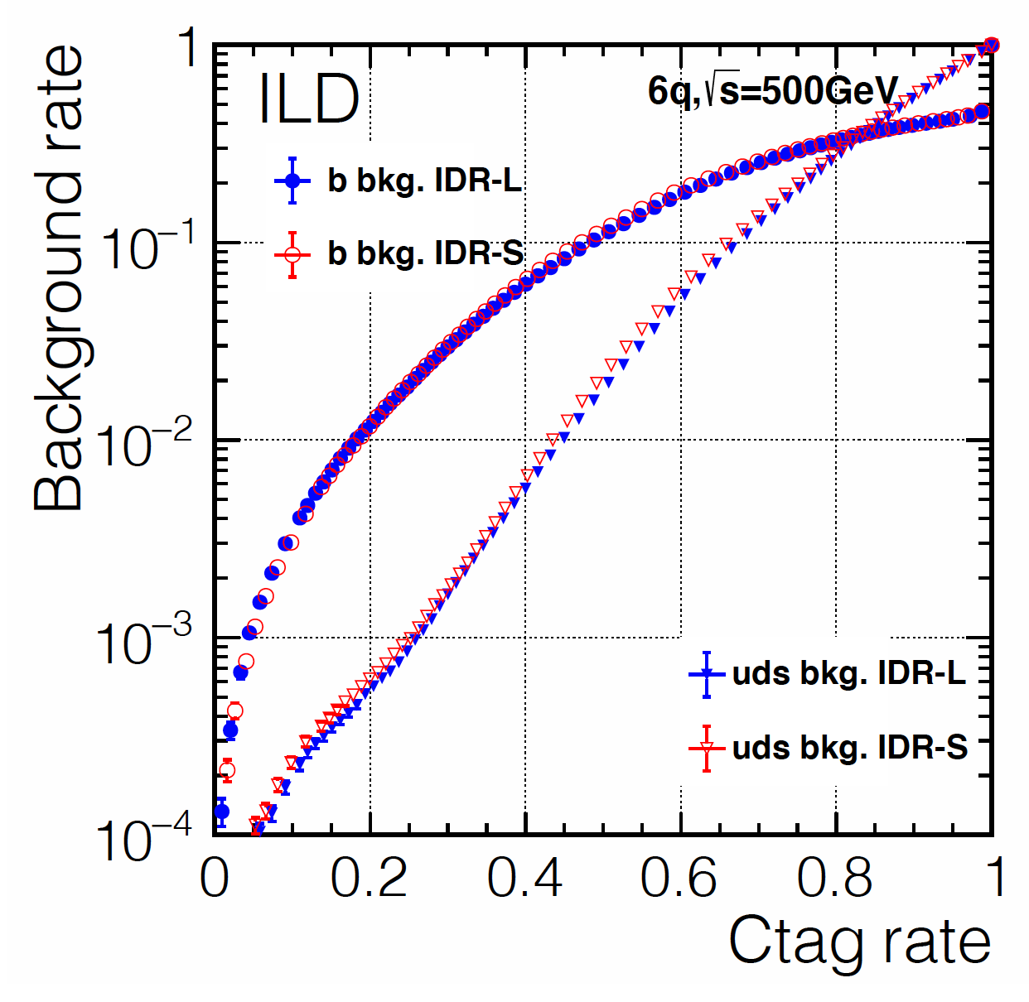
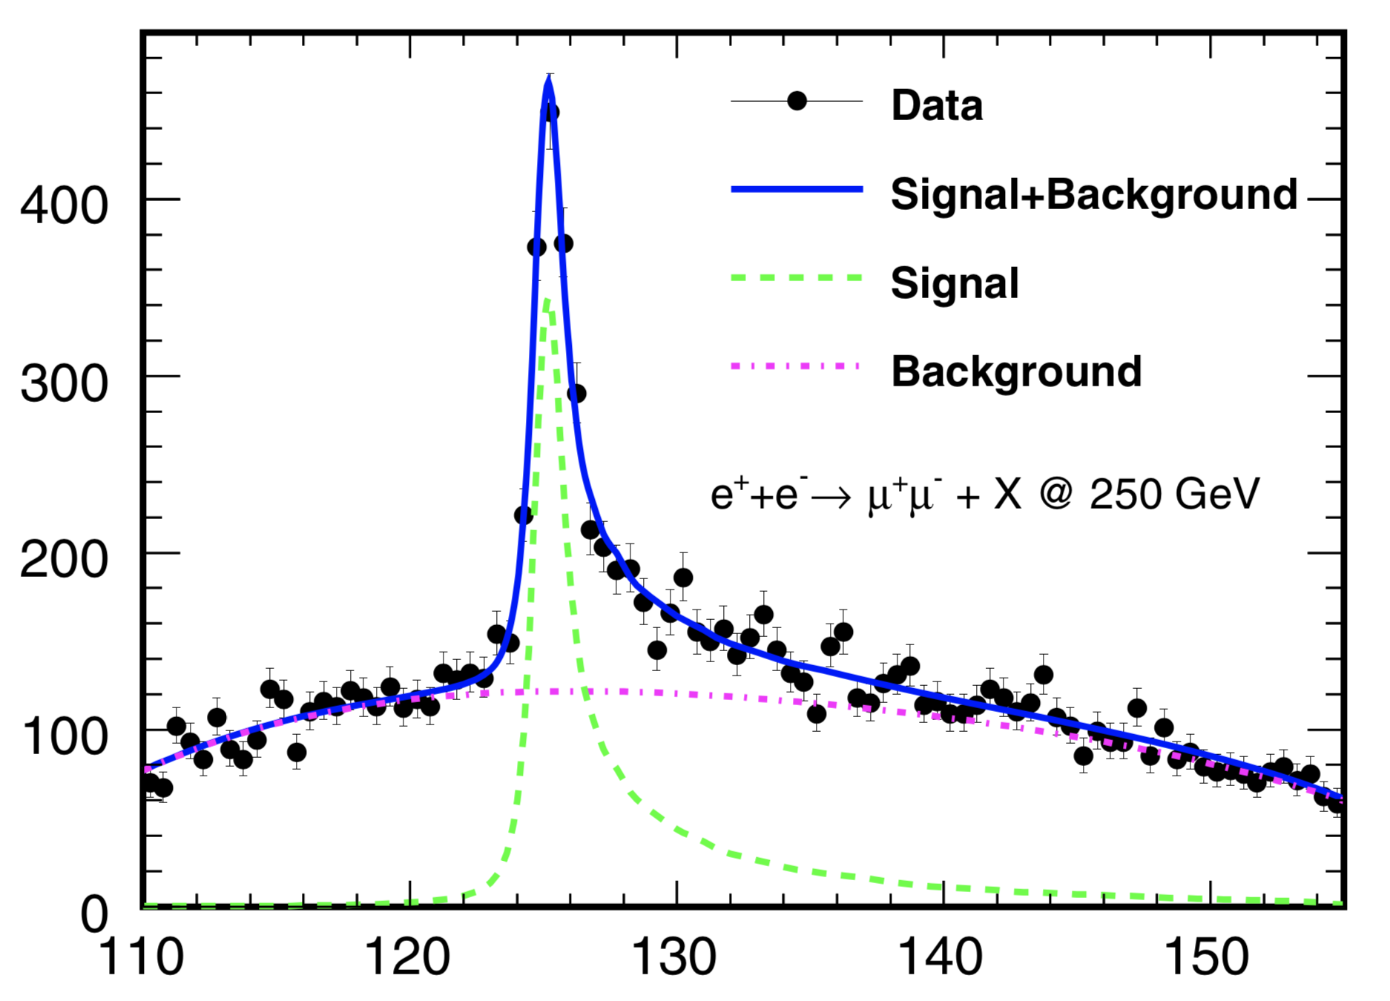
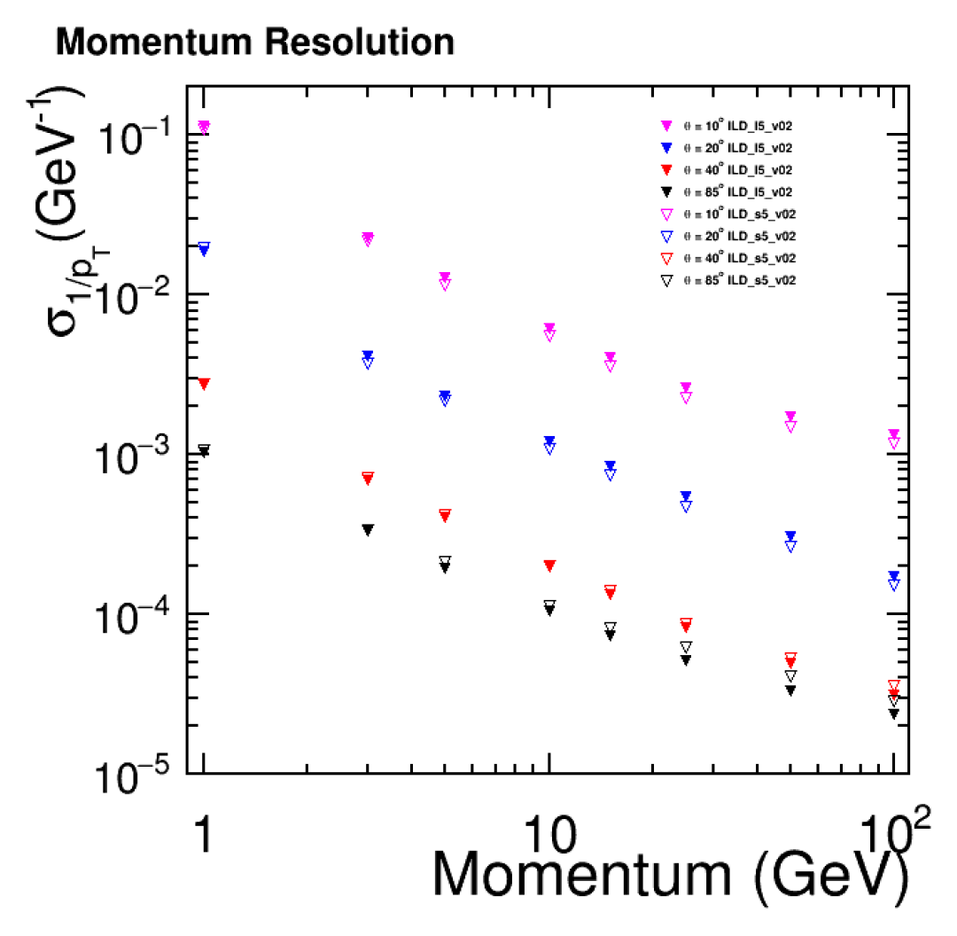
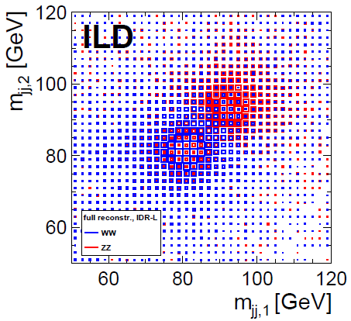
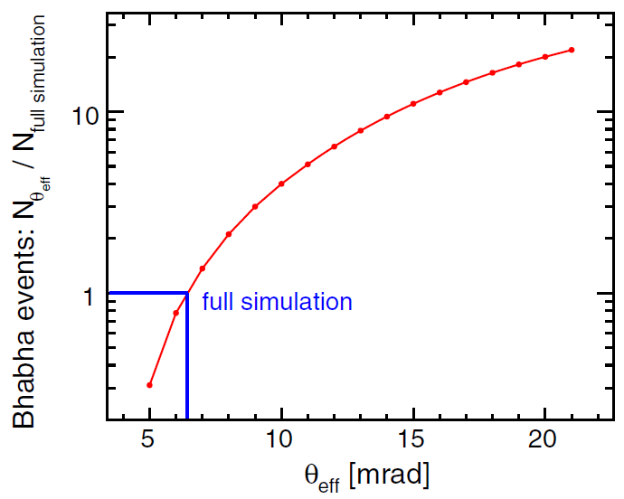
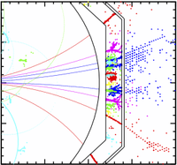
ILD Design Goals
b-tagging
Features of ILC: low backgrounds, low radiation, low collision rate
These allow us to pursue more aggressive detector designs:
c-tagging
Detector Requirements
Physics Studies
Impact parameter resolution
  σ(d₀) < 5 ⊕ 10 / (p[GeV] sin^{3/2}θ) μm
Transverse momentum resolution
  σ(1/p_{T}) = 2 x 10⁻⁵ GeV⁻¹ ⊕ 1 x 10⁻³ / (p_{T} sin^{1/2}θ)
Jet energy resolution
  3-4% (around E_{jet} ~100 GeV)
Hermeticity
  θ_{min} = 5 mrad
H→bb,cc,ττ
Total σ(e+e-→ZH)
Z/W/H→jj; H→invisible
H→invisible; BSM
Higgs recoil
against Z→μμ
p_{T} resolution
arXiv:2003.01116
ILD is optimized around particle flow:
Highly granular calorimeters
Low-mass trackers
Software reconstruction
→ Separation of clusters at particle level
Bhabha rejection
vs. polar angle coverage
[PRD 101, 075053 (2020)]
dijet mass
ννWW & ννZZ

Slide 3
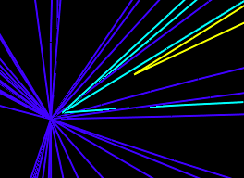
Decay Chains
Primary
Vertex
B
K
Lifetime of c hadrons: cτ ~80μm
b hadrons: cτ ~400μm
b jet
D
D
K
c jet
K
~100μm
s jet
Event Display (Generator-level)
Blue: primary tracks
Cyan: b/c tracks
Yellow: V0
ud jet
Gluon tagging not considered here

Slide 4
Categories
Primary
Vertex
B
K
b jet
Under perfect reconstruction, we only need to count:
D
 | # of secondary vertices (excluding V⁰) | # of strange hadrons (K±, K_{L}⁰, K_{S}⁰, Λ⁰)
b | 2 | ≥1
c | 1 | ≥1
s | 0 | ≥1
ud | 0 | 0
D
K
c jet
K
s jet
ud jet
In reality: missing tracks / fake tracks → migration
→ These provide natural categories for multivariate classification.

Slide 5
Discriminants
Primary
Vertex
B
K
b jet
Charged Kaon track
Zero track impact parameter w.r.t. primary vertex
Momentum fraction relative to the jet momentum carried by the leading Kaon
  (Longitudinal vs transverse components?)
V⁰ (K_{S}⁰,Λ⁰)
Vertex momentum & displacement must point in the same direction
Mean vertex distance smaller compared to b/c
+ the usual b/c discriminants (vertex mass, impact parameter for all tracks, etc.)
Remember to normalize the discriminants to make them boost invariant (as much as possible)
D
D
K
c jet
K
s jet
ud jet

Slide 6
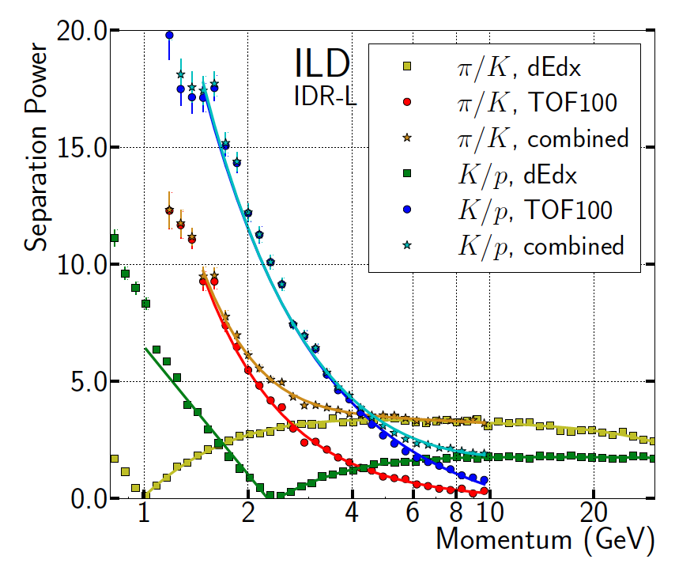
Strange Hadron Reconstruction/Selection
OPEN QUESTIONS
Pion/Kaon separation:
  With and without timing
K_{S} & Λ reconstruction: efficiency/purity?
  Does proton tag help Λ reconstruction?
Neutron/K_{L} separation (probably not)
Best strange hadron selection:
  Lists ordered by purity, or likelihood in terms of PID/mass?
[Do we want perfect (cheated) reconstruction?]
Strange Hadron reconstruction
K± [PID]
K_{S}⁰ → π⁺π⁻ [Vertex] (BF ~69.2%)
Λ⁰ → pπ⁻ [Vertex] (BF ~64%)
K_{L}⁰ [Particle Flow]
Λ

Slide 7
ILD Samples
Event Generator
 | DST | Mini-DST
Tracks | ✔
MC Particles | ✔ | ✔
Reconstructed Particles | ✔ | ✔
Primary Vertex | ✔ | ✔
Isolated e/mu/tau |  | ✔
Jets (2, 3, 4, 5, 6) |  | ✔
b/c/o tagging |  | ✔
Particle ID | ✔ | ✔
Secondary Vertices | ✔
V0 Vertices [pandora] | ✔
V0 Vertices [lcfiplus] | ✔
Detector Simulation
SIM
Digitization/
Vertex Finding
DST
Jet Finding/
Flavor Tagging/
Lepton Finding
DST +more
(Drop collections)
Mini-DST
Do we want to request mini-DSTs with the full collections (for a select few channels)?

Slide 8
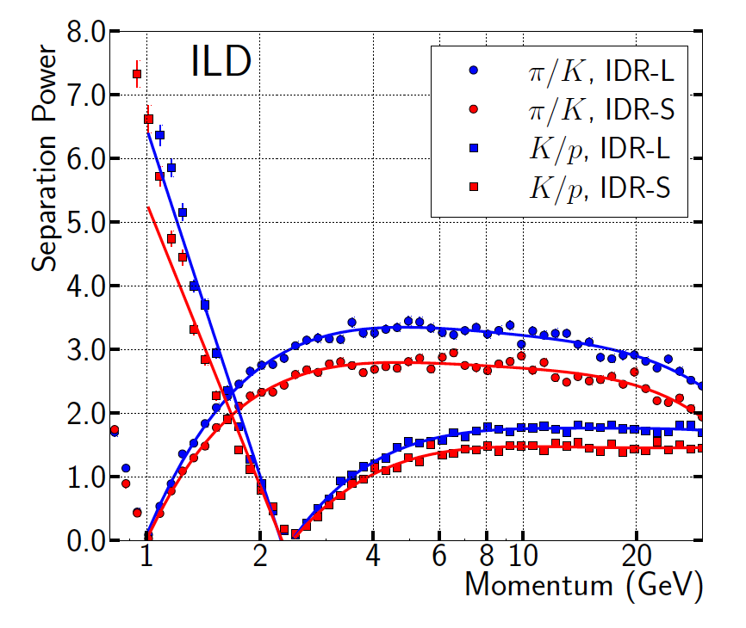
Particle Identification
TPC dE/dx only:
Combine dE/dx with ECAL time-of-flight (100ps):
A_{FB}(b) from e⁺e⁻ → bb @ 250 GeV
Vertex charge reconstruction corrected using Kaon ID and detector acceptance:
Proof of concept.
→100 ps needs to be demonstrated in test beam prototype.
#4 Top/EW (Jul 31)
A. Irles: Heavy quark production in high energy electron positron collisions
→ Particle identification capabilities offer unique physics opportunities

Slide 9
b/c Tagging Overview

Slide 10
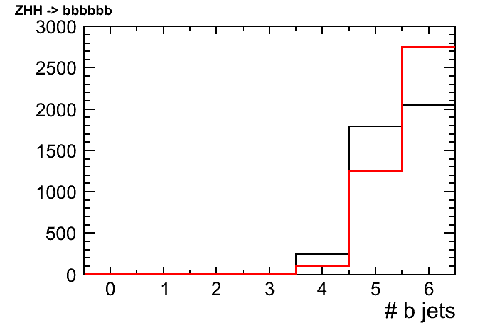
Vertex Finding First
Traditionally, jet finding → vertex finding
  Secondary tracks can get split into different jets; especially significant in many jet events
We perform vertex finding → jet finding
  computationally more challenging but doable at e+e-
[T. Suehara]
ZHH -> bbbbbb
Durham
-Vertex First
b finding efficiency increase in ZHH (self-coupling)

Slide 11
Decay Chain
Ideally want to reconstruct the entire decay chain in a jet:
b
c
SV
s
Primary Tracks
Secondary Tracks
PV
SV
SV
PV: Primary Vertex
SV: Secondary Vertex
Vertex reconstruction is key to flavor tagging
Require at least two reconstructed tracks
Use track impact parameter if vertex reco. not possible
PV
b

Slide 12
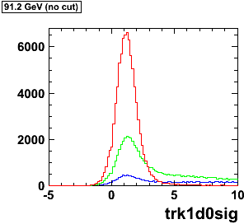
Signed Impact Parameter Significance
Z→qq sample
b
c
uds
Impact parameter significance:
S(d₀) = sgn(p_{jet}･r_{d0}) d₀/σ_{d0}
Sign is defined in terms of jet direction
Uncertainty taken from track fit: σ_{d0}
Signed transverse impact parameter significance
Track having the highest value is chosen to represent the variable per jet

Slide 13
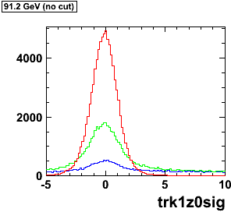
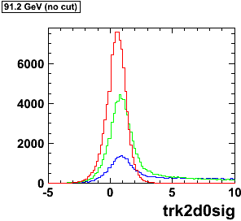
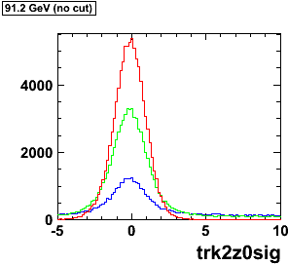
d₀/σ_{d0}
z₀/σ_{z0}
for track with
highest d₀/σ_{d0}
d₀/σ_{d0}
d₀/σ_{d0}
for track with
second highest
d₀/σ_{d0}

Slide 14
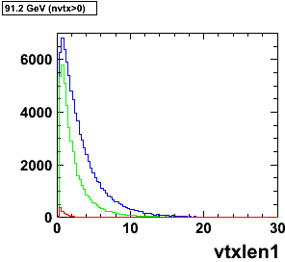
Secondary Vertex
Identifying the flavor of the originating quark helps with the reconstruction of the parent particle:
H → bb, cc, gg
t → bW
W → cs, ud
Z → bb, cc, ss, dd, uu
~1mm
Key signature of heavy quarks:
secondary vertices
Lifetime of c hadrons: cτ ~ 80μm
b hadrons: cτ ~400μm
Exponential decay
Not Gaussian peaks!
Mean secondary vertex distance:
<L_{vtx}> = γβcτ
e.g. for B meson (m_{B}~5 GeV) with E=45 GeV, γ~9, β~1 → L~3.6mm
Z→qq sample
b
c
uds
strange vertices
suppressed via
V⁰ rejection
Distance between secondary vertex
and primary vertex (reco.) [mm]

Slide 15
Vertex Finding
Two standard approaches to vertex reconstruction:
“tear down” method
  Start with all tracks
  Fit the tracks to a vertex
  Remove track which is most inconsistent with the vertex
  Repeat until all tracks are consistent with the vertex,
  i.e. χ² contribution is smaller than some threshold value
Primary
Vertex
“build up” method
  Create vertex “seeds” from track pairs
  Try to add more tracks to the vertex, accept if the vertex fit is good
  Repeat until there are no more tracks to add
Secondary
Vertex
~1mm

Slide 16
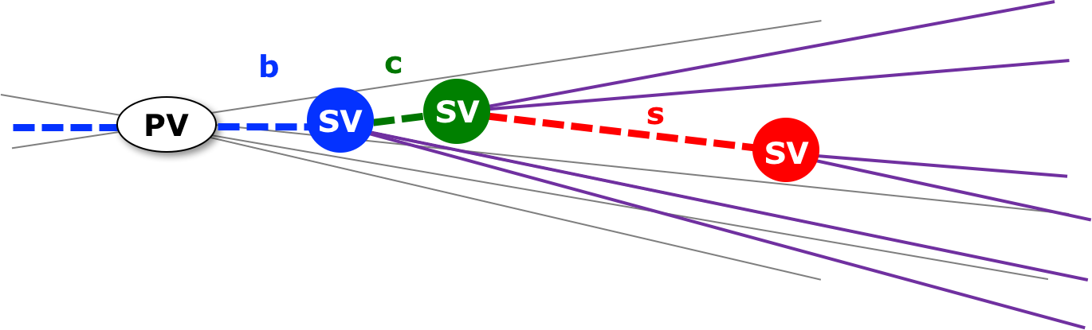
V⁰ Rejection
Long-lived neutral particles “V⁰ particles” decaying to two charged tracks are backgrounds in flavor tagging.
Strange neutral hadrons:
K_{S} : lifetime cτ ~26mm
  K_{S}→π⁺π⁻
Λ : lifetime cτ ~79mm
  Λ→pπ
Material interaction:
γ conversions : γ(N)→e⁺e⁻ (N)
Reconstructed
Λ mass
Photon conversions occur where there is detector material
V⁰ particles are removed by applying selections on the mass and direction to the primary vertex.

Slide 17
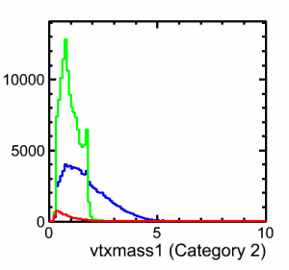
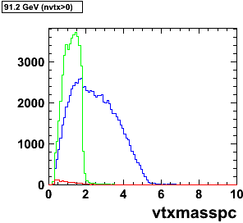
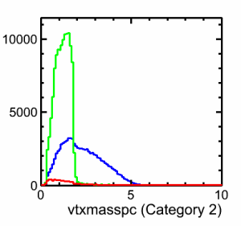
Secondary Vertex Reconstruction
More plots at https://confluence.slac.stanford.edu/display/ilc/LCFIPlus+Variables
Z→qq sample
b
c
uds (V⁰ removed)
Distance between SV and PV [mm]
Vertex mass with pT correction[GeV]
m_{b} ~ 5 GeV, m_{c} ~ 2 GeV
Vertex mass powerful discriminant for b/c separation
Add minimum amount of pT to the vertex (contribution from neutral particles) needed to make the vertex momentum direction consistent with the primary vertex

Slide 18
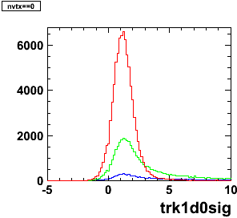
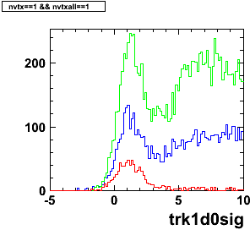
b/c Tagging Categories
Training is done by separating the jet sample into the following categories:
  Category 1: # of vertex = 0
  Category 2: # of vertex = 1
  Category 3: # of vertex = 1+1(pseudo vtx)
  Category 4: # of vertex = 2
Z→qq
sample
b
c
uds
#vtx=0
#vtx=1
Different categories can give very different distributions of the same variable

Slide 19
b/c Tagging Performance
T. Suehara, TT 10.1016/j.nima.2015.11.054
b tagging
c tagging

Slide 20
b/c Tagging Performance

Slide 21
Additional Slides

Slide 22
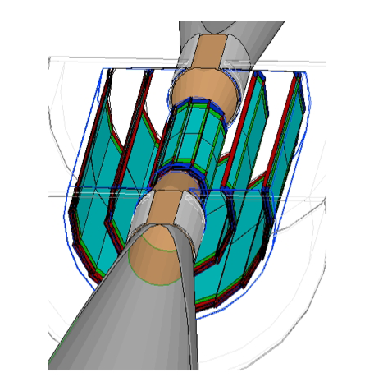
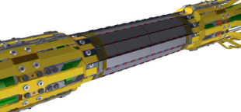
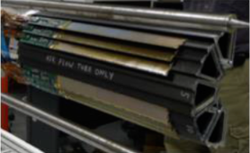
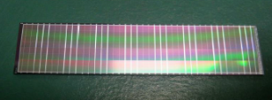
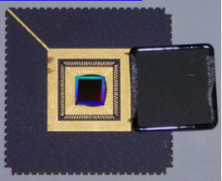
Vertex Detector
SiD
ILD
CMOS
DEPFET
Silicon pixels
  5 single layers or 3 double-sided layers
  e.g. σ_{rφ} ~3 μm → ~17μm pitch
Low material budget: O(0.15%X₀) per layer
Challenges: beam backgrounds, cooling, alignment
Last detector to be installed; several options currently exist
Fine pixel CCD
Chronopixel
SOI
Readout strategies: exploiting the ILC duty cycle O(10⁻³):
  Slow readout (low power) in-between trains
    either ~5μm pitch for occupancy or in-pixel timestamping
  Fast readout with power cycling
    mechanical stress from Lorentz forces in high B field

Slide 23
Application:
Higgs hadronic decays
Template distributions for H→bb,cc,gg:
ILC 250 GeV [H.Ono]

Slide 24
Impact Parameter
Transverse impact parameter
Longitudinal impact parameter
y
z
track
at the point where d₀ is measured
track
d₀
z₀
PV
PV
x
x
Impact parameter significance:
S(d₀) = d₀/σ_{d0} , S(z₀) = z₀/σ_{z0}
Uncertainty taken from track fit: σ_{d0} , σ_{z0}

Slide 25
Signed Impact Parameter
Secondary decays should be in the direction of the jet
track
track
y
y
Jet momentum: p_{jet}
Displacement vector
for d₀ : r_{d0}
PV
PV
x
x
Positive if (p_{jet}･r_{d0}) > 0
Negative if (p_{jet}･r_{d0}) < 0

