Slide 1
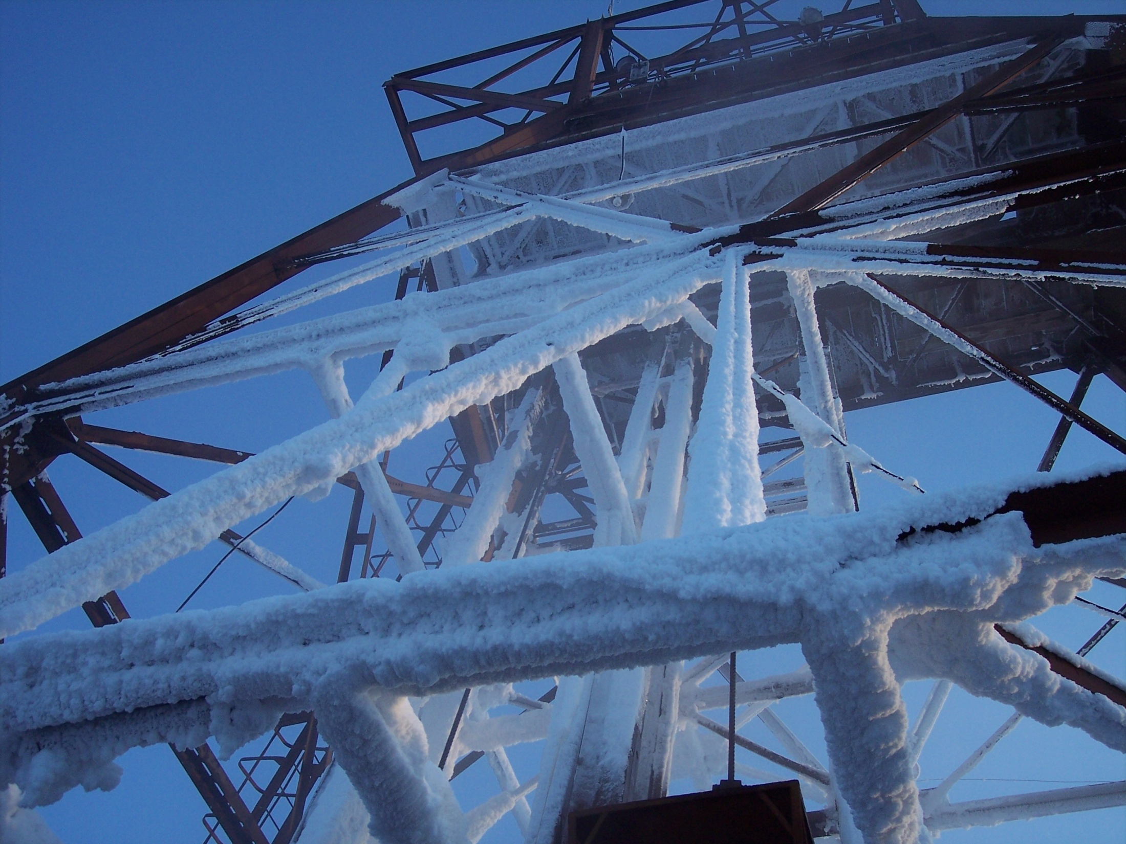

Searching for low-mass dark matter with SuperCDMS
Ray Bunker
Syracuse University

Slide 2
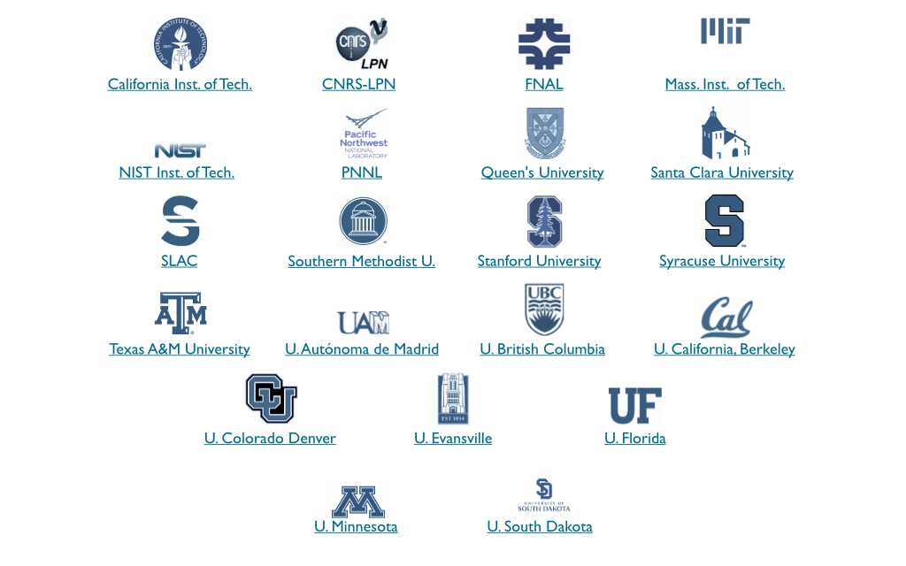
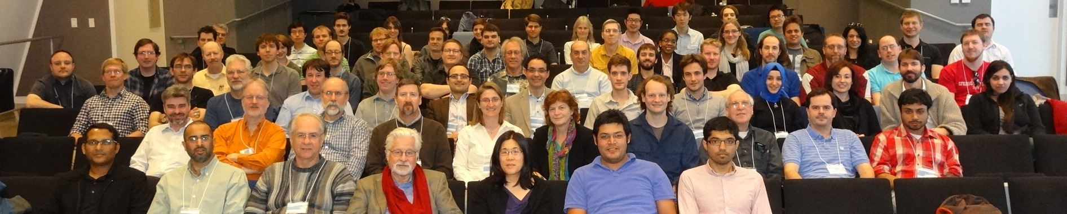
The SuperCDMS Collaboration

Slide 3
Outline
Introduction
SuperCDMS direct-detection technique
Demonstrated background discrimination
SuperCDMS Soudan
Run description
High-voltage-bias operation (CDMSlite)
Low-threshold analysis
SuperCDMS SNOLAB
Improvements vs. Soudan
Projected reach
Radon Mitigation & Assay
Vacuum-swing absorption filtering
Emanation assay & the BetaCage
V. Conclusions

Slide 4
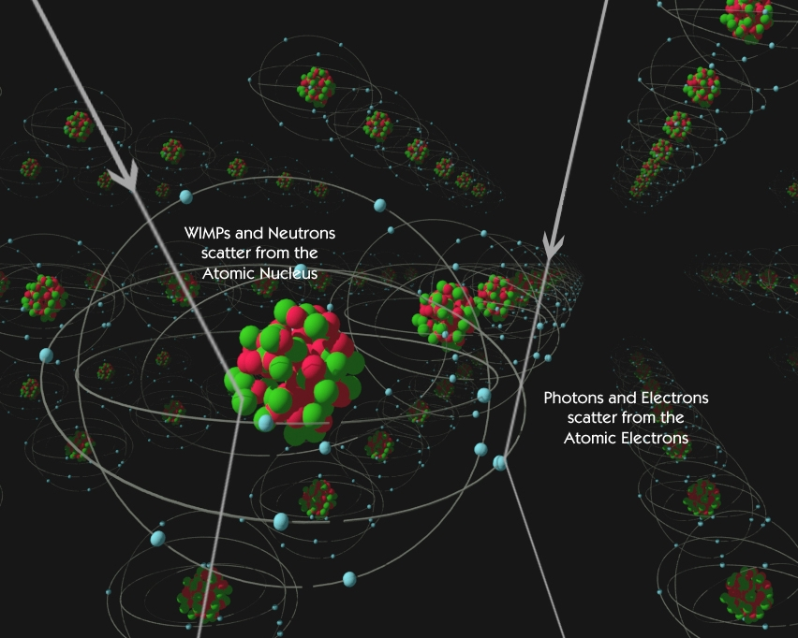
Direct detection
Neutral
Particle
Electrically
Charged
Particle
Slow Nuclear Recoil (NR),
deposits energy
over short distance
Fast Electron Recoil (ER), deposits energy
over large distance
Courtesy M. Attisha

Slide 5
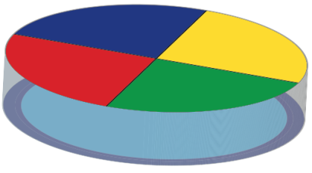
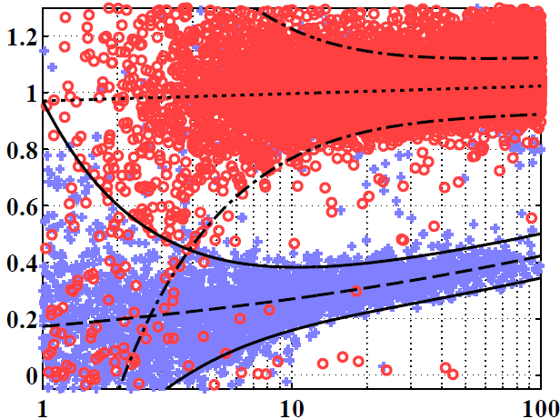
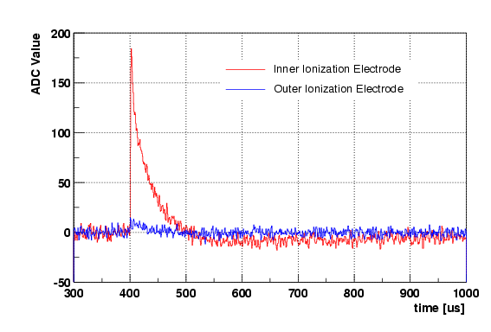
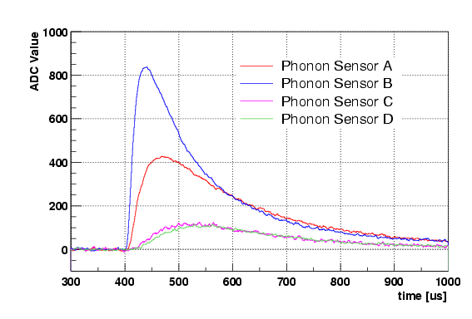
CDMS technique — ionization & phonons
Inner & outer electrodes
for radial fiducialization
A
Channel partitioning enables
xy-position reconstruction
A
D
Recoil energy
B
D
B
C
C
Extra energy:
Neganov-Luke phonon amplification → CDMSlite
Quasiparticle
trap
tungsten
Transition Edge Sensor (TES)
holes⁺
e⁻
Cooper pair
Aluminum collector
Ge or Si
Nuclear
recoil (NR)
Electron
recoil (ER)
Diffusion
Some confusion
due to
finite resolution
at low energy
γ-ray calibration ERs
Phonons
Ge or Si crystal
Near-perfect ID of
NRs and (bulk) ERs
Above ~10 keV
NR causes ≈20–30% ionization
relative to equal-energy ER
Phonons provide equal measure
of NR & ER recoil energies
Ionization Yield
Face events
Near-surface ERs
most problematic
in original CDMS
ZIP-detector design
Phonon (P) Pulses
Ionization (Q) Pulses
200
Neutron calibration NRs
Inner Electrode
Outer Electrode
800
Sensor A
Sensor B
Sensor C
Sensor D
100
Pulse Height (ADC bins)
Pulse Height (ADC bins)
400
Sidewall events
0
0
300 400 500 600 700 800 900 1000
Recoil Energy (keV)
Time (μs)
300 400 500 600 700 800 900 1000
Time (μs)

Slide 6
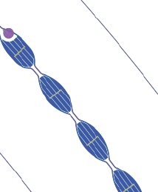
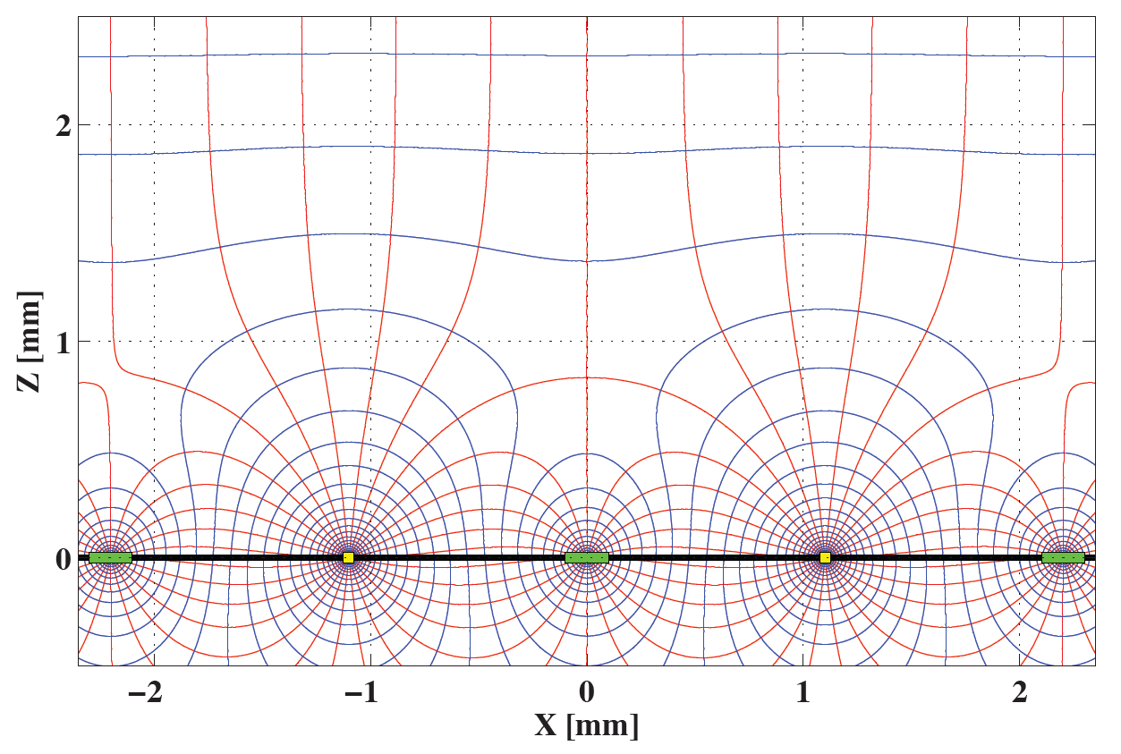
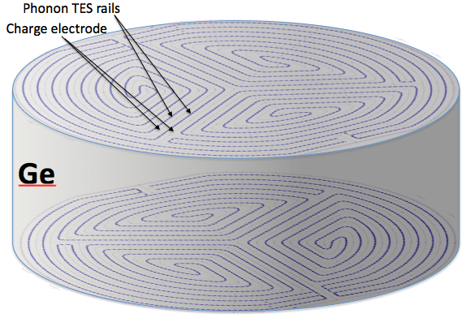
SuperCDMS technique — the iZIP
Interleaved ionization & phonon sensors
Phonon sensors @ 0V
Bulk event → Side-symmetric Ionization signal
Surface event → Asymmetric ionization signal
Ionization
electrodes @ ±2V
Significantly improved face-event rejection
Holes
Electrons
Holes
Electrons
6

Slide 7
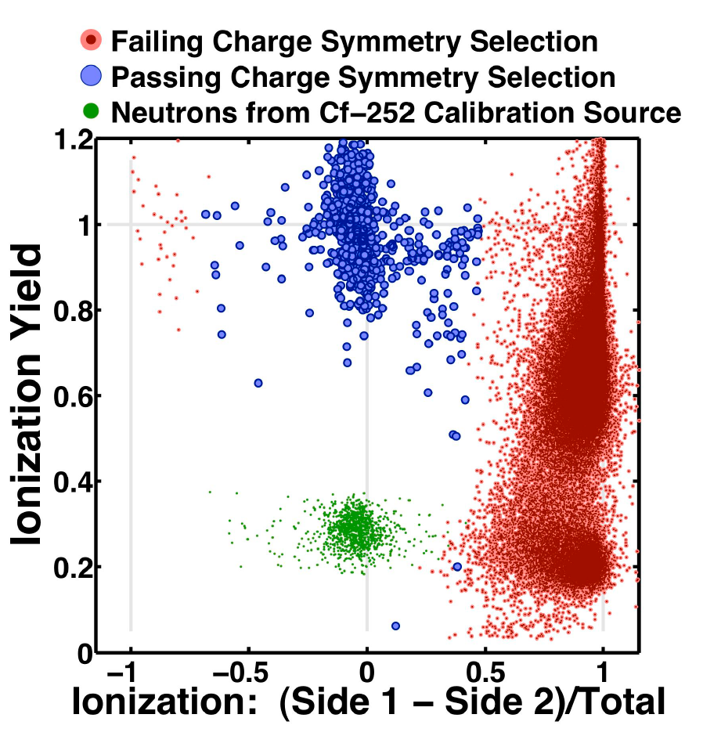
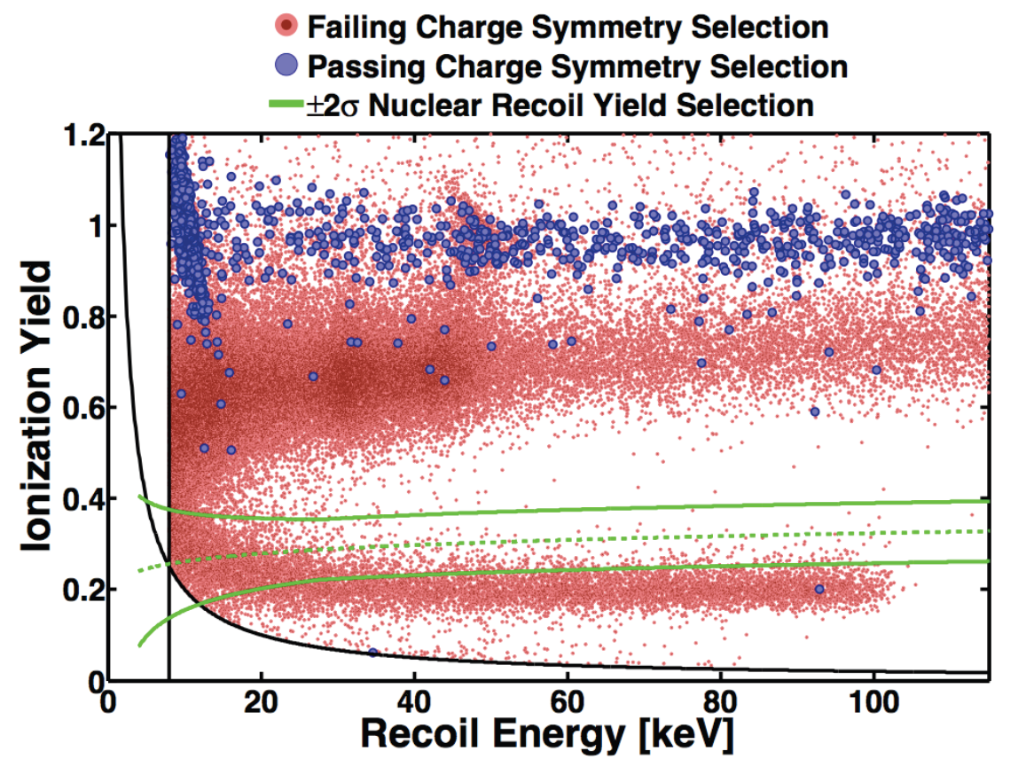
SuperCDMS background rejection
Surface-event Rn-daughter sources placed above and below 2 detectors (in situ @ Soudan)
50 live days → 0 of 132,968 leaked surface events in (symmetric) NR signal region
→ Good enough rejection for proposed SuperCDMS SNOLAB
(100 kg, σ_{χ-N}< 8 x 10⁻⁴⁷ cm² for 60 GeV/c² dark matter)
Surface Betas
Bulk ERs
Bulk ERs
Bulk NRs
Bulk NRs
²⁰⁶Pb Recoils
Appl.Phys.Lett. 103 (2013) 164105
[arXiv:1305.2405]

Slide 8
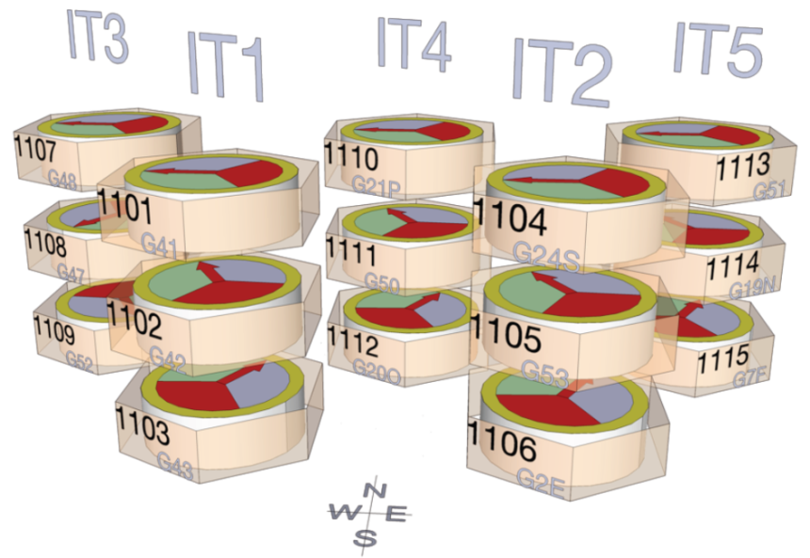
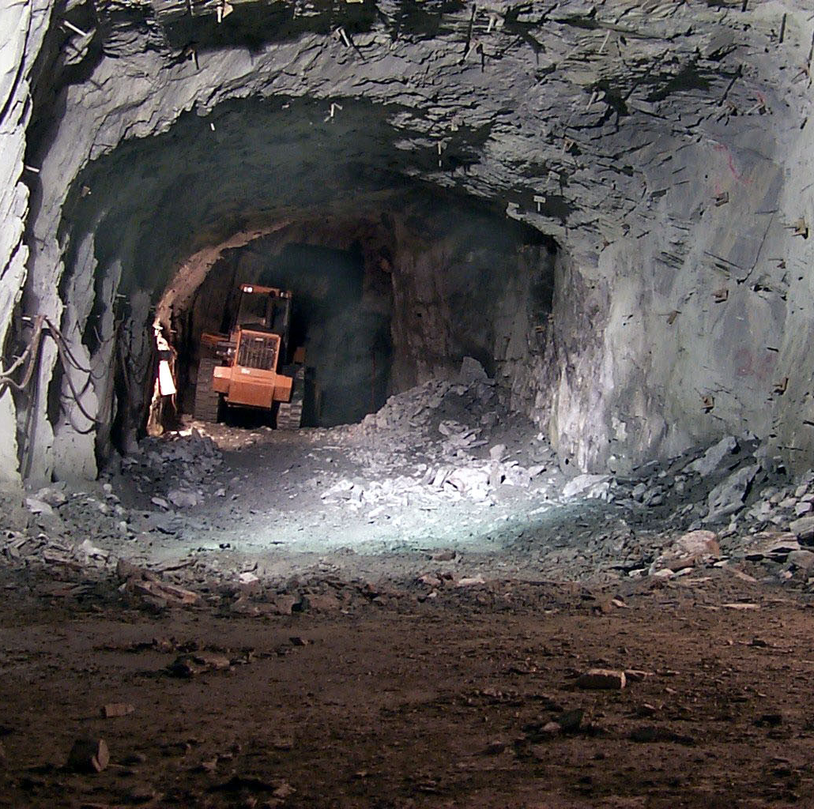
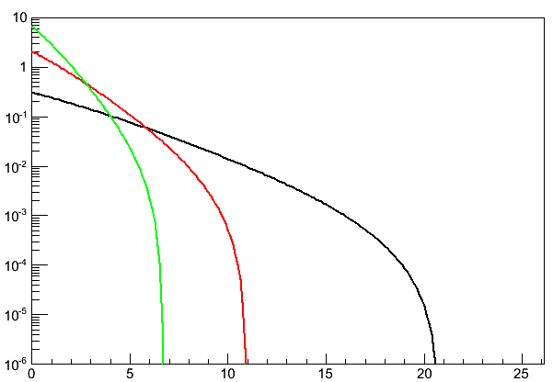
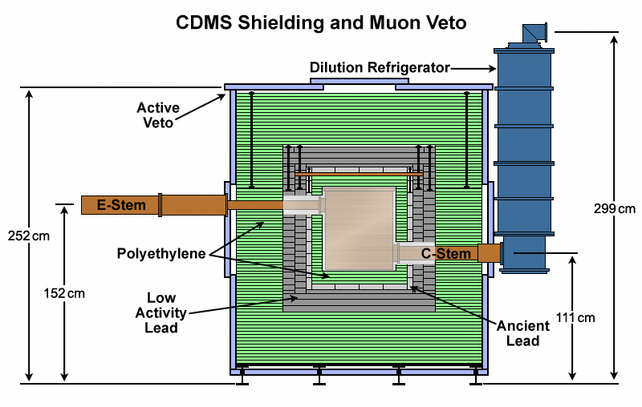
SuperCDMS Soudan
5 Super Towers of Ge iZIPs
3 iZIPs per tower, 0.6 kg each
→ total mass of 9 kg
Installed in CDMS II shielding end of 2011
Fully operational since early 2012
Science run ends this summer.
Tower 3
Sources
Expected recoil spectra for 7 GeV/c² DM particle
Low-mass Search Strategies
Ge is a relatively heavy nucleus
→ Go as low in threshold as possible
CDMSlite →
Special bias configuration & readout
Extra-low threshold: < 1 keV_{nr}
Target masses: < 10 GeV/c²
Low-threshold (LT) analysis →
Low threshold: ≈1.6 keV_{nr}
Use improved iZIP fiducial volume
Target masses: < 20 GeV/c²
Analysis range
Si (A≈28)
Ge (A≈72)
Xe (A≈131)
V_{esc} = 544 km/s
σ_{χ-N} = 10⁻⁴¹ cm²
Event rate [keV⁻¹ kg⁻¹ d⁻¹]
Recoil energy [keV_{nr}]

Slide 9
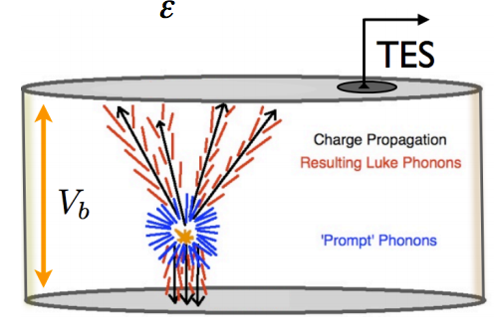
SuperCDMS Soudan — CDMSlite
Luke-amplified ionization-energy measurement
24x amplification of ionization energy via phonons
→ 10x lower threshold for ERs
→ ≈ equal noise performance
No event-by-event ER-NR discrimination
→ But near perfect signal efficiency
Fall 2012 search for light WIMPs
→ Single-detector 10-day exposure (5.9 kg-days)
→ Observed rate → 1.2±0.2 events /keV_{nr} /kg-d
vs. normal
±2V mode
Ge 1.3 keV_{ee} L-shell
activation line
0 volts
Readout S1 phonons
Electron propagation
Luke phonons
Primary recoil phonons
Hole propagation
-69 volts

Slide 10
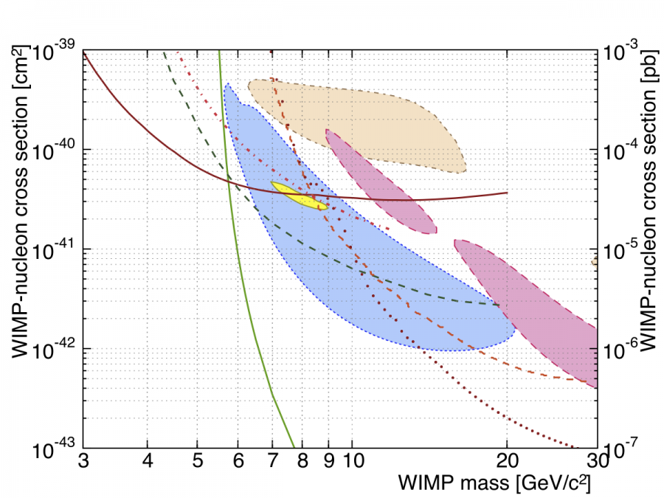
CDMSlite result
CDMSlite Run 1 — PRL 112 (2014) 041302
XENON10 S2
DAMA/LIBRA
CDMS II Ge (LT)
~6-month CDMSlite
Run 2 with
electronics upgrade
now complete!
(analysis in progress)
DM-nucleon cross section [cm²]
DM-nucleon cross section [pb]
CDMS II Si
CRESST II
LUX
EDELWEISS (LT)
CDMS II Ge
Dark-matter mass [GeV/c²]
SuperCDMS SNOLAB CDMSlite → even lower threshold via:
Lower backgrounds, improved electronics, higher voltage & superior resolution

Slide 11

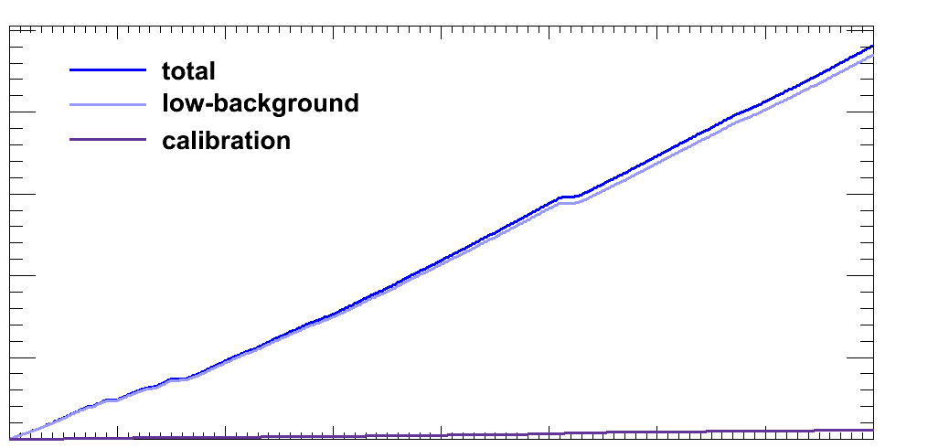
SuperCDMS Soudan — LT analysis
T1Z1
4.6 keV_{nr}
T4Z2
4.7 keV_{nr}
T2Z1
1.5 keV_{nr}
Normal ±2V bias configuration
WIMP search → Oct 2012 – July 2013
577 kg-day blinded exposure
ER calibration throughout via ¹³³Ba
NR calibrations via ²⁵²Cf
→ 97 kg-day open dataset
7 detectors w/ lowest trigger thresholds
→ ~1.6 to 5 keV_{nr} (detector & time dependence)
Note: 2 special-case detectors
→ T5Z2 in 2013 had noisy S1 Q guard
→ T5Z3 has S1 Q guard not biased
Tower 3
Sources
T5Z2
2.0 keV_{nr}
CDMSlite
~ ¾ keV_{nr}
CDMSlite
? keV_{nr}
T5Z3
1.7 keV_{nr}
T4Z3
1.7 keV_{nr}
T2Z2
1.8 keV_{nr}
Post-Cf periods
500
Total
WIMP search
Calibration
400
300
Integrated raw live time [days]
CDMSlite Run 1
CDMSlite Run 2
200
100
SuperCDMS LT
Mar 14, 2012
Sep 17, 2012
Mar 22, 2013
Sep 25, 2013
Mar 30, 2014

Slide 12
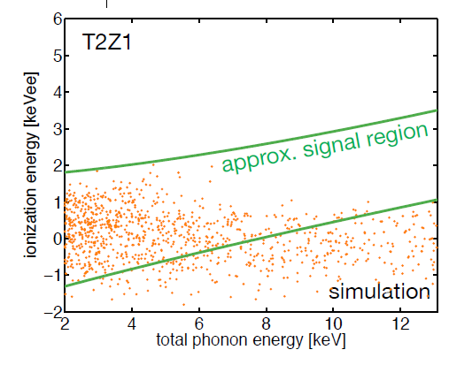
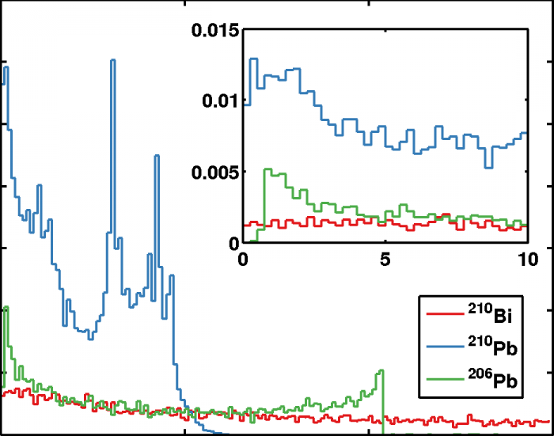
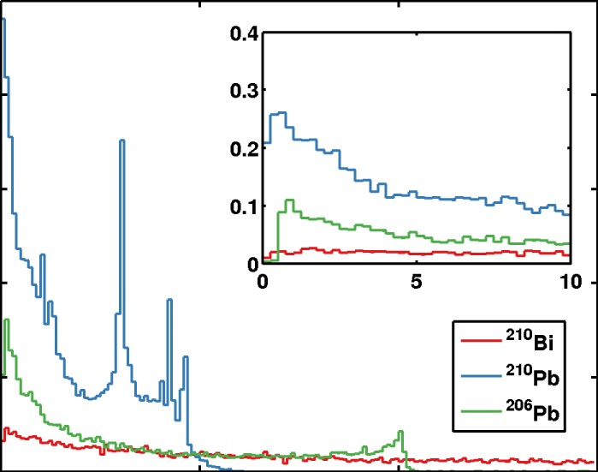
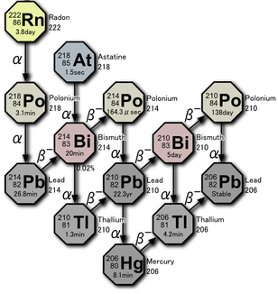
LT-analysis backgrounds
²¹⁰Pb decay chain
“Pulse Simulation”
Simulate low-energy detector
response by combining noise traces
w/ template pulses taken from
higher-energy sidebands & scaled
to give MC energy spectrum
Event rate [a.u.]
Faces
Sidewalls
²¹⁰Pb, ²¹⁰Bi → β’s & X-rays
²¹⁰Po decays → ²⁰⁶Pb recoils
Divide by location:
→ detector faces
→ detector sidewalls
0
50
100
150
Recoil energy [keV]
Geant4
simulation
Rn progeny plate-out
onto detector &
copper surfaces,
creating long-lived
²¹⁰Pb source
β
α
β
²⁰⁶Pb
copper housing
β
detector

Slide 13
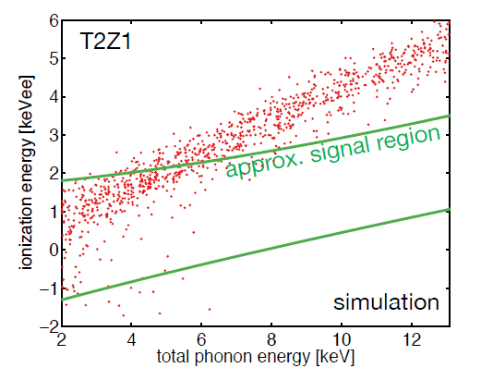
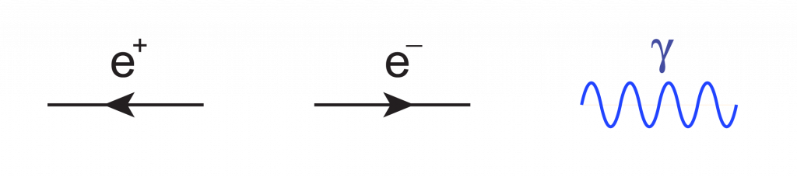
LT-analysis backgrounds
²¹⁰Pb decay chain
External Gammas
²¹⁰Pb, ²¹⁰Bi → β’s & X-rays
²¹⁰Po decays → ²⁰⁶Pb recoils
Divide by location:
→ detector faces
→ detector sidewalls
External gammas from radioactivity in
shielding & cryostat
Detector response via pulse simulation
γ
β
α
β
²⁰⁶Pb
copper housing
γ
β
detector

Slide 14
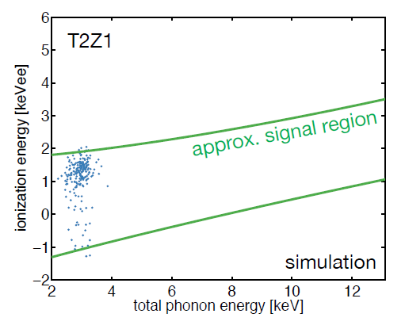

LT-analysis backgrounds
²¹⁰Pb decay chain
External Gammas
Internal Activation Lines
²¹⁰Pb, ²¹⁰Bi → β’s & X-rays
²¹⁰Po decays → ²⁰⁶Pb recoils
Divide by location:
→ detector faces
→ detector sidewalls
External gammas from radioactivity in
shielding & cryostat
Detector response via pulse simulation
Detector activation from cosmics
& thermal-neutron capture
X-rays & Auger electrons from ^{68,71}Ge,
⁶⁵Zn, ⁶⁸Ga L-shell e– capture
Detector response via pulse simulation
γ
β
γ
γ
Also, radiogenic & cosmogenic neutron backgrounds
→ but irreducible & rate is very low
Signal region blinded & no calibration for ²¹⁰Pb-sourced sidewall events
→ ²¹⁰Pb decay-chain simulation systematics not yet understood in detail
→ Before unblinding, chose to set upper limit based on any candidates
α
e–
β
²⁰⁶Pb
γ
γ
copper housing
e–
γ
β
detector

Slide 15
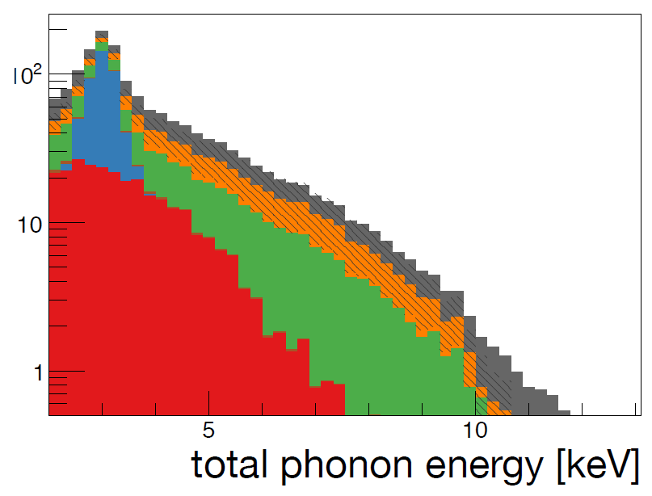
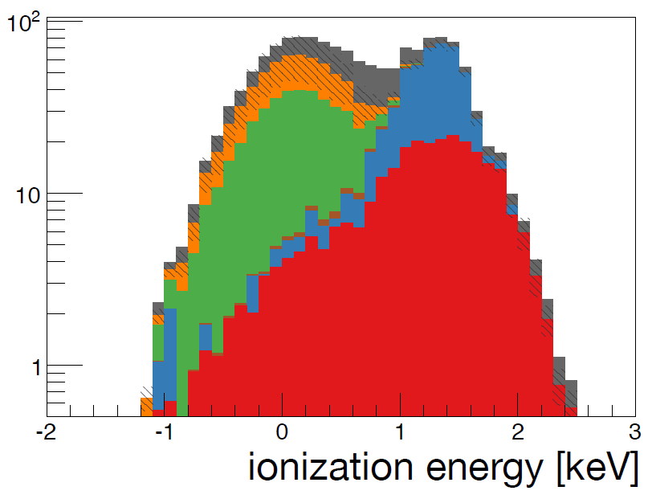
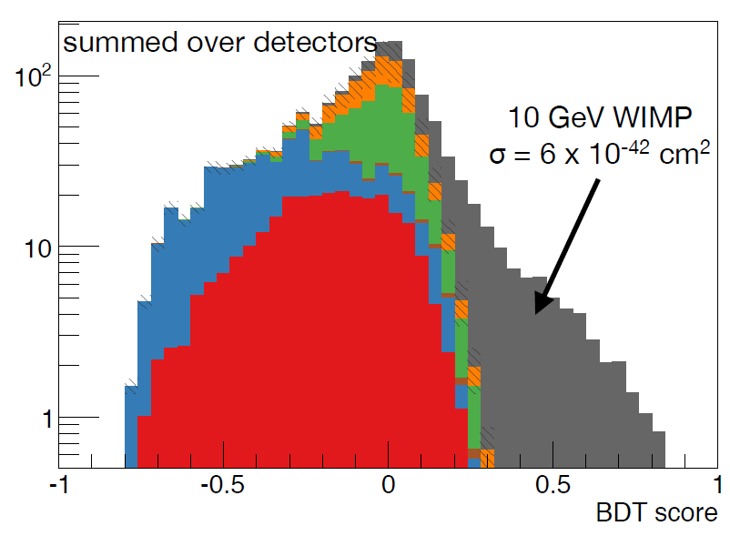
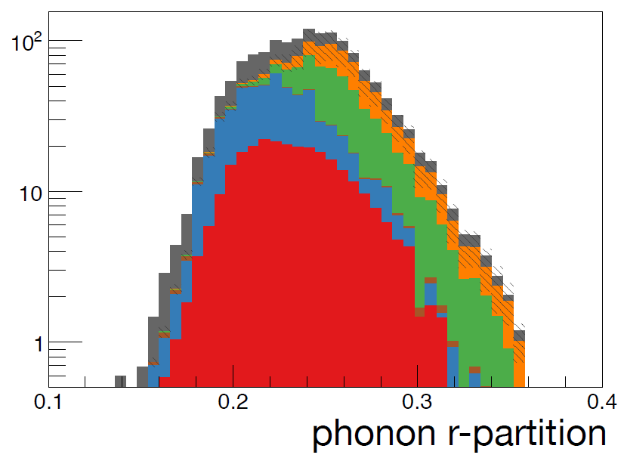
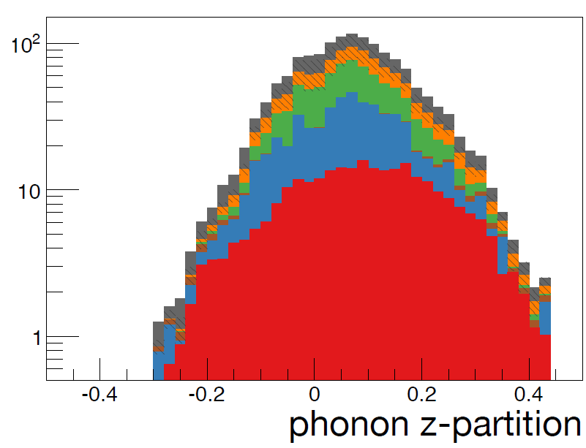
LT-analysis BDT
Boosted Decision Tree — Output
10 GeV/c² DM
Train BDT with:
Background events from pulse simulation
Signal from ²⁵²Cf NRs reweighted to expected
energy spectra for 5, 7, 10 & 15 GeV/c² DM particles
Create 1 BDT per detector per DM-particle mass
Optimize BDT-score cuts simultaneously across
detectors to minimize expected 90% C.L.
upper limit separately for each mass
OR across 4 DM-particle masses to accept events that
pass one or more of 4 BDT cuts
Boosted Decision Tree — inputs
Expected signal (10 GeV/c² shown here)
Sidewall ²⁰⁶Pb recoils
Sidewall β’s & X-rays
²¹⁰Pb-sourced
Face β’s & X-rays
1.1–1.3 keV L-shell activation lines
External gammas (“Comptons”)

Slide 16
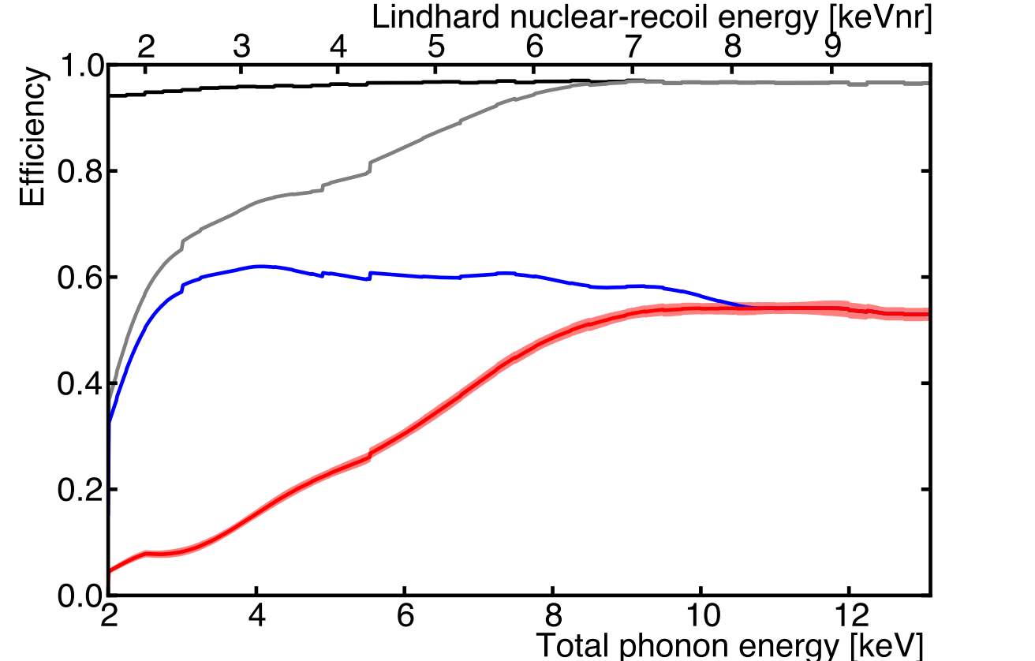
LT-analysis detection efficiency
Remove:
→ bad data periods (e.g. noise)
→ incorrect pulse shapes (e.g. glitches)
Efficiency via pulse-shape simulation
Quality
Apply trigger & analysis thresholds
→ ≈ 1.5–5 keV_{nr}
Efficiency measured from ¹³³Ba
calibration ERs
+ Thresholds
+ Preselection
Single-detector events only
No activity in muon veto
Loose ionization-based 3D fiducial volume
NR-consistent ionization energy
+ BDT
Final selection optimized on energy
& phonon position estimators
Efficiency measured together with preselection
using ²⁵²Cf passage fraction & Geant4 sim to
correct fiducial volume for differences
between neutrons & DM particles
1σ band includes uncertainties in:
Trigger efficiency
Fiducial volume (stat. & syst.)
NR energy scale

Slide 17
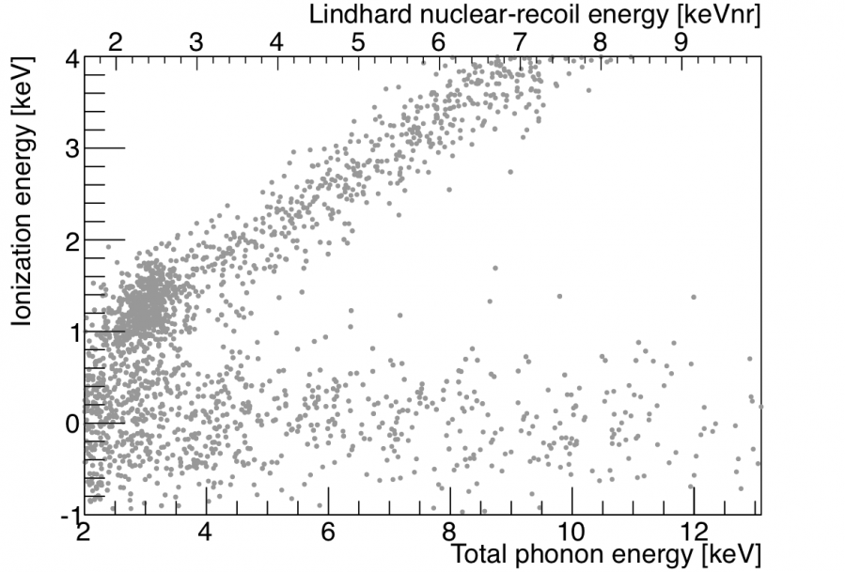
LT-analysis unblinding (before BDT)
All events passing:
Quality &
Thresholds &
Preselection (except NR ionization)
3 background components evident:
²¹⁰Pb-sourced surface events
External gammas (“Comptons”)
Internal activation lines
Expected background after BDT:
6.1 (stat. & syst.)
Also, 0.10 ± 0.02 neutrons
+1.1
–0.8

Slide 18
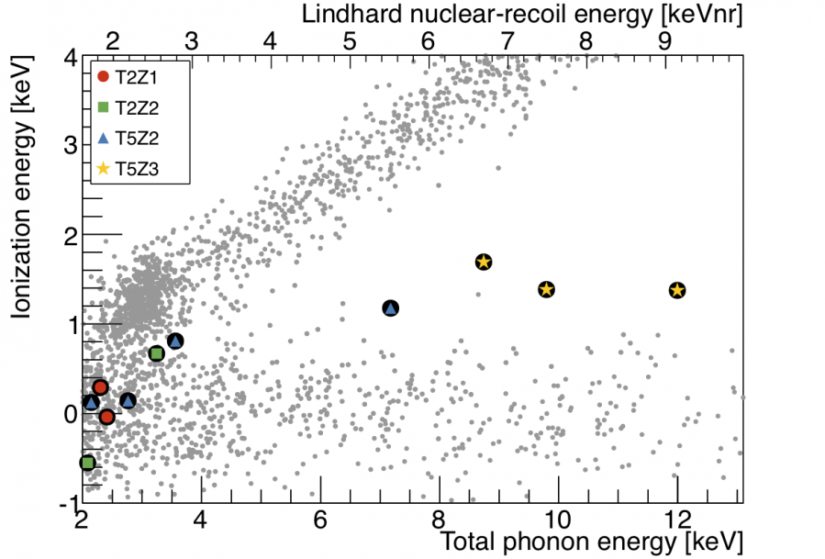
LT-analysis unblinding (after BDT)
11 candidate events pass all cuts!
(6.1 expected)
3 with unexpectedly high energies
→ all in T5Z3 w/ altered E-field
+1.1
–0.8

Slide 19
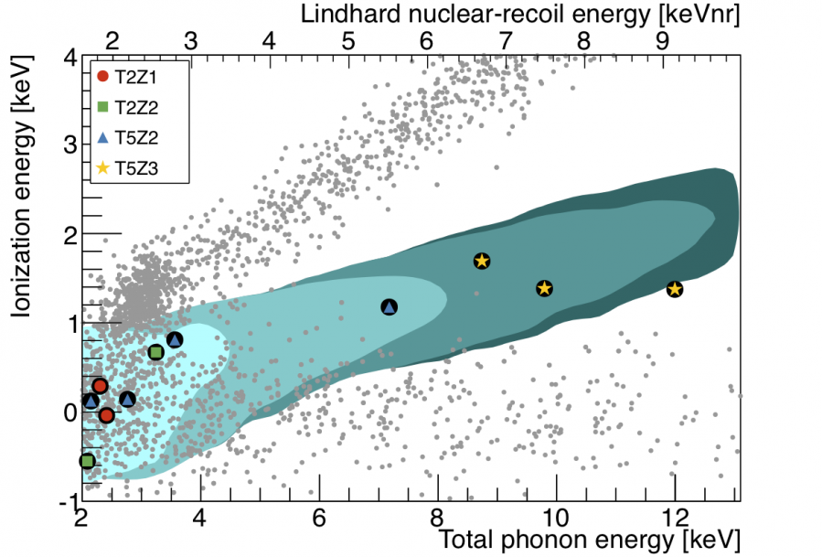
LT-analysis unblinding (after BDT)
11 candidate events pass all cuts!
(6.1 expected)
3 with unexpectedly high energies
→ all in T5Z3 w/ altered E-field
95% confidence contours for expected
signal from 5, 7, 10 & 15 GeV/c² DM
+1.1
–0.8

Slide 20
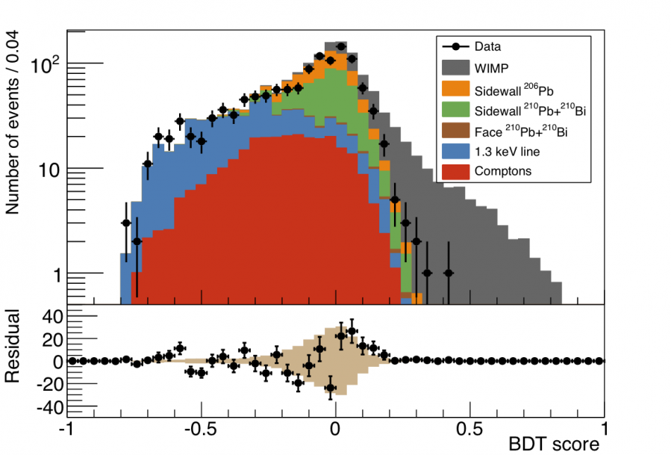
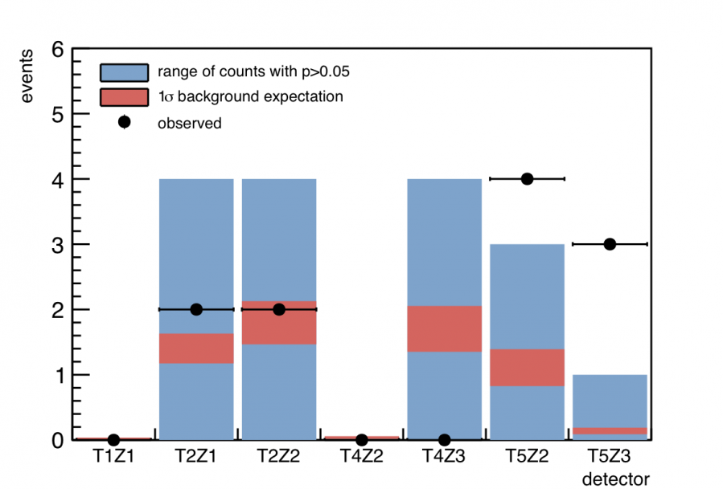
LT-analysis post-unblinding comparison
Overall, 11 candidate events are
consistent w/ background expectation &
most individual detectors agree w/ model
Quality + Thresholds + Preselection
p-value = 14%
DM → 10 GeV/c²
Altered electric field on T5Z3 may have
affected background-model performance
→ further investigation in progress
Average thresholds (keV_{nr}):
4.6 1.5 1.8 4.7 1.7 2.0 1.7
Events passing BDT
Background model agrees well with
events observed in preselection region
→ p-values = 8–26% for 4 DM masses

Slide 21
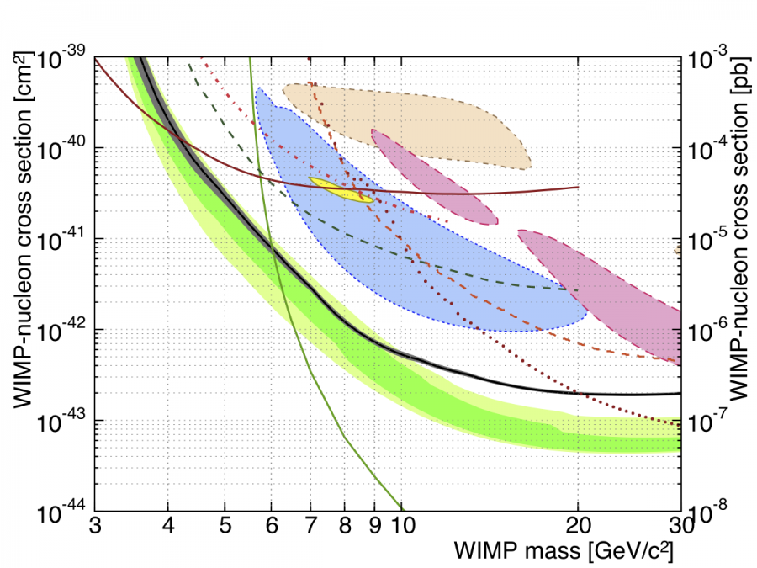
LT-analysis result
95% C.L. uncertainty band
(trigger, energy scale, fiducial volume)
XENON10 S2
DAMA/LIBRA
CDMS II Ge (LT)
CDMSlite
DM-nucleon cross section [pb]
SuperCDMS LT
(this result)
DM-nucleon cross section [cm²]
CDMS II Si
CRESST II
LUX
CDMS II Ge
EDELWEISS (LT)
difference due to T5Z3
high-energy events
Expected sensitivity
at 68 and 95% C.L.
Dark-matter mass [GeV/c²]
PRL 112 (2014) 241302 — Editor’s suggestion!

Slide 22
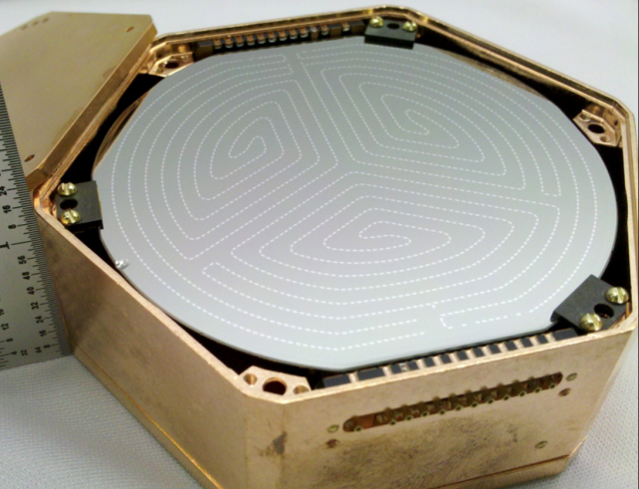
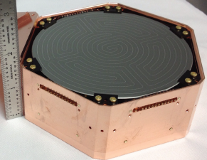
Next generation → SuperCDMS SNOLAB
SuperCDMS Soudan SuperCDMS SNOLAB
Larger target mass:
More & larger iZIPs
Cryostat large enough for 400 kg
Si & Ge crystals
1 tower in CDMSlite configuration
→ also with Si & Ge
Lower background:
New facility at deeper site
Cleaner materials selection
Active neutron veto
Improved signal readout:
Phonons → new SQUID arrays
Ionization → switch to HEMTs
Improved tower design
Improved resolution:
σ_{phonon} ∝ T_{c}³ →lower operating temp
42 eV demonstrated (>4x better)
Improved cryogenics could give
>100x improvement!
2.5 cm thick
3”diameter
600 g Ge
3.3 cm thick
4”diameter
1.4 kg Ge / 615 g Si
2 ionization + 2 ionization 4 phonon + 4 phonon
2 ionization + 2 ionization 6 phonon + 6 phonon
5 towers of 3 iZIPs each
7 towers of 6 iZIPs each

Slide 23
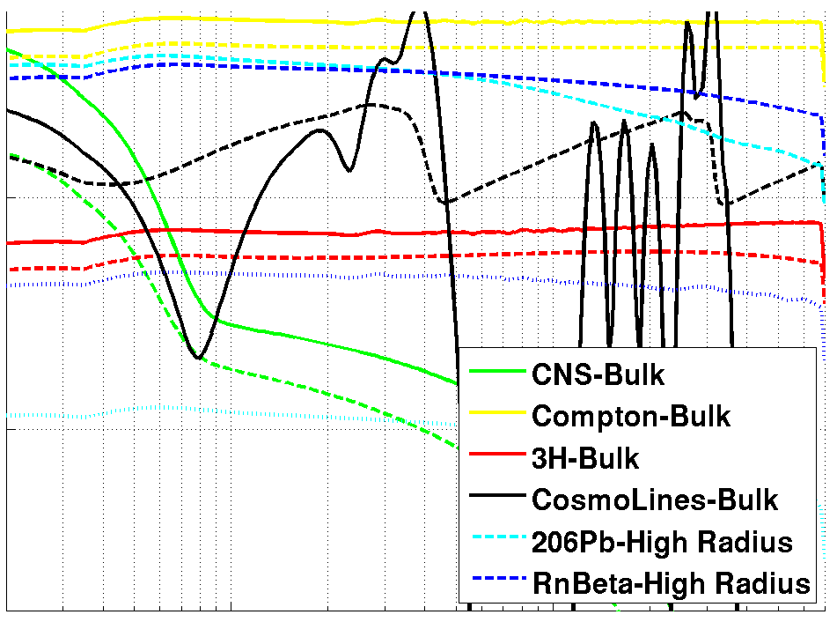
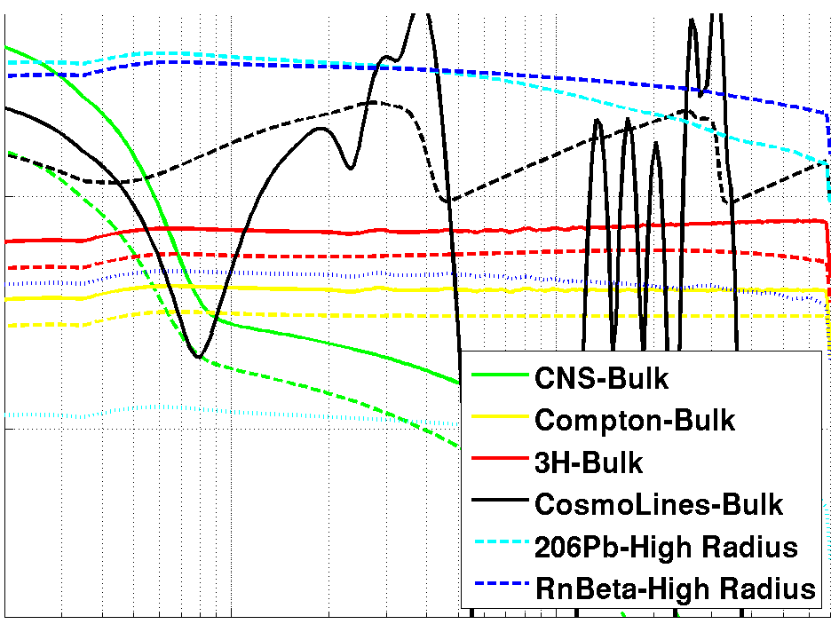

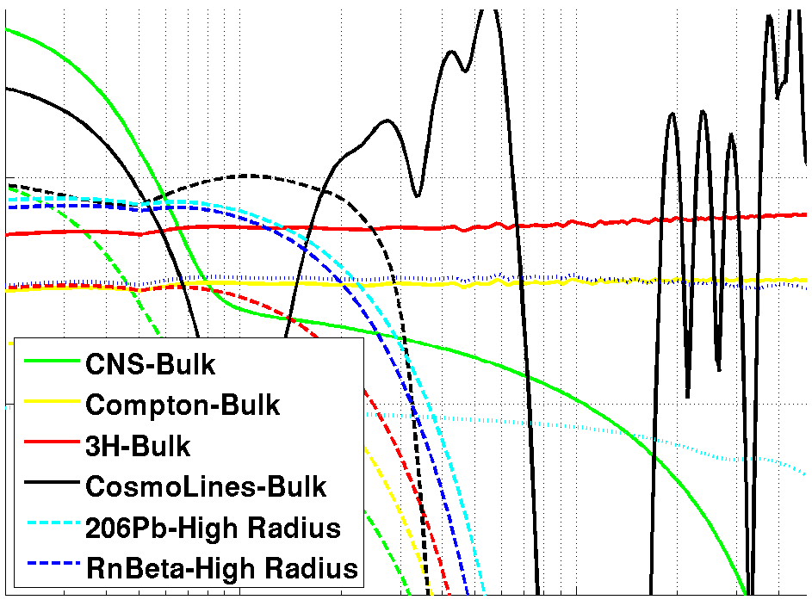
Beyond SuperCDMS Soudan
Simulation of current background levels
CDMSlite mode w/ modest radial fiducialization
Background Reduction
Step 1 → Bulk gamma background via
cleaner copper … 220x lower
→ Based on levels achieved by
DEAP/CLEAN and XENON100
Step 2 → Rn-sourced backgrounds,
primarily at high radius
→ copper housings … 22x lower
via cleaner handling & storage
Further improvement →
Superior resolution via lower Tc’s
Fiducialization
Lower energy thresholds
10⁰
Event rate [kg⁻¹ keVt⁻¹ yr⁻¹]
10⁻²
Courtesy M. Pyle
1.0
10
Total phonon energy (keV)
Dependent on detector mode!

Slide 24
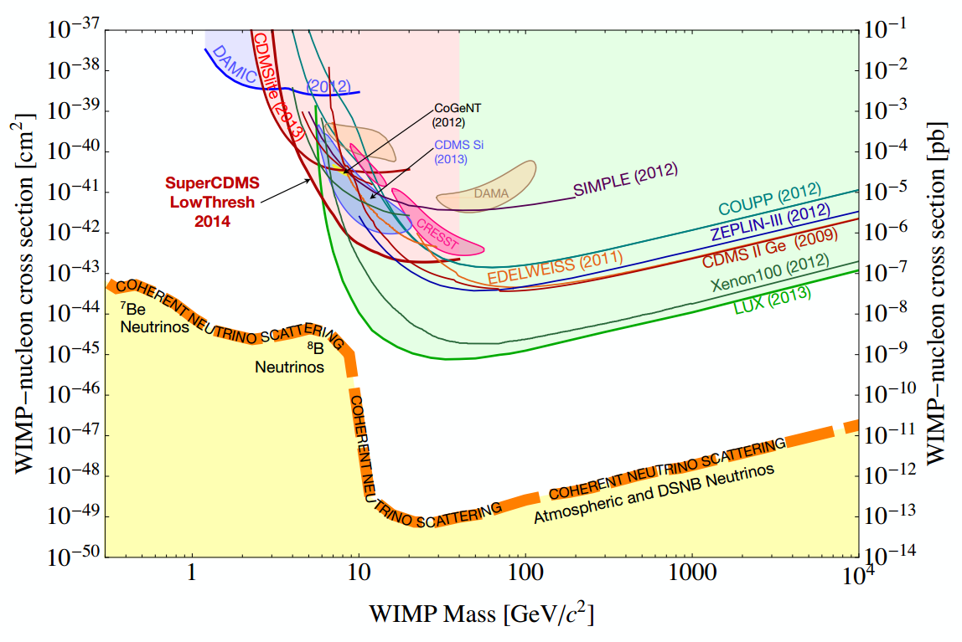
SuperCDMS SNOLAB expected sensitivity
courtesy T.Figueroa

Slide 25
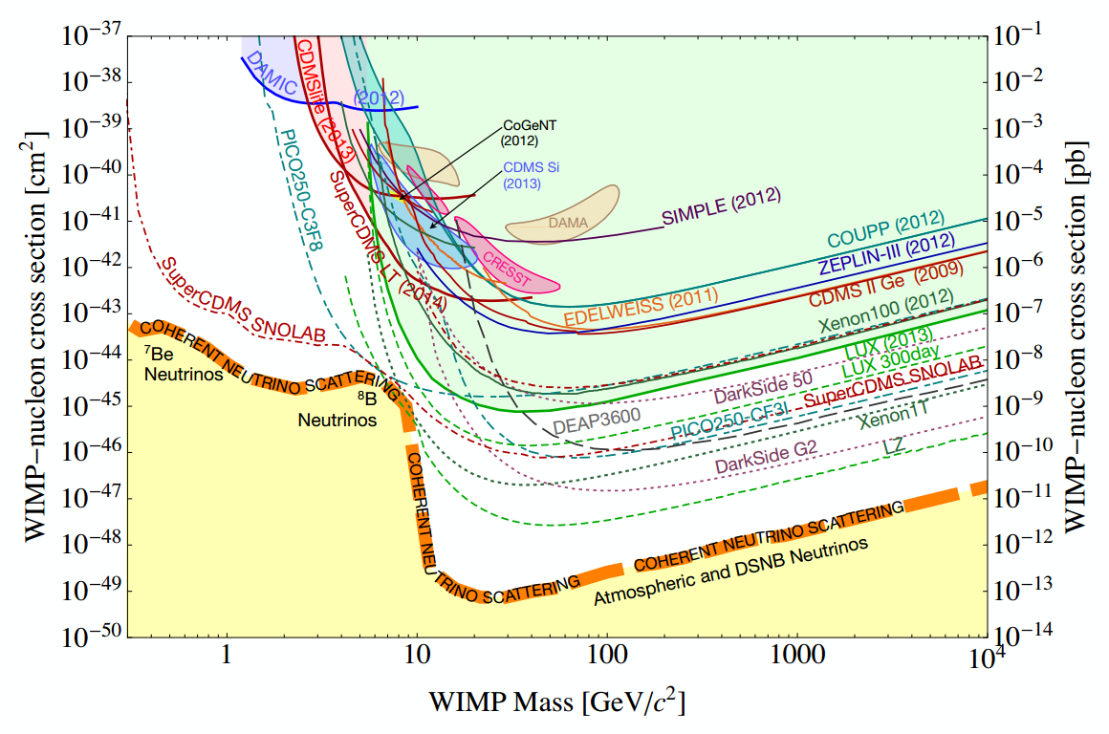
SuperCDMS SNOLAB expected sensitivity
Previous expectations assumed 110 kg target
G2 approval for ~½ as many detectors &
but with large cryostat for up to 400 kg target
Still provide complimentary sensitivity,
But need to reevaluate higher-mass sensitivity
Unique
sensitivity
Detection of coherent
neutrino scattering
courtesy T.Figueroa

Slide 26
Beyond SuperCDMS Soudan
Simulation of current background levels
Background Reduction
Step 1 → Bulk gamma background via
cleaner copper … 220x lower
→ Based on levels achieved by
DEAP/CLEAN and XENON100
Step 2 → Rn-sourced backgrounds,
primarily at high radius
→ copper housings … 22x lower
via cleaner handling & storage
Further improvement →
Superior resolution via lower Tc’s
Fiducialization
Lower energy thresholds
10⁰
Event rate [kg⁻¹ keVt⁻¹ yr⁻¹]
10⁻²
Courtesy M. Pyle
1.0
10
Total phonon energy (keV)

Slide 27
Plans for Radon Exclusion
Protect detector and nearby copper surfaces from exposure to Rn!
Use standard etching techniques to clean copper surfaces
Radiopurity of Ge & Si substrates already sufficient for SNOLAB sensitivity
Improved procedures to limit exposure during payload assembly
Radon-mitigated clean room underground at SNOLAB
→ To prevent contamination during detector installation
Looking toward the future and G3:
More robust protection while in storage
→ Use radon emanation measurements to study storage cabinets & purge packaging
→ Commission & operate Rn-emanation system
Development of BetaCage detector
→ More sensitive screening of α- & β-emitting surface contaminants (i.e., Rn daughters)

Slide 28
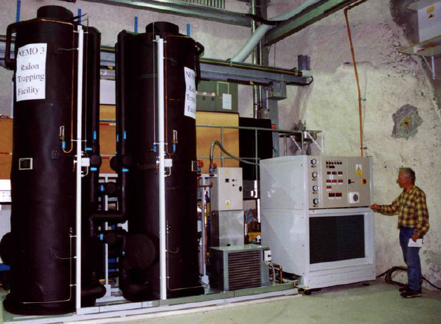
Radon Mitigation Systems
Continuous flow:
Swing flow:
Most Rn decays before exiting carbon
C_{final} = C_{initial} exp[-t/t_{Rn}]
→ Assuming ideal column
Relatively simple & robust
Need to cool carbon to be effective
→ Ateko commercial system effective for NEMO
Stop gas flow well before breakthrough
Use at least 2 columns:
→ Regenerate column #1
→ Flow through column #2
C_{final} = 0
→ Assuming ideal column
More complicated
Vacuum-swing:
Potentially better performance than
continuous system at lower cost
A. Pocar, LRT2004 (Borexino)
Temperature-swing:
→ Expect best performance at highest cost
→ A. Hallin, LRT2010
breakthrough time
Rn lifetime

Slide 29
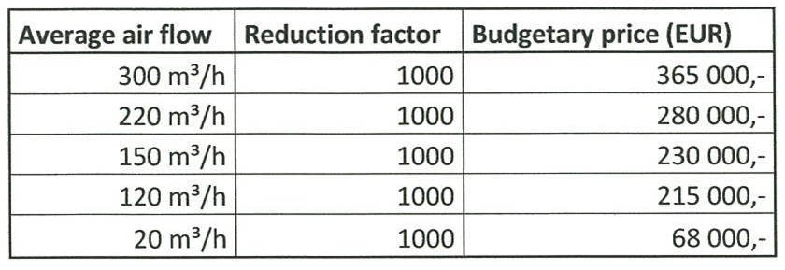
Radon Mitigation Systems
Continuous
system
commercially
available from
Ateko
Syracuse
Vacuum-swing
90 m³/h | >50 | 40 000,-
Hardware only

Slide 30
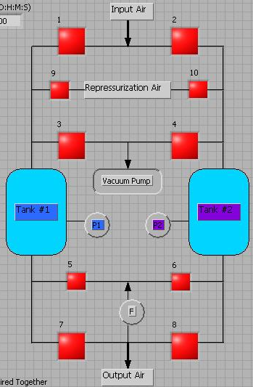
Vacuum-Swing Absorption (VSA)
Takes advantage of greater adsorption
capacity at high pressures:
Regenerate carbon by flowing small
fraction f of gas mass flow F back
through tank at low purge pressure
Volume purge flow φ_{purge}
Push back radon front if:
Syracuse system, f ≈ 10% with
P_{purge} ≈ 2.5 Torr → G ≈ 30 (ideally)
Input Air
F
Vacuum Pumps
Carbon
Column
#1
Carbon
Column
#2
P_{atm}
P_{purge}
f F
F
(1-f) F
Filtered output air

Slide 31
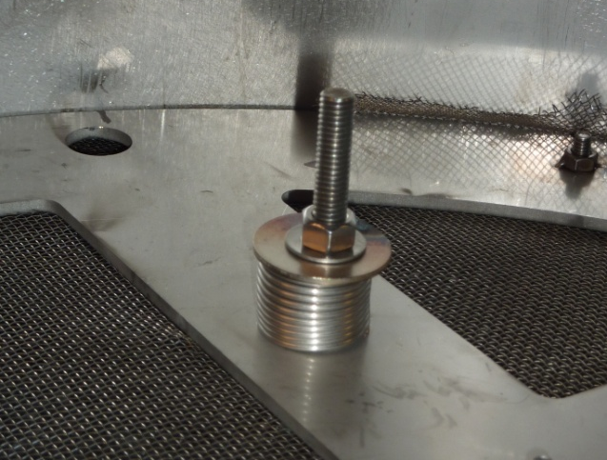



Activated-Carbon Columns
Calgon Coconut Activated Carbon
Product OVC Plus 4x8 (mesh)
Multiply rinsed, then dried
under high-flow fume hoods
Two Identical
Stainless-steel
Vacuum Vessels
Filled with
~150 kg each &
Spring Loaded
Opened up tank after first month commissioning, found carbon still in good shape & well packed.

Slide 32

The VSA Radon Filter
≈10 Bq/m³
≈0.1 Bq/m³

Slide 33

The VSA Radon Filter

Slide 34

Initial Performance at Filter Output
Unfiltered, but conditioned air
from building HVAC, first
collected by vent at roof level
Re-binned RAD7 measurements,
derived from ²¹⁴Po & ²¹⁸Po alphas &
originally taken in 1-hour intervals
>10x
Reduction

Slide 35


Optimizations in 2013-2014
Increased robustness of system:
Overcame difficulty of roughing pump to handle high humidity of upstate NY in summer
Identified & reduced leaks all along system:
Still limited by leaks in clean-room HVAC when HVAC circulation is on
Clean-room HVAC Off → >50x reduction
Clean-room HVAC On → >25x reduction
Further recent optimizations → 0.1 Bq/m³ in clean room with HVAC circulation on!

Slide 36



Radon Emanation System
HEPA-filtered acrylic
enclosure … class ≈100
Currently commissioning
→ Demonstrated sensitivity to Po peaks
Gas panel fabricated
by Swagelok with
carbon & brass-wool traps
Initial backgrounds
indicate ≈10 μBq
readily achievable
Electropolished
chamber for emanating
radon from samples
Small liquid-nitrogen
dewar for freezing radon
onto brass wool
Electrostatic detector:
Ortec Si alpha detector held
at large negative voltage

Slide 37


The BetaCage Concept
Goal is for 100x more sensitive surface β screening
Radiopure time projection chamber
Wires provide minimum surface area for emissions
Crossed grids → ≈mm xy position information
Can screen for ²¹⁰Pb β’s promptly,
without waiting for ²¹⁰Po grow-in
Sensitivity goals are: (Bunker LRT2013)
→ 0.1 β /keV/m²/day
→ 0.1 α/m²/day
Smaller-sized prototype should have
essentially zero background for α’s

Slide 38

The BetaCage Prototype
2 40x40-cm² MWPCs around 20-cm field-cage
→ Trigger MWPC & imaging “bulk” MWPC
Characterized with ⁵⁵Fe X-rays
→ Achieved intrinsic resolution of ≈14% vs ideal
12-13% from Fano & avalanche statistics
JINST 9 (2014) P01009
Stability to voltage & pressure variations
consistent with Diethorn formalism

Slide 39
Conclusions
SuperCDMS Soudan
CDMSlite demonstrates utility of Luke-amplified phonons for low-mass DM
→ PRL 112 (2014) 041302 with 170 eVee threshold
→ Better measure of backgrounds with 2nd run
577 kg-day low-threshold analysis sets 90% C.L. limit of 1.2x10⁻⁴² at 8 GeV/c²
→ Rules out DM interpretation of CoGeNT excess, also for standard-halo
spin-independent interpretations of CDMS II Si, DAMA/LIBRA & CRESST
→ Rules out new parameter space for masses < 6 GeV/c²; PRL 112 (2014) 241302
SuperCDMS SNOLAB
Lower backgrounds, improved resolution, lower energy thresholds:
→ unique discovery potential for WIMP masses 1–10 GeV/c²
CDMSlite tower with high-gain, low-noise operation:
→ extremely low thresholds for world leading light-WIMP sensitivity from 0.3–5 GeV/c²
Radon exclusion critical to achieve background goals:
→ VSA technique is viable alternative to more expensive continuous-flow filter

Slide 40
Backup slides

Slide 41
2) Asymmetric Dark Matter
Kaplan et al
0901.4117
Rooted in Technicolor
Relic Density Determined by Asymmetry Magnitude (NOT Freeze Out)
No Power Injection at low Z-> No distortion of CMB
“ADM Miracle”
Ω_{DM} ~ 5 Ω_{B} -> M_{DM} ~ 5 M_{B}
M_{DM} ~5GeV
Courtesy M. Pyle

Slide 42


SuperCDMS iZIP
Top face @ +2V = Side 1 (S1)
Bottom face @ -2V = Side 2 (S2)
Detector upgrade to CDMS II
2.5x thicker → 600 gram Ge crystals with
interleaved phonon & ionization sensors
Doubled channel count:
Ionization Sensors (on both sides)
Inner & Outer-guard electrodes
Radial partitioning: Outer / (Inner + Outer)
z-direction partitioning: (S1 – S2) / (S1 + S2)
3D fiducialization with ionization signals alone
Near-perfect rejection of surface events for >8 keVr
Phonons Sensors (on both sides)
3 Inner channels + Outer-guard channel
Radial partitioning: Outer/(Outer + Σ Inner)
z-direction partitioning: (S1 – S2)/(S1 + S2)
Better signal to noise for lowest-energy triggers
→ Extend 3D fiducialization to low energy!

Slide 43
Searching for low-mass dark matter
Experiments with lighter targets and lower thresholds have the advantage when looking for dark-matter (DM) particles with mass < 10 GeV/c²
Expected recoil spectra for 7 GeV/c² DM particle
Our strategy
Analysis range
Si (A≈28)
Ge (A≈72)
Xe (A≈131)
Ge is a relatively heavy target, so go as low in threshold as possible
CDMSlite search → < 1 keV_{nr}
LT analysis → ≈1.6 keV_{nr}
Backgrounds more difficult to reject below 10 keV_{nr}
CDMSlite → extra-low threshold
LT analysis → use improved iZIP
fiducialization capability to reject
as much background as possible
V_{esc} = 544 km/s
σ_{χ-N} = 10⁻⁴¹ cm²
Event rate [keV⁻¹ kg⁻¹ d⁻¹]
Recoil energy [keV_{nr}]
We expect background events in the signal region…
tradeoff is greater sensitivity to low masses

Slide 44
LT-analysis energy scale
Ionization for nuclear recoils
measured from ²⁵²Cf data
Total phonon energy =
E_{total} = E_{Luke} ⁺ E_{recoil}
E_{total} is measured with phonons
NR equivalent energy =
E_{total} – E_{Luke,NR}
E_{Luke,NR} estimated from mean NR ionization, varies with E_{total}
(same as CDMS II low-energy analysis)
5
Detector: T2Z2
Ionization energy [keV_{ee}]
1
3
4
5
10
20
Total phonon energy [keV]
Note: we sometimes approximate mean ionization with Lindhard theory because measured values are detector-dependent. This is labeled “Lindhard nuclear recoil energy”; difference is a few %.

Slide 45

CDMSlite Run 1 raw spectrum

Slide 46

LT-analysis pulse simulation
High energy event
w/ good signal to noise,
scaled down in amplitude
Random trigger
(e.g. noise)
Backgrounds at low energy are more difficult to separate from signal region due to poor signal to noise
Study directly with a pulse simulation, using high energy events in sidebands and calibration data
Simulated low energy event
weight events as a function of energy to match low energy spectrum

Slide 47




LT-analysis backgrounds
Detector T2Z2 post-Cf open dataset
²¹⁰Pb-sourced templates:
From WIMP-search sidebands
Sidewalls → high radius, mid & low yield
Faces → inner radius, asymmetric, mid & low yield
Dominant systematic uncertainty:
→ yield naively extrapolated to low energy
Normalized to ²⁰⁶Pb rates at higher energy
→ checked with ²¹⁰Po α rates
→ difference assigned as systematic uncertainty
External-gamma templates:
From ≈100 keV_{ee} ¹³³Ba calibration events
Randomly chosen from WIMP-search period
Normalized to WIMP-search sideband:
→ 2.6–5.1 keV_{ee} bulk ER rate
Internal activation-line templates:
From WIMP-search sideband
K-shell e– captures at ≈10.4 keV_{ee}
→ same distribution in crystal as L-shell captures
Normalize using K-shell rate in sidebands & ratio
of L- to K-shell captures in post-Cf open dataset
L-shell lines
Detector T2Z1 — WIMP-search sideband
Detector T1Z1 — WIMP-search sideband
⁶⁵Zn, ⁶⁸Ga,
^{68,71}Ge
Ionization energy
Ionization yield
Sidewall ²¹⁰Pb & ²¹⁰Bi
β & X-ray templates
Event rate / 0.4 keV
Sidewall ²⁰⁶Pb-recoil templates
^{68,71}Ge
K-shell lines
Recoil energy [keV]
Total phonon energy [keV]
⁶⁵Zn
⁶⁸Ga
Total phonon energy [keV]

Slide 48

LT-analysis by-detector efficiencies

Slide 49


LT-analysis fiducial-volume correction
corrected to remove ER contribution
fully corrected, including
neutron multiple scattering
& stat. + syst. uncertainty
uncorrected ²⁵²Cf passage fraction
uncorrected ²⁵²Cf passage fraction

Slide 50

LT-analysis candidate summary

Slide 51

LT-analysis lowest-energy candidate
Detector T2Z2, total phonon energy = 2.09 keV

Slide 52


LT-analysis background-model uncertainty
Detector T2Z2 → 1.77 +0.36 -0.31 events
Statistical & systematic
uncertainties combined
via Monte Carlo simulation
Statistical only
+ MC sampling statistics
+ 210Pb normalization
+ low-energy β yield
Low-energy β yield uncertainty
→ highly asymmetric
Probability density (a.u.)
Detector T2Z2
Probability density (a.u.)
Expected number of events passing BDT
Expected number of events passing BDT

Slide 53




LT-analysis BDT inputs vs. data

Slide 54



LT-analysis BDT vs. WIMP mass
5 GeV/c²
7 GeV/c²
10 GeV/c²
15 GeV/c²

Slide 55
LT-analysis BDT scoring of data
5 GeV/c² BDT
7 GeV/c² BDT
10 GeV/c² BDT
15 GeV/c² BDT

Slide 56
LT-analysis BDT scoring of signal
5 GeV/c² BDT
7 GeV/c² BDT
10 GeV/c² BDT
15 GeV/c² BDT

Slide 57


LT-analysis tower-5 BDTs
Generally good agreement with background model
Low-rate BDT tails in data not
well-represented by model

Slide 58


LT-analysis exclusion limit (w/o T5Z3)

Slide 59

LT-analysis limit: alternate energy scales

Slide 60


LT-analysis exclusion limits
with CoGeNT likelihood analysis
with solar-neutrino floor
[arXiv:1401.6234]
[arXiv:1307.5458]

Slide 61

SuperCDMS Soudan full exposure
Near-zero background WIMP-search
Different strategy:
→ higher thresholds
→ larger exposure (≈3000 kg-days)
→ background from low-rate tails of
of surface-event distributions
→ expect larger fiducial volume
Analysis effort ongoing!
Use full detector array
Tower 3
Sources
Post-Cf periods
Use full exposure from first ≈2 years
500
Total
WIMP search
Calibration
400
300
Integrated raw live time [days]
200
100
SuperCDMS LT
Mar 14, 2012
Sep 17, 2012
Mar 22, 2013
Sep 25, 2013
Mar 30, 2014

Slide 62

SuperCDMS SNOLAB shielding
Outer shielding (neutrons & gammas):
→ 60 cm water or polyethylene
Inner passive shielding (gammas):
→ 23 cm lead with radon purge
Electronics signals
Active shielding (neutrons):
→ 40 cm doped scintillator
Cold finger
Detectors
Nested cryostat (gammas):
→1/2–3/8” low-activity copper
Assumed bulk contaminant levels no lower than measured
by other experiments for easily available radiopure materials

Slide 63



SuperCDMS SNOLAB ladder lab
μ flux down
by nearly 10³
Shielding
Electronics
Cryogenics

Slide 64

SuperCDMS SNOLAB reach with theory
courtesy T.Figueroa

Slide 65

VSA Cost Breakdown
Based closely on Princeton design for Borexino (described well in Pocar thesis, and thanks to T. Shutt, A. Hallin, A. Pocar for discussions)
J. Collar
SU cost SDSMT added
(10 years later) cost (now)
2002 Princeton
9k 19k
1.5k 3.3k
10k 10k
7k
7.5k
(none) 0.7k
1k 0.4k
6k including gauges
5k + 8k chiller 3k (later)
55k + 36k
(0.3 t) (0.8 t)
no radon source
$8k pylon radon source

Slide 66


VSA Comparison: Princeton vs Syracuse
Takes 5 minutes to pump down to ≈10 torr (vs Princeton ≈1 min)
→ So part of cycle is inefficient
Lower base pressure allows
higher volume flow gain

Slide 67


VSA Comparison: Princeton vs Syracuse
Want large G, big output flow and short cycle times:
Must have G > 1 for system to mitigate at all
Note this is not a valid direct comparison
→ same G in different systems can be different performance
Princeton
Syracuse

Slide 68

The Syracuse Clean Room
Designed for 30 cfm low-Rn makup up
(0.04” w.g. in overpressure)
8 ft x 12 ft x 8 ft high
With 4’ x 8’ anteroom
As small as would be practical
All aluminum panels/extrusions
Thick polycarbonate windows
Minimize emanation/permeation
Very leak tight, eventually (0.25” w.g.)
HVAC box for re-circulation outside
Extensive efforts to make leak tight
Aged water for humidification
Fast HEPA filtration: 1 air exchange per 30 s

Slide 69

The Syracuse Clean Room

Slide 70



Air Sampling of Clean Room
Use high-volume air sampling system with Whatman GF/F
glass-fiber filters, transfer to Ortec alpha counter to count
²¹⁸Po, ²¹⁴Po decays and infer airborn concentrations of
²¹⁸Po, ²¹⁴Bi, ²¹⁴Pb
Indicates clean room ≈10x lower radon daughter
concentrations than outside lab prior to radon mitigation
²¹⁴Po
HI-Q Environmental
Products CF-901
~70 lpm sampling rate
²¹⁸Po
Clean room prior to
radon mitigation

Slide 71

Electrostatic Detector Background
Initial rate from fill 100x too large for LN₂ boil-off
→ 300x lower than our room air
Decayed as expected if no
source from chamber leaks
or emanation
Reduced by factor 4 as expected
when lowered pressure from
1000 to 230 Torr:
→ No evidence of chamber
leaks/emanation with
better sensitivity

Slide 72

Expected BetaCage Photon Background
mBq/kg | ²³⁸U | ²³²Th | ⁴⁰K
Resistors ª | 6,000 | 5,000 | 35,000
Noryl ^{b} | <3 | <1 | 5
Lead ^{c} | 3,000 ²¹⁰Pb
Acrylic ª | <0.12 | <0.04 | <1.5
Copper ^{d} | 0.08 | 0.12 | 0.04
Stainless Steel ^{a,e} | <1 | <10 | <4
[a] Community Material Assay Database, radiopurity.org
[b] U/Th→UMN Gopher HPGe & Caltech ICP-MS;
K→UC Davis NAA
[c] PLOMBUM low-activity lead, www.plombum.republika.pl
[d] E. Aprile et al., Phys. Rev. D83 (2011) 082001
[e] SS feedthrough contributes negligibly to beta background
Full background simulation using measured or limited radiopurity of
components indicates should be dominated by gammas from Pb shielding:
→ Most challenging component was plastic for wire frames

Slide 73


Expected BetaCage Radon Background
Some radon induced events rejected by requiring energy in trigger and bulk
but not edge regions:
But expected background would still dominate w/o mitigation
100x improvement sufficient to make subdominant & achievable w/ 30 lpm flow
rate through cooled carbon trap
Keep wire surfaces clean via stringing in Rn-mitigated clean room

Slide 74

Mature Design for Gas Handling System

Slide 75



Fully Strung MWPC Frame
MWPC comprised of 2 cathode layers and a
crossed anode layer: 5 mm pitch, 5 mm plane
spacing
MWPC frame assembly occurred in a class
1000 clean room
Wires were strung using a custom stringing jig
Spring-loaded feedthroughs
… roughly 6 minutes per wire.

Slide 76

Prototype Setup for X-ray Characterization

Slide 77


Prototype ⁵⁵Fe Spectrum
Data collected from 55Fe source x-rays
Collimated into the central 3-wire channel.
Read into a charge integrating amp and a
Slow digitizer.
Nearly ideal intrinsic energy resoluiton!
Typical pulse through Cremat amp
With ⁵⁵Fe x-ray source.
Gain ~10⁴ with P10 at STP
Anode 2100 V, Cathode 100 V

