Slide 1
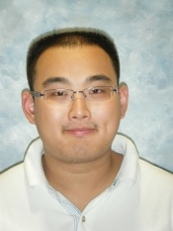
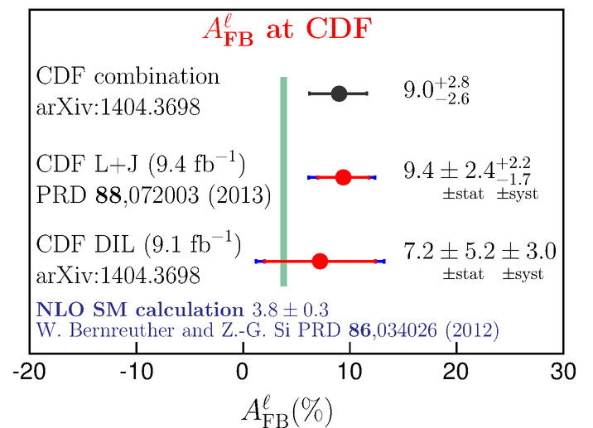
Wednesday July 9, 2014
12:30 pm – 1:30 pm
Madrone Conference Room
Measurement of the Forward-Backward Asymmetry of tt̅ at the Fermilab Tevatron
Ziqing Hong
The anomalous large forward-backward asymmetry of top-quark pairs measured at the Tevatron has been a hot topic for almost a decade. In this talk we will discuss this important result and additional handles to follow on it with new final states and a measurement of the leptonic asymmetry. We will focus on recent developments on the measurement methodologies, new results from the CDF experiment, as well as prospects of the Tevatron legacy results on this topic.
https://www-group.slac.stanford.edu/slacExp/

