Slide 1
Alignment and Magnetic Field Measurements: MAGIS-100

Slide 2
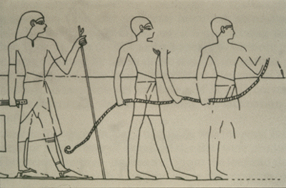
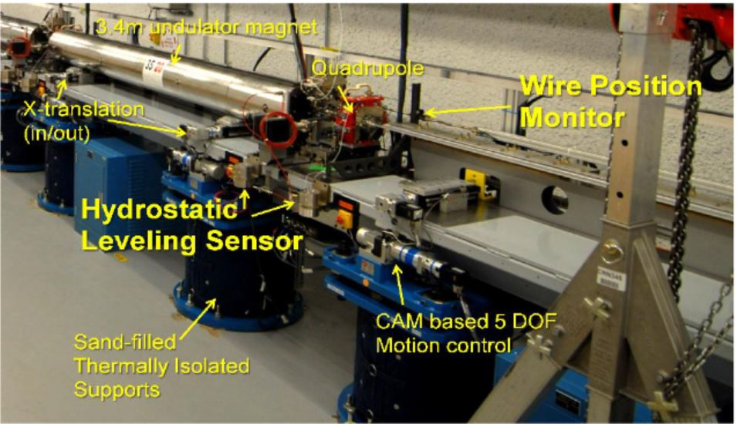
Alignment: 100M vertical pipe and cameras.
Wire alignment
Technique ~4500 years old, used for pyramid construction!
Standard technique for aligning particle accelerators
Sub-millimeter accuracy for 100M,
Dominated by vertical sag of horizontal wire (not an issue here)
Typically used in air, where air current limit (also not an issue here)
Wire provides an optical reference for camera system without requiring insertable targets
One-time alignment at setup
Alignment checking:
Ground tilt changes
Shaft distortions
Accidental bumping of cameras

Slide 3
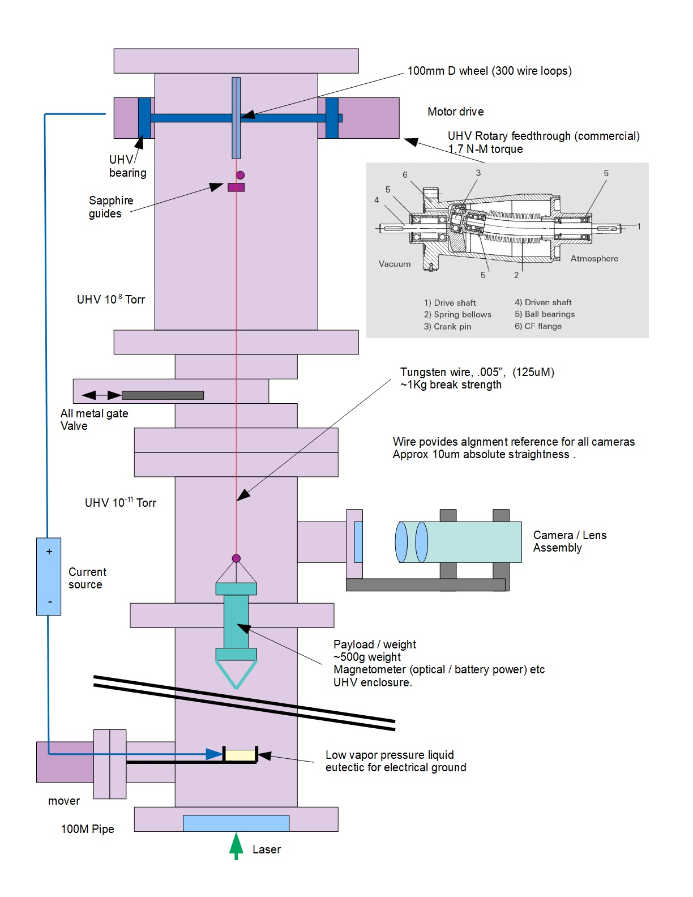
Concept
Modest UHV wire reel
UHV components
Modest 250°C bake
No organics
Gate valve to isolate low UHV environment
Wire visible in all cameras
Allows focus and alignment
Magnetometer “spacecraft”
Wire is straight and vertical
Except see next slides!

Slide 4
Why not a laser?
Over 100M, green laser will have a spot radius ~4mm average
Possible to measure to << spot size, but requires care for beam mode cleaning
Requires insertable targets which need to be aligned relative to the camera system.
Depth of field issues complicate using angled targets
Could use insertable position detectors, but added complexity
Wire is a target in the same place as the atomic beam and provides easy focus adjustment for the cameras.

Slide 5
How straight is a wire?
Finite stiffness and residual stresses can result a non-straight wire
No simple calculation, but example from Gorden Bowden
0.5mm steel wire, with 150mm diameter bend, tensioned to ½ breaking strength: 64-micron residual deviations
We plan 0.125mm wire, which should not be stressed beyond yield on a 100mm reel, but if it is, deflection should be << 50 microns
Good calculation for a mechanical engineering student! Probably OK at our tolerances
In our scheme we lower the wire from a spool and monitor continuously, so some of this effect can be averaged away
Is it vertical?
Yes, similar to above: only expected deviations are from the internal stresses described above and should be small.
Estimates (guesses really) from Heinz-Dieter Nuhn and Georg Glassner are <100um absolute straightness.

Slide 6
Wire Motion
Pendulum motion
14 second period – will take pretty much forever to damp
Use low vacuum pressure liquid metal (gallium / indium alloy) as pendulum damper at bottom of tower
Cameras can record for multiple periods, and remove the motion component corresponding to the pendulum resonance
Vibration
Transverse wave speed ~100M/s.
Lowest mode ~0.5Hz. (will get this and harmonics)
If wire modes are significant, these can be averaged in the camera data

Slide 7
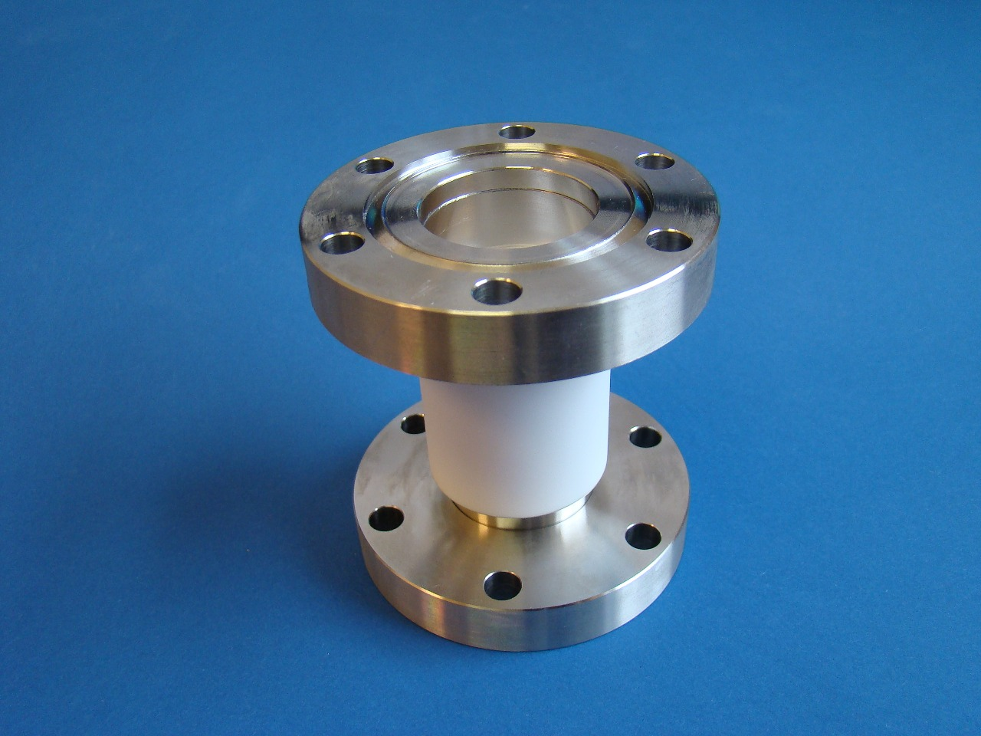
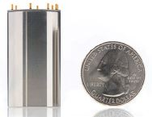
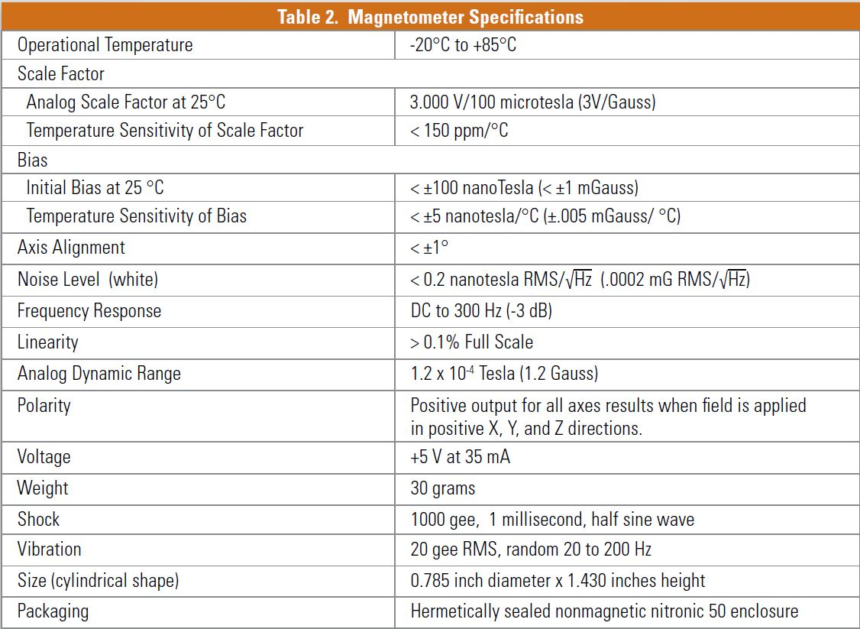
Magnetometer “Spaceship”
Put a microcontroller controlled compact magnetometer inside of a vacuum vessel.
Lower slowly while recording magnetic field
Read out recorded data (probably Bluetooth is easiest, since built-in including software with some controllers)
Lots of details:

Slide 8
Magnetometer Details
Power required: 200mW
Cooling OK through radiation with 25C temperature rise
Lithium batteries have enough energy density for a few-hour scan
Recharge at docking station at top
Rotation: (If we need vector integrals, not just showing it is below some tolerance
Big problem: nothing to set angle, can expect slow rotation / torsional modes.
Linear polarized laser from base, with constant rotation
Detector on bottom of “spaceship”
Fiducial markers on laser intensity
Can time synchronize all data – cameras can see when the spaceship passes.
“Small matter of software!”

Slide 9
How bad is the software
Cameras:
Image processing software to find a single bright line is straightforward with existing toolboxes
Thing move slowly, so ~1 second timing synchronization is probably fine.
“Spacecraft” controls / data
Within capability of an Arduino (probably an undergrad project)
Magnetic field data:
3 axis, recorded at ~10Hz for a few hours (very modest total data)
Intensity data:
Record at 10Hz, offline look for notches
Match to phase of polarization dependent modulation
Timing
1ppm accurate clock is easy – so even without fiducials expect to be good to milliseconds during a few-hour scan
Laser controls
Likely have an alignment laser anyway
Motorized lambda/2 plate to rotate polarization
Shutter to produce timing fiducials

Slide 10
Issues
Sword of Damocles
You *really* don’t want the “spaceship” dropping 100M onto your optics
Fortunately, we are not working very hard for the alignment tolerance, so can have a substantial safety factor on the wire strength. (and measure)
Vacuum design
Hard – but built out of commercial components, almost nothing custom
Software
Always harder that it sounds.

Slide 11
Camera requirements
Resolution 50-100um, ~10cm working distance. 700nm wavelength. Want 1-2 cm depth of field
Gaussian beam propagation:
30 micron waist radius (w₀), -> 4mm Rayleigh length, 8mm depth of field.
Just physics, but need to think about definitions:
Resolution: factor of 2 matters here.
Divergence 7.4 mradians: Very high F# Is there enough light?
Any reasonable lens will be near diffraction limited in this situation

Slide 12
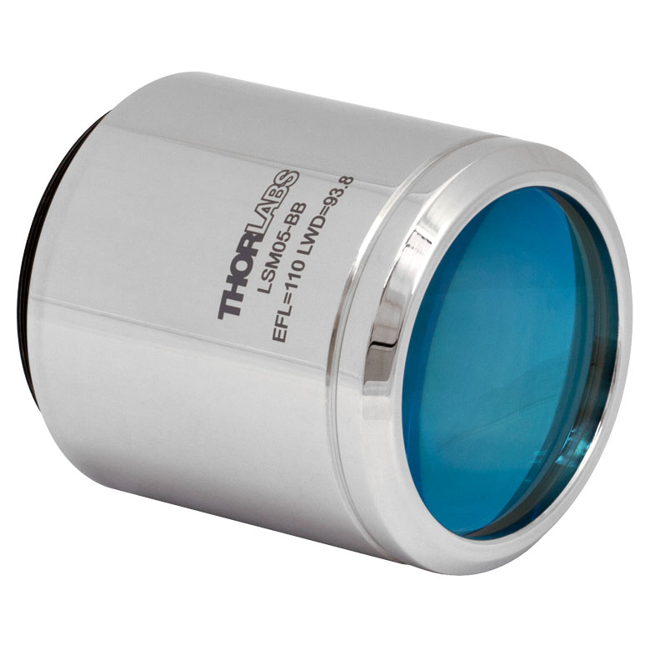
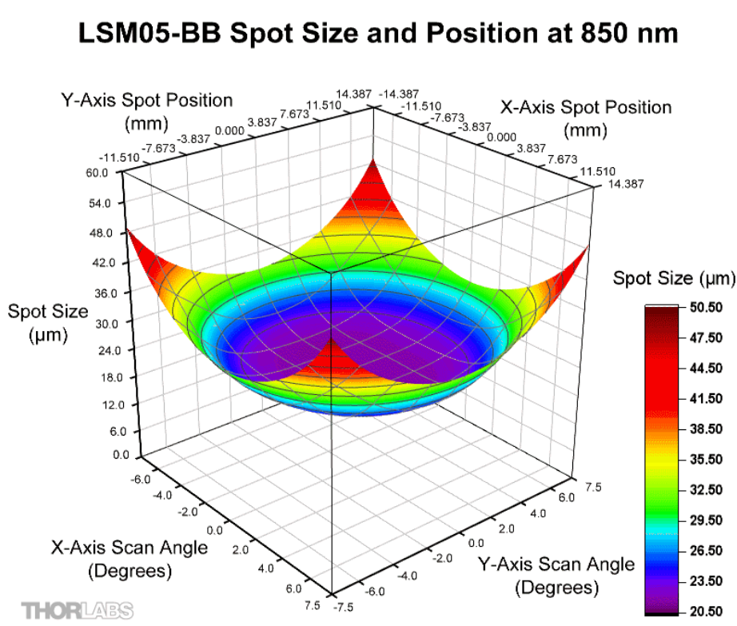
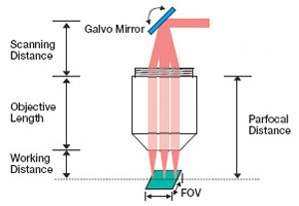
Lens: example Thorlabs LMS05-BB 680-810nm
+/- 14mm scan range
Not exactly what we want but close

